Slide 1
Genesis and the Biblical World View
John Oakes
Detroit, 2/18/2011

Slide 2
You Are Invited

Slide 3
Also…
Apologetics Research Society Presents
Certificate Program in Christian Apologetics
Classes on DVD
For information: joakes01@san.rr.com
www.evidenceforchristianity.org

Slide 4
An Outline of the Bible:
Genesis 1: Who is God?
Genesis 2: Who is man?
Genesis 3 & 4 The problem of sin.
Genesis 5-Revelation 22 The solution.

Slide 5
Genesis 1 and World View Who is God?
Genesis 1:1 In the beginning God created the heavens and the earth.
Genesis 1:31 God saw all that he had made and it was very good.
If Genesis 1:1 is true, then animism, polytheism, pantheism, dualism, naturalism, deism, postmodernism and every other ism is false.

Slide 6
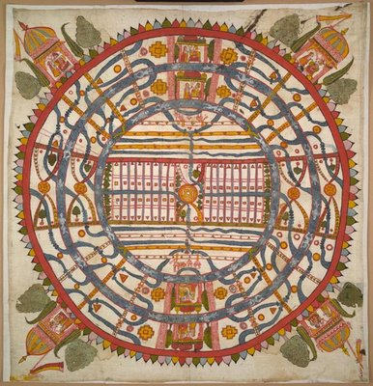
World View
One's world view is the perspective one uses to process and interpret information received about the world.
James W. Sire put it this way, "A world view is a set of presuppositions (ie. assumptions) which we hold about the basic makeup of our world."
James W. Sire, The Universe Next Door (InterVarsity Press, 1997)
A Jain World View

Slide 7
A “Good” World View Defined
A. It is true.
It is consistent with reality. It works.
B. It answers satisfactorily the questions people really want answered.
What is prime reality/the ultimate cause/the nature of God?)
What is my value as a human being?
What happens to a person at death?
How do we know what is right and wrong?
What is my purpose?
What is the nature of my relationship, with the "prime reality?"
C. It causes those who hold to it to be better people than they would otherwise have been if they held to competing alternative world views.

Slide 8
The Hard Questions
Evil: What is Evil and Why is There Evil
Why is There Suffering?
The Problem of Justice
The Problem of Sin.
The Problem of Death.

Slide 9
The Important Questions
Why am I here?
Is that the right thing to do?
How valuable am I?
Does God exist? Does God act (theism)?
Will that God respond if I pray?
Do supernatural events (miracles) happen?

Slide 10
The Christian World View According to Genesis 1-4:
1. The physical world is: a. real b. created out of nothing (ex nihilo) and c. essentially good.
2. There exists an unseen spiritual reality which is not limited to or defined by the physical reality. Human beings have a spiritual aspect to their nature.
3. The creator of both the physical and spiritual realm is the God who reveals himself in the Bible.
4. Human beings have both a physical and a spiritual nature, The spiritual nature is more essential as it is eternal.
5. God is not easily defined but he can be characterized by certain qualities. God is a person. God is love, God is just, God is holy, God is omniscient, omnipotent and omnipresent.

Slide 11
The Christian World View (cont.)
6. Although all God’s creation, including the physical world is good, evil does exist. Such evil is the result of freedom of will given to created beings and their subsequent decision to use that freedom to rebel--to “sin”
7. Because of God’s justice and his holiness, those who choose to rebel against him will ultimately be judged and separated from God for eternity.
8. The solution to evil, to sin and its eternal consequences is provided by God through the atoning substitutionary sacrifice of Jesus Christ.
All of this is found in Genesis 1-4

Slide 12
Competing World Views
Naturalism
Postmodernism: No World View
Deism
Pantheism
Animism/Polytheism
Dualism
Biblical Theism

Slide 13
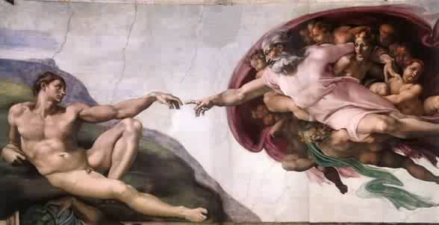
A Question: Who reaches out to whom?

Slide 14
Initiative
Human approach Truth
God God
Mankind Mankind

Slide 15
Works Salvation: Man reaches out to God.
Islam
Hinduism
Jaina
Sikkhism
Gnosticism
New Age
Buddhism?
Salvation by Grace: God reaches out to man.
Judaism
Christianity

Slide 16
The Christian World View Is True
The Universe is Real
The creation is good.
Evil exists.
Despite what Naturalists say, there is a spiritual reality. For example, “I” exist. Consciousness is not simply an epiphenomenon.
Science and the Christian world view do not contradict.

Slide 17
Christian World View Answers the Big Questions
How did I get here?
Why am I here?
Where am I going?
Why are human beings able to comprehend the universe?
Why is there pain and suffering and evil in the world?

Slide 18
Christianity Offers Solutions to the Big Problems of Human Beings
The Problem of Sin (the substitutionary death of Jesus)
Romans 7:24,25
The Problem of Suffering (compassion)
Matthew 9:35-36
The Problem of Death
1 Corinthians 15:54-56

Slide 19
Genesis Chapter One: Creation
Young Earth Theory
Earth is young and science supports this conclusion.
Earth is young because God created it “with an appearance of age.”
Day/Age Theory
Gap Theory
A huge “gap” of time between Genesis 1:1 and 1:2
It’s all just a myth
Each view has its problems

Slide 20
A Quick Summary of Genesis One:
a. God pre-existed the universe
b. God created the universe: “Let there be light”
c. God created the earth
d. God created life
e. Last of all, God created mankind

Slide 21
A More Detailed Summary of Genesis One From the Viewpoint of an Observer on the Earth:
a. The earth created and is spinning: night and day. Day 1
b. Water covers earth, Very thick atmosphere forms. Day 2
c. The earth cools, land appears out of the water. Day 3
d. Life appears on the earth. Day 3
e. (Photosynthetic life dramatically changes the chemistry of the atmosphere from reducing to oxidizing.)
f. Finally, the heavenly objects appeared in the sky Day 4
g. More advanced life forms; first in the water, later on the land Day 5
h. Even more advanced life forms. Last of all human beings Day 6
Where is the scientific error in this?

Slide 22
Is Genesis 1:1 a Myth?
Yes! It is a true myth.
A myth is a simplified story, given to explain the gods (or God) to common people.

Slide 23
Creation Myths
Babylonian Creation Myth
Primeval swamp. Marduk kills Tiamat. Blood + mud = humans
Egyptian Creation Myth
Primeval ocean “Nun” from which arrises a Primeval hill.
Greek Creation Myth
Prometheus and Epimetheus form clay molds. Earth supported by Atlas.
Iroquois Creation Myth
Enigorio and Enigohahetgea: Good and evil brothers battle
Genesis One is an obvious exception to this pattern

Slide 24
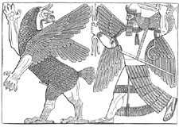
Babylonian Creation Myth: Marduk kills Tiamat

Slide 25
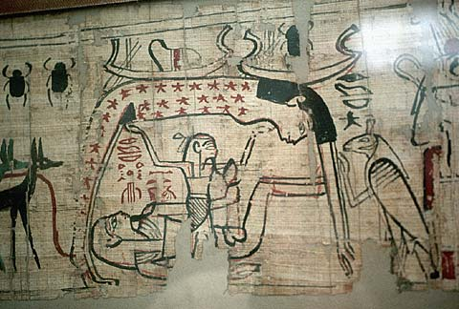
Egyptian Creation Myth

Slide 26
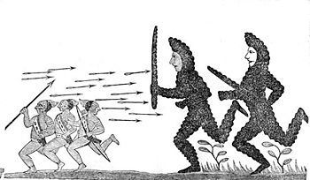
Iroquois Creation Myth:
Enigorio and Enigohahetgea Battling the Ronnongwetowanca (Stone Giants)

Slide 27
Is the Metaphorical Day a Reasonable Interpretation? Pre-Science Theologians Who Said Yes.
Philo 1st century
Origen early 3rd century
Augustine early 5th century
Thomas Aquinas 13th century

Slide 28
Translations of yom in the Old Testament (NIV)
1181 times as “day” (but with several different connotations of the word, some not being literal)
Isaiah 4:2 In that day the Branch of the Lord will be beautiful…
67 times as “time”
30 times as “today”
18 times as “forever”
10 times as “continuously”
6 times as “age”
4 times as “life”
2 times as “perpetually”

Slide 29
Genesis 2 Who is man?
Created in God’s image.
Created to know God and to be known by him.
Created for relationships Genesis 2:18
Given everything, including “free will.” Genesis 2:15-17
Adam and Eve are us!

Slide 30
Genesis 3 & 4 The Problem
Genesis 3:6 The fruit was desirable.
Adam and Eve are us in this sense as well.
Genesis 3:15 God will provide a solution: Jesus.
Genesis 4:1-16 Things did not improve with their children
4:6 For us, “sin is crouching at your door; it desires to have you, but you must master it.”

Slide 31
Genesis 5-8 Things get even worse (But God has a plan to save us from our sin)
Gen 6:6 “The Lord was grieved that he had made man on the earth, and his heart was filled with pain.”
The world was judged (2 Peter 3:5-9), but Noah and his family were saved.
We are Noah and his family!!! (1 Peter 3:20-22)

Slide 32
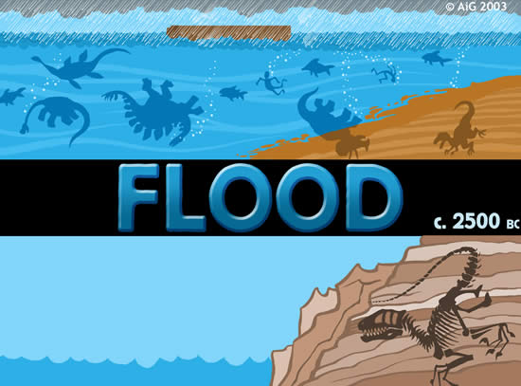
The Flood: Genesis 6-8

Slide 33
Explanations of the Flood
Just an unfounded myth.
Worldwide flood.
With a “scientific” explanation
A unique and completely miraculous event
Local flood

Slide 34
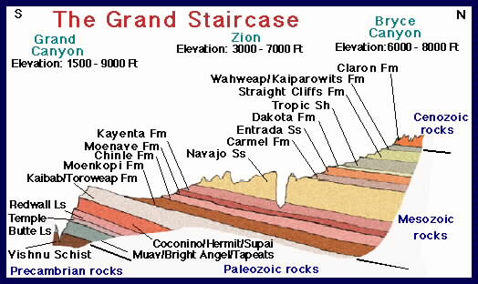
Did all this happen in a single, cataclysmic flood?

Slide 35
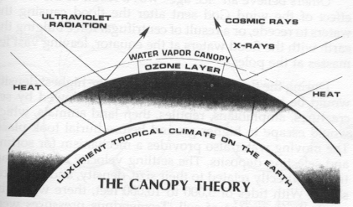

Slide 36
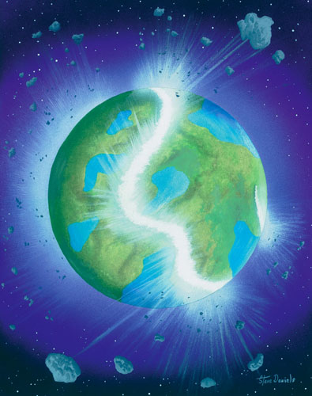
Can an opening of “the fountains of the deep” explain the flood?

Slide 37
Ancient Cultures With Flood Stories
Hindus
Burma (Myanmar)
New Guinea
Aborigines of Australia
New Zealand
Iroquoi
Incas
Aztecs
Greeks
Babylonians
Sumerians
Celts
Hottentots (Southern Africa)

Slide 38
Common Elements
1. The flood a judgment.
2. Massive or world wide in effect.
3. Some humans saved from this flood and repopulate the earth.

Slide 39
The Bible and the Flood
New Testament writers clearly believe this was a historical event. Matthew 24:38-39
It happened as judgment for sin 2 Peter 3:6-7
It is a prefigure of final judgment
It is a miracle, not a “natural” event—like the fire which will destroy the world
Belief in the flood based chiefly on faith in the Bible, certainly not on science.

Slide 40
Genesis 12-50 Salvation by faith.
Genesis 12-22 God chooses a man of faith through whom to bring the Messiah.
Romans 4:16 Abraham is the father of us all (who are saved by leaving everything to follow God into the Promised Land)
Genesis 23-50 God prepares a people through whom to send the Messiah.

Slide 41
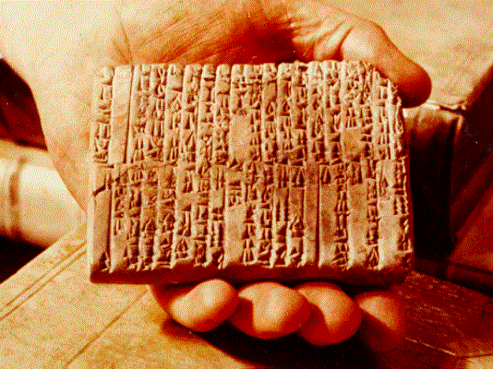
One of the Ebla Tablets about 2100 BC
Nahor, Terug, Abram, Sarai

Slide 42
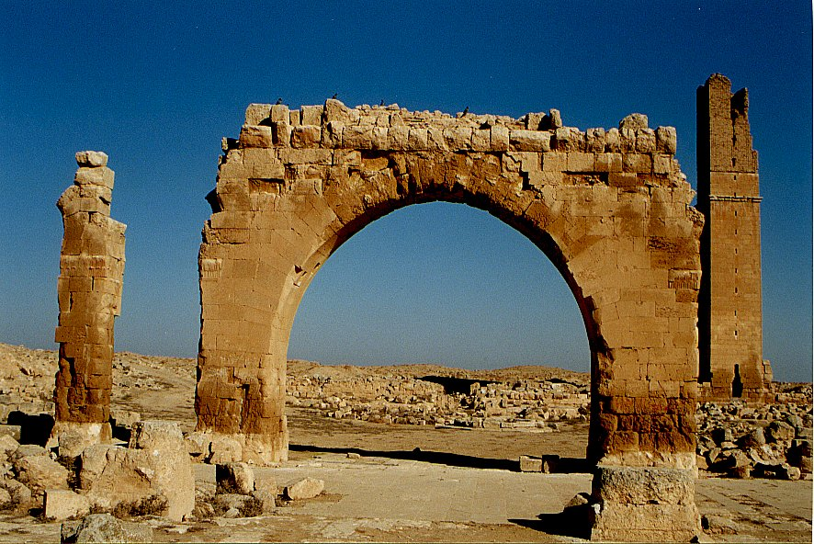
Haran Ruins In Mesopotamian Plane Near Sanli Urfa, Turkey

Slide 43
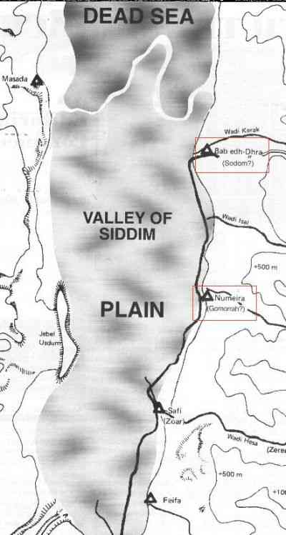
The Five City League, including Sodom and Gomorrah
Genesis 14:2

Slide 44
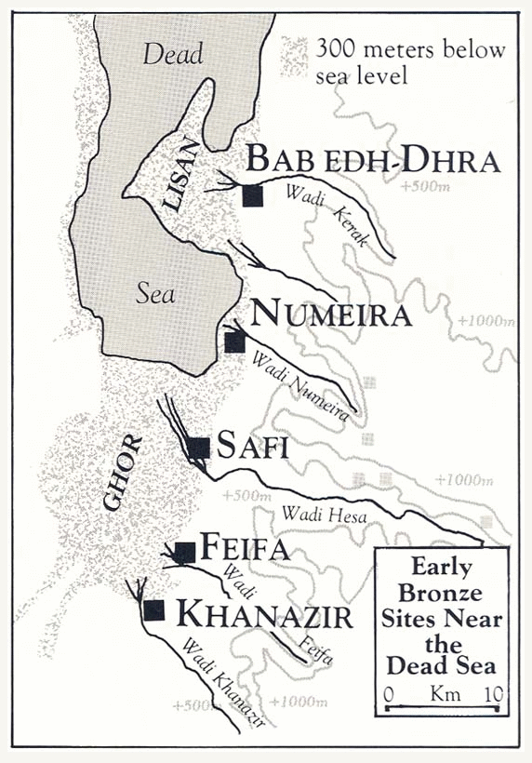

Slide 45
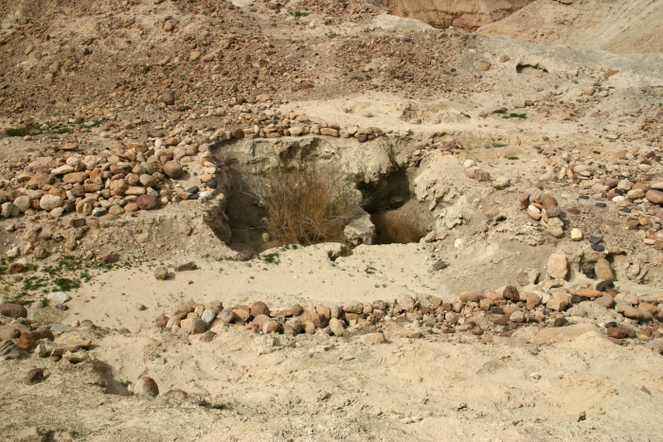
Ruins at Bab ed-Dhra (Sodom)

