Slide 1
The Bible, Science and the Paranormal
John Oakes
January, 2012
Hong Kong

Slide 2
SUPERNATURAL PHENOMENA?
Divining Occult Miracles Magic
Poltergeist Spirits Hauntings Ghosts
Telekinesis ESP Psychic Ouija
Reincarnation UFO Auras Angels
Clairvoyance Parapsychology Exorcism
Shadow People Mediums Astrology
Spirit Photography Demons Afterlife
Near Death Experiences

Slide 3
PARANORMAL Experiences that lie outside the range of normal experience or scientific explanation.

Slide 4
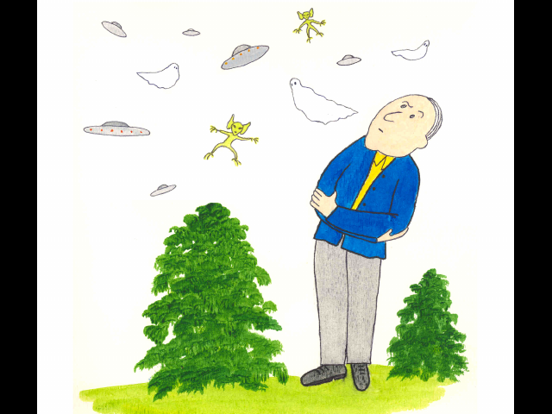

Slide 5
Possible Points of View on Claims of the Supernatural
#1 The phenomenon is real.
#2 The phenomenon was real in the past, but is not today.
#3 The entire claim is a scam. It is not real.

Slide 6
Possible Explanations
Hoax
Natural Phenomenon
Supernatural

Slide 7
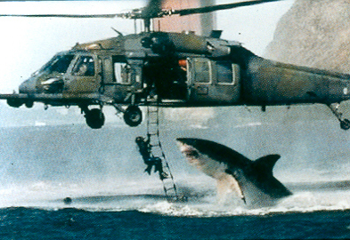

Slide 8
Kinds of Evidence
Empirical/Scientific
Rational/Logical/Critical Thinking
Biblical

Slide 9
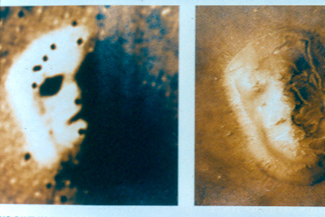

Slide 10
We cannot completely trust our senses

Slide 12
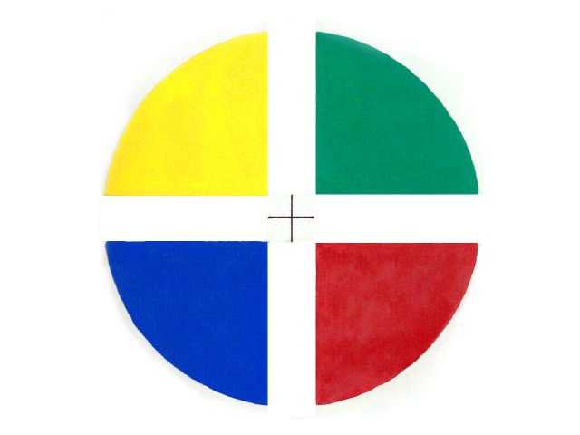

Slide 14
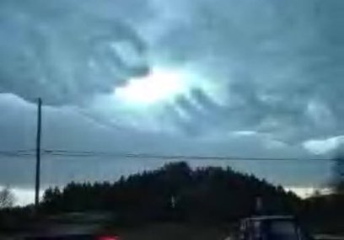

Slide 15
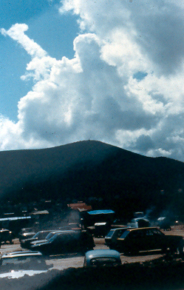

Slide 16
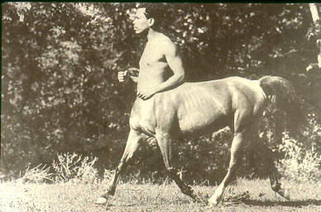

Slide 17
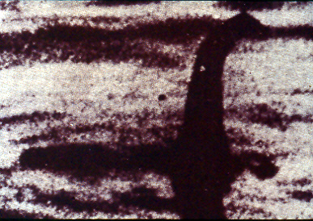

Slide 18
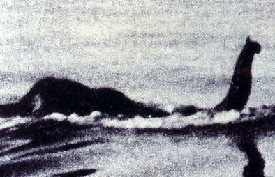

Slide 19
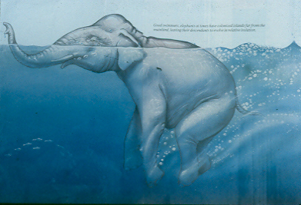

Slide 20
Categories of Possible Paranormal Phenomena
Aliens
Angels
Apparitions, consulting the dead.
Astrology, divination
Prophecy, Dreams.
Demons, Exorcism.
Ghosts, Reincarnation.
Out of body experiences.
Miracles.

Slide 21
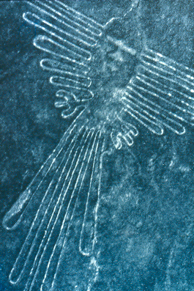
1. Aliens, UFOs and Ancient Astronauts

Slide 22
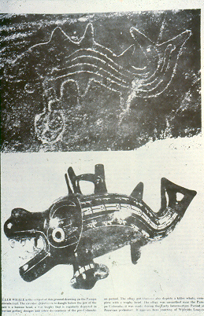

Slide 23
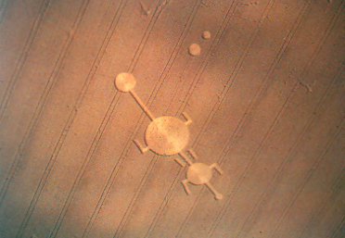

Slide 24
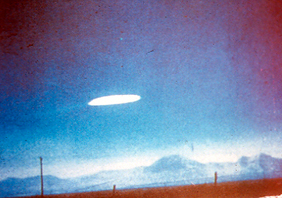

Slide 25
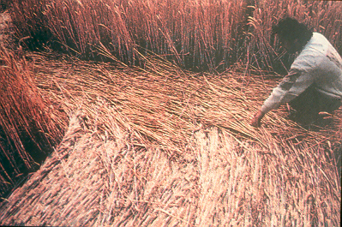

Slide 26
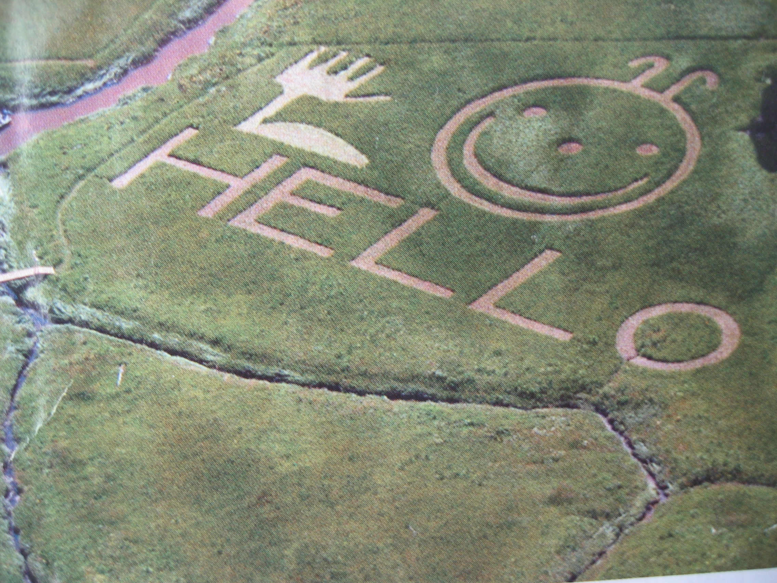

Slide 27
1. Aliens UFOs and Ancient Astronauts
Empirical/Scientific Evidence: anecdotal only
Rational: Unlikely
Biblical: None

Slide 28
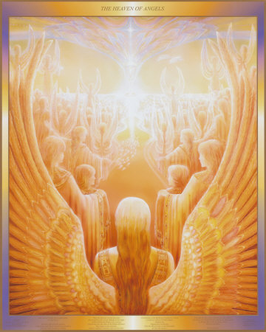
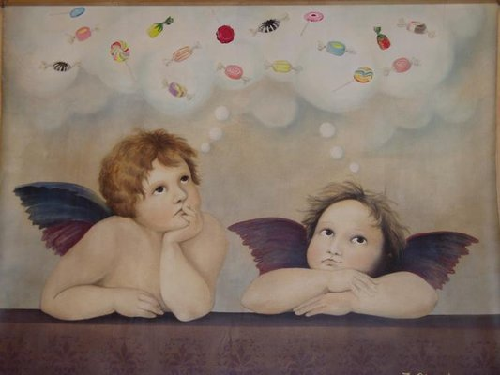
2. Angels

Slide 29
The Bible and Angels
Bible: Angels are real. They are are lesser beings than we are (although some are very powerful) Hebrews 1:14
Angels are messengers Hebrews 1:14
Angels have names Gabriel, Michael (Uriel, Ariel, etc)

Slide 30
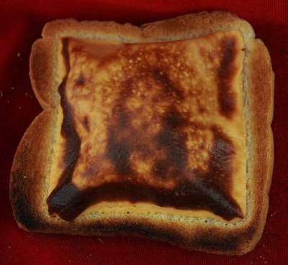
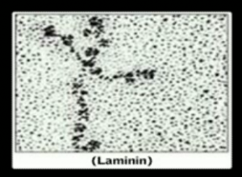
3. Apparitions, Mediums
Grilled Cheese Jesus

Slide 31
3. Apparitions, Mediums
Lourdes, Medjugorge, Virgin of Guadalupe
Jesus appears to the disciple.
Saul and the Witch of Endor

Slide 32
EXODUS 22:18
“Do not allow a sorceress to live.”

Slide 33
Warnings Against Involvement in the Occult/Paranormal
Deut 18:10-11 2 Chron 33:6 Micah 5:12
1 Sam 15:23 Gal 5:20 Lev 19:31
Lev 20:6 Lev 20:27 2 Kings 21:6
Isa 8:19 Isa 19:3 Dan 2:10
Exodus 7:11,22 8:7,19 9:11

Slide 34
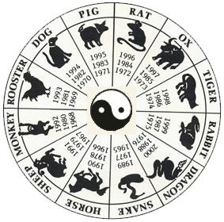
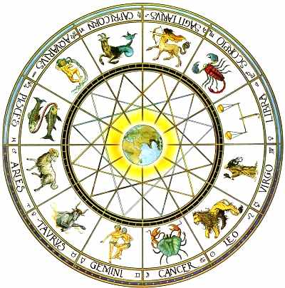
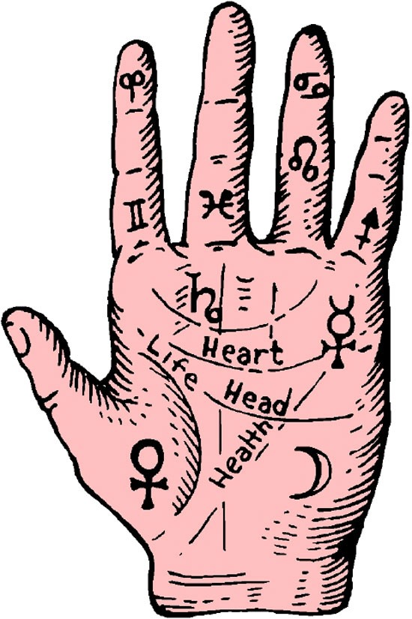
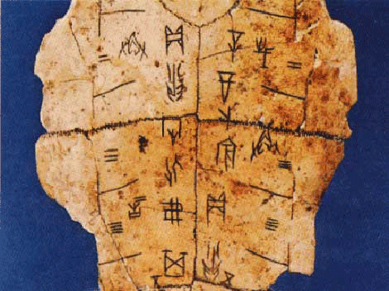
4. Astology, Divination

Slide 35
4. Astology, Divination
Completely Illogical
The Bible: These are frauds.
They represent a lack of faith in God.

Slide 36
5. Prophecy, Dreams
Many biblical examples, both of prophecies and dreams coming true. (Daniel, Revelation, etc.)
The Biblical prophet had an extremely high standard of accuracy. Deuteronomy 13:1
Modern day prophets are frauds.
Interpretation of dreams is extremely subjective.
Might God speak to us through a dream? Maybe…

Slide 37
The Bible: Test such claims
1 John 4:1 “Do not trust every spirit my friend, but test the spirits to see if they come from God.,”
2 Thess 2:2 Do not be easily alarmed by prophecies.

Slide 38
The Bible: Do not be deceived
1 Timothy 4:1
“God’s spirit specifically tells us that in later times some will desert the faith because they continuously give their attention to deceiving spirits and demonic teachings”

Slide 39
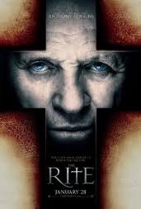
6. Demons, Exorcisms

Slide 40
6. Demons, Exorcisms
Few if any examples in the Old Testament.
Many examples in the New Testament, especially in the ministry of Jesus.
Might demon possession have ceased today? (Revelation 20:2)
Powerful anecdotal evidence.
What about exorcisms?

Slide 41
Demons, Exorcisms, cont.
Conclusion: Satan and demons are real.
Satan and demons are not a “personification” of evil or of our sinful nature.
But… God is in control.
A Christian cannot be possessed by a demon.
Help on this topic:
www.evidenceforchristianity.org
search Denice MacKenzie

Slide 42
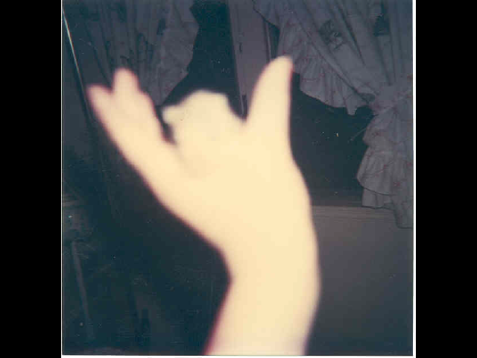
8. Ghosts, Reincarnation
A real
ghost?

Slide 43
8. Ghosts, Reincarnation
Definition: The disembodied spirit of a now-dead person still here on the earth.
Scientific Evidence: Weak or nonexistent.
Bible: Ghosts, as defined above, are not real.
Hebrews 9:27 Just as man is destined to die once, and after that to face judgment.
Associated with pantheistic world view.
The dead go to Sheol/Hades (Luke 16:19-31 for example)

Slide 44
Ghosts, Reincarnation (cont.)
What about the anecdotal evidence? Work of demons?
Biblical advice: Stay away from such things.

Slide 45
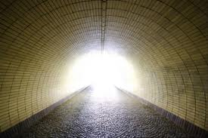
8. Near-Death and Out-of-Body Experiences
Is there a light
at the end of
the tunnel?

Slide 46
8. Near Death and Out-of-Body Experiences
More than 50% of Americans believe that these are real and have some relevance to life after death.
These experiences are more or less completely explainable by science.
Do not put your trust in these stories. Put the trust for your soul in God’s hands.

Slide 47
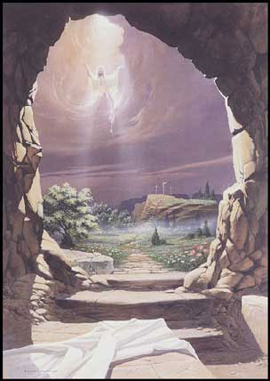
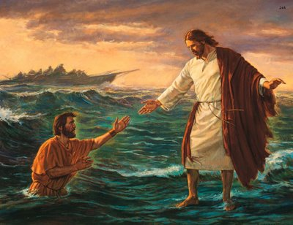
9. Miracles

Slide 48
9. Miracles
By definition, these are paranormal phenomena.
Very strong biblical support for miracles.
Science can neither prove or disprove the reality of miracles.
Evidence for Old Testament miracles.

Slide 49
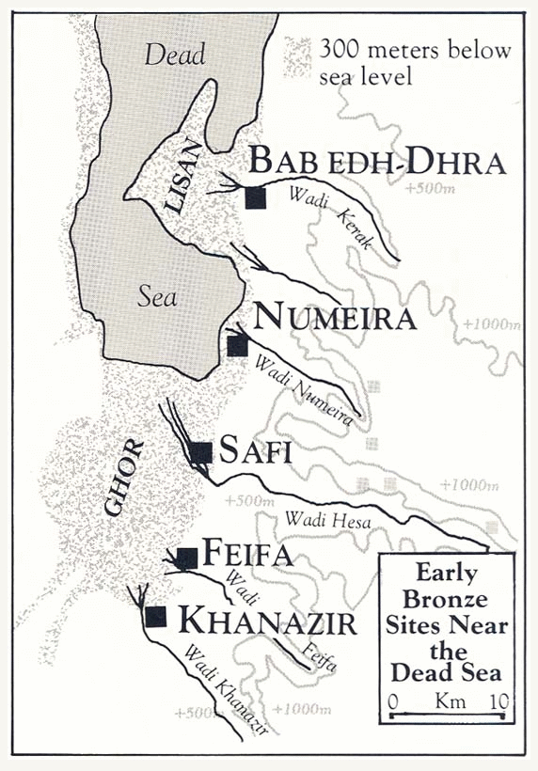

Slide 50
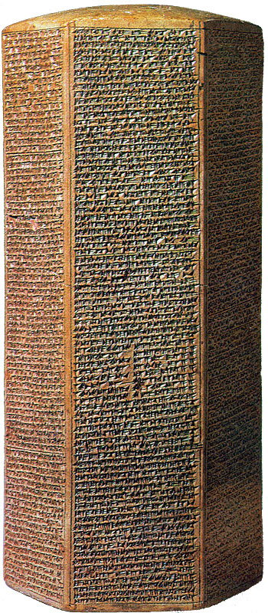
The Sennacherib Cylinder or Taylor Prism British Museum, London (2 Kings 18) 691 BC
As to Hezekiah the
Jew… I made him…
“like a bird in a
cage”

Slide 51
Miracles (cont.)
Conclusion: Miracles are real.
What about modern-day miracles?
We need to put our trust in God, not in miracles.

Slide 52
Conclusion
Many, but not all claims of the paranormal are not real.
The Christian does not need to fear such things as ghosts, demons, witchcraft, prophecies, etc. because God is in control.
John 14:1f “Trust in God. Trust also in me. In my Father’s house there are many rooms… I am going there to prepare a place for you…
www.evidenceforchristianity.org

