Slide 1
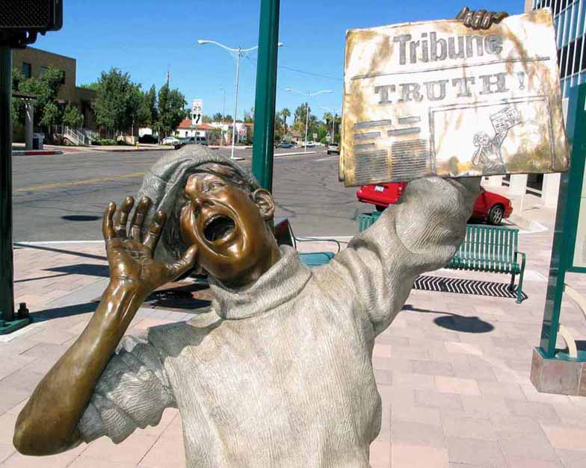
Christian Apologetics: Answering the Hard Questions
John Oakes
ICEC
June, 2015

Slide 2
Outline
A. The Trinity
B. Predestination, Foreknowledge, Free Will
C. The Question of Evil
D. The Problem of Pain and Suffering
E. The Problems of Violence and Slavery
F. The Question of Justice and the Problem of Hell

Slide 3
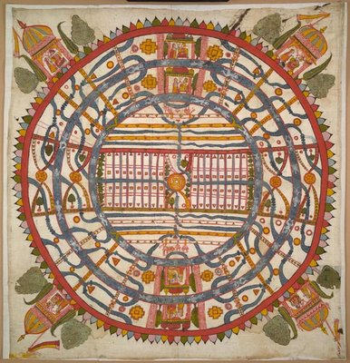
World View
One's world view is the perspective one uses to process and interpret information received about the world.
James W. Sire put it this way, "A world view is a set of presuppositions (ie. assumptions) which we hold about the basic makeup of our world."
James W. Sire, The Universe Next Door (InterVarsity Press, 1997)
A Jain World View

Slide 4
A “Good” World View Defined
A. It is true.
It is consistent with reality. It works.
B. It answers satisfactorily the questions people really want answered.
What is my value as a human being?
What happens to a person at death?
How do we know what is right and wrong?
What is my purpose?
Why is there suffering?
Why is there evil?
C. It causes those who hold to it to be better people than they would otherwise have been if they held to competing alternative world views.

Slide 5
The Christian World View
1. The physical world is: a. real b. created out of nothing (ex nihilo) and c. essentially good.
2. There exists an unseen spiritual reality which is not limited to or defined by the physical reality. Human beings have a spiritual aspect to their nature.
3. The creator of both the physical and spiritual realm is the God who reveals himself in the Bible.
4. Human beings have both a physical and a spiritual nature, The spiritual nature is more essential as it is eternal.
5. God is not easily defined but he can be characterized by certain qualities. God is a person. God is love, God is just, God is holy, God is omniscient, omnipotent and omnipresent.

Slide 6
The Christian World View (cont.)
6. Although all God’s creation, including the physical world is good, evil does exist. Such evil is the result of freedom of will given to created beings and their subsequent decision to use that freedom to rebel--to “sin”
7. Because of God’s justice and his holiness, those who choose to rebel against him will ultimately be judged and separated from God for eternity.
8. The solution to evil, to sin and its eternal consequences is provided by God through the atoning substitutionary sacrifice of Jesus Christ.

Slide 7
Competing World Views for Us
Naturalism/Materialism
Postmodernism
Deism
Pantheism/Eastern Religions
Islamic Worldview
Dualism
Biblical Theism

Slide 8
THE TRINITY
Emmanuel Emeh
Evangelist, ICOC Nigeria
emmanuelemeh@yahoo.co.uk

Slide 9
THE TRINITY
The Most Important Apologetic Issue in the First Five Centuries of Christianity.

Slide 10
A. The Trinity as an Apologetic Issue
A stumbling block to the Greeks.
God distant, unchanging, impassive 1 Cor 1:23
A major stumbling block to Muslims.
Tritheism/Polytheism
A problem for unbelievers in general.
Not logical/not rational
Question: What is the trinity?
Do you believe in the trinity doctine?

Slide 11
The Trinity is not logical!
John 1:1
John 1:14 Not only not logical—a scandal!!!
Peter Chacon: “It’s not logical, it’s Godgical”
Q: Is the goal of apologetics to present Christianity as rational?
The nature of God is a mystery!

Slide 12
The Mystery
1Timothy 3:16
‘‘Beyond all question, the mystery of godliness is great:
He [God] appeared in the body,
was vindicated by the Spirit,
Was seen by angels,
was preached among the nations,
Was believed on in the world,
was taken up in glory’’.
[A possible "early creed" of the church]

Slide 13
What is 1Tim. 3:16 saying?
This scripture is telling us that we cannot completely understand the infinite God with our finite minds.
We will get into trouble if we try to make God "reasonable", or "easily understood". God is complex. His thoughts are higher than our thoughts as the prophet pointed out in
Isaiah 55: 9
"As the heavens are higher than the earth, so are my ways higher than your ways and my thoughts than your thoughts.
Nevertheless, God has made a revelation of Himself in the Bible, which we can accept or reject as we please.

Slide 14
The Mystery of God.
I Cor 1:19-20. Where is the philosopher, Where is the wise man of this age?
Ezekiel 18:25 Whose way is “unjust”?
Mystery: Romans 16:25 gospel a mystery, Ephesians 1:9, Ephesians 3:3-9 The Messiah a mystery, Colossians 1:26-27 the mystery: Christ in you Colossians 2:2 Christ a mystery.

Slide 15
Apologetics and the Trinity
Bottom line, the trinity is a mystery. We cannot defend it as a logical concept.
It is not rational, but it is also not irrational.
The “apologetics” of the trinity is that God became a man so that he could reach out to us—so that we could know Him.

Slide 16
Predestination, Foreknowledge, Free Will
How can God foreknow without predetermining?
Critic: The Biblical God is the source of evil.
If God already knows what I will do, why do I need to take responsibility for my actions?
But first….

Slide 17
B. Attributes of God
Eternal
Omnipresent
Omniscient
Omnipotent
Righteous, Holy
Sovereign
Love
Justice
God is not merely loving, he is love
Is it logical for God to be omniscient, loving and just?

Slide 18
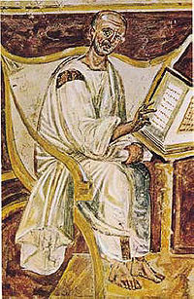
C. Sin, Redemption, Salvation
Augustine!!!!!
The City of God Soveriegnty
Total depravity
Monoergism (only God)
Predestination
Original Sin
Infant baptism required for salvation
City and State
Opposed Donatists
Augustine of Hippo (from 6th century)

Slide 19
Augustine: Evil and Free Will
About Augustine: “Evil arises from the corruption of a nature which is essentially good. What is called evil is good corrupted; if it were not corrupted it would be wholly good; but even when it is corrupted, it is good in so far as it remains a natural thing, and bad only in so far as it is corrupted.”
“A man’s free will avails for nothing except to sin.”

Slide 20
Augustine
Strong emphasis on depravity of man.
The Sovereignty of God: “The City of God”
Monergism.
Very logical!
Augustine: “An infant who dies unbaptized is damned even where no baptism is possible.”
“Rightly, therefore, by virtue of that condemnation which runs throughout the mass [of humanity] is he not admitted into the kingdom of heaven, although he was not only not a Christian, but was unable to become one.”

Slide 21
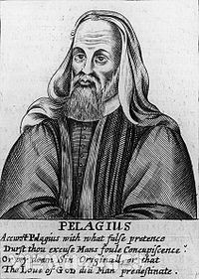
Pelagius AD c. 354-430
Works Salvation?
Affirmed the existence of free will. “Evil is not born with us, and we are procreated without fault.” Rejected infant baptism. Taught that we become holy through our own effort?
Adam was not immortal
“We are procreated without fault”

Slide 22
Q: What is the nature of “the Fall” of mankind? What happened in the garden?
Puritans: “In Adam’s fall we sinned all.”
Romans 5:12-19 What “death” is this in v. 12

Slide 23
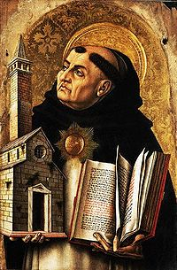
Thomas Aquinas
1225-1274
Aristotle
Revelation by reason
Scholasticism
Arguments for existence of God
Natural Theology
“Summa Theologica”

Slide 24
Thomas Aquinas:
“God, therefore, is the first cause, who moves causes both natural and voluntary. And just as by moving natural causes He does not prevent their actions from being natural, so by moving voluntary causes He does not deprive their actions of being voluntary; but rather is He the cause of this very thing in them, for He operates in each thing according to his own nature.”
In other words, Aquinas believed in free will and not a strict monergism.

Slide 25
Question:
Do you believe in Predestination?

Slide 26
History of the Doctrine of Predestination
Augustine of Hippo AD 354-430 “The City of God”
Martin Luther (1483-1546): an Augustinian monk.
Ulrich Zwingli (1484-1531) Reformed Theology.
John Calvin (1509-1564) “Institutes of the Christian Religion”
The key: A profound belief in the sovereignty of God
Double Predestination and TULIP

Slide 27
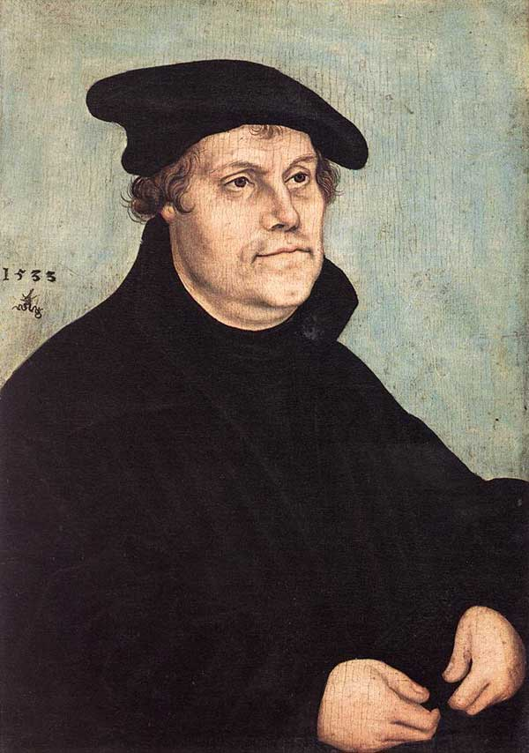
Martin Luther 1483-1541
Augustinian Monk
Faith Alone
Grace Alone
Scripture Alone
Predestination

Slide 28
Martin Luther:
“Away with James… His authority is not great enough to cause me to abandon the doctrine of faith [alone] and to deviate from the authority of the other apostles and the entire Scripture.” St. James’ epistle is really an epistle of straw, compared to these others (Romans, Galatians, John) for it has nothing of the nature of the gospel about it.”

Slide 29
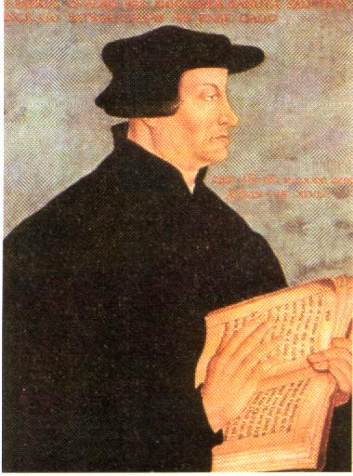
Ulrich Zwingli
1484-1531
Opposed baptismal regeneration
Double Predestination
Reformed Theology
“Those individuals who end up damned forever in hell are also eternally determined by God for that fate.”

Slide 30
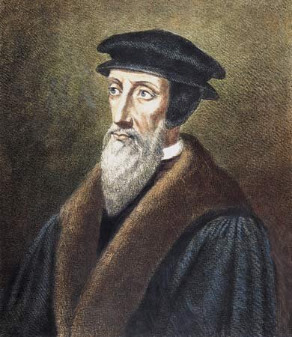
John Calvin 1509-1564
Institutes of Christian Religion
His emphasis: the sovereignty of God
TULIP

Slide 31
TULIP
Total depravity
Unconditional election
Limited atonement
Irresistable grace
Perseverence of the saint (once saved, always saved)

Slide 32
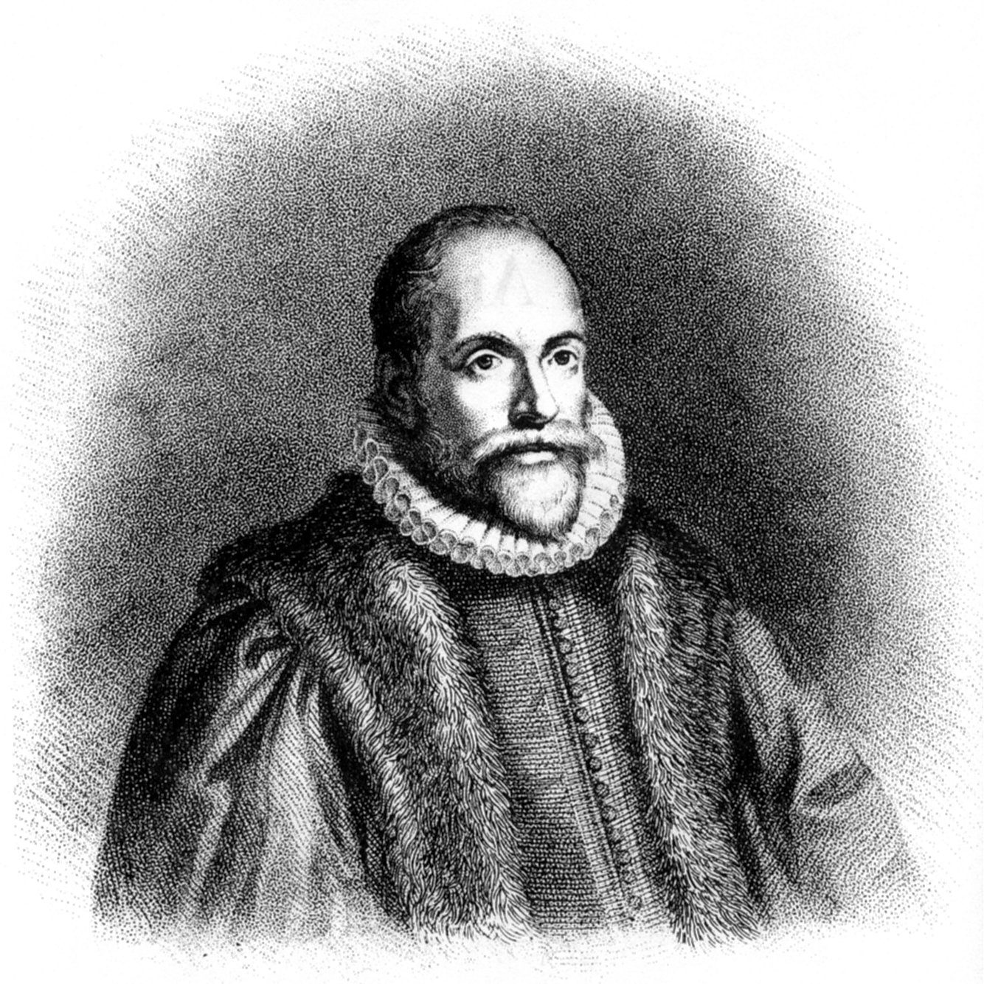
Jacob Arminius
(1560-1609)
Opposed Reformed idea of predestination.
Are we Arminians?

Slide 33
Q: Scriptures which appear to support the doctrine of predestination?
Q: Scriptures which prove free will and refute predestination?

Slide 34
Biblical Predestination
God predestined all of us for salvation.
God’s sovereign will is that we have free will to choose to accept or refuse the offer.
God predestined that Jesus would come and die to provide salvation for our sins.
God intervened in history to make this happen.
But God did not steal free will from anyone.
God can perfectly predestine and perfectly give free will at the same time. God is awesome!!!

Slide 35
D. The Problem of Evil
If God is good, if God is loving and if God is omniscient, omnipotent, omnipresent,… why is there evil in the world?

Slide 36
What is Evil?
Is it real?
Is it a “thing”?
Is it simple “the absence of good” or “the absence of God?
Did God create evil?
Is God responsible for evil?

Slide 37
Augustine on Evil
When accordingly it is inquired, whence is evil, it must first be inquired what is evil, which is nothing else than corruption, either of the measure, or the form or the order, that belong to nature. Nature therefore which has been corrupted, is called evil, for assuredly when incorrupt it is good; but even when corrupt, so far as it is nature, it is good, so far as it is corrupted it is evil.
Sin is not the striving after an evil nature, but the desertion of a better, and so the deed itself is evil, not the nature which the sinner uses amiss. For it is evil to use amiss that which is good.

Slide 38
Thomas Aquinas:
“God, therefore, is the first cause, who moves causes both natural and voluntary. And just as by moving natural causes He does not prevent their actions from being natural, so by moving voluntary causes He does not deprive their actions of being voluntary; but rather is He the cause of this very thing in them, for He operates in each thing according to his own nature.”
In other words, Aquinas believed in free will and not a strict monergism.

Slide 39
Apologetics and Evil: What are the alternatives?
Dualism: Good and Evil in an unending more or less equal balance
Pantheism: The physical world is evil. Evil is being tied down to the physical—it is missing the god-likeness in you. Physical things are an illusion (maya) and therefore are ultimately not real. Therefore, evil is not ultimately real.
Naturalism: There is no evil. It is not real.
Postmodernism: Evil???
Determinism/Fate God is the cause of evil.

Slide 40
Christianity and the Problem of Evil
Evil is very much real. Quite indirectly, it is the product of God’s love. God loved us so much that he loved us and that he gave us a choice. We chose evil, and thus evil came into the world.
Remember your alternatives:
Predestination/Determinism God is the cause of evil.
Deny evil exists
Physical creation is evil, but you are God
An unending battle/balance between good and evil.

Slide 41
What about Satan and Demons?
Who created Satan?
Was Satan created evil? If not, how did he become evil?
Are demons real?
If demons are real, how did they become demonic? Are they “fallen angels?”
Note: Isaiah 14 and “Lucifer” is problematic

Slide 42
Evil Beings (cont.)
Does demon possession still happen today? Why or why not?
How does demon possession relate to free will?
Will there be free will in heaven?

Slide 43
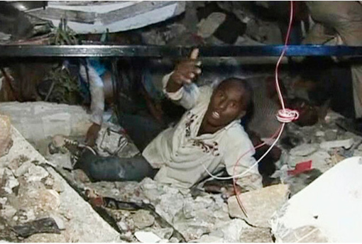
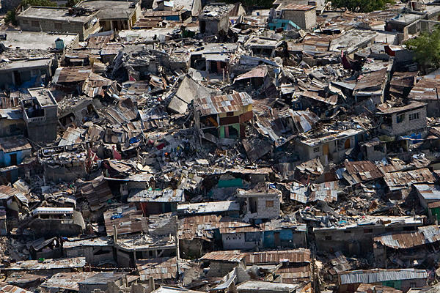
E. The Problem of Pain and Suffering
Haiti, January, 2010

Slide 44
The Problem of Pain and Suffering
An apologetic/intellectual problem
A human problem

Slide 45
Pain and Suffering: An Apologetic Problem
Agnostic:
The God of the Bible is completely good and loving.
The God of the Bible is all-knowing and all-powerful.
Conclusion: Given all the pain and suffering in the world, the God of the Bible is not real.

Slide 46
Examples of Suffering
Are they truly bad/evil?
Are they God’s fault?

Slide 47
Kinds of Suffering
Physical pain: acute and chronic
Disease: acute and chronic
Broken relationships
Poverty, hunger, etc.
Violence; terrorism, genocide, violent crime, etc.
Chronic fear (rape, natural disasters, abuse, etc.)
Disappointment, feelings of failure, loss of hope
Death of a loved one, mourning

Slide 48
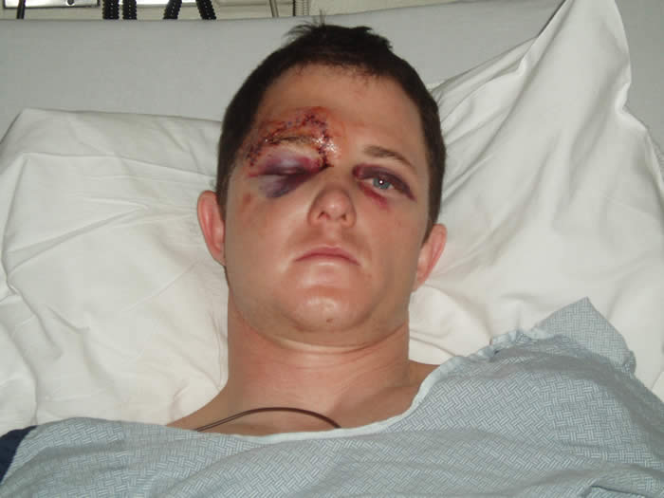

Slide 49
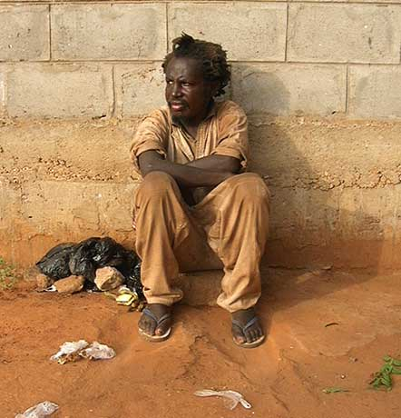

Slide 50
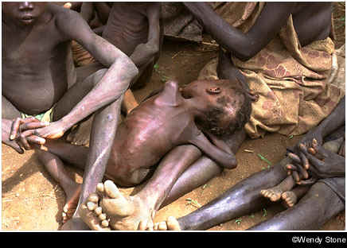

Slide 51
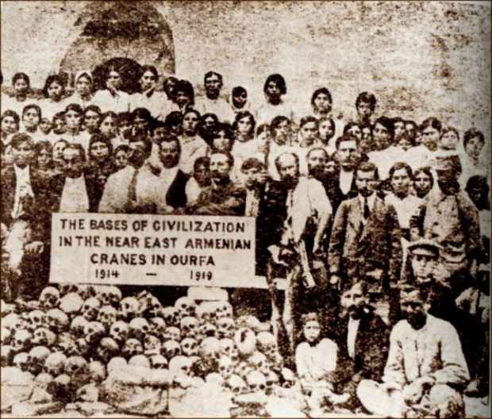

Slide 54
Bottom line, there is a lot of pain and suffering in the world.
Question: Is this because God does not care, or is this because he is not sufficiently powerful to prevent human suffering and evil in the world?
Caution: There is no simple answer.

Slide 55
Causes of Suffering
Free Will and Sin
Natural Disasters
Stupidity

Slide 56
Free Will: God Gives Us a Choice
Deuteronomy 30:15-20
Joshua 24:15
John 7:17
Question: What is the alternative?
Question: Is this a sign that God does not love us?
God took a huge risk…

Slide 57
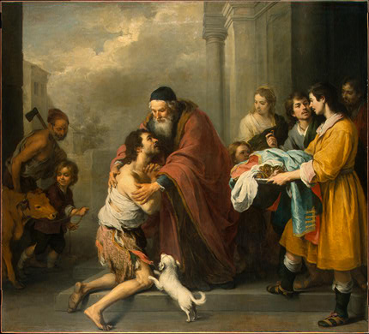
Free Will, An Illustration: The Prodigal Son

Slide 58
Cause of Human Suffering and Evil: SIN
The great majority (but not all) of suffering is the result of sin
Addiction, lack of self-control
Sexual immorality, perversion and abuse
Anger, violence
Greed
Pride, arrogance, jealousy, desire for control
Selfishness

Slide 59
God’s Moral Law is Simple: Sin Produces Suffering
Exodus 20:5-6 You shall not bow down to them (the idols you have made) or worship them; for I, the Lord your God, am a jealous God, punishing the children for the sin of the fathers to the third and fourth generation of those who hate me, but showing love to thousands who love me and keep my commands.
God is love and God is just.
Bear in mind Ezekiel 18:19-20

Slide 60
Is Sin the Cause of All Suffering?
Job: Why did he suffer?
John 9
Is AIDS God’s punishment for homosexuality? No!

Slide 61
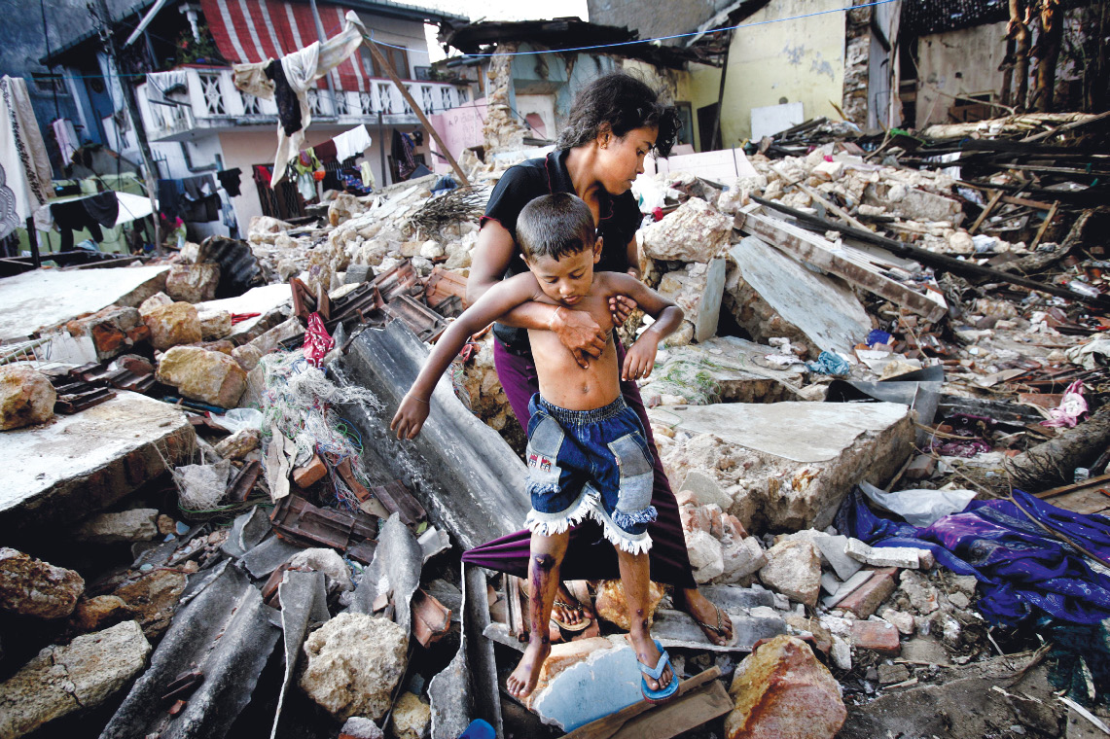
Tsunami off Sumatra in 2004: Whose sin was this a punishment for?

Slide 62
Causes of Suffering #3: Natural Causes
Plate Tectonics
Weather
Bacteria
These are all very good things.

Slide 63
A Question: Is Pain Evil?
Touch a burner on the stove
Broken Bone
Overeating
Emotional Pain
Pain is Good. Pain is from God
But… Not all pain is explained so easily.

Slide 64
A Question: Is Death Evil?
For plants and animals, death is a positive good.
Isaiah 57:2
Philippians 1:21
For humans, death is a transition, not an end.
If the atheist is right, then maybe death is evil, but if the atheist is right, there is no evil.

Slide 65
Question: Is Suffering Evil?
Psalm 30:5 For Humans, without suffering there is no joy.
John 9:1-3 Suffering, if received correctly, glorifies God.
Romans 8:28 All kinds of suffering can be used for good (but be careful how you use this passage)
Romans 5:3, James 1:2-3 Suffering produces good character. No pain, no gain.
1 Peter 2:20-22, 2 Tim 3:12. Suffering is the natural result of doing good.
Coll 1:24-29, 1 Pet 4:12-17 Suffering is how we come to know Christ and to fill up his suffering.
Through shared suffering is how we become close to one another.

Slide 66
Suffering and Evil: The Apologetic Problem A Summary
Most suffering is the result of free will and our choice to sin. It is because God loves us, not because he does not care or is not powerful enough to stop us from suffering.
Pain is not evil, death is not evil, suffering is not evil. All of these are gifts from a loving God.

Slide 67
The Problem of Pain and Suffering Part II The Human Problem
Our response to suffering depends on our world view.
What is the Hindu world view?
Suffering is an illusion
What is the Buddhist world view?
Suffering is the result of passion.
What is the world view of Islam?
Inshallah It is God’s will. Fatalislm.
What is the world view of the atheist/naturalist?
Too bad…. Deal with it!

Slide 68
The Christian World View
The physical world is real.
The physical world is good, not evil. (Gen 1:31)
Pain and suffering are very real, but they are not the problem: the human problem is sin and separation.
The Christian response: Compassion! Micah 6:8, James 1:27 Jeremiah 22:15-16 Prov 14:31 Isaiah 58:6-7

Slide 69
Julian “the Apostate” (AD 332-363)
“Atheism (i.e. Christian faith) has been specially advanced through the loving service rendered to strangers, and through their care for the burial of the dead. It is a scandal that there is not a single Jew who is a beggar, and that the godless Galileans care not only for their own poor but for ours as well; while those who belong to us look in vain for the help that we should render them.”

Slide 70
God Understands (and so should we)
God is ready and willing to hear our complaints.
Habakkuk 1:2-4, Jeremiah 12:1
Even Jesus cried out in his suffering. “My God, my God…
Jesus can relate fully to our suffering.
Hebrews 2:17-18, Hebrews 4:15.
This ought to affect our response to others’ suffering. 2 Cor 5:14-15
Look at Jesus’ response to suffering: John 11:35 Jesus wept. Matthew 23:37 O Jerusalem, Jerusalem… Compassion.

Slide 71
What Should We Do?
Live with integrity, like Job.
Use your suffering as an opportunity to show empathy.
Alleviate suffering, not because it is evil, but because that is how God responds to suffering
Show compassion. Matthew 9:36-38

Slide 72
F. Violence and Slavery in OT
The critic of Christianity: The God of the Old Testament is a sadistic, violent, ethnic cleanser.
1 Samuel 15:2-3 “This is what the Lord of Hosts says: ‘I witnessed what the Amelekites did to the Israelites when they opposed them along the way as they were coming out of Egypt. Now, go and attack the Amelekites, and completely destroy everything they have. Do not spare them. Kill men and women, children and infants, oxen and sheep, camels and donkeys.’”
This is pretty tough stuff!

Slide 73
Response to the Question of Violence in the OT
If you are not bothered by this on some level, I am worried about you!
The argument assumes that physical death is bad/evil. This is a false assumption. Sin is evil but death is not. Death is a transition, hopefully, to something better.
God has a perfect right to judge—not us.
There is the issue of the religion of the Amelekites. Sacrificing of children in fire, worshipping gods by having sex with a prostitute in the temple, etc.
The situation for the children in this situation was hopeless.

Slide 74
Violence in the OT (cont.)
In the case of Amelek and other Canaanites, both God’s love and his justice demanded that something be done.
Either God was going to create a nation or he was not. If God is going to have a “people,” then such people must have a physical land and must have an army.
God’s plan is to choose a man, then a nation, through whom to send a savior. God’s plan to bless humanity through Jesus trumps all else.
It is sinful to take the life of another in anger, out of greed or selfishness, but it is not necessarily sinful to take a life in war.
Everything God did to Israel as a nation was to limit their ability to wage war.
No authority to establish an empire.
No standing army.
No cruelty, no abuse, no rape

Slide 75
The Problem of Slavery in the OT
First, let us acknowledge that, on some level, God legislating slavery is troubling.
God accommodated rather than approved slavery.
All of God’s regulations with regard to slavery were to limit it. (Eph 6:9)
Slaves could not be bought and sold.
Humane treatment. Deuteronomy 23:15, Leviticus 25:14
All slaves were eventually given their freedom at the Jubilee year.

Slide 76
The Question of Slavery (cont.)
God is not concerned with physical slavery nearly so much as spiritual slavery.
Nevertheless, Paul asked Philemon to free his slave Onesimus in an inspired passage.
William Wilberforce. It was Christian influence which ended the slave trade world wide.

Slide 77
A Broader Question: Is the God of the Old Testament Good?
The Three Horsemen of the New Atheism:
Richard Dawkins
“The God Delusion”
Christipher Hitchens
“God is Not Good”
Sam Harris
“The End of Faith”

Slide 78
Is the God of the Bible Good?
Dawkins: God is a “moral monster.”
Hitchens: “The nightmare of the Old Testament
Harris: We should be “stoning people to death.”
Ouch!
Response:
These guys are very angry
They do not know what they are talking about
Their criticism is quite shallow

Slide 79
Does God encourage slavery in the Bible?
Does God authorize Christians to start wars and commit genocide?
Does God view women as inferior and as property of men?
Is the God of the Old Testament a petty, jealous God?

Slide 80
Response:
Go back to Genesis 1 and 2 (or anywhere in the Bible for that matter)
God accomodated the Law of Moses to the times, the local situation and to the hard heartedness of his people.
The Law of Moses was intended as a “tutor” (Gal 3:24) His revelation is progressive.
The laws are physical foreshadows of spiritual truths. They served their purpose and are no longer in force.

Slide 81
Does God Get Jealous?
Yes he does!!!
Two kinds of jealousy
Selfish, self-centered.
Spousal jealousy—concern over losing a deep relationship and over the pain the partner will experience.
God’s Jealousy:
Hosea
Ezekiel 6:9 How I have been hurt by their adulterous heats which turned away from me and by their eyes which played the harlot after their idols.
Genesis 6:6 The Lord was grieved…. And his heart was filled with pain.

Slide 82
God Accommodates to Our Sinful Nature
God’s Ideal: Genesis 2:24 vs Matthew 19:3-9
Galatians 3:24 The law was a guardian/tutor until the coming of Christ.

Slide 83
G. The Problem of Hell
The most difficult questions:
The Question of Evil
The Problem of Suffering
The Trinity
Violence for God in OT
The Problem of Hell

Slide 84
The Problem of Justice and the Problem of Hell
Would a loving God send one of those he loves to eternal torment in hell?
We understand discipline….
But hell is not about discipline. It is not an improvement program. It is a final state.

Slide 85
The Problem of Hell
Romans 3:10f There is no one righteous, not even one.
Revelation 20:15 If anyone’s name was not found written in the book of life, he was thrown into the lake of fire. Rev 21:8 …the fiery lake of burning sulfur. This is the second death. Rev 20:10 … They will be tormented day and night for even and ever.
Does God choose to send us to hell? No! We choose hell and God, in his justice, accepts our decision.
Is suffering in hell literally eternal? Is joy in heaven literally eternal?

Slide 86
Attributes of God
Eternal
Omnipresent
Omniscient
Omnipotent
Righteous, Holy
Love
Justice
God is not merely loving, he is love
God, in his awesomeness is fully love and fully just

Slide 87
Love and Justice
For God so loved the world…
The wages of sin is death Rom 6:23
The law of sin and death Rom 8:2
We like God’s love, but we are not so fired up about his justice.

Slide 88
How Should I Feel About This?
When we reach heaven, we will understand and fully appreciate, on an emotional level, God’s justice.
Rev 11:17-18 Rev 16:5-6 The elders are thankful that God’s judgement has finally come. You are just, O God.
Psalm 94:1-3 David How long, O Lord

Slide 89
Here is the Good News
God’s love met God’s justice at the cross. As far as we are concerned, love won.
Romans 3:21-26

Slide 90
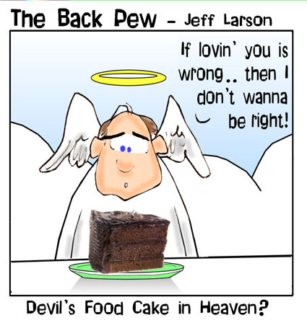
H. The Problem of Heaven.
How can we be joyful in heaven knowing that others are in hell?
If there is no suffering in heaven, how can there be so much joy?
Will there be free will in heaven? How will that work?
Do all dogs go to heaven?

Slide 91
Summary
All the hard questions have reasonable answers
The Christian World View is the only one which comes even close to answering these questions.
But… Do not forget the role of faith. Faith is belief in things unseen…. Even the answers to hard questions!!!
The trinity is a mystery. God’s love is not rational, and neither is our relationship with him.

