Slide 1
The Bible
Reliability, Inspiration and Inerrancy
October, 2016
San Diego

Slide 2
Apologetic Strategies: John Oakes
Defending the Faith
  History and Archaeology
  How We Got the Bible (including response to form criticism, etc.)
  Science
  Refuting Contradictions in the Bible
Creating Faith
  World View
  Prophecy
  Miracles/Resurrection
  Claims of Jesus

Slide 3
Outline
I. General Introduction: How to handle apologetic questions.
II. New Testament Documents
III. New Testament Canon
IV. Old Testament Documents and Canon
V. Contrast: Extrabiblical documents
VI. Contrast: Scriptures of other religions.
VII. Definition and Defense of Biblical Inspiration.
VIII. Definition and Defense of Biblical Inerrancy.
IX. Supposed Bible Contradictions.
X. Internal Evidence; Consistency, etc.
XI. The Bible: The Best Book of….

Slide 4
I. Introduction: How Do I Answer Questions?
Don’t overreach. Don’t oversell the evidence.
Don’t paint yourself into a corner.
Don’t undersell either.
Leave some ammunition in your “gun”.
Be confident: You are right! (at least in the big picture)

Slide 5
Common Criticisms
The gospels were written in the second century and are fabrications, designed to make Jesus into some sort of God, with virtually no historical content at all.
2. There were dozens of gospels in existence in the second and third century. There was no consensus about which of these “gospels” was the most reliable picture of Jesus. In the 4th century, Constantine became emperor, what is now the Orthodox position won out. At this time, all the other gospels were suppressed, and the New Testament documents which remain were edited to fit Orthodox doctrine.
3. Bart Ehrman: The Orthodox Corruption of Scripture. The New Testament was a very fluid document until well into the fifth century, with copyists feeling free to edit the text in order to make it fit their own theology.

Slide 6
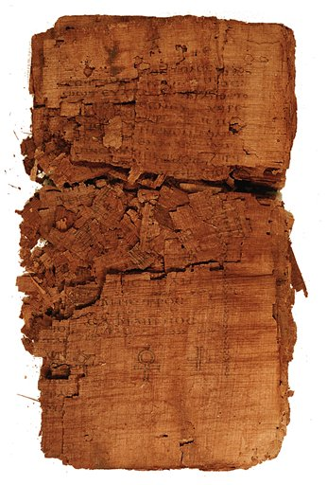
Judas:
Another Gospel?

Slide 7
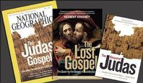
National Geographic Article:
“Some of these alternative versions (Gospel of Thomas, Gospel of Phillip, Gospel of Judas) may have circulated more widely than the familiar four Gospels”
“A long-buried side of Christianity is re-emerging”
“In fact, it is unclear whether the authors of any of the gospels—even the familiar four—actually witnessed the events they described.”

Slide 8
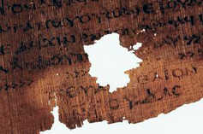
Is it Genuine?
Discovered in a subterranean chamber in Egypt in 1970’s.
Carbon-14 dating: AD 220-340.
A Coptic manuscript on papyrus.
Quoted by Iranaeus Against Heresies AD180.
Probably originated AD 150-170.
Bottom line, it is genuine!

Slide 9
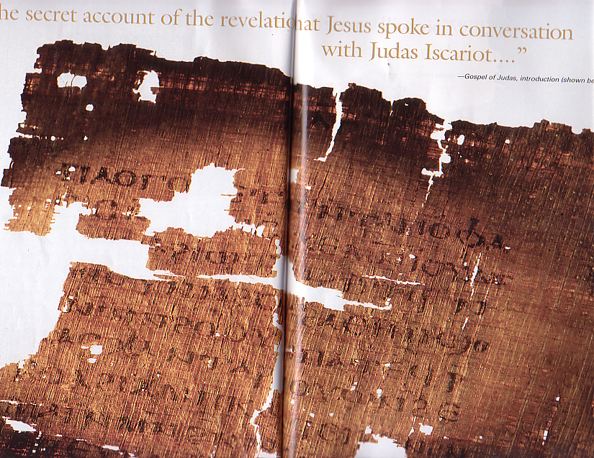
The Theme of the Gospel of Judas:
“The secret account of the revelation that Jesus spoke in conversation with Judas Iscariot.”
Judas was Jesus’ closest apostle.
Jesus revealed secret, deeper knowledge of his purpose and ministry to Judas. This Gospel reveals this deeper knowledge (gnosis).

Slide 10
Content (cont.)
A bizarre Gnostic cosmology put into the mouth of Jesus
“Come, that I may teach you about [secrets] no person [has] seen…” (GJ, p. 47)
12 Aeons (gods?) (see on Gnosticism below).
72 heavens and 72 luminaries: six for each of the Aeons.
360 firmaments and 360 luminaries: five for each of the heavens.
Characters such as Nebro, Yaldabaoth, Saklas, Galila, Yobel, Adonaios, Seth. “The first is Seth, who is called Christ” (GJ p. 52) Jesus is Seth, one of the five rulers of the underworld.

Slide 11
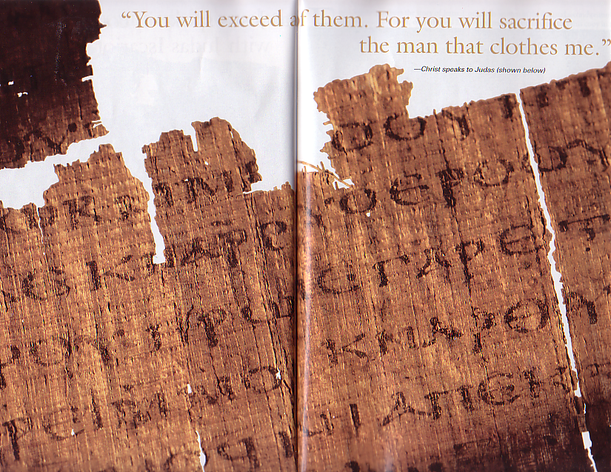
Content (cont.)
The key like comes near the end: “For you will sacrifice the man that clothes me.” (GJ p. 56) Believe it or not, this makes sense (to a Gnostic)!

Slide 12
What about the other “gospels?”
There were several Gnostic “gospels,” such as the Gospel of Thomas, the Gospel of Phillip, and the gospel of Judas.
These books were written AD 150-250 and definitely were not written by the apostles.
Even the Gnostics such as Marcion did not include them in their canon of scripture, because everyone knew they did not have apostolic authority.

Slide 13

The fictional conspiracy of the book
  Quote from The Da Vinci Code
    “…almost everything our fathers taught us about Christ is false.” (page 255, DVC)

Slide 14
Excerpt from DVC
  “Constantine turned Jesus into a deity who existed beyond the scope of the human world, an entity whose power was unchallengeable. …It was all about power… the early Church literally stole Jesus from his original followers, hijacking His human message, shrouding it in an impenetrable cloak of divinity, and using it to expand their own power.” (page 253, DVC)

Slide 15
Excerpt from DVC
    (speaking of the Council of Nicaea, in 325 A.D.) “My dear,’ Teabing declared, ‘until that moment in history, Jesus was viewed by His followers as a mortal prophet… a great and powerful man, but a man nonetheless. A mortal.”
    “Not the Son of God?”
    “Right,’ Teabing said, ‘Jesus’ establishment as ‘the Son of God’ was officially proposed and voted on by the Council of Nicaea. ‘…A relatively close vote at that.’ (page 253, DVC)

Slide 16
Excerpt from DVC
“More than eighty gospels were considered for the New Testament, and yet only a relative few were chosen for inclusion – Matthew, Mark, Luke and John among them.” (page 251, DVC)

Slide 17
II. New Testament Manuscript Evidence
Definitions
Manuscripts
Church Father Quotes
The Question of Greek Manuscript Errors

Slide 18
Definitions
manuscript
Any ancient document which contains all or parts of either the New of the Old Testament. The word literally means hand-written. Manuscripts may be in the original language or they may be a translation from the original language.
canon
The canon (Greek: reed, or measuring stick) of either the New or the Old Testament is the officially accepted list of books to be included in the scriptures.
scroll
A long piece of material, usually leather, which contains a number of pages of writing in rows, arranged in columns, designed to be rolled up and stored. This was the principal form of manuscripts before the time of Christ (2 Timothy 4:13).
codex
A long piece of either leather or papyrus, folded up in a format basically like a modern book. This was the most common form of manuscripts after about 200 AD.

Slide 19
Definitions (cont.)
papyrus
Papyrus is found in the Nile delta. Horizontal and vertical layers were glued together to create a light and easy-to-use writing substrate. Unfortunately, papyrus is the least likely of the ancient writing materials to survive for long periods without disintegrating. Commonly used in the first and second century.
vellum, parchment
Parchments are specially prepared sheep of goat skins used as writing materials. Vellum was made of calf or antelope skins. When papyrus became scarce in the early centuries AD, vellum became the chief material for creating manuscripts.
uncial
These are manuscripts which are written using all capital letters. The oldest Greek manuscripts are uncials.
Cursive/miniscule
These are manuscripts which use both capital and small letters, similar to a modern style of writing. The later manuscripts—after about AD 800—are usually cursives.

Slide 20
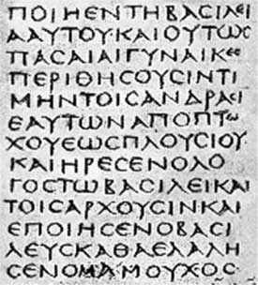
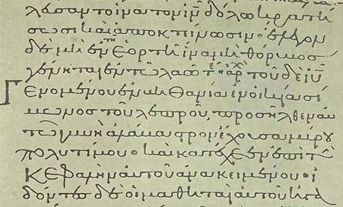
A Miniscule Manuscript
An Uncial Manuscript

Slide 21
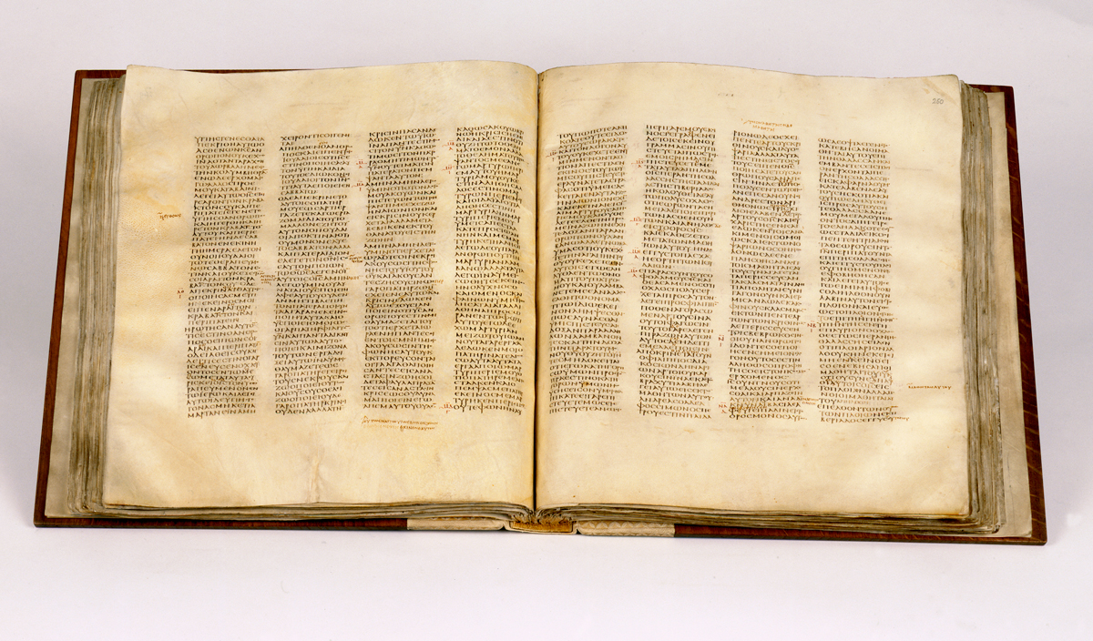
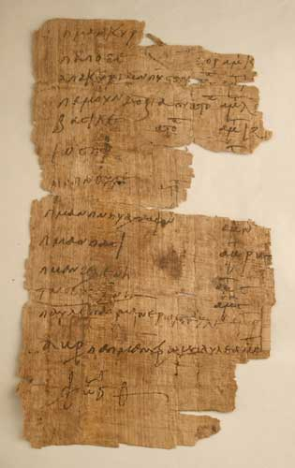
A papyrus manuscript
A vellum codex

Slide 22
Textual Evidence for Ancient Manuscripts
Author
Date
Oldest Copy
Interval
Copies
Aristophanes
400 BC
AD 900
1,300 years
45
Aristotle
340 BC
AD 1100
1,450 years
5
Demosthenes
300 BC
AD 1100
1,400 years
200
Julius Caesar
50 BC
AD 900
950 years
10
Herodotus
435 BC
AD 900
1,350 years
8
Homer
800 BC
AD 100
900 years
643
Plato
360 BC
AD 800
1,150 years
15
Sophocles
415 BC
AD 1000
1,400 years
7
Thucydides
410 BC
AD 900
1,300 years
8
Old Testament
1400 BC – 430 BC
250 BC
200-400 years
5,000
New Testament
AD 50-90
AD 125
50 years
8,000

Slide 23
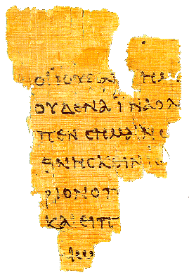
Manuscript evidence for the canonical gospels
The Rylands
Fragment
John 18:31-33, 37
AD 125

Slide 24
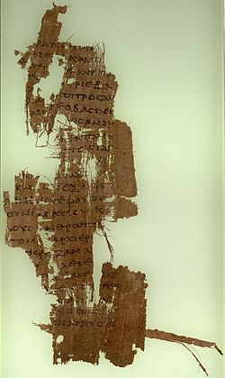
Sackler Library
John 18:36-19:1
150 AD

Slide 25
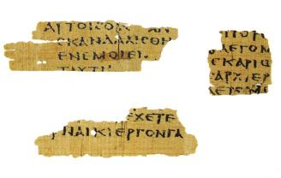
Magdalen Manuscript Matthew 3:5,26 AD 175

Slide 26
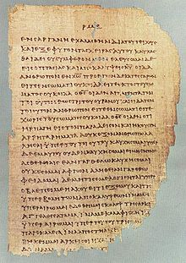
Chester Beatty Papyrus
2 Cor 11:33-12:9
200 AD

Slide 27
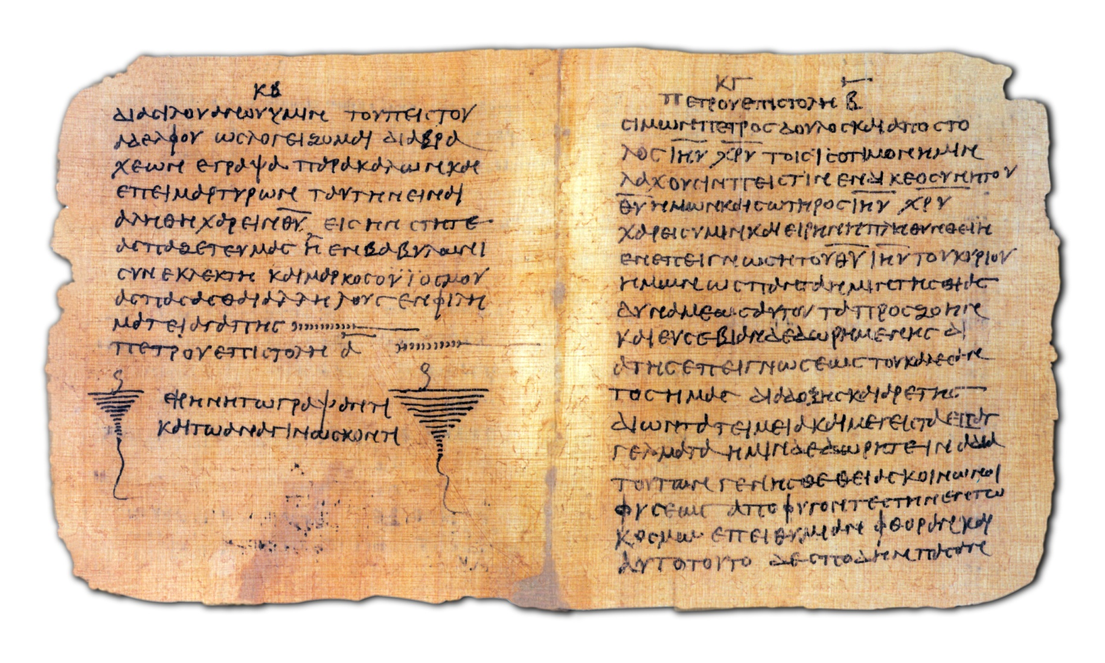
Bodmer Papyrus Codex c. 200AD

Slide 28
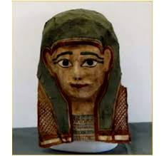
Mark Fragments
from a mummy mask?
Discovered 2012
AD 80 ± 20

Slide 29
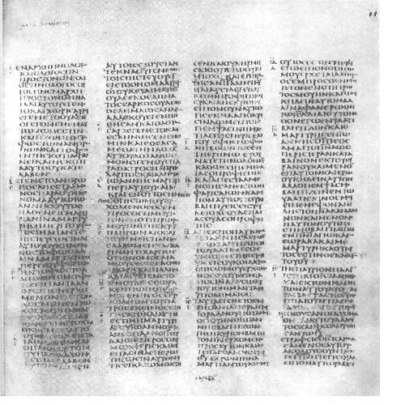
Codex Sinaiticus AD 350 British Museum

Slide 30
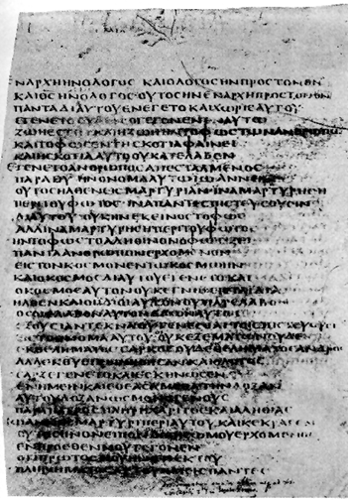
Codex Bezae D

Slide 31
John Rylands Papyrus (AD 125)
Chester Beatty Papyrus (AD 200)
Bodmer Papyri (AD 200)
Codex Vaticanus (AD 325)
Codex Sinaiticus (350 AD)
Codex Alexandrinus (400 AD)
Codex Bezae (450 AD)

Slide 32
Text Types
Alexandrine
Western
Byzantine

Slide 33
Other Evidence: Translations
Coptic (Alexandrine) 2nd Century
Old Syriac 2nd Century
Old Latin (Western?) 2nd Century
Jerome: The Vulgate 384 AD
These are a “snapshot” of the NT in the 2nd century.

Slide 34
Church Father Quotes
Clement of Rome AD 95 or 96 quotes from ten of the twenty-seven New Testament books. Matthew, Mark Luke (possibly only two of the three), Acts, Romans 1 Corinthians, Hebrews, James, 1,2 Peter.
Ignatius d. AD 108 Letter to Ephesians: Matthew, Luke, John, Romans, 1,2 Corinthians, Ephesians, 2 Timothy, James, 1 Pet.
Also quoted in other letters, 1 Tim, 2 Thess, Acts, Hebrews, Galatians, Revelation.

Slide 35
Church Father Quotes (cont.)
Polycarp, writing to the Philippians in AD 120 quotes from Matthew, Mark, Luke, Acts, 1,2 Corinthians, Galatians, Ephesians, Philippians, 1,2 Thessalonians, 1,2 Timothy, Hebrews, 1 Peter, and 1,3 John.
Irenaeus AD 180 quotes from all NT books.
Nearly the entire New Testament can be reconstructed from quotes of the church fathers in the 2nd and 3rd centuries.
None of these ever quoted from a Gnostic gospel, ever! (although they quoted the OT Apocrypha)

Slide 36
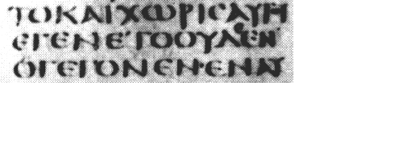
What about the 200,000 manuscript errors in the New Testament?
Blow-up of text from Codex Sinaiticus
Showing uncial manuscript type
NOTEVERYONEWHOSAYSTOMELORDLORDWILLENTERTHEKINGDOMOFHEAVENBUTONLYHEWHODOESTHEWILLOFMYFATHERWHOISINHEAVEN

Slide 37
Copying Errors/Editing of the Text?
Slips of the pen
Lines repeated, switched, etc.
Scribes’ attempts to “improve” or “smooth” the text.
Interpolations (generally inserted in the margins and later incorporated into the text).

Slide 38
How many textual variants?
Notes:
Word order. For example “Jesus Christ” and “Christ Jesus”

Slide 39
Meaningful but not viable
1 Thessalonians 2:9
1 Thessalonians 2:9
Surely you remember, brothers and sisters, our toil and hardship; we worked night and day in order not to be a burden to anyone while we preached the gospel of God to you.
3rd Century
Surely you remember, brothers and sisters, our toil and hardship; we worked night and day in order not to be a burden to anyone while we preached the gospel of Christ to you.
13th Century

Slide 40
Significant Textual Issues
About 60 in number
Matthew 11:19 for example
  But wisdom is proved right by her actions/deeds
  But wisdom is proved right by her children
  Compare to Luke 7:35

Slide 41
Textual (Lower) Criticism
Age and quality of witnesses.
Unharmonized reading is preferred.
The “more difficult” reading is preferred.

Slide 42
Significant Textual Issues
John 7:53-8:11 Woman caught in adultery
Acts 8:37 If you believe with all your heart…
1 John 5:7 There are three that testify…
John 5:4 The angel stirred the water…
Mark 16:9-20

Slide 43
What is a Textual Variant?
Any place where two manuscripts differ from each other
Mark 9:29
Mark 9:29
He replied, “This kind can come out only by prayer.”
He replied, “This kind can come out only by prayer and fasting”

Slide 44
Meaningful and Viable
Acts 15:40
Acts 15:40
But Paul chose Silas and departed, being commended by the brethren to the grace of God.
But Paul received Silas and departed, being commended by the brethren to the grace of God

Slide 45
Chose/Received
Chose
Received
ἐπιλεξάμενος
ἐπιΔεξάμενος
Notes:
This is a Permutation
Permutation: Letters that are hard to distinguish from each other

Slide 46
Orthodox Corruption of Scripture?
Luke 3:22
  You are my beloved Son; in you I am well pleased.
  Vaticanus, Sinaiticus, Alexandrinus, etc.
  You are my beloved Son; today I have begotten you.
  Bezae, Justin Martyr, Clement of Alexandria, Old Latin
Compare to Mark 1:11
Compare to Psalm 2:7

Slide 47
Even the hyper-critic Bart Ehrman says:
I do not think that the "corruption" of Scripture means that scribes changed everything in the text, or even most things. The original texts certainly spoke at great length about Jesus' crucifixion and resurrection. The issues involved in the corruption of the text usually entail nuances of interpretation. These are important nuances; but most of the New Testament can be reconstructed by scholars with reasonable certainty -- as much certainty as we can reconstruct *any* book of the ancient world.

Slide 48
Summary:
Westcott and Hort 1881. .1%? 1%? 2%?
No significant point of doctrine or theology is at stake.
The Greek text we have at this point is a nearly perfect representation of the autographs of the New Testament.

Slide 49
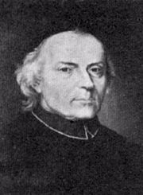
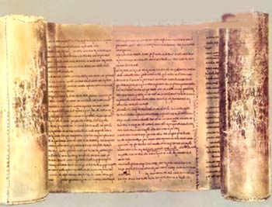
III. The Canon of the New Testament
The Muratorian Fragment?
Ledovio Muratori

Slide 50
Development of the New Testament Canon
A collection of Paul’s letters, perhaps not including the Pastoral Epistles, was circulating among the churches by the 90s AD
Four gospels circulating and recognized as apostolic by AD 100 or even by AD 90.
Marcion: AD 140 Developed and alternative canon.
A still fluid, but developing list of canonical books being read in the church by AD 150. “The memoirs of the apostles.”

Slide 51
Development of the New Testament Canon
Irenaeus AD 180. Gosples “the four pillars” of the church.
Muratorian Fragment. AD 180.
By AD 200, the New Testament as we know it was canonized by acclamation of the church.
Origen 220 AD Still some doubt about Hebrews, 2 Peter, 2,3 John, Jude, Revelation.
Shepherd of Hermas, Epistle of Barnabas, Didache “profitable for reading in the church.”

Slide 52
So, What About Those Claims of Corruption?
Muslims: “The Bible is Corrupt.”
Daniel Brown et al: Constantine/the Catholic Church changed the Bible.
Hindus: At the Council of Nicea they removed all mention of reincarnation from the New Testament.
There were many competing gospels and after Nicea, the Orthodox view won, and all others were destroyed.
Response: This is pure fiction. The claims are absolutely insupportable by the facts.

Slide 53
Summary
The New Testament canon was selected by consensus of the church in the second century as those books with apostolic authority.
The evidence is conclusive that the Greek New Testament we have is virtually identical to the original writings of the inspired writers.

Slide 54
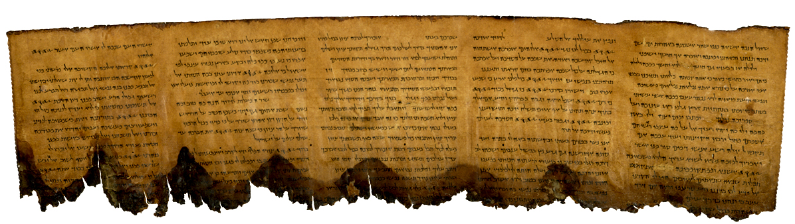
IV. The Hebrew Text of the Old Testament
A section of the Psalms from the Dead Sea Scrolls

Slide 55
Reliability of the Old Testament Hebrew and Aramaic Text
The Masoretic Text
The Dead Sea Scrolls
The Septuagint and Other Early Translations

Slide 56
Early Translations of the Old Testament
Samaritan Pentateuch 400 BC 6000 errors?
Septuagint 200 BC
Syriac Version AD 100
Quotes from the Mishnah/Talmud

Slide 57
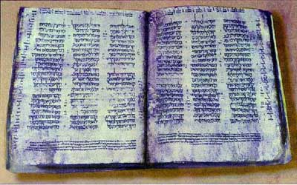
The Hebrew Text of the Old Testament
The Cairo Codex: The former and latter prophets AD 895
The Aleppo Codex: Oldest Hebrew manuscript of the entire Old Testament AD 920
The Leningrad Codex: Manuscript of the whole Old Testament AD 1008
The Masoretes and the Masoretic Text. These guys were fanatics!
The Cairo Codex

Slide 58
The Masoretes AD 500-1000 Tiberias
Before starting to copy the scrolls or codices, the scribe required by the Masoretes to go through an elaborate ceremony. In order to preserve the integrity of the text, the Masorete scribes counted all the letters in the Old Testament. They kept track of such arcane details as the middle verse of the Pentateuch (Leviticus 8:7). They also found the middle verse of the entire Hebrew Bible (Jeremiah 6:7). They were aware of the middle word of the whole Old Testament, as well as the middle word of each book. They also kept record of the middle letter and verse of each book. Taking it to the extreme, they also counted the number of times each Hebrew letter appeared in each book and counted the number of verses which contained all the letters of the Hebrew alphabet. All this was intended to produce exact copies of the Scriptures. All this without word processors.

Slide 59
The Talmudists (AD 100-400) were radical too!!!
A synagogue roll must be written on the skins of clean animals, prepared for the particular use of the synagogue by a Jew. These must be fastened together with strings taken from clean animals. Every skin must contain a certain number of columns, equal throughout the entire codex. The length of each column must not extend over less than forty-eight, or more than sixty lines; and the breadth must consist of thirty letters. The whole copy must be first lined; and if three words be written in it without a line, it is worthless. The ink should be black, neither red, green, nor any other color and be prepared according to a definite recipe. An authentic copy must be the exemplar, from which the transcriber ought not in the least deviate. No word or letter, not even a yod (a vowel mark), must be written from memory, the scribe not having looked at the codex before him…. Between every consonant the space of a hair or thread must intervene; between every word, the breadth of a narrow consonant; between every new section, the breadth of nine consonants; between every book, three lines. The fifth book of Moses must terminate exactly with a line, but the rest need not do so. Besides this, the copyist must sit in full Jewish dress, wash his whole body, not begin to write the name of God with a pen newly dipped in ink, and should a king address him while writing that name he must take no notice of him…. The rolls in which these regulations are not observed are condemned to be buried in the ground or burned; or they are banished to the schools, to be used as reading books.

Slide 60
But…
There is still that annoying 1400 years or so!

Slide 61
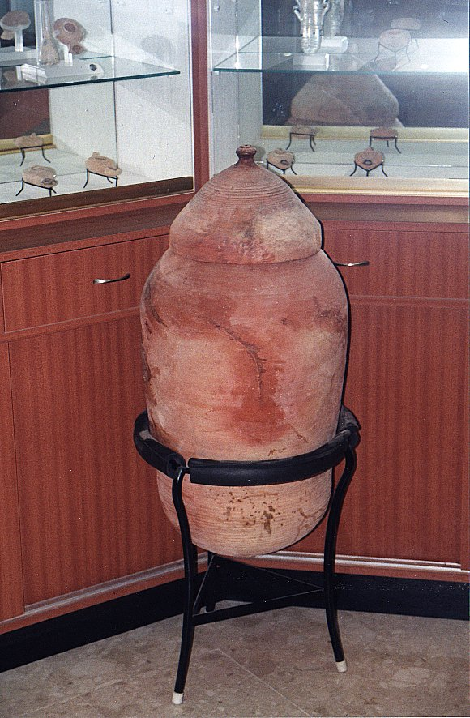
All this changed in 1947 with an Arab child in the hills east of Jerusalem….

Slide 62
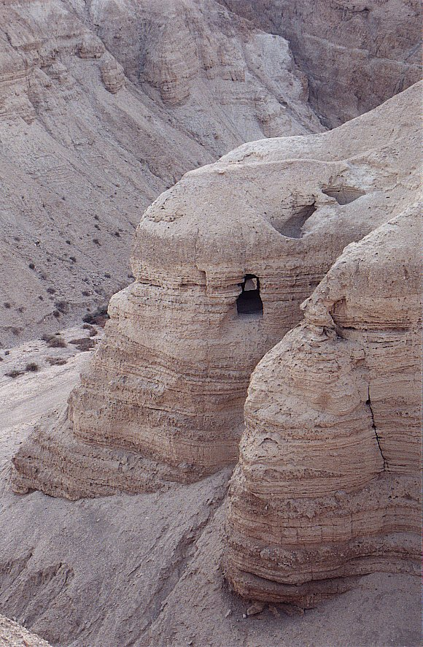
Qumran
Cave #4

Slide 63
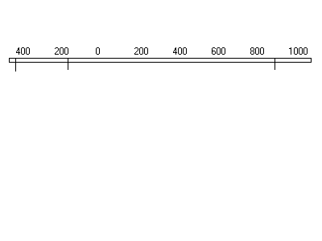
The Effect of the Dead Sea Scrolls
Last Old Testament Book Written Autograph | Dead Sea Scrolls Written | Oldest Old Testament Manuscript Before Dead Sea Scrolls

Slide 64
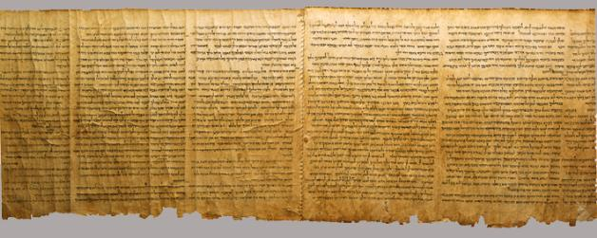
Important Dead Sea Scrolls
Isaiah 58:6-65:4
Isaiah A 13 changes t0 1952 RSV
Isaiah B
Samuel
1 & 2 Samuel 250 BC
Psalms
Exodus paleo-Hebrew 200 BC

Slide 65
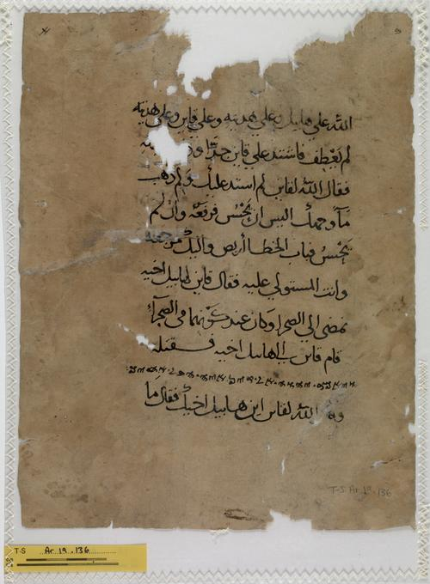
Other Hebrew Bible Translations
Samaritan Pentateuch 400 BC
6000 errors?
Septuagint 250 BC
Aramaic Targums about 0 BC
Old Syriac AD 100
Old Latin AD 100
Vulgate Jerome AD 386
Arab Translation of Samaritan Pentateuch

Slide 66
Textual Errors in the Hebrew Bible
Names and numbers
Amerixan vs American 510 vs 51 or 5100 or 500 soldiers
The Hebrew letters kaleth (ד) and resh (ר) are very difficult to distinguish. Similarly, the letters he (ה) and heth (ח) could easily be mistaken for one another.

Slide 67
III. Old Testament Canon
Targums, Talmud, Mishna
  Talmud: Ezra
Josephus Not 10,000 but 22 books
New Testament!!! (all but either books quoted)
Council of Jamnia AD 90-100 Confirmed that Ecclesiastes and Song of Solomon should remain included in the accepted canon. Did NOT create an OT canon.

Slide 68
Old Testament Reliability: A Summary
The canon of the Old Testament was set by general consensus of the Jewish rabbis perhaps as early as 300 BC, but almost certainly by 200 BC. The council of Jamnia more or less confirmed this list of books.
The Hebrew and Aramaic text of the Old Testament is remarkably close to that of the original writings.

Slide 69
VI. Further Evidence: Compare to Extra-Biblical Writings
Old Testament Apocrypha
Other Jewish Extra-Biblical Writings (1 Esdras, 1 Enoch, etc…)
Church Father writings not included in NT canon.
Heretical Writings (Gospel of Thomas, Gospel of Peter, Gospel of Judas, etc.)

Slide 70
Old Testament Apocrypha
Included in the Septuagint?
Included by Jerome in Vulgate under protest.
Never quoted by Jesus. Mentioned in Jude, alluded to in Hebrews.
Used extensively by the Church Fathers, esp. after AD 200. 1 Esdras included in Coptic Bibles.
Finally rejected definitively by Jewish Rabbis.

Slide 71
Old Testament Apocrypha
Composed in the 3rd and 2nd century BC
Never quoted in NT (Jude 14 and exception?)
By 3rd Century these books were quoted extensively and treated as scripture by church fathers
Included in Jerome’s Vulgate
Rejected by Jews by 3rd century. NOT in Jewish Bible
Included in KJV, Luther’s Bible
Excluded by Protestant Bibles in 17th century

Slide 72
Old Testament Apocrypha
Tobit
Judith
Additions to Esther
First Maccabees
Second Maccabees
Wisdom
Ecclesiasticus (Wisdom of Jesus Ben Sirach)
Baruch
Additions to Daniel:
  The Prayer of Azariah and The Song of the Three Children
  Susanna
  Bel and the Dragon

Slide 73
Tobit, Judith, Additions to Esther, Susanna, Bel and the Dragon
Jewish Fables/Parables
Tobit: Using the smoke from the liver and heart of a fish to drive off a demon.
Judith: Nebuchadnezzar called a king of the Assyrians.
Additions to Esther: A Greek interpolation. A “Targum” A Jewish commentary. Never in Hebrew.
Susanna: Daniel as a young boy. “And from that day onward, Daniel was greatly esteemed by the people.”
Bel and the Dragon: Daniel convinces Cyrus that Bel and “the Dragon” are mere idols

Slide 74
1st and 2nd Maccabees
1st Maccabees of very high quality. Rejected because it is favorable of the Romans?
2nd Maccabees of much lower quality.
  Some very inspiring stories. (2 Maccabees 7)
  Many historical errors.
  2 Maccabees 6:17 “Without further ado, we must go on with our story.”
  “I will bring my own story to an end here too. If it is well written, and to the point, that is what I wanted; if it is poorly done and mediocre, that is the best I could do” (2 Maccabees 15:37-38)

Slide 75
Wisdom and Ecclesiasticus
Very similar in form and substance to Proverbs.
Wisdom is a Pseudepigrapha (falsely ascribed book) Solomon? Written about 100 BC
Some very good advice.
  Envy and anger shorten one’s life, Worry brings on premature age. One who is cheerful and gay while at table benefits from his food (Sirach 30:24,45)
  If there are many with you at table, be not the first one to reach out your hand. Sirach 31:18)

Slide 76
Wisdom and Sirach Include False Doctrine and Unbiblical Advice
Tell nothing to a friend or foe; If you have a fault, reveal it not (Sirach 19:7)
For kindness to a father will not be forgotten, it will serve as a sin offering–it will take lasting root. In time of tribulation it will be recalled to your advantage, like warmth upon frost it will melt away your sins (Sirach 3:14-15).
Water quenches a flaming fire and alms atone for sins. (Sirach 3:29)
Worst of all wounds is that of the heart, worst of all evils is that of a woman.... There is scarce any evil like that in a woman; may she fall to the lot of the sinner (Sirach 25:12,18).

Slide 77
Documents Considered for Inclusion in the New Testament
Shepherd of Hermas, Epistle of Barnabas, Didache, 1st Clement “profitable for reading in the church.”
Epistle of Barnabas:
  Unfounded allegorical interpretation of the Old Testament.
  Anti-Semitic attitude which contradicts Paul’s statements.
Shepherd of Hermas.
  Highly allegorized interpretation of the Old Testament.

Slide 78
What about the other “gospels?”
There were several Gnostic “gospels,” such as the Gospel of Thomas, the Gospel of Phillip, and the gospel of Judas.
These books were written AD 150-250 and definitely were not written by the apostles.
Even the Gnostics such as Marcion did not include them in their canon of scripture, because everyone knew they did not have apostolic authority.

Slide 79
From “The Gospel of Thomas”
    (supposedly quoting Peter) “Let Mary go away from us, because women are not worthy of life.”
    Then Jesus allegedly tells Peter that “he will make Mary male so that she may enter the kingdom of heaven.”
    Childhood miracles such as bringing clay birds to life and speaking from the cradle.
    Gospel of Phillip: Echamoth is one thing and Echmoth another. Echamoth is Wisdom simply, but Echmoth is the Wisdom of death, which is the one who knows death, which is called “the little Wisdom.”

Slide 80
VII. Inspiration of the Bible: Compare to the Scriptures of Other Religions
Islam
Bahai
Mormonism (Don’t go there!)
Hinduism, Buddhism, etc.
In all religions, it is clear the Bible is the standard of inspiration to which all others are compared!!!!

Slide 81
Muslim Apologetics
Perfectly reliability text.
Numerology.
Scientific accuracy.
Beauty of the Arabic text.
The main thing: Undermine the Bible at any cost!

Slide 82
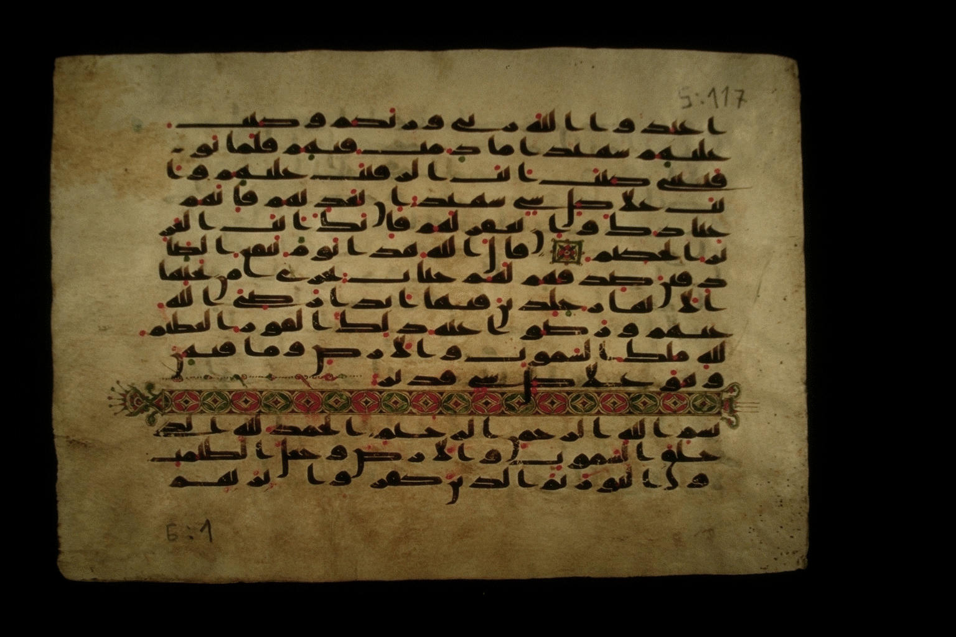
Muslim Claims of Inerrancy
Claim that the text is without error
  Uthman
  Sana’a Manuscripts
Generally refuse to allow translation because, unlike Christians, they require that we read a perfect Qur’an
Sana’a Manuscript

Slide 83
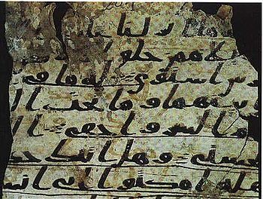
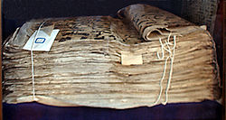
Islam
Sana’a Manuscript
AD 710
Tashkent Manuscript AD 850

Slide 84
Quranic view of biblical inspiration
Follow the Injil 5:47
( euvaggelion )
Follow the O.T. 6:92, 37:117, 40:53
“Qur’an unchanged” MS Discoveries...
“The people of the Injil shall rule in accordance with Allah’s revelations therein. Anyone who does not rule in accordance with Allah’s revelations -- these are the wicked!”
Inconsistency: Use OT and NT to refute Christians. Why, if the scriptures are “corrupt”?

Slide 85
Purported Prophecies (I)
Deut 18:15-18
¹⁵The Lord your God will raise up for you a prophet like me from among your own brothers. You must listen to him. ¹⁶For this is what you asked of the Lord your God at Horeb on the day of the assembly when you said, "Let us not hear the voice of the Lord our God nor see this great fire anymore, or we will die.“ ¹⁷The Lord said to me: "What they say is good. ¹⁸ I will raise up for them a prophet like you from among their brothers; I will put my words in his mouth, and he will tell them everything I command him.

Slide 86
Purported Prophecies (III)
Isa 21:7 ”when he sees…riders on donkeys or riders on camels, let him be fully alert”
Muslim claim: riders on donkeys = Jesus, riders on camels = Mohammed. Context: fall of Babylon!
Jn 14:16—parakletos → periclytos (praised one)—without any MS supp. Moreover, 14:26 shows the helper is the Spirit. Jn 16—The helper to abide forever. (M is dead.) 14:26—Helper to be sent in Jesus’ name; but no Muslim would allow this! Besides, Acts 1:5—helper to come in not many days – not in the 7th century!

Slide 87
Scientific errors in Qur’an (II)
21:33—Sun and stars orbit the earth
41:12 7--“heavens”, stars, comets in “lowest heaven
34:9, 52:44—Piece of sky falls and kills someone
36:4, 23:14--Man deposits child into the mother

Slide 88
Scientific Errors in the Qur’an
23:14—Creation from the clot of blood
“Then we made the sperm into a clot of congealed blood; then from that clot we made a lump; and we made out of that lump bones and clothed the bones with flesh.”
18:86—Traveling west…
“… till, when he reached the setting-place of the sun, he found it setting in a muddy spring.”

Slide 89

Historical errors in the Qur’an
Ishmael = Isaac 37:102
2 trees in Eden = 1 tree 20:120
Noah’s 4th son drowns 11:43
Zechariah silent 3 days (not 9 months) 3:41
Pharaoh’s magicians repent 20:70
Judges 7 / 1 Sam 17 conflated 2:249
Jesus’ childhood miracles 3:49, 5:110, 19:30

Slide 90
Purported Prophecies
Isa 21:7 ”when he sees…riders on donkeys or riders on camels, let him be fully alert”
Muslim claim: riders on donkeys = Jesus, riders on camels = Mohammed. Context: fall of Babylon!
Jn 14:16—parakletos → periclytos (praised one)—without any MS supp. Moreover, 14:26 shows the helper is the Spirit. Jn 16—The helper to abide forever. (M is dead.) 14:26—Helper to be sent in Jesus’ name; but no Muslim would allow this! Besides, Acts 1:5—helper to come in not many days – not in the 7th century!

Slide 91
Theory of Abrogation
Sura 6:34 “no one can alter Allah’s promises”
Sura 6:115 “No one can change His words”
Sura 10:64 “There is no changing the promises of Allah”
vs.
Sura 2:106 None of Our revelations do We abrogate or cause to be forgotten, but We substitute something better or similar: Knowest thou not that Allah hath power over all things?
Whatever Mohammad said later “abrogates” his previous sayings.

Slide 92
Abrogation (cont.)
Sura 53:19 In “a moment of weakness” Muhammad said: “Have you thought of Al-lat, al Uzza and AManat? These are exalted intermediaries whose intercession is to be hoped for.” Later abrogated, of course.
Examples: More than four wives for Muhammad 33:50 and 33:52
Praying toward Jerusalem abrogated by praying toward Mecca.
Sura 9 “Ultimatum” 9:5 “Verse of the sword” abrogates milder statements about unbelievers.

Slide 93
Bahai Scriptures inspired?
Prophecies in Bible fulfilled by the Bab or Baha Ullah?
  Dan 8:13-14, Revelation 11:3, Rev 12:1
Prophecies of Baha Ullah fulfilled?
  Ottoman Empire to fall apart
  Demise of Abdul Aziz
  Ali Pasha will lose his position as vizier

Slide 94
Scriptures of Hinduism
Vedas Poems. Ritualistic, priestly. 1500-1000 BC. Especially the Rig Veda. Include the Brahmanas.
Upanishads Highly philosophical essays about brahman, atman, transmigration of atman, karma and so forth. 800-600 BC.
Epics (Ramayana, Mahabarata, Bhagavad Gita) Mythic adventures of Rama, Krishna and others.
Puranas Largely local legends, myths, many local deities. AD 400-1000. This is the “scripture” of most local Hindus.
Tantras Religious discussions/teachings.

Slide 95
Hindu Scriptures Inspired and Reliable?
Written down 500 BC. Oldest manuscripts of the Rig Veda AD 1300. Nearly 3000 years after it was written.
Scriptures self-contradictory.
Does anyone actually consider these scriptures inspired in the sense Christians defend the Bible?

Slide 96
Buddhist Scriptures Inspired and Reliable?
No universal canon.
Pali Canon: Tripitaka. Collected AD 400.
Oral tradition from 500 BC until 100 BC.
Oldest manuscripts AD 100.

Slide 97
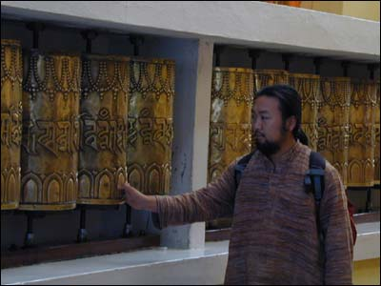
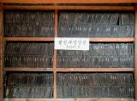

Slide 98
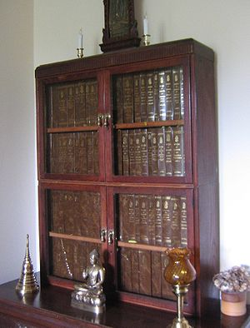
Thai Pali Canon

Slide 99
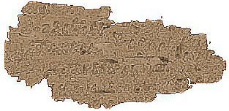
Oldest Buddhist Text AD 100

Slide 100
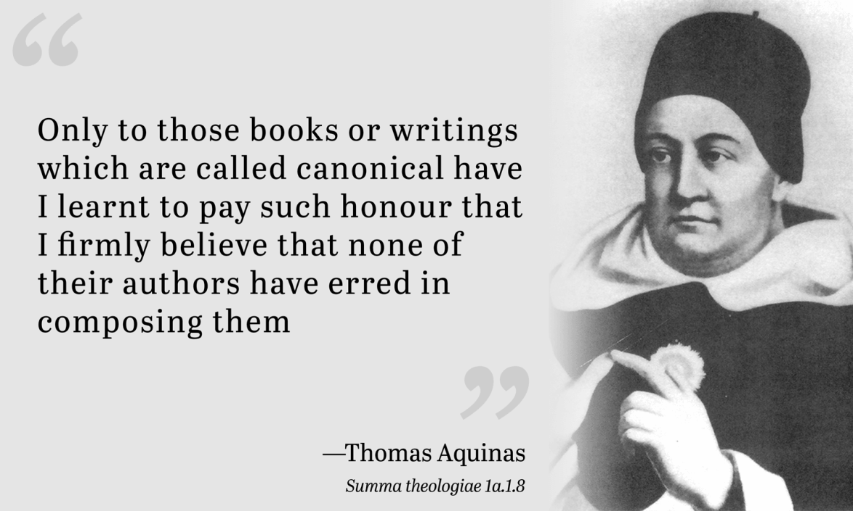
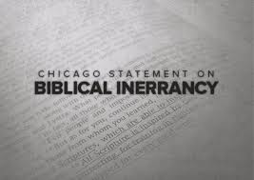
Inspiration and Inerrancy
Inspiration: Is the Bible inspired by God?
Inerrancy: Is the Bible inerrant?

Slide 101
VIII. Inspiration: Is the Bible Inspired by God?
The entire Bible, although authored by men, is divinely and authoritatively the revelation of God.
2 Peter 1:19-21, 2 Tim 3:16, 1 Thess 2:13, 2 Peter 3:15-16
Is there such a thing as inspired opinion? (1 Cor 7:12 I, not the Lord)
What about John 9:31? Is there inspired error?

Slide 102
What, Exactly, Is Inspired by God?
The Original Autographs For sure!
  (But we do not have those)
The Copyists? No
  Why would God trust his inspired word to fallible copyists?
The Translators? No
  Why would God trust his inspired word to fallible translators?

Slide 103
Verbal Inspiration
Galatians 3:16 An argument based on singular vs. plural of a noun.
Luke 20:37-38 An argument based on tense of a verb.
Jesus and Paul clearly believed in verbal inspiration.

Slide 104
Do we read inspired Scripture?
No! Translations are not inspired.
No! Translations are made from uninspired copies.
The autographs (the original written letters/histories/proverbs, etc. are inspired.
Does uninspired copying affect our faith?

Slide 105
How Do We Know the Bible is Inspired?
Can I prove Esther 3:4 is inspired?
Remember: Do not oversell your evidence.
Also, do not undersell your evidence.

Slide 106
Evidence of Biblical Inspiration
1. Historical Reliability.
2. Fulfilled Prophecy.
3. Fulfilled foreshadow and prefigure. In the Bible, history itself becomes a prophecy! (RFB p. 238-239 for examples)
4. Consistency of doctrine and theology.
5. Lack of contradiction.
6. Scientific wisdom.
7. Jesus believed it was inspired (Matt 15:6) and he did miracles and was resurrected from the dead.
8. Quality of the text. Ridiculously compact. Genesis 1 philosophically dense.

Slide 107
Can I be confident the Bible is inspired by God?
The preponderance of the evidence… What is the most rational conclusion?
The rest is filled in by faith.

Slide 108
IX. Is the Bible Inerrant?
  Inerrant: The Bible contains no errors whatsoever. This is the standard fundamentalist view.
  Translation issues. Translations are not perfect.
  Copyist errors. It is a fact that Hebrew and Greek texts have errors.
  Inerrancy needs to be defined carefully.

Slide 109
Definitions of Inerrancy
“The inerrancy of Scripture means that Scripture in the original manuscripts does not affirm anything that is contrary to fact.” - Wayne Grudem (Systematic Theology, page 90)
Chicago Statement 1978

Slide 110
Is the Bible Inerrant?
Are There Mistakes in the Autographs (Original Manuscripts)?
    Does the sun move across the sky?
    Are the gospels or Bible in general exact transcriptions?
    Are the “days” in Genesis 1 literal?
    Did Jesus clear the temple twice?
    Are there chronological errors in the NT?
    What about paraphrases of scripture or quotes from uninspired translations?
    Hyperbole: Against you, you only have I sinned….
    Was Moses literally in the desert exactly 40 years
    Be cautious about imposing a modernist/Western concept of inerrancy.

Slide 111
Bible “Errors”? (cont.)
Is David mistaken? Psalm 51:4 Against you only have I sinned. Psalm 51:5 Original sin?
Psalm 103:12 How far is it from the East to the West?
Do Bible writers misquote the OT? Is it an “error” if they quote from an unispired translation (the Septuagint)? Are they paraphrasing? Is that a mistake?
Bottom line, Inspiration is very solid, but inerrancy should be defined and defended carefully.

Slide 112
Chicago Statement
We further deny that inerrancy is negated by Biblical phenomena such as a lack of modern technical precision, irregularities of grammar or spelling, observational descriptions of nature, the reporting of falsehoods, the use of hyperbole and round numbers, the topical arrangement of material, variant selections of material in parallel accounts, or the use of free citations.

Slide 113
Chicago Statement on Inerrancy
Article X.
WE AFFIRM that inspiration, strictly speaking, applies only to the autographic text of Scripture, which in the providence of God can be ascertained from available manuscripts with great accuracy. We further affirm that copies and translations of Scripture are the Word of God to the extent that they faithfully represent the original.
WE DENY that any essential element of the Christian faith is affected by the absence of the autographs. We further deny that this absence renders the assertion of Biblical inerrancy invalid or irrelevant.
Article XI.
WE AFFIRM that Scripture, having been given by divine inspiration, is infallible, so that, far from misleading us, it is true and reliable in all the matters it addresses.
WE DENY that it is possible for the Bible to be at the same time infallible and errant in its assertions. Infallibility and inerrancy may be distinguished, but not separated.

Slide 114
Chicago Statement on Inerrancy
Article XII.
WE AFFIRM that Scripture in its entirety is inerrant, being free from all falsehood, fraud, or deceit.
WE DENY that Biblical infallibility and inerrancy are limited to spiritual, religious, or redemptive themes, exclusive of assertions in the fields of history and science. We further deny that scientific hypotheses about earth history may properly be used to overturn the teaching of Scripture on creation and the flood.
Article XIII.
WE AFFIRM the propriety of using inerrancy as a theological term with reference to the complete truthfulness of Scripture.
WE DENY that it is proper to evaluate Scripture according to standards of truth and error that are alien to its usage or purpose. We further deny that inerrancy is negated by Biblical phenomena such as a lack of modern technical precision, irregularities of grammar or spelling, observational descriptions of nature, the reporting of falsehoods, the use of hyperbole and round numbers, the topical arrangement of material, variant selections of material in parallel accounts, or the use of free citations.
Article XIV.
WE AFFIRM the unity and internal consistency of Scripture.
WE DENY that alleged errors and discrepancies that have not yet been resolved vitiate the truth claims of the Bible.

Slide 115
So, What Would Constitute an Error?
If David did not live.
If David did not kill Goliath.
If Jesus was not descended from David.
If David was not, indeed, a prefigure of Christ.
If prophecies of David turned out to not be fulfilled.
If the Bible made a clear, unambiguous statement of historical significance which was in fact, not true.

Slide 116
What Would Constitute a Biblical Error?
If the Bible made a clear and unambiguous statement about physical reality/nature which was not true.
If the Bible included a promise of God which was not fulfilled
If the Bible contained doctrinal or theological statements which were unambiguously in contradiction to one another.
If the Bible made a theological statement about reality which is not true.
I Believe it does not!

Slide 117
What About Accommodation?
Did God “accommodate” the false thinking of people in the ancient world—for example so that it contains errors of fact with regard to cosmology?
The sun rises and sets
Paul was taken to the “third heaven”
Isaiah 40:22 God sits above the circle of the earth
Chicago Statement: “We deny that Jesus’ teaching about scripture may be dismissed by appeals to accommodation or to any natural limitation of His humanity”

Slide 118
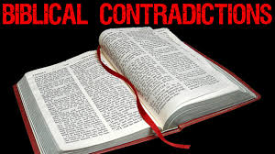
X. Supposed Contradictions in the Bible
Claim: The Bible is full of obvious errors of fact and of doctrine, which is proved by all the contradictions it has with itself.
Possible Reactions:
  Ignore the questions (a bad idea)
  Think carefully and “Be prepared to give an answer” (1 Peter 3:15)

Slide 119
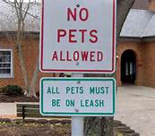
Bible “Contradictions”
Identical events described by two different authors have details of fact that appear to contradict.
Claims that a doctrine which is taught in two different passages is contradictory.
Numbers of objects, people or years in two different passages do not agree.

Slide 120
Questions To Ask
1. Is this a legitimate contradiction? In other words, is there a perfectly reasonable explanation of the supposed contradiction that can be found simply by reading the relevant passages in context, giving the benefit of the doubt to biblical reliability.
2. Is there any chance that a scribal error could explain the apparent discrepancy? This will be a particularly relevant question in the supposed contradiction involves numbers from the Old Testament Text.
3. Is it possible that the two passages, rather than contradictions one another, actually complement one another? In other words, is it possible that the two apparently discrepant scriptures, when taken together, actually create a fuller picture of what God is trying to communicate?

Slide 121
Categories of Bible “Contradictions”
Contradictions of Fact:
  Genesis 7:17 vs Genesis 8:3
  Genesis 37:36 vs Genesis 39:1
  Matthew 27:5 vs Acts 1:18
  John 19:17 vs Mark 15:21-23
  Actual contradictions! 2 Samuel 8:4 vs 1 Chron 18:4
Contradictions of Doctrine:
  Exodus 20:4-5 vs Ezek 18:19-20
  Exodus 20:8 vs Isaiah 1:13
  Ephesians 2:8-9 vs James 2:24
  Proverbs 26:4 and Proverbs 26:5

Slide 122
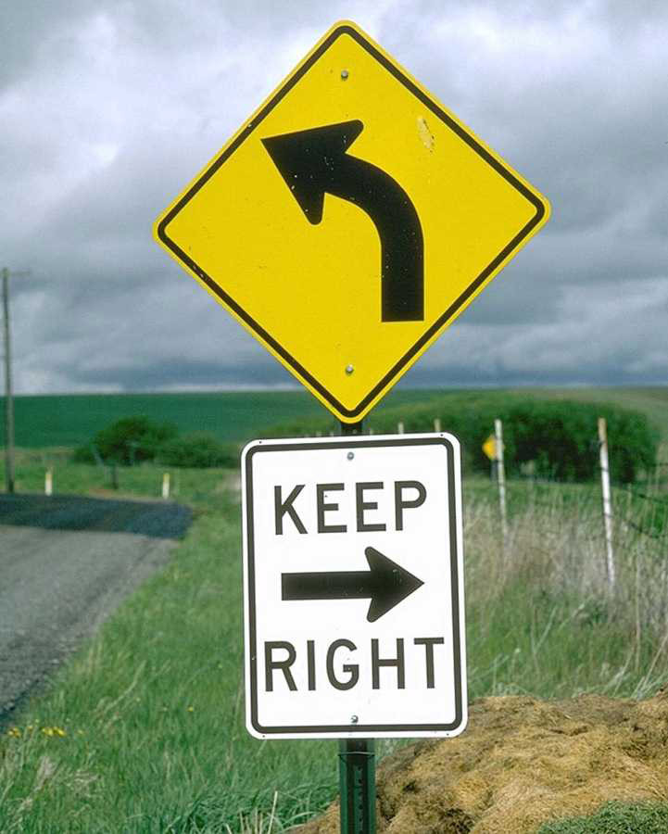
Bible Contradictions (cont.)
“David took seven hundred (2 Samuel 8:4) or seven thousand (1Chronicles 18:4) horsemen from Hadadezer. Which is correct?”
“Exodus 20:8, ‘Remember the Sabbath day by keeping it holy’ contradicts Isaiah 1:13 ‘Your… Sabbaths and convocations—I cannot bear…’”

Slide 123
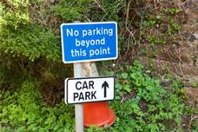
More Difficult Supposed Contradictions
Ephesians 2:8-9 vs James 2:20-24. Are we saved by works?
Exodus 20:4-5 vs Ezek 18:19-20
All-time most difficult: Matt 10:10, Luke 9:3 vs Mk 6:8 Were they to carry a staff?

Slide 124
Bible Errors/Contradictions?
Matthew 2:23 Where is the prophecy that Jesus will be called a Nazarene? Answer: Isaiah 11:1-2, Zechariah 6:9-15
Two different and contradictory Genealogies in Matthew and Luke. Answer: Matthew is genealogy of Joseph and Luke is genealogy of Mary (Joseph the son in law of Heli)
Matthew 1:23 “The virgin will be with child” is a misquote of the Bible.
Matthew 2:15 Mistakenly makes Hosea 11:1 a prophecy (no, it is a fulfilled foreshadow, not a fulfilled historical prophecy)

Slide 125
Assignment: Pick a Proposed Contradiction and Solve It
1. Romans 2:6 says we "are justified by Jesus' blood," then how is it that "God gives to each person according to what he has done?" Is there a contraditction?
2. Why are there 41 generations from David to Jesus in Luke, but only 28 generations in Matthew?
3. Can you explain the apparent contradiction between Genesis 50:12 and Acts 7:15-16? (regarding the cave Abraham built)
5. How do you explain the apparent contradiction between Mark 16:5-7 (one angel) and Luke 24:4-7 (two angels)
6. Did Saul kill himself (1 Sam 31) or did the Amalekite soldier kill him? (2 Sam 1)
7. Please explain the contradiction createde by 2 Samuel 24, where it says that Satan incited
David and 1 Chron 21 where it says that God incited David
9. Please explain to me the discrepancies, both theological and numerical, between 2 Samuel 24 and 1Chronicles 21
10. Leviticus 26:19 mentions iron when the iron age did not start in Canaan until 1150 BC. Doesn’t this prove that Moses did not write Leviticus?
11. How do you resolve the difference between 23,000 mentioned as killed in 1 Corinthians 10:8 and the 24,000 mentioned in Numbers?
12. Was it one thief (Luke) or both (Matthew) who mocked Jesus? How can you resolve this?
13. Where did Jesus first appear to the eleven disciples? It there a contradiction in the gospel accounts?
14. How do you reconcile: Gen.23:2 with Joshua 14: 13 - 15 and Gen. 14:14 with Judges 18:29?
15. Please explain the contradiction between Acts9:7 and 22:9

Slide 126
More Thoughts on Biblical Inspiration
The Bible has dozens of authors, yet a miraculously consistent message and theme.
  Mesopotamians, Egyptians, Bedouins and Greeks
  Priests, farmers, soldiers, kings, fishermen, prophets and prime ministers Historians, poets, seers, teachers
The whole Bible is about Jesus. (John 5:39-40)
Moses frees God’s people
Abraham offers his only son
A snake is lifted up on a pole.
No dualism, polytheism, animism, deism.
Balance of judgment and grace.
Etc.

Slide 127
The Bible is the best book in the world on…
  Psychology
  Teaching Look at Jesus’ parables
  Literature (Psalms)
  Wisdom (Proverbs)
  Philosophy
  Character, Ethics
  Child Raising
  Finances
  Government Q: Other????
The Bible works
  Changed Lives. John 7:17

Slide 128
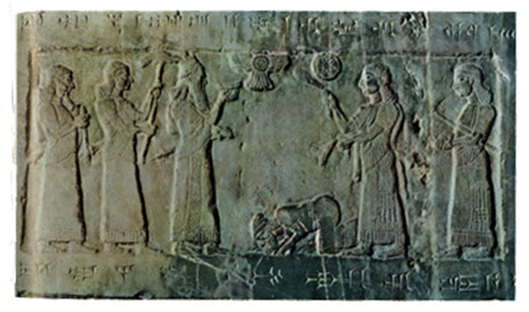
Evidence of Inspiration:
OT History and Archaeology

Slide 129
DOMINANT POWERS DURING THE HISTORY OF ISRAEL
Dominant Power
Dates
Hittites and Egyptians
2000-900 BC
Assyria
900-606 BC
Babylon
605-539 BC
Persia
538-331 BC
Alexander and the Greek Dynasties
330-63 BC
Rome
After 63 BC

Slide 130
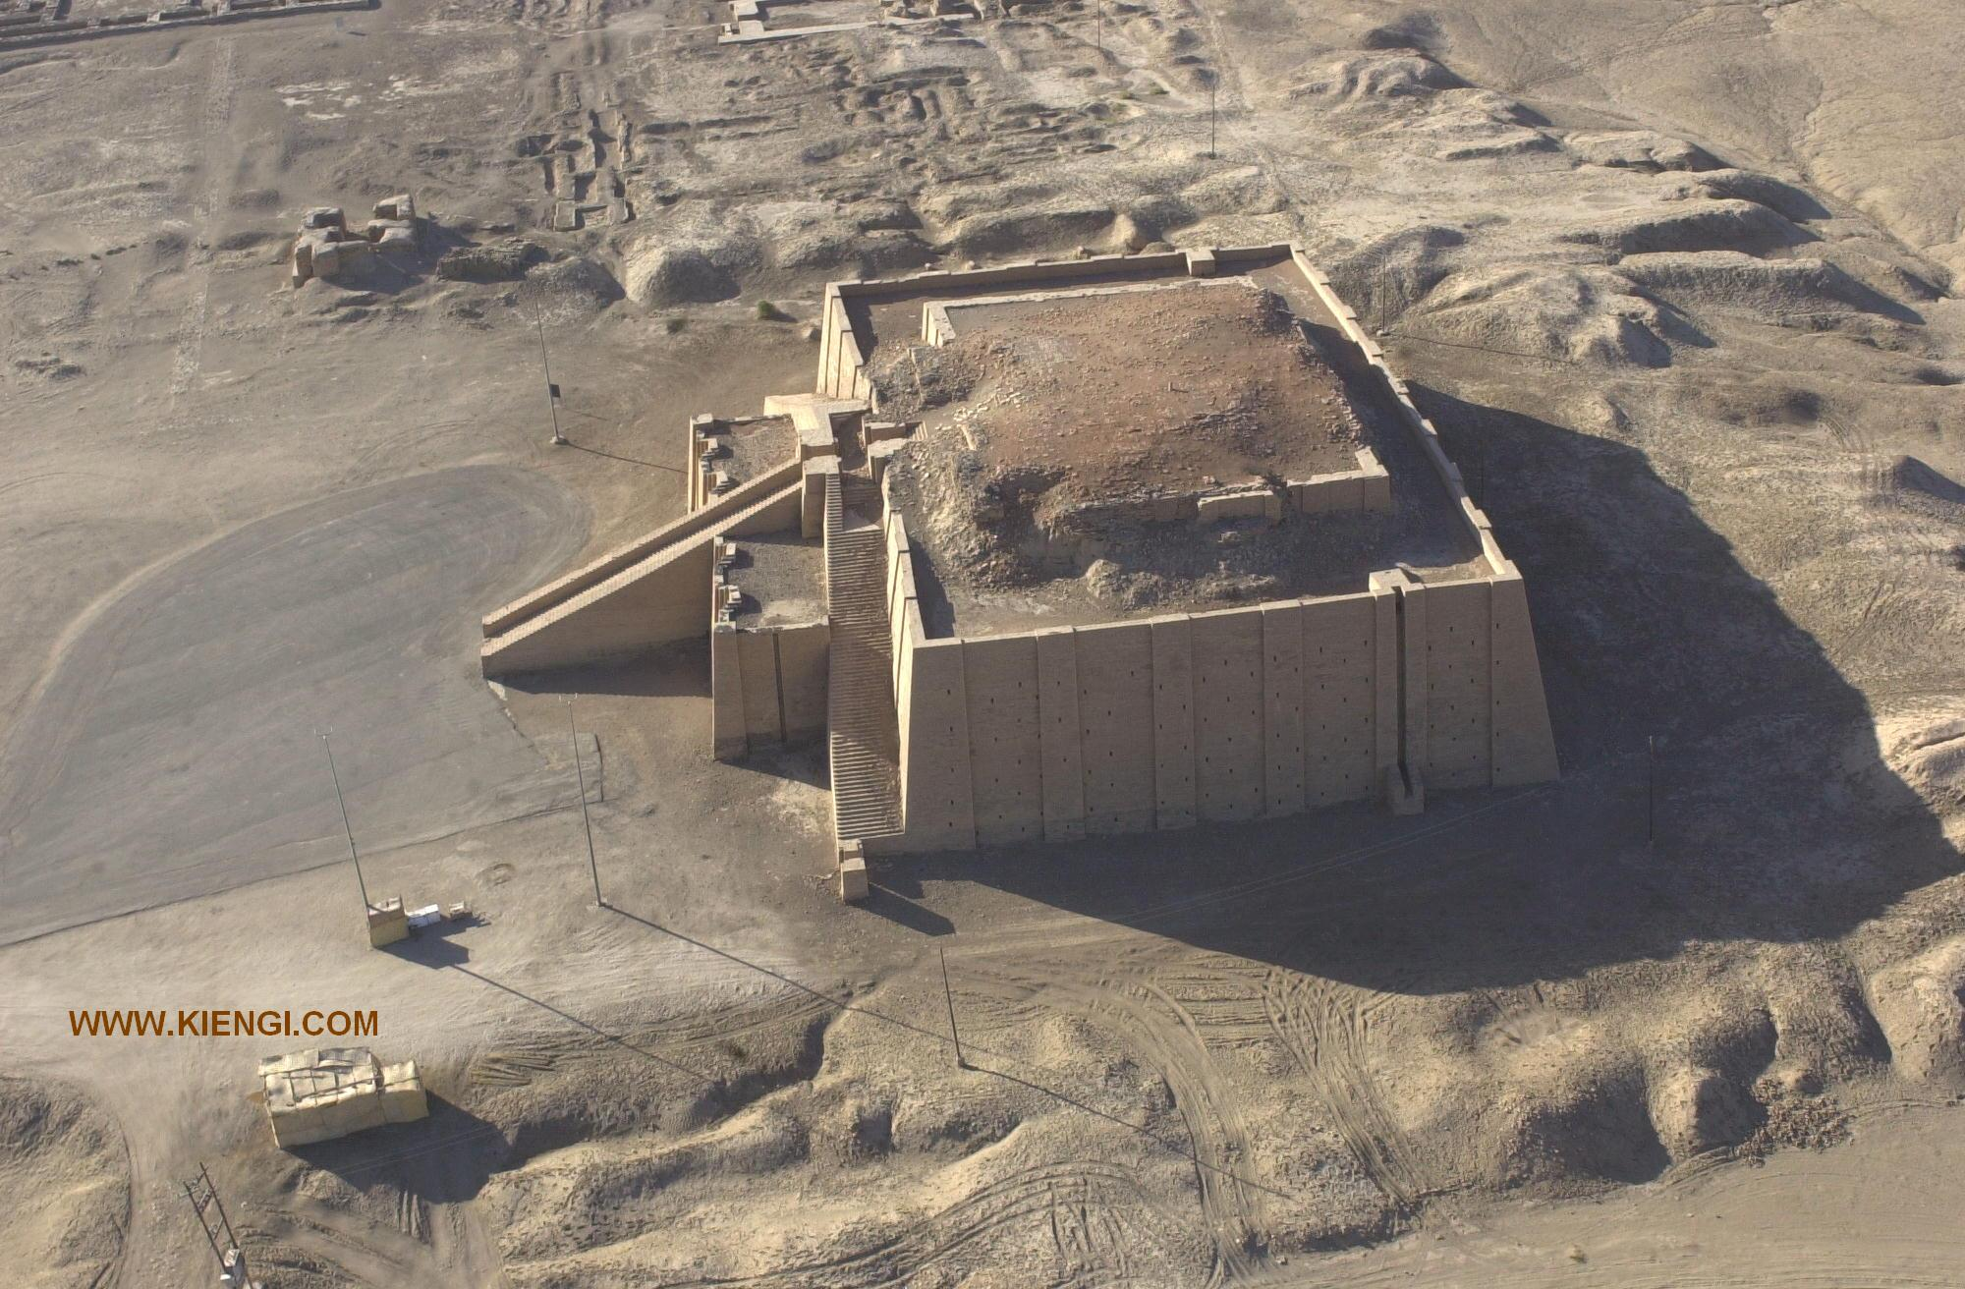
Ziggurat in Ur

Slide 131
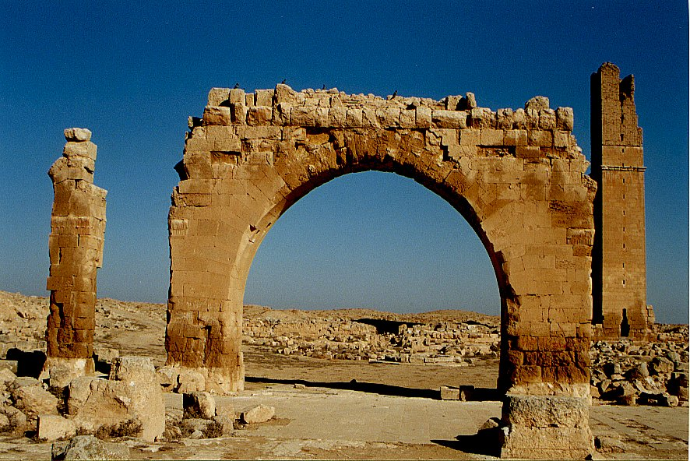
Haran Ruins In Mesopotamian Plane Near Sanli Urfa, Turkey

Slide 132
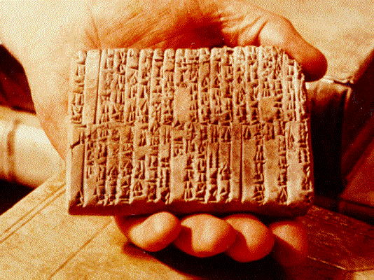
One of the Ebla Tablets about 2100 BC
Nahor, Terug, Abram, Sarai

Slide 133
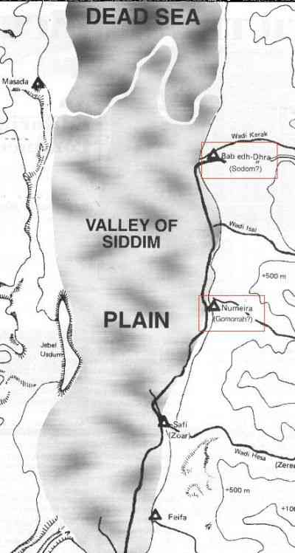
The Five City League, including Sodom and Gomorrah
Genesis 14:2

Slide 134
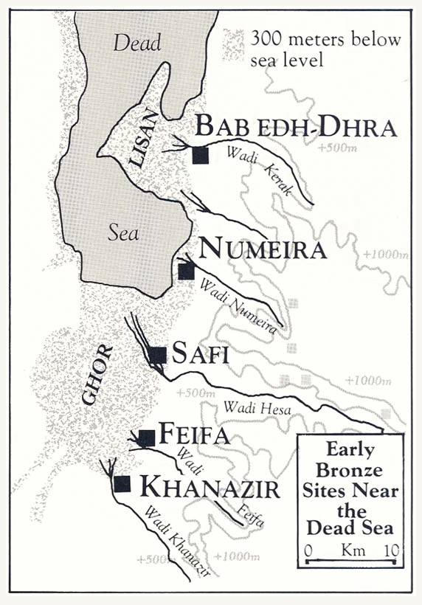

Slide 135
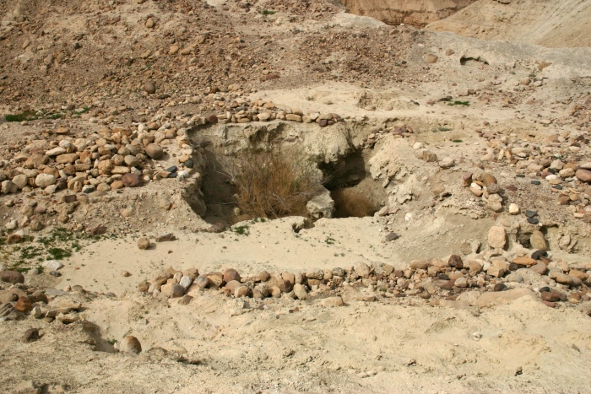
Ruins at Bab ed-Dhra (Sodom)

Slide 136
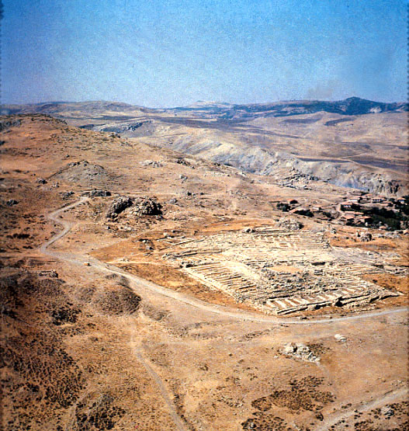
Ruins of Hattusha, capital of the Hittites

Slide 137
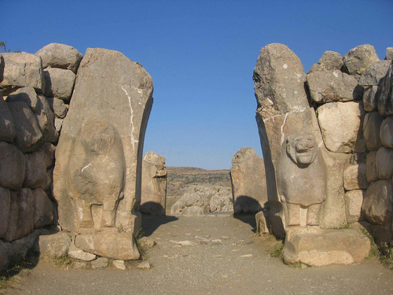
The Lion Gate in Hattusha

Slide 138
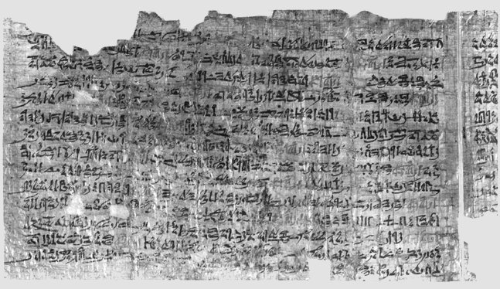
Papyrus Ipuwer
• 2:2—The river is blood = The river was turned to blood—Exod 7:20
• 2:6— Blood is everywhere = Blood is throughout all the land of Egypt— Exod 7:21
• 4:14—Trees are destroyed = And the hail… broke every tree in the field— Exod 9:25
• 9:11—The land is not light = And Moses stretched forth his hand… and there was a thick darkness— Exod 10:22
• 2:13—He who places his brother in the ground is everywhere = For there was not a house where there was not someone dead— Exod 12:30

Slide 139

‘The Habiru plunder all lands of the king. If archers
are here this year, then the lands of the king, the
lord, will remain; but if the archers are not here,
then the lands of the king, my lord, are lost.’
One of the Tel El Amarna Letters c. 1400 BC

Slide 140

Deir Alla Inscription: Balaam the Seer
8th Century Jabbok River (Ammon)

Slide 141
Archaeological Facts about Jericho
1. The city was strongly fortified in the Late Bronze I period, the time of the Conquest according to the biblical chronology (Joshua 2:5,7,15).
2. The city was massively destroyed by fire (Joshua 6:24).
3. The fortification walls collapsed at the time the city was destroyed, possibly by earthquake activity (Joshua 6:20).
4. The destruction occurred at harvest time, in the spring, as indicated by the large quantities of grain stored in the city (Joshua 2:6, 3:15, 5:10).
5. The siege of Jericho was short, as the grain stored in the city was not consumed (Joshua 6:15,20).
6. Contrary to what was customary, the grain was not plundered, in accordance to the command given to Joshua (Joshua 6:17,18).

Slide 142

The Stele of Merneptah Egypt, 1230 BC
Mentions the Israelites in Canaan

Slide 143

The Moabite Stone or Mesha Stele 870 BC
the Louvre
Ahab “of the house of Omri”
1 Kings 16:28

Slide 144

The Tel Dan Inscription
820 BC
2 Kings 8:28-29
‘I killed Jehoram, son of Ahab, king of Israel and I killed Ahaziah, son of Jehoram, king of the house of David”

Slide 145



Black Obelisk of Shalmanezer III 840 BC
British Museum 2 Kings 17:3-6

Slide 146

The Sennacherib Cylinder or Taylor Prism British Museum, London (2 Kings 18) 691 BC
As to Hezekiah the
Jew… I made him…
“like a bird in a
cage”

Slide 147

The Siloam Inscription.
2 Kings 20:20-21
"Now the rest of the acts of Hezekiah--all his might, and how he made a pool and a tunnel and brought water into the city--are they not written in the book of the chronicles of the kings of Judah? So Hezekiah rested with his fathers."

Slide 148

Lachish Room, British Museum

Slide 149

Israeli Captives Being Led from Lachish

Slide 150

Jewish captives skinned alive in front of Lachish Walls

Slide 151

One of the Lachish Letters, 588 BC
Jeremiah 34:6,7

Slide 152

The Babylonian Chronicles British Museum, London, 597 BC 2 Kings 24:10-17
[In] the seventh year, the month of Kislev, the king of Babylonia mustered his forces and marched to Syria. He camped against the city of Judah (Jerusalem) and on the second day of the month of Adar he took the city and captured the king. He appointed a king of his own choice there, took its heavy tribute and brought them to Babylon.

Slide 153

Yaukin (Jehoiachin), king of the land of Judah

Slide 154
Ziggurat in Ur: Nabonidus and Belshazzar

Slide 155

Cyrus Cylinder British Museum 535 BC
Ezra 1:2-4

Slide 156

Pilate Inscription Cesarea Maritima AD 30
Discovered 1961
Tiberius, Pontius Pilatus, Prefect of Judea

Slide 157

Archaeological Evidence

Slide 158

The Pool of Siloam

Slide 159

Caiaphas Ossuary
“Caiaphas, son of Joseph”

Slide 160

Corban

Slide 161

Acts 13:6-7 Sergius Paulus

Slide 162
Sir William Ramsay
I found myself brought into contact with the Book of Acts as an authority for the topography, antiquities, and society of Asia Minor. It was gradually borne upon me that in various details the narrative showed marvelous truth. In fact, beginning with a fixed idea that the work was essentially a second century composition, and never relying on its evidence as trustworthy for first century conditions, I gradually came to find it a useful ally in some obscure and difficult investigations.
Luke is a historian of the first rank; not merely are his statements of fact trustworthy; he is possessed of the true historic sense; he fixes his mind on the idea and plan that rules in the evolution of history, and proportions the scale of his treatment to the importance of each incident. He seizes the important and critical events and shows their true nature at greater length, while he touches lightly or omits entirely much that was valueless for his purpose. In short, this author should be placed along with the very greatest of historians.
Sir William Ramsay, St. Paul, the Traveler and the Roman Citizen, (Hodder and Stoughton, 1920).

Slide 163

Chapter 17:6 Politarchs
From a column in Thessalonika, listing six “politarchs.”

Slide 164


Acts 18:11-17
Proconsul in ancient Greece by the name of Gallio
The Greek inscription refers to Gallio noted in the Bible. It was written in the 1st century AD and was discovered in the Temple of Apollo in Delphi in 1905.
It originally consisted of various fragments that were pieced together in 1967.
The artifact is now in the Delphi museum, Greece.

Slide 165

Temple of Apollo at Delphi where Delphi Inscription was discovered in the 20th century, used to date the proconsulship of Gallio which provides a peg for the chronology of Paul. Paul was in Corinth c. 52-53 AD.

Slide 166

Erastus Inscription in Corinth
Acts 19:22 AD 50

Slide 167

Let no Gentile enter within the partition and barrier surrounding the Temple; whosoever is caught shall be responsible for his subsequent death.

Slide 168


Acts 23:24
Marcus Antonius Felix was the ancient Roman procurator of the Judaea Province from 52-60 AD. Felix’s cruelty and licentiousness, coupled with his accessibility to bribes, led to a great increase of crime in Judaea.

Slide 169
VII. Messianic Prophecies
Luke 24:44 He said to them, “This is what I told you while I was still with you; Everything must be fulfilled that is written about me in the Law of Moses, the Prophets and the Psalms.

Slide 170
Good Questions:
Where these prophecies in fact written hundreds of years before Jesus lived?
Were they in fact written about the Jewish Messiah?
Might Jesus have arranged to fulfill the prophecies in order to support his claim to be the Mesiah?
Do we know from extra-biblical sources that Jesus did in fact do this?

Slide 171
Isaiah 53:1-13:
He was despised and rejected by men, a man of sorrows, familiar with suffering. (v. 3)
But he was pierced for our transgressions, he was crushed for our iniquities; the punishment that brought us peace was upon him, and by his wounds we are healed. (v. 5) (John 19:31-37)
He was oppressed and afflicted, yet he did not open his mouth; he was led like a lamb to the slaughter and as a sheep before her shearers is silent, so he did not open his mouth. (v. 7)

Slide 172


Slide 173
Micah 5:2
But you, Bethlehem Ephrathrah, though you are small among the clans of Judah, out of you will come for me one who will be ruler over Israel, whose origins are from old, from ancient times.
Isaiah 9:1,6
In the past he humbled the land of Zebulun and the land of Naphtali, but in the future he will honor Galilee of the Gentiles, by the way of the sea, along the Jordan…. For to us a child is born… And he will be called Wonderful Counselor, Mighty God, Everlasting Father, Prince of Peace.

Slide 174


Slide 175


Slide 176
Psalm 22:16-18
Dogs have surrounded me;
a band of evil men have encircled me,
they have pierced my hands and my feet.
I can count all my bones; (John 19:3-37)
people stare and gloat over me.
They divide my garments among them
and cast lots for my clothing. (John 19:23,24)

Slide 177


Slide 178


Slide 179
Daniel 9:24-26
Seventy ‘sevens’ are decreed for your people and your holy city to finish transgression, to put an end to sin, to atone for wickedness, to bring in everlasting righteousness, to seal up vision and prophecy and to anoint the most holy.
Know and understand this: From the issuing of the decree to restore and rebuild Jerusalem, until the Anointed One, the ruler comes, there will be seven ‘sevens’ and sixty two ‘sevens’
Decree of Artaxerxes (Ezra 7:12-26) 458 BC
458 BC - 490 years = -32 (no zero BC)

Slide 180

Zechariah 11:12,13
I told them, “If you think it best, give me my pay; but if not, keep it.” so they paid me thirty pieces of silver. (Matthew 26:14-16)
And the Lord said to me, “Throw it to the potter”—the handsome price at which they priced me! So I took the thirty pieces of silver and threw them into the house of the Lord, to the potter. (Matthew 27:3-8)

Slide 181
According to the Old Testament, the Messiah must:
Be born in Bethlehem
Be raised in Galilee near Nazareth
Be despised and rejected by men
Be meek and silent before his accusers
Be “pierced”
Be crucified
Have his garments divided and gambled over
Be betrayed for 30 pieces of silver
Come to Jerusalem to make atonement for sin in about AD 33
And many more….
Was all this an accident, or did God plan all along for the death of Christ for forgiveness of sins?

Slide 182
But There is More… A Lot More!
Historical Foreshadows
Prefigures of the Messiah

