Slide 1
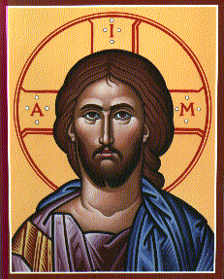
Dr. Robert C. Kurka Lincoln Christian University
The First, Second, and Third Quest’s Search for the Historical Jesus

Slide 2
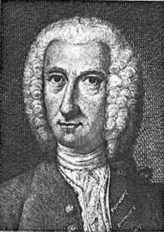
In the 18th century, German scholar, Hermann Samuel Reimarus (1694-1768) forever changed the course of historical Jesus studies. A firm line was drawn between the Jesus of history and the Christ confessed by the Christian Faith:
“Now, where the doctrine is not controlled by the history but vice versa, both history and doctrine are to this extent unfounded; the history because it is not taken from events themselves…; and the doctrine because it refers to facts that originated in the writers’ thinking only after the doctrine was altered and which were simply fabricated and false.” –Fragments, 134

Slide 3
A worldview shift had taken place… and the first of Three Quests for the historical Jesus had been launched
THEISM DEISM
GOD(TRIUNE) God(Unitarian)
World
HUMANS
World
HUMANS

Slide 4
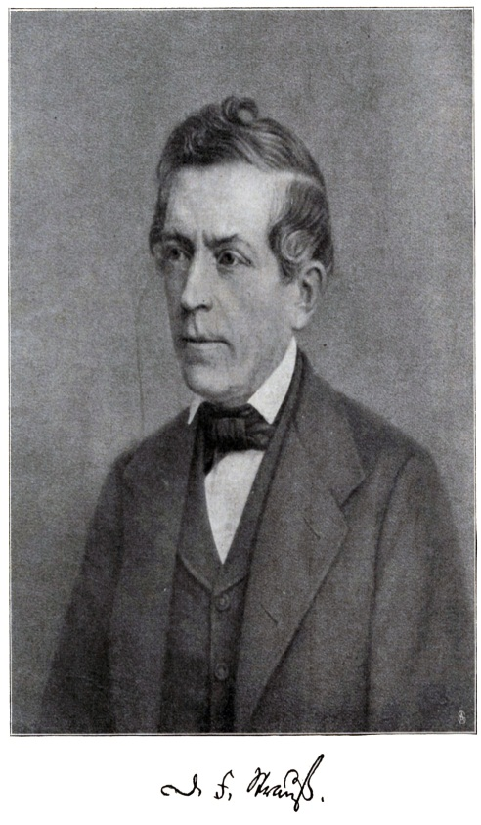
First Quest (1780-1901)
Early Period (1780-1810): No attempt to eliminate idea of miracles from the Gospels but rather offer some “natural” explanations of such
Middle Period (1810-30): Complete rejection of miraculous; attempt to account for miracles purely in naturalistic terms
Last Period (1830-1900)
1. D.F. Strauss , Das Leben Jesu (1835):Gospels are myths, legends, and editorial additions not history. In essence, little of the “historical Jesus” could be found.

Slide 5
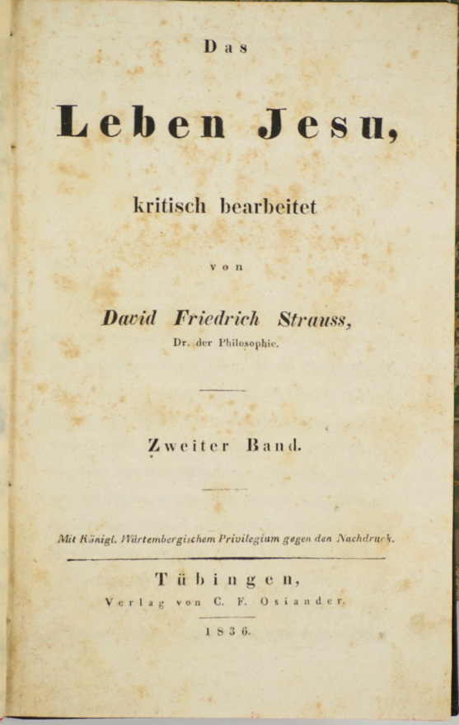

Slide 6
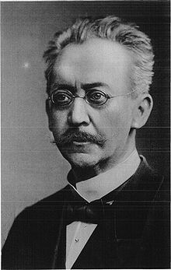
2. Liberal Theology (e.g., Von Harnack, Hermann): Historical Jesus discoverable behind Gospel Tradition
a. “Synoptic Problem”—Mark and “Q” are the sources of Matthew and Luke and the “key” to the HJ (“Two Source Theory”)
b. Jesus=great ethical teacher and brings the advent of the “Kingdom of God” (human brotherhood and love)

Slide 7
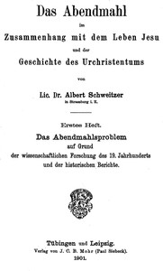
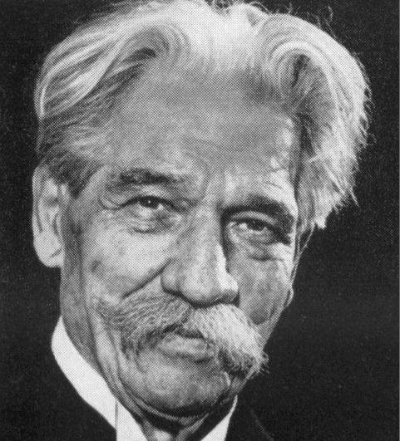
3. Wilhelm Wrede, The Messianic Secret
a. Jesus never made messianic claims. Mark invented the “Messianic Secret” (i.e., Jesus’ attempts to conceal his identity in the Gospel) as an apologetic for the Church that was claiming these messianic statements for Jesus in the face of his contemporaries who were unaware that he had much such.
4. Albert Schweitzer’s Grand Conclusion: We can know much about a scholar’s own presuppositions but very little about the historical Jesus

Slide 8
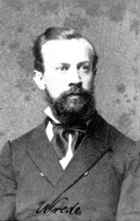
An example of Wrede’s “Messianic Secret”:
“But who do you say that I am?” Peter replied, “You are the Messiah.” Jesus warned them not to tell anyone about him. [Mark 8:29-30, TNIV]
+ Wrede’s point: Historical Jesus did not make the claims about himself that his followers did years later. In order for the Church to give some “evidence” for the absence of Messianic claims from the lips of Jesus, himself, Mark invented the “Messianic Secret.” In this way, Wrede (and others) could have a Jesus who was worthy of people’s admiration and praise but not one who made extravagant claims about himself, and tried to silence his overly-enthusiastic followers. Jesus’ silence is also seen in his commands to those who witnessed miracles (i.e., “He gave strict orders not to let anyone know about this…”—Mk. 5:43), and in his use of parables (veiling truths about the kingdom).

Slide 9
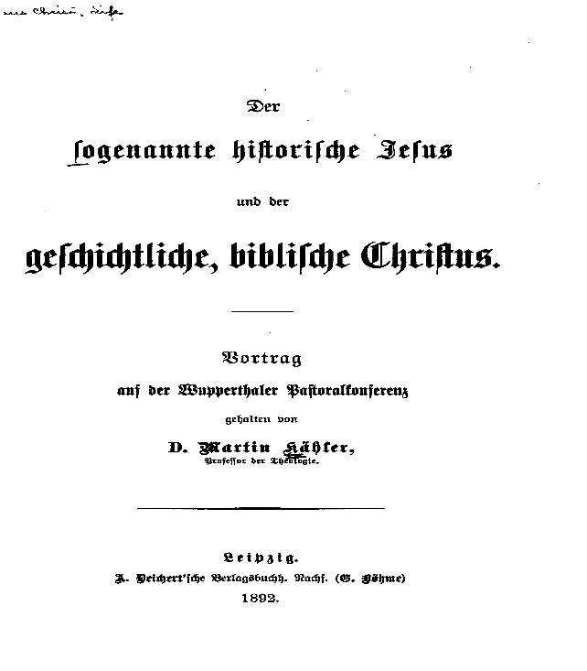
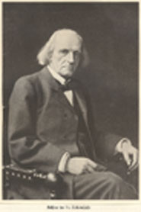
Martin Kahler (1835-1912)
Der soggennante historische Jesus und der geschichtliche biblische Christus
Historical facts of Jesus’ life=unknowable and a distraction(historische)
What really matters=his redeeming death and resurrection (geschictliche)

Slide 10
Six Questions which “Life of Jesus” Scholars have to deal with:
1. It is possible to write a biography (history) of Jesus?
2. What is the place of miracle in the life of Jesus”
3. How should the resurrection of Jesus be interpreted…literally or in some other way?
4. What is the nature and place of mythology in the NT?
5. What is the historical value of John as compared with the Synoptics?
6. What is the central significance of Jesus?
--C. Anderson, Critical Quests of Jesus, 24

Slide 11
“First Quest”
Jesus of History
Separated--but the historical Jesus can be found________________________
Christ of the Gospels/ Church’s Faith

Slide 12
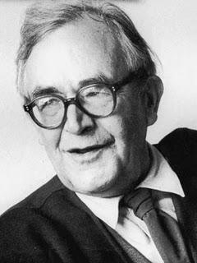
“No Quest” (1906-53) to a “Second Quest” (1953-1970’s)
Prompted by Neo-Orthodoxy’s “Almost Complete” Disconnecting of the Jesus of History from the Christ of Faith
1. Karl Barth: Heilsgeschichte (“Salvation history” is not to be evaluated like “regular” history. Historical questions are largely irrelevant to the theological purposes of the Gospels/Bible)
2. Rudolf Bultmann: “demythologizing” project and Form Criticism (re-interpret the NT
message in the worldview of modern
(Western) humanity

Slide 13
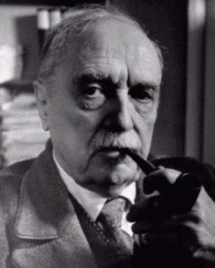
“No Quest”
“It is impossible to use electric light and the wireless (radio) and to avail ourselves of modern medical and surgical discoveries, and at the same time to believe in the New Testament world of spirits and miracles.”– Rudolf Bultmann, “New Testament and Mythology”

Slide 14
“Form Criticism”
Ernst Kasemann: “The work of the Form Critics was designed to show that the message of Jesus as given to us by the synoptists is, for the most part, not authentic but was minted by the faith of the primitive Christian community in its various stages”—Essays on New Testament Themes

Slide 15
Basics of Form Criticism
At its earliest stages, the material in the Gospels was passed on orally—series of disconnected units, anecdotes, stories, sayings, teachings, parables, etc.
Each unit of tradition has its own history in the church
Historical outline of Jesus’ career is largely the creation of Mark who used this narrative to “thread” these “disconnected beads” of independent traditions—there is no real biography of Jesus to be discovered
As these units (pericopes) were passed on by word of mouth, both their literary forms and contents were shaped to address the life and needs of particular church situations (sitz im leben). The Gospels as we have them are products of the Christian Church at the end of the first century, reflecting Christian beliefs and practices that developed over time.
John’s Gospel reflects a sitz im leben in the Hellenistic world, thus requiring the author to radically reinterpret the person and message of Jesus into “Greek thought.” Thus, it has virtually no historical value. (Finding of the DSS seriously challenged this!)

Slide 16
“No Quest”
Jesus of History
Separated—we can know very little about the top but much about the bottom___________________________
Christ of NT/Church’s Faith (and its existential relevance)

Slide 17
“Second Quest” Characteristics
Launched by Bultmann’s former students (e.g., Kasemann, Bornkamm, Ebeling)
Desire to avoid repeating “docetic heresy”—a concern for Jesus’ true humanity
Concerned about establishing some continuity between the Jesus of history and the Christ of the Gospels
While skeptical of Jesus’ messianic claims admits he had some messianic characteristics that drew a following)(Ebeling:1)Jesus emphasized nearness to God--repentance; 2) His teaching on obeying the will of God; 3)His call to discipleship
Cross may be a “contact point”

Slide 18
“Second Quest” Contributions
Redaction criticism—literary creativity of the Gospel authors, themselves
“Q”—a full-blown “Gospel” in its own right
“Criteria of Authenticity”
(e.g., “Criterion of Double Dissimilarity”—the earliest form of a saying may be regarded as authentic if it can be shown to be dissimilar to characteristic emphases in ancient Judaism and Christianity)

Slide 19
“Second Quest” Contributions
Other Criteria for determining historical authenticity…
+ Coherence
+ Multiple Attestation
+ Unintentionality (“Embarrassment”)
+ Causal Effect

Slide 20
“Second Quest”
Three prevailing assumptions…
1. Gospels lack objectivity-- because their purpose is to evangelize unbelievers
2. Gospels in their present form were compiled years after the historical Jesus lived and are very limited windows into the life of this first-century figure
3. Gospels reflect religious stories and myths of other neighboring religions; e.g., “Gnostic Redeemer” myths

Slide 21
“Second Quest”
Jesus of History
Separated but some minimal contact between the two__________________________
Christ of NT and Church’s Faith

Slide 22
The Demise of the Second Quest was brought on by:
1) New “openness” to the scientifically improbable
2) Less stringent authenticity criteria
3) New approaches to Oral Tradition
4) Emphasis upon Jewishness of Jesus
5) [more recently] emphasis upon the Worship (confessions, liturgy, etc.) of Early Christianity
6) Willingness to temporarily suspend some controlling presuppositions about what Jesus should look like

Slide 23
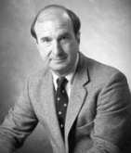
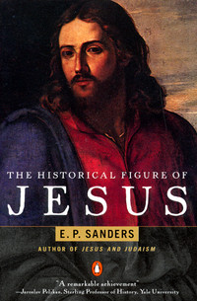
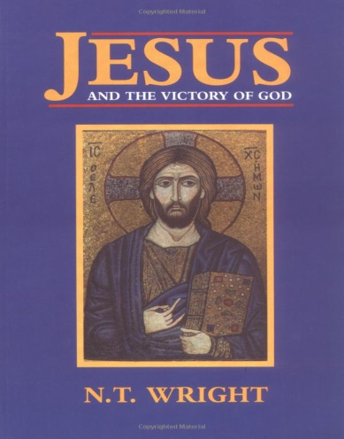
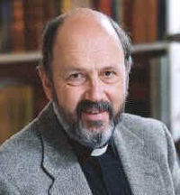
Third Quest Methodologies
Major premise: Historical analysis must begin with the texts WE HAVE and not some alleged “text-behind-the-text”
Two Third Quest Scholars:
1) E.P Sanders: Jesus came proclaiming the Kingdom of God and called twelve apostles signaling the restoration of Israel and the dawn of the eschaton. Jesus was also engaged in controversy with the ruling priests and underwent a Roman execution.
2) N. T. Wright: Critical realism as a philosophic/historiographical approach that yields a Jesus who came announcing “the end of the Exile”—a messianic activity in Judaism—yet in a manner that defied many notions that Second Temple Jews would have generally associated with the End.

Slide 24
Interlude:More recent “Liberal” Historical Jesus Scholars (e.g., the Jesus Seminar) are essentially “Throwbacks” to Bultmann and/or the failed, Second Quest

Slide 25
“This book challenges the reader on the level of formal method, material investment, and historical interpretation. It presumes that there will always be divergent historical Jesuses, that there will always be divergent Christs built upon them but above all, it argues that the structure of Christianity will always be: this is how we Jesus—then as Christ now.”
-- John Dominic Crossan, The Historical Jesus: The Life a Mediterranean Jewish Peasant

Slide 26
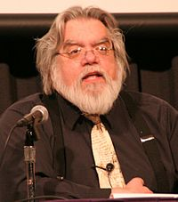
“I will argue that it is quite likely there never was any historical Jesus…I shifted toward a more mainstream critical position like Bultmann’s…Might there still have been a historical Jesus who, however, has been irretrievably lost behind the stained glass curtain of his own glorification? Indeed. But I should think that the burden of proof lies with the one who would affirm such a Jesus.”
--Robert M. Price, “Jesus At the Vanishing Point,” in The Historical Jesus: Five Views

Slide 27
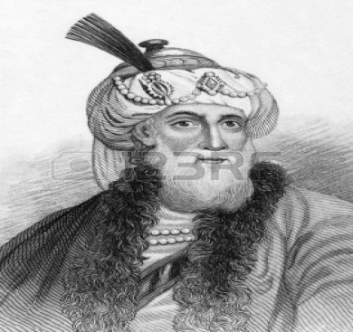
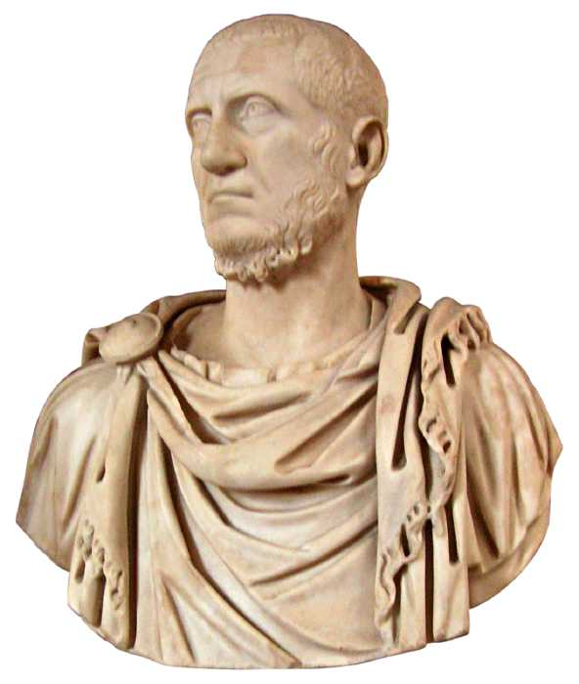
Josephus and Tacitus
Extra-Biblical Testimony to a Historical Jesus:
“Most Important Documents” (Craig Evans)

Slide 28
Josephus, Antiquities 18.63-64 (“Testimonium Flavianum”)
Jewish historian, JOSEPHUS (AD 37-100)
Jesus of Nazareth:
“At this time there appeared Jesus, a wise man, if indeed one ought to call him a man. For he was the doer of amazing deeds, a teacher of persons who receive truth with pleasure. He won over many Jews and many of the Greeks. He was the Messiah. And when Pilate condemned him to the cross, the leading men us having accused him, those who loved him from the first did not cease to do so.

Slide 29
Note: Italicized words are likely later Christian insertions
For he appeared to them the third day alive again, the divine prophets having spoken these things and a myriad of other marvels concerning him. And to the present the tribe of Christians, named after that person, has not disappeared.”

Slide 30
Josephus, Antiquities 20.200-201
James, the Brother of Jesus
“He [Ananus] convened the council of judges and brought before it the brother of Jesus—the one called ‘Christ’– whose name was James, and certain others. Accusing them of transgressing the law he delivered them up for stoning. But those of the city considered the most fair-minded and strict concerning the laws were offended at this and sent to the king secretly urging him to order Ananus to take such actions no longer.”

Slide 31
Josephus, Antiquities 18.116-19
John the Baptist
”Now it seemed to some of the Jews that the destruction of Herod’s army was by God, and was certainly well-deserved, on account of what he did to John, called the Baptist. For Herod had executed him, though he was a good man and had urged the Jews—if inclined to exercise virtue, to practice justice toward one another and piety toward God—to join in baptism…”

Slide 32
An interesting “Jesus Parallel”
“Four years before the war…there came to the feast, at which is the custom of all Jews to erect tabernacles to God, one Jesus son of Ananias, an untrained peasant, who standing in the Temple, suddenly began to cry out, ‘A voice from the east, a voice from the west, a voice from the four winds, a voice against Jerusalem and the sanctuary, a voice against the bridegroom and the bride, a voice against all the people’ [Jer. 7:34]…Some of the leading citizens, angered at this evil speech, arrested the man and whipped him with many blows…

Slide 33
Josephus, Jewish Wars 6.300-309
But he not speaking anything in his own behalf or in private to those who struck him, continued his cries as before. Thereupon, the rulers brought him to the Roman governor. There, they flayed to the bone with scourges, he neither begged for mercy or wept…When Albinus the governor asked him who and whence he was and why he uttered these cries, he gave no answer to these things…Albinus pronounced him a maniac and released him…He cried out especially at the feasts…While shouting from the wall, ‘Woe once more to the city and to the people and to the sanctuary…’ a stone…struck and killed him.”

Slide 34
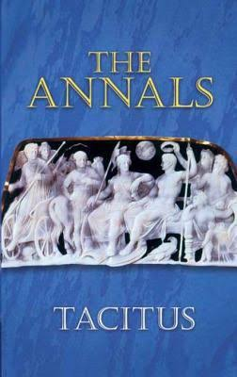
Annals 15.44
A Roman Writer: Cornelius Tacitus (AD 56-118)
“Therefore, to squelch the rumor [had taken place by order], Nero supplied (as culprits) and punished in the most extraordinary fashion those hated for their vice, whom the crowds called ‘Christians.’ Christus, the author of their name, had suffered the death penalty under the reign of Tiberius, by sentence of the procurator[sic] Pontius Pilate. The pernicious superstition was checked for a time, only to break out once more, not merely in Judea, the origin of the evil, but in the capital itself, where all things horrible and shameful collect and are practiced.”

Slide 35
“Third Quest”
Jesus of History
Little separation to very close connection_________________________
Christ of the NT and Christian Faith

Slide 36
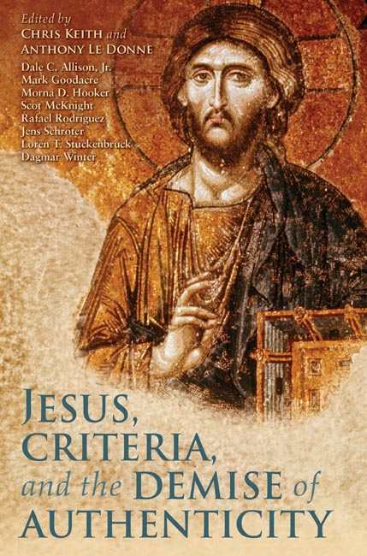
Is there now a “Post-Quest Quest”?
1. Rejection of the traditional, “modern” tools of historical criticism
2. Openness to more “postmodern” methodologies; e.g., Social-Memory Theory(ies)

Slide 37
Basic “Social Memory Theory”
1. All memory is constructed in social categories and interactions
2. Memory is not frozen or passive but is fluid and ever-changing
3. Memories tell us as much (or more) about the social groups than they do about the past events/figures
--A. LeDonne
* Conservative NT scholars like C. Keith would argue that the Gospels tell us about both the historical Jesus and the Early Christian communities

Slide 38
In Conclusion…
The tide of scholarly historical Jesus studies has turned in a conservative direction pointing to a close history-faith connection; good news for the Christian apologist. Today’s popular skeptics need to be “called out” for operating with past, discredited models!

