Slide 1
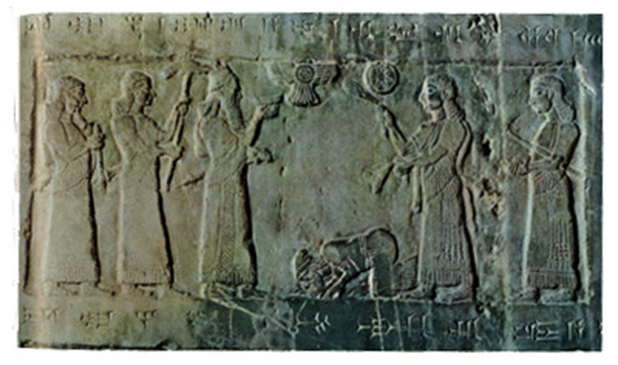
Evidence of Inspiration:
OT History and Archaeology

Slide 2
IMPORTANT PERIODS IN THE HISTORY OF ISRAEL
Period in the History of Israel
Dates
The Patriarchs
Abraham, Isaac, Jacob and Joseph
2050-1800 BC
Moses and Joshua
The Exodus and the Conquest
1450-1400 BC
The Period of the Judges
Deborah, Jephthah, Gideon and Samuel
1400-1050 BC
The United Kingdom
Saul, David, Solomon and Rehoboam
1050-931 BC
The Northern Kingdom (Samaria)
Destruction and captivity under Assyria
931-722 BC
The Southern Kingdom (Judah)
Destruction and captivity under Babylon
931-586 BC
Defeat and destruction of Jerusalem
The period of the exile in Babylon
605-536 BC
Return of the captives, rebuilding of the
temple and of Jerusalem
536-440 BC
The period “between the Testaments”
440-6 BC
THE PATRIARCHAL PERIOD
We will begin, then, with the time of Abraham. In the Bible, Abraham is the father of Israel

Slide 3
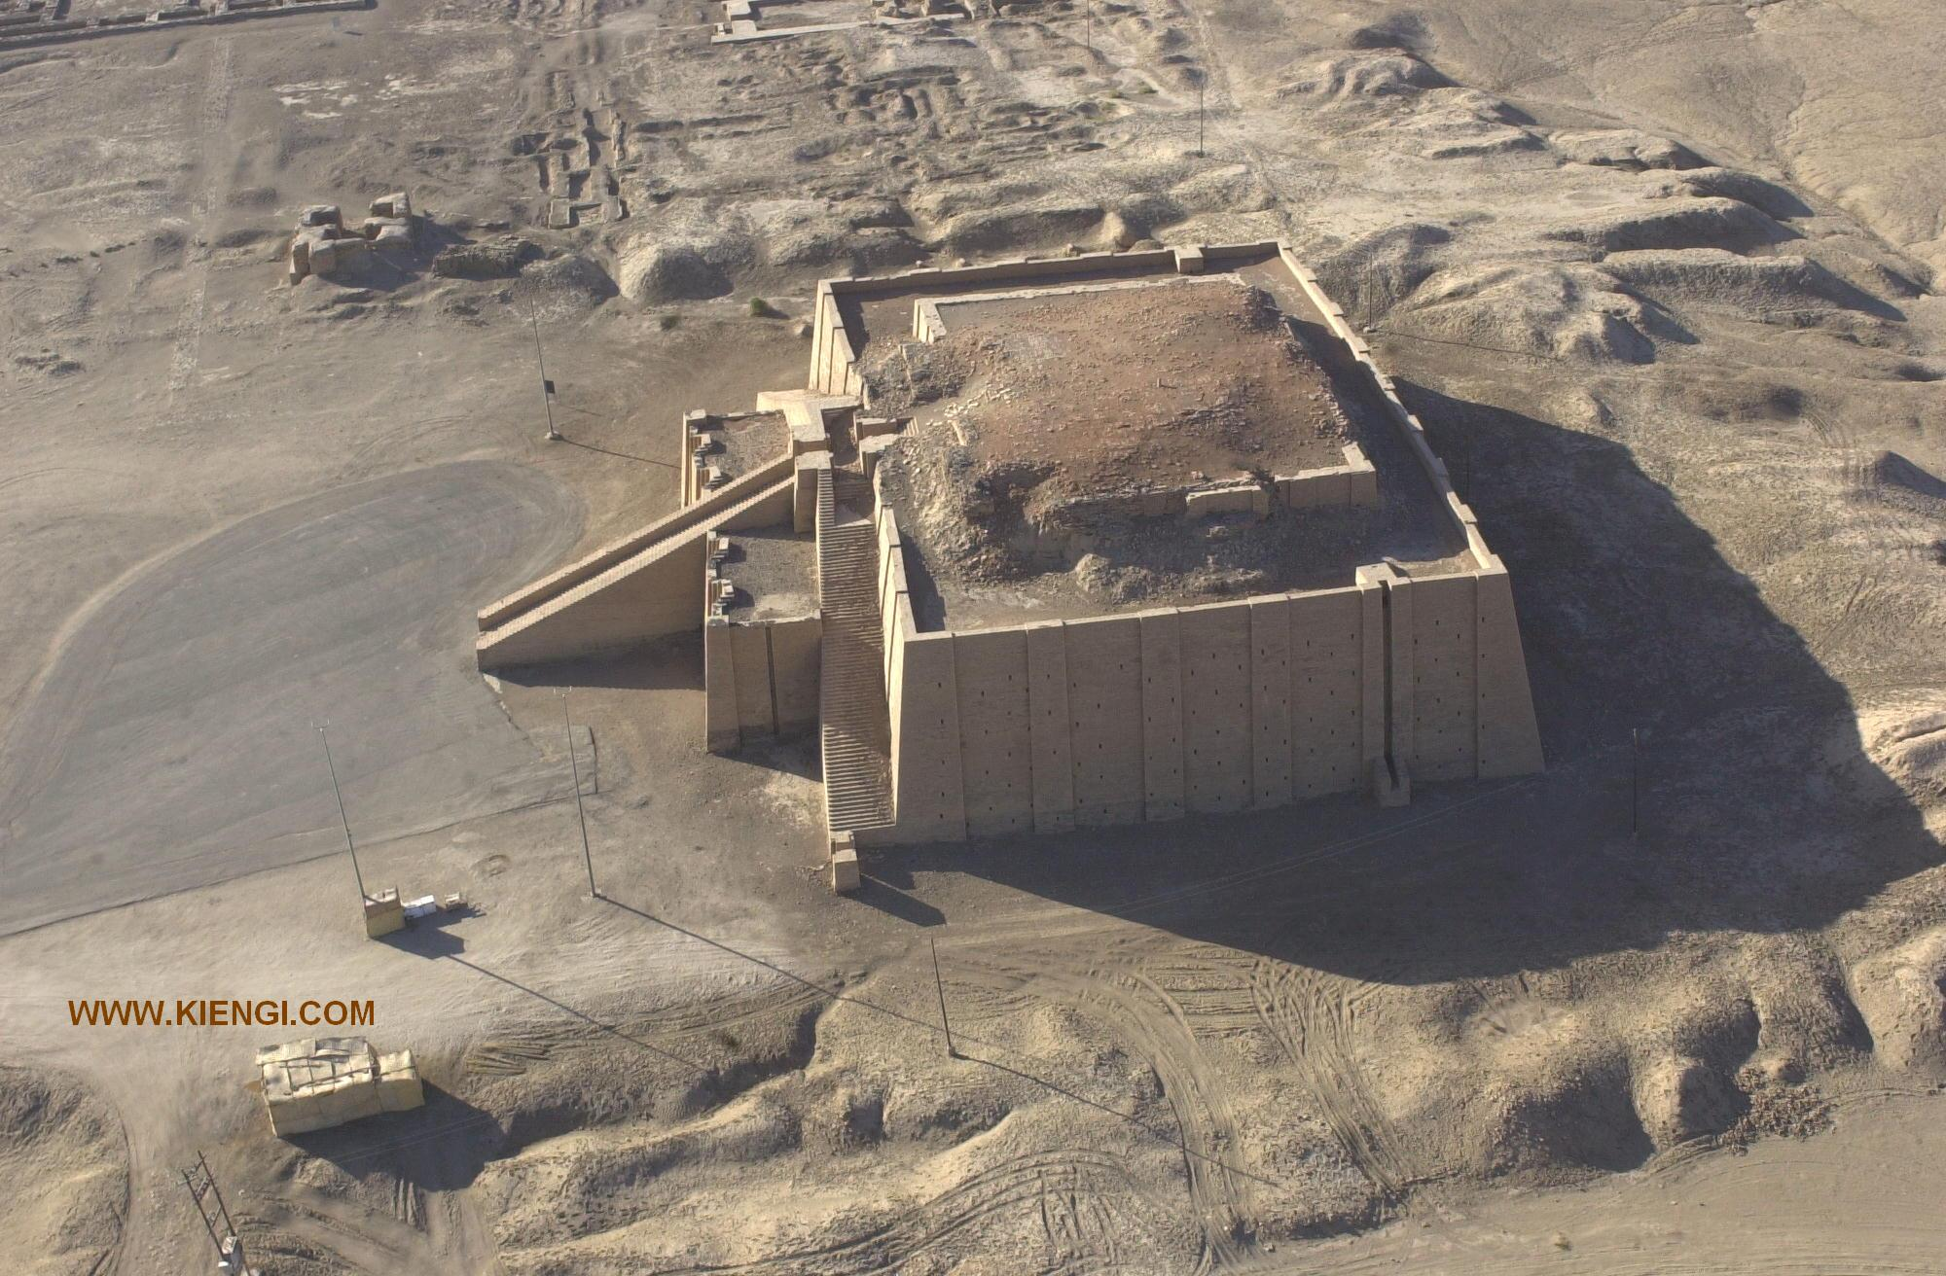
Ziggurat in Ur

Slide 4
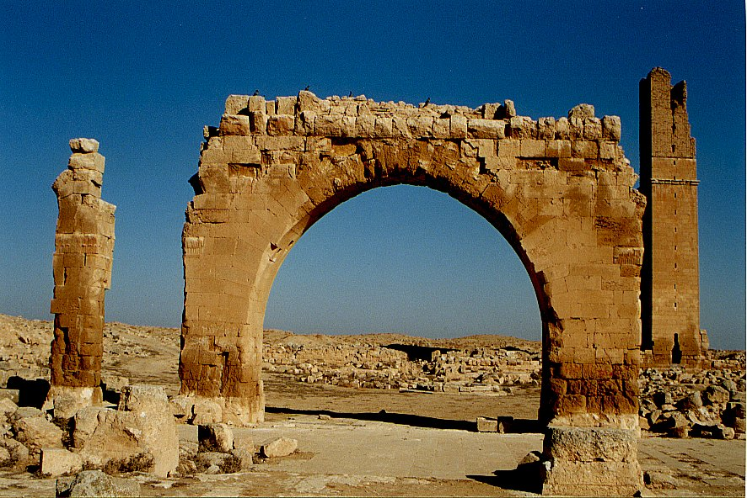
Haran Ruins In Mesopotamian Plane Near Sanli Urfa, Turkey

Slide 5
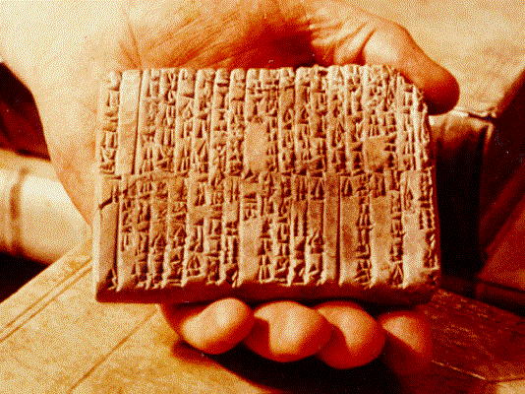
One of the Ebla Tablets about 2100 BC
Nahor, Terug, Abram, Sarai

Slide 6
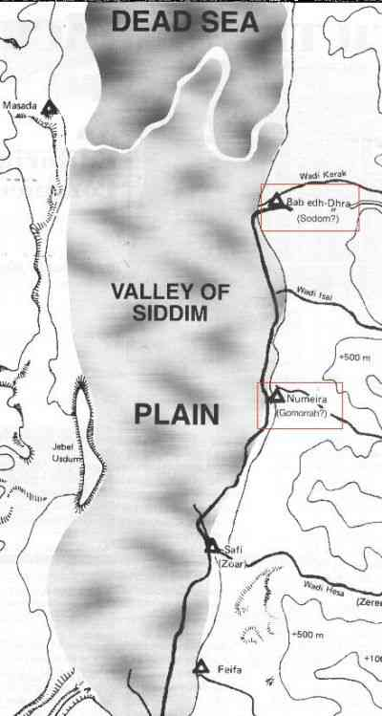
The Five City League, including Sodom and Gomorrah
Genesis 14:2

Slide 7
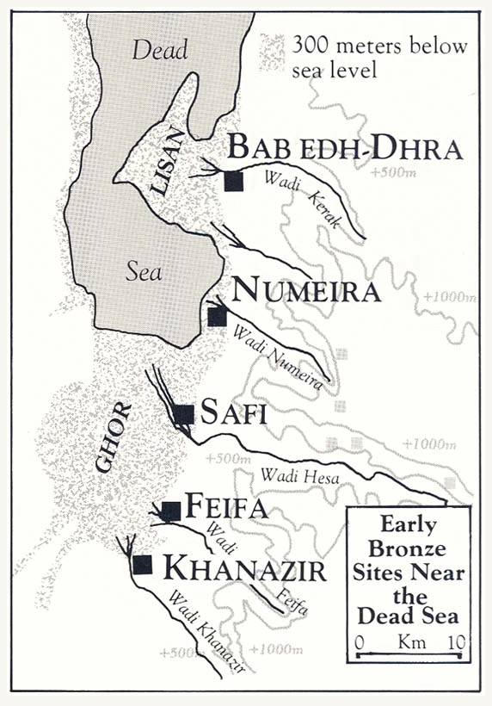

Slide 8
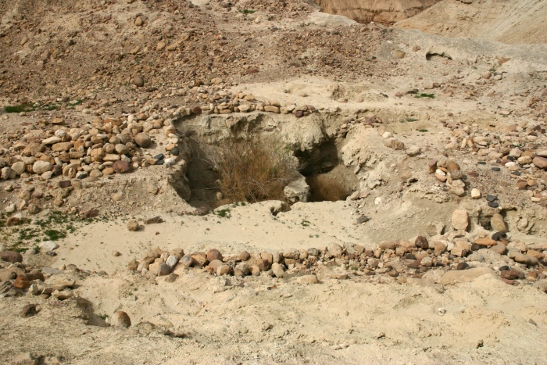
Ruins at Bab ed-Dhra (Sodom)

Slide 9
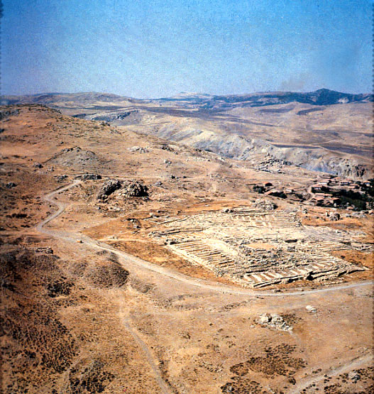
Ruins of Hattusha, capital of the Hittites

Slide 10
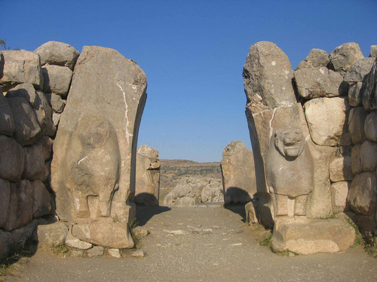
The Lion Gate in Hattusha

Slide 11
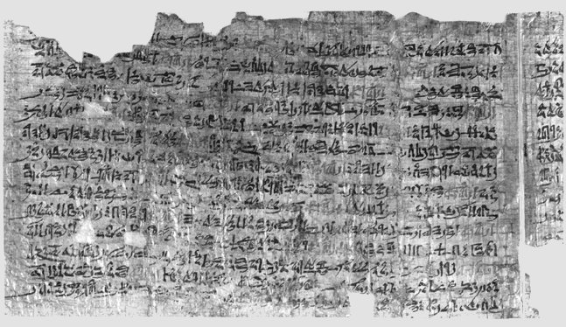
Papyrus Ipuwer
• 2:2—The river is blood = The river was turned to blood—Exod 7:20
• 2:6— Blood is everywhere = Blood is throughout all the land of Egypt— Exod 7:21
• 4:14—Trees are destroyed = And the hail… broke every tree in the field— Exod 9:25
• 9:11—The land is not light = And Moses stretched forth his hand… and there was a thick darkness— Exod 10:22
• 2:13—He who places his brother in the ground is everywhere = For there was not a house where there was not someone dead— Exod 12:30

Slide 12
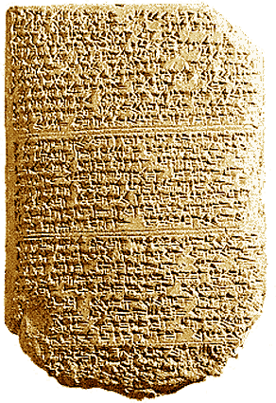
‘The Habiru plunder all lands of the king. If archers
are here this year, then the lands of the king, the
lord, will remain; but if the archers are not here,
then the lands of the king, my lord, are lost.’
One of the Tel El Amarna Letters c. 1400 BC

Slide 13
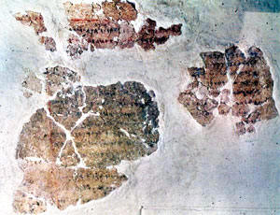
Deir Alla Inscription: Balaam the Seer
8th Century Jabbok River (Ammon)

Slide 14
Archaeological Facts about Jericho
1. The city was strongly fortified in the Late Bronze I period, the time of the Conquest according to the biblical chronology (Joshua 2:5,7,15).
2. The city was massively destroyed by fire (Joshua 6:24).
3. The fortification walls collapsed at the time the city was destroyed, possibly by earthquake activity (Joshua 6:20).
4. The destruction occurred at harvest time, in the spring, as indicated by the large quantities of grain stored in the city (Joshua 2:6, 3:15, 5:10).
5. The siege of Jericho was short, as the grain stored in the city was not consumed (Joshua 6:15,20).
6. Contrary to what was customary, the grain was not plundered, in accordance to the command given to Joshua (Joshua 6:17,18).

Slide 15
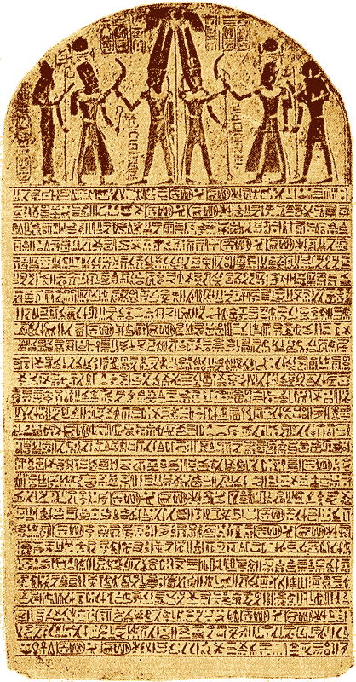
The Stele of Merneptah Egypt, 1230 BC
Mentions the Israelites in Canaan

Slide 16
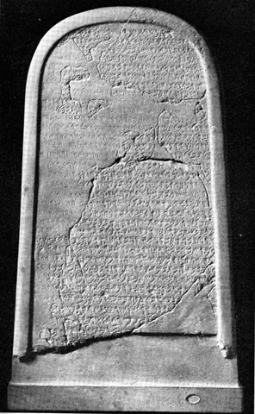
The Moabite Stone or Mesha Stele 870 BC
the Louvre
Ahab “of the house of Omri”
1 Kings 16:28

Slide 17
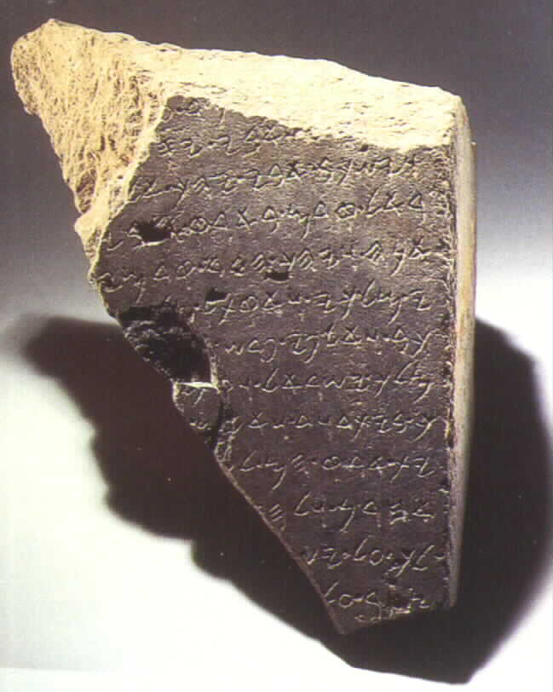
The Tel Dan Inscription
820 BC
2 Kings 8:28-29
‘I killed Jehoram, son of Ahab, king of Israel and I killed Ahaziah, son of Jehoram, king of the house of David”

Slide 18
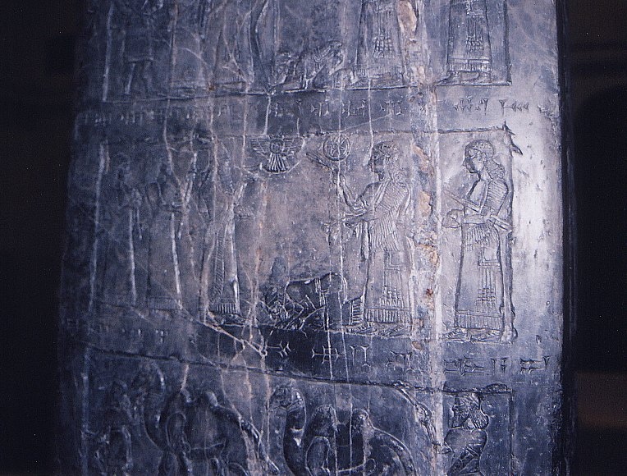
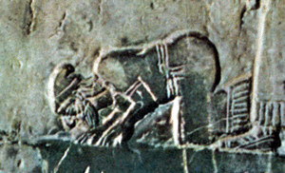
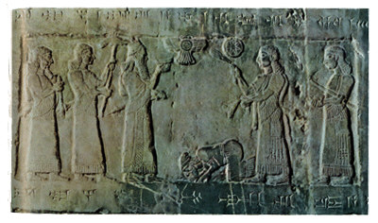
Black Obelisk of Shalmanezer III 840 BC
British Museum 2 Kings 17:3-6

Slide 19
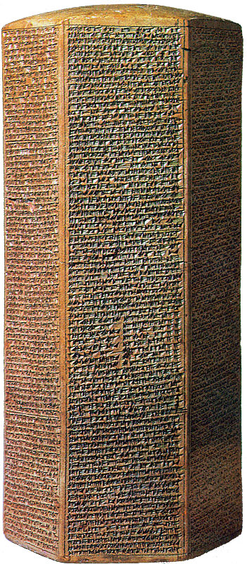
The Sennacherib Cylinder or Taylor Prism British Museum, London (2 Kings 18) 691 BC
As to Hezekiah the
Jew… I made him…
“like a bird in a
cage”

Slide 20
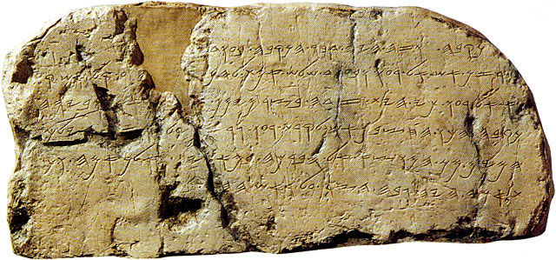
The Siloam Inscription.
2 Kings 20:20-21
"Now the rest of the acts of Hezekiah--all his might, and how he made a pool and a tunnel and brought water into the city--are they not written in the book of the chronicles of the kings of Judah? So Hezekiah rested with his fathers."

Slide 21
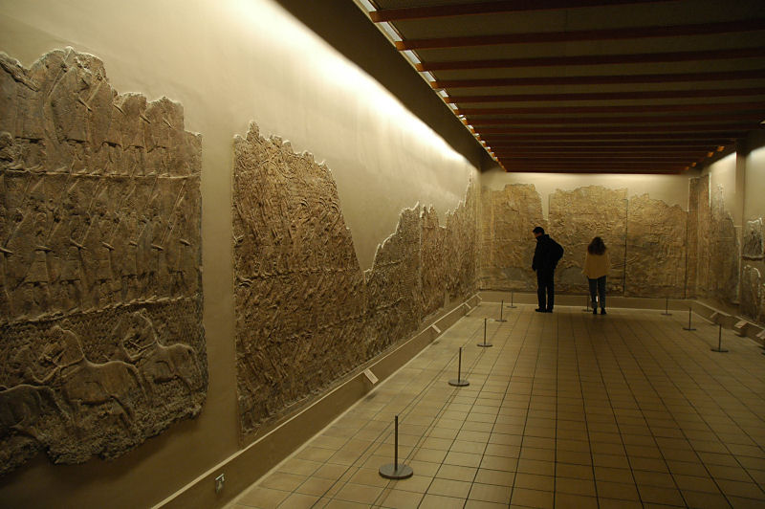
Lachish Room, British Museum

Slide 22
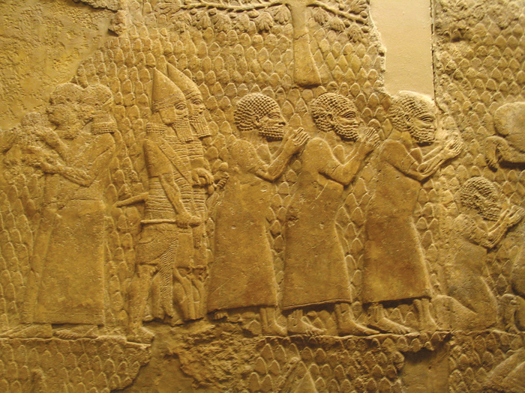
Israeli Captives Being Led from Lachish

Slide 23
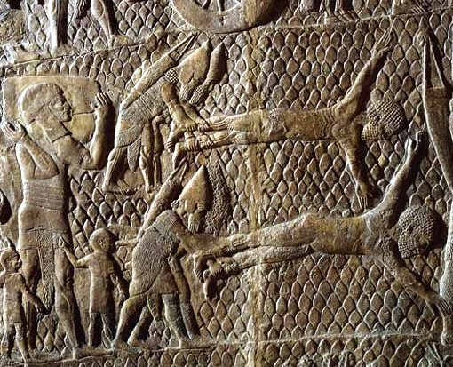
Jewish captives skinned alive in front of Lachish Walls

Slide 24
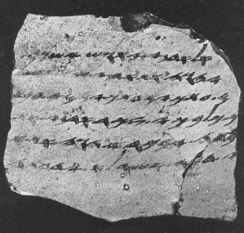
One of the Lachish Letters, 588 BC
Jeremiah 34:6,7

Slide 25
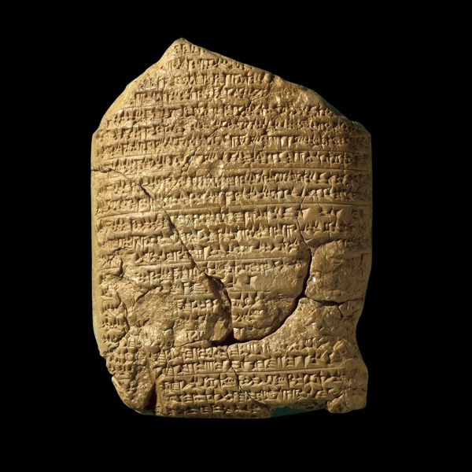
The Babylonian Chronicles British Museum, London, 597 BC 2 Kings 24:10-17
[In] the seventh year, the month of Kislev, the king of Babylonia mustered his forces and marched to Syria. He camped against the city of Judah (Jerusalem) and on the second day of the month of Adar he took the city and captured the king. He appointed a king of his own choice there, took its heavy tribute and brought them to Babylon.

Slide 26
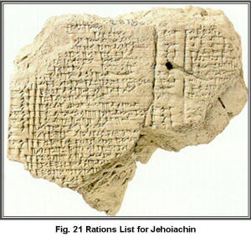
Yaukin (Jehoiachin), king of the land of Judah

Slide 27
Ziggurat in Ur: Nabonidus and Belshazzar

Slide 28
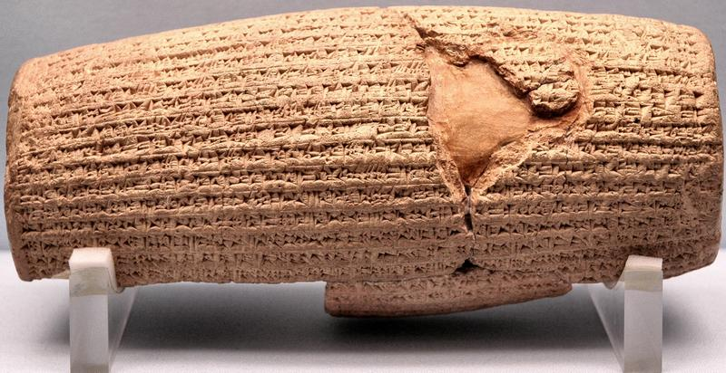
Cyrus Cylinder British Museum 535 BC
Ezra 1:2-4

Slide 29
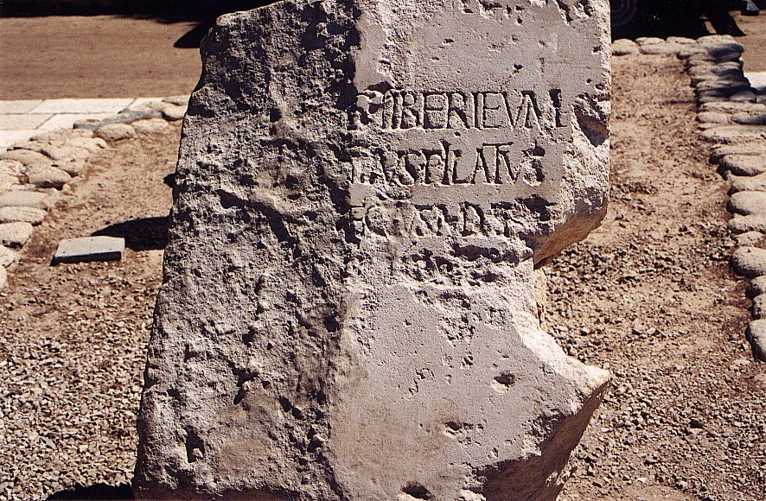
Pilate Inscription Cesarea Maritima AD 30
Discovered 1961
Tiberius, Pontius Pilatus, Prefect of Judea

Slide 30
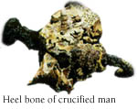
Archaeological Evidence

Slide 31
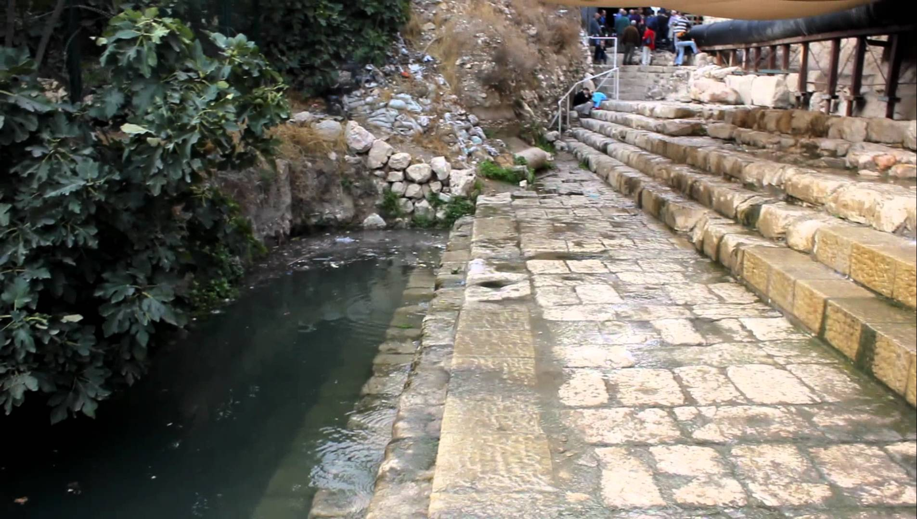
The Pool of Siloam

Slide 32
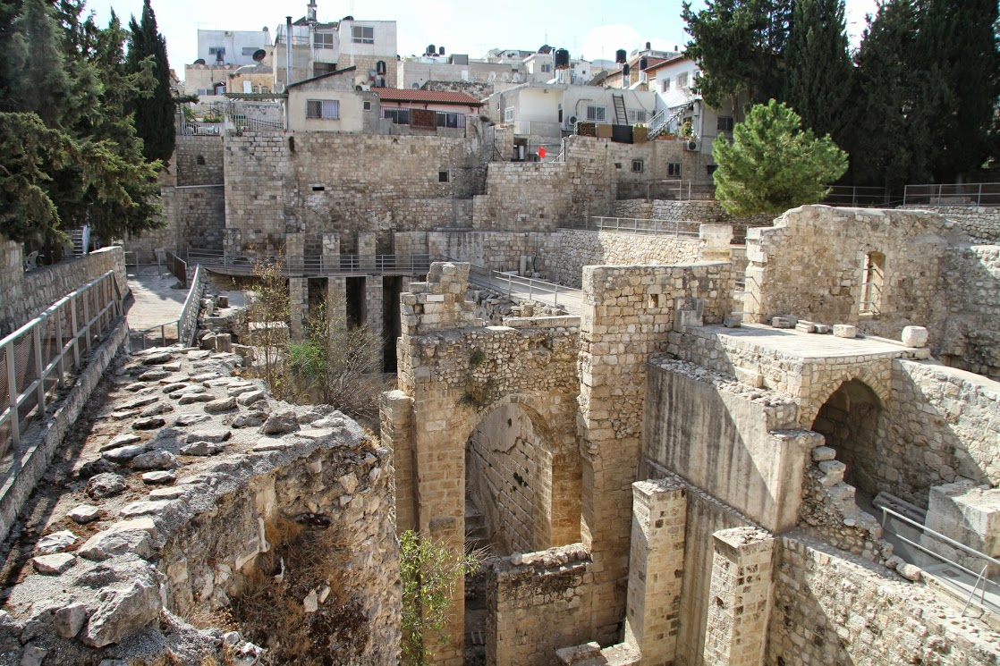
Pool of Bethesda

Slide 33
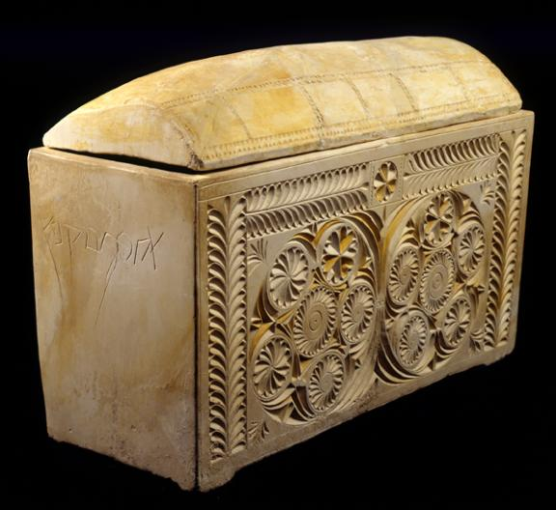
Caiaphas Ossuary
“Caiaphas, son of Joseph”

Slide 34
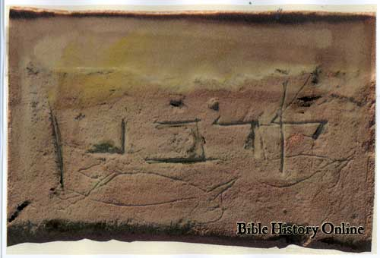
Corban

Slide 35
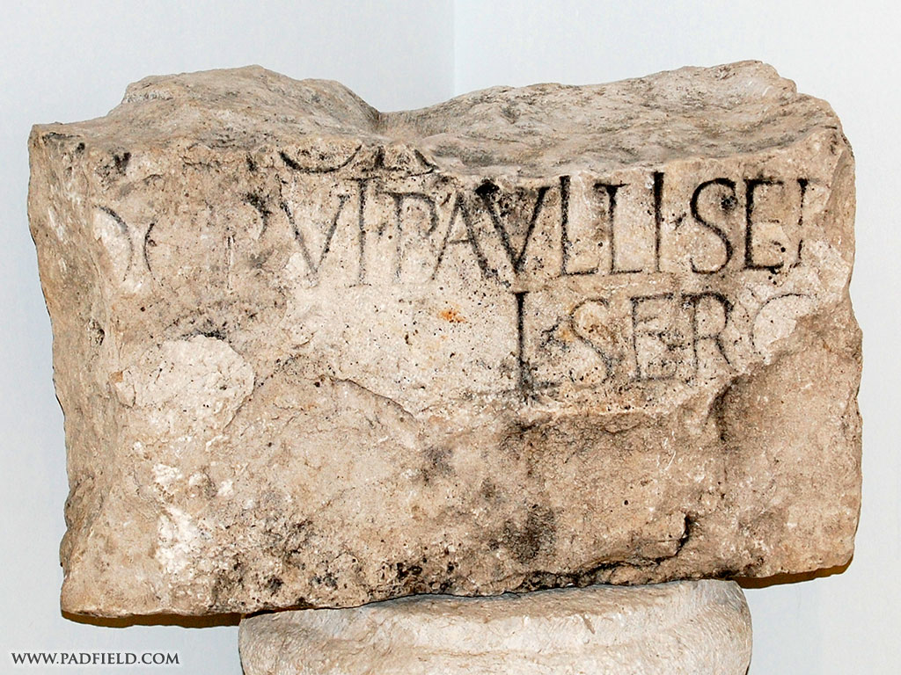
Acts 13:6-7 Sergius Paulus

Slide 36
Sir William Ramsay
I found myself brought into contact with the Book of Acts as an authority for the topography, antiquities, and society of Asia Minor. It was gradually borne upon me that in various details the narrative showed marvelous truth. In fact, beginning with a fixed idea that the work was essentially a second century composition, and never relying on its evidence as trustworthy for first century conditions, I gradually came to find it a useful ally in some obscure and difficult investigations.
Luke is a historian of the first rank; not merely are his statements of fact trustworthy; he is possessed of the true historic sense; he fixes his mind on the idea and plan that rules in the evolution of history, and proportions the scale of his treatment to the importance of each incident. He seizes the important and critical events and shows their true nature at greater length, while he touches lightly or omits entirely much that was valueless for his purpose. In short, this author should be placed along with the very greatest of historians.
Sir William Ramsay, St. Paul, the Traveler and the Roman Citizen, (Hodder and Stoughton, 1920).

Slide 37
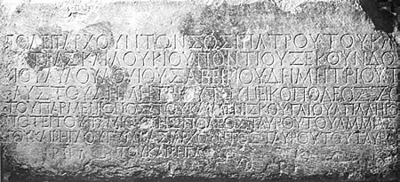
Chapter 17:6 Politarchs
From a column in Thessalonika, listing six “politarchs.”

Slide 38
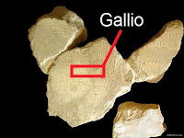
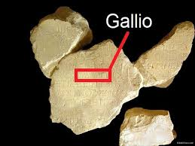
Acts 18:11-17
Proconsul in ancient Greece by the name of Gallio
The Greek inscription refers to Gallio noted in the Bible. It was written in the 1st century AD and was discovered in the Temple of Apollo in Delphi in 1905.
It originally consisted of various fragments that were pieced together in 1967.
The artifact is now in the Delphi museum, Greece.

Slide 39
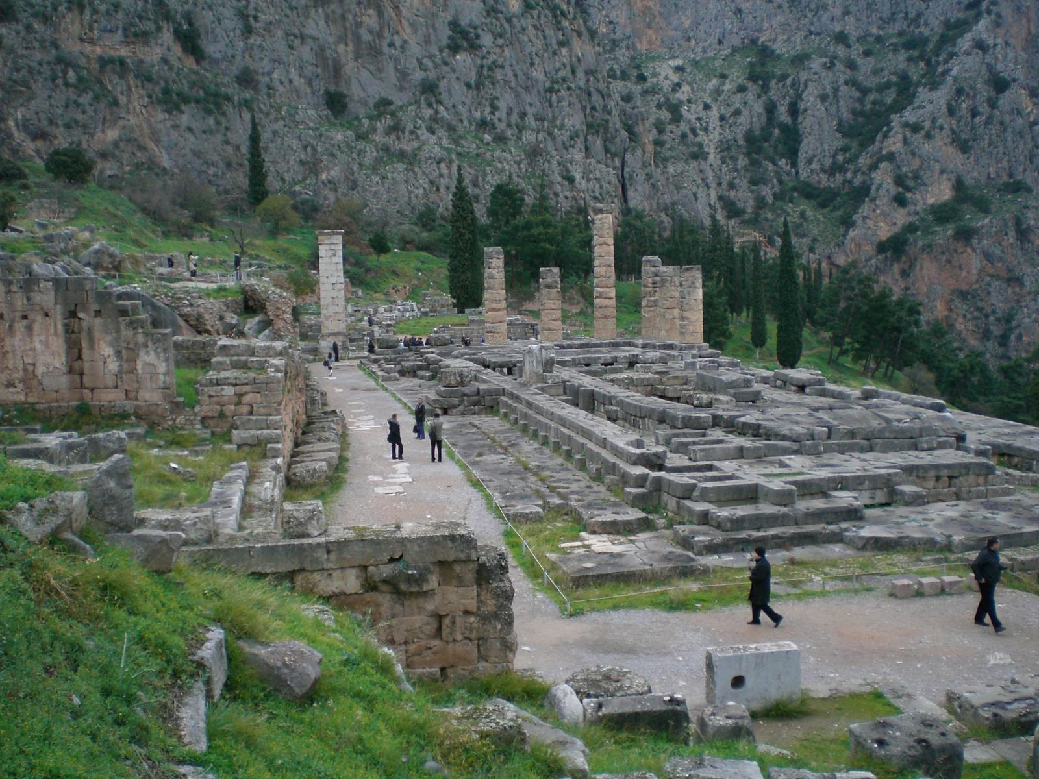
Temple of Apollo at Delphi where Delphi Inscription was discovered in the 20th century, used to date the proconsulship of Gallio which provides a peg for the chronology of Paul. Paul was in Corinth c. 52-53 AD.

Slide 40
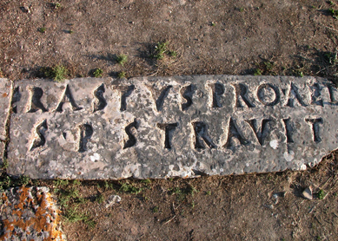
Erastus Inscription in Corinth
Acts 19:22 AD 50

Slide 41
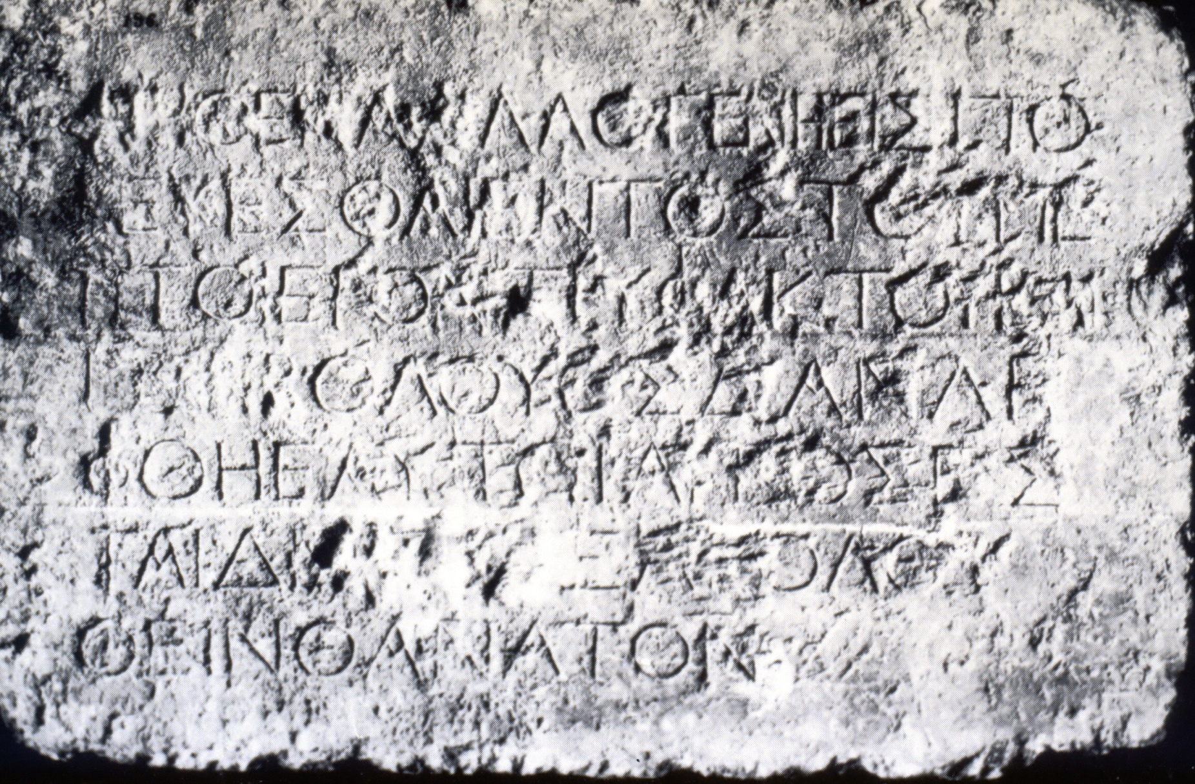
Let no Gentile enter within the partition and barrier surrounding the Temple; whosoever is caught shall be responsible for his subsequent death.

Slide 42
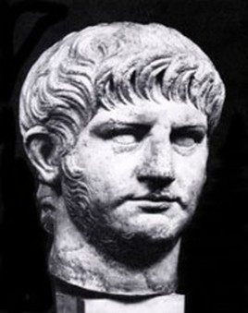
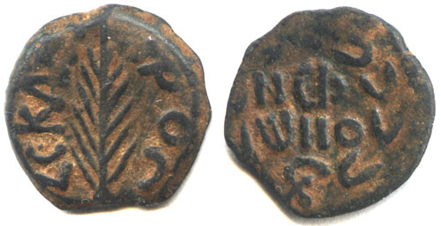
Acts 23:24
Marcus Antonius Felix was the ancient Roman procurator of the Judaea Province from 52-60 AD. Felix’s cruelty and licentiousness, coupled with his accessibility to bribes, led to a great increase of crime in Judaea.

