Slide 2
The Intolerance of Tolerance

Slide 9
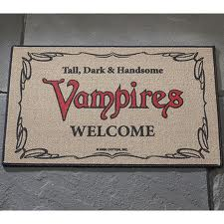

Slide 11
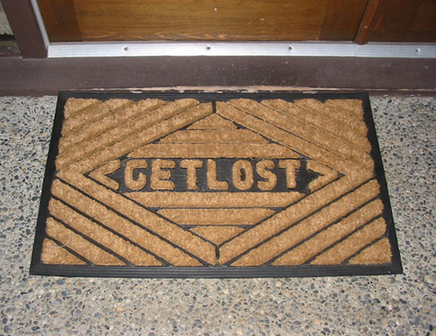

Slide 15
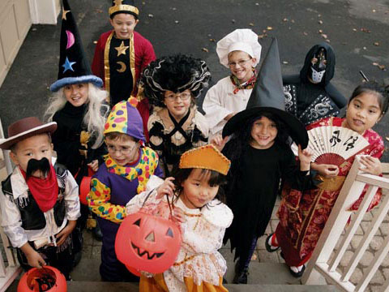

Slide 16
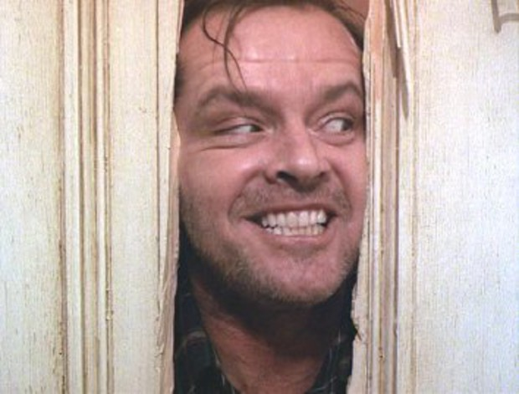

Slide 20
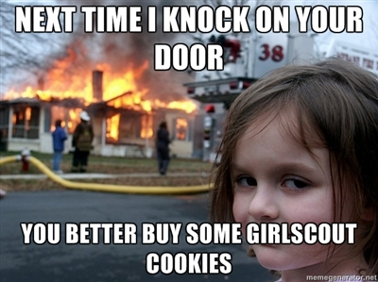

Slide 23
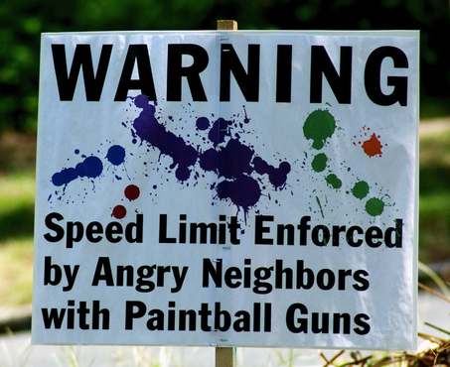

Slide 25
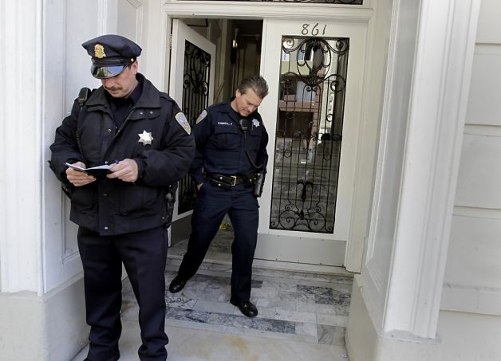

Slide 26
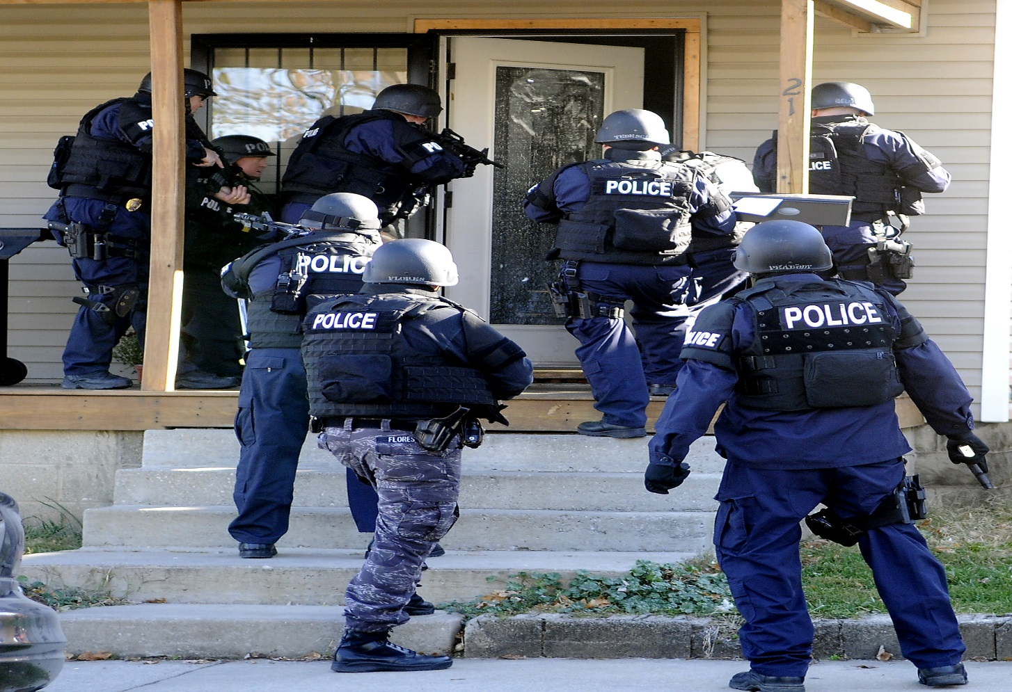

Slide 28
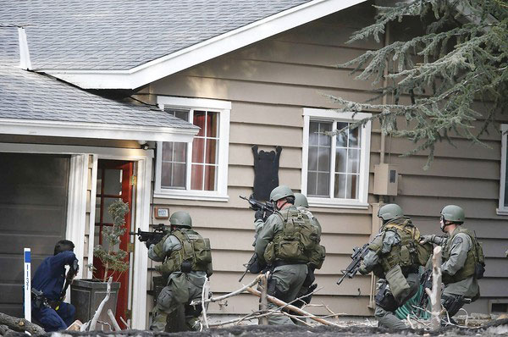

Slide 31
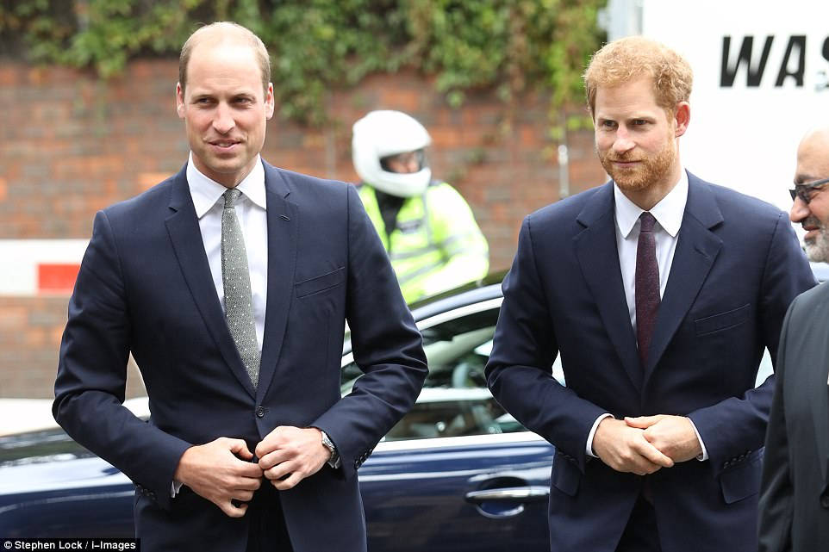

Slide 33
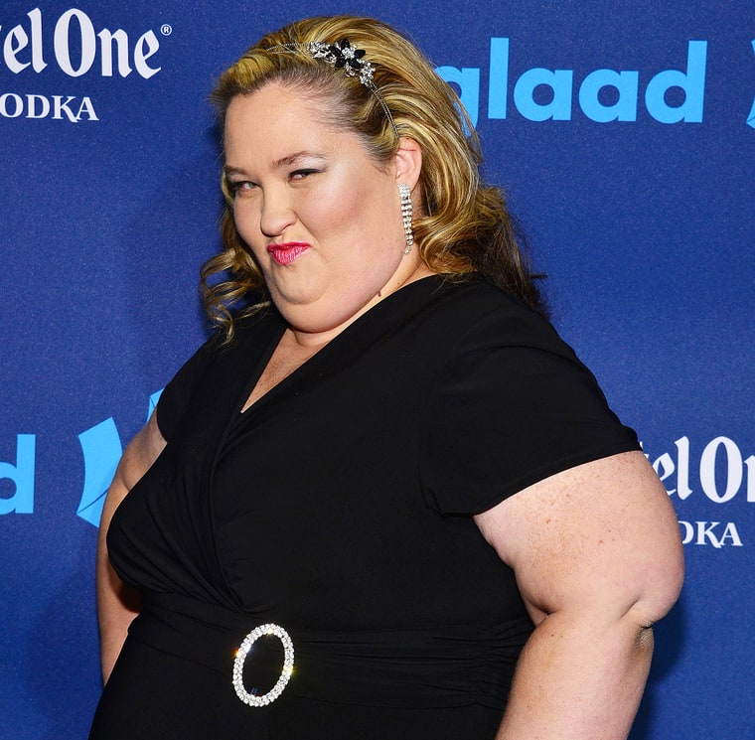

Slide 37
TOLERANCE
=
GOOD

Slide 38
INTOLERANCE
=
BAD

Slide 40
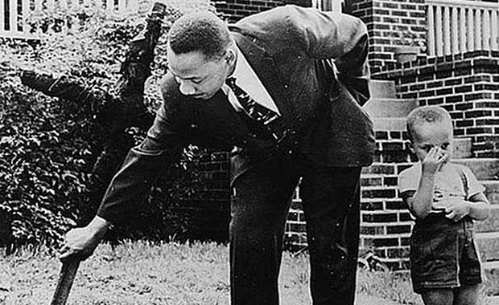

Slide 42
TOLERANCE
is a patience toward a practice or opinion that one disapproves of

Slide 43
TOLERANCE
is inevitably connected with disagreement and moral evaluation

Slide 44
TOLERANCE
always has limits

Slide 45
“Absolute tolerance is altogether impossible;

Slide 46
“Absolute tolerance is altogether impossible; the allegedly absolute tolerance turns into ferocious hatred of those who have stated clearly and most forcefully that there are unchangeable standards founded in the nature of man and the nature of things.” - Leo Strauss

Slide 47
TOLERANCE
always has a context

Slide 49
TRUE TOLERANCE involves
- patience toward a practice or opinion that one disapproves of
disagreement
moral evaluation
- limits
- context

