Slide 1
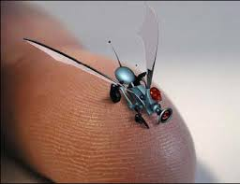
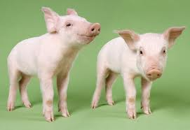
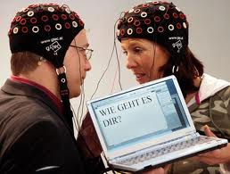
Christianity and Bioethics John Oakes Christianity and Culture

Slide 2
Bioethics: A Definition
Ben Mitchell and John F. Kilner in Does God Need our Help?
“Bioethics is a process of distinguishing between what we should pursue and what we shouldn’t pursue in matters of life and health.”

Slide 3
Morality vs. Ethics
Morality has to do with right and wrong, assumes an authoritative source of such morality.
Ethics has to do with better or worse or cost/benefit analysis and has primarily to do with human-human interaction.
Christians will have a fair amount in common with the wider world on ethical questions, but not on moral questions.

Slide 4
Why Should a Christian Care About Bioethics?
Biotechnology: Scientific methodologies specifically directed toward manipulating living things—whether human or non-human.
Examples: psychopharmaceuticals, genetically modified crops, artificial organ transplants, computer-aided prosthesis, gene therapy (embryonic and post-birth), stem cell and fetal tissue therapies, human and therapeutic cloning, neural implants, IVF, artificial enhancement of intelligence, etc.
Are these good things?

Slide 5
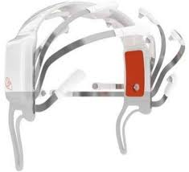
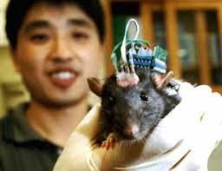
Will Gamers Be Able to Resist Brain Implants?

Slide 6
The Future is Almost Here
Nanotechnology will allow us to enhance our muscles, clear up our minds, deliver a drug to a desired organ.
Gold particles can produce an artificial antennae in our brains.
Genetic modification of unborn children
Externally-induced emotions

Slide 7
mHuman Enhancement
Leon Kass: “Human nature itself lies on the operating table, ready for alteration, for eugenic and neuropsychic enhancement, for whole-sale redesign.”
Transhumanists view human nature as a work-in-progress, a half-baked beginning that we can learn to remold in desirable ways.”

Slide 8
Human Enhancement
“The very identity of the human person and the very substance of reality are presumably called into question by developments in artificial intelligence, in genetics, and in virtual reality.” Albert Borgmann
“The artificial improvement of human beings will come, one way or another, whether we like it or not, as soon as the progress of biological understanding makes it possible. When people are offered technical means to improve themselves and their children, the offer will be accepted. Improvement may mean better health, longer life, a more cheerful disposition, a smarter brain, the ability to earn more money. The technology of improvement may be hindered or delayed by regulation, but it cannot be permanently denied.” Freeman J. Dyson, Physicist.

Slide 9
A Simple Answer
Well, as long as it is voluntary….
Is it really voluntary?
Will all have equal access?
All of these issues cry out for a “Christian” response.

Slide 10
Some Questions to Think About
What is the purpose of human existence?
What is the meaning of human dignity?
What is free will and what is its relationship to technologies?
What is a soul and what are the implications of the mind/body/soul relationship as it relates to biotech?
What is the meaning of human autonomy, is this a Christian value, and is it in play in these technologies?

Slide 11
Questions (cont.)
Are we prepared to let market forces determine the direction of biotechnological advance?
Should we leave control for the direction of biotechnological moves in the hands of avowed naturalists/scientific materialists?
Are we going to simply take the “It is in God’s hands” approach to this?

Slide 12
Toward a Christian Response to Bioethical Questions
The naturalist view:
We are the purposeless result of blind natural forces. We are temporal and are not spiritual. In this world view, biotechnological choices come down to cost/benefit analysis alone. Human dignity (worth) is a questionable concept.
In the Christian world view, the individual has a dignity because we are made in the image of God (Genesis 1:26-27) which should be respected. This limits the viability of cost/benefit analysis.

Slide 13
Human Responsibility
Genesis 2:15 (about the garden) keep (shamar) it
Genesis 1:28 Fill the earth and subdue it.
But…
1 Cor 4:2 It is required that those who have been given a trust must prove faithful.
Conclusion: We do not worship nature (biocentrism) but we are over nature as responsible, caring stewards.

Slide 14
A cautionary tale: The Tower of Babel
Genesis 11 Come let us build…. and make a name for ourselves.
C S Lewis in The Abolition of Man, “What we call man’s power over nature turns out to be a power exercised by some men over other men with nature as its instrument.”
Applied to biotech, should we have as a goal to remake, redesign and prefabricate ourselves?
Did Jesus enhance or reengineer either himself or others?

Slide 15
A Preliminary Answer
Morally and ethically responsible stewardship (guided by a biblical understanding of the relationship between the created (man) and the creator).
The ultimate goal of Christian medicine is not immortality. Our goal is not to avoid death at all costs, but to create as fulfilled a life on earth as we can.
We should use biotechnologies to relieve suffering in a way which protects human dignity without making humans less human.

Slide 16
Another Way to Put It
The natural Christian attitude seems to be liberal when it comes to using technology to reduce suffering and to improve the quality of natural life, but to be conservative in unnaturally altering life for personal or monetary benefit.

Slide 17
Helpful Questions (from Biotechnology and the Human Good by Ben Mitchel et al)
1. Does the technology assist us in fulfilling or stewardship responsibilities?
2. Does the technology require or promote the commodification or destruction of human life? Does the technology demean, debase or degrade individuals?
3. Does the technology primarily appeal to our basest inclinations?
4. Is the technology a vehicle to promote our own narcissistic self-absorption?

Slide 18
Questions (cont.)
5. Does the pursuit or use of the technology make just use of resources?
6. Does the technology promote genuine human flourishing or does it more likely promote economic imperatives? Must we adapt to the technology, or was the technology designed to adapt to human nature and human needs?

Slide 19
Conclusion
Science itself is ethically and morally neutral, but the Christian worldview suggests:
We should use biotechnologies to relieve suffering or improve quality of life in a way which protects human dignity without making us either more than or less than human.

Slide 20
A Case Study: Stem Cell Research
Are there moral implications? We should start there.
Are there ethical issues?
Is this to enhance human capability or is it to give health and alleviate suffering?
Is there sufficient negative harm to others which more than offsets possible good?
Caution: We will not all agree on these things…

