Slide 1
Resurrection Worldview
Living Apologetics

Slide 2
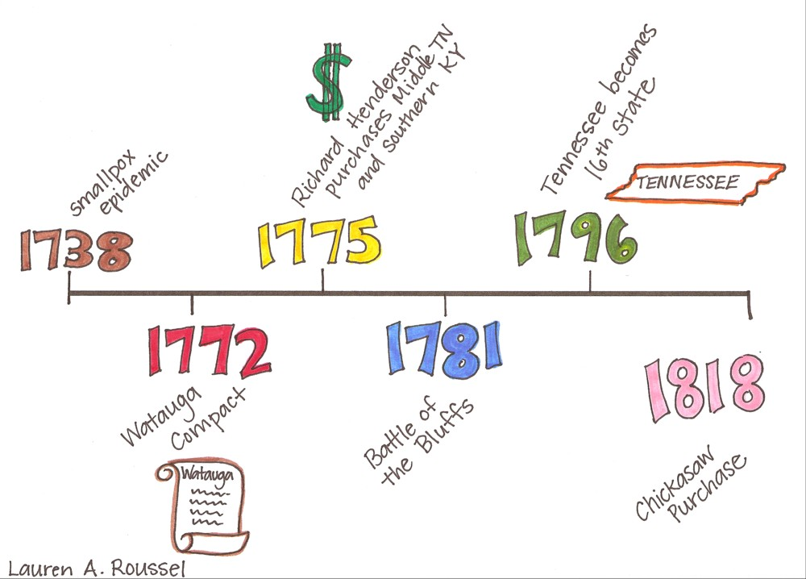
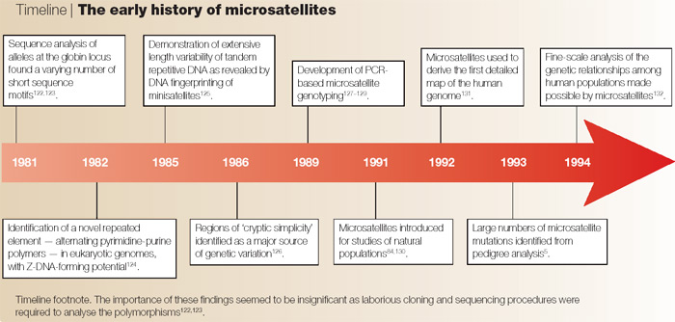
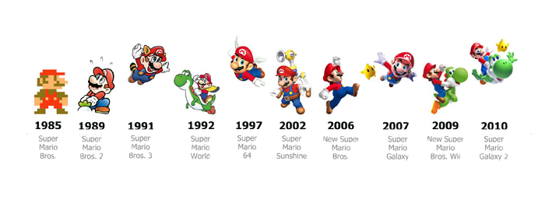
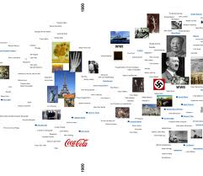

Slide 3
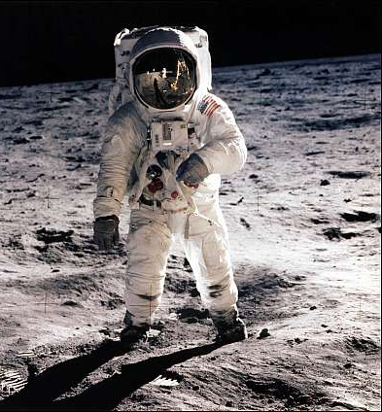
What would you do if this was the future?
Notes:
May require more than one slide

Slide 4
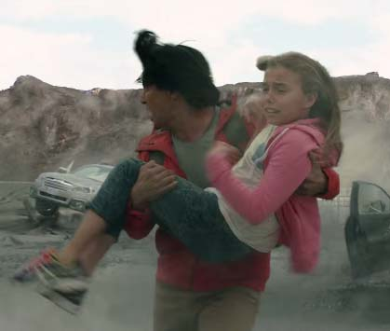

Slide 5
Resurrection in the Ancient World

Slide 6
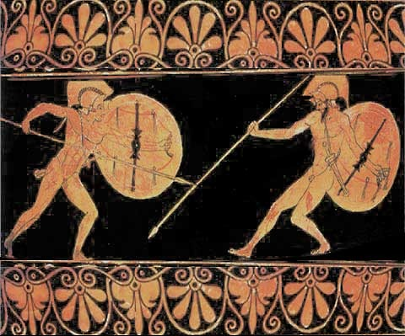
Illiad
“Achilles held out his arms to clasp the spirit, but in vain. It vanished like a wisp of smoke and went gibbering underground. Achilles. . . Cried, ‘Ah then, it is true that something of us does survive even in the Halls of Hades but with no intellect at all, only the ghost and semblance of a man.”
Notes:
May require more than one slide

Slide 7
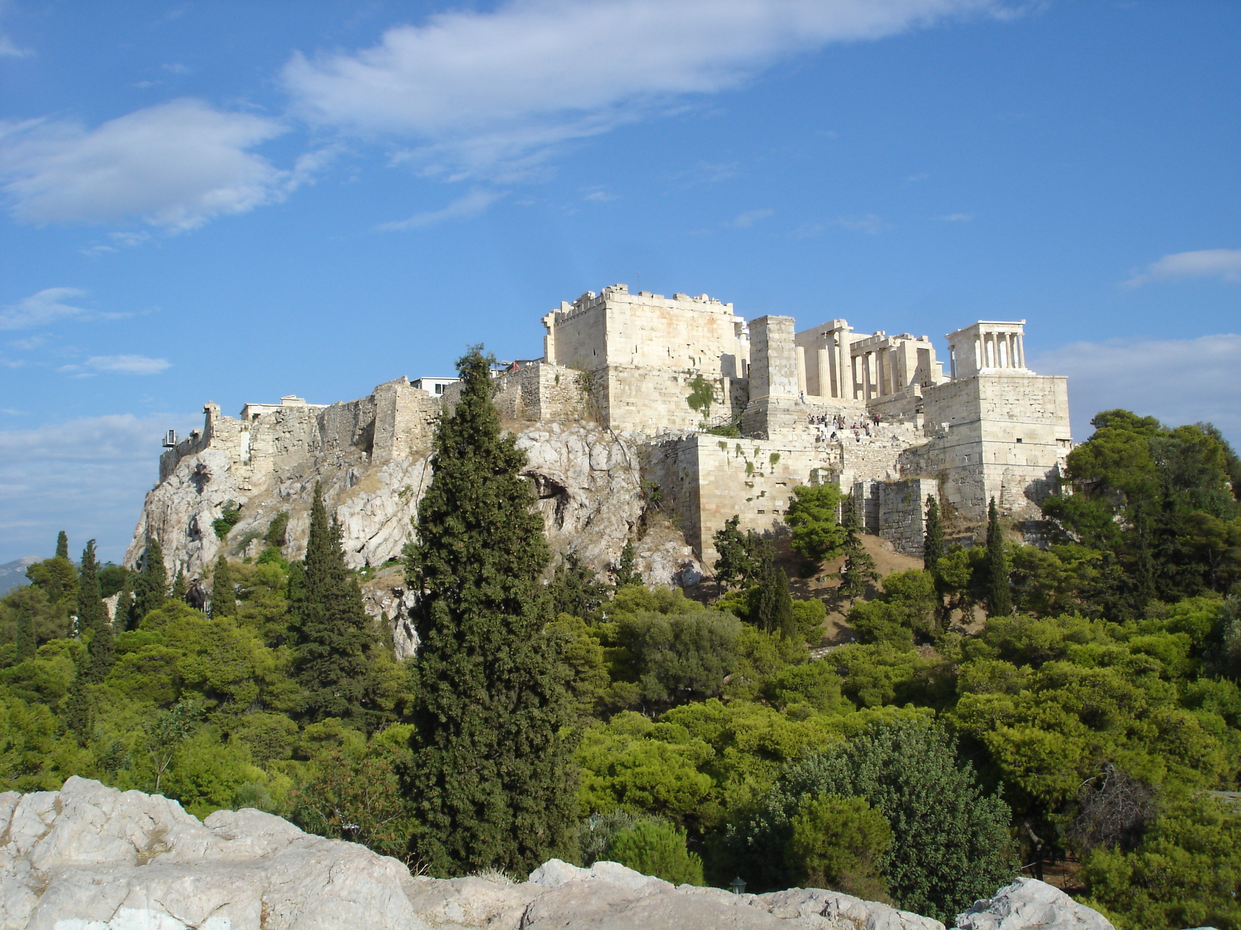
Eumenides by Aeschylus
“Once a man has died, and the dust has soaked up his blood, there is no resurrection.”
- Apollo
Notes:
May require more than one slide

Slide 8
Iliad
Achilles’ wrath:
“sent down to Hades many valiant souls of warriors, and made the men themselves to be spoil for dogs and birds of every kind, for so were the counsels of Jove. “
Notes:
Soul and the person were separate things

Slide 9
Greco-Roman belief on Resurrection
Multi-faceted beliefs
Tended to fall into 2 categories
Those who wished for resuscitation or resurrection of some type, but who knew those sorts of things only happened in the world of myth
Those who knew it was simply impossible
Notes:
May require more than one slide

Slide 10
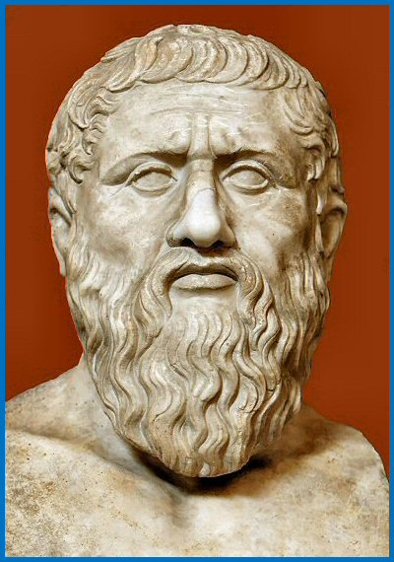
Plato – Changes in thinking
The soul doesn’t just survive death, but is freed from the prison on the body
Hades is not a place of gloom but a place of pleasure and delight
Judgment is given based on behavior in life; the virtuous go to the Islands of the Blessed; the wicked go to Tartarus
Transmigration was a sort of re-incarnation but was a return to the prison of the body
Notes:
Soul and the person were separate things

Slide 11
Plato – Changes in thinking
Despite many important changes in Greek thinking, no one returned from Hades to resume their previous life or to have a superior life in the physical realm.
Notes:
Soul and the person were separate things

Slide 12
Platonic Worldview
The physical/material world was inferior (evil)
The spiritual world was the true reality and was superior
The two realms were disconnected—you could do something with your body that would not effect your soul
The great hope was for the soul to escape the prison of the body and be a bodiless spirit in the afterlife
Notes:
Soul and the person were separate things

Slide 13
God of the living
That same day the Sadducees, who say there is no resurrection, came to him with a question…
Jesus replied, “You are in error because you do not know the Scriptures or the power of God… have you not read what God said to you, ‘I am the God of Abraham, the God of Isaac, and the God of Jacob’? He is not the God of the dead but of the living.”
- Matthew 22:23, 29, 31-32
Notes:
Soul and the person were separate things

Slide 14
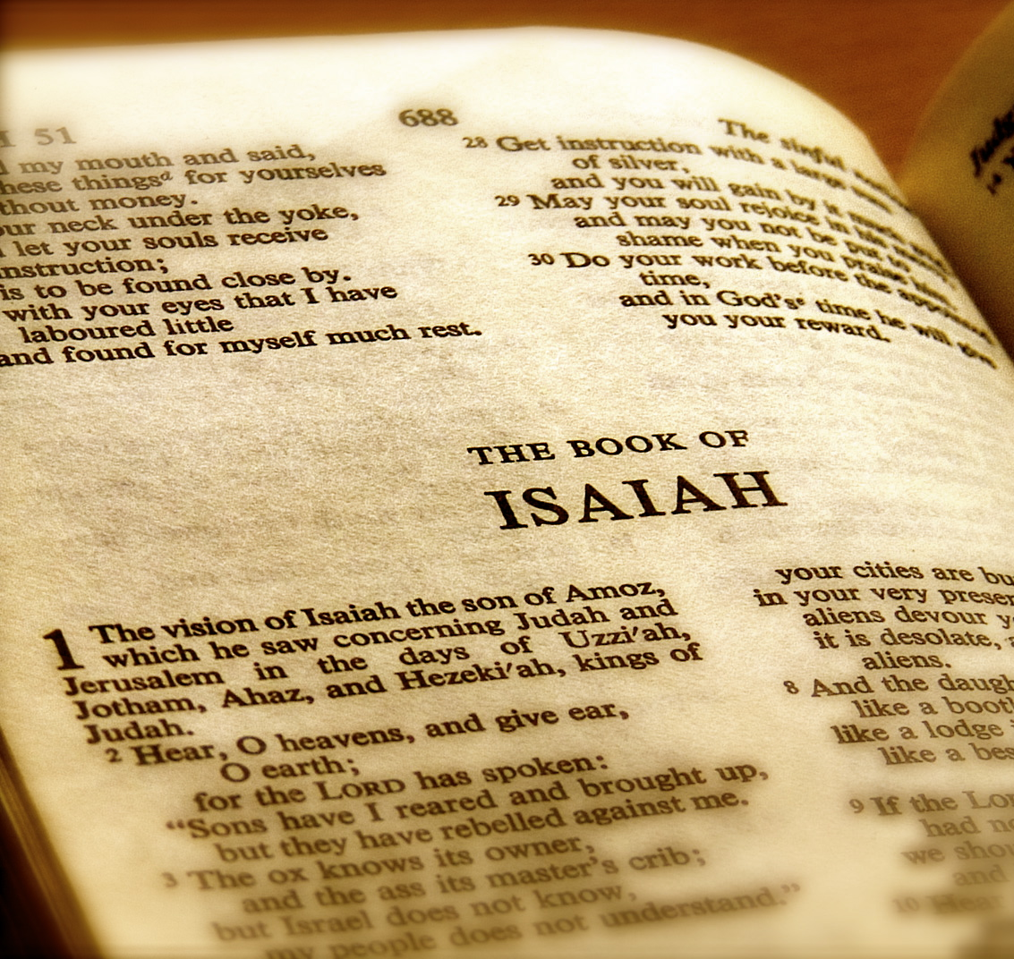
Swallowed Up
On this mountain he will destroy the shroud that enfolds all peoples, the sheet that covers all nations; he will swallow up death forever.
- Isaiah 25:7
Notes:
Soul and the person were separate things

Slide 15
Awaken to Everlasting Life
Multitudes who sleep in the dust of the earth will awake: some to everlasting life, others to shame and everlasting contempt. Those who are wise will shine like the brightness of the heavens, and those who lead many to righteousness, like the stars for ever and ever.
- Daniel 12:2-3

Slide 16
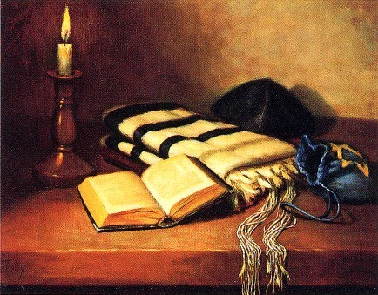
Shemoneh Esrei “18 Benedictions”
You are mighty, humbling the proud… you live for evermore, and raise the dead; you make the wind to return and the dew to fall… and bring the dead to life; you bring forth salvation for using the blinking of an eye. Blessed are you, O Lord, who bring the dead to life.

Slide 17
On the Third Day
“Come, let us return to the Lord. He has torn us to pieces but he will heal us; he has injured us but he will bind up our wounds. After two days he will revive us; on the third day he will restore us, that we may live in his presence. Let us acknowledge the Lord; let us press on to acknowledge him. As surely as the sun rises, he will appear; he will come to us like the winter rains, like the spring rains that water the earth.
- Hosea 6:1-3

Slide 18
Resurrection in the New Testament

Slide 19
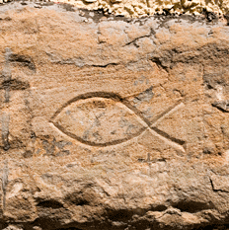
Early Christian View
The physical/material world was part of God’s good creation
The spiritual realm was intended to be one with the physical realm
Sin separated the two realms
Ultimately the effects of the physical and spiritual realms cannot be separated
The great hope was for the soul and body to be reunited and transformed
Notes:
Soul and the person were separate things

Slide 20
Hints of Resurrection
John 5:28 – “Those who have done what is good will rise to live…”
Luke 14:13-14 – “You will be repaid at the resurrection of the righteous
Matthew 17:23 – “They will kill him, and on the third day he will be raised to life.”

Slide 21
Hints of Resurrection
“Lord,” Martha said to Jesus, “if you had been here, my brother would not have died. But I know that even now God will give you whatever you ask.”
Jesus said to her, “Your brother will rise again.”
Martha answered, “I know he will rise again in the resurrection at the last day.”
Jesus said to her, “I am the resurrection and the life. The one who believes in me will live, even though they die; and whoever lives by believing in me will never die. Do you believe this?”
John 11:21-26

Slide 22
Fact 1: Jesus Died by Roman Crucifixion
Biblical Sources: | Four gospels; 6 other NT books
Non-biblical: Jewish/ Roman historian Josephus: | “When Pilate, upon hearing him accused by men of the highest standing amongst us, had condemned him to be crucified”
Other non-biblical sources: | Tacitus, Lucian, Mara bar Serapion, the Jewish Talmud

Slide 23
Fact 2: Disciples Believed Resurrection
They claimed it: | Paul (2 Tim. 2:8): Remember Jesus Christ, raised from the dead, descended from David. This is my gospel
Early oral tradition citing eyewitnesses (1 Cor. 15:3-7) that Paul likely received about 34-36 AD | ³ For what I received I passed on to you as of first importance^{[a]}: that Christ died for our sins according to the Scriptures, ⁴ that he was buried, that he was raised on the third day according to the Scriptures, ⁵ and that he appeared to Cephas,^{[b]} and then to the Twelve. ⁶ After that, he appeared to more than five hundred of the brothers and sisters at the same time, most of whom are still living, though some have fallen asleep. ⁷ Then he appeared to James, then to all the apostles
Other non-biblical sources: | Tacitus, Lucian, Mara bar Serapion, the Jewish Talmud

Slide 24
Fact 2: Disciples Believed Resurrection
They believed it: The willingness of the disciples to boldly proclaim the resurrection and go to their own violent deaths for doing so is strongly attested to: | Luke (Acts 7, 12) Clement of Rome Ignatius Polycarp Dionysius of Corinth (cited by Eusebius) Tertullian Origen
Important Points | Their willingness to die is evidence of sincerity This doesn’t verify the truth of their beliefs but does confirm that they were not liars Legends and liars make poor martyrs

Slide 25
Fact 3: The Persecutor Saul (Paul)
His Conversion: | Paul as a source (1 Cor. 15:9-10; Gal. 1:13-16; Phil. 3:6-7) Luke as a source (Acts 9; 22; 26) Early oral tradition in Judea (Gal. 1:22-23)
His suffering and martyrdom | Paul as a source (2 Cor. 11:23-28) Luke as a source (Acts 14; 16; 17; 18; 21; 23) Other Sources: Clement of Rome; Polycarp; Tertullian; Dionysius of Corinth; Origen
Important Note | Paul lost everything by converting and gained persecution, and death

Slide 26
Fact 4: The Skeptic James
His skepticism: | John 7:4-5; Mark 3:31-32; 6:3-4
Appearance to James of Resurrected Christ: | 1 Corinthians 15:7
Identified as a leader in the church in Jerusalem: | (Gal. 1:19; Acts 15:12-21
His suffering and martyrdom: | Josephus Hegesippus Clement of Alexandria

Slide 27
Fact 5: The Jerusalem Problem
The Jerusalem Problem: | Preaching of Resurrection in Jerusalem within months of resurrection would be impossible with eyewitnesses everywhere Producing a corpse would have ended Christianity immediately
The Record: | The book of Acts and various secular sources attest that the gospel preaching began in Jerusalem within months of the crucifixion

Slide 28
Fact 6: Testimony of Women
Women are listed as the first eyewitnesses of the empty tomb: | Luke 24:11; Josephus; The Jewish Talmud; Origen; Seutonius
The problem: | “Soon let the words of the Law be burnt than delivered to a woman (Talmud, Sotah 19a)” “But let not the testimony of women be admitted, on account of the levity and boldness of their sex (Joesphus, Antiquities) Any evidence which a woman [gives] is not valid . . . A robber is qualified to give the same evidence as a woman (Talmud , Rosh Hashannah 1.8)”

Slide 29
Fact 7: The Empty Tomb
The Empty Tomb Problem: | Producing a corpse would have ended Christianity immediately
Enemy attestation: | Matthew 28:12-13; Justin Martyr; Tertullian Claiming that the disciples stole the body is inadvertent affirmation that the tomb was empty

Slide 30
The bodily resurrection of Jesus
Facts | Legend | Fraud | Mistake | Halluc. | Delusion | Swoon | Spiritual Exp. | Res. Of Jesus
1. Jesus Died by Roman Crucifixion | X | X | X | X | X | X | X | X
2. The Disciples Believed It |  |  | X | ? | X |  |  | X
3. Conversion of Saul |  |  |  | ? | ? |  |  | X
4. Conversion of James |  |  |  | ? | ? |  |  | X
5. The Jerusalem Factor |  | X |  |  |  |  |  | X
6. The Witness of Women |  |  |  |  |  |  |  | X
7. The Empty Tomb |  | X | X |  |  | X |  | X

Slide 31
Key Beliefs on the Resurrection

Slide 32
Resurrection
Jesus was the prototype

Slide 33
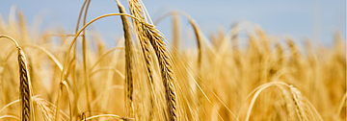
Firstfruits
But Christ has indeed been raised from the dead, the firstfruits of those who have fallen asleep. . .Christ, the firstfruits; then, when he comes, those who belong to him. . . For he must reign until he has put all his enemies under his feet. The last enemy to be destroyed is death. – 1 Corinthians 15:20-26

Slide 34
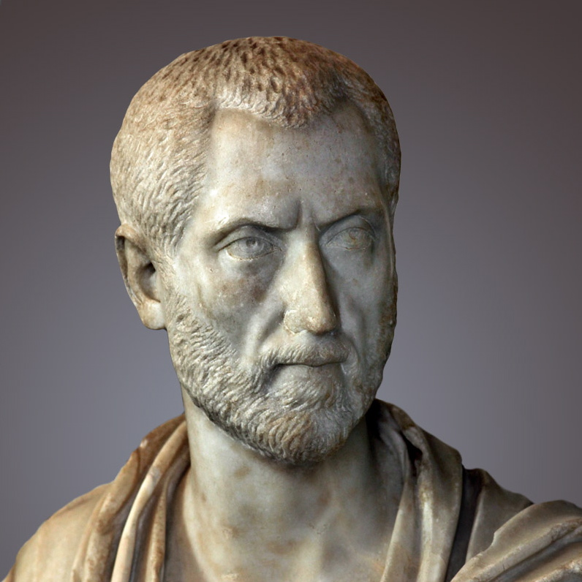
Novatian
A law of resurrection is established in that Christ raised up in the substance of the body as an example for the rest.
- c. 235
Notes:
Soul and the person were separate things

Slide 35
Resurrection
Jesus was the prototype
Jesus is the resurrection

Slide 36
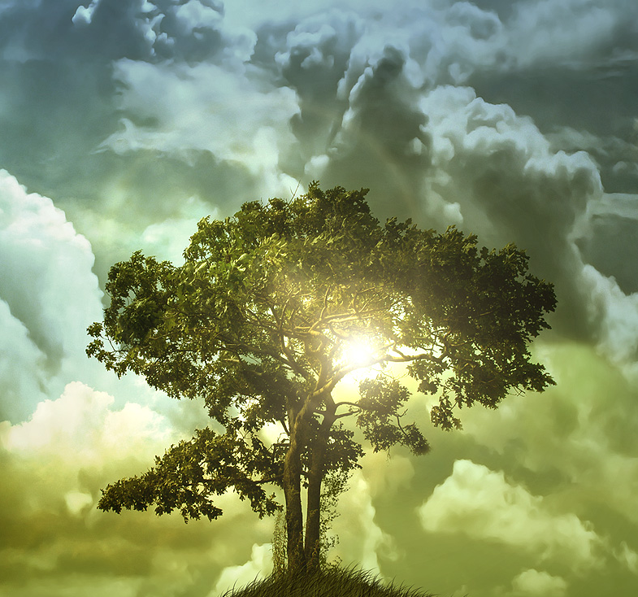
The Resurrection
Martha answered, “I know he will rise again in the resurrection at the last day.”
Jesus said to her, “I am the resurrection and the life. The one who believes in me will live, even though they die; and whoever lives by believing in me will never die. Do you believe this?”
– John 11:24-26

Slide 37
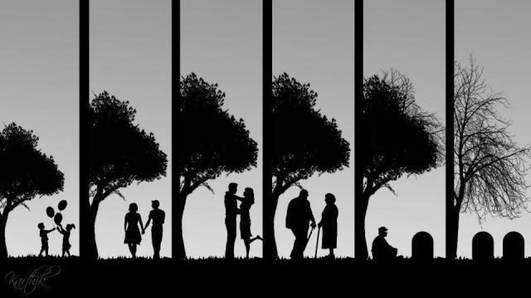
The Resurrection
Death . . . then life
. . . unless a kernel of wheat falls to the ground and dies, it remains only a single seed. But if it dies, it produces many seeds. Anyone who loves their life will lose it, while anyone who hates their life in this world will keep it for eternal life. – John 12:24-25

Slide 38
The Resurrection Life
Or don’t you know that all of us who were baptized into Christ Jesus were baptized into his death? We were therefore buried with him through baptism into death in order that, just as Christ was raised from the dead through the glory of the Father, we too may live a new life.
For if we have been united with him in a death like his, we will certainly also be united with him in a resurrection like his. For we know that our old self was crucified with him so that the body ruled by sin might be done away with, that we should no longer be slaves to sin— because anyone who has died has been set free from sin.
Now if we died with Christ, we believe that we will also live with him. For we know that since Christ was raised from the dead, he cannot die again; death no longer has mastery over him. The death he died, he died to sin once for all; but the life he lives, he lives to God.
Romans 6:3-10

Slide 39
Resurrection
Jesus was the prototype
Jesus is the resurrection
Resurrection is redemption of the body

Slide 40
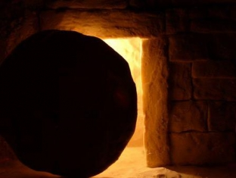
An Empty Tomb
When the perishable has been clothed with the imperishable, and the mortal with immortality, then the saying that is written will come true: “Death has been swallowed up in victory.”
“Where, O death, is your victory? Where, O death, is your sting?”
– 1 Corinthians 15:53-55

Slide 41
The Redemption of Our Bodies
Not only so, but we ourselves, who have the firstfruits of the Spirit, groan inwardly as we wait eagerly for our adoption to sonship, the redemption of our bodies.
- Romans 8:23

Slide 42
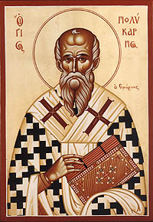
Polycarp
I give thanks . . . that I can have a part . . . in the resurrection of eternal life, both of soul and body.
– c. 160

Slide 43
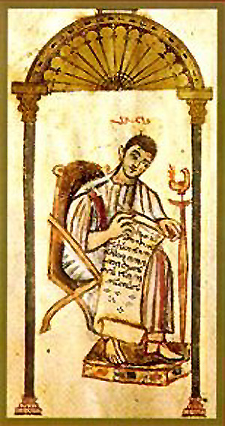
Tatian
We believe that there will be a resurrection of bodies after the consummation of all things.
– c. 160

Slide 44
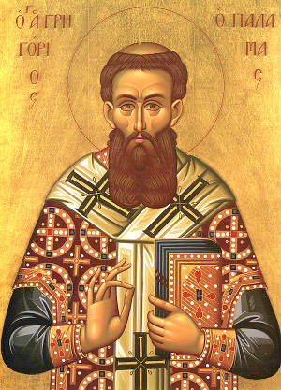
Irenaeus
When [the body] is re-cast, it will not be as this corruptible body. Rather, it will be pure, and no longer subject to decay. To each body, its own soul will be restored.
– c. 180

Slide 45
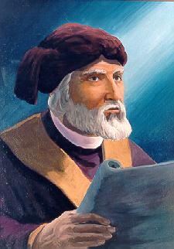
Tertullian
If the resurrection of the flesh is denied, a prime article of the faith is shaken . . . . He therefore, will not be a Christian who will deny this doctrine. For it is confessed by Christians.
– c. 210

Slide 46
Resurrection
Jesus was the prototype
Jesus is the resurrection
It includes redemption of the body
It is transformational

Slide 47
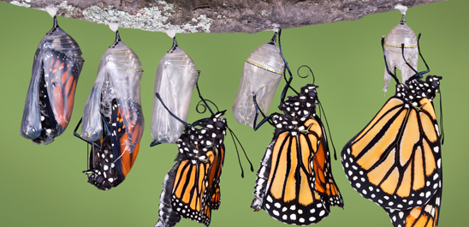
1 Corinthians 15:42-44
So will it be with the resurrection of the dead. The body that is sown is perishable, it is raised imperishable; it is sown in dishonor, it is raised in glory; it is sown in weakness, it is raised in power; it is sown a natural body, it is raised a spiritual body.
If there is a natural body, there is also a spiritual body.

Slide 48
Surprised by Hope, p. 44
“Unfortunately, many translations get him radically wrong at this point, leading to the widespread supposition that for Paul the new body would be a spiritual body in the sense of a nonmaterial body, a body that in Jesus’ case wouldn’t have left an empty tomb behind it. It can be demonstrated in great detail, philologically and exegetically, that this is precisely not what Paul meant. The contrast he is making is not between what we would mean by a present physical body and what we would mean by a future spiritual one, but between a present body animated by the normal human soul and a future body animated by God’s Spirit.”

Slide 49
1 Corinthians 15:50
. . . flesh and blood cannot inherit the kingdom of God. . .

Slide 50
Irenaeus
‘Flesh and blood cannot inherit the kingdom of God.’ This is put forward by all the heretics in support of their folly [i.e., their denial of the resurrection of the body]. They do this to try to annoy us and to point out that the handiwork of God [i.e., the flesh] is not saved. . . . However, by ‘flesh and blood,’ Paul refers to all of those (as many as there are) who do not have that which saves and forms us into life. These are the ones who do not have the Spirit of God in themselves. For that reason, men of this mold are spoken of by the Lord as ‘dead.’ For He says, ‘Let the dead bury their dead.’
- c. 180

Slide 51
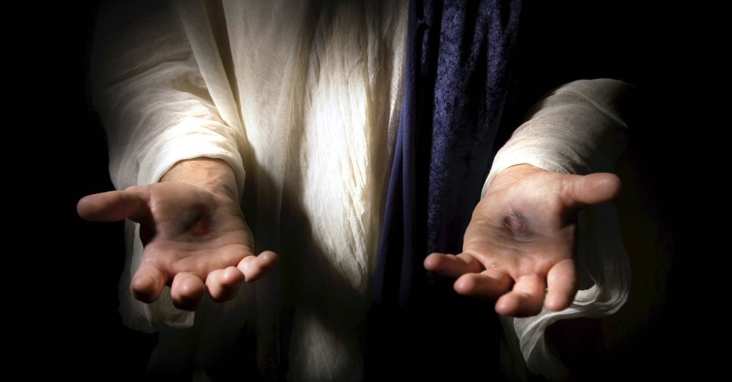
Resurrected Body
Look at my hands and my feet. It is I myself! Touch me and see; a ghost does not have flesh and bones, as you see I have.”
– Luke 24:37

Slide 52
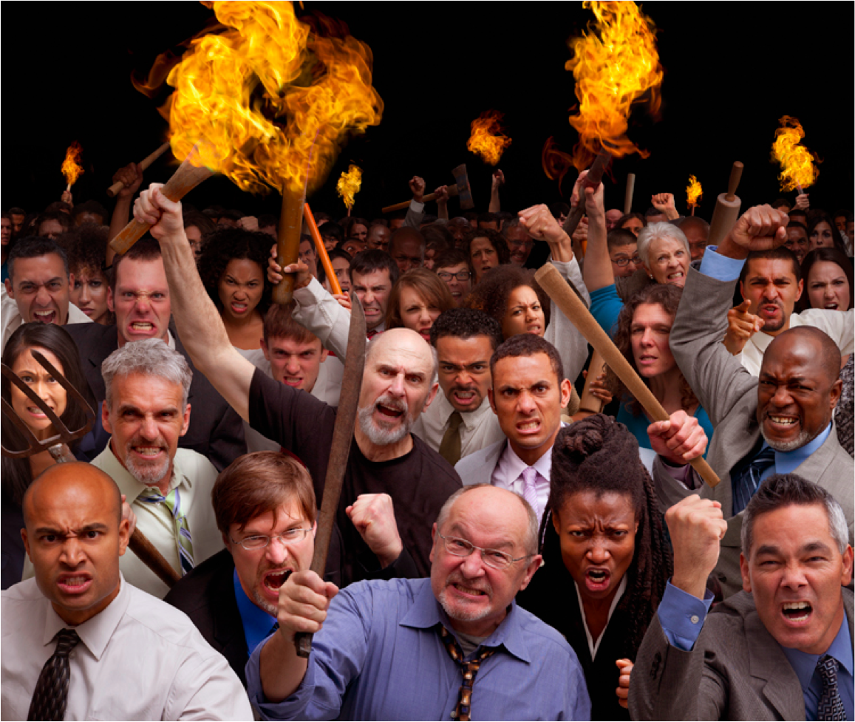
The Problem
The problem for humanity is not that we have skin but that we are sinners.
Our final enemy is not death or the body but sin.

Slide 53
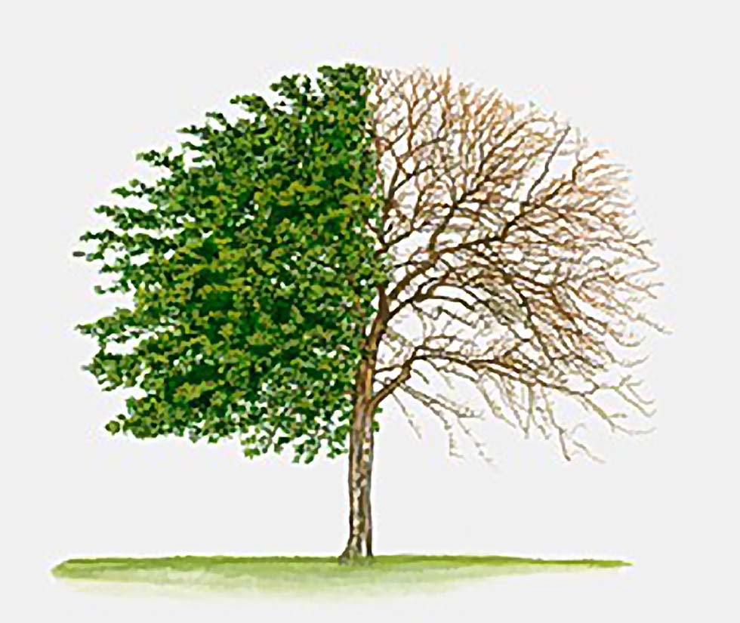
Transformed
And we eagerly await a Savior from there, the Lord Jesus Christ, who, by the power that enables him to bring everything under his control, will transform our lowly bodies so that they will be like his glorious body.
- Philippians 3:20-21

Slide 54
Resurrection
Jesus was the prototype
Jesus is the resurrection
It includes redemption of the body
It is transformational
It will restore the whole creation

Slide 55
Creation Restored
For the creation waits in eager expectation for the children of God to be revealed. ²⁰ For the creation was subjected to frustration, not by its own choice, but by the will of the one who subjected it, in hope ²¹ that the creation itself will be liberated from its bondage to decay and brought into the freedom and glory of the children of God.
We know that the whole creation has been groaning as in the pains of childbirth right up to the present time.
- Romans 8:19-23

Slide 56
Renewal of all things
Jesus said to them, “Truly I tell you, at the renewal of all things, when the Son of Man sits on his glorious throne, you who have followed me will also sit on twelve thrones, judging the twelve tribes of Israel. – Matthew 19:28

Slide 57
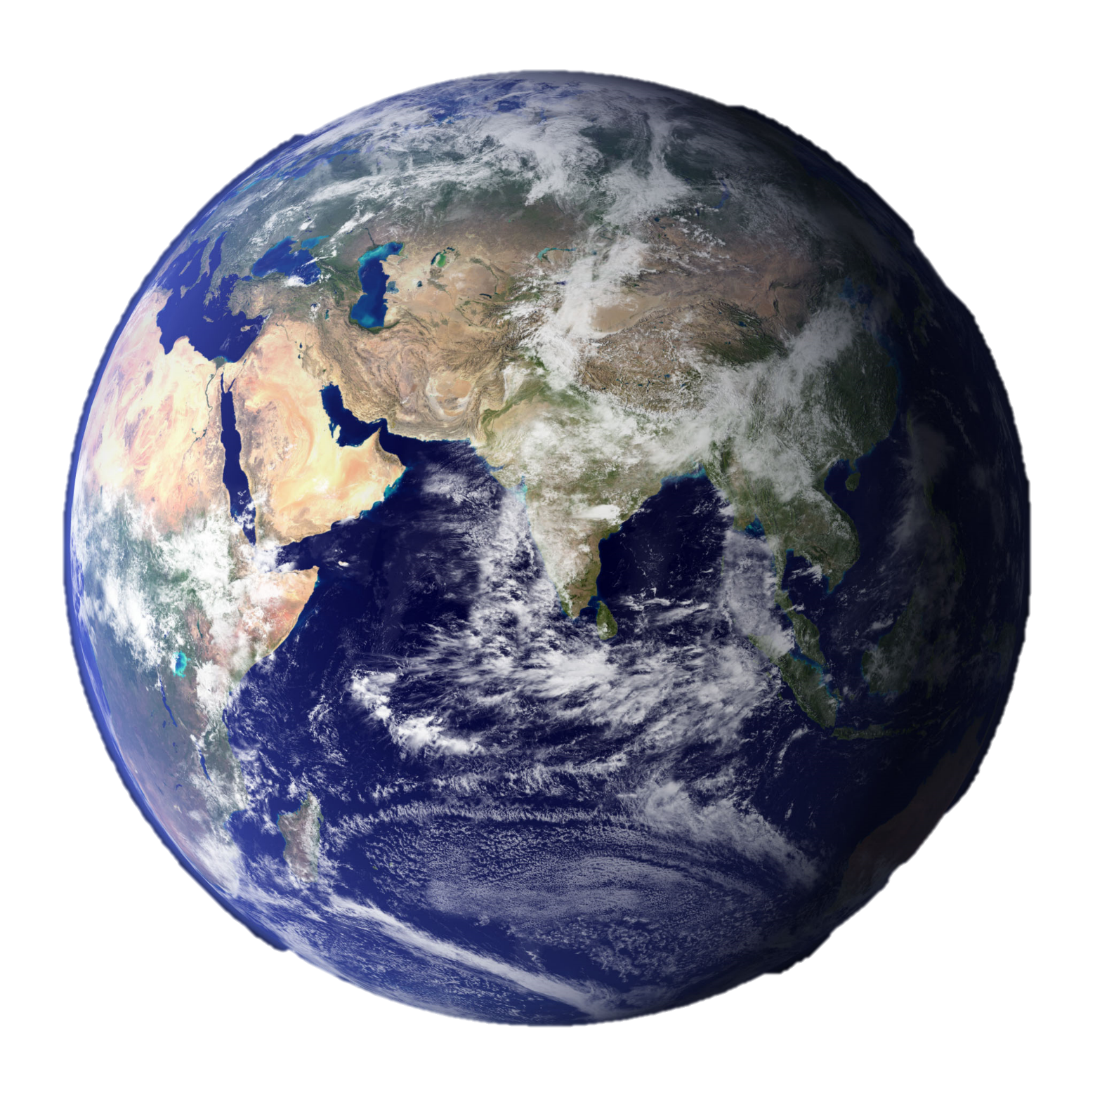
The Earth
Blessed are the meek, for they will inherit the earth.
- Matthew 5:5

Slide 58
Restoration
Heaven must receive [Jesus] until the time comes for God to restore everything, as he promised long ago through his holy prophets.
- Acts 3:21

Slide 59
Restoration
He who was seated on the throne said, “I am making everything new!”
- Revelation 21:5

Slide 60
2 Peter 3:10-11
But the day of the Lord will come like a thief. The heavens will disappear with a roar; the elements will be destroyed by fire, and the earth and everything done in it will be laid bare.
Since everything will be destroyed in this way, what kind of people ought you to be? You ought to live holy and godly lives

Slide 61
2 Peter 3:10
The heavens will disappear
(move forward)

Slide 62
2 Peter 3:10
the elements
Colossians 2:8 – See to it that no one takes you captive through hollow and deceptive philosophy . . . And the elemental spiritual forces of this world rather than on Christ.
[See also Col. 2:20; Gal. 4:3, 9; Heb. 5:12)

Slide 63
2 Peter 3:10
will be destroyed
By these waters also the world of the that time was deluged and destroyed – 2 Peter 3:6
“Destroyed” = Cleansed or Purged

Slide 64
2 Peter 3:10
by fire
To the Israelites the glory of the LORD looked like a consuming fire on tope of the Mountain. – Ex. 24:17
[See also Deut. 4:24; Heb. 12:29]

Slide 65
2 Peter 3:10
and the earth and everything done in it will be laid bare.
As in “disclosed” or “found out”

Slide 66
2 Peter 3:10-11
The heavens will move forward with a roar; the principles of the world will be purged by the consuming fire and the earth and everything done in it will be found out.
Since everything will be purged in this way, what kind of people ought you to be? You ought to live holy and godly lives as you look forward to the day of God and speed its coming.

Slide 67
2 Peter 3:15-16
Bear in mind that our Lord’s patience means salvation, just as our dear brother Paul also wrote you with the wisdom that God gave him. He writes the same way in all his letters,
speaking in them of these matters.

Slide 68
Resurrection
Jesus was the prototype
Jesus is the resurrection
It includes redemption of the body
It is transformational
It will restore the whole creation
Anticipate resurrection

Slide 69
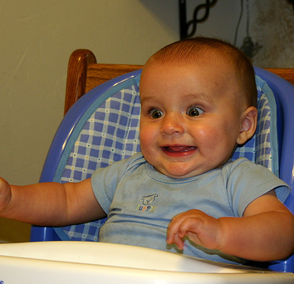
Waiting
But our citizenship is in heaven. And we eagerly await a Savior from there, the Lord Jesus Christ.
- Philippians 3:20

Slide 70
It’s coming
Praise be to the God and Father of our Lord Jesus Christ! In his great mercy he has given us new birth into a living hope through the resurrection of Jesus Christ from the dead, and into an inheritance that can never perish, spoil or fade. This inheritance is kept in heaven for you, who through faith are shielded by God’s power until the coming of the salvation that is ready to be revealed in the last time.
- 1 Peter 1:3-5

Slide 71
1 Thessalonians 4:17
After that, we who are still alive and are left will be caught up together with them in the clouds to meet the Lord in the air. And so we will be with the Lord forever.

Slide 72
1 Thessalonians 4:17
Clouds
I am going to come to you in a dense cloud - Exodus 19:9
the glory of the Lord settled on Mount Sinai. For six days the cloud covered the mountain, and on the seventh day the Lord called to Moses from within the cloud. - Exodus 24:16

Slide 73
1 Thessalonians 4:17
Meet the Lord
At midnight the cry rang out: ‘Here’s the bridegroom! Come out to meet (apantesis) him!’ … The virgins who were ready went in with him to the wedding banquet. And the door was shut. – Matthew 25:6, 10
And so we came to Rome. The brothers and sisters there had heard that we were coming, and they traveled as far as the Forum of Appius and the Three Taverns to meet (apantesis) us. At the sight of these people Paul thanked God and was encouraged. When we got to Rome, Paul was allowed to live by himself, with a soldier to guard him. – Acts 28:14-16

Slide 74
1 Thessalonians 4:17
In the Air
The lower surface atmosphere as opposes to the higher air in the sky they were shouting and throwing off their cloaks and flinging dust into the air – Acts 22:23
I do not fight like a boxer beating the air. – 1 Corinthians 9:26
[See also 1Cor. 14:9; Ephesians 2:2]

Slide 75
1 Thessalonians 4:17
After that, we who are still alive and are left will be caught up together with them in God’s presence to meet and escort the Lord into our space. And so we will be with the Lord forever.

Slide 76
Ephesians 1:8-10
With all wisdom and understanding, he made known to us the mystery of his will according to his good pleasure, which he purposed in Christ, to be put into effect when the times reach their fulfillment—to bring unity to all things in heaven and on earth under Christ.

Slide 77
2 Corinthians 5:1-5
…if the earthly tent we live in is destroyed,
we have a building from God, an eternal house in heaven, not built by human hands.
Meanwhile we groan, longing to be clothed with our heavenly dwelling, because when we are clothed, we will not be found naked.
For while we are in this tent, we groan and are burdened,
Present age
Waiting in heaven
Age to come

Slide 78
2 Corinthians 5:1-5
because we do not wish to be unclothed
but to be clothed with our heavenly dwelling, so that what is mortal may be swallowed up by life.
Now the one who has fashioned us for this very purpose is God, who has given us the Spirit as a deposit, guaranteeing what is to come.
Present age
Waiting in heaven
Age to come

Slide 79
2 Corinthians 5:6-8
Therefore we are always confident and know that as long as we are at home in the body we are away from the Lord.
{While in the present age we are not with the Lord}
For we live by faith, not by sight.
{We live as though we really believe that we will be resurrected}
We are confident, I say, and would prefer to be away from the body and at home with the Lord.
{Don’t misunderstand the earlier point about desiring to not be naked; phase 2 is still desirable compared to phase 1—it’s just not the final hope}

Slide 80
Stage 1 – The Present Age
If the earthly tent we live in is destroyed
- While we groan in this tent we are burdened
We long to be clothed
We are given the Spirit guaranteeing the next two phases
While in the body in this age we are away from the Lord
We live by faith and not by sight
Stage 2 – The Intermediate Phase
We wait for resurrection so as to not be found naked
We do not wish to be unclothed [as our final state]
This phase is still preferable to the present age, but is not the final hope
Stage 3 – The Resurrection Age
- We have a building from God, an eternal house in heaven, not built by human hands.
Will not be naked
Wish to be clothed with our heavenly dwelling, so that what is mortal may be swallowed up by life.

Slide 81
The Implications of a Resurrection Worldview

Slide 82
Resurrection Worldview
It better informs how we live now.
1 Cor. 15:58
Romans 13:11-14
It demands death

Slide 83
What would you do if this was the future? Start living as though it really was!
Notes:
May require more than one slide

Slide 84
Resurrection Worldview
It removes the fear of death and persecution

Slide 85
Different View of Death
Since the children have flesh and blood, he too shared in their humanity so that by his death he might break the power of him who holds the power of death—that is, the devil—and free those who all their lives were held in slavery by their fear of death. – Hebrews 2:14-15
Since then, there is certainty as to the resurrection of the dead, grief for death is needless. . . For why should you grieve, if you believe that your loved one has not perished? . . . We wound Christ when we do not accept with equanimity the summoning out of this world of anyone by Him, as if they were to be pitied.” – Tertullian, c. 210

Slide 86
Resurrection Worldview
It is the evidence of our faith
Hebrews 11:1

Slide 87
Resurrection Worldview
It makes even more sense of baptism

Slide 88
Resurrection Worldview
It combats the “wonderful plan for your life” theology
Notes:
Teaches people to die now, not have your best life

Slide 89
Resurrection Worldview
It brings clarity to we view political, environmental, and social issues

Slide 90
Resurrection Worldview
7. It addresses post modern concerns
It combats the escapist mentality
and Casper the friendly ghost worldview
Notes:
LGBT issues
Actions over words

Slide 91
Resurrection Worldview
8. Gives meaning to evil, struggle, and trial
Notes:
LGBT issues
Actions over words

Slide 92
Resurrection Worldview
9. It changes the
world, now!
Notes:
LGBT issues
Actions over words

