Slide 1
Ethical Answers in an Unethical World
What is Truth?
John Oakes, PhD
Singapore
June 10, 2015
Christian and Other World Views

Slide 2
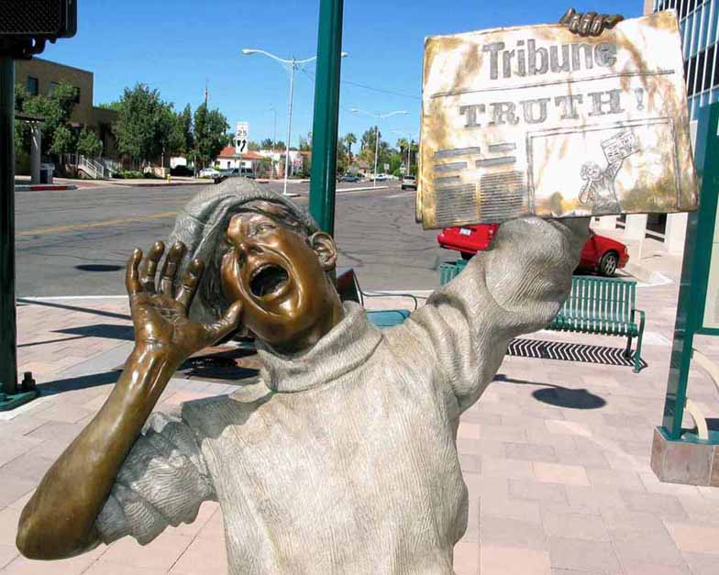
Jesus Christ: “I came to testify to the truth.”
Pontius Pilate: “What is truth?”

Slide 3
The Problem as I See It
The Secularization of Culture
The Loss of Morality
The Loss of God
The Loss of the Intellectual High Ground at the University to Non-Believers.

Slide 4
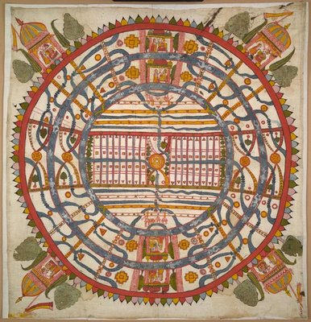
World View
One's world view is the perspective one uses to process and interpret information received about the world.
James W. Sire put it this way, "A world view is a set of presuppositions (ie. assumptions) which we hold about the basic makeup of our world."
James W. Sire, The Universe Next Door (InterVarsity Press, 1997)
A Jain World View

Slide 5
A “Good” World View Defined
A. It is true.
It is consistent with reality. It works.
B. It answers satisfactorily the questions people really want answered.
What is prime reality/the ultimate cause/the nature of God?)
What is my value as a human being?
What happens to a person at death?
How do we know what is right and wrong?
What is my purpose?
What is the nature of my relationship, with the "prime reality?"
C. It causes those who hold to it to be better people than they would otherwise have been if they held to competing alternative world views.

Slide 6
The Hard Questions
Evil: What is Evil and Why is There Evil
Why is There Suffering?
The Problem of Justice
The Problem of Sin.
The Problem of Death.

Slide 7
Competing World Views
Naturalism
Postmodernism: No World View
Pantheism
Animism/Polytheism
Dualism
Islamic Worldview
Biblical Theism

Slide 8
One Point of View:
“Wide is the gate and broad is the road that leads to destruction, and many enter through it. But small is the gate and narrow the road that leads to life, and only a few find it.” -Jesus of Nazareth (Matthew 7:13-14)
I am the way, the truth and the life. No one comes to the Father except through me. Jesus of Nazareth (John 14:6)

Slide 9
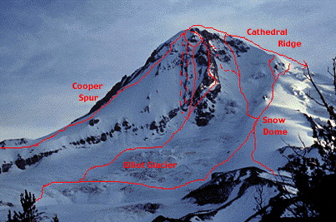
Another Point of View: Different Paths to the Same Goal?
God
Islam
Ba’hai
Mysticism
Buddhism

Slide 10
Materialism
“We exist as material beings in a material world, all of whose phenomena are the consequences of material relations among material entities." In a word, the public needs to accept materialism, which means that they must put God in the trash can of history where such myths belong.”
Richard Lewontin
Retrospective essay on Carl Sagan in the January 9, 1997 New York Review of Books,

Slide 11
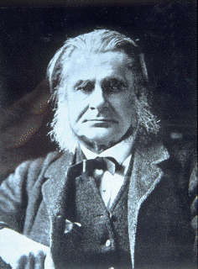
Thomas Huxley, Darwin’s “bulldog”
“We are as much the product of blind forces as is the falling of a stone to earth, or the ebb and flow of the tides. We have just happened, and man was made flesh by a series of singularly beneficial accidents.”

Slide 12
Richard Dawkins
In the universe of blind physical forces and genetic replication, some people are going to get hurt and other people are going to get lucky: and you won’t find any rhyme or reason to it, nor any justice. The universe we observe has precisely the properties we should expect if there is at the bottom, no design, no purpose, no evil and no good. Nothing but blind, pitiless indifference. DNA neither knows nor cares. DNA just is, and we dance to its music.

Slide 13
#1 Is Materialism True?
Circular Reasoning
Science presupposes
1. The universe is ordered
2. Humans are rationally capable of understanding the universe
3. The universe is governed by mathematics.
None of these are observable. Therefore, by the tenets of materialism, science is no real.

Slide 14
Circular Reasoning
“To say with the radical empiricist (ie the determinist) that only factual statements have validity is to be not only dogmatic, but self-contradictory, since the statement itself is not factual.”
“By implicitly undercutting the validity of rational thought, the modern naturalists render meaningless and self-contradictory all they have to say.”
“Science is a good servant but a bad master.”
Michael D. Aeschliman

Slide 15
A recent BBC broadcast forum:
Questioner: How do you know that physical reality is all there is: that there is no God?
Response of a vehement materialist (after much prodding): I simply believe it to be true.
Questioner: Well, now we at least have it out on the table!
In other words, the strongest argument I have that physical reality is “all there is” is that I believe physical reality is “all there is.”

Slide 16
If Scientific Materialism is True, Then…
“I” do not exist
I am a body. I do not have a body
Human consciousness is an illusion—an epiphenomenon
Love is just neurotransmitters and neurons firing
Logic is meaningless
Belief in God is irrational—the unfortunate accidental result of an evolutionary process
No soul, spirit “Man is a soulless ticking mechanism”
“Thoughts come out of the brain as gall from the liver or urine from the kidneys.”
Karl Vogt

Slide 17
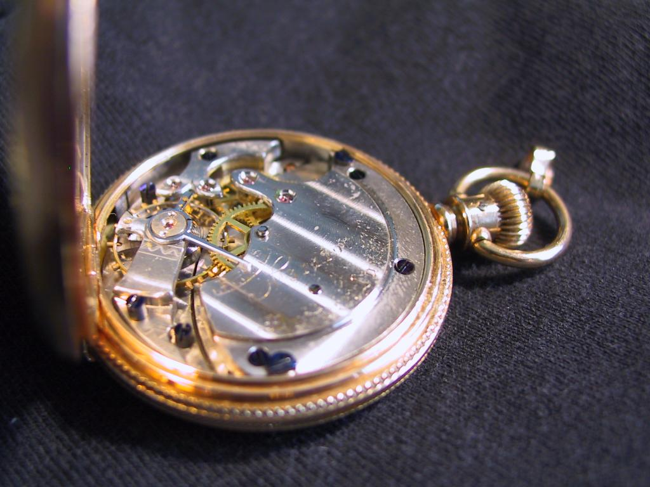
More Reasons Philosophical Naturalism is Not True
The universe was created.
The anthropic principle works. Apparent design.

Slide 18
Is Materialism True?
Does the Materialist World View correspond with a common sense understanding of the world
A resounding NO!

Slide 19
#2 Does Materialism Adequately Answer the Questions Humans Care About?
Questions science is good at answering:
When?
Where?
How many?
Why (small w)? By what means
Does anyone care about these questions?

Slide 20
Questions Science is Very Bad at Answering:
Why does the universe exist?
Why am I here? What is my purpose?
What is my value?
Is that the right thing to do?
Does God exist?
Do supernatural things happen?
“Religion without science is lame, but science without religion is blind.”
A. Einstein

Slide 21
Answers From Naturalism:
What is my value? $3.49
What is my purpose? To create as many copies of my DNA as possible.
Does God exist? No! How do you know? Because I said so!
Is there a supernatural? Same answer.
Does Determinism adequately answer the questions human beings care about? You decide.

Slide 22
#3 Does Naturalism Make Us Better People?
No good, no evil.
No objective reason to do good.
Is sex with animals bad?
Violence, racism and genocide are not evil and perhaps are justified.
Justice is a meaningless word.
No basis for human rights.
“In the end all corruption will come from the natural sciences.” “We are happy to let science deal with plants and animals and stars, but to handle the spirit of man in such a fashion is blasphemy” Kierkegaard

Slide 23
By the Way, the Experiment Has Been Tried
French Revolution
Marxism
Soviet Russia
Red China
Pol Pot
In the words of Mark Wilkinson: “How’s that working for you?”

Slide 24
Conclusion
Science is not the enemy. Scientism/Naturalism is.
We need to confront the “enemy” (and love him/her, by the way) by asking questions—by asking them to honestly consider the implications of their presuppositions.
Our example counts for more than our arguments

Slide 25
Hindu World View
Maya. The physical world is an illusion.
Brahman. Universal soul.
The goal: Nirvana; oneness with the universal soul which is within yourself.
The Hindu world view has man looking inward, not outward.

Slide 26
The Hindu World View
■ “There is no holy life. There is no war between good and evil. There is no sin and no redemption. None of these things matter to the real you. But they all matter hugely to the false you, the one who believes in the separate self. You have tried to take your separate self, with all its loneliness and anxiety and pride, to the door of enlightenment. But it will never go through, because it is a ghost.”
―Deepak Chopra

Slide 27
Hinduism and Time
Time is cyclic. There is a “wheel of time.”
World is cyclically created by Brahma, sustained by Vishnu and destroyed by Shiva.
Creative/destructive cycles called Yugas

Slide 28
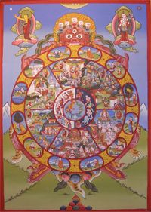
Hindism and Time (cont)
One full cycle = 100 “Brahma years” 311 trillion years.
Then Brahma himself dies and is reborn

Slide 29
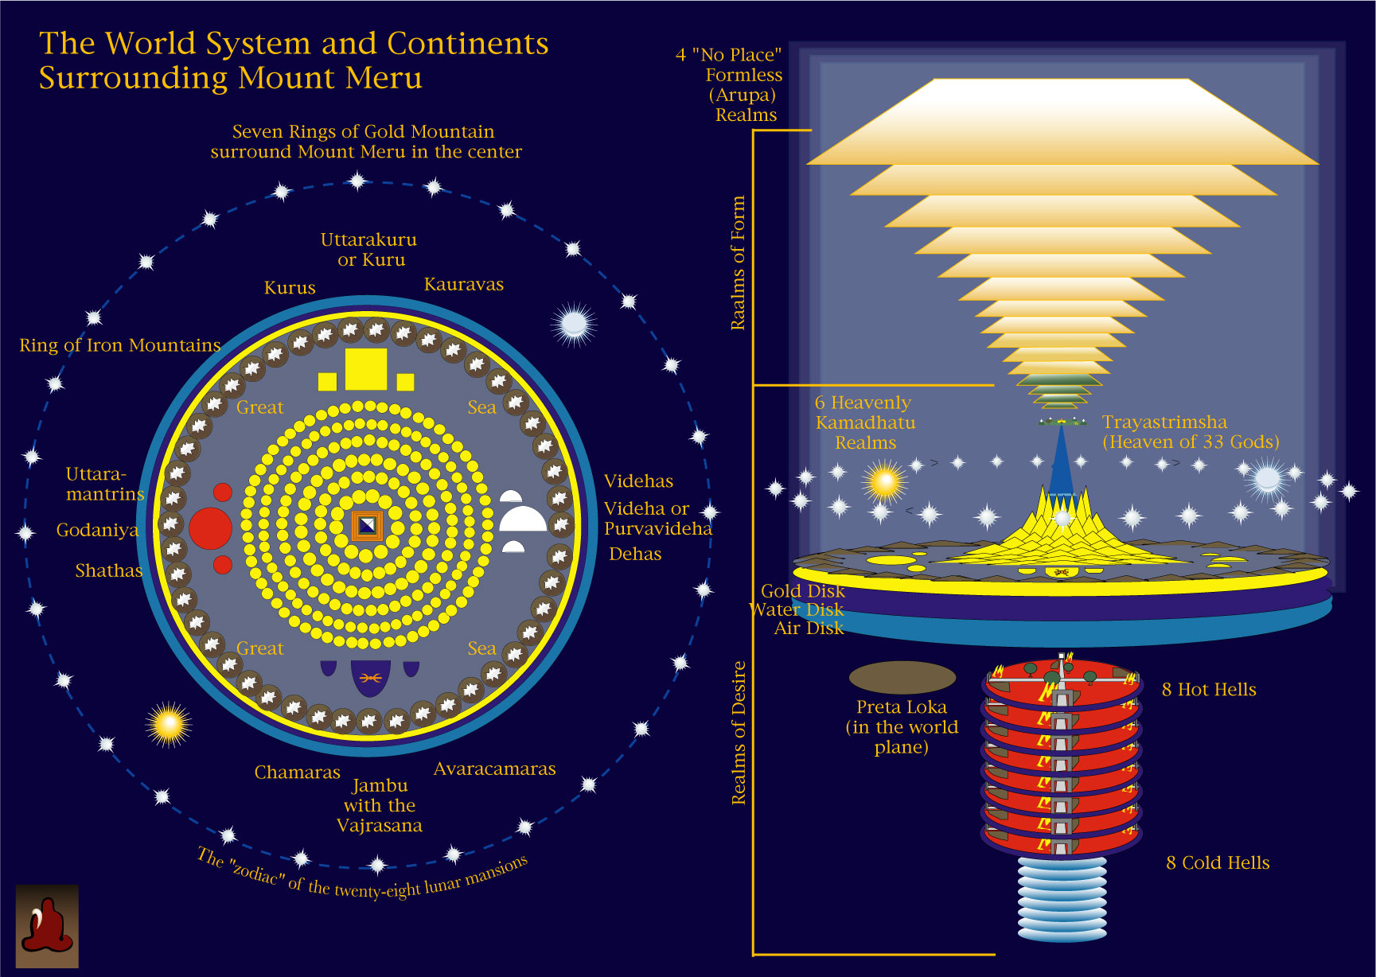

Slide 30
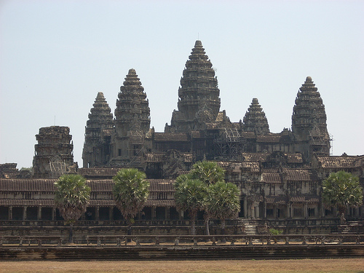
Angkor Wat: Mount Meru

Slide 31
Is The Hindu World View a Good One?
Is it true?
Hindu cosmology (cycles of creation, destruction and rebirth, eternal universe) is patently false.
The physical world is real and it is good.
Evil is NOT an illusion
Does it answer the important questions?
It does better than postmodernism or naturalism!
Purpose: To cease to exist.

Slide 32
Is Hinduism/Pantheism a Good World View?
Does accepting this world view make one a better person?
Better than naturalism.
Self-focus and dispassion are not helpful.
Suffering is not real.
Christian groups do the majority of benevolent work in
India
Evil is not real. What is the effect of this belief?

Slide 33
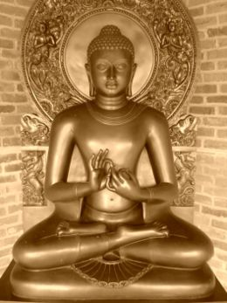
The Buddhist World View
The Four Noble Truths:
Suffering is not getting what one wants.
The cause of suffering is desire which leads to rebirth.
The way to end suffering is to end desire.
The way to the end of desire and of suffering is the eight-fold path.

Slide 34
The eight-fold path to bodhi/dharma/nirvana/lack of suffering
Right viewpoint (the four noble truths).
Right values.
Right speech.
Right actions.
Right livelihood
Right effort
Right mindfulness
Right meditation
Hard to argue with these values.

Slide 35
Other Buddhist Ideas
Buddha claimed to be agnostic, but his world view was clearly pantheistic.
Physical things are illusion.
Evil is not real.

Slide 36
Buddhist Cosmology
Like Jaina, Hinduism, a vertical cosmology, with multiple levels/earths/heavens/lokahs
31 planes of existence, each with 3 realms.
Higher ones more blissful, lower ones more like hell.
Endless cycle of time Cosmic wheel.

Slide 37
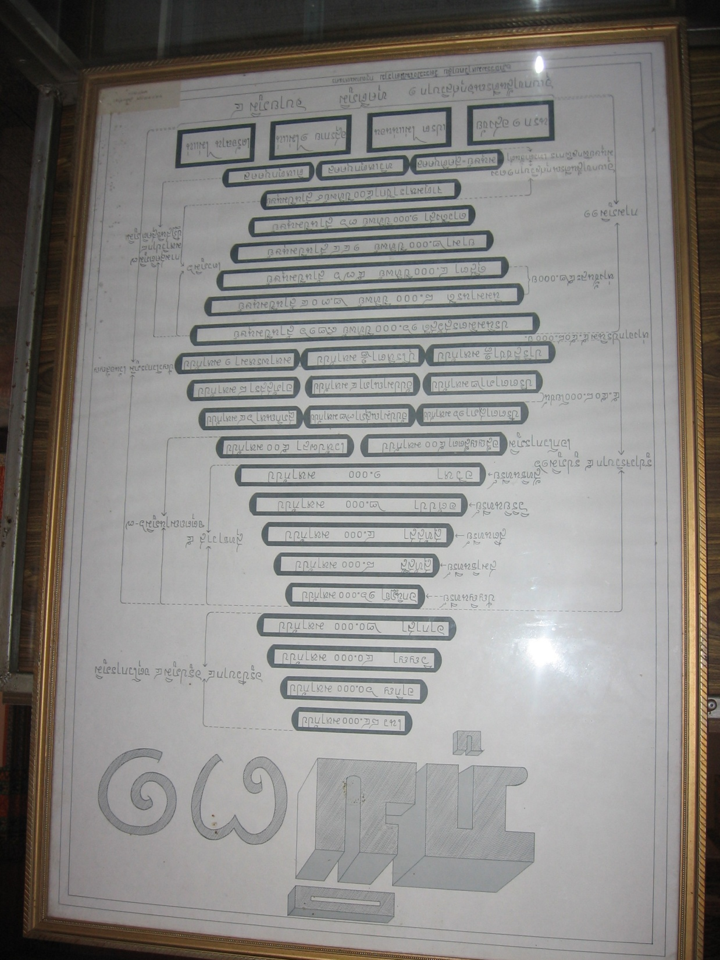
Buddhist Cosmology
Notes:
37

Slide 38
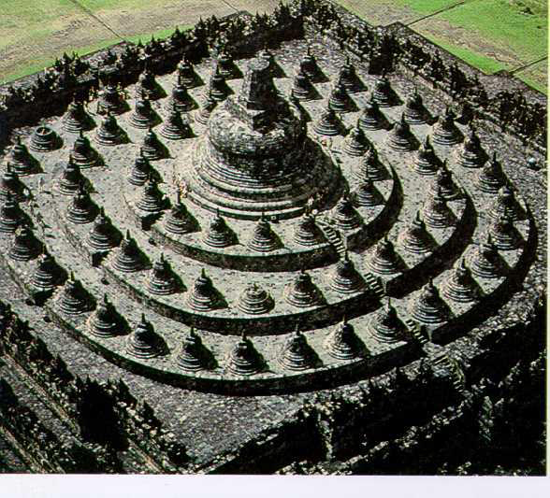
Borodbur in Indonesia: A Buddhist concept of the world

Slide 39
Is The Buddhist World View a Good One?
Is Buddhist Cosmology true?
Is matter illusion?
Purpose of life: To lose oneself and to become dispassionate.
A better person?
Less self-focused than Hinduism
Dispassion: Christians do a majority of the benevolent work in Buddhist countries.

Slide 40
Islamic Worldview:
Monotheistic, of course
God is very distant from mankind
In Islam, Allah determines everything, even who will choose to follow him.
Sura 2:142, 6:39 6:125
Inshallah God willing. It is God’s will that people suffer.
.

Slide 41
Islamic Theology
“Surely good deeds take away evil deeds” (11:114).
Salvation by own effort
(40:9, 39:61, 7:43)
Charity atones for sins
(2:271,277)
Earn grace.
Earn favor of Allah.
Earn salvation.
Earn paradise.

Slide 42
Salvation by own effort
(40:9, 39:61, 7:43)
Charity atones for sins
(2:271,277)
Earn grace.
Earn favor of Allah.
Earn salvation.
Earn paradise.

Slide 43
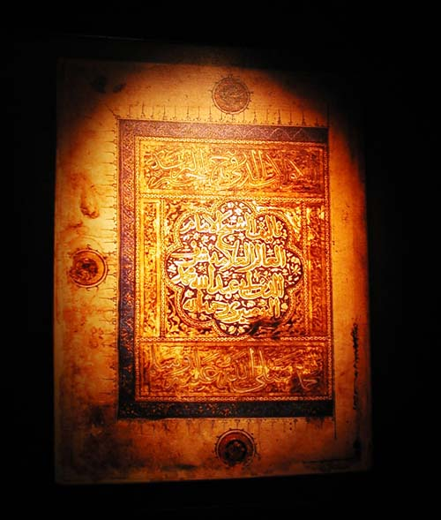
Sura 23:102-103
Those whose balance of good deeds is heavy, they will be successful. But those whose balance is light will be those who have lost their souls

Slide 44
Islam: Salvation is earned through the efforts of those who were pre-selected by Allah to inhabit a very sensual paradise.
Christianity: Salvation is granted by the grace of a loving God to those who, through faith and repentance and baptism accept that love.

Slide 45
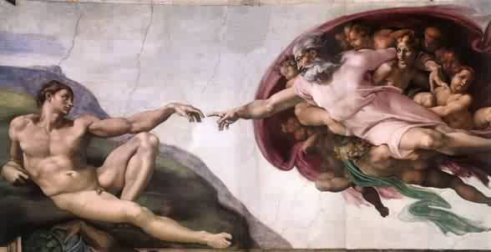
A Question: Who reaches out to whom?

Slide 46
Initiative
Human approach Truth
God God
Mankind Mankind

Slide 47
Works Salvation: Man reaches out to God.
Islam
Hinduism
Jaina
Sikkhism
Gnosticism
New Age
Buddhism?
Salvation by Grace: God reaches out to man.
Judaism
Christianity

Slide 48
The 5 Pillars of Islam
Recite the profession of faith: “There is no God but Allah, Mohammed is his prophet.”
Pray five times a day
Pay the tax for the poor
Fast during Ramadan
Do the Hajj (the pilgrimage)

Slide 49
Is the Islamic World View a Good One?
Is it true?
Like Christianity, it is in reasonably good correspondence
with reality.
Does it give satisfactory answers to the important questions?
Better that pantheism, dualism, naturalism…
Does it make one better than other world views?
Alms only for Muslims
Fate/Predestination. God is the source of suffering and
even evil.

Slide 50
Is Islam a Good World View?
Is it true? Is Mohammed a prophet?
Fifteen wives
Massacre of 700 Jews
Doctrine of Abrogation
Science errors
Does it make its followers better?
Motivation to help others?
Are women respected?
Does emphasis on Jihad lead to loving non-Muslims?

Slide 51
Qur’an and Jihad
“Wage war on them until the infidels are no more and Allah’s religion reigns supreme.”
8:12 Cut off their finger tips, stab them in the neck.
48:16,17 Atone for sin by killing in war.
47:4-6 Martyrdom → Heaven.

Slide 52
The Christian World View
1. The physical world is: a. real b. created out of nothing (ex nihilo) and c. essentially good.
2. There exists an unseen spiritual reality which is not limited to or defined by the physical reality. Human beings have a spiritual aspect to their nature.
3. The creator of both the physical and spiritual realm is the God who reveals himself in the Bible.
4. Human beings have both a physical and a spiritual nature, The spiritual nature is more essential as it is eternal.
5. God is not easily defined but he can be characterized by certain qualities. God is a person. God is love, God is just, God is holy, God is omniscient, omnipotent and omnipresent.

Slide 53
The Christian World View (cont.)
6. Although all God’s creation, is good, evil does exist. Such evil is the result of freedom of will given to created beings and their subsequent decision to use that freedom to rebel--to “sin”
7. Because of God’s justice and his holiness, those who choose to rebel against him will ultimately be judged and separated from God for eternity.
8. The solution to evil, to sin and its eternal consequences is provided by God through the atoning substitutionary sacrifice of Jesus Christ.

Slide 54
The Christian World View
1. Is it true that the universe was created, that evil is real, that there is both a physical and spiritual reality?
2. Why? Because of God
Purpose? To know and be known by God
Value? More than the entire world
3. Are we made better?
Evil is real and is to be rejected.
Suffering: Compassion!
Abolition of slavery, science, human rights, etc.

Slide 55
Is it True?
Was the universe created from nothing?
Is creation good?
Is the universe understandable?
Is evil real?

Slide 56
The Assumptions of Science come from the Christian World View
Presupposition #1 The unchanging God is Creator of the physical universe.
Assumption of Science #1 There are natural laws that govern the real world. These laws do not change over time and space.
Presupposition #2 God created us in order to know us and that we can know him.
Assumption of Science #2 The world can be understood by human beings.
The real world is knowable and comprehensible.
There are laws that govern the real world.
Those laws don't [radically] change according to place or time
Those laws are governed by mathematics

Slide 57
No Christianity, No Science
Presupposition #3 God is a god of order and beauty
Assumption of Science #3 The Laws of Nature will be rational and they will obey mathematical laws.
All of these came from Roger Bacon

Slide 58
Basic Assumptions of Science
Assumptions are accepted without proof
They form the basis of all scientific thinking
In other words, the basic assumptions of science are derived from Christian theology and are accepted on faith.
None can be observed. Science is, in a sense, not scientific

Slide 59
Christianity Offers Solutions to the Big Problems of Human Beings
The Problem of Sin (the substitutionary death of Jesus)
Romans 7:24,25
The Problem of Suffering (compassion)
James 1:27 Micah 6:8
The Problem of Death
1 Corinthians 15:54-56

Slide 60
The Christian World View Has Given Us:
Science
Abolition of Slavery (Wilberforce)
Civil Rights
Women’s Rights
Christian groups do a majority of all benevolent work in the world (James 1:27, Micah 6:8)
Notes:
60

Slide 61
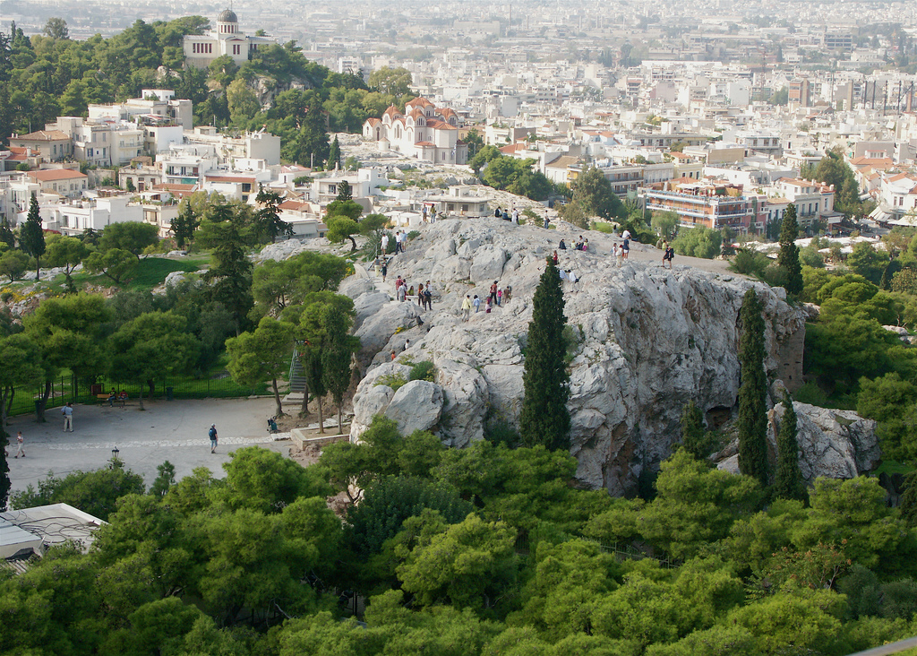
Engage the World Intellectually With the Christian World View
Acts 17:16-34
Paul in Athens
We need to confront the enemy in the Areopagus and in the Lecture Hall of Tyrannus
The Areopagus in Athens

Slide 62
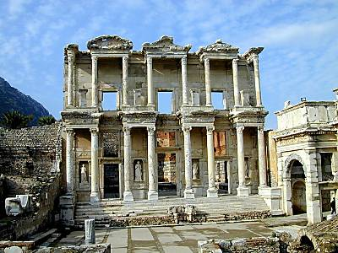
The Lecture Hall of Tyrannus

Slide 63
Acts 17:16-34 Paul confronts Greek World Views
God is Creator. He exists outside creation.
Disproves pantheism/Stoicism.
God is close to us.
Disproves deism/Epicureanism.
God is personal and has given us an individual purpose.
God will bring all of us to judgment. Evil will be defeated
Disproves dualism/Gnosticism.

Slide 64
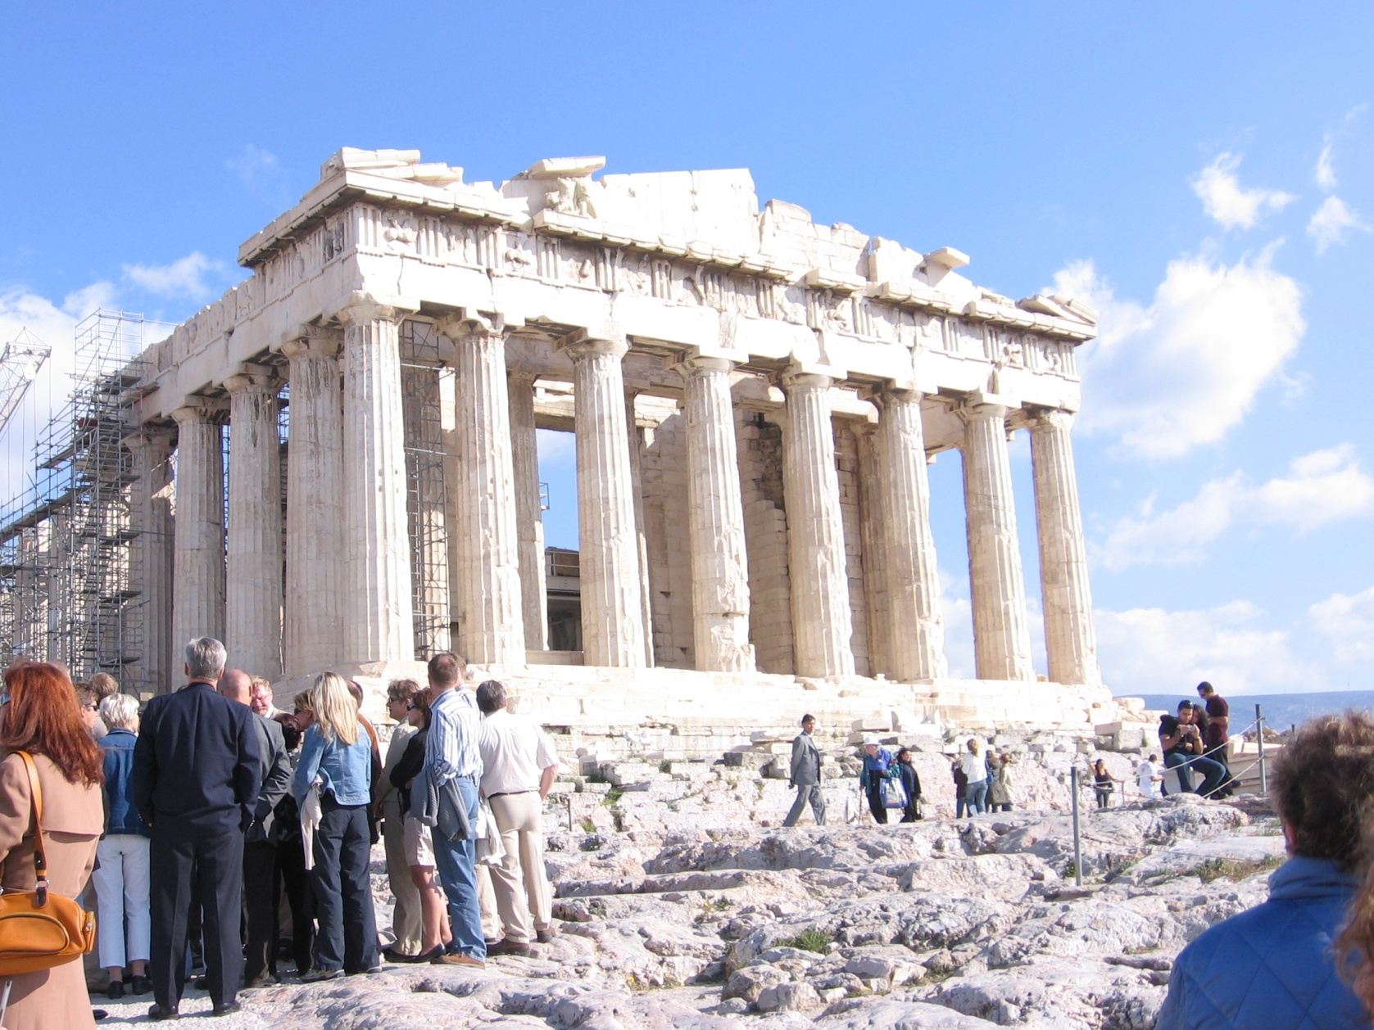
Paul Confronts Greek World Views

Slide 65
The Bible and Other World Views (cont.)
Acts 17:16-34 Paul shares the gospel by arguing for the Christian World View.
v. 22-23 Paul finds common ground.
v. 24-28 Paul argues for the superiority and the truth of the Christian world view as opposed to Epicureanism/pantheism and Stoicism/deism
v. 28 Paul quotes from Aretas a Stoic philosopher. “ For we are his offspring.”
v. 29-31 Having laid the groundwork, Paul points them to Jesus.
v. 32-34 Some, but not all were converted.

Slide 66
How, then, should we interact with members of other religions?
Find common ground.
Give respect where respect is due.
Acknowledge the good and do not make personal attacks—especially toward revered people.
Highlight distinctions in world view/theology and introduce them to Jesus Christ.
This is EXACTLY what Paul did in Acts 17:22-34

