Slide 1
Malachi: God’s Messenger

Slide 2
Malachi: God’s Messenger
Message: Faithful to God vs. Faith in God
Malachi = my messenger
Date of writing 458-432 BC
Malachi is God’s last word to the Jews. It is a capstone to the message of the Old Testament and a final preparation for the ministry of John the Baptist and of Jesus. The next word from God will be “Repent for the kingdom of heaven is near” (John the Baptist)

Slide 3
Background to Malachi
The earlier generation had repented, returned been restored and rebuilt. The new generation are becoming cynical and questioning that God has fulfilled his promise to restore and rebuild. They need personal repentance and restoration. Will they have faith in God or will they be faithful to God?
Socratic Style
God: You have robbed me.
People: How have we robbed you?
God: In tithes and offerings.

Slide 4
Outline of Malachi
Introduction: God still loves Israel. God has been faithful to Israel. 1:1-5
I The Priests have been unfaithful 1:6-2:9
II The People have been unfaithful 2:10-3:15
III The Day of the Lord is coming Malachi 3:16-4:6

Slide 5
Introduction: Malachi 1:1-5
God: I still love you. I have kept my covenant with you. I have been faithful to you.
God: I have loved you.
People: How have you loved us? Cynical. Do not feel that God has been faithful. God has not loved them the way they expected to be loved.
Jacob have I loved, Esau I have hated….
This sets the tone for the book. I have been faithful to you, will you be faithful to me (or will you merely have faith in me)?

Slide 6
I. The Priests have been unfaithful
It is you, O priests, who show contempt for my name.
Priests: Who,… Us?
How have we shown contempt?
Remember: We are the priests!
1 Pet 2:5,9 a royal priesthood
Exodus 19:6 A kingdom of priests.

Slide 7
Unfaithful priests
People: How have we shown contempt?
God: You place defiled food on my altar.
People: Who, us?
God: Yes, you. You have not show me the respect I deserve.
People: Who us? How?
God: You gave me your second best.
People: Oh……
God: Try offering that to your boss.

Slide 8
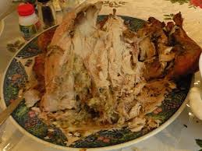
Unfaithful priests
Message: We can be religious, yet show complete contempt for God by giving Him our second best.
Faith: Giving something to God.
Faithful: Giving your very best to God.
Q: Do you give God your
left-overs?

Slide 9
Does God get your leftovers?
Malachi 1:9 Let’s reason together. Do you really feel that God should accept the second best?

Slide 10
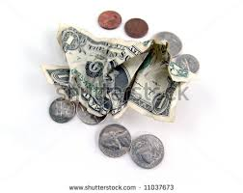
Unfaithful priests
Q: Is it better to give $5 or $0?
Malachi 1:10-11 God: Do me a favor. Leave your leftovers at home. Giving nothing at all is better than publicly disrespecting me.
My name will be great!!!!!

Slide 11
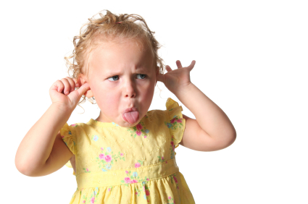
Unfaithful priests
Malachi 1:12-14 The key point:
Malachi 1:12 Have you “sniffed contemptuously” to God? People: How?
Malachi 1:13a “What
a burden.”
Zech 7:2-3

Slide 12
Unfaithful priests
Malachi 1:14 If you give your second best, God calls you a “cheat.”
God: I am a king and I expect to be treated as one.

Slide 13
Malachi 2:1-9 Warnings for priests
A. Malachi 2:1-4 If you give me the leftovers—if you do not honor me, I will smear your faces with your sacrifices. Wow!
Q: Is God being harsh here?
v. 4 It is about my covenant. God has been faithful to his covenant.
… this calls for reverence.

Slide 14
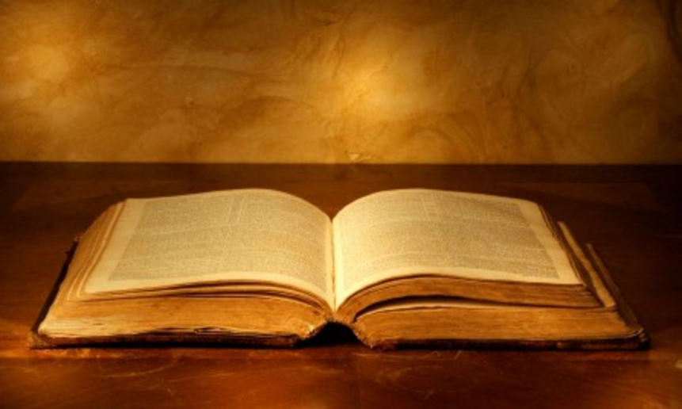
Malachi 2:1-9 Warnings for priests
Malachi 2:5-9. My priests have not taught my Word.
v. 6 true instruction
v. 7 preserve knowledge
Quoting Tyndale commentary: “Right behavior on the part of the people of Israel in covenant relationship with Jehovah was dependent on sound priestly instruction in the Torah and the virtuous example of the priests as covenant-keepers themselves.

Slide 15
II. Malachi 2:10-3:18 The people have been unfaithful
A. Malachi 2:10-16 Divorce as a sin and as a metaphor for unfaithfulness.
2:10 “Breaking faith” –unfaithful to one another is unfaithful to God.
2:14 You have “broken faith.” It is about covenant.
2:16 “I hate divorce.” God sees divorce as a kind of social violence against the wife and the people.

Slide 16
II. Malachi 2:10-3:18 The people have been unfaithful
B. Malachi 2:17 The people have stopped trusting in God’s love.
The people are accusing God of not living up to his side of the covenant. They do not trust God’s justice.

Slide 17
Malachi 3:1-5 The Day of the Lord Part I
Malachi 3:1 I will send my messenger (Malachi).
John the Baptist (Matthew 11:3, 10, 14)
The Lord you are seeking will come to his temple.
The messenger of the covenant whom you desire = The Messiah.
Malachi 3:2-5 Are you sure you want God to come?
The people will get what they are asking for (God to come) but not what they want (a free ride without judgment).

Slide 18
Malachi 3:6-15 The People have been unfaithful
Malachi 3:6-7 God: Return to me and I will return to you.
People: Who, me? I never left!!
Q: Can you leave God while still
attending church?

Slide 19
Malachi 3:6-15 The People have been unfaithful
Malachi 3:8 God: You have robbed me!
People: Who… Me?
v. 9 God: Yes, you. In tithes and offerings.
v. 10 Trust me in this….
It is not about money, it is about trusting God. It is about covenant
You are Stingy

Slide 20
The key question
Here is the key question of Malachi:
Do you really, in your heart of hearts, believe that if you put all your trust in God, that he will take care of you.
Do you feel that what God has for you is enough?
If so, then you will be faithful to God.

Slide 21
Malachi 3:6-15 The people have been unfaithful
Malachi 3:13
God: You have said harsh things against me.
People: I have????
God: Yes!!! When you said “it is futile to serve God.”
What am I getting out of this?
You have said that you do not believe that God will take care of you.
1 Timothy 6:6-10

Slide 22
III. The Day of the Lord Malachi 3:16-4:6
The Day of the Lord is a Day when God comes.
This is principally about end times, but it is also about the coming of John the Baptist and of Jesus.
3:16 A scroll of remembrance Rev 20:15 The book of life. v. 17 They will be mine.
v. 18 righteous vs evil will be clear.

Slide 23
Malachi 4 The Day of the Lord
The Day of the Lord will be either disaster or deliverance.
4:1 Disaster. stubble… root and branch…
4:2 Deliverance by the sun of righteousness
Jesus Christ.

Slide 24
Malachi 4:4-6 God’s final word to his people
1. Remember my law—remember Moses (v 4)
2. Be ready. I will send Elijah before that day. John the Baptist.
Matthew 17:11 “To be sure, Elijah comes and will restore all things.” Then the disciples understood that he was talking to them about John the Baptist.
Repent, Return, Restore, Rebuild All this is fulfilled in Jesus of Nazareth.

