Slide 1
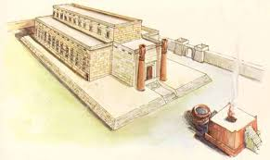
Solomon: Building God’s Temple
God Will Live In His People

Slide 2
An Outline of the Bible
I. Genesis 1 God created the universe and the earth. It was very good.
II. Genesis 2 God created man so that we could have an intimate relationship with him.
III. Genesis 3 and 4 We messed up very badly—destroying that relationship.
IV. Genesis 5-Rev 20 God is repairing the damage done by sin.
V. Rev 21-22 God has fixed the problem and we are back in a relationship with him.

Slide 3
Genesis 12, 15, 17 The torch is lit!
Genesis 12:2 I will make you into a great nation.
Genesis 12:3 All nations will be blessed through you.
Gen 13:15 I will give you this land.
Genesis 15:4-5 I will give you a son, and your offspring will be like the stars in the sky.
Genesis 17:6 Kings will come from you.

Slide 4
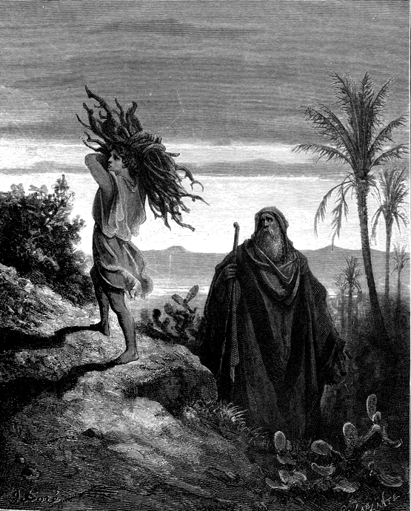
Abraham and Isaac The torch is passed to the son
Genesis 22:2-14
Take your son… your only son Isaac…
1 Cor 15:3-4 3rd day.
Heb 11:19 Figuratively, Abraham received is son on the 3rd day.

Slide 5
Genesis 49 The Torch is Passed to the Nation Israel Through Judah
Genesis 49:10-11
Scepter
Staff
“until the coming of the one whom all nations will obey”
Foal, colt
Wine, “blood of grapes”

Slide 6
Ruth: Gentiles in the Relay
Theme: The lineage of David. God is sending the Messiah
God’s providence in preserving the line of the Messiah
God uses the faith of a Gentile woman to work his plan. Matthew 1:5
Genealogy of David Ruth 4:13-21

Slide 7
David: The Messiah Will Be King
Born in Bethlehem
A very good shepherd
Anointed as king 1 Sam 16:13 The Spirit descended on David.
Physical king of Jerusalem. Jesus spiritual king of Jerusalem.
Brought the ark (brought God) to Jerusalem. So did Jesus!!!
Saved Israel from slavery to Philistia. Killed Goliath
Saved Israel by offering a sacrifice on Mt. Moriah. 2 Sam 24

Slide 8
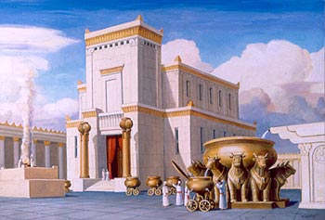
Solomon God Will Live in His Temple
1 Kings 2:1-4
To pass the torch:
Be strong.
Be a man.
Obey the Lord.
Walk by faith.

Slide 9
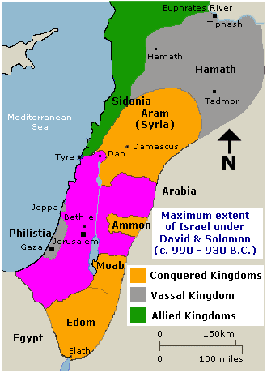
Solomon’s Kingdom about 940 BC

Slide 10
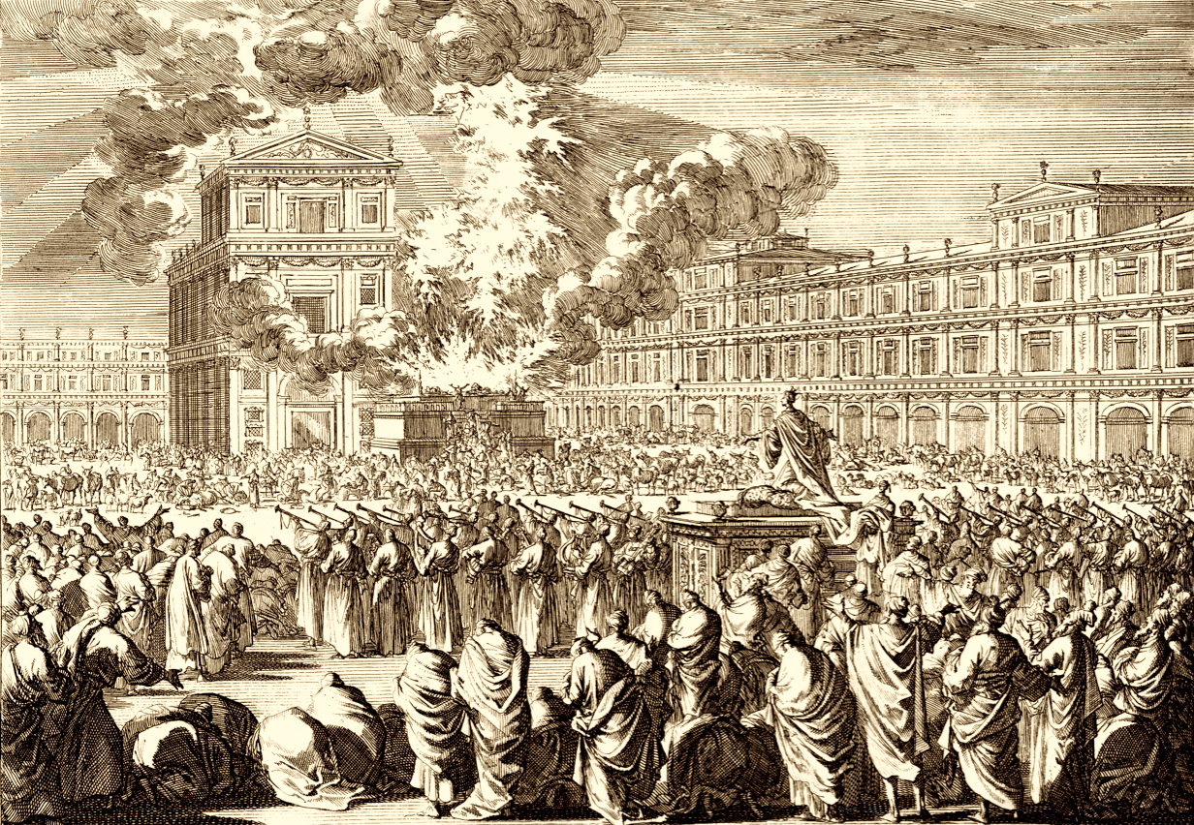
Solomon God Will Live in His Temple
1 Kings 3:1-14
1 Kings 8:6-27
Shekinah
God’s glory fills the
temple.
Will God really dwell
on earth????

Slide 11
Foreshadows Fulfilled in the New Testament
John 1:14 Jesus tabernacled among us.
1 Corinthians 3:16-17 We are God’s temple.
1 Corinthians 6:19 Therefore: Honor God with your body.
Hebrews 10:19-22 We have access.

