Slide 1
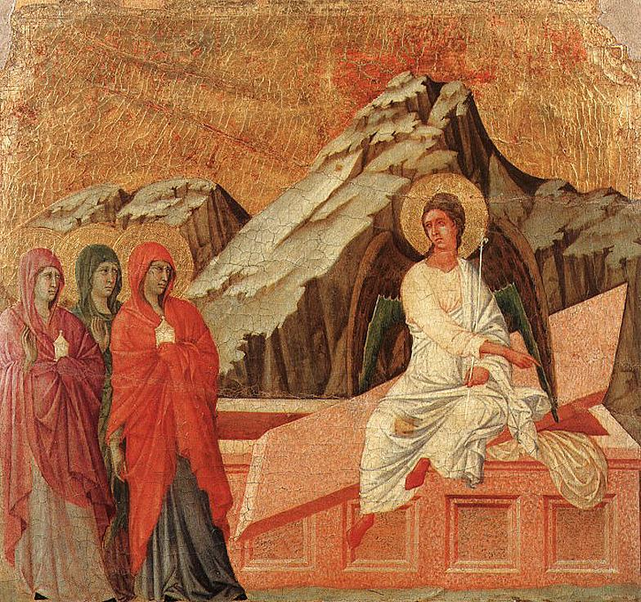
Apologetics Research Society Annual Conference York College, York, NE November 11-13, 2016
“A Postmodern Approach to Affirming the Historicity of the Resurrection”
Dr. Robert C. Kurka
Professor of Theology and Church in Culture
Lincoln Christian University

Slide 2
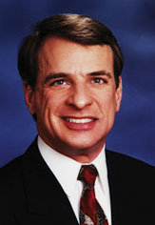
For many years, Christian apologists have argued for the historicity of Jesus’ Resurrection upon the evidence of THREE “INDESPUTABLE” FACTS
Empty Tomb
Post-Resurrection Appearances
Origin of the Christian Church
“If these three facts can be established and no plausible natural explanation can account for them, then one is justified in inferring Jesus’ resurrection as the most plausible explanation of the data.”
--William Lane Craig, Reasonable Faith [1994],272

Slide 3
Arguments that go something like this…
Empty Tomb
1. Joseph of Arimathea’s association with Jesus’ burial
2. Paul’s “50’s Testimony”—1 Cor. 15:3-5
3. Mark’s “Source Material”
4. Discovery by WOMEN (in the Gospels not in the Pauline kerygma)
5. Disciples preached the resurrection in Jerusalem (Acts 2:32; 3:15)—place of tomb
6. Early Jewish propaganda (cf. Matt. 28:11-15)

Slide 4
Post-Resurrection Appearances
1. 1 Cor. 15:3-8—Resurrected Jesus’ multiple appearances…notably “James”
2. The “Post-Resurrection Appearances” are part of the Christian confession some twenty-five years after Jesus’ death—too short a period for legend to arise
3. Physicality of these appearances—what accounts for these? Jewish Tradition? Culture?
Origin of the Christian Church
1. Origin of Church’s existence: Proclamation that “Jesus Christ is risen from the dead!” –Where did they get this message from?
2. Religious and cultural nonsense…unless something like this really occurred

Slide 5
However, a Postmodernist Historiography has changed the apologetic playing field..
“History is a shifting problematic discourse, ostensibly about an aspect of the world, the past, that is produced by a group of present-minded workers…who go about their work in mutually recognizable ways that are epistemologically, methodologically, ideologically and practically positioned and whose products once in circulation, are subject to a series of uses and abuses that are logically infinite but which in actuality generally correspond to a range of power bases that exist at any given moment and which structure and distribute the meanings of histories along a dominant-marginal spectrum.”
--Keith Jenkins, Re-thinking History [1991],70

Slide 7
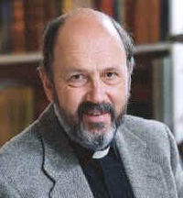
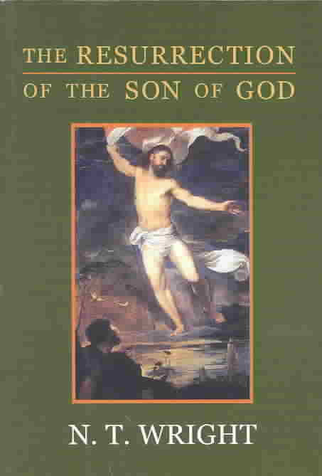
Which in turn produces the “Dominant Paradigm” for understanding Jesus’ Resurrection Source: N.T. Wright, The Resurrection of the Son of God [2003], 7
Jewish context provides only a fuzzy setting in which “resurrection” can mean a variety of different things
Earliest Christian writer, Paul, did not believe in a bodily resurrection but a more “spiritual” one
Earliest Christians did not believe in Jesus’ bodily resurrection but rather in his exaltation/ascension—a “going to heaven” in some capacity that was called a “resurrection”
Resurrection narratives in the gospels are late inventions designed to bolster a second-stage belief
Sightings of the resurrected Jesus are best explained in terms of a Paul-like conversion experience, internal to the subject and not a real external reality
Whatever happened to Jesus’ body (and some critics doubt if it even was buried), it certainly was not “resuscitated” or resurrected as a face value reading of the gospels would demand

Slide 8
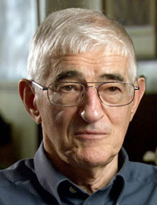
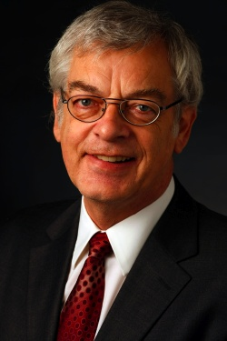
In short, the first two lines of “Resurrection Evidence” have been set aside…
Empty tomb is the invention of Christian leaders who have the “power” to establish the story which will support their religious faith
Post-Resurrection Appearances of Jesus are merely spiritual visions and mystical experiences
* Of course, beneath these two rejections is generally an anti-supernatural worldview that prohibits anything like a straight-forward reading of the biblical text

Slide 9
…but that still leaves critics to explain the origin and theology of the Christian Church
This third “fact,” then, becomes the new point of departure in addressing a postmodernist challenge
Origin and theology of Early Christianity becomes the chief “evidence” that in turn, that demands that critics revisit the empty tomb and post-resurrection appearances of Jesus and seriously consider their plausibility
Traditional Modern Model:
Empty Tomb→ Post-Resurrection appearances→ Christian Church
“New,” Postmodern Model:
Christian Church → Post-Resurrection appearances→ Empty Tomb

Slide 10
Two Key Concerns: 1. Emergence of a New, Distinctive, Christian Movement
1. A diverse, inclusive community of “Equals” in a very class-oriented world (cf. Gal. 3:28)
2. Distinctive sacraments: Baptism and the Lord’s Supper (focused in Christ’s death and resurrection [Parousia])
3. Distinctive day of corporate assembly and worship; i.e., First day of the week
4. “New” Biblical interpretation: Old Testament is now understood Christologically
5. Growing corpus of an additional authoritative Scripture; i.e., New Testament (cf. 2 Pet. 3:16)
5. Concept of a “suffering/dying” Messiah

Slide 11
2. …largely due to a new, distinctive doctrine of DEATH
The belief in Christ’s resurrection does not have parallels in antiquity…
1. Ancient Paganism (Greek)
a. Dead were beings that were once embodied human beings but are now souls, shades, or eidola
b. They existed mostly in Hades, but also in the Isle of the Blessed or Tartarus—essentially they lived in a different world
c. For the Greek philosophers (e.g., Platonists, Stoics), death was the welcome release of the soul from the body
d. For the Greek populace, though, death was seen as an all-powerful and frightening end to human existence

Slide 12
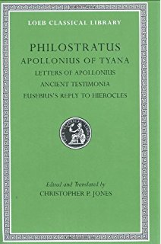
1. Ancient Greece
“The soul is immortal, and ’tis no possession of thine own; but of Providence; And after the body is wasted away, like a swift horse freed from its traces, It lightly leaps forward and mingles itself with the light air, Loathing the spell of harsh and painful servitude which it has endured. But for thee, what use is there in this? Some day when thou art no more thou shalt believe it. So why, as long as thou art living beings, does thou explore these mysteries?”
--Philostratus, Apollonius 8.30 [cited in Wright, 75]

Slide 13
2. Ancient Egypt
a. More positive view of death than the Greeks (and ancient cultures, in general) but primarily as a “progression” to a more fulfilling bodily existence in which the person would be identified with Osiris, god of the dead. After death, one would continue in a many-sided form of life
b. The only thing to be feared in this view was a “second death”
c. “Mummy” exhibited this belief that death was some continuation of the embodied life
d. “There was no eschatology, no apocalypse, no collective cataclysm, because there was crisis. Death was life.” (J. Davies, Death, Burial and Rebirth in the Religions of Antiquity; cited by Wright)

Slide 14
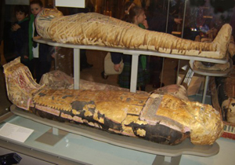
“This land which has no opponent—All our kinfolk rest in in it since the first day of time. They who are to be, for millions of millions, will all come to it. There exists none who may tarry in the land of Egypt; there is not one who fails to reach your place. As for the duration of what is done on earth, it is a kind of dream; (but) they say: ‘Welcome, safe and sound!’ To him who reaches the West.”
-- “The Good Fortune of the Dead,” in James A. Pritchard, Ancient Near Eastern Texts, 33-34

Slide 15
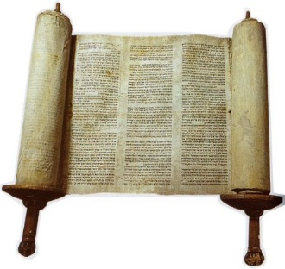
3. Old Testament
a. OT portrays a God who “breathes life” and is faithful to his Creation intentions and promises (Gen 3:15; 12:1-3). At the end of time, there will be a new heavens and earth (Isa. 65:17-25) – a reversal of the “Curse” (often in spite of Israel’s disobedience)
b. Unlike cultures around her which saw death as an “underworld” version of present human existence (e.g., Egypt), The OT viewed death as a temporal “sleep”(cf. “Then David rested with his ancestors…”—1 Kings 2:10) and/or an impermanent abode of the dead (Sheol). Death was not the final chapter of individual human life…or that of the Nation Israel. Resurrection would play that eschatological role
c. Two key ideas emerge in the OT concerning the future of the post-mordem state (“resurrection”): 1) Metaphorical: Corporate Israel would be raised from her Exilic skeletal state (Ezek. 37)
2) Literal: Individual human beings that are “awakened” from the state of death to a new bodily existence at the cosmic judgment( Dan. 12:2-3; cf. Isa. 24-27; 52-53)

Slide 16
“The he said to me: ‘Son of man, these bones are the people of Israel. They say: Our bones are dried up and our hope is gone; we are cut off.’ Therefore, prophesy: I am going to open your graves and bring you up from them; I will bring you back to the land y and say to them: ‘This is what the Sovereign LORD say: My people, I am going to open your graves and will bring you up from them; I will bring you back to the land of Israel.’’
--Ezek. 37:11-12 [NIV]

Slide 17
“But at that time your people—everyone whose name is found written in the book—will be delivered. Multitudes who sleep in the dust of the earth will awake some to everlasting life, others to shame and everlasting contempt.”
--Dan. 12:1b-2 [NIV]

Slide 18
4. Post-Biblical Judaism
…contra popular belief, Judaism did not have an entirely unified view concerning what happened to a person at death. However, there are some general observations we can:
a. In Second Temple Judaism: Sadducees rejected the idea of a coming resurrection
b. Yet a strong resurrection belief was developing—not as some life after death but a reversal or defeat of death
c. Certainly, the metaphorical definition of the OT was embraced—but increasingly, due to the deaths of Jewish martyrs, but as a reaffirmation of the ancient belief in the created goodness of the body. One day, after the nation’s “resurrection,” the bodies of the faithful would be restored
d. There was considerable debate over the nature of the “intermediate state” of individuals (some adopted Platonic notions of the “soul”) but there was a growing embrace of a physical resurrection (especially of the martyrs) since God was a faithful and just Creator
e. “Resurrection” was not applied to the exaltations of Enoch or Elijah—or any other prophet
f. No traditions that the Messiah would be raised to life
g. No belief in a resurrection of anyone prior to the Last Day

Slide 19
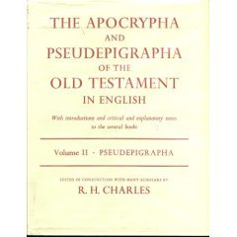
2 Macc. 7:8-9: “Therefore he in turn underwent tortures as the first brother had done. And when he was at his last breath, he said, ‘You accursed wretch, you dismiss us from this present life, but the King of the universe will raise us up to an everlasting renewal of life, because we have died for his laws.’”
Testament of Benjamin 10:5-8:“‘…Keep God’s commandments until the Lord reveals his salvation to all the nations.’ And then you will see Enoch and Seth and Abraham and Isaac and Jacob being raised up to the right hand in great joy. Then shall we also be raised, each one of us over our tribe, and we shall prostrate ourselves before the heavenly king. Then all shall be changed…’”

Slide 20
But something remarkable emerges in the early –middle First Century…a profoundly distinct resurrection theology appears in the preaching and writings of Jews who have become “Christian”…
Resurrection #1: Messiah-----------------------------→
Resurrection #2: General Resurrection
“But Christ has indeed been raised from the dead, the first-fruits of those who have fallen asleep.”
-- 1 Cor. 15:20 [NIV]

Slide 21
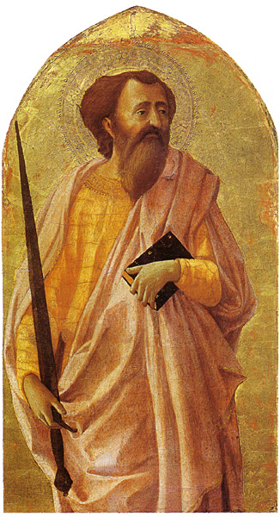
5. Earliest New Testament Writings
What caused this “mutation” of resurrection theology that is at once, so continuous with Jewish thought—and yet so very discontinuous?
From the Pauline letters it is clear that Jesus’ own resurrection from the dead is the source of this “novel” belief (although the Christian theologian Paul sees such as the fulfillment of the OT Scripture (“…that he was raised on the third day according to the Scriptures”—1 Cor. 15:4)

Slide 22
1 Corinthians 15: Jewish Understandings of Death/Resurrection are Met…and (radically) Modified by Christ’s Resurrection
Unique Event that re-shapes Jewish theology: “For what I received I passed on to you as of first importance: that Christ died for our sins according to the Scriptures, that he was buried, that he was raised on the third day according to the Scriptures, that he appeared to Cephas, and then to the Twelve. After that, he appeared to more than five hundred of the brothers and sisters at the same time, most of whom are still living, though some have fallen asleep. Then he appeared to James, then to all the apostles, and last of all he appeared to me also, as to one abnormally born...” vv. 3-8
Jewish theology: “If there is no resurrection from the dead, than Christ has not been raised either…” v.13
Jewish theology of creation, fall, death, resurrection modified to Christ’s “First fruits: “Now indeed Christ has been raised from the dead, the first fruits of those who have fallen asleep. For since death came through a man, the resurrection of the dead comes also through a man. For in Adam all die, so in Christ all will be made alive. But each in turn: Christ, the first fruits; then those who belong to him….For he must reign until he has put all his enemies under his feet. The last enemy to be destroyed is death.” vv. 20-26

Slide 23
Romans 6-8: Resurrection as a “Transformational” Event and an Everyday Christian Experience…
“We were therefore buried with him through baptism into death in order that, just as Christ was raised from the dead through the glory of the Father, we too may live a new life. For if we have been united in a death like his, we will certainly also be united with him in a resurrection like his. For we know that our old self was crucified with him so that the body ruled by sin might be done away with, that we should no longer be slaves to sin…” vv. 4-6 [NIV]
“In the same way, count yourselves dead to sin but alive to God in Christ Jesus.” v. 11 [NIV]

Slide 24
Paul on the Resurrection: A Summary…
a. Paul’s understanding of death clearly falls into a Jewish understanding—a future bodily resurrection of all the genuine people of God accomplished by the Spirit (akin to the, Pharisees and many of the apocalypticists)
b. However, Paul deviates from this view in two significant ways(Wright-- “mutations within the Jewish worldview”):
1) Resurrection has been divided into two: a. Messiah b. all people at his future Parousia
2) Resurrection (which would not have been understood in anything but a bodily sense) is associated with Transformation—both the future general resurrection of believers but also in the present sanctifying work of the Holy Spirit (Romans 6 and 8 may be more important in our apologetic presentation than 1 Cor. 15!)

Slide 25
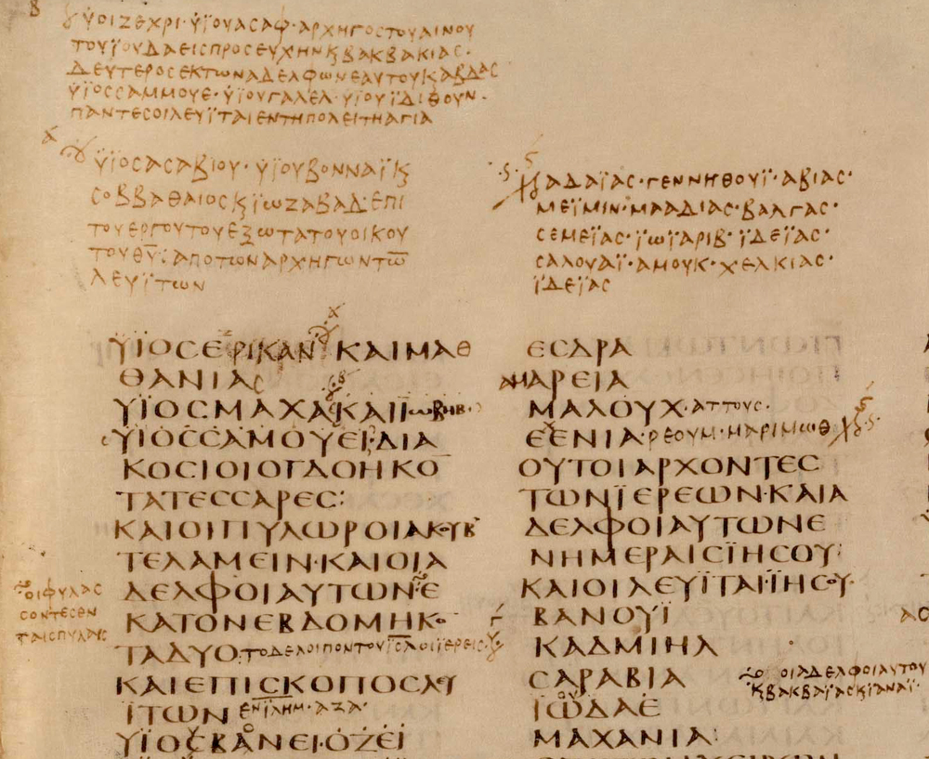
6. Non-Pauline New Testament Literature: (cf. Wright, 477-78)
1. While resurrection was taught in Judaism, it was not a central concern. In Christianity, it became central
2. While the early Christians came from many different backgrounds in Judaism and paganism, they had an uniform view of the resurrection (there was not a spectrum of beliefs)
3. Christian view of resurrection modified that of the Pharisees in two significant areas: 1) Its eschatological fulfillment occurs into events—Jesus’ and at his return, his people; and 2) Resurrection body was physical but also significantly different from the present one—an “incorruptible or imperishable body” (cf. 1 Cor. 15:42)
4. While the NT clearly attributes its concept to OT Scriptures (e.g., Acts 2:25-28/Psalm 16:8-11), it avoids passages like Dan. 12:2-3 which would have been “easy proof texts”
5. NT replaces the metaphorical understanding of resurrection in Judaism with present, concrete Christian experiences: baptism, bodily holiness, and the witness to the gospel

Slide 26
“After being made alive, he (Christ) went and made proclamation to the imprisoned spirits…and this water symbolizes baptism that now saves you also—not the removal of dirt from the body but the pledge of a clear conscience toward God. It saves you by the resurrection of Jesus Christ…”
--1 Pet. 3:19,21[NIV]
* In this “postmodern” approach, the “Resurrection Narratives” in the Gospels attain there historical veracity because of the “Resurrection Message” of these earlier epistles

Slide 27
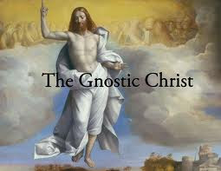
7. Non-Canonical Early Christian Literature: Some Summary Conclusions
a. “Gnostic Gospel” differs from the message of the NT writers and early orthodox Christians (e.g., Tertullian) in three significant ways:
1) Absence of the affirmation of the goodness of God’s creation order and his intention to remake it
2)No emphasis on a future judgment making resurrection a “necessity” if it is truly just
3) Little evidence that resurrection challenges the present world—as a transformed, kingdom lifestyle and as a confidence about the future in light of persecution and/or death
b. “Orthodox gospel” affirmed (with the NT writers) that:
1) Future bodily resurrection of God’s People –and all people whether righteous or not
2) Resurrection involved going through death and into an incorruptible body
3) It involved the raising of one Man—Jesus—who went ahead of everyone else
4) There was an “intermediate state” in which the deceased believer could be described as “being with the Lord” prior to the general resurrection
5) Bodily resurrection of the body was an affirmation of the goodness of God’s creation
6) When used metaphorically, it did not refer to a future restoration of a nation but of the Christian’s conversion and present holiness

Slide 28
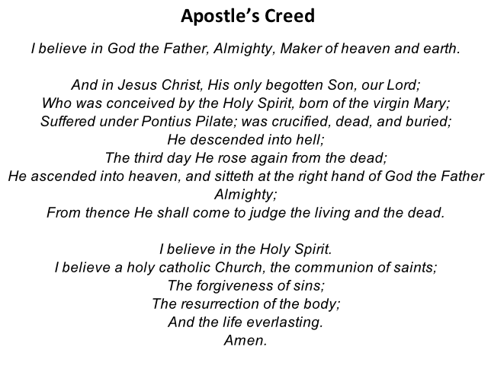
A more typical—and orthodox—confession..

Slide 29
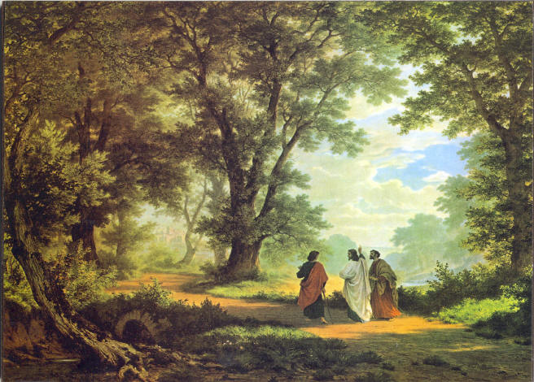
…In summary: The Early Church and the Doctrine of the Resurrection Source: N.T. Wright, The Resurrection of the Son of God
1. Unlike classic Judaism, the Early Christians believed ONE MAN (Jesus) had been raised from the dead before the rest of God’s People.
2. The Early Christians believed that the resurrection would involve the transformation of the physical body. Jews who believed in the resurrection, understood it in two ways: 1) we would receive a body just like the one we have; or 2) we would receive a luminous body shining like a star. The Christian view is neither: A new physicality that is definitely bodily but one that no longer experiences pain, suffering, or death.

Slide 30
3. They believed that the MESSIAH himself had been raised from the dead…something no Second Temple Jew believed (since they did not believe that the Messiah would be killed).
4. Early Christians used the idea of “resurrection” in new ways—in connection with baptism, holiness, and other aspects of Christian living. In Judaism, it was often used as a metaphor for “return from the exile” (cf. Ezek. 37).
5. For the earliest Christians, resurrection comes to be associated with something that God’s People contribute to; i.e., working together with God to implement the “New Age” that had been inaugurated at Easter. This “new order” would in turn, anticipate the complete renewal that would come at the eschaton.

Slide 31
6. The Christian doctrine of the resurrection is not simply one doctrine among many others as it is in Judaism) but rather the center of everything. Eliminate it from Paul’s letters, the General Epistles, Revelation, or the second-century Patristics, and there is no Christian Faith.
7. In early Christianity there is virtually no spectrum of belief about what happens after death. In both Judaism and pagan religions, there were several different views at to what happens after death; in Christianity only one: resurrection. While the early Christians had their share of disagreements, they showed remarkable unanimity about the resurrection—what it is and how it works.

Slide 32
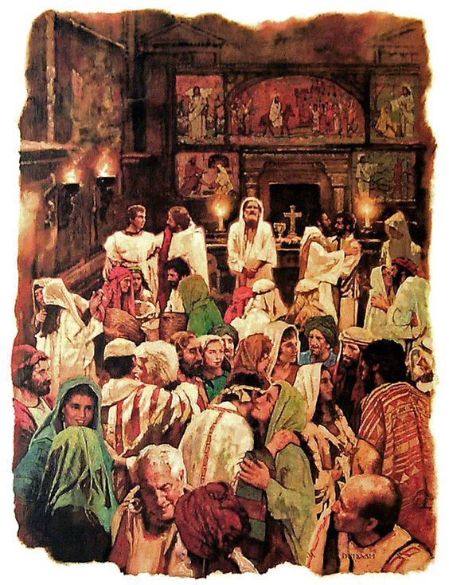
While our “Church-first” approach to Resurrection maybe a bit new, in actuality it mirrors Paul’s well-known argument…
“And if Christ has not been raised, our preaching is futile and so is your faith” –1 Cor. 15:14 (AD 55)
What could possibly account for this distinctive doctrine/message of the Christian Faith? Answer: Only something like the bodily resurrection of Jesus Christ. This is not a proof (a modernistic claim) but the most probable conclusion that can be drawn from the First Century emergence of a new phenomenon—the Church.

Slide 33
Resurrection looks like this!

