Slide 1
Dr. Gregg Marutzky
GOSPEL GRACE
Part One

Slide 2
A Question….
What is the most common word or expression used in the New Testament for a person who is saved?

Slide 3
A Question….
What is the most common word or expression used in the New Testament for a person who is saved?
Saved?
Christian? Disciple?
Forgiven?

Slide 4
The Answer….
In Christ
In Christ, in Him, In the Lord 164 times in Paul alone.

Slide 5
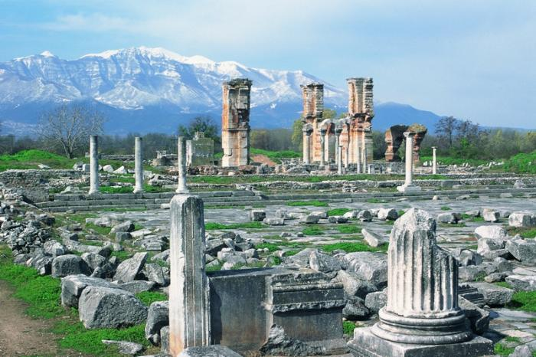
Philippians: Life in Christ
Phil 1:1-30 To Live is Christ
Phil 2:1-18 Living Like Christ
Phil 3:1-21 Put Your Confidence in Christ
Phil 4:1-23 Practical Living in Christ

Slide 6
Theme of Colossians:
Christ in You the Hope of Glory

Slide 7
So… What do we have in Christ?
Philippians 1:1 Saints in Christ Jesus
Phil 4:7 peace of God
Philippians2:1 Encouragement in Christ.
Gal 3:26 Children of God.
Coll 1:14, Eph 1:7 Redemption
Colossians 2:10 fullness
Coll 2:11-12 Put off the flesh

Slide 8
We Have Everything in Christ!
Ephesians 1:3 every spiritual blessing
Ephesians 1:4, 11 chosen
1 Corinthians 15:22 we will be made alive/resurrected
2 Corinthians 5:21 we become the righteousness of God
Romans 6:23 have eternal life
Romans 8:38-39 secure love of God

Slide 9
2 Timothy 1:9 grace
2 Corinthians 5:17 a new creation
2 Corinthians 1:20 all God’s promises fulfilled

Slide 10
Even More in Christ
Romans 8:1 No condemnation
Coll 1:27, 2:3 The mystery is revealed in Christ.
Coll 2:17 Reality is found in Christ.
We were made these things.
We are being made these things.
We will be made these things.

Slide 11
Paul’s Goal: To be found in Christ.
Phil 3:7-10
To Paul, everthing else was garbage by comparison.
It was worth less than nothing compared to knowing Christ and to being in Christ.

Slide 12
Refuse!
A mathematical equation:
Jew + Benjamite + Pharisee + top 2% righteous
+ top 2% devoted = 0
Actually, it adds up to less than nothing.

Slide 13
Knowing Christ/Being in Christ
All things
Being in Christ

Slide 14
If We are in Christ, How and when did we get into Christ?
Gal 3:26 Baptized into Christ
Romans 6:4 Baptized into Christ
Believe into Christ?
Repent into Christ?
Pray into Christ?
How do you get in there?
You were out here

Slide 15
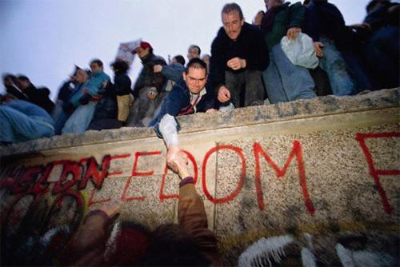
Galatians 5:1 Freedom in Christ

Slide 16
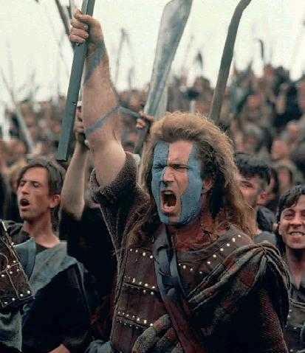
Freedom!!!!!!

Slide 17
Yeah; We’re Free!

Slide 18
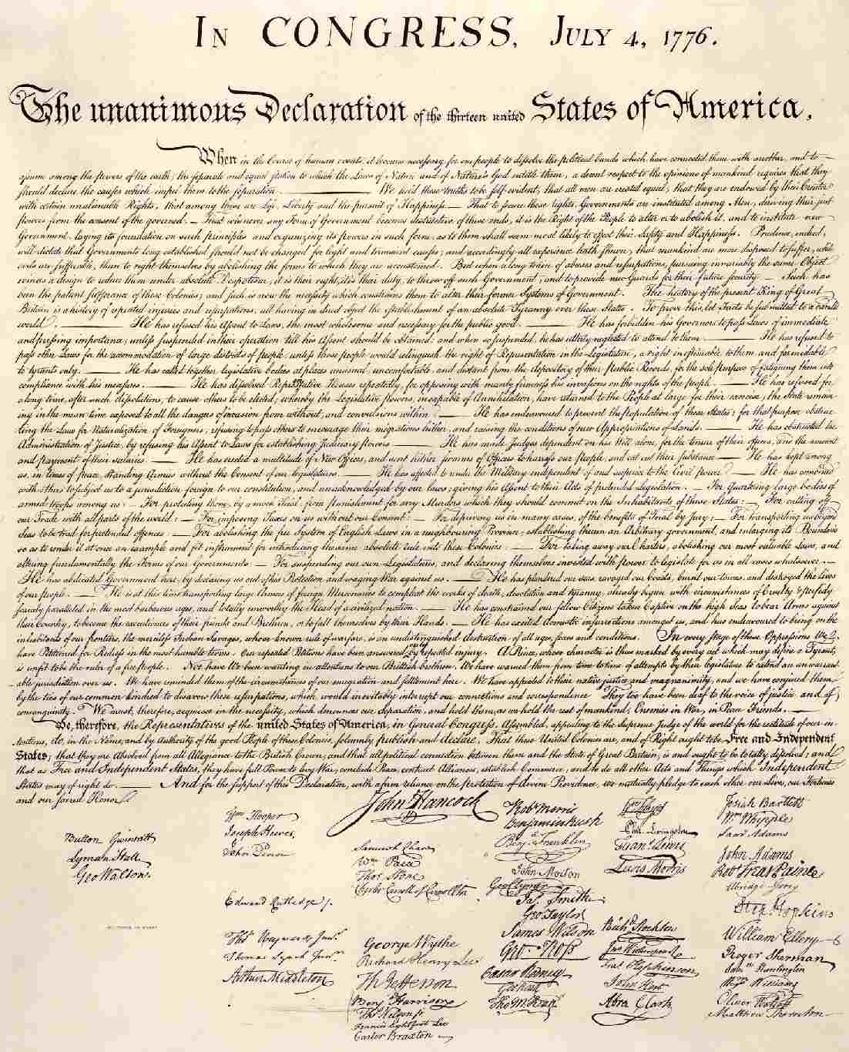
1 Cor 9 Our Christian Bill of Rights Question: What Have You Done With Your Freedom in Christ?

Slide 19
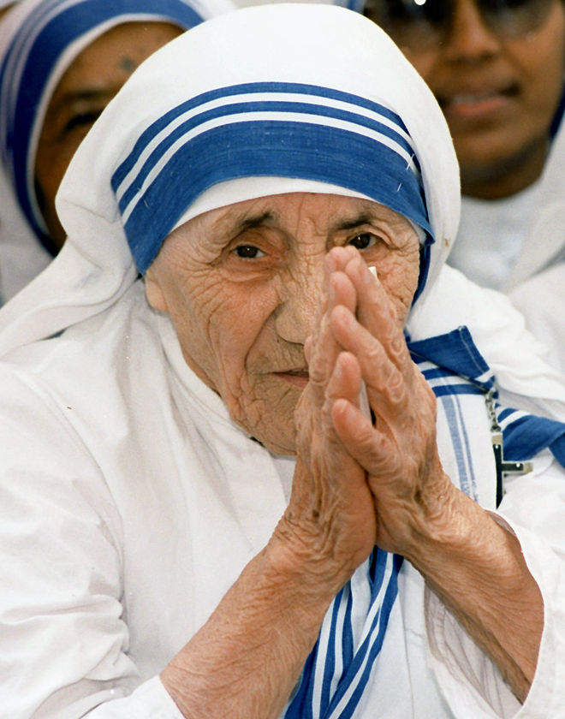
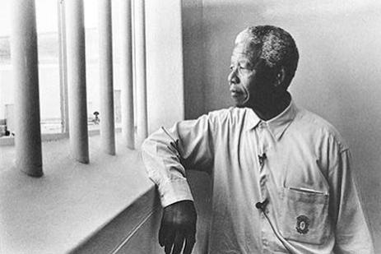
1 Cor 9:1-2 Paul: Am I not free?
Question: Who Does the world see as truly great, and what do they have in common?

