Slide 1
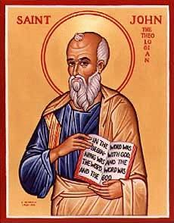
The Gospel of John And Jewish Festivals
John Oakes
LASMM
2/23/18

Slide 3
Uniqueness of John

Slide 4
John the solo Gospel
Geographical setting:
Synoptics: Jesus’ ministry is in Galilee. He goes to Jerusalem once near end of his ministry
John: Jesus visits Jerusalem often. Majority of the gospel takes place there.
Duration of his ministry:
Synoptics: Could all conceivably have happened within one year.
John: Based on Passovers mentions three years.

Slide 5
Uniqueness of John
John is the most Jewish of the gospels. (Many scholars will say that Matthew is the most Jewish)

Slide 6
Where Does John Fit In?
Matthew: Jesus is revealed for who he is through the fulfillment of prophecy and the Jewish messianic expectation. Matthew 5:17
Luke: Jesus is revealed for who he is through his ministry to the poor, women, Gentiles and outcasts in general. Luke 4:18-21
John: Jesus is revealed through his statements about himself and through his miracles and….
Through his fulfillment of the messianic expectation through the Jewish festivals.

Slide 7
John: Jesus is the Second Moses
John 1:17 For the law was given through Moses; grace and truth came through Jesus Christ.
Bill R. Day: Jewish messianic expectations, “instead of looking for only a few specific verbal predictions to be fulfilled in the life and times of the Messiah, they were looking for a reenactment of the entire salvation history of Israel. The Jews of Jesus’ day were looking for the events and miracles of their divine history to be repeated in the Messianic age.”

Slide 8
Outline of John
I. Prologue 1:1-1:18
II. Book of Signs 1:19-12:50
III. Book of Glory Passion Story 13:1-20:31
IV. Epilogue 21:1-21:25
Theme: The Son of who reveals God’s glory.
Theme verses 1:14, 1:18, 3:16 20:30-31

Slide 9
Seven I Am Statements
I AM the bread of life 6:35
I AM the light of the world 8:12,9:5
I AM the door (and the gate) 10:7
I AM the good shepherd 10:1,14
I AM the resurrection and the life 11:25
I AM the Way the Truth and the Life 14:6
I AM the true vine 15:1
All are metaphors

Slide 10
Book of Signs 1:19-12:50
[knew thoughs of Nathanael 1:43-50]
water to wine 2:1-11
healing of official’s son 4:43-54
healing at pool of Bethesda 5:1-5
feeding of 5000 6:1-14
walking on water 6:16-21
man born blind 9:1-12
resurrection of Lazarus 11:1-44
[miraculous catch of fish John 21:1-13]
Seven Signs

Slide 11
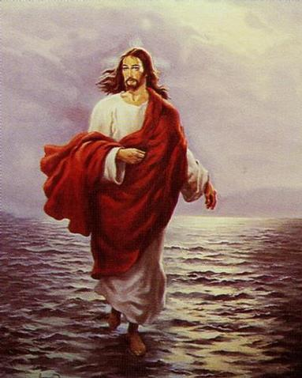
Purpose of the Signs of Jesus
Cause people to have faith in God
Cause people to give glory to God
Fulfill festival prefigures
Show he is the new Moses.

Slide 12
II. Water to Wine: The “first sign” of Jesus
Water to wine is the antitype of Moses turning water to blood—his first miracle of many which led to the freeing of God’s people from captivity.
empty jars = Jewish ritual wine = New Covenant
Result: 2:11 God’s glory is revealed and people (the disciples in this case) put their faith in Jesus.

Slide 13
III. Jesus Clears the Temple Another “sign”
Jesus clears the temple John 2:12-17 a “sign”
2:13 at thePassover.
Jesus cleanses the temple as this is his house as one does before the Passover.
Jesus’ authority over the temple. The temple of God is my body!

Slide 14
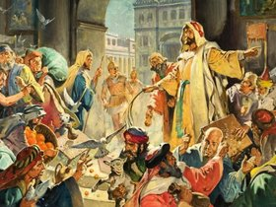
Jesus Clears the Temple
John 2:18-19. What is the sign of Jesus?—the sign proving my right to be greater than the temple? I will be raised from the dead on the third day.

Slide 15
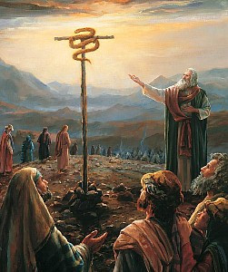
Jesus Greater than Moses
John 3:14 I am the fulfillment of Moses. Just as Moses lifted up the snake in the wilderness, so the Son of Man must be lifted up, that everyone who believes may have eternal life.

Slide 16
IV. Sign #2 The Official’s Son
Jesus heals official’s Son 4:43-54 (parallels Matt 8:5-13, Luke 7:1-10)
Healing for Gentiles too.
Healing from a distance.
Context: The Feast of Dedication: about rededication and life from the dead.

Slide 17
V. Sign #3 Healing at Bethesda
John 5:1-9 Jesus: the Lord of the Sabbath.
“My father is always at work to this very day and I, too, am working” (v17)
5:18 Result: The Jews tried even harder to kill him. Why? He claims to be equal to God.

Slide 18
Theme: Jesus Replacing/Greater than the Jewish Festivals
1. Jesus greater than the Sabbath (and the Feast of
Dedication) Jn 5:1-18
2. Jesus greater than Passover Jn 6:1-70
3. Jesus greater than Booths/Tabernacles Jn 7:1-9:41
4. Jesus greater than Festival of Lights (Chanukkah)
Jn 10

Slide 19
Testimonies of Jesus John 5:31-40
Jesus: There are three things which testify about me:
a. John the Baptist
b. The miracles
c. Prophecy/Scripture
John 5:45-47 I am Greater than Moses.
(note: this is right after 5:39 the Scripture is about me)

Slide 20
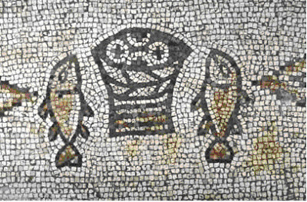
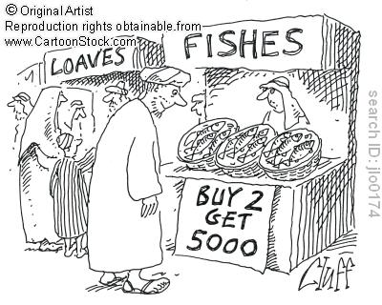
VI. Sign #4 Feeding the 5000
Theme: Jesus will replace Moses and will replace the Passover.
Type: Marriage feast with God
Jesus gives bread (like the manna)
People’s response: 6:14 “Surely this is the Prophet” (Deuteronomy 18:17-19)

Slide 21
VII. Sign #5 Walking on Water
Jn 6:16-24 (Matt14:22-33, Mark 6:47-51)
John’s emphasis: A parallel to Moses parting the water. An Exodus/Passover scene.
“It is I” (I AM that I AM ego eimi Exodus 3:14) Do not be afraid. Suddenly they are on the other side (recalling the crossing of the Red Sea)

Slide 22
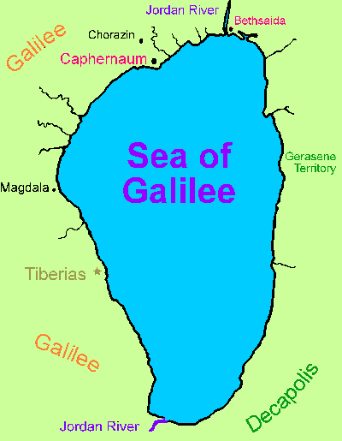

Slide 23
VIII. John 6:25-70 I AM The Bread of Life subtext: I am greater than Moses
v. 25-27 Seek spiritual not physical food
“Work” for spiritual food.
v. 28-29 What is the work of God? Believe in the one he sent. Irony
v. 30 Jews demand a sign again (recall clearing the temple)
Jesus: I gave you bread. I am greater than Moses. Isn’t that testimony enough?
In fact: I AM the bread of life. physically v. 35 and eternally v. 47-51.

Slide 24
A Practical Question
6:35b What is “bread” for you? What do you hunger for?
6:35c What is “water” for you? What do you thirst for?
The people: Please give us this bread!

Slide 25
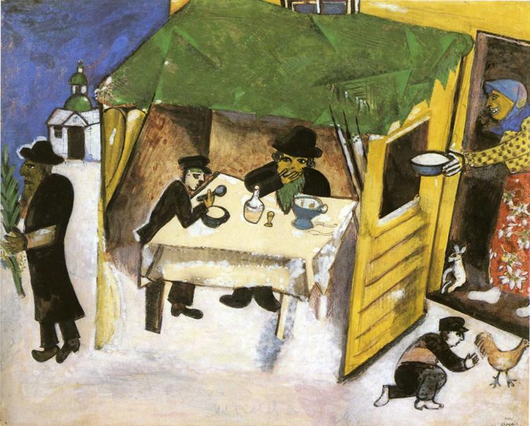
IX. John 7:1-9:41 Tabernacles Discourses
Tabernacles (Sukkot)
Harvest Festival
Remembrance of Wandering in the Wilderness = living by faith in a relationshiip with God
John 1:14

Slide 26
John 7-8 Many Claims
7:16-My teaching is from God. If anyone chooses to do God’s will….
Response: You are demon-possessed.
7:37-38 I am the source of living water.
Response: He is the Prophet. He is the Christ. Tried to seize him
8:12 I AM the light of the world.
Response: Many put their faith in him.
8:46 Sinless
Response: A Samaritan and Demon-possessed.
8:51 If anyone keeps my word, he will never see death. (I am greater than Abraham)
Response: You are demon-possessed
8:58 Before Abraham was born, I AM. (claims to be God)
Response: Picked up stones to stone him.

Slide 27
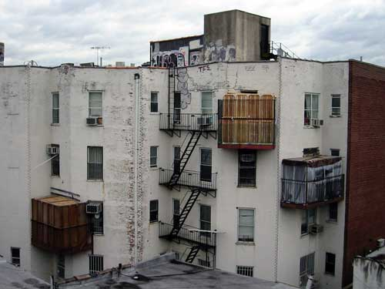
Sukkot in a City

Slide 28
Tabernacles/Booths/Sukkot
A Celebration of Wandering in the Wilderness: Living in Close Fellowship with God (John 1:14 Jesus tabernacled with us)
Water Motif: Water Pouring Ceremony
Light Motif: The Illumination of the Temple

Slide 29
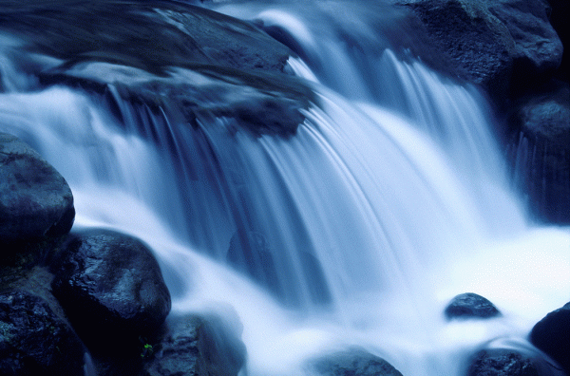
John 7:37 Living Water
If anyone is thirsty, let him come and drink. Whoever believes in me, as the Scripture has said, streams of living water will flow from within him
Isaiah 12:3
Zech 14:8,16
Joel 3:18

Slide 30
The Water-Pouring Ceremony
Every Day of the Feast
Procession from the Temple to the Pool of Siloam
Priest fills a golden pitcher with water from Siloam (“living” water, by the way)
Recite Isaiah 12:3
Back through the Water Gate to the Temple
Pour the water out over the altar of sacrifice
A symbol of the Holy Spirit and of salvation.
Isaiah 12:3, Zechariah 14:8,16, Joel 3:18, Ezek 45:25 41:1-11
Jesus: The Messianic Age has come.

Slide 31
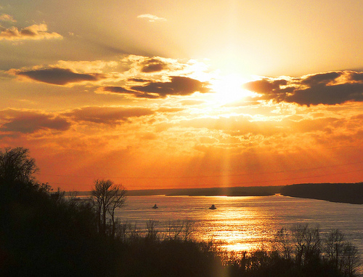
John 8:12 I Am The Light of the World
John 8:12 I AM the light of the world.
John 9:5 While I am in the world, I AM the light of the world.
John 12:46 I have come into the world as a light, so that no one who believes in me should stay in darkness.

Slide 32
The Illumination of the Temple
Every night during Tabernacles.
Entire Temple lit up with lamps.
Celebration in the Court of Women.
A symbol of the shekinah—God’s glory which was in and above the Tabernacle.
Jesus: I am the shekinah of God.
John 12:36 Through Jesus we can become sons of light, and no longer walk in darkness.
Jesus: I am the fulfillment of Tabernacles.

Slide 33
John 8:48-58 The Greatest Claim of Jesus
8:51 If anyone keeps my word, he will never see death.
Now we know you are demon-possessed!
Before Abraham was born: I AM.
They picked up stones to stone him.

Slide 34
X Sign # 6 Jesus proves he is the light of the world
9:5 I AM the light of the world.
This miracle involves both water and light.
Note: Wash in the Pool of Siloam.
The man grows in his faith.
v. 11 “the man Jesus”
v. 17 “the Prophet”
v. 31 from God
v. 38 Lord, I believe!
The parents and the Pharisees become more blind than they were at the beginning.

Slide 35
XI. John 10 More claims and testimonies
The Context: The Feast of Dedication (Hannukuh) John 10:22
John 10:7 I AM the gate. (John 14:6)
John 10:11,14 I AM the good shepherd.
The Shepherd Discourse Ezekiel 34:2-10
1st Macabbees: false shepherds
1 Samuel 17:34
Response: Division. You are demon-possessed!
Could a demon give sight to the blind?
John 10:25,32,38 My miracles testify to the things I say

Slide 36
Jesus: I AM God
John 10:30 I and the father are one.
Response: John 10:31 They picked up stones to stone him.
You, a mere man, claim to be God.

Slide 37
XII. Sign #7 The Raising of Lazarus
For John: The greatest of Jesus’ signs.
John 11:4 This sickness will not end in death (irony)
Purpose: To give glory to God (and to his son)
John 11:23-26 I AM the resurrection and the life! He who believes in me will live, even though he dies.
John to the reader: Do you believe this?

Slide 38
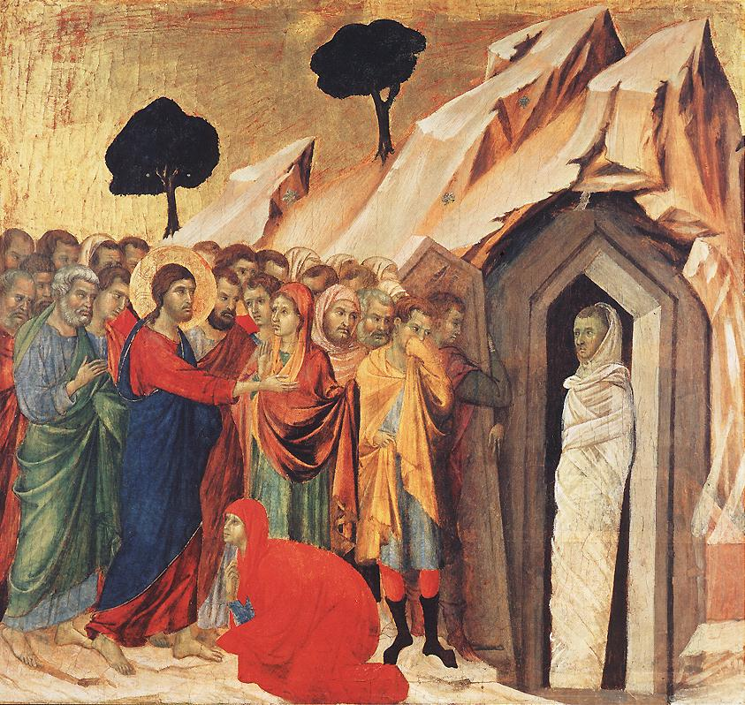
Jesus proves he is the resurrection and the life.
“Lazarus: Come out!”
John 11:45-51 Believe or murder Jesus. A stark choice.
What about you?

Slide 39
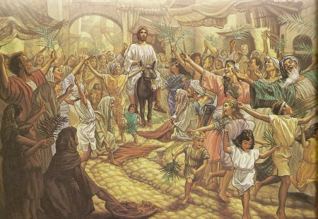
John 12:12 The Passion Story Begins…
I Maccabees 13:21
(Simon Maccabeus)
Hosannah! Ps 118:25-26
Jesus hailed as King and Messiah.
King of Peace (donkey)
Zechariah 9:9

Slide 40
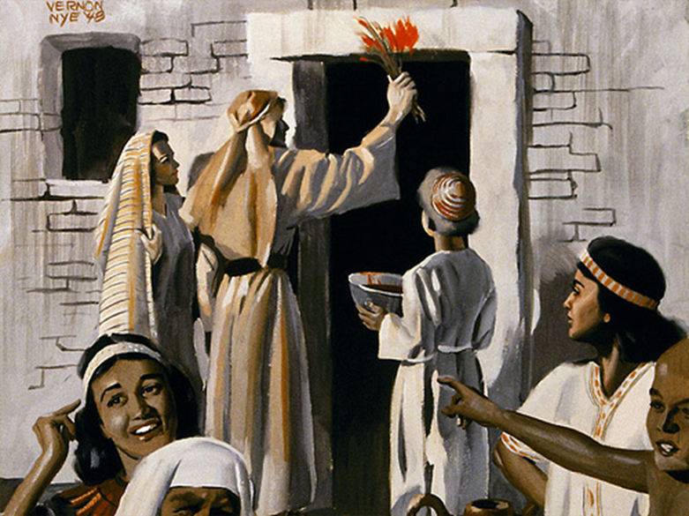
The Ultimate Passover Miracle
Jesus a perfect Passover Lamb.
His blood on a wooden beam.
Offered on the eve of the Passover.
The Last Supper is the last Seder.
None of his bones were broken.
Jesus is the bread without leaven.

Slide 41
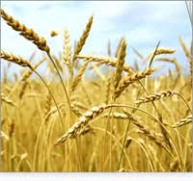
Jesus Fulfills the Feast of Firstfruits
Feast of Firstfruits 15 Nisan.
Celebrating the harvest when there is not yet a harvest.
A foreshadow of our resurrection.
Jesus is the firstfruit from the dead.

