Slide 1
Malachi: God’s Messenger

Slide 2
Malachi: God’s Messenger
Malachi = my messenger
Message: Faithful to God vs. Faith in God
Date of writing 458-432 BC
Malachi is God’s last word to the Jews. It is a capstone to the message of the Old Testament and a final preparation for the ministry of John the Baptist and of Jesus. The next word from God will be “Repent for the kingdom of heaven is near” (John the Baptist)

Slide 3
Background to Malachi
The earlier generation had been been restored and rebuilt.
The new generation are becoming cynical. God has not blessed them in the way they expected. Will they have faith in God or will they be faithful to God?
Socratic Style
God: You have robbed me.
People: How have we robbed you?
God: In tithes and offerings.

Slide 4
Outline of Malachi
Introduction: God still loves Israel. God has been faithful to Israel. 1:1-5
I The Priests have been unfaithful 1:6-2:9
II The People have been unfaithful 2:10-3:15
III The Day of the Lord is coming Malachi 3:16-4:6

Slide 5
Introduction: Malachi 1:1-5
God: I still love you. I have kept my covenant with you. I have been faithful to you.
I have loved you. Hesed Unfailing love, loyal love, covenental love, devotion.

Slide 6
Hesed Covenant Love
People: How have you loved us?
God has not loved them the way they expected to be loved.
Jacob have I loved, Esau I have hated….
I have been faithful to you, will you be faithful to me (or will you merely have faith in me)?

Slide 7
I. The Priests have been unfaithful
It is you, O priests, who show contempt for my name.
Priests: Who,… Us?
How have we shown contempt?
Remember: We are the priests!
1 Pet 2:5,9 a royal priesthood
Exodus 19:6 A kingdom of priests.

Slide 8
Unfaithful priests
People: How have we shown contempt?
God: You place defiled food on my altar.
People: Who, us?
God: Yes, you. You have not show me the respect I deserve.
People: Who us? How?
God: You gave me your second best.
People: Oh……
God: Try offering that to your boss.

Slide 9
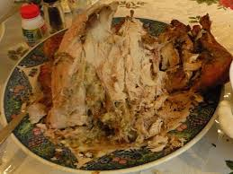
Unfaithful priests
Message: We can be religious, yet show complete contempt for God by giving Him our second best.
Faith: Giving something to God.
Faithful: Giving your very best to God.
Q: Do you give God your
left-overs?

Slide 10
Does God get your leftovers?
Malachi 1:9 Let’s reason together. Do you really feel that God should accept the second best?
Try giving that to your
Governor!

Slide 11
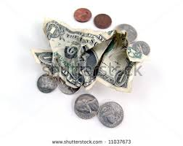
Unfaithful priests
Q: Is it better to give $5 or $0?
Malachi 1:10-11 God: Do me a favor. Leave your leftovers at home. Giving nothing at all is better than publicly disrespecting me.
My name will be great!!!!!

Slide 12
Unfaithful priests
Malachi 1:12-14 The key point:
Malachi 1:12 Have you “sniffed contemptuously” to God? People: How?
Malachi 1:13a “What
a burden.”
Zech 7:2-3

Slide 13
Unfaithful priests
Malachi 1:14 If you give your second best, God calls you a “cheat.”
God: I am a king and I expect to be treated as one.

Slide 14
II. Malachi 2:10-3:18 The people have been unfaithful
B. Malachi 2:17 The people have stopped trusting in God’s love.
The people are accusing God of not living up to his side of the covenant. They do not trust God’s justice.

Slide 15
Malachi 3:6-15 The People have been unfaithful
Malachi 3:6-7 God: Return to me and I will return to you.
People: Who, me? I never left!!
Q: Can you leave God while still
attending church?

Slide 16
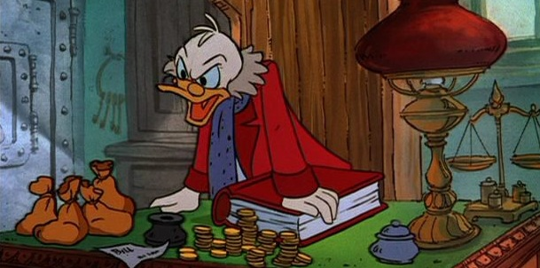
Malachi 3:6-15 The People have been unfaithful
Malachi 3:8 God: You have robbed me!
People: Who… Me?
v. 9 God: Yes, you. In tithes and offerings.
v. 10 Trust me in this….
It is not about money, it is about trusting God. It is about covenant
You are Stingy

Slide 17
The key question
Here is the key question of Malachi:
Do you really, in your heart of hearts, believe that if you put all your trust in God, that he will take care of you.
Do you feel that what God has for you is enough?
If so, then you will be faithful to God.

Slide 18
Malachi 3:6-15 The people have been unfaithful
Malachi 3:13
God: You have said harsh things against me.
People: I have????
God: Yes!!! When you said “it is futile to serve God.”
What am I getting out of this?
You have said that you do not believe that God will take care of you.
1 Timothy 6:17-19

