Slide 1
Malachi: God’s Messenger

Slide 2
Meet the oakes

Slide 3
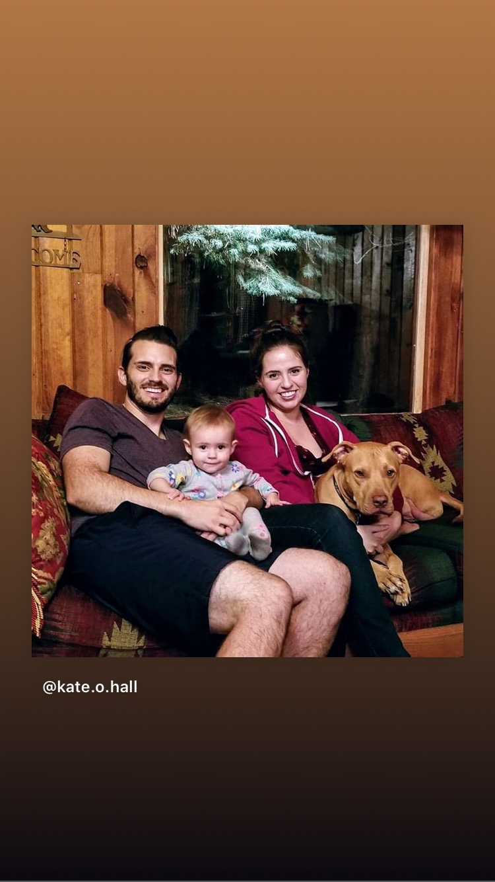

Slide 4
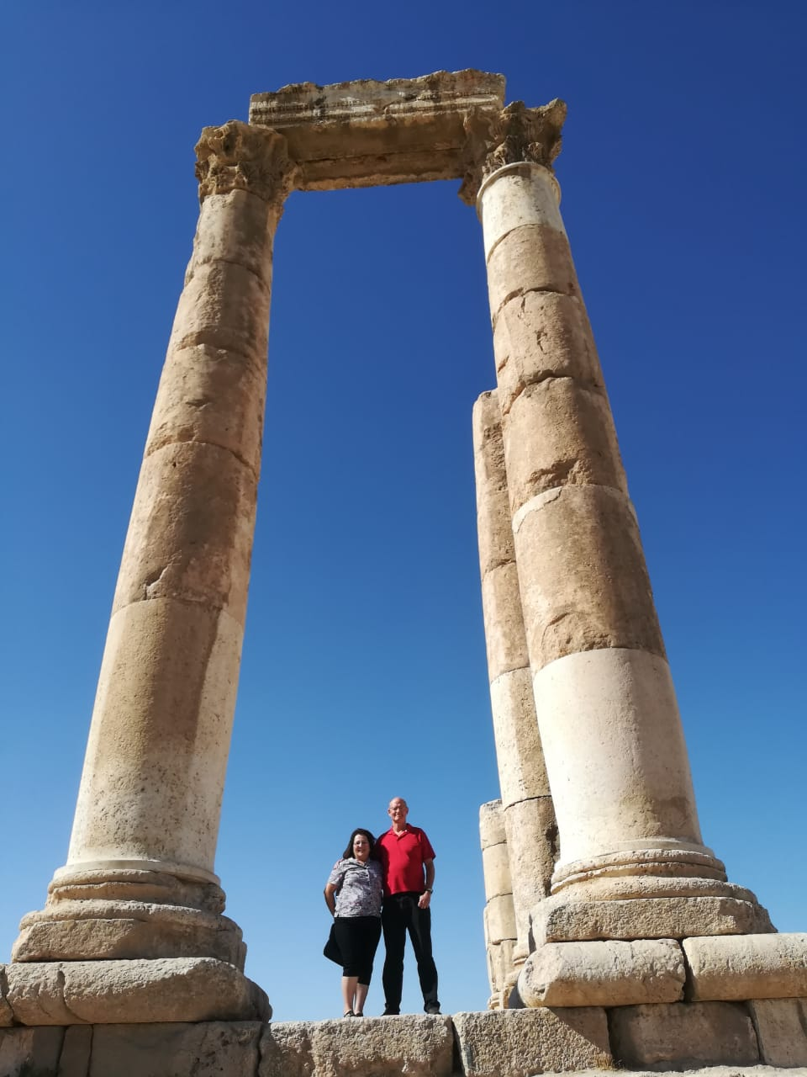

Slide 6
Africa Missions trip report
=

Slide 7
Abuja, Nigeria

Slide 8
Persecution in Abuja

Slide 9
Church in abuja

Slide 10
Street scene in abuja

Slide 12
A sister in abuja

Slide 13
Security in Jos

Slide 14
Church in Jos

Slide 15
Church in Lome, Togo

Slide 16
Sewing Shop in Kpalime, Togo

Slide 17
A couple in Lome, Togo

Slide 18
Kids at church, togo

Slide 19
A boy with a toy, togo

Slide 20
Married’s group Brazzaville Congo

Slide 21
A curious child, Pointe Noire, Congo

Slide 22
Midweek, pointe noire

Slide 23
Market scene pointe noire

Slide 24
Overflow at church, pointe NOire

Slide 25
Aids grandmothers at hope site, Lusaka, zambia

Slide 26
Hope after-school program, zambia

Slide 27
Bible class, Lusaka, zambia

Slide 28
Risky behavior?

Slide 29
Malachi: God’s Messenger

Slide 30
Malachi: Faith in God vs Faithful to God
Malachi = my messenger
Message: Faithful to God vs. Faith in God
Date of writing 458-432 BC
Malachi is God’s last word to the Jews. It is a capstone to the message of the Old Testament and a final preparation for the ministry of John the Baptist and of Jesus. The next word from God will be “Repent for the kingdom of heaven is near” (John the Baptist)

Slide 31
Background to Malachi
The earlier generation had been restored and rebuilt.
The new generation are becoming cynical. God has not blessed them in the way they expected. Will they have faith in God or will they be faithful to God?
Style: Rhetorical Questions—a staged debate with God’ priests or his people.

Slide 32
Outline of Malachi
Introduction: God still loves Israel. God has been faithful to Israel. 1:1-5
I The Priests have been unfaithful 1:6-2:9
II The People have been unfaithful 2:10-3:15
III The Day of the Lord is coming Malachi 3:16-4:6

Slide 33
Introduction: Malachi 1:1-5
God: I still love you. I have kept my covenant with you. I have been faithful to you.
I have loved you. Hesed Unfailing love, loyal love, covenental love, devotion.
What does God want from us? Hesed Faithfulness

Slide 34
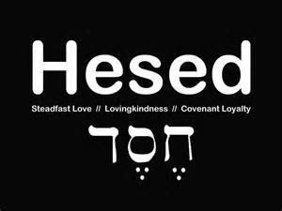

Slide 35
Hesed Covenant Love
People: How have you loved us?
God has not loved them the way they expected to be loved.
Jacob have I loved, Esau I have hated…. (Rom 9:13)
I have been faithful to you, will you be faithful to me (or will you merely have faith in me)?

Slide 36
I. The Priests have been unfaithful
It is you, O priests, who show contempt for my name.
Priests: Who,… Us?
How have we shown contempt?
[Remember: We are the priests!]
1 Pet 2:5,9 a royal priesthood
Exodus 19:6 A kingdom of priests.

Slide 37
Unfaithful priests
People: How have we shown contempt?
God: You place defiled food on my altar.
People: Who, us?
God: Yes, you. You have not show me the respect I deserve.
People: Who us? How?
God: You gave me your second best.
People: Oh……
God: Try offering that to your boss.

Slide 38
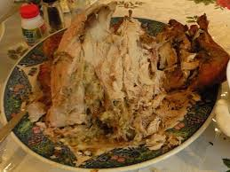
Unfaithful priests
Message: We can be religious, yet show complete contempt for God by giving Him our second best.
Faith: Giving something to God.
Faithful: Giving your very best to God.
Q: Do you give God your
left-overs?

Slide 39
Does God get your leftovers?
Malachi 1:9 Let’s reason together. Do you really feel that God should accept the second best?
Try giving that to your
Governor!

Slide 40
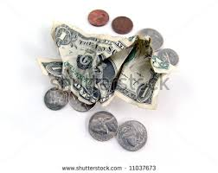
Unfaithful priests
Q: Is it better to give $5 or $0?
Malachi 1:10-11 God: Do me a favor. Leave your leftovers at home. Giving nothing at all is better than publicly disrespecting me.
My name will be great!!!!!

Slide 41
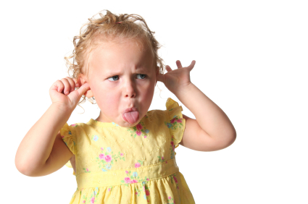
Unfaithful priests
Malachi 1:12-14 The key point:
Malachi 1:12 Have you “sniffed contemptuously” to God? People: How?
Malachi 1:13a “What
a burden.”
Zech 7:2-3

Slide 42
Unfaithful priests
Malachi 1:14 If you give your second best, God calls you a “cheat.”
God: I am a king and I expect to be treated as one.

Slide 43
II. Malachi 2:10-17 The people have been unfaithful
Malachi 2:11 Judah has been unfaithful. She had faith, but has not been faithful. The people have stopped trusting in God’s love.
Malachi uses the analogy of a divorce.
God: I hate divorce. It breaks hesed.

Slide 44
Malachi 3:6-15 The People have been unfaithful
Malachi 3:6-7 God: Return to me and I will return to you.
People: Who, me? I never left!!
Q: Can you leave God while still
attending church?

Slide 45
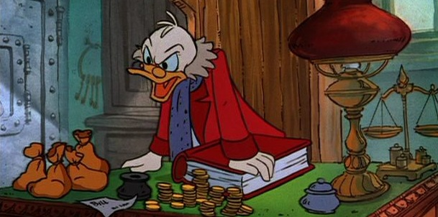
Malachi 3:6-15 The People have been unfaithful
Malachi 3:8 God: You have robbed me!
People: Who… Me?
v. 9 God: Yes, you. In tithes and offerings.
v. 10 Trust me in this….
It is not about money, it is about trusting God. It is about covenant
You are Stingy with God

Slide 46
The key question
Here is the key question of Malachi:
Do you really, in your heart of hearts, believe that if you put all your trust in God, that he will take care of you? (Hebrews 11:6)
Do you feel that what God has for you is enough?
If so, then you will be faithful to God.

Slide 47
Malachi 3:6-15 The people have been unfaithful
Malachi 3:13
God: You have said harsh things against me.
People: I have????
God: Yes!!! When you said “it is futile to serve God.”
What am I getting out of this?
You have said that you do not believe that God will take care of you.
(1 Timothy 6:17-19)

Slide 48
Malachi 3:1-5 The Day of the Lord Part I
Malachi 3:1 I will send my messenger (Malachi).
John the Baptist (Matthew 11:3, 10, 14)
Malachi 3:2-5 Are you sure you want God to come?
The people will get what they are asking for (God to come) but not what they want (a free ride without judgment).

Slide 49
Malachi 4:4-6 God’s final word to his people
Be ready. I will send Elijah before that day. John the Baptist.
God: I will be faithful, whether you are or not.
Let us be faithful to God. Let us show hesed.

