Slide 1
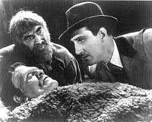
Ezekiel 37 the valley of dry bones
The promise of resurrection (on many levels and in many ways)
He’s Alive!

Slide 2
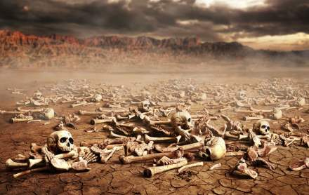
Ezek 37 The valley of dry bones
Ezek 37:2 The bones are “very dry” No hope!!! God specializes in this kind of situation.
Ezek 37:3 Son of man, can these bones live?
Q: Can your neighbor live? Can your marriage live? Can you spiritual life be revived? Can you overcome an addiction?

Slide 3
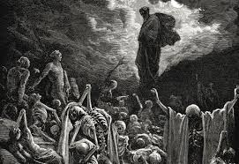
I. Hear the word of the lord
The solution:
I. 37:4 “Dry bones, hear the word of the Lord.” Sometimes we need to preach to dry bones!
37:5-8 A bizarre vision!

Slide 4
II. Breath: The Holy Spirit
II. We need to receive the Holy Spirit.
Ezekiel 37:9-10
Zech 4:6 Rom 8:9-11
37:11-14 God interprets the vision. Resurrection!!!!
Primary application is to Israel. God will bring them back to life in Canaan.
Secondary application: the Church.
Tertiary application: Heaven.

Slide 5
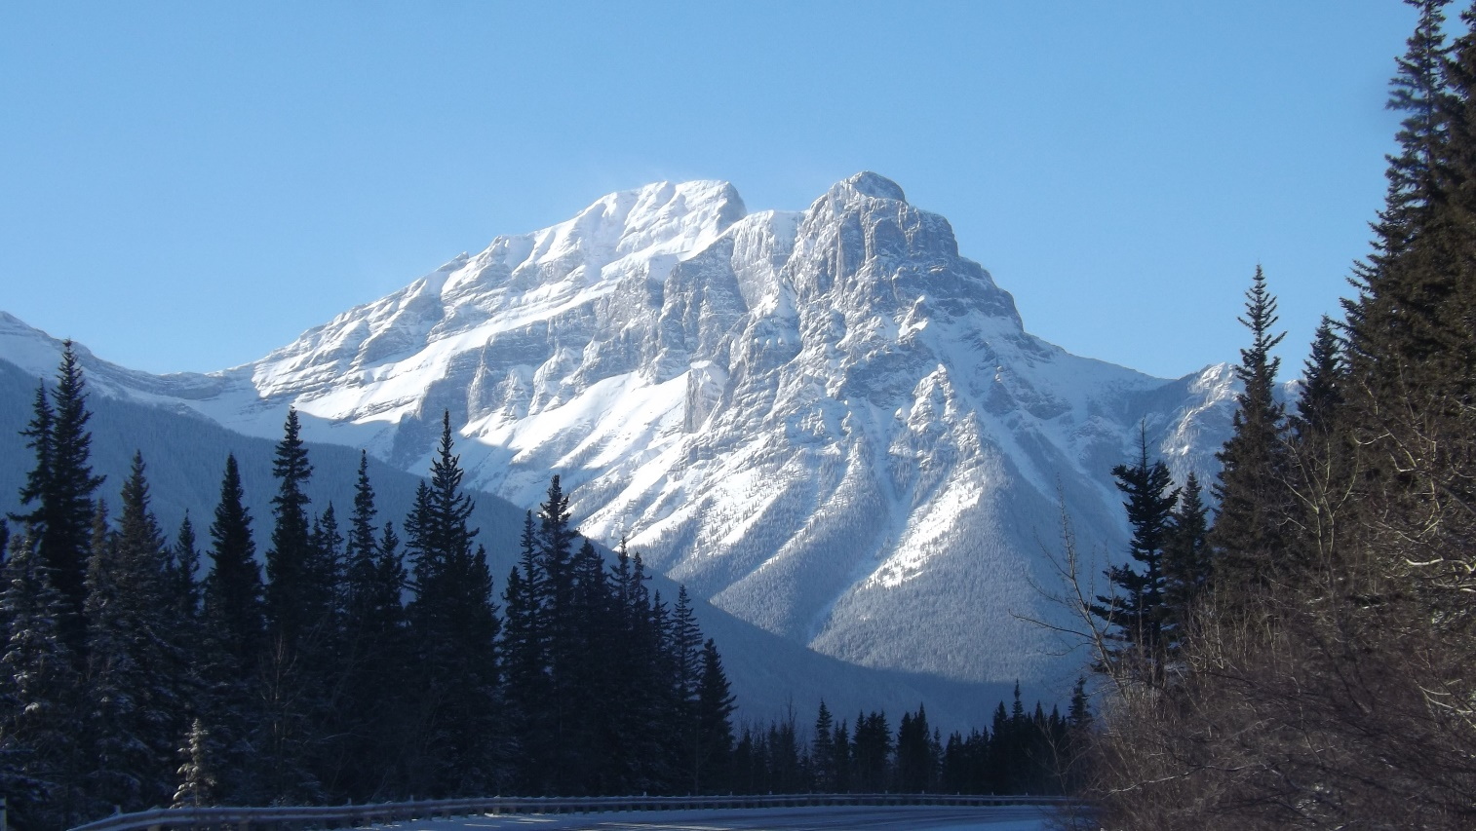
Ezekiel 36 The mountain of the lord
Ezekiel 36:1 Mountains of Israel, hear the world of the Lord.”
Ezek 36:22 It is not for your sake that I do this. It is for my holy name. Deut 7:7-9.

Slide 6
Ezek 36 a new covenant
Ezek 36:24f A remnant devoted to God. A New Covenant.
v. 24 all nations
v. 25 cleansed by water
v. 26 a new heart and a new spirit
v. 27 receive the Holy Spirit
v. 29-30 blessings
v. 31 repentance
No wonder Jesus challenged Nicodemus he should have known
v. 22, 32 not because you are awesome

Slide 7
A new eden
v. 33 much fruit
v. 35 imagery from the Garden of Eden. The Kingdom of God Isaiah 65:19-25
v. 36 When people see how God has blessed us, “Then they will know that I am the Lord”

Slide 8
Ezekiel 37:22-28 The Messiah!
One nation v. 22
One king v. 22
I will save them v. 23
I will cleanse them v. 23
My servant David will be king over them v. 24
A new covenant. v. 26
I will dwell (tabernacle) with them v. 26-27 John 1:14
This is about the Church but it is also about heaven—the Kingdom

