Slide 1
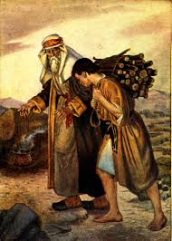
Jesus in the Old Testament:
From Shadow to
Reality
John Oakes

Slide 2
John 5:39-40 You diligently study the Scriptures because you think that by them you possess eternal life. These are the Scriptures that testify about me, yet you refuse to come to me to have life.
Old Testament like a play….
Old Testament like a mystery….

Slide 3
Foreshadow: An object, event, person or situation which stands for something similar, but of greater significance in the future.
Prefigure: A specific thing which stands for another specific thing similar to it in the future.
Type and Antitype: A person or thing regarded as the symbol of someone or something which is yet to appear

Slide 4
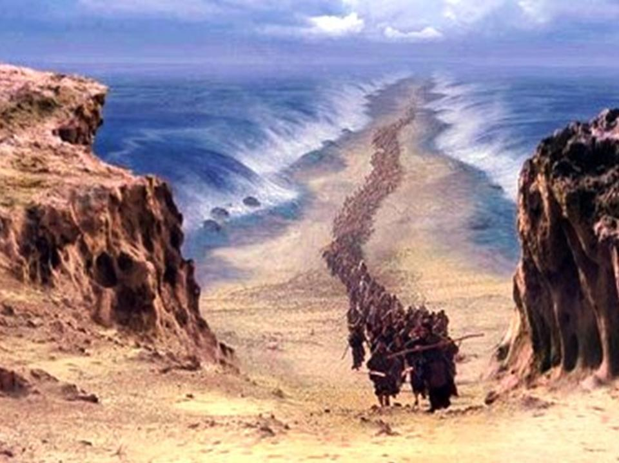
Historical Foreshadows
1 Corinthians 10:11 These things happened to them as examples and were written down as warnings for us, on whom the fulfillment of the ages has come.

Slide 5
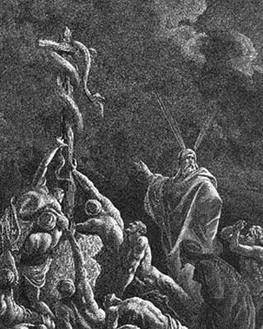
A little example: Numbers 21:4-9.
Snake-bite = sin. Both result in death Romans 6:23
The solution? Look to the snake, lifted up on a wooden pole John 3:14
Why a snake? 2 Corinthians 5:21

Slide 6
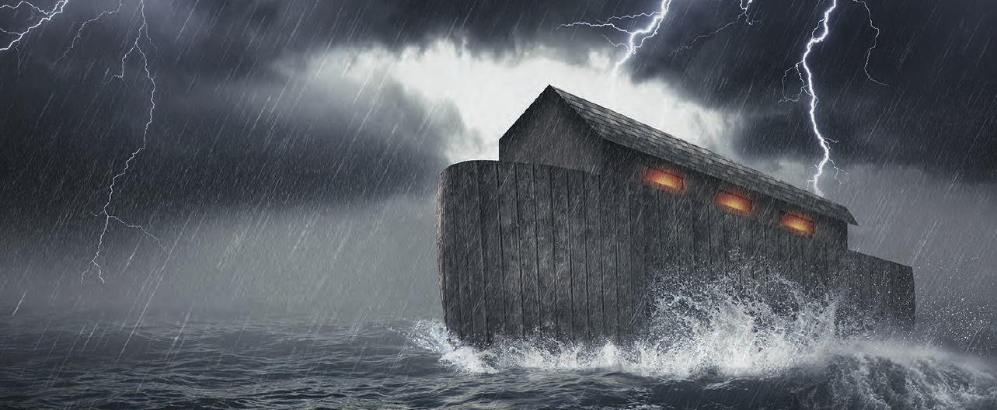
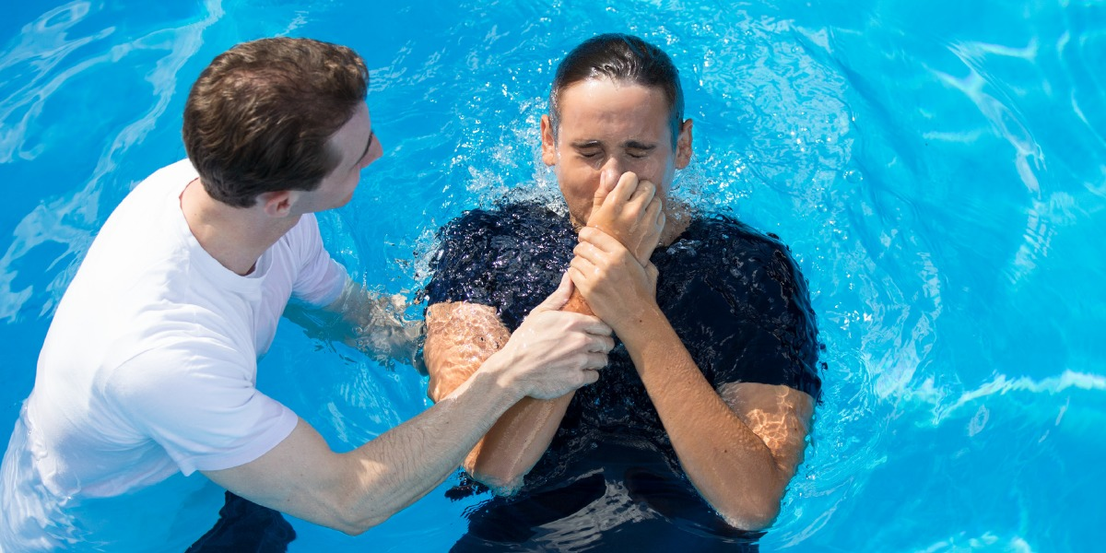
The Flood as a Foreshadow

Slide 7
Foreshadows surrounding Abraham
Isaac = children of promise = us
Ishmael = children born in the usual way = Israel
Hagar = Old Covenant = Mt. Sinai = “present Jerusalem”
Sarah = New Covenant = “the Jerusalem that is above”

Slide 8
Genesis 22:1-11
Your only son…
Mt. Moriah
On the 3rd day
Isaac carries the wood
Abraham carries the knife
Raised from the dead (figuratively, Heb 11:19)

Slide 9
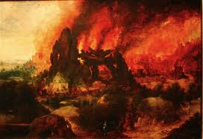
Sodom and Gomorrah
Sodom is symbolic of “the world.”
Sodom = Egypt = Babylon Revelation 11:8
Rev 18:2-3
Sodom is a symbol of what God will do to the unrighteous Luke 17:28-31
Who is Lot? 2 Peter 2:6
Who is Lot’s wife? Luke 17:32

Slide 10
Historical type/antitype in the Exodus
OLD TESTAMENT TYPE
NEW TESTAMENT ANTITYPE
SLAVERY IN EGYPT
LOST, SLAVE TO SIN
WANDERING IN THE WILDERNESS
SAVED, BUT LIVING THE LIFE OF A DISCIPLE
ENTERING THE PROMISED LAND
ENTERING HEAVEN

Slide 11
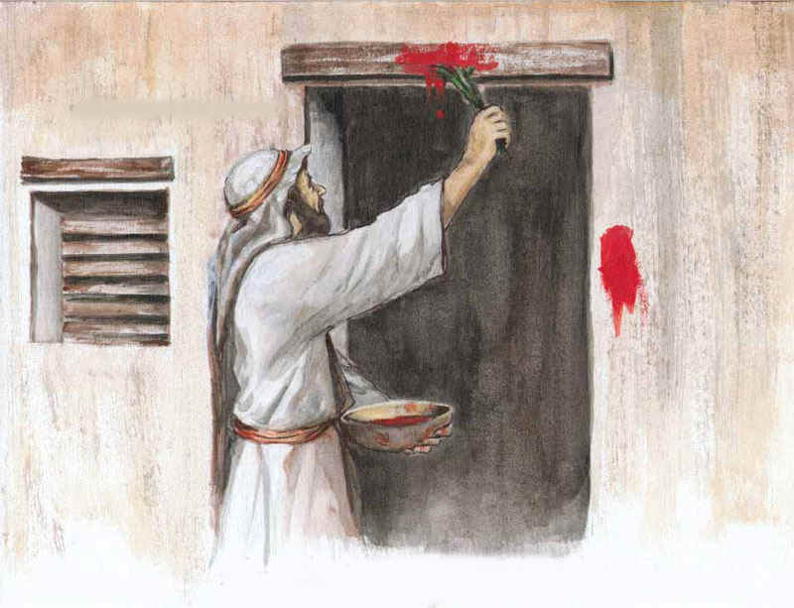
Foreshadows in the Exodus
Exodus 3:7-10 The people are enslaved: God sends a savior.
Moses = Jesus
Pharaoh = Satan
Plague #10: A death sentence
1 Cor 5:7

Slide 12

Passing Through the Red Sea
We’re free!!!
Not yet!!!
1 Cor 10:1-4

Slide 13
Prefigures of Jesus Christ
Adam
Melchizedek, Isaac, Joseph
Moses
Joshua
Deborah, Samson, Saul
David
Elijah, Jonah
Daniel, Cyrus
Joshua the priest, Esther

Slide 14
To Be a Prefigure of the Messiah
Prophet, Priest or King (or prince…)
Save Israel (or Gentiles)

Slide 15
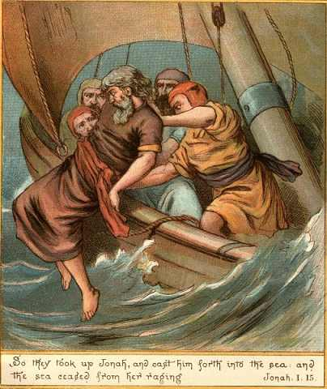
Jonah
John 7:52 No prophet ever came from Galilee…
Matthew 12:39,40 Three days and three nights
Luke 11:30-32 Offered salvation to the Gentiles
Jonah 1:7 Gambling
Jonah 1:12 Willingly offered his life to save the Gentiles
Jonah calmed a storm

Slide 16
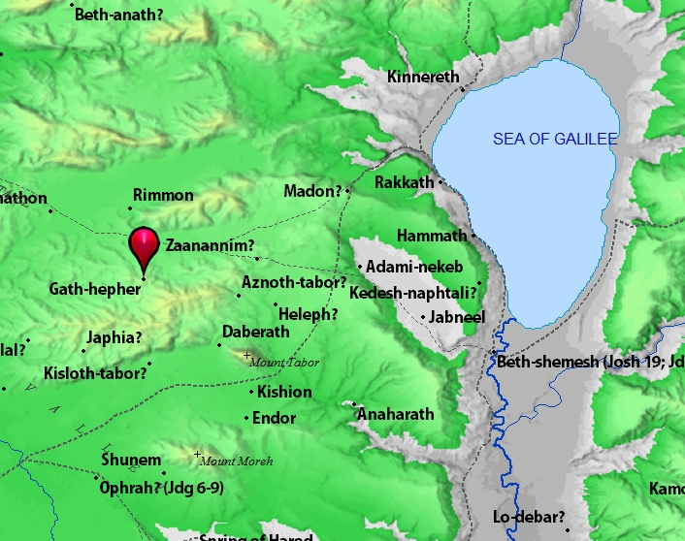
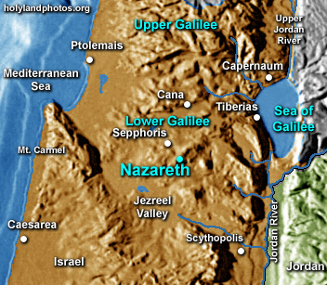
Gath Hepher and Nazreth 3 miles apart

Slide 17
Melchizedek: Prefigure of Christ
Melchizedek means King of Righteousness.
King of Salem means King (prince?) of Peace.
He blessed Abraham. (Genesis 14:19)
Abraham offered him a tithe/sacrifice (Genesis 14:20).
High Priest because of his character, not by descent. Heb 7:15-16
Greater than Abraham Heb 7:4.
Gave Abraham bread and wine (last supper, Lord’s Supper)
A priest for everyone; not just for the Jews.

Slide 18
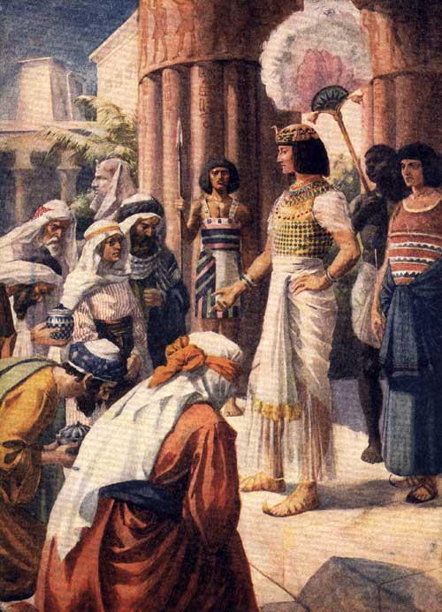
Joseph: Savior of Israel
From the right hand of his father, he became a slave in Egypt and was later raised to the right hand of the king
A shepherd
A dream: You will be King of the Jews
Jealous brothers decided to kill him
Betrayed for 20 pieces of silver
Went down to Egypt
Saved Israel

Slide 19
Parallels Between Moses and Jesus
Moses
Jesus
Pharaoh tried to kill him
Herod tried to kill him
Called by God to leave Egypt
Carried out of Egypt
Forty years in the wilderness to prepare for his ministry
Forty days in the wilderness to prepare for his ministry
Left his position with the king of Egypt to dwell with the Jews
Left the right hand of the Father to life with the Jews
Led Israel out of slavery in Egypt
Leads Spiritual Israel out of sin
Aaron prepared the way
John the Baptist prepared the way
Baptized Israel in the Red Sea in order to free them
Commands baptism in water for freedom from sin
Gave manna in the wilderness
(sort of)
Gives spiritual bread to all who hunger
Gave water to the people in the desert
Gives spiritual water: the Holy Spirit
Spoke to God on Mt. Sinai
Spoke to God on Mt. Hermon

Slide 20
David My Servant (Ezek 37:24-25)
Born in Bethlehem Micah 5:2
A very good shepherd John 10:11
Anointed king (parallel to Jesus’ baptism) 1 Sam 16:13
Physical king of physical Jerusalem
Brought God (the ark) to Jerusalem (Palm Sunday)
Saved Israel from slavery to Philistia
Offered a sacrifice on Mt. Moriah that saved Israel

Slide 21
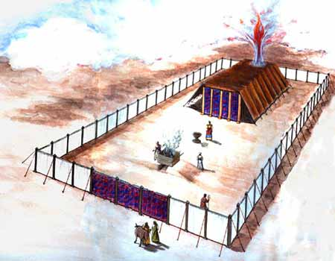
Model of The Jewish Tabernacle
Hebrews 10:19-20

Slide 22
Type/Antitype Relationships in the Tabernacle
ITEM IN TABERNACLE OR TEMPLE
ANTITYPE IN THE NEW COVENANT
SCRIPTURE REFERENCE
The tabernacle itself
God dwelling with his people
John 14:1-3, John 1:14J. Rev 1:13
The bronze altar of sacrifice
The sacrifice of Jesus for sins
Hebrews 9:14
The basin/laver
Baptism
Titus 3:5
The show bread
The bread of life, Jesus Christ
John 6:48-51
The lampstand
The Holy Spirit
Zechariah 4:1-6
The altar of incense
The prayers of the saints
Revelation 5:8
The blue, purple and scarlet yarn
The heavens, the kingship of God, the blood of Jesus
The curtain
Separation from God
Matthew 27:51
The ark of the covenant
The presence of God
Psalm 132:7,8
The Mercy Seat
The grace of God
The Cherubim
The angels in heaven
Ezekiel 10:15-22

Slide 23
Type and Antitype in the First and Second Covenants
Prefigure in the Law of moses
Realization in the law of christ
Obedience to physically defined rules required.
Obedience to spiritual principles required.
Physical blessings promised.
Spiritual blessings promised.
Ceremonial uncleanness.
Sin and separation from God.
Sacrifice bridges the chasm between law and effort.
Sacrifice bridges the chasm between law and effort.
Sealed with the blood of bulls and goats.
Sealed with the blood of Jesus Christ.
Mediated by a High Priest.
Mediated by THE High Priest, Jesus Christ.
Laws, rules and regulations for behavior.
Behavior based on spiritual principle and love.
Tithing.
Sacrifice and giving from the heart.
Sabbath.
Come…. I will give you rest. Relying on Jesus.
Death.
Life.

Slide 24
Sacrificial Type and Antitype
Old Testament Sacrifice
New Testament fulfillment
Scriptures
Sweet Savor Sacrifices
The Burnt Offering
Jesus’ and our devotion to God
Ephesians 5:1,2 Romans 12:1,2
The Grain Offering
Giving back a contribution to God
Matthew 6:19-21
Romans 8,9
The Drink Offering
Pouring out our life for God
Luke 22:20 Philippians 2:16
The Fellowship Offering
Celebrating our blessings from God
John 10:10
1 Thess 5:16
Blood Sacrifices
The Sin Offering
Jesus’ sacrifice for our sins
1 Peter 1:18,19
2 Corinthians 5:21
The Guilt Offering
Maintaining a relationship with one another
Matthew 5:23,24

Slide 25
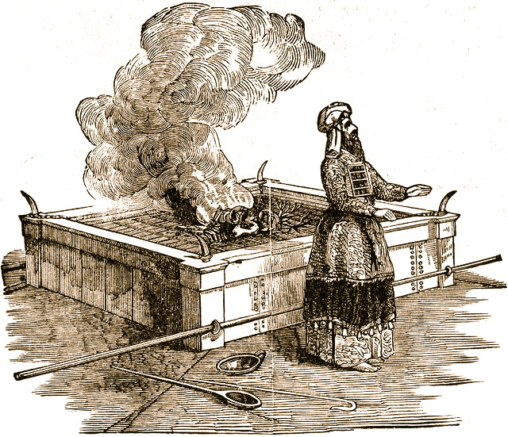
The Burnt Offering Leviticus 1
Lay hands on the animal.
Sacrifice the animal
Clean the body but not the head
Burn them on the altar
Meaning: Total commitment of one’s life to God.

Slide 26
The Red Heifer Sacrifice as a Prefigure
The Red Heifer Sacrifice | The Sacrifice of Jesus
A very rare red heifer | A unique son
Sacrificed outside the camp (on the Mount of Olives) | Sacrificed outside the camp (on the Mount of Olives)
To purify both Jews and Gentiles | To purify both Jews and Gentiles
A sacrifice without blemish (not even one black hair!) | A sacrifice without blemish
Never been yoked (voluntary, not sinned) | A voluntary sacrifice, without sin
Scarlet wool and wood | Blood on wood
Hyssop (purification from infection) | Purifies from the infection of sin
Combines ashes from sacrifice with water for purification. | Combine the blood of Jesus with baptism for purification

Slide 27
First Covenant Festivals as Types
Jewish Festival
Antitype in the Christian Life
Passover (pesach)
The Sacrificial Death of Jesus Christ
Feast of Firstfruits
The Resurrection of Jesus Christ
Feast of Unleavened Bread
Celebrating Being Free of Sin in Our Lives
Feast of Weeks/Pentecost (shavoat)
The Giving of the Holy Spirit and the Initiation of the Church
Feast of Trumpets (rosh hashanah)
Judgement Day, Jesus Coming Back
Day of Atonement (yom kippur)
The Day We Were Saved—Spiritual Birthday
Feast of Booths
(Tabernacles)
Celebrating Life in Fellowship with God

Slide 28
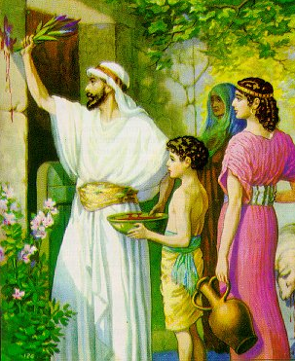
Passover/Pesach (Exodus 12:24-28)
Under a death sentence
Pure, undefiled Passover lamb (1 Cor 5:7-8, Rev 13:8)
Blood sprinkled on the wooden beam above the door.

Slide 29
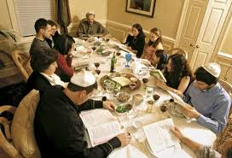
Passover/Pesach (Exodus 12:24-28)
A remembrance of salvation from death
A remembrance of salvation from slavery
No bone broken (Exodus 12:46 Psalm 22:17 Jn 19:31-33
Remove all the leaven (1 Cor 5:7)
Bitter herbs
The third cup:
the cup of redemption.

Slide 30
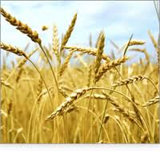
Feast of Firstfruits Lev 23:9-14
A harvest festival when there was no harvest.
A promise of a future harvest.
A foreshadow of the final resurrection.
A prefigure of the resurrection of Jesus. 1Cor 15:20-21
Coll 1:18 The first born from among the dead.

Slide 31
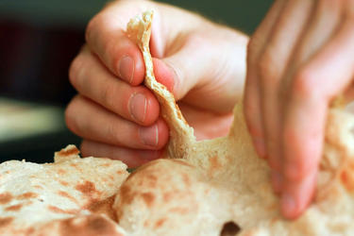
Feast of Unleavened Bread
Exodus 12:17-19 Celebrating a life of freedom in Christ. Freedom from sin.

Slide 32
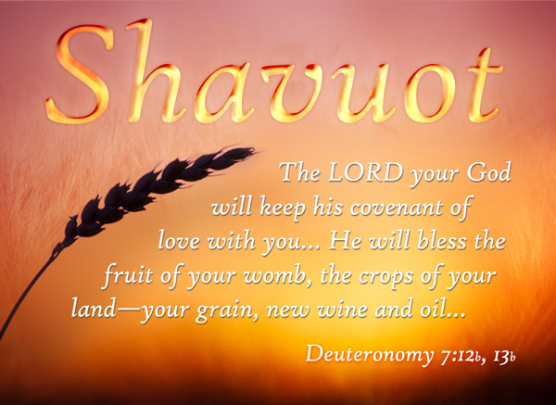
The Feast of Weeks/Pentecost/Shavuot
50 days after the Passover 49 days (7 weeks) after the Feast of Firstfruits.
Leviticus 23:15-17
Celebrating the harvest
of souls for eternity
1 Cor 3:5-9 The harvest
is the Lord’s

Slide 33

Feast of Trumpets Rosh Hashanah/Yom Teruah
A foreshadow of the Return of Jesus.
  Matt 25:30-31, I Thess 4:13-14 Trumpet call.
A foreshadow of Judgment Day
Rabbis: Stay awake all night so you will be prepared.

Slide 34
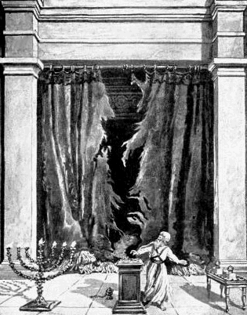
The Day of Atonement Yom Kippur
Sacrificial goat and scape goat.
Sins laid on sacrificial goat, killed outside the camp.
Prefigure of the salvation of Jesus.

Slide 35
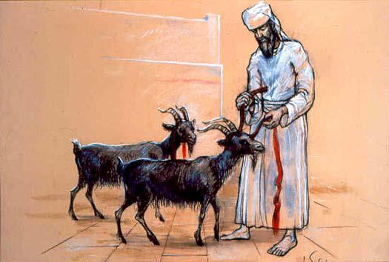
The Day of Atonement Yom Kippur
Scapegoat (Azazel) sent off into the wilderness
Bodies burned outside the camp (Hebrews 13:11-14)
Prefigure of the salvation of Jesus. Hebrews 9:11-15, 23-24

Slide 36
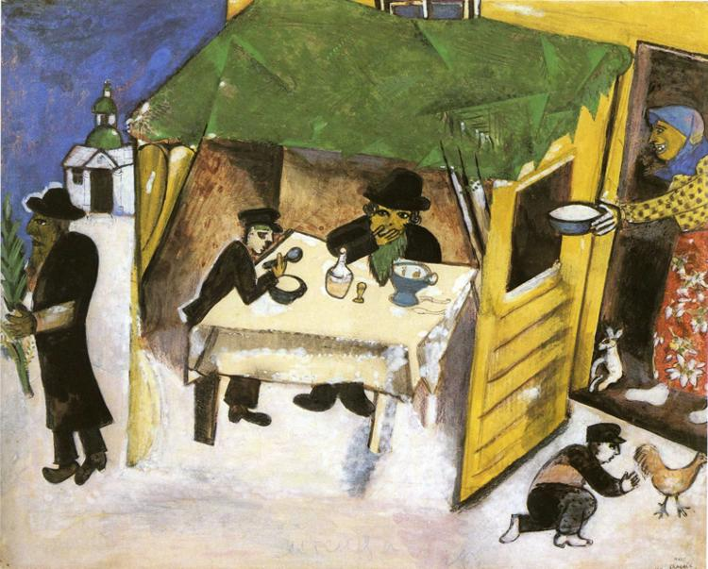
Sukkot/Feast of Booths/Tabernacles
Seven day festival
Harvest Festival
Build a booth and live in it for a week. Leviticus 23:33-43
Remembrance of Wandering in the Wilderness = living in a relationshiip with God.
John 1:14

Slide 37
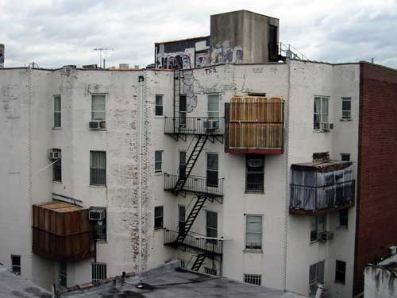
Sukkot in a City

Slide 38
www.evidenceforchristianity.org/ articles/bible

