Slide 1
In Christ
In Christ, in Him, In the Lord 164 times in Paul alone.

Slide 2
If We are in Christ, How and when did we get into Christ?
Gal 3:26 Baptized into Christ
Romans 6:4 Baptized into Christ
Believe into Christ?
Repent into Christ?
Pray into Christ?
How do you get in there?
You were out here

Slide 3
So… What do we have in Christ?
Coll 1:14, Eph 1:7 Redemption in Christ
1 Cor 1:2 Sanctified in Christ
2 Cor 5:21 Righteous in Christ
Eph 2:1-4 Alive in Christ
2 Cor 5:17 A New Creation in Christ
Romans 8:1-2 No Condemnation in Christ

Slide 4
So… What do we have in Christ?
Eph 1:4 We are Chosen by God in Christ
Gal 3:26 We are Children of God in Christ Jesus
Rom 8:38-39 We Have Secure Love in Christ
Romans 6:22-23 We Have Eternal Life in Christ Jesus

Slide 5
Peace With God in Christ Jesus
Do not be anxious about anything, but in every situation, by prayer and petition, with thanksgiving, present your requests to God. And the peace of God, which transcends all understanding will guard your hearts and your minds in Christ Jesus. (Philippians 4:6–7)

Slide 6
Fullness of God in Christ
For in Christ all the fullness of deity lives in bodily form, and in Christ you have been brought to fullness. (Colossians 2:9–10)
We become like God in Christ.

Slide 7
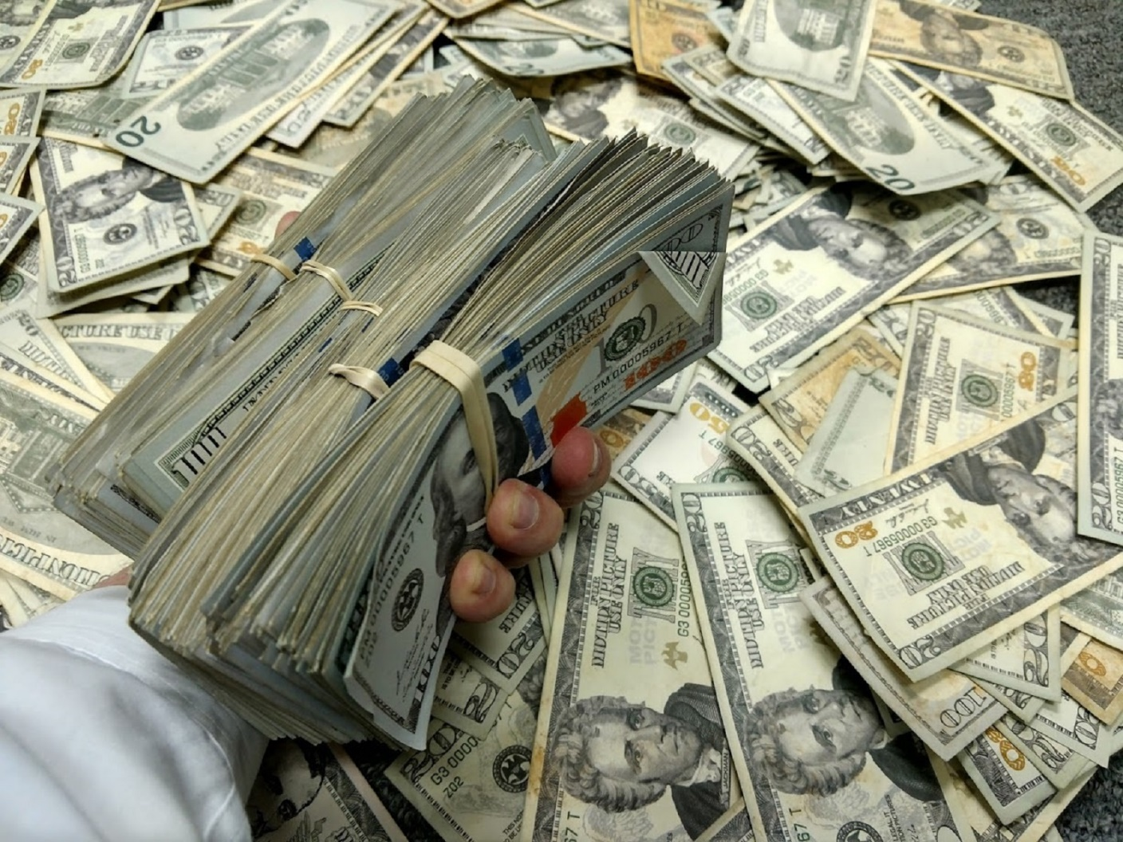
We Have Surpassing Worth in Christ
0.00000012%
$3.50
1972 Ford Pinto $200,000
Phil 3:5-11
< 0 “garbage”

Slide 8
Phil 3:8 Overwhelming gain
2 Cor 5:20 ambassadors
Rom 8:17 co-heirs with Christ
1 Cor 6:3 we will judge angels

Slide 9
Precious!
Isaiah 49:16 See, I have engraved you on the palms of my hands….
Exodus 19:5 …out of all the nations you will be my treasured possession.
Matt 10:29-31
1 John 3:1

Slide 10
Challenge
Let us treat our bodies, our time, our energy, our purity, our relationships as being of surpassing worth.

Slide 11
We Are All One in Christ
Gal 3:26-28 So in Christ you are all children of God through faith, for all of you we were baptized into Christ have clothed yourselves with Christ. There is neither Jew nor Gentile, neither slave nor free, nor is there male and female, vor you are all one in Christ Jesus.

Slide 12
What Do We Have in Common?
Christ
What is our uniform?
Christ

Slide 13
One in Christ
Matt 5:14-16 A city on a hill…
Micah 4:1-3 Many nations…
Zechariah 8:23 All languages and nations
Psalm 133 How good and pleasing it is…
John 17:23 …may they be brought to complete unity

Slide 14
Challenge
Let us celebrate and maintain our unity of culture, race and generations.
Let us build stronger bridges between generations and the cultures we have not yet reached.

Slide 18
All the Promises of God Find Their ‘Yes’ in Christ

Slide 19
You Have Every Spiritual Blessing in Christ

