Slide 1
Care packages

Slide 2
Strength class Thanks, Paul!

Slide 3
Singles at Christmastown

Slide 4
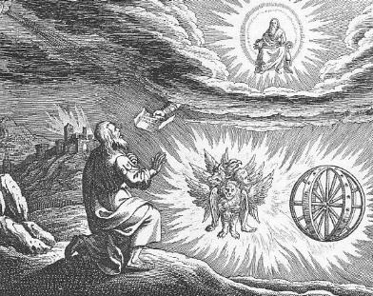
Ezekiel III God’s Justice

Slide 5
Themes in Ezekiel
1. The Sovereignty/glory of God
a. Theodicy: Free will
2. The utter sinfulness of humanity/Judah
3. The inescapability of God’s justice
4. The Messiah is coming/ The restoration of God’s Remnant.

Slide 6
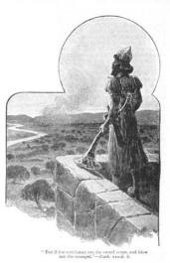
IV. The Watchman of Israel
We need to see God
We need to stand up for God
We need to eat the scroll
We need to be God’s watchman

Slide 7
Ezekiel 7 Cursed Money
Ezekiel 7:19-22 They will throw their silver into the streets. On the Day of Judgment, what the world holds to be valuable will be abominable.
Things you can buy Things you cannot buy
Medicine health
Books knowledge of God, wisdom
Position favor with God
Attention love

Slide 8
Ezekiel 9
9:1 Executioners from North (Babylon).
9:2 Put a mark on the foreheads of those who grieve and lament. Rev 7:1-17 Mark = protect from eternal judgment. (note: not protected from temporal judgment Ezek 21:3-4)
For us, the mark is the Holy Spirit Eph 1:13-14.

Slide 9
Ezekiel 9 (cont.)
Ezek 9:5 Kill without pity or compassion. Whew!
9:6 Begin at my sanctuary (leaders, the church) (1 Pet 4:17)
9:9-10 They brought this on themselves
9:11 It (God’s wrath) is accomplished!

Slide 10
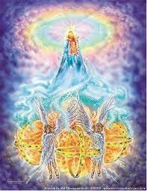
Ezekiel 10,11 Necessity of Judgment
Ezek 10:1 God on a sapphire throne with the cherubim.
Ezek 10:18 The Lord departs from the temple. Jerusalem is doomed.
Ezekiel 11:22-23 The end of the road for Jerusalem.
But… Good news in Ezekiel 43:1-5 God will return to his temple.

Slide 11
conclusion so far
If we are in a relationship with God but become unfaithful, he will come in judgment. If the Holy Spirit leaves us we are lost. “Once saved always saved is not biblical!”
But… God will always save a remnant, no matter how bad it gets.
This is a pattern throughout the Bible.

Slide 12
An Outline of the Bible
I. Genesis 1 God created the universe and the earth. It was very good.
II. Genesis 2 God created man so that we could have an intimate relationship with him.
III. Genesis 3 and 4 We messed up very badly—destroying that relationship.
IV. Genesis 5-Rev 20 God is repairing the damage done by sin.
V. Rev 21-22 God has fixed the problem and we are back in a relationship with him.

Slide 13
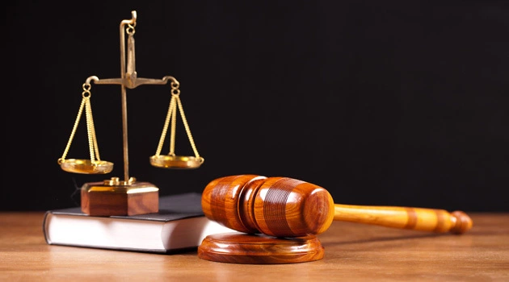
Ezekiel 18 God’s Justice
Q: Is God a just God?
If so, what is his justice like?
Theodicy

Slide 14
Ezekiel 18 Individual Righteousness
Ezek 18:2 A proverb: Sour grapes.
The exiles: It is not our fault. Blame it on our fathers!
Ezek 18:3 God: Wrong! Everyone is accountable for their own actions.
Ezek 18:4 All souls are mine. All can be saved (Rom 8:28-30)
Ezek 18:5-18 God’s justice. (does this contradict Exodus 20:4?)

Slide 15
individual righteousness
Ezek 18:21-24 Our final state determines our eternal destiny (but be aware of Hebrews 6:4-6 and 2 Peter 2:20-22)
18:22 For the righteous: None of his offenses will be remembered
18:24 For the unrighteous: None of his good deeds will be remembered.
18:25-29 Godly vs human justice. (Matthew 20:1-16 exp. v. 14)
18:30 The bottom line: Each will be judged by their ways.
18:32 The bottom line for God. He wants all to be saved.

Slide 16
Ezekiel 23 Oholah and oholibah Shameful History IV
Oholah (Heb: her tent) is Samaria/Ephraim/Northern Kingdom
Oholibah (Heb: my tent is in her) is Jerusalem/Judah
This chapter is R-rated. It is shocking on purpose.
Message: God will give us over to our lusts if we live by sight, not by faith (Romans 1:24-28)
Ezek 23:5-10 Oholah prostituted herself with Egypt and Assyria.
Ezek 23:11-27 Oholibah was worse than her sister!
v. 20 This is disgusting! Sin is disgusting. Their mistake: They were not satisfied with God. 1 Tim 6:8 Are you satisfied with what God has for you?

Slide 17
Oholah and Oholibah cont.
Ezek 23:22 The take-home lesson: I will give you over to what you give yourself to.
Ezek 23:25 God: I am jealous. Amazingly, God still loves Samaria and Judah. This is the story of Hosea. Romans 5:8 While we were still sinners, Christ died for us.
Ezek 23:28 I will give you over to the very thing you hate. This is what sin does. John 10:10 The thief comes to steal and kill and destroy. Jesus came that we can have life.
Summary: 23:49 Then you will know that I AM the Lord.

Slide 18
Ezekiel 24 The cauldron Ezekiel refuses to mourn
Jan 588 BC A date to mark down. The date Jerusalem was put under siege. Again, Ezekiel proves himself to be a prophet.
Ezek 24:6 A cauldron with encrusted layers of unrepented sin. Judah. 24:12 A heavy deposit.
Ezek 24:11,13 When God’s wrath is poured out, it will get hot enough to burn off the encrusted layers.
24:14 I will not have pity (as illustrated later in Ezek 24:15-24)
24:15-24 God to Ezekiel: Do not mourn when your wife dies. I will take away the delight of your eyes. How does God feel about judging Judah? Like Ezekiel feels about God taking away his wife.
The point: When we suffer discipline for our sins, we should accept it without complaint.

