Slide 1
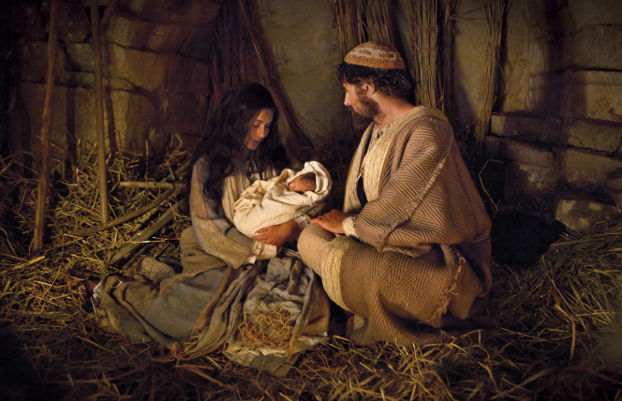
A Savior is Born

Slide 2
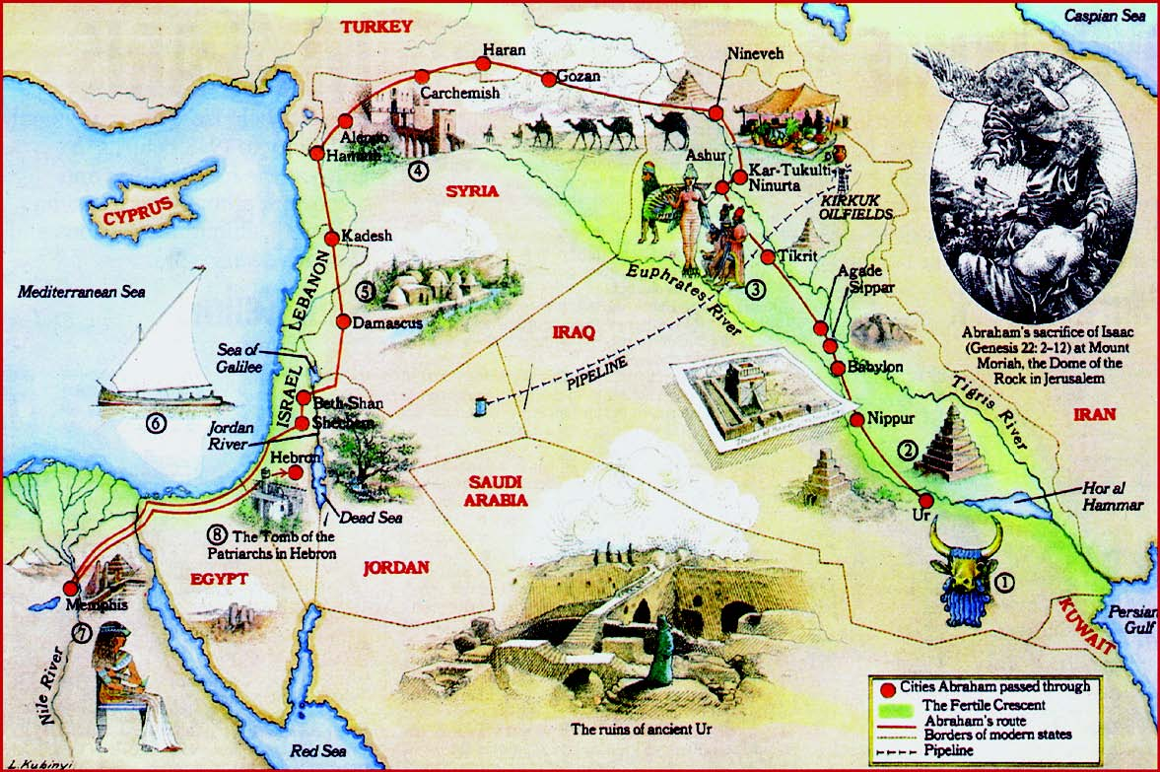
Luke 2:1-7 In those days…

Slide 3
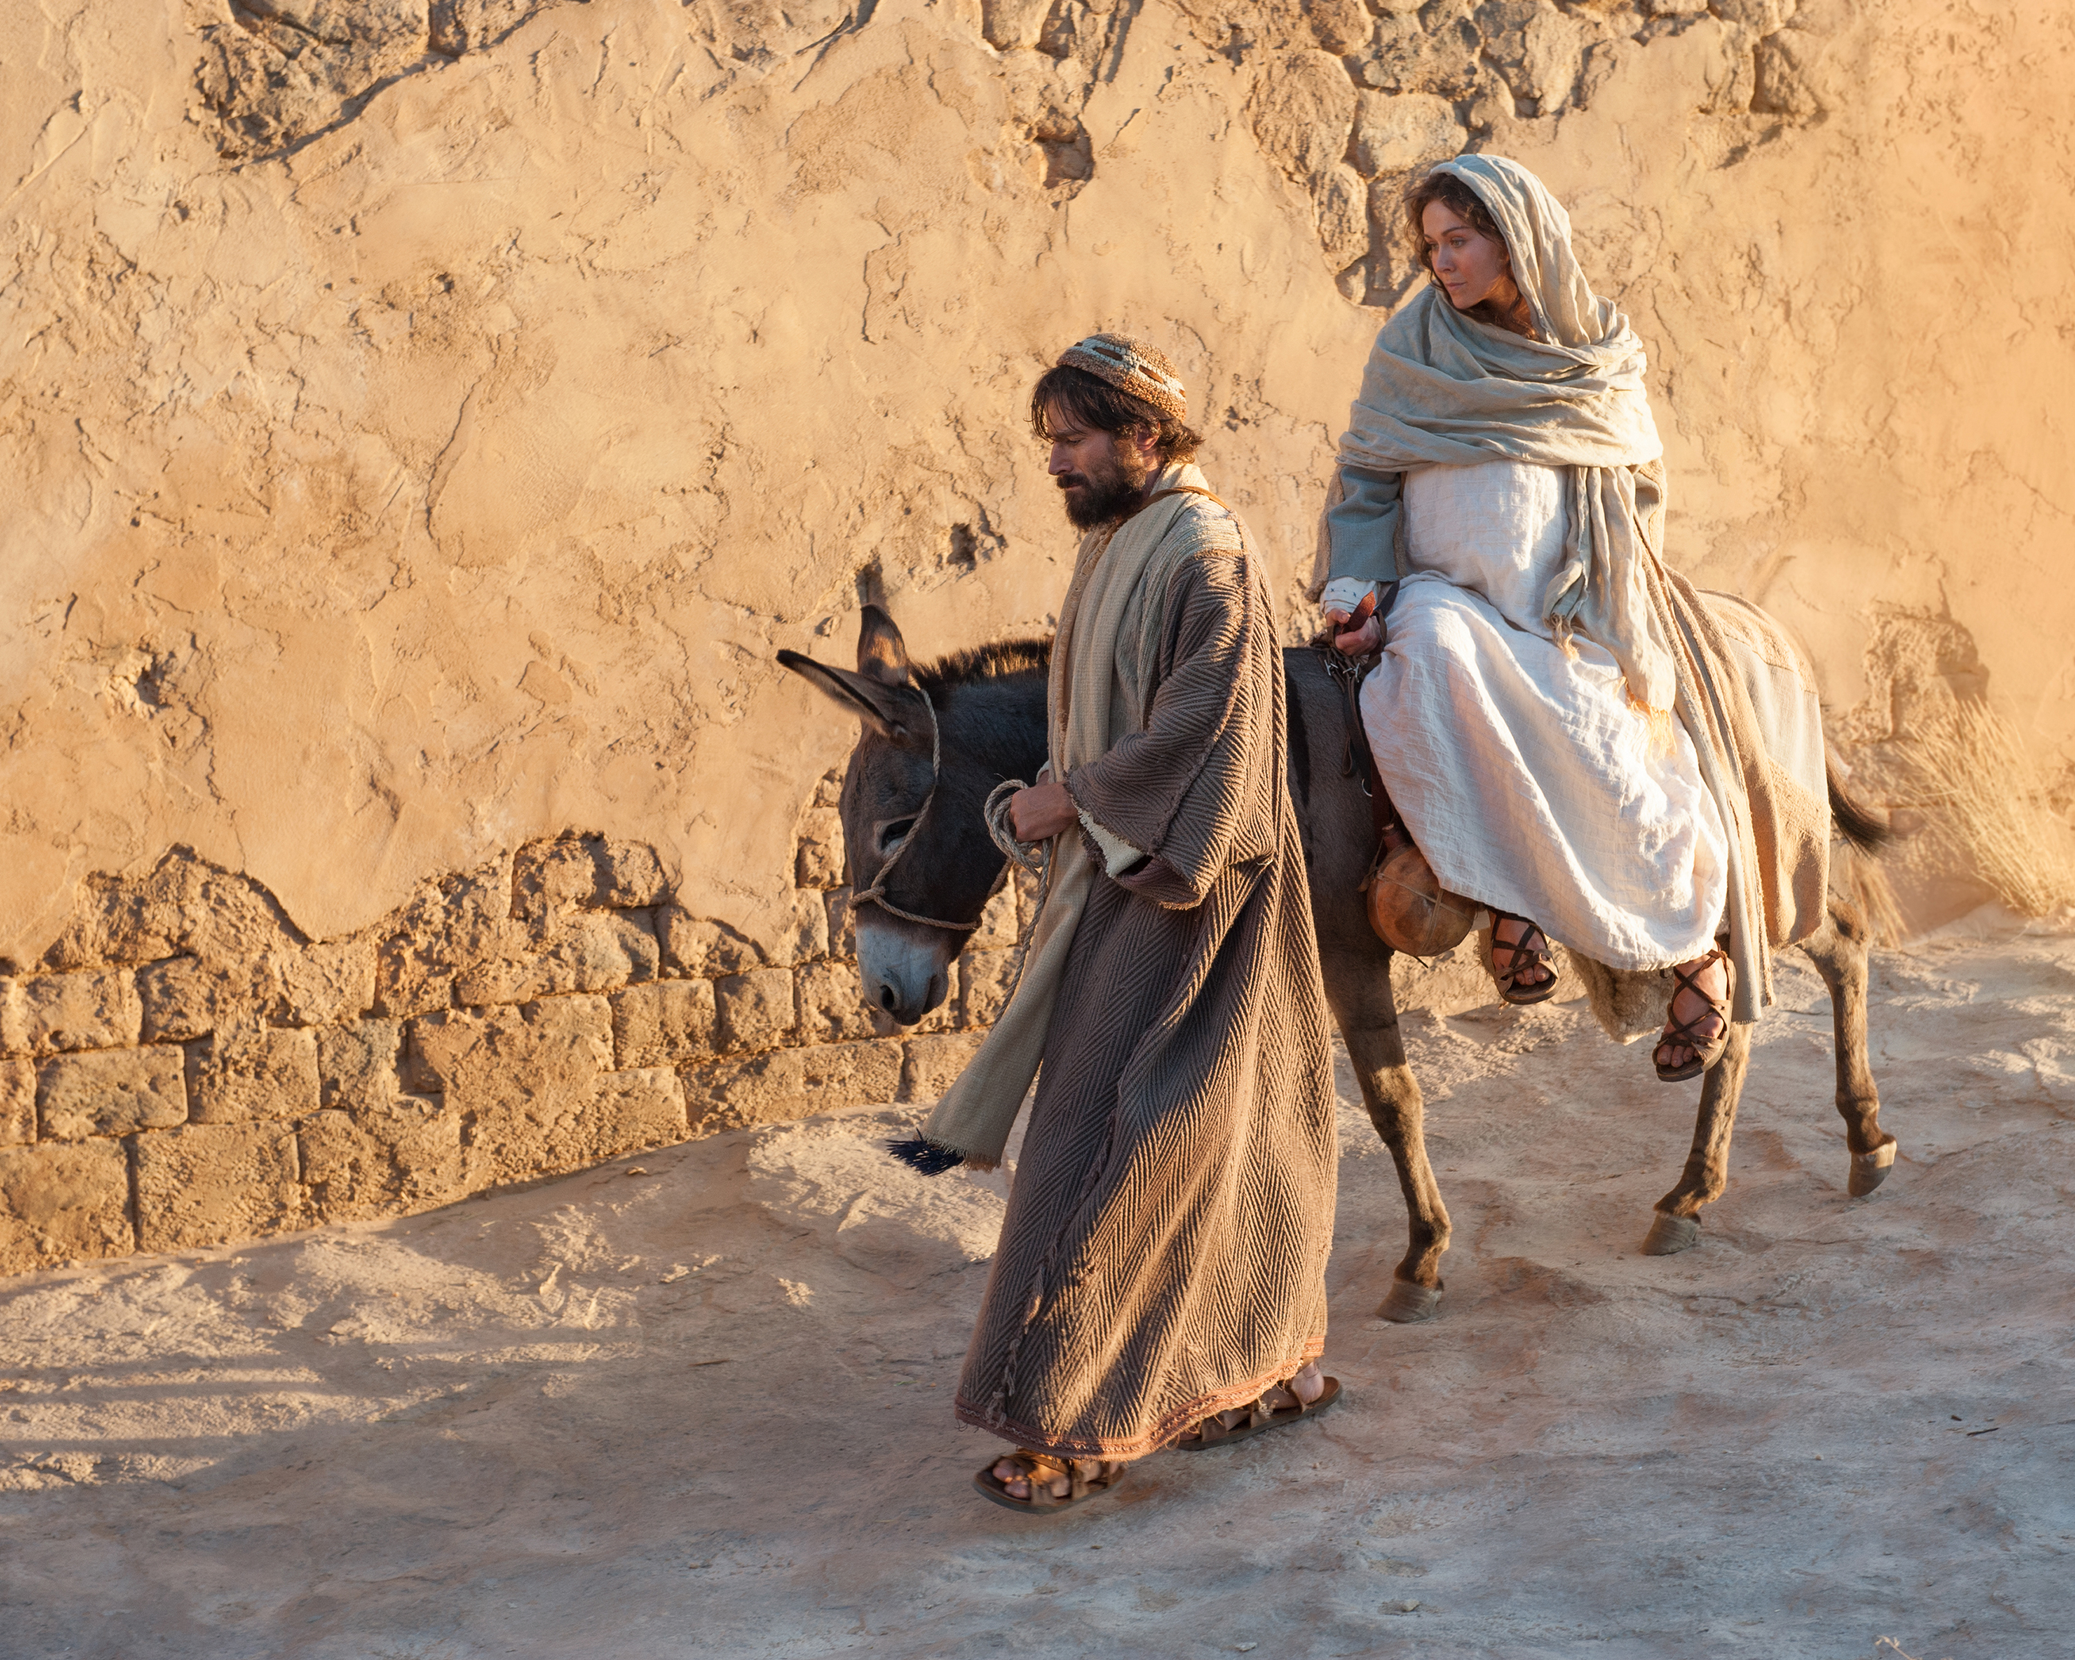
Luke 2:4-6 Joseph and Mary went up to Bethlehem for the census.

Slide 4
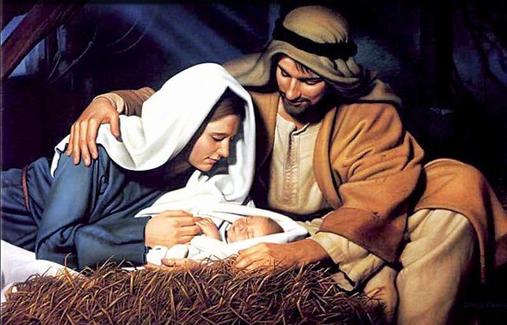
Luke 2:6-7 A Savior is born
A messiah is born.
A king is born.
A Savior is born.
No room at the
Inn….

Slide 5
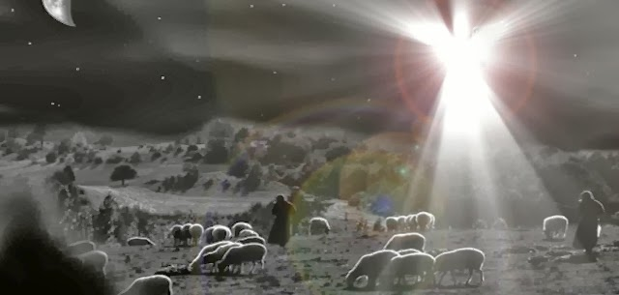
Luke 2:8-15
Good news that will cause great joy announced to shepherds
A savior
has been
born. He is
the Messiah
and Lord.

Slide 6
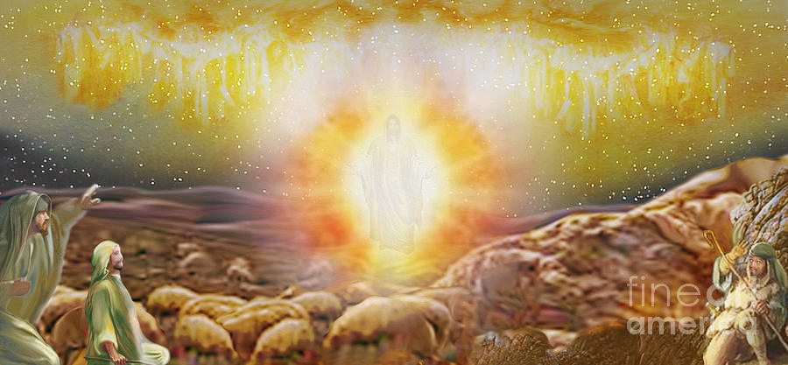
Glory to God in the highest heaven,
and on earth, peace to those on whom his favor rests.

Slide 7
Matthew 1:18-2:12
Jesus is God who came toward/among us to save us who would be your king.

Slide 8
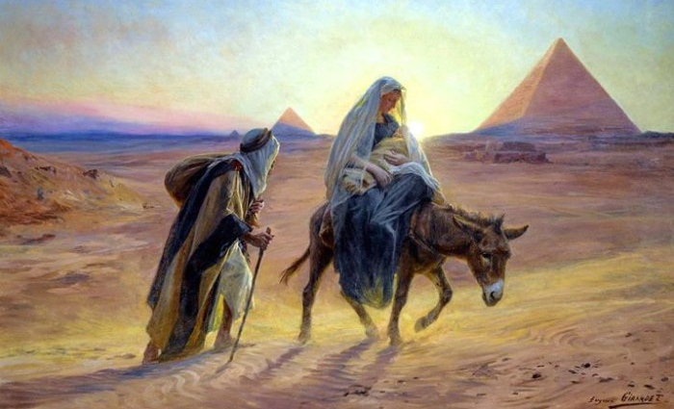
Matthew 2:9-18 Jesus: Called out of Egypt
Jesus calls us out of Egypt

Slide 9
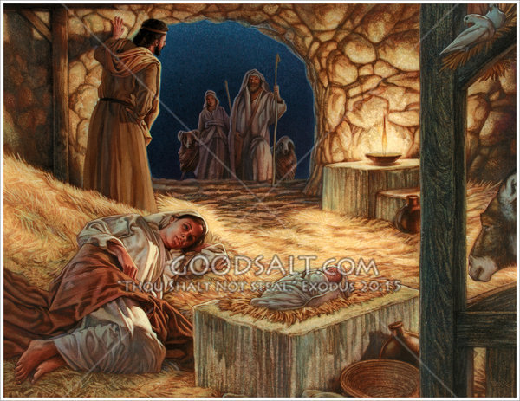
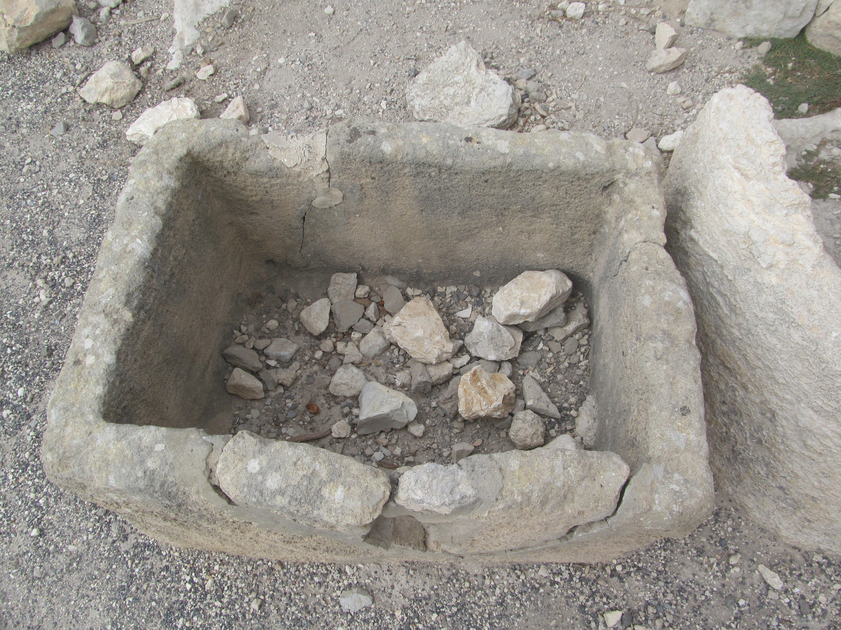
Luke 2:16-20 The King of kings and Lord of lords is lying in a feeding trough

Slide 10
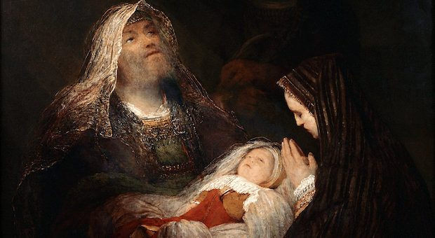
Luke 2:22-38 Jesus presented at the temple
Jesus will:
Bring people together (Eph 2:11-18, 3:4-6) A light of revelation to the Gentiles.
Divide the lost from the saved. A sign spoken against

Slide 11
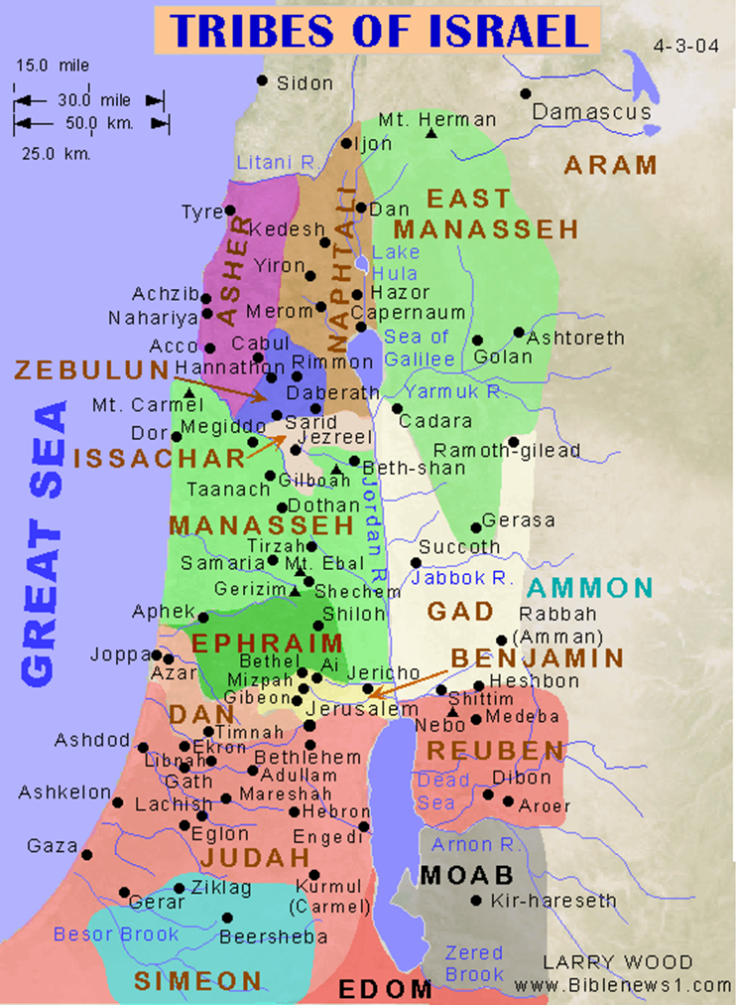
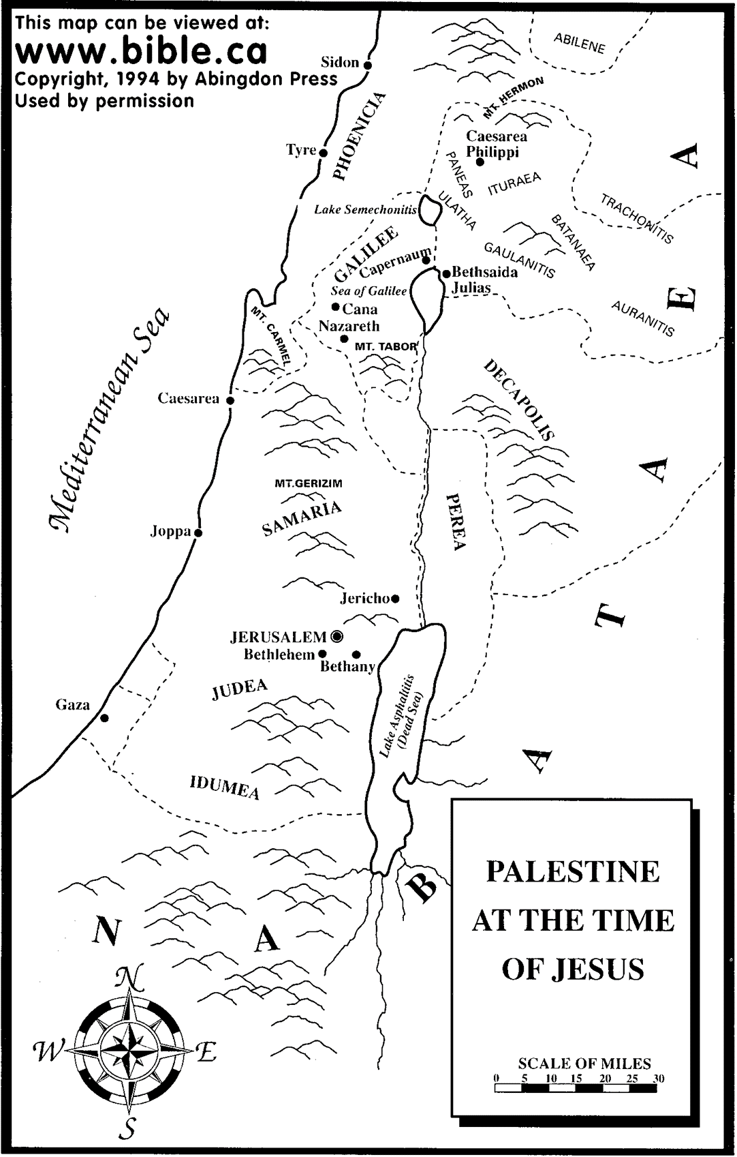
Luke 2:39-40 Joseph and Mary return to Nazareth. Isaiah 9:1, 6-7.

Slide 12
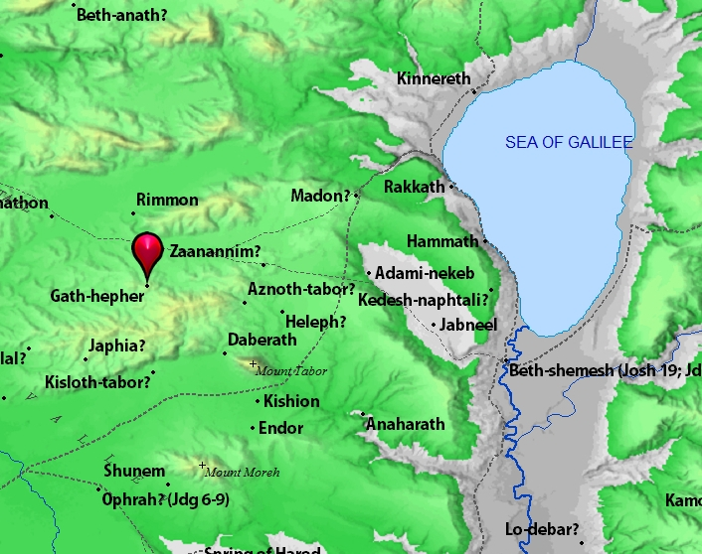
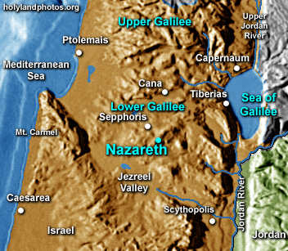
Gath Hepher (Jonah) and Nazareth (Jesus) 3 km apart

Slide 13
Isaiah 9:6-7
“For to us a child is born, to us a son is given
And the government will be on his shoulders,
And he will be called Wonderful Counselor, Mighty God, Everlasting Father, Prince of Peace….
He will reign in David’s throne and over his kingdom establishing it an upholding it with justice and righteousness from that time on and forever….
A Savior is born…

