Slide 1
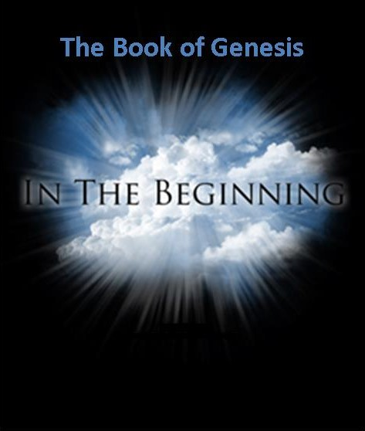

Slide 2
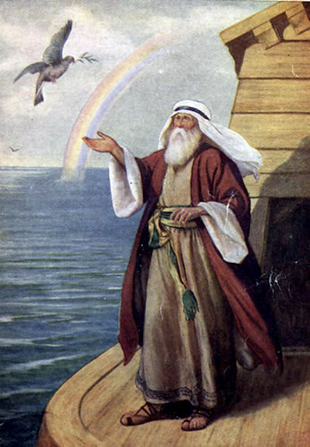
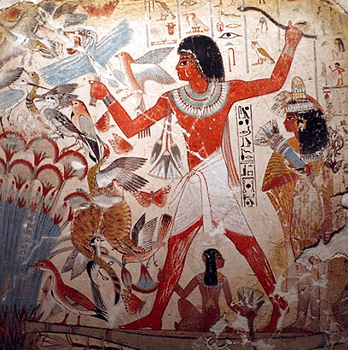
Genesis and Apologetics
Genesis and Worldview
Genesis, Creation and Science
The Flood
Genesis, Prefigures and Foreshadows
Genesis and Archaeology

Slide 3
An Outline of the Bible:
Genesis 1: Who is God?
Genesis 2: Who is man?
Genesis 3 & 4 The problem of sin.
Genesis 5-Revelation 20 God is solving the problem
Genesis 21-22 The problem is solved.

Slide 4
Another Outline of the Bible
I. Genesis 1 God created the universe and the earth. It was very good.
II. Genesis 2 God created man so that we could have an intimate relationship with him.
III. Genesis 3 and 4 We messed up very badly—destroying that relationship.
IV. Genesis 5-Rev 20 God is repairing the damage done by sin.
V. Rev 21-22 God has fixed the problem and we are back in a relationship with him.

Slide 5
Genesis Chapter 1: Creation
Genesis Ch 1-3 is primarily theology.
Genesis 1:1
In the beginning…
In the beginning, God…
In the beginning, God created… (Heb 11:3 Rom 1:21-25)
In the beginning God created the heavens and the earth

Slide 6
Genesis 1: A Polemic
A polemic against Enumah Elish. The Babylonian creation myth.
Wenham: “Gen 1-11 is a commentary, often highly critical, on ideas current in the ancient world about the natural and supernatural world.”
In Enumah Elish creation of mankind was an afterthought. In the Genesis mankind are the apex and purpose of creation.

Slide 7
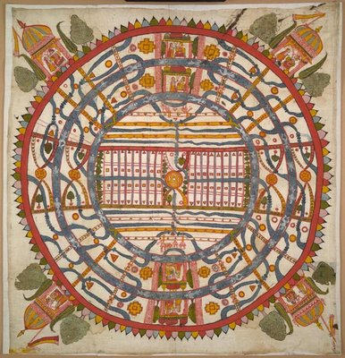
World View
One's world view is the perspective one uses to process and interpret information received about the world.
James W. Sire, The Universe Next Door (InterVarsity Press, 1997)
A Jain World View

Slide 8
Competing World Views
Naturalism/Atheism
Postmodernism: No World View
Deism
Pantheism
Animism/Polytheism
Dualism
Biblical Theism

Slide 9
The Christian World View According to Genesis 1-4:
1. The physical world is: a. real b. created out of nothing (ex nihilo) and c. essentially good.
2. There exists an unseen spiritual reality which is not limited to or defined by the physical reality. Human beings have a spiritual aspect to their nature.
3. The creator of both the physical and spiritual realm is the God who reveals himself in the Bible.
4. Human beings have both a physical and a spiritual nature.
5. God is characterized by certain qualities. God is a person. God is love, God is just, God is holy, God is omniscient, omnipotent and omnipresent.

Slide 10
The Christian World View (cont.)
6. Although all God’s creation is good, evil does exist. Evil is the result of freedom of will given to created beings and their decision to use that freedom to rebel--to “sin”
7. Because of God’s justice and his holiness, those who choose to rebel against him will ultimately be judged and separated from God for eternity.
8. The solution to evil, to sin and its eternal consequences is provided by God through the atoning substitutionary sacrifice of Jesus Christ.
All of this is found in Genesis 1-4

Slide 11
A Good World View
True. It is consistent with reality.
Successfully answers the important questions.
Purpose of life
Why is there evil
What is my value?
What is the right thing to do?
3. Makes those who accept it better than they otherwise would have been.

Slide 12
The Hard Questions
Evil: What is Evil and Why is There Evil
Why is There Suffering?
The Problem of Justice
The Problem of Sin.
The Problem of Death.

Slide 13
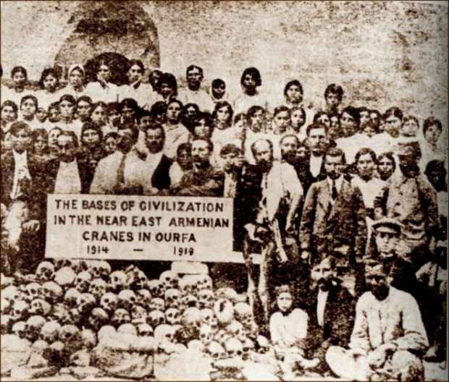
The Problem of Evil: What is it and what is its cause?

Slide 14
Augustine on Evil
About Augustine: “Evil arises from the corruption of a nature which is essentially good. What is called evil is good corrupted; if it were not corrupted it would be wholly good; but even when it is corrupted, it is good in so far as it remains a natural thing, and bad only in so far as it is corrupted.”

Slide 15
Apologetics and Evil: What are the alternatives?
Dualism: Good and Evil in an unending more or less equal balance
Pantheism: The physical world is evil. Evil is being tied down to the physical—it is missing the god-likeness in you.
Naturalism: There is no evil.
Postmodernism: Evil???
Determinism/Fate God is the cause of evil.

Slide 16
Christianity and the Problem of Evil
Evil is very much real. Quite indirectly, it is the product of God’s love. God loved us so much that he loved us and that he gave us a choice. We chose evil, and thus evil came into the world.
Remember your alternatives:
Predestination/Determinism God is the cause of evil.
Deny evil exists
Physical creation is evil, but you are God
An unending battle/balance between good and evil.

Slide 17
Christianity: A Good World View
It is true (the universe was created from nothing)
It answers the hard questions (why is there evil,
what is my purpose, what is my value, etc.)
It makes us better that polytheism, animism, dualism, atheism, panteism…

Slide 18
Genesis Chapter 1: Creation
Genesis 1:2-10 God creates order and distinctions out of disorder and formlessness
Light vs dark
Sky, water, land
Living vs non-living 1:11
Male vs female 1:27
Good vs evil Gen Ch 3

Slide 19
What Does God Do in Genesis 1?
He creates out of nothing.
He creates order out of chaos.
He creates distinctions/ separation
separation = holiness
He names things
naming = having power over

Slide 20
Two things to notice in Gen 1:2
v. 2 The Spirit of God was hovering…
The Holy Spirit in Genesis?
v. 2 etc. Evening and morning… the first day.
We would say morning and evening.
The Jewish day begins at sunset.

Slide 21
Genesis 1:11-25 God Creates Life
A lot of order from a lot of chaos.
Gen 1:14 The greater and lesser lights.
Again, a polemic against Mesopotamian worship of heavenly objects.

Slide 22
In God’s image and likeness
Genesis 1:26-30 God creates mankind in his image, to rule the earth.
Q: In what sense are we created in God’s image?
Q: What are the implications that God put us in charge of the earth?

Slide 23
Blessings
1:26 Let us make mankind in our image.
- The royal we?
- The heavenly court?
- The trinity?
1:28 God blessed humankind. This was his plan all along.

Slide 24
God: Mankind Will Rule the Earth
v. 28-30 Subdue and rule
Hebrews 2:8 “in putting everything under them…”
Q: What are the implications that we are in charge of the earth?
Does this mean we can do what we like? 1 Cor 4:2

Slide 25
It’s All Good
Genesis 1:31 Summary: It was all very good.
Q: Do you agree with God’s analysis here?

Slide 26
Genesis 2:1-3 The Seventh Day
Genesis 2:2 God rests from creating (but he is not completely resting).
This is theological justification for the Jewish Sabbath.
Heb 4:8-11 We do not rest. Our Sabbath-rest is in heaven.

Slide 27
Genesis Chapter One: Creation
Young Earth Theory
Earth is young and science supports this conclusion.
Earth is young because God created it “with an appearance of age.”
Day/Age Theory
Gap Theory
Framework Theory
It’s all just a myth
Each view has its problems

Slide 28
Framework Theory
Habitats Creatures
Day 1 Light Day 4 Luminaries
Day 2 Sky Day 5 Birds and fish
Day 3 Land Day 6 Land animals, man

Slide 29
A Quick Summary of Genesis One:
a. God pre-existed the universe
b. God created the universe: “Let there be light”
c. God created the earth
d. God created life
e. Last of all, God created mankind

Slide 30
A More Detailed Summary of Genesis One From the Viewpoint of an Observer on the Earth:
a. The earth created and is spinning: night and day. Day 1
b. Water covers earth, Very thick atmosphere forms. Day 2
c. The earth cools, land appears out of the water. Day 3
d. Life appears on the earth. Day 3
e. (Photosynthetic life dramatically changes the chemistry of the atmosphere from reducing to oxidizing.)
f. Finally, the heavenly objects appeared in the sky Day 4
g. More advanced life forms; first in the water, later on the land Day 5
h. Even more advanced life forms. Last of all human beings Day 6

Slide 31
Is Genesis 1:1 a Myth?
Yes! It is a true myth.
A myth is a simplified story, given to explain the gods (or God) to common people.
“Genesis 1 is a mixture of historical facts and religious truth based on these facts”

Slide 32
Creation Myths
Babylonian Creation Myth
Primeval swamp. Marduk kills Tiamat. Blood + mud = humans
Egyptian Creation Myth
Primeval ocean “Nun” from which arrises a Primeval hill.
Greek Creation Myth
Prometheus and Epimetheus form clay molds. Earth supported by Atlas.
Iroquois Creation Myth
Enigorio and Enigohahetgea: Good and evil brothers battle
Genesis One is an obvious exception to this pattern

Slide 33
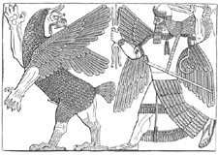
Babylonian Creation Myth: Marduk kills Tiamat

Slide 34
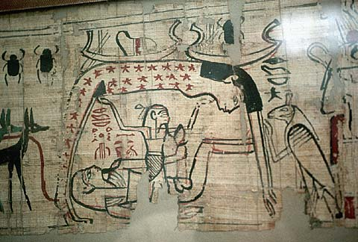
Egyptian Creation Myth

Slide 35
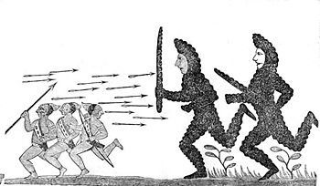
Iroquois Creation Myth:
Enigorio and Enigohahetgea Battling the Ronnongwetowanca (Stone Giants)

Slide 36
Is the Metaphorical Day a Reasonable Interpretation? Pre-Science Theologians Who Said Yes.
Philo 1st century
Origen early 3rd century
Augustine early 5th century
Thomas Aquinas 13th century

Slide 37
Translations of yom in the Old Testament (NIV)
1181 times as “day” (but with several different connotations of the word, some not being literal)
Isaiah 4:2 In that day the Branch of the Lord will be beautiful…
67 times as “time”
30 times as “today”
18 times as “forever”
10 times as “continuously”
6 times as “age”
4 times as “life”
2 times as “perpetually”

Slide 38
Adam: A Type of Jesus
Romans 5:12-19 The sin of Adam set a pattern and produced a terrible result.
The sinless life of Jesus set a pattern and produced a wonderful result.
1 Cor 15:45-49 Like Adam in our physical nature. Like the second Adam in our spiritual nature.

Slide 39
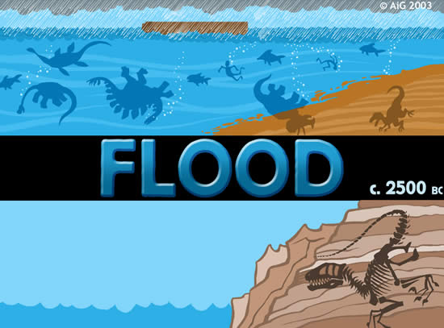
The Flood: Genesis 6-9

Slide 40
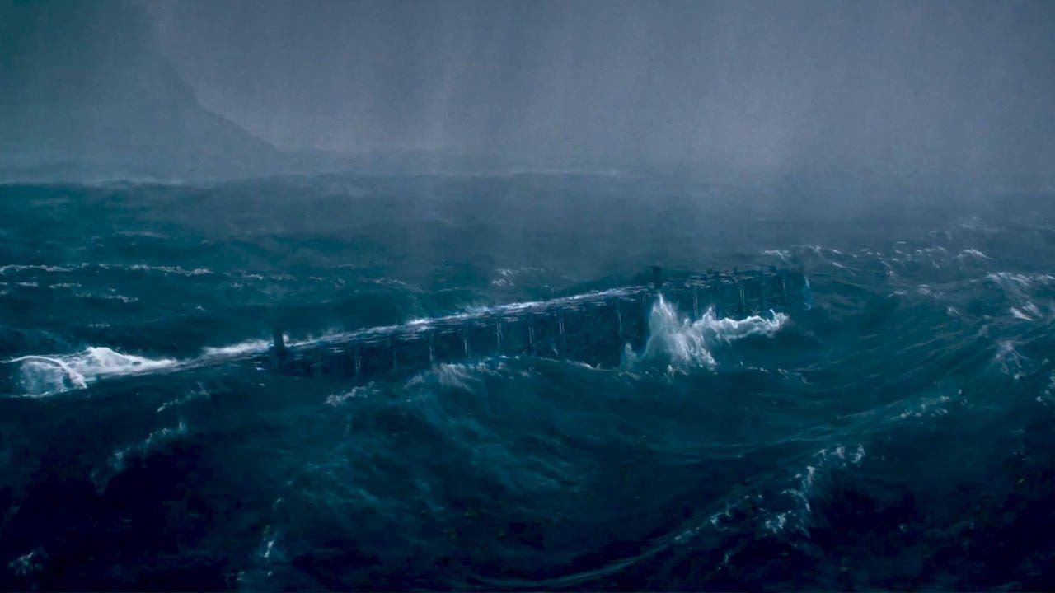
The Flood: Another True Myth
Wenham: “In the flood, the bounds established at creation were overstepped, and chaos and death ensued.”

Slide 41
Ancient Cultures With Flood Stories
Hindus
Burma (Myanmar)
New Guinea
Aborigines of Australia
New Zealand
Iroqoi
Incas
Aztecs
Greeks
Babylonians
Sumerians
Celts
Hottentots (Southern Africa)

Slide 42
Common Elements in Flood Myths
1. The flood a judgment.
2. Massive or world wide in effect.
3. Some humans saved from this flood and repopulate the earth.

Slide 43
Common Elements with Gilgamesh
1. A decision to destroy mankind
2. God or god warns a hero about the impending flood
3. Flood hero (Utnapishtim, Noah) told to build an boat
4. Hero obeys
5. Hero enters ark and the door is closed
6. Flood comes
7. Live destroyed
8. Water subsides
9. Boat grounded in mountians
10. Birds sent out.
11. Exit and sacrifice

Slide 44
Differences from Gilgamesh
The gods not unanimous.
Utnapishtim saved because he worships a god who does not favor bringing on the flood.
Utnapishtim closes the boat himself
The gods lose control of the flood. They “cowered like dogs.”
After the flood, the gods crowd “like flies” around the sacrifice because mankind was created to feed the gods.
The gods are capricious, are not omnipotent and are not just or loving.

Slide 45
Explanations of the Flood
Just an unfounded myth.
Worldwide flood.
With a “scientific” explanation
A unique and miraculous event
Local flood
Earth (erets) and all/every (kol) allow for a local meaning. Ex. Gen 41:57

Slide 46
Historical Foreshadows
The world was judged (2 Peter 3:5-9)
But Noah and his family were saved. (1 Peter 3:20-22)
Noah is a second Adam. Adam 2.0
As Noah was raised, Jesus was raised
Jesus is Adam 3.0

Slide 47
The Bible and the Flood
New Testament writers clearly believe this was a historical event. Matthew 24:38-39
It happened as judgment for sin 2 Peter 3:6-7
It is a prefigure of final judgment
It is a miracle, not a “natural” event—like the fire which will destroy the world
Belief in the flood based chiefly on faith in the Bible, certainly not on science.

Slide 48
Melchizedek: Prefigure of Christ
Melchizedek means King of Righteousness.
King of Salem means King (prince?) of Peace.
The King of physical Jerusalem.
Without beginning or end of days.
Without descendants.
High Priest because of his character, not by descent.
Greater than Abraham (Heb 7:4, John 8:53-58).
Blessed Abraham Gen 14:19

Slide 49
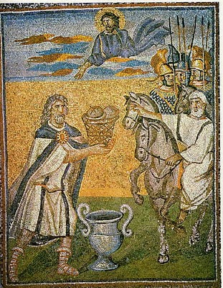
Melchizedek: Prefigure of Christ
Blessed Abraham Gen 14:19
Gave Abraham bread and wine (prefigures Lord’s Supper)
Not a Levite (not even a Jew!)
A priest for everyone; not just for the Jews.
A priest and a king.
A priest forever (Heb 7:3, Ps 110:4

Slide 50
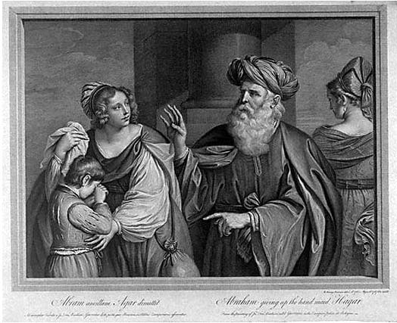
Genesis 16-18, 21 Hagar, Sarah, Ishmael and Isaac
Hagar, Ishmael represent slavery and they represent physical Israel.
Ishmael… born “the usual way”
Sarah and Isaac represent freedom, promise. They represent spiritual Israel—us?
Isaac the child of promise
Galatians 4:21-31

Slide 51
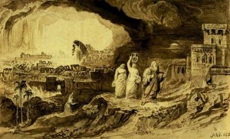
Genesis 19: Sodom and Gomorrah
Sodom and Gomorrah is about Judgment!
Sodom and Gomorrah is about Salvation.
We need to be like the two angels.

Slide 52
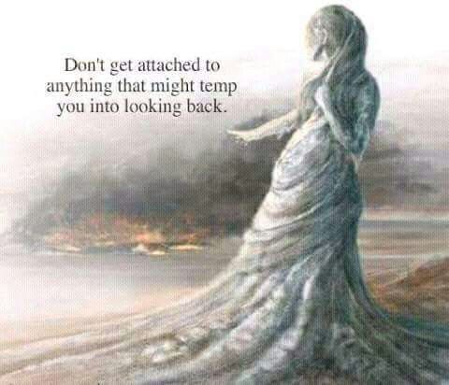
Who is Lot? Who is Lot’s Wife?
2 Peter 2:6 Lot, a righteous man.
Luke 17:32 Remember Lot’s wife.
We need to remember Lot’s wife.
Gen 19:29 God remembered Abraham and saved Lot.

Slide 53
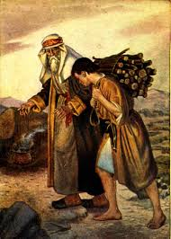
Abraham and Isaac
Genesis 22:2-14
Take your son… your only son Isaac…
1 Cor 15:3-4 On the 3rd day.
Heb 11:19 Figuratively, Abraham received is son on the 3rd day.

Slide 54
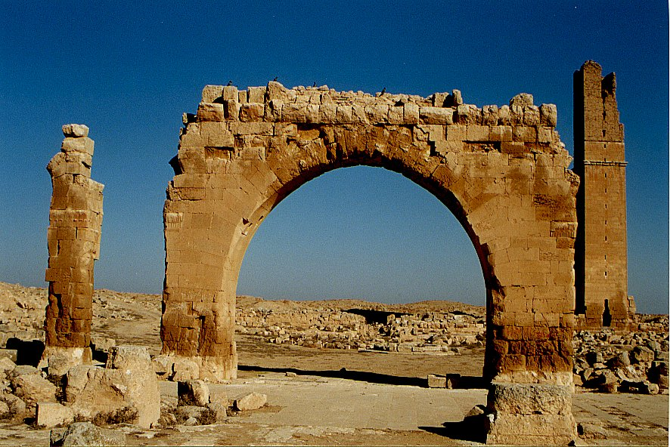
An Aside: Archaeology and Genesis
Haran Ruins In Mesopotamian Plane Near Sanli Urfa, Turkey

Slide 55
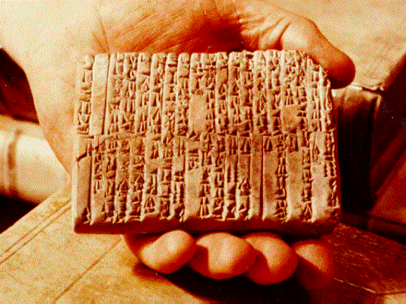
One of the Ebla Tablets about 2100 BC
Nahor, Terug, Abram, Sarai

Slide 56
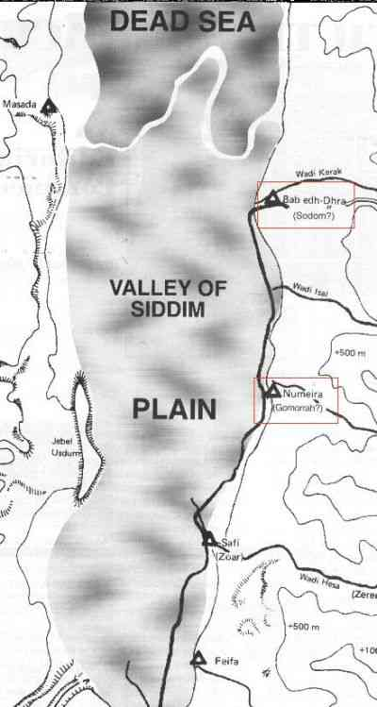
The Five City League, including Sodom and Gomorrah
Genesis 14:2

Slide 57
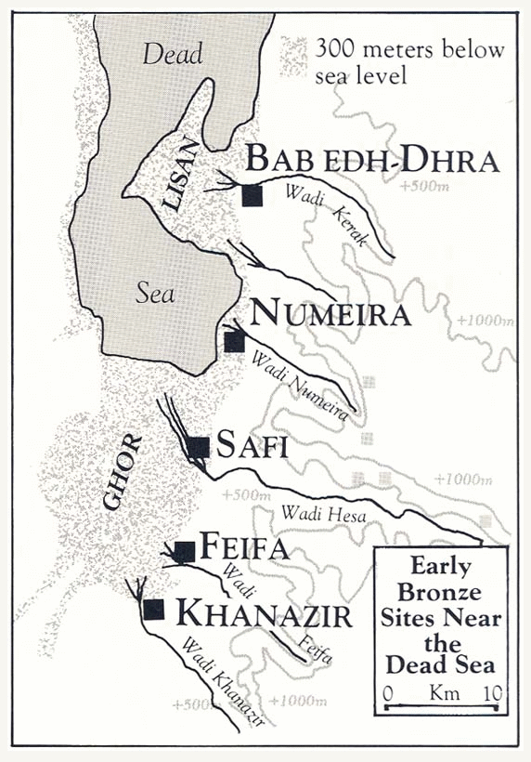

Slide 58
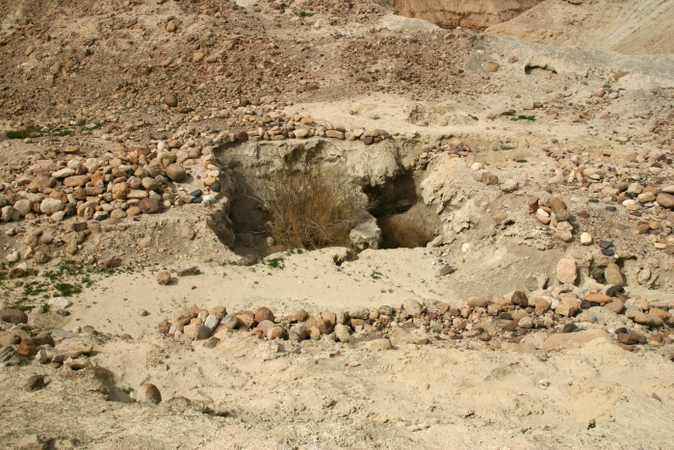
Ruins at Bab ed-Dhra (Sodom)

Slide 59
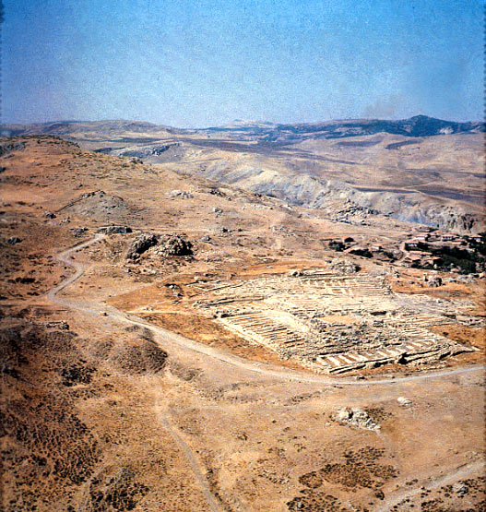
Ruins of Hattusha, capital of the Hittites

Slide 60
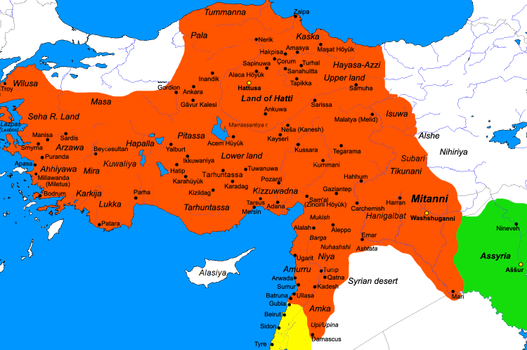
The Hittite Empire ca. 1300 BC

Slide 61
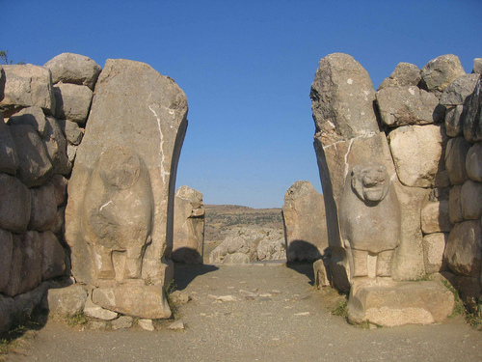
The Lion Gate in Hattusha

