Slide 1
A Question….
What is the most common word or expression used in the New Testament for a person who is saved?

Slide 2
A Question….
What is the most common word or expression used in the New Testament for a person who is saved?
Saved?
Christian? Disciple?
Forgiven?

Slide 3
The Answer….
In Christ
In Christ, in Him, In the Lord 164 times in Paul alone.

Slide 4
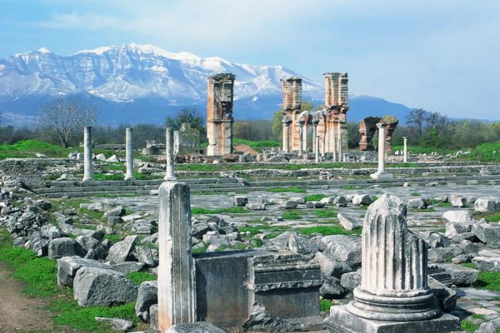
Philippians: Life in Christ
Phil 1:1-30 To Live is Christ
Phil 2:1-18 Living Like Christ
Phil 3:1-21 Put Your Confidence in Christ
Phil 4:1-23 Practical Living in Christ

Slide 5
Theme of Colossians:
Christ in You the Hope of Glory

Slide 6
If We are in Christ, How and when did we get into Christ?
Gal 3:26 Baptized into Christ
Romans 6:4 Baptized into Christ
Believe into Christ?
Repent into Christ?
Pray into Christ?
How do you get in there?
You were out here

Slide 7
So… What do we have in Christ?
Coll 1:14, Eph 1:7 Redemption in Christ
John 8:34-35
Hosea 2:5, Hosea 3:1-3
1 Cor 6:20 bought at a price
Philippians 1:1 Saints in Christ Jesus
1 Cor 1:2 Sanctified in Christ

Slide 8
Already But Not Yet
We were made these things.
We are being made these things.
We will be made these things.
We have been made holy.
We are being made holy.
We will be made holy.
God sees us as he is making us!!!!!!

Slide 9
We Have So Much in Christ
Phil 4:7 Peace with God
Philippians2:1 Encouragement in Christ.
Gal 3:26 Children of God in Christ
Colossians 2:10 Fullness in Christ
Coll 2:11-12 Put off the flesh in Christ

Slide 10
We Have Everything in Christ!
Ephesians 1:3 Every spiritual blessing in Christ
Ephesians 1:4, 11 Chosen in Christ
1 Corinthians 15:22 We will be made alive/resurrected in Christ
2 Corinthians 5:21 We become the righteousness of God
Romans 6:23 We have eternal life in Christ
Romans 8:38-39 We have secure love of God in Christ

Slide 11
2 Timothy 1:9 grace
2 Corinthians 5:17 a new creation
2 Corinthians 1:20 all God’s promises fulfilled

Slide 12
Even More in Christ
Romans 8:1 No condemnation
Coll 1:27, 2:3 The mystery is revealed in Christ.
Coll 2:17 Reality is found in Christ.

Slide 13
Paul’s Goal: To be found in Christ.
Phil 3:7-10
To Paul, everthing else was garbage by comparison.
It was worth less than nothing compared to knowing Christ and to being in Christ.

Slide 14
Refuse!
A mathematical equation:
Jew + Benjamite + Pharisee + top 2% righteous
+ top 2% devoted = 0
Actually, it adds up to less than nothing.

Slide 15
Knowing Christ/Being in Christ
All things
Being in Christ

Slide 16
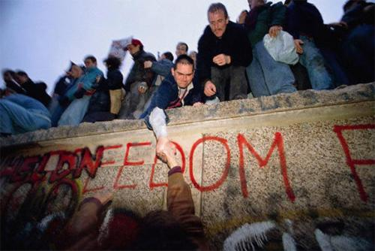
Galatians 5:1 Freedom in Christ

Slide 17
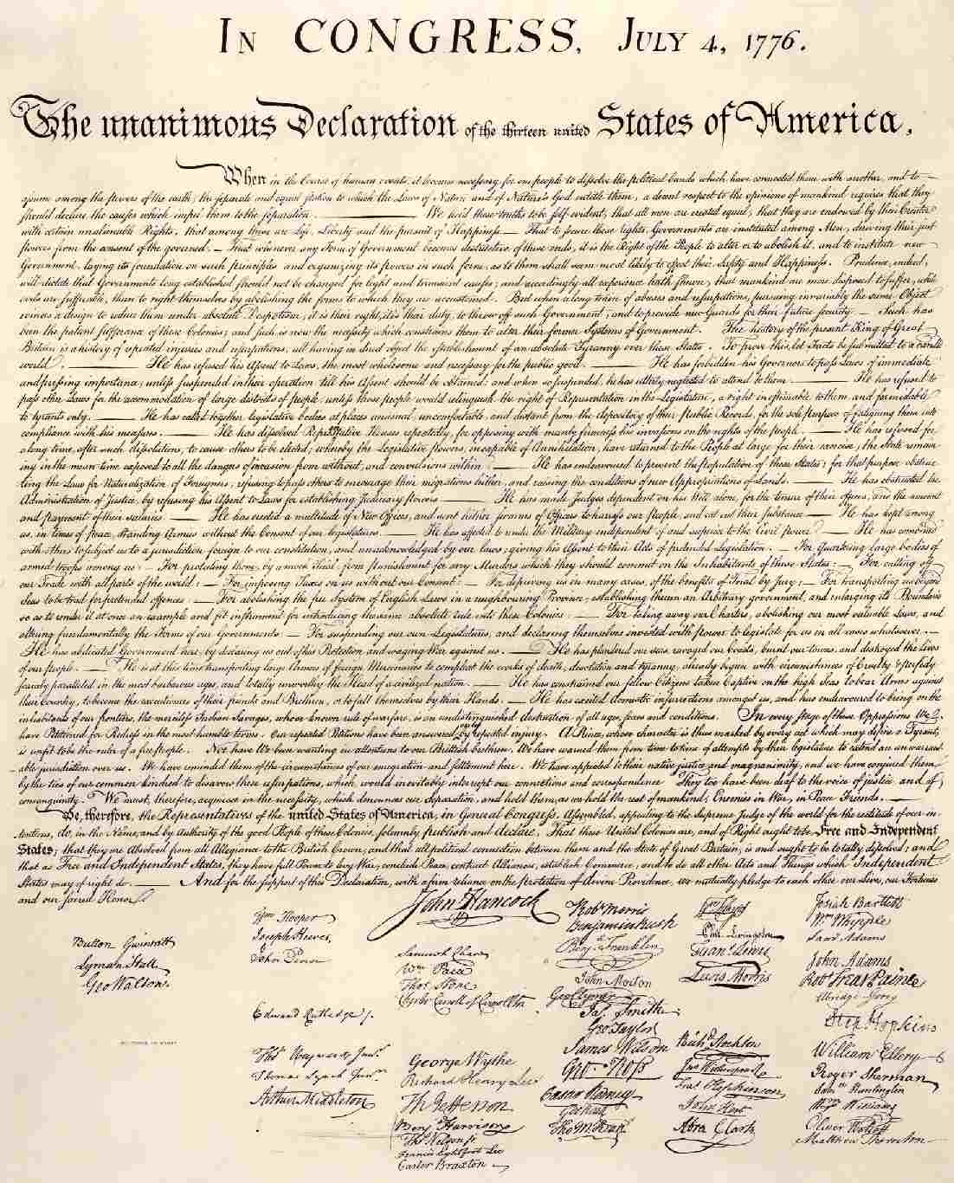
1 Cor 9 Our Christian Bill of Rights Question: What Have You Done With Your Freedom in Christ?

