Slide 1
Four Portraits, One Jesus
Matthew
Mark
Luke
John

Slide 2
Mark
Theme of Mark: Jesus: Messiah and Son of God: suffering servant and savior of mankind.
Theme verse: Mark 10:45 For even the Son of Man did not come to be served, but to serve, and to give his life as a ransom for many.
1. Very fast-paced Greek euthys immediately Ex: Mark 1:10,12,18,20,21,23,28,29,30,42,43
2. People are amazed by Jesus. Mark 1:27 Who is this? 4:41, 8:27.
3. Apostles put in a relatively negative light. 4:13,40, 6:37,52, 7:18, 8:4,32, 9:19,32,38, 10:13,37,41

Slide 3
Matthew
Theme verse: Matthew 5:17 I did not come to abolish the Law or the Prophets; I have not come to abolish them but to fulfill them.
a. In that he, unlike any human before him, he literally fulfilled all the requirements of the Law of Moses.
b. In that through his actions he satisfied the penalty for all of us who did not fully obey the Law of Moses.
c. In that his life fulfilled all the Messianic expectations in the OT (prophecies, foreshadows and prefigures
d. Jesus completes/explains more fully what was only implied by the Law of Moses.

Slide 4
Jesus fulfills messianic prophecy * = Matthew uses the “this was to fulfill” formula.
*1:22-23 Isaiah 7:14 virgin birth
2:5-6 Micah 5:2 Birth in Bethlehem
*2:15 Out of Egypt I called my son.
*2:17-18 Jeremiah 31:15 Tears in Ramah for the death of children.
*2:23 He will be called a Nazarene
3:3 As in Mark, JTB fulfills Isaiah 40:3 in preparing the way for Jesus.
*4:14-16 Jesus is from Zebulun/Naphtali
*8:17 Jesus fulfills Isaiah 53:4 by healing many.
10:34-35 Jesus fulfills Micah 7:6 when families divide over the gospel.
11:2-6 John the Baptist prepares the way for the Messiah/Jesus Mal 3:1.
*12:17-21 The Messiah a humble and gentle servant. Isaiah 42:2

Slide 5
More Prophecies fulfilled in Matthew
13:14-15 Parables not to be understood by the hard-hearted Isaiah 6:9
*13:35 Messiah to speak in parables Psalm 78:2
15:7-9 Disobedience Isaiah 29:13
*21:4-5 Jesus enters Jerusalem on a colt, the foal of a donkey Zech 9:9
21:13 The temple a den of robbers Isaiah 56:7 Jer 7:11
21:16 Praise from the lips of children Psalm 8:2
21:42 Jesus rejected and becomes the capstone Ps 118:22
26:31 Shepherd struck and sheep scattered Zechariah 13:7
*27:9-10 Betrayed for 30 pieces of silver Zechariah 11:12-13

Slide 6
Luke
Theme: God’s salvation, as predicted by the prophets has arrived in the coming of the Messiah—Jesus of Nazareth. He is the savior of the world and this salvation is now spreading throughout the world (including that of the Gentiles, of course).
Theme verses: Luke 2:11, Luke 19:9-10

Slide 7
Jesus is revealed as Messiah primarily through his ministry to the sick, downtrodden, women, the outcast and the Gentile.
Theme verse: Luke 2:11 (to lowly shepherds) Today in the town of David a Savior has been born to you; he is Christ the Lord.

Slide 8
Luke
Jesus is revealed as Messiah primarily through his ministry to the sick, downtrodden, women, the outcast and the Gentile. Theme verse: Luke 2:11 (to lowly shepherds) Today in the town of David a Savior has been born to you; he is Christ the Lord.
Jesus’ concern for outsiders, the poor, “sinners”, Samaritans
Reversal of fortune (poor become rich, rich become poor)
Emphasis on role of women in Jesus’ life and ministry

Slide 9
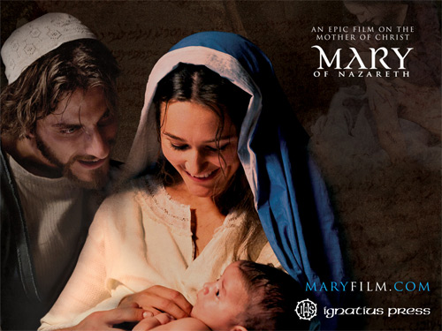
Mary: The Favored of the Lord
Facts about Mary:
1. She was very young.
2. She was female.
3. She was poor.
4. She was defenseless
and vulnerable

Slide 10
Mary: The Favored of the Lord
What does God say about Mary? Luke 1:26-28
1. You are highly favored.
2. God is with you.
Why Mary? Luke 1:38 Luke 1:45 (a great memory verse)
Good News:
The old will be productive
The barren will be fruitful
Our disgrace will be removed
We will be greatly favored and God will be with us
If we will: Be righteous and observant
Believe that what the Lord has said will be accomplished

Slide 11
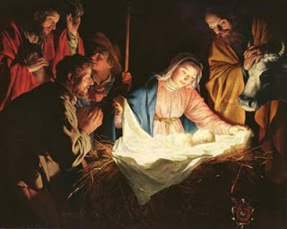
The Birth of Jesus
Announced to lowly
shepherds (Luke 2:17)
A ministry of salvation
(Luke 2:11, 30)
A light to the Gentiles
(Luke 2:32)
A sign spoken against
(Luke 2:34)

Slide 12
Jesus Brings Good News Luke 4:18-19 Isaiah 61:1-2
1. Good news for the poor
2. Freedom for prisoners
3. Healing for the sick.
4. Release the oppressed.
5. The favor of the Lord.
Jesus: “Today this Scripture is
fulfilled in your hearing”

Slide 13
The People’s Response
Luke 4:22 Amazed… “What happened to the kid we knew growing up?”
Jesus (not impressed) The Gentiles will be saved before you!
Luke 4:28 Furious...
This incident is a foreshadow of his entire ministry and death of Jesus of Nazareth.

Slide 14
Luke 4:31-44 Jesus fulfills Isaiah 61:1-2
Jesus frees the prisoners (Luke 4:31-37)
Jesus heals the sick (Luke 4:38-44, 5:12-14, 5:17-26).
Jesus releases the oppressed (Luke 4:41)
Jesus proclaims the Lord’s favor (Luke 4:43)
All this is used to point to the breaking out of the Kingdom of God (Luke 4:43)

Slide 15
The Poor are Saved Before the Rich
The rich fool Luke 12:13-21
Invite the poor, the lame and the blind to your banquets. Luke 14:12-13
The Pharisees sin? They are lovers of money Luke 16:14
The Parable of the rich man and Lazarus Luke 16:19-31

Slide 16
The Samaritans are Preferred to the Jews
James and John rebuked for calling fire down on a Samaritan village Luke 9:51-16
The Parable of the Good Samaritan Luke 10:29-37
The only leper who returns to thank Jesus is a Samaritan Luke 17:11-19

Slide 17
Women Come Into the Kingdom Before Men
Luke lists 13 women not mentioned in the other Gospels
Women with great faith:
Elizabeth
Mary
Ana
Widow of Nain Luke 7:12-15
Woman who anoints Jesus’ feet Luke 7:36-50

Slide 18
Jesus and Women
Women supported Jesus financially Luke 8:1-3
Woman healed of bleeding Luke 8:43-48
Mary and Martha Luke 10:38-42
Crippled woman healed on the Sabbath Luke 13:10-17
The poor widow Luke 21:1-4
Women were the chief witnesses and comforters of Jesus at the crucifixion Luke 23:49
Women were the first to witness the resurrection Luke 23:55-24:11

Slide 19
Parables about the poor, disenfranchised, disadvantaged and oppressed--Reversal
Luke 10:25-37 Parable of the Samaritan.
Luke 12:13-21 Parable of the rich fool.
Luke 13:10-17 Healing a crippled woman
Luke 14:16-24 Parable of the Great Banquet
Luke 15:1-32 Parable of the Lost Coin, Lost Sheep and Lost(Prodigal) Son.
Luke 16:19-31 Parable of the Rich Man and Lazarus. Luke 17:11-19 Healing the lepers. Notice, it was the Samaritan who came back and thanked him!
Luke 18:1-8 The persistent widow.
Luke 18:9-14 The Pharisee and the Tax Collector.
Luke 18:15 Let the children come to me.
Luke 18:35-43 A blind beggar receives his sight.

Slide 20
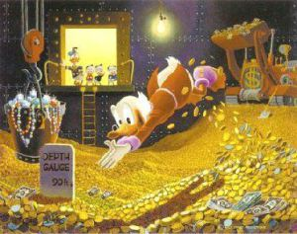
Jesus and the Rich
Luke 12:13-21
The Rich Fool

Slide 21
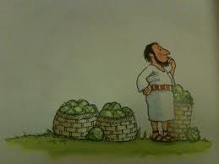
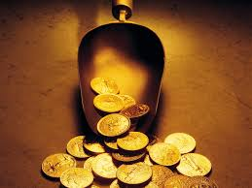
The Rich Fool
12:15 What are some “different kinds of greed?
12:15 What, then, does a man’s life consist of?
12:20 What was so foolish about this man?
How might we be like this fool?

Slide 22
Jesus and the Rich
Luke 14:12-13 Do not invite the rich to your banquets…. Invite the poor.
Should we take this literally?
Luke 16:19-31 The rich man and Lazarus.
Who would you go up and talk to? What about Jesus?
Luke 18:18-30 The rich ruler. Why is it so difficult for rich people to enter the Kingdom of God?

Slide 23
John
John: Jesus is revealed through his miracles and through his statements about himself.
Central Theme: Jesus is the divine son of God who reveals the father, providing eternal life to all who believe in him
Key Verse: John 1:14 and/or 3:16
John 20:30 These are written that you may believe that Jesus is the Messiah, the Son of God, and that by believing you may have life in his name.

Slide 24
7 I AM Statements
I AM the bread of life 6:35
I AM the light of the world 8:12,9:5
I AM the door (and the gate) 10:7
I AM the good shepherd 10:1,14
I AM the resurrection and the life 11:25
I AM the Way the Truth and the Life 14:6
I AM the true vine 15:1

Slide 25
7 Miraculous Signs
Water to wine 2:1-11
Healing of official’s son 4:43-54
Healing at pool of Bethesda 5:1-5
Feeding of 5000 6:1-14
Walking on water 6:16-21
Man born blind 9:1-12
Resurrection of Lazarus 11:1-44

Slide 26
Jesus Works a Miracle, Makes a Claim and calls us to believe
John 6:1-14 Jesus feeds 5000
John 6:35-59 I AM the bread of life
John 11:25 I AM the resurrection and the life
John 11:38-44 Jesus raises Lazarus

Slide 27
Jesus the Perfect High Priest
What is a priest?
A Pontifex Literally, a bridge-builder. A mediator. An advocate. A representative. One who give access. One who can speak the language of both the worshipper and the one worshipped.
The bridge before Jesus:
The Law
The Priest and the Sacrificial System
But they did not work, and that is the point of Hebrews 7-10:18

Slide 28
Jesus the Great High Priest
Like a High priest:
Can relate to us (Heb 4:15)
Makes intercession before God for us (Heb 4:16)
Offer gifts (fragrant offerings) and sacrifices (sin, guilt offering) (Heb 5:1)
Selected by God from men (Heb 5:1,4-5)
Represents man to God (Heb 5:1)
Greater than any High Priest
Serves in the Heavenly Tabernacle, not the earthly one. (Heb 4:14)
Tempted, yet was without sin. (Heb 4:15)
Did not need to offer sacrifices for his own sin. (Heb 5:3)
A priest forever (Heb 5:6)
A priest from the order of Melchizedek (Heb 5:6)

Slide 29
A wonderful word…
metriopatheia Heb 5:2
Empathy, Sympathetic feeling,
Bear with people without becoming angry
Completely unlike the Greek concept of God
(God cannot possibly feel anything or he is weak.)

Slide 30
Hebrews 5:2 cont.
“He deals gently with those who are ignorant and going astray.” This is accidental sin, not willful sin.
There was no sacrifice for willful sin in the Law of Moses. Hebrews 10:26, Leviticus 4:13, Numbers 15:30-31
Willful sin is defiance, rebellion, willful (obviously)
Unwillful sin is an act of impulse or thoughtlessness or ignorance.

Slide 31
Willful Sin

Slide 32
Hebrews 5:8-9
5:8 Jesus learned obedience through suffering.
“learned” in the sense of experiencing.
5:9 once made perfect (teleio) = complete

Slide 33
2020 Bakersfield Church of Christ Congregational Workshop

