Slide 1


Slide 2
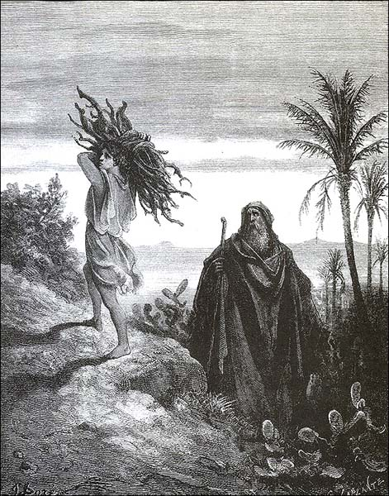
Introduction to the Old Testament
John Oakes
Spring, 2020

Slide 3
Required Reading
“The Casket Empty” Carol Kaminsky
“From Shadow to Reality” John Oakes IPI Books

Slide 4
Recommended Reading
“He Loves Forever” Thomas Olbricht College Press
“A Quick Overview of the Bible” Douglas Jacoby Harvest House
“Into the Psalms” Rolan Monje IPI
A Survey of Old Testament Introduction Gleason Archer Moody Press

Slide 5
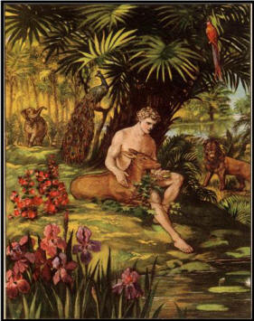
Biblical Themes
Bible: God wants a relationship with us.
Old Testament: The Messiah is coming, bringing salvation.
New Testament: The Messiah is here, and he has brought salvation.
  John 5:39 These scriptures testify about me.
  Matthew 5:17

Slide 6
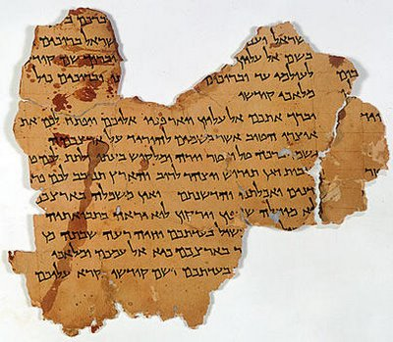
The Jewish Bible tanakh (Luke 24:44)
The Law torah, pentateuch
  Genesis - Deuteronomy
The Prophets neviim
  Joshua, Judges… Ezekiel,
  …“the twelve”
The Writings ketuvim
  Job, Psalms, Proverbs,
  Ecclesiastes,… 2 Chronicles
  (Matt 23:35)

Slide 7
Our Outline
I. Genesis
II. Moses and the Law
III. History: Joshua – 2 Samuel
IV. History: Divided Kingdom
V. History: Exile and Post-Exile
VI. Prophets
VII. Wisdom Literature

Slide 8
Old Testament Themes
I The Messiah is coming.
II God chooses a person and a people through whom to send the Messiah.
III God wants to bless his people (physically). The grace of God.
IV The call to repentance.
V God’s amazing patience with his people
VI Judgment for those who will not repent. This is a major and unmistakable theme!
VII. Salvation and forgiveness
VIII God works through history

Slide 9
Historical Outline
The Fall
God chooses a man of faith
God creates a people of his own
God gives his people a covenant
God gives his people a place and a temple
God sends his prophets.
God sends his Son

Slide 10
Historical Periods
Patriarchal Period
Captivity in Egypt
Escape from Egypt and Conquest of Canaan
Judges
United Kingdom
Divided Kingdom
Captivity in Babylon
Restoration to Judea

Slide 11
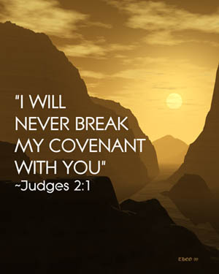
Covenants
Noah Genesis 9
Abraham Genesis 17
Moses Exodus 24
David 2 Sam 7
The New Covenant Jeremiah 31:31

Slide 12
Major Historical Events:
God Saves and God Judges His People
Creation
The Flood judgment
The choice of Abraham salvation
Escape from Egypt salvation
Kingship of David salvation
Destruction of the Northern Kingdom judgment
Destruction of the Southern Kingdom judgment
Restorations under Zerubabbel and Ezra salvation

Slide 13
Language and Authors
Hebrew and Aramaic (Ezra and Daniel)
30+ authors
Hosea: The Grace of God
Amos: Social Justice
Isaiah: The Holiness of God
David: The Heart of God
Joel: Judgment
Job: The Problem of Suffering
Solomon: Wisdom

Slide 14
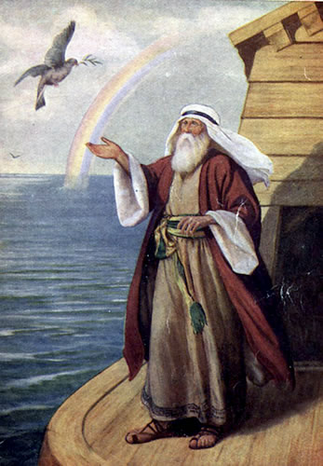
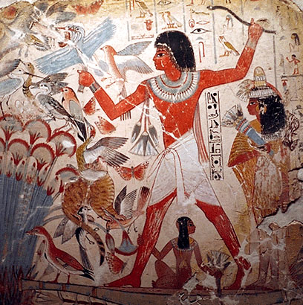
Genesis
Creation, Fall and Judgment
God chooses a man through whom to send the Messiah

Slide 15
An Outline of the Bible:
Genesis 1: Who is God?
Genesis 2: Who is man?
Genesis 3 & 4 The problem of sin.
Genesis 5-Revelation 20 God is solving the problem

Slide 16
Another Outline of the Bible
I. Genesis 1 God created the universe and the earth. It was very good.
II. Genesis 2 God created man so that we could have an intimate relationship with him.
III. Genesis 3 and 4 We messed up very badly—destroying that relationship.
IV. Genesis 5-Rev 20 God is repairing the damage done by sin.
V. Rev 21-22 God has fixed the problem and we are back in a relationship with him.

Slide 17
Themes in Genesis
God: a loving Creator.
The Fall: Sin and separation from God.
Judgment
The Solution: God chooses a man of faith through whom to send the Messiah.

Slide 18
Outline of Genesis
Ch 1 Creation God, the creator
Ch 2,3 Adam and Eve The fall of man, God’s plan begun.
Ch 4 Cain and Abel Temptation, sin, judgment and death.
Ch. 5 Genealogy God’s plan to send the Messiah
Ch 6-9 The Flood Judgment against sin and salvation by faith
Ch 10 More Genealogy God’s plan to send the Messiah
Ch 11 The tower of Babel God opposes the proud
Ch 12-23 Abraham; The Father of Faith God chooses a person through whom to send the Messiah.

Slide 19
Outline of Genesis (cont.)
Ch 24-26 Isaac The Son of Promise
Ch 27-35 Jacob The Father of the Nation
Ch 37-47 Joseph Favorite son and savior of Israel
Genesis 49 The Twelve Tribes Prophecies about God’s People.
Genesis 50 The Death of Jacob

Slide 20
Genesis Chapter 1: Creation
Genesis Ch 1-4 is primarily theology.
Genesis 1:1
  In the beginning…
  In the beginning, God…
  In the beginning, God created… (Heb 11:3 Rom 1:21-25)
  In the beginning God created the heavens and the earth

Slide 21
Competing World Views
Naturalism/Atheism
Postmodernism: No World View
Deism
Pantheism
Animism/Polytheism
Dualism
Biblical Theism

Slide 22
The Christian World View
According to Genesis 1-4:
1. The physical world is: a. real b. created out of nothing (ex nihilo) and c. essentially good.
2. There exists an unseen spiritual reality which is not limited to or defined by the physical reality. Human beings have a spiritual aspect to their nature.
3. The creator of both the physical and spiritual realm is the God who reveals himself in the Bible.
4. Human beings have both a physical and a spiritual nature, The spiritual nature is more essential as it is eternal.
5. God is not easily defined but he can be characterized by certain qualities. God is a person. God is love, God is just, God is holy, God is omniscient, omnipotent and omnipresent.

Slide 23
The Christian World View (cont.)
6. Although all God’s creation, including the physical world is good, evil does exist. Such evil is the result of freedom of will given to created beings and their subsequent decision to use that freedom to rebel--to “sin”
7. Because of God’s justice and his holiness, those who choose to rebel against him will ultimately be judged and separated from God for eternity.
8. The solution to evil, to sin and its eternal consequences is provided by God through the atoning substitutionary sacrifice of Jesus Christ.
All of this is found in Genesis 1-4

Slide 24
What Does God Do in Genesis 1?
He creates something out of nothing.
He creates order out of chaos.
He creates distinctions/ separation
separation = holiness
He names things
naming = having power over

Slide 25
Genesis Chapter 1: Creation
Genesis 1:2-10 God creates order and distinctions out of disorder and formlessness
  Light vs dark
  Sky, water, land
  Living vs non-living 1:11
  Male vs female 1:27
  Good vs evil Gen Ch 3
Genesis 1:11-25 God creates life

Slide 26
Genesis 1:26-30 God creates mankind in his image, to rule the earth.
  Q: In what sense are we created in God’s image?
  Q: What are the implications that God put us in charge of the earth?
  God blessed them 1:28 This was his plan.
Genesis 1:31 Summary: It was all very good.
  Q: Do you agree with God’s analysis here?

Slide 27
Genesis Chapter One: Creation
Young Earth Theory
  Earth is young and science supports this conclusion.
  Earth is young because God created it “with an appearance of age.”
Day/Age Theory
Gap Theory
Framework Theory
It’s all just a myth
Each view has its problems

Slide 28
A Quick Summary of Genesis One:
a. God pre-existed the universe
b. God created the universe: “Let there be light”
c. God created the earth
d. God created life
e. Last of all, God created mankind

Slide 29
A More Detailed Summary of Genesis One
From the Viewpoint of an Observer on the Earth:
a. The earth created and is spinning: night and day. Day 1
b. Water covers earth, Very thick atmosphere forms. Day 2
c. The earth cools, land appears out of the water. Day 3
d. Life appears on the earth. Day 3
e. (Photosynthetic life dramatically changes the chemistry of the atmosphere from reducing to oxidizing.)
f. Finally, the heavenly objects appeared in the sky Day 4
g. More advanced life forms; first in the water, later on the land Day 5
h. Even more advanced life forms. Last of all human beings Day 6

Slide 30
Is the Metaphorical Day a Reasonable Interpretation?
Pre-Science Theologians Who Said Yes.
Philo 1st century
Origen early 3rd century
Augustine early 5th century
Thomas Aquinas 13th century

Slide 31
Translations of yom in the Old Testament (NIV)
1181 times as “day” (but with several different connotations of the word, some not being literal)
  Isaiah 4:2 In that day the Branch of the Lord will be beautiful…
67 times as “time”
30 times as “today”
18 times as “forever”
10 times as “continuously”
6 times as “age”
4 times as “life”
2 times as “perpetually”

Slide 32
Framework Model
Day 1 Light Day 4 Luminaries
Day 2 Sky and Water Day 5 Birds and Sea Creatures
Day 3 Land and plants Day 6 Land Creatures and Man

Slide 33
Is Genesis 1:1 a Myth?
Yes! It is a true myth.
A myth is a simplified story, given to explain the gods (or God) to common people.
“Genesis 1 is a mixture of historical facts and religious truth based on these facts”

Slide 34
Creation Myths
Babylonian Creation Myth
  Primeval swamp. Marduk kills Tiamat. Blood + mud = humans
Egyptian Creation Myth
  Primeval ocean “Nun” from which arrises a Primeval hill.
Greek Creation Myth
  Prometheus and Epimetheus form clay molds. Earth supported by Atlas.
Iroquois Creation Myth
  Enigorio and Enigohahetgea: Good and evil brothers battle
Genesis One is an obvious exception to this pattern

Slide 35
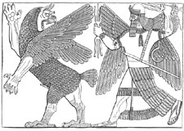
Babylonian Creation Myth: Marduk kills Tiamat

Slide 36
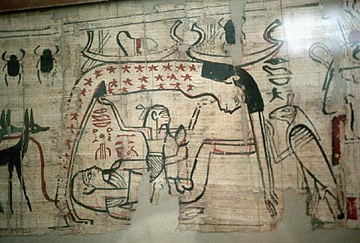
Egyptian Creation Myth

Slide 37
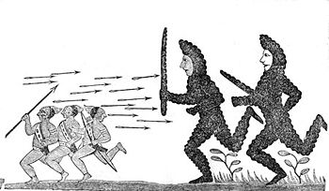
Iroquois Creation Myth:
Enigorio and Enigohahetgea Battling the Ronnongwetowanca (Stone Giants)

Slide 38
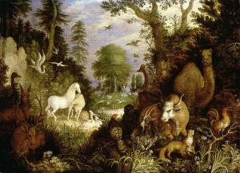
Genesis 2 Who is man?
Created in God’s image 1:27
Given authority over the earth 1:26 2:19-20
Created to know God and to be known by him.
  Created for relationships Genesis 2:18. 23-25
  God walked in the garden 3:8
Given everything, including “free will.” Genesis 2:9, 15-17
Adam and Eve are us!

Slide 39
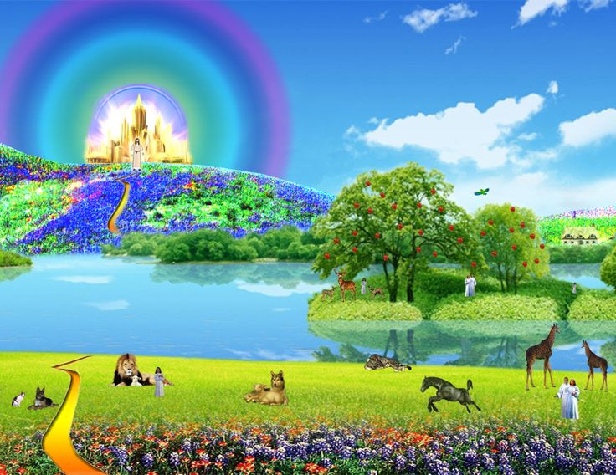
Genesis 2:4-25 How it was supposed to be
Eden is a picture of heaven.
Heaven imagery comes from Eden
Ezekiel 47:1-12, Revelation 22:1-5

Slide 40
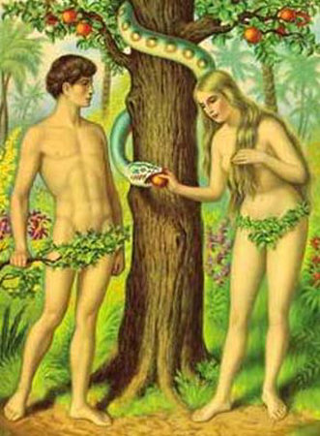
Genesis 3 & 4 The Problem: Sin
Genesis 3:6 The fruit was desirable.
Their sin? Pride. Wanted to be “like” God.
The result: lost innocence death and separation from God.
Adam and Eve are us in this sense as well.
Genesis 3:15 God will provide a solution: Jesus.

Slide 41
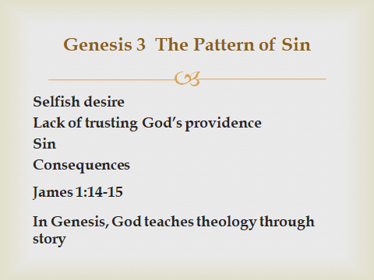

Slide 42
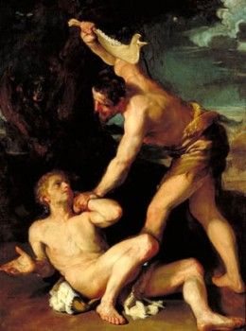
Genesis 3 & 4 The Problem: Sin
Genesis 4:1-16 Cain and Abel. Things did not improve with their children
4:6 For us, “sin is crouching at your door; it desires to have you, but you must master it.”

Slide 43
Genesis 6-8 Things get even worse
(But God has a plan to save us from our sin)
Gen 6:6 “The Lord was grieved that he had made man on the earth, and his heart was filled with pain.”
The world was judged (2 Peter 3:5-9), but Noah and his family were saved.
Genesis 6:8 But Noah found favor in the eyes of the Lord.
We are Noah and his family!!! (1 Peter 3:20-22)

Slide 44
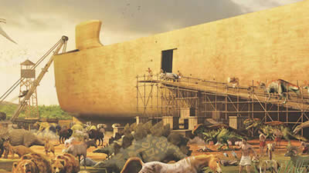
Noah: A Man of Faith
Genesis 6:11-22
Build a massive boat.
I will send the animals.
6:22 An amazing statement. “Noah did everything just as God commanded him.”

Slide 45
The Bible and the Flood
New Testament writers clearly believe this was a historical event. Matthew 24:38-39
It happened as judgment for sin 2 Peter 3:6-7
It is a prefigure of final judgment
It is a miracle, not a “natural” event—like the fire which will destroy the world
Belief in the flood based chiefly on faith in the Bible, certainly not on science.

Slide 46
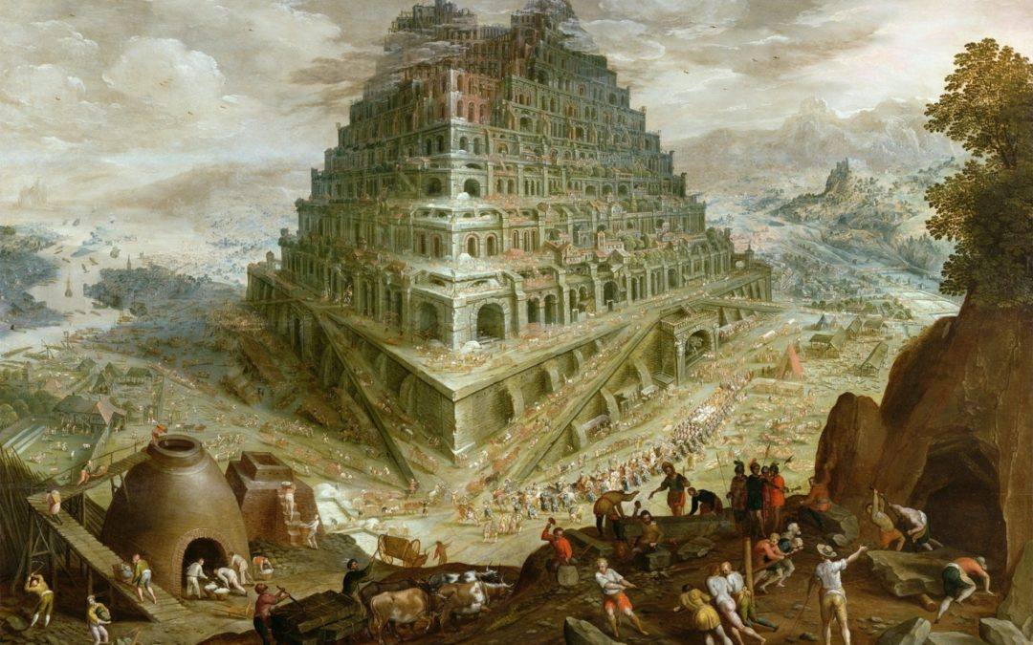
Genesis 11 The Tower of Babel
Genesis 11:1-4 Hubris. Man seeks to make himself great. “Let us make a name for ourselves.”
Like Daniel 4:30
Like us?
1 Corinthians 4:7

Slide 47
God’s Response to Babel
The Lord came down to see the city.
We look tiny to God.
Great accomplishment on our part may not be in our best interest.
Q: Are you trying to make yourself great?
Prov 16:3 Commit your work to the Lord and your plans will be established.

Slide 48
Genesis 12-50
God’s Plan: Salvation by faith.
Genesis 12-23 God chooses a man of faith through whom to bring the Messiah.
Genesis 24-50 God prepares a people through whom to send the Messiah.

Slide 49
Genesis 12-23 Abraham
Abraham the chief (human) figure in Genesis
Abraham is a “type” and we are the “antitype”.
  Romans 4:11-12, 16-17 Faith is why Abraham was made the father of us all and the father of many nations.
Abraham: Salvation is by faith. Romans 4:3

Slide 50
Genesis 12, 15, 17
A covenant with Abraham
Genesis 12:2 I will make you into a great nation.
Genesis 12:3 All nations will be blessed through you.
Gen 13:15 I will give you this land.
Genesis 15:4-5 I will give you a son, and your offspring will be like the stars in the sky.
Genesis 17:6 Kings will come from you.

Slide 51
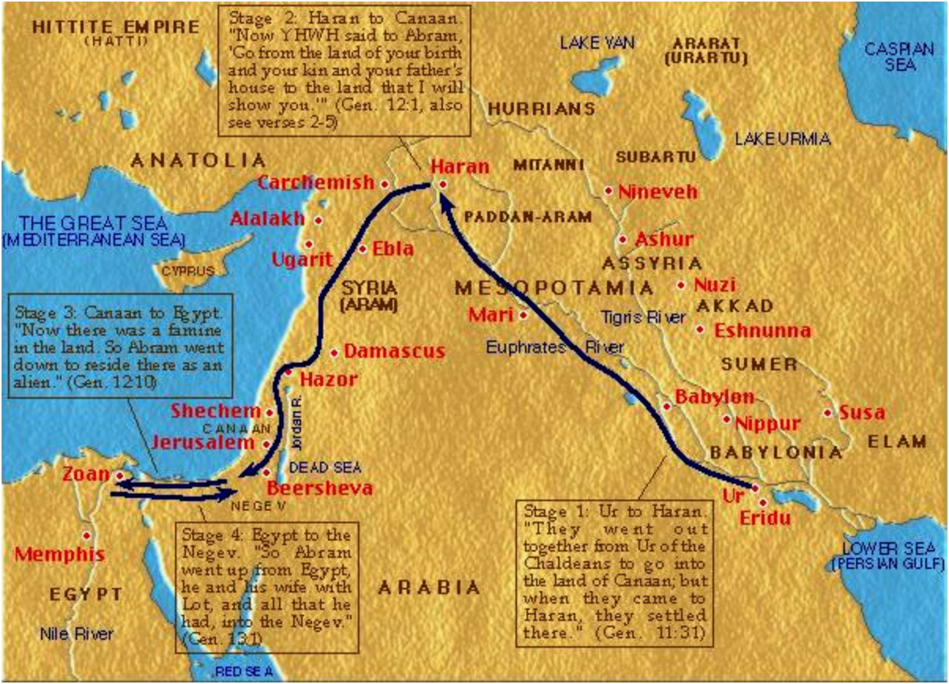
Travels of Abraham and Sarah

Slide 52
Melchizedek: Prefigure of Christ
Melchizedek means King of Righteousness.
King of Salem means King (prince?) of Peace.
The King of physical Jerusalem.
Without beginning or end of days.
Without descendants.
High Priest because of his character, not by descent.
Greater than Abraham (Heb 7:4, John 8:53-58).
Blessed Abraham Gen 14:19

Slide 53
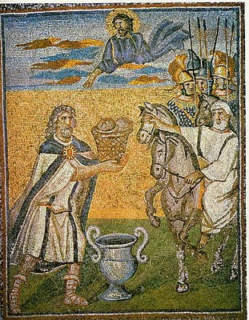
Melchizedek: Prefigure of Christ
Blessed Abraham Gen 14:19
Gave Abraham bread and wine (prefigures Lord’s Supper)
Not a Levite (not even a Jew!)
A priest for everyone; not just for the Jews.
A priest and a king.
A priest forever (Heb 7:3, Ps 110:4

Slide 54
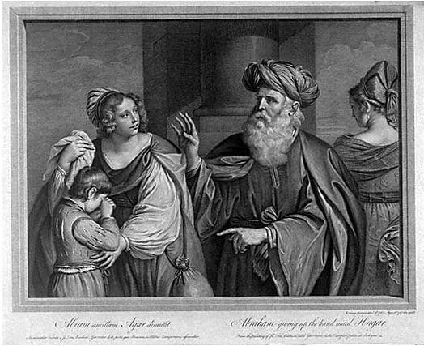
Hagar, Sarah, Ishmael and Isaac
Hagar, Ishmael represent slavery and they represent physical Israel.
  Ishmael… born “the usual way”
Sarah and Isaac represent freedom, promise. They represent spiritual Israel—us?
  Isaac the child of promise
Galatians 4:21-31

Slide 55
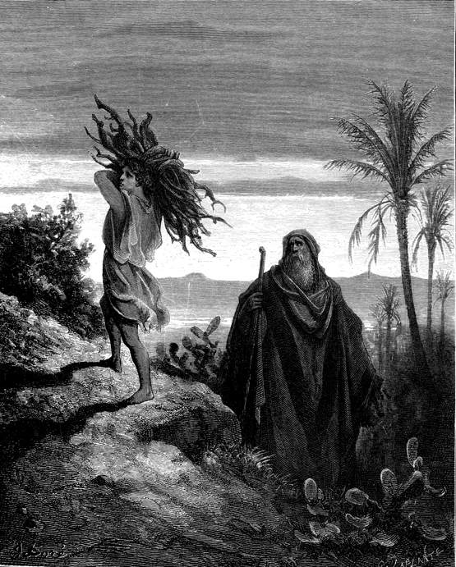
Abraham and Isaac
Genesis 22:2-14
Take your son… your only son Isaac…
1 Cor 15:3-4 3rd day.
Heb 11:19 Figuratively, Abraham received is son on the 3rd day.

Slide 56
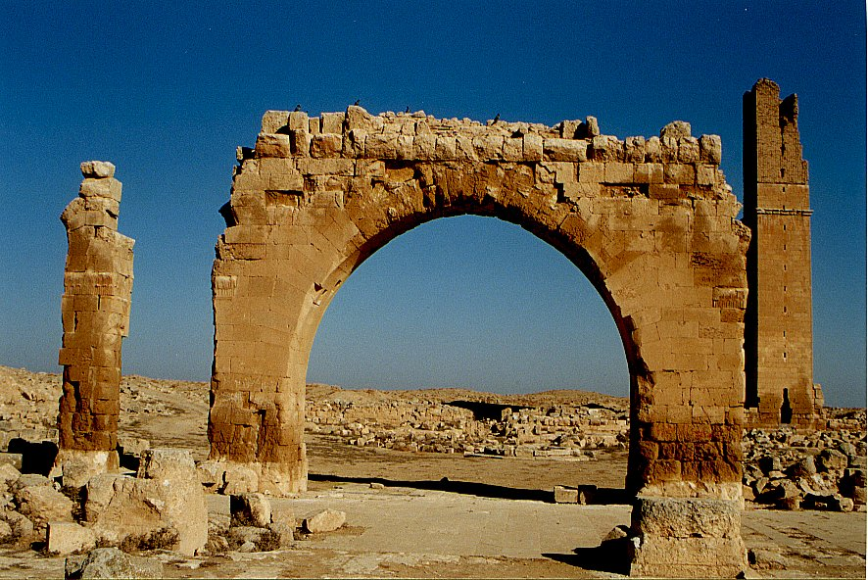
An Aside:
Archaeology and Genesis
Haran Ruins In Mesopotamian Plane Near Sanli Urfa, Turkey

Slide 57
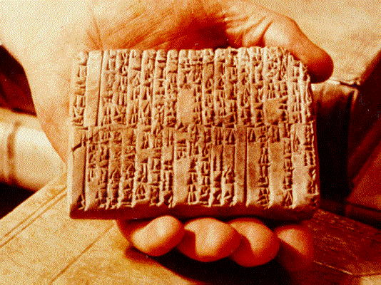
One of the Ebla Tablets about 2100 BC
Nahor, Terug, Abram, Sarai

Slide 58
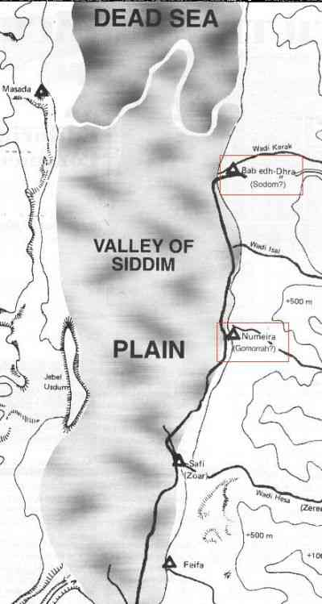
The Five City League, including Sodom and Gomorrah
Genesis 14:2

Slide 59
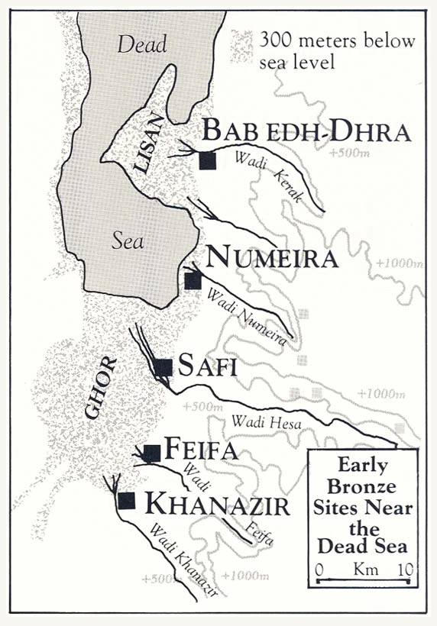

Slide 60
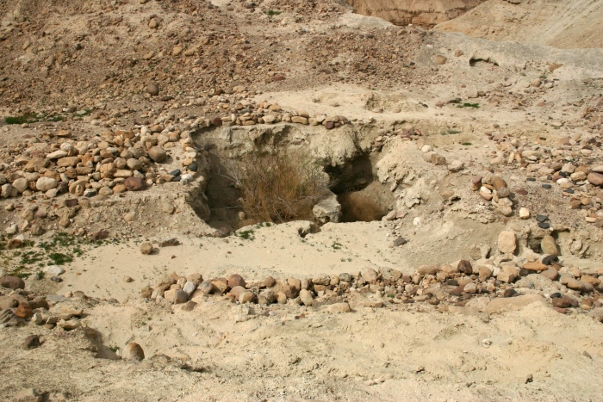
Ruins at Bab ed-Dhra (Sodom)

Slide 61
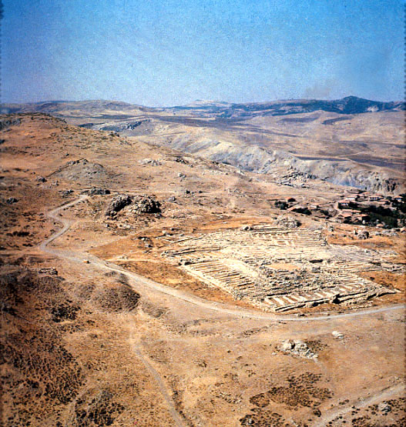
Ruins of Hattusha, capital of the Hittites

Slide 62
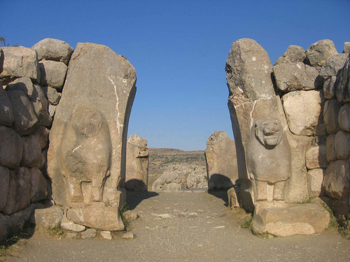
The Lion Gate in Hattusha

Slide 63
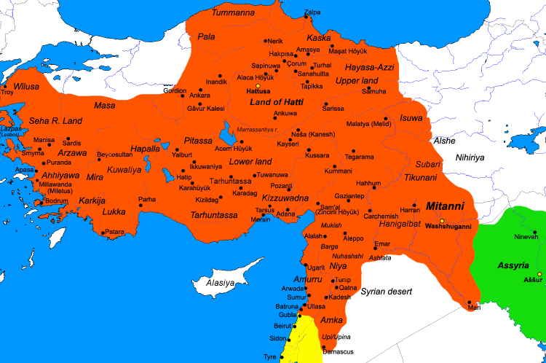
The Hittite Empire ca. 1300 BC

Slide 64
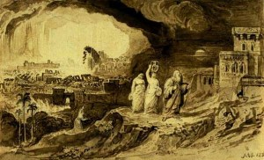
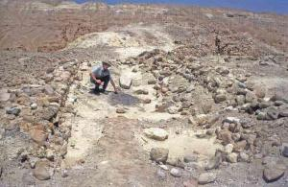
Genesis 19: Sodom and Gomorrah
Judgment!
Salvation
2 Pet 2:6 Lot, “a righteous man.”
Lot’s wife Luke 17:32

Slide 65
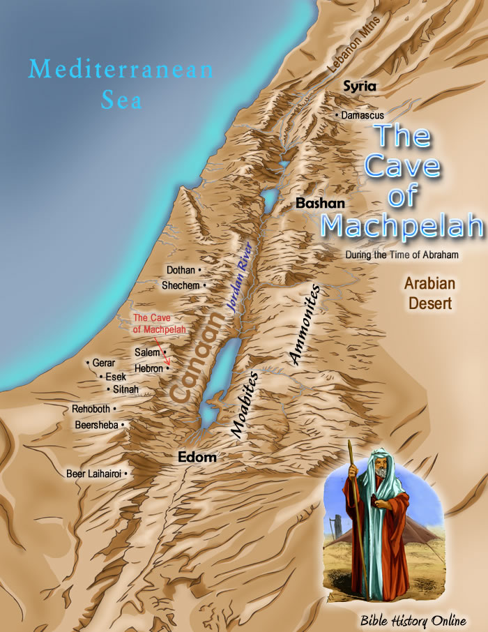
Genesis 23 Abraham Buys a Field
Abraham buys a cave and field in Machpelah.
Heb 11:13 Abraham only saw the fulfillment of the promise from afar.

Slide 66
Genesis 25: Jacob and Esau
Esau: Israel and the Old Covenant.
  The natural first-born.
Jacob: Spiritual Israel and the New Covenant.
  The chosen “first-born.” Romans 9:10-13 Malachi 1:2-3.
  Q: Did God hate Esau?

Slide 67
Genesis 37, 39-45
Joseph: A prefigure of the Messiah.
Prince … Slave in Egypt…. Prince
Favorite son.
A shepherd.
A dream: King of the Jews.
Brothers decided to kill him.
Instead, they betrayed him for 20 pieces of silver.
Became a slave in Egypt. (Hosea 11:1)

Slide 68
Genesis 37, 39-45
Joseph: A prefigure of the Messiah.
Raised up to Pharaoh’s right hand.
Saved Israel. Literally.
Saved Gentile nations as well.
Gave bread to the whole world (Gen 41:57)
Jacob, his father, received him back from the dead (Genesis 45:28)

Slide 69
Genesis 42-47 Joseph Saves Israel
Gen 45:1-4 Joseph reveals himself as savior.
Gen 45:5 “And now, do not be distressed and do not be angry with yourselves for selling me here, because it has was to save lives that God sent me ahead of you…. to save your lives by a great deliverance.”
Gen 50:20 “You intended to harm me, but God intended it for good to accomplish what is now being done, the saving of many lives.”

Slide 70
Genesis 49 Final Prophecies
God is sending the Messiah
Genesis 49:10-11
  Scepter
  Staff
  “until the coming of the one whom all nations will obey”
  Foal, colt
  Wine, “blood of grapes”
Genesis 50 Jacob dies. End of the Patriarchal Period

Slide 71
Class #2
The Law: Exodus, Leviticus, Numbers, Deuteronomy
Outline of the four books:
God saves his people from slavery
God gives his people a Law and a Covenant
God protects his people in the Wilderness.
  He also disciplines them for their hard hearts.
  He is amazingly patient with them.
God brings his people to the Promised Land

Slide 72
Exodus: Leaving a Life of Sin
Theme: God saves his people from bondage.
Application: God will go to any length for us to be saved from bondage to sin.
Theme verse: Exodus 14:13-14
“Do not be afraid. Stand firm and you will see the deliverance the Lord will bring you today. The Egyptians you see today, you will never see again. The Lord will fight for you, you need only be still.”

Slide 73
Exodus: Leaving a Life of Sin
Simple Outline:
I. God Saves Israel from Egyptian Slavery 1:1-18:27
II. God Gives Israel his Law/Establishes his Covenant 19:1-24:18
III. God Commands Israel to Build the Tabernacle for him to dwell in it. 25:1-40:38
Extended Outline:
Ch 1 Israel in slavery.
Ch 2 God prepares Moses.
Ch 3-6 God sends Moses.
Ch 7-11 The ten plagues.
Ch 12 The Passover.
Ch 12-14 The Exodus, crossing the Red Sea
Ch 15-17 Wandering and grumbling.
Ch 18-40 At Mt. Sinai. Moses receives the Law.

Slide 74
Historical Foreshadows
Exodus - Deuteronomy
In Egypt = bondage to sin, being a non-Christian
Escape from Egypt = salvation, leaving our life of sin.
Wandering in the Wilderness = life of a disciple, learning to rely on God
Entering the Promised Land = entering heaven—a secure relationship with God.

Slide 75
Historical type/antitype in the Exodus
OLD TESTAMENT TYPE
NEW TESTAMENT ANTITYPE
SLAVERY IN EGYPT
LOST, SLAVE TO SIN
WANDERING IN THE WILDERNESS
SAVED, BUT LIVING THE LIFE OF A DISCIPLE
ENTERING THE PROMISED LAND
ENTERING HEAVEN

Slide 76
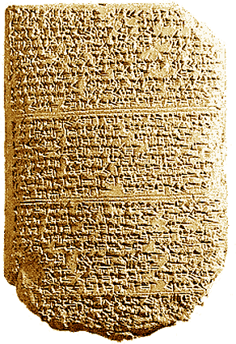
Date of the Exodus:
1420 BC more likely
1280 BC less likely
‘The Habiru plunder all lands of the king. If archers are here this year, then the lands of the king, the
lord, will remain; but if the archers are not here, then the lands of the king, my lord, are lost.’
One of the Tel El Amarna Letters c. 1400 BC

Slide 77
Slavery in Egypt = Slavery to Sin
Exodus 2:23-25 Suffering in slavery
Exodus 3:7-10 God sends a savior
  Exodus 3:14 God’s name is YHWH
Exodus 5:1-5 Let my people go.
When we are enslaved (to sin) we cannot
worship God.

Slide 78
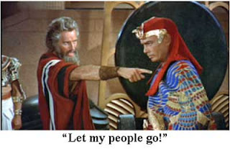
Jesus to Pharaoh: Let my people go!

Slide 79
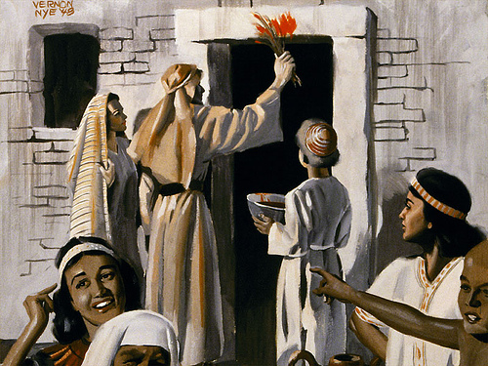
Plague #10: The Passover
A death sentence
An unblemished Passover lamb
  John 1:29, 1 Cor 5:7, Rev 13:8
Blood sprinkled on the wooden beam above their doors
Saved from death and saved from slavery

Slide 80
Passover (Pesach) and the Lord’s Supper
Passover meal (seder) a remembrance of salvation Exodus 12:14
Do not break the bones of the lamb. Ex 12:46
Unleavened bread (the influence of sin 1 Cor 5:7-8
Bitter herbs to remember the bitterness of slavery (to sin)
3rd cup (the one they took after the supper): the cup of redemption.

Slide 81
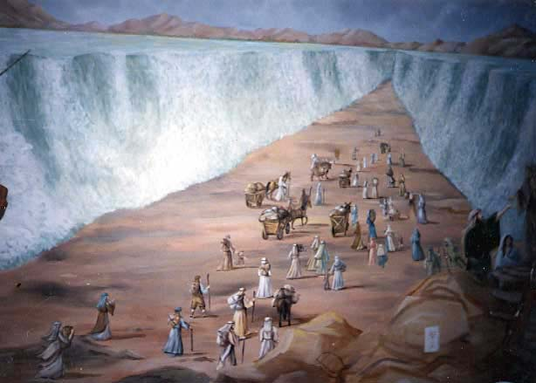
Crossing the Red Sea: Baptized into Moses (1 Cor 10:1-4)

Slide 82
Parallels Between Moses and Jesus
Moses
Jesus
Pharaoh tried to kill him
Herod tried to kill him
Called by God to leave Egypt
Carried out of Egypt
Forty years in the wilderness to prepare for his ministry
Forty days in the wilderness to prepare for his ministry
Left his position with the king of Egypt to dwell with the Jews
Left the right hand of the Father to life with the Jews
Led Israel out of slavery in Egypt
Leads Spiritual Israel out of sin
Aaron prepared the way
John the Baptist prepared the way
Baptized Israel in the Red Sea in order to free them
Commands baptism in water for freedom from sin
Gave manna in the wilderness
(sort of)
Gives spiritual bread to all who hunger
Gave water to the people in the desert
Gives spiritual water: the Holy Spirit
Spoke to God on Mt. Sinai
Spoke to God on Mt. Hermon

Slide 83
Wandering and Grumbling:
The Life of a Disciple
Many left Egypt, but few entered the Promised Land
  Hebrews 3:14-4:2 1Cor 10 Do not be like them!
Why? They looked back to Egypt Exodus 16:2,3 Numbers 11:4-15 Numbers 21:4-9
The life of a disciple: Deut 8:2-5
We need to eat the manna and drink the water!

Slide 84
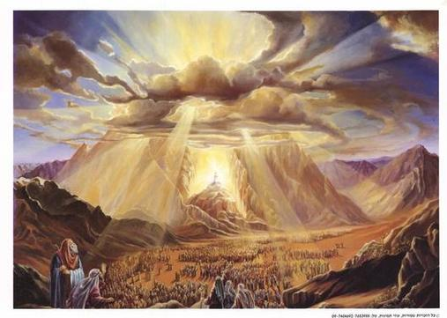
Exodus 19-31: Moses Receives the Law at Sinai
Exodus 19:12-19 A consuming fire, smoke, clouds, earthquakes…
The greatest moment in the history of Israel.
Exodus 20 The ten commandments
Exodus 24: The covenant is sealed.
Ex 24:3 “We will do everything that the Lord has commanded.”

Slide 85
Numbers:
The Stubbornness of Israel and God’s Patience
Ch 1-4 The nation of Israel. A census.
Ch 5-9 Dedication of the Tabernacle.
Ch 10-12 Wandering again. Quail, grumbling and rebellion.
Ch 13,14 Exploring Canaan. Bad and good reports. All will die in the desert.
Ch 15 More laws.
Ch 16,17 Korah’s rebellion.
Ch 18,19 More laws.
Ch 20 Moses strikes the rock: will not enter Promised Land. Aaron dies.
Ch 21 Rebellion, the bronze snake, defeat of the Amorites.
Ch 22-25 Balaam. Israel falls into idolatry.
Ch 26-30 Various laws. Joshua to succeed Moses.
Ch 31-37 Victory east of the Jordan. Division of the land.

Slide 86
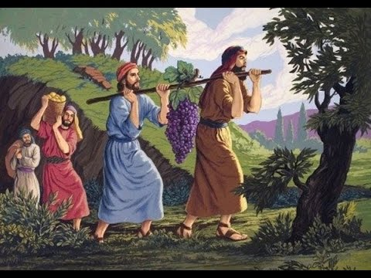
Key Events in Numbers
Numbers 11:4-6 Grumbling quail
Numbers 12:3 Moses’ humility
Numbers 14:20-24 Judgment on the first generation for not trusting God.

Slide 87
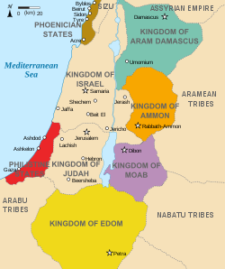
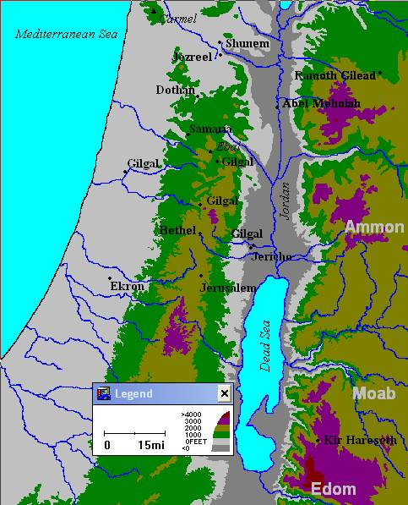
Edom, Moab, Ammon, Midian

Slide 88
Leviticus:
The Seriousness of Sin and the Need for Sacrifice
Ch 1-7 The five sacrifices.
  Ch 1 The Burnt Offering.
  Ch 2 The Grain Offering.
  Ch 3 The Fellowship Offering.
  Ch 4,5 The Sin Offering.
  Ch 5,6 The Guilt Offering.
Ch 8-10 The Priesthood.
Ch 11-22 Various laws.
Ch 23-25 The Sabbath and the Feasts
Ch 26 Punishment and Reward.
Ch 27 More laws.

Slide 89
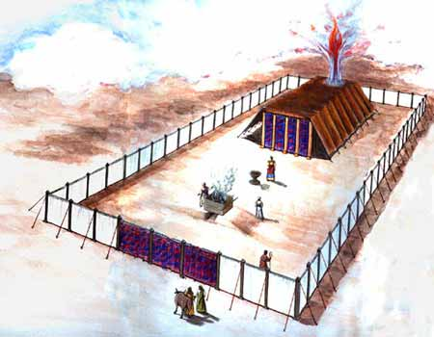
Model of The Jewish Tabernacle
Hebrews 8:1-6
Exodus 25:8-9
Follow the exact pattern.

Slide 90
Type/Antitype Relationships in the Tabernacle
ITEM IN TABERNACLE OR TEMPLE
ANTITYPE IN THE NEW COVENANT
SCRIPTURE REFERENCE
The tabernacle itself
God dwelling with his people
John 14:1-3, John 1:14J. Rev 1:13
The bronze altar of sacrifice
The sacrifice of Jesus for sins
Hebrews 9:14
The basin/laver
Baptism
Titus 3:5
The show bread
The bread of life, Jesus Christ
John 6:48-51
The lampstand
The Holy Spirit
Zechariah 4:1-6
The altar of incense
The prayers of the saints
Revelation 5:8
The blue, purple and scarlet yarn
The heavens, the kingship of God, the blood of Jesus
The curtain
Separation from God
Matthew 27:51
The ark of the covenant
The presence of God
Psalm 132:7,8
The Mercy Seat
The grace of God
The Cherubim
The angels in heaven
Ezekiel 10:15-22

Slide 91
Sacrificial Type and Antitype
Old Testament Sacrifice
New Testament fulfillment
Scriptures
Sweet Savor Sacrifices
The Burnt Offering
Jesus’ and our devotion to God
Ephesians 5:1,2 Romans 12:1,2
The Grain Offering
Giving to God from our blessings
Matthew 6:19-21
Romans 8,9
The Drink Offering
Pouring out our life for God
Luke 22:20 Philippians 2:16
The Fellowship Offering
Celebrating our blessings from God
John 10:10
1 Thess 5:16
Blood Sacrifices
The Sin Offering
Jesus’ sacrifice for our sins
1 Peter 1:18,19
2 Cor 5:21
The Guilt Offering
Relationship with one another
Matthew 5:23,24

Slide 92
Gifts/Offerings/Sweet Smelling Sacrifices
The Burnt Offering olah Leviticus 1
The Grain Offering minchah Leviticus 2
The Drink Offering nesek Leviticus 23
The Fellowship Offering shelem Lev 3

Slide 93
The Burnt Offering Leviticus 1
Lay hands on the animal.
Sacrifice the animal
Clean the body but not the head
Burn them on the altar
Meaning: Total commitment of one’s life to God.

Slide 94
The Burnt Offering
Jesus gave a burnt offering: Ephesians 5:1-2
God calls us to give a burnt offering
Romans 12:1-2 … in view of God’s mercy
Isaiah 6:8 Here am I, send me
What will you lay on the altar?

Slide 95
The Grain Offering
Give the FIRST FRUITS of what God has blessed you with.
NOT voluntary.
Grain hard work
Oil joy
Incense prayer
Salt eternal blessings, “treasures in heaven”
No yeast!!! 1 Cor 5:6-8

Slide 96
The Grain Offering
Application: Our contribution to God 2 Cor 8,9
For us, 10% is not mandatory, but giving sacrificially is.
Malachi 3:7-10
Matthew 5:20

Slide 97
The Drink Offering
Drink Poured out on the altar.
Application: Pouring out our life on the altar.
Usually given with the grain offering.
Application: We give our tithe, but God wants much more. He wants us to be “all in.”
Luke 22:20 Jesus gives a drink offering

Slide 98
The Drink Offering
Jesus gave a drink offering Luke 22:20
Paul gave a drink offering Phil 2:16-17 2 Tim 4:6,7
Haggai 1:3 What are you saving for?
The greatest joy comes from giving a drink offering.

Slide 99
The Fellowship Offering
Party Time!!!!! Celebrate the blessings of God.
Voluntary
Vow Offering Leviticus 11:16
  Blessings hoped for
Thank Offering Leviticus 7:11-15
  Blessings already received.
Free Will Offering Leviticus 22:23
  Thankful for blessings in general

Slide 100
The Fellowship Offering
Application I Thess 5:16-18
  Rejoice always (free will offering)
  Pray continually (vow offering)
  Give thanks in all circumstances (thank offering)
Placed on top of the burnt offering

Slide 101
Blood Sacrifices
The Sin Offering chatat Leviticus 4
  For sins against God
The Guilt Offering asham Leviticus 5
  For offenses against a fellow Jew
Hebrews 9:13-14
No sacrifice for willful sin! Leviticus 4:1 (Heb 10:26)

Slide 102
The Sin Offering Lev 4:1-5:13
Unblemished bull or goat (like Jesus)
Offender laid their hands on the animal (God put our sins on Jesus on the cross) Isaiah 53:6
Offender killed the animal. (We killed Jesus) Matt 27:25
Blood sprinkled on the altar, as well as on the curtain.
Body burned outside the camp (like Jesus) Heb 13:11-13

Slide 103
The Guilt Offering Lev 5:14-6:7
Only for offenses of individuals, not groups.
Offender must make restitution first before bringing the sacrifice. (Matthew 5:23-24)
But….
God wants us to be confident Heb 10:19-22

Slide 104
A Better Sacrifice
Hebrews 9:23 It was necessary, then, for the copies of the heavenly things to be purified with these sacrifices, but the heavenly things with better sacrifices than these
The lesser sacrifice: Bulls, goats, red heifer | The greater sacrifice: Jesus
Outward (appearance) | Inward (reality)
Temporary, repeated many times | Eternal, done only once
Ceremonial | Real
Not voluntary | Voluntary

Slide 105
The Red Heifer Sacrifice as a Prefigure
The Red Heifer Sacrifice | The Sacrifice of Jesus
A very rare red heifer | A unique son
Sacrificed outside the camp (on the Mount of Olives) | Sacrificed outside the camp (on the Mount of Olives)
To purify both Jews and Gentiles | To purify both Jews and Gentiles
A sacrifice without blemish (not even one black hair!) | A sacrifice without blemish
Never been yoked (voluntary, not sinned) | A voluntary sacrifice, without sin
Scarlet wool and wood | Blood on wood
Hyssop (purification from infection) | Purifies from the infection of sin
Combines ashes from sacrifice with water for purification. | Combine the blood of Jesus with baptism for purification

Slide 106
Leviticus 8-10, 21-22 The Levitical Priesthood
Levitical Priesthood a Prefigure of our Priesthood.
  1 Pet 2:5,9 Rev 5:9-10, Romans 15:15-16
  No inheritance: fully devoted to the work of God 2 Chron 31:4
  Cannot touch a dead body Lev 21:11
  Cannot become unclean Lev 21:11-12
Melchizedek Priesthood a Prefigure of Jesus’ Priesthood.

Slide 107
First Covenant Festivals as Types Leviticus 23-25
Jewish Festival
Antitype in the Christian Life
Passover (pesach)
The Sacrificial Death of Jesus Christ
Feast of Firstfruits
The Resurrection of Jesus Christ
Feast of Unleavened Bread
Celebrating Being Free of Sin in Our Lives
Feast of Weeks/Pentecost (shavoat)
The Giving of the Holy Spirit and the Initiation of the Church
Feast of Trumpets (rosh hashanah)
Judgement Day, Jesus Coming Back
Day of Atonement (yom kippur)
The Day We Were Saved—Spiritual Birthday
Feast of Booths
(Tabernacles)
Celebrating Life in Fellowship with God

Slide 108
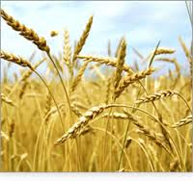
Feast of Firstfruits Lev 23:9-14
A harvest festival when there was no harvest.
A promise of a future harvest.
A foreshadow of the final resurrection.
A prefigure of the resurrection of Jesus. 1Cor 15:20-21
Coll 1:18 The first born from among the dead.

Slide 109
FEAST OF FIRSTFRUITS
CELEBRATE OUR PRESENT AND FUTURE RESURRECTION

Slide 110

Feast of Trumpets Rosh Hashanah/Yom Teruah
A foreshadow of the Return of Jesus.
  Matt 25:30-31, I Thess 4:13-14 Trumpet call.
A foreshadow of Judgment Day
Rabbis: Stay awake all night so you will be prepared.

Slide 111
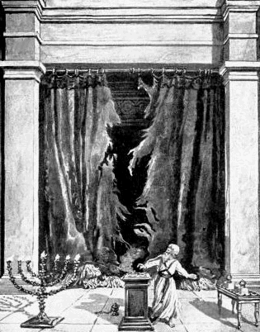
The Day of Atonement Yom Kippur
Bull for sin of the high priest
Sacrificial goat and scape goat.
Sins laid on sacrificial goat, killed outside the camp.
Prefigure of the salvation of Jesus. Heb 9:11-15

Slide 112
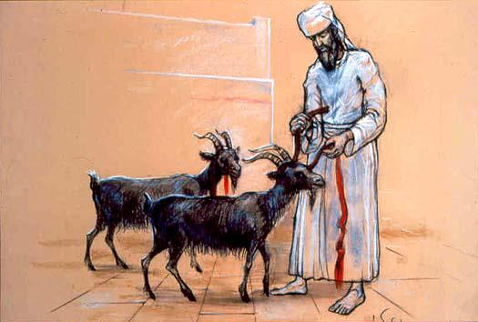
The Day of Atonement Yom Kippur
Scapegoat (Azazel) sent off into the wilderness
Bodies burned outside the camp (Hebrews 13:11-14)
Prefigure of the salvation of Jesus. Hebrews 9:11-15, 23-24

Slide 113
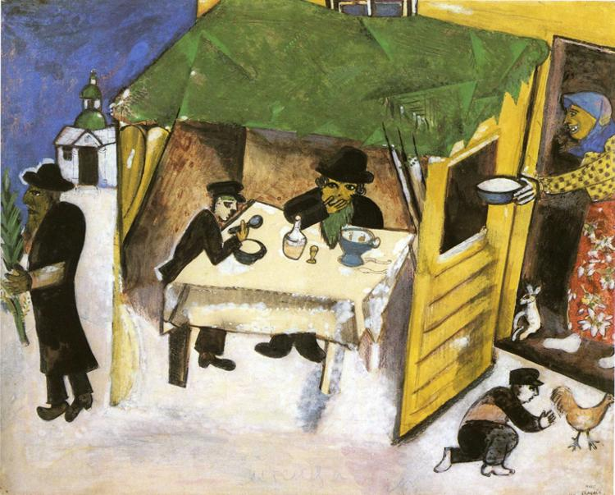
Sukkot/Feast of Booths/Tabernacles
Seven day festival
Harvest Festival
Build a booth and live in it for a week. Leviticus 23:33-43
Remembrance of Wandering in the Wilderness = living in a relationshiip with God.
John 1:14

Slide 114
TABERNACLES
EXPERIENCING LIFE IN FELLOWSHIP WITH CHRIST AND WITH THE HOLY SPIRIT

Slide 115
Deuteronomy:
A Second Reading of the Law
Themes:
I. Learning to Rely on and be loyal to God.
hesed loyal, familial love
II. Blessings and Curses

Slide 116
Outline of Deuteronomy
Ch 1-3 Moses recounts the wanderings in the wilderness.
Ch 4-11 Do not forget your God. God is great, not you.
Ch 12-27 The Law revisited (this is the meaning of the word Deuteronomy)
Ch 28-30 Blessings for obedience and curses for disobedience.
Ch 31-33 Farewell address of Moses.
Ch 34 The death of Moses on Mt. Nebo.

Slide 117
Deuteronomy: Learning to Rely on God
Deut 1:17 Do not be afraid of man.
Deut 4:2 Do not add or subtract to my words.
Deut 6:4-5 Love God
Deut 6:24-25 Be careful to obey
Deut 7:7-8 Chosen by God
Deut 8:1-5 Rely on God, not self
Deut 9:4-6 Do not rely on self

Slide 118
Deuteronomy 7:1-6 Make no treaty, show no mercy
Q: Why no treaties?
Q: Why no mercy?
Q: How does this apply to us?

Slide 119
Response to the Question of Violence in the OT
If you are not bothered by this on some level, I am worried about you!
The argument assumes that physical death is bad/evil. This is a false assumption. Sin is evil but death is not. Death is a transition, hopefully, to something better.
God has a perfect right to judge—not us.
There is the issue of the religion of the Amelekites. Sacrificing of children in fire, worshipping gods by having sex with a prostitute in the temple, etc.
The situation for the children in this situation was hopeless.

Slide 120
Violence in the OT (cont.)
In the case of Amelek and other Canaanites, both God’s love and his justice demanded that something be done.
Either God was going to create a nation or he was not. If God is going to have a “people,” then such people must have a physical land and must have an army.
  God’s plan is to choose a man, then a nation, through whom to send a savior. God’s plan to bless humanity through Jesus trumps all else.
  It is sinful to take the life of another in anger, out of greed or selfishness, but it is not necessarily sinful to take a life in war.
Everything God did to Israel as a nation was to limit their ability to wage war.
  No authority to establish an empire.
  No standing army.
  No cruelty, no abuse, no rape

Slide 121
Deuteronomy: Blessings and Curses
Deut 28:1f Blessings for obedience.
Deut 28:15f Curses for disobedience.
  Deut 28:36-37 A prophecy.
Deut 30:11-20 Summary. Choose life so that God can bless you in the land you are entering to possess.

Slide 122
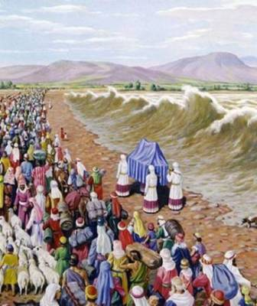
Joshua: Entering the Promised Land
Theme: Victory for God’s people.
Subtheme: Joshua: God’s leader.
Subtheme: Sin in the camp.

Slide 123
Outline of Joshua
Ch 1-5 God prepares Joshua, Israel crosses the Jordan River.
Ch 6 Defeat of Jericho.
Ch 7,8 Achan’s sin and the battle of Ai.
Ch 9 Gibeonite deception.
Ch 10-12 Victory in Canaan.
Ch 13-22 Division of the land.
Ch 23,24 Joshua’s farewell address.

Slide 124
Entering the Promised Land
Ch 1 God strengthens Joshua. Josh 1:6-9
Ch 2 Spies check out Jericho.
Ch 3 Crossing the Jordan. Josh 3:7-8, 14-17
Ch 4-5 12 stones and circumcision

Slide 125
Joshua: Prefigure of the Messiah
Saved Israel—brought them to Promised Land.
Joshua (aramaic) Jeshua (Greek) Jesus (English)
2nd Generation baptized into Joshua in the Jordan.
Josh 5:2-3 Circumcision: a prefigure of baptism.
  Coll 2:11-12
Josh 6 Defeats God’s enemies

Slide 126
Archaeological Facts about Jericho
1. The city was strongly fortified in the Late Bronze I period, the time of the Conquest according to the biblical chronology (Joshua 2:5,7,15).
2. The city was massively destroyed by fire (Joshua 6:24).
3. The fortification walls collapsed at the time the city was destroyed, possibly by earthquake activity (Joshua 6:20).
4. The destruction occurred at harvest time, in the spring, as indicated by the large quantities of grain stored in the city (Joshua 2:6, 3:15, 5:10).
5. The siege of Jericho was short, as the grain stored in the city was not consumed (Joshua 6:15,20).
6. Contrary to what was customary, the grain was not plundered, in accordance to the command given to Joshua (Joshua 6:17,18).

Slide 127
Sin in the camp: God’s people defeated
Joshua 7 Failed attack on Ai.
Joshua 7:10-12 Sin in the camp.

Slide 128
Joshua Ch 8-14 Victories (mostly)
Ch 10 Sun stands still.
Southern kings defeated.
Northern kings defeated.
Ch 14 Caleb: Give me that hill country

Slide 129
But….
Joshua 9 Gideonite deception.
Joshua 13 Unconquered territory.

Slide 130
Joshua 23-24 God’s Leader Gives His Final Words
Josh 24:14-15. Choose today whom you will serve. As for me and my house, we will serve the Lord!

Slide 131
Judges
Theme: God’s people with and without a godly leader
Theme passage (bad) Judges 21:25
Theme passage (good) Judges 5:2

Slide 132
Outline of Judges
Ch 1,2 Compromise with “the world”, disobedience and defeat.
Ch 3 Ehud
Ch 4,5 Deborah
Ch 6-8 Gideon
Ch 9 Abimelech The worst kind of leader.
Ch 10-12 Jephthah
Ch 13-16 Samson
Ch 17-21 Further misadventures in Israel without a godly ruler.

Slide 133
Judges: Prefigures of the Messiah
The pattern: Judges 2:6-16
A typical example: Judges 10:11-16
Lessons from Judges:
  Boldness of Ehud
  Deborah: When the men do not take the lead…
  Gideon: Relying on God, not your own power.
  Jephthah: Don’t speak too quickly
  Samson: Great potential wasted because of worldliness.

Slide 134
Ruth
Theme: The lineage of David. God is sending the Messiah
God is our kinsman-redeemer hesed
  God’s providence in preserving the line of the Messiah
  God uses the faith of a Gentile woman to work his plan.
  Genealogy of David Ruth 4:13-21

Slide 135
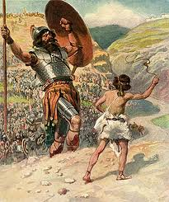
I and II Samuel, 1 Chronicles
Theme: God’s plan to bless his people. God gives them a King and a Savior: David.
Subtheme: An ungodly leader (Saul) and a godly leader (David)

Slide 136
Outline of I,II Samuel, I Chronicles
1 Sam 1-9 Samuel, Priest, Prophet and Judge
1 Sam 10-15 Rise and Fall of Saul, the first king of Israel.
1 Sam 16-29 David anointed as king and persecuted by Saul.
1 Sam 30-2 Sam 1 Death of Saul.
2 Sam 2-10 David, King of Israel.
2 Sam 11-21 David’s sins and the consequences.
2 Sam 22-24 David’s accomplishments.

Slide 137
Samuel: A Prefigure of the Messiah
Prophet, Priest and King (Judge)
The last Judge and the first Prophet.
Born of a barren woman (think about how many examples). Jesus of a virgin.
Dedicated to God from birth. A nazarite.

Slide 138
David: A Prefigure of the Messiah
Born in Bethlehem
A shepherd
Anointed as king 1 Sam 16:13 The Spirit descended on David. (foreshadow of Jesus’ baptism)
Physical king of Jerusalem. Jesus spiritual king of Jerusalem.
Brought the ark (brought God) to Jerusalem. So did Jesus!!!
Saved Israel from slavery to Philistia. Killed Goliath
Saved Israel by offering a sacrifice on Mt. Moriah. 2 Sam 24
Persecuted by God’s people. Very similar to Jesus (Psalms 2:1,2 Psalms 22, etc.

Slide 139
Key Events in 1 Samuel
1 Sam 1-3 Miraculous birth and ministry of Samuel.
1 Sam 8 Israel demands a king.
1 Sam 9-10 Saul, first king of Israel.
1 Sam 13, 15 Saul disobeys, rejected as king
1 Sam 16 David anointed King of Israel.
1 Sam 17 David and Goliath.
1 Sam 18-30 Saul, David and Jonathan.
1 Sam 31 Death of Saul and Jonathan.

Slide 140
Key Events in 2 Samuel
2 Sam 2 David, King of Israel
2 Sam 2-10 David’s victories.
2 Sam 7:12-16 God makes a covenant with David.
2 Sam 10-11 Sin with Bathsheeba
2 Sam 12-21 Consequences for David’s sin.
2 Sam 24 David’s unfaithful census.
1 Chron 29:10f David’s farewell address

Slide 141
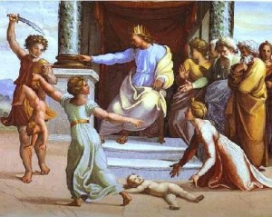
I, II Kings, 2 Chronicles
Theme: Israel sins and God judges his people.

Slide 142
Outline of I, II Kings
1 Kings 1-11 Solomon, son of Bathsheeba, King of Israel. 970-930 BC
1 Kings 12 The kingdom of Israel divided under Rehoboam by revolt of Jeroboam. 930 BC
1 Kings 13-2 Kings 16 The divided kingdom. Israel (Samaria, Ephraim) and Judah. 930-722 BC
2 Kings 17 Northern Kingdom (Samaria) destroyed by Assyria. 722 BC
2 Kings 18-24 Judah alone 722-586 BC
2 Kings 25 The fall of Jerusalem and Judah to Babylon. 586 BC

Slide 143
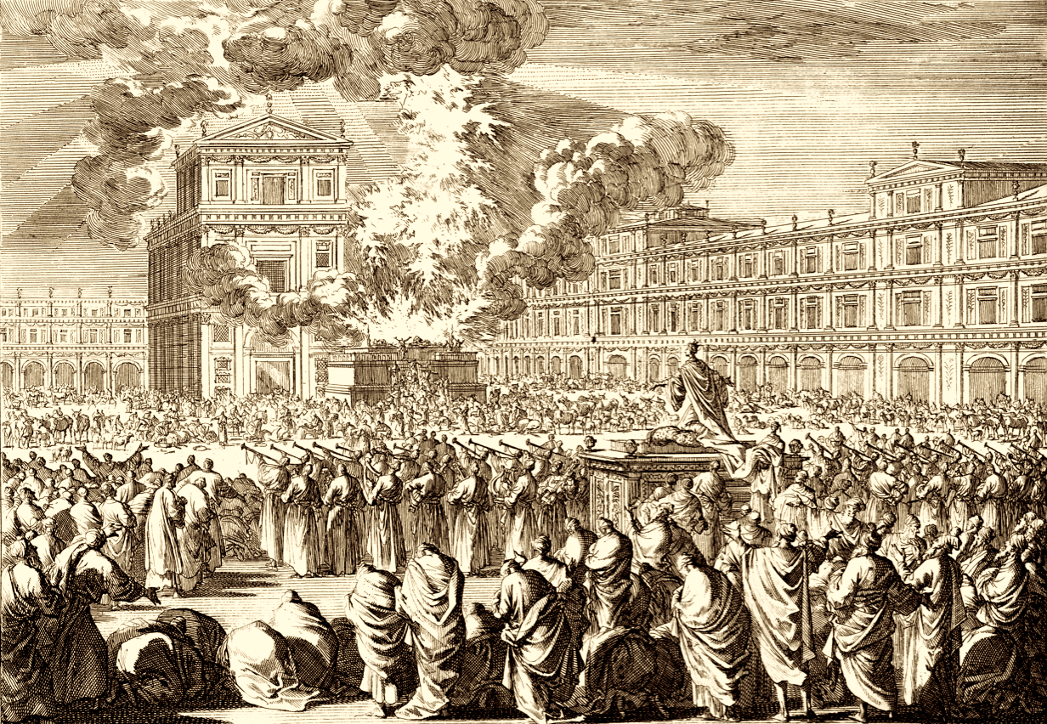
A Key Event in 1 Kings:
The Temple Dedicated
1 Kings 8:10-11
2 Chron 5:11-6:6

Slide 144
Key Events in 1 Kings:
1. Solomon asks for wisdom.
2. Solomon Dedicates the Temple
3. Rehoboam ignores wise advice, Jeroboam rebels, Israel divided.
4. Ministry of Elijah

Slide 145
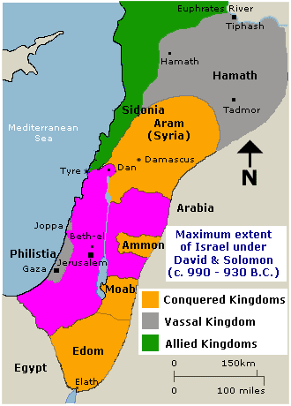
Solomon’s Kingdom about 940 BC

Slide 146
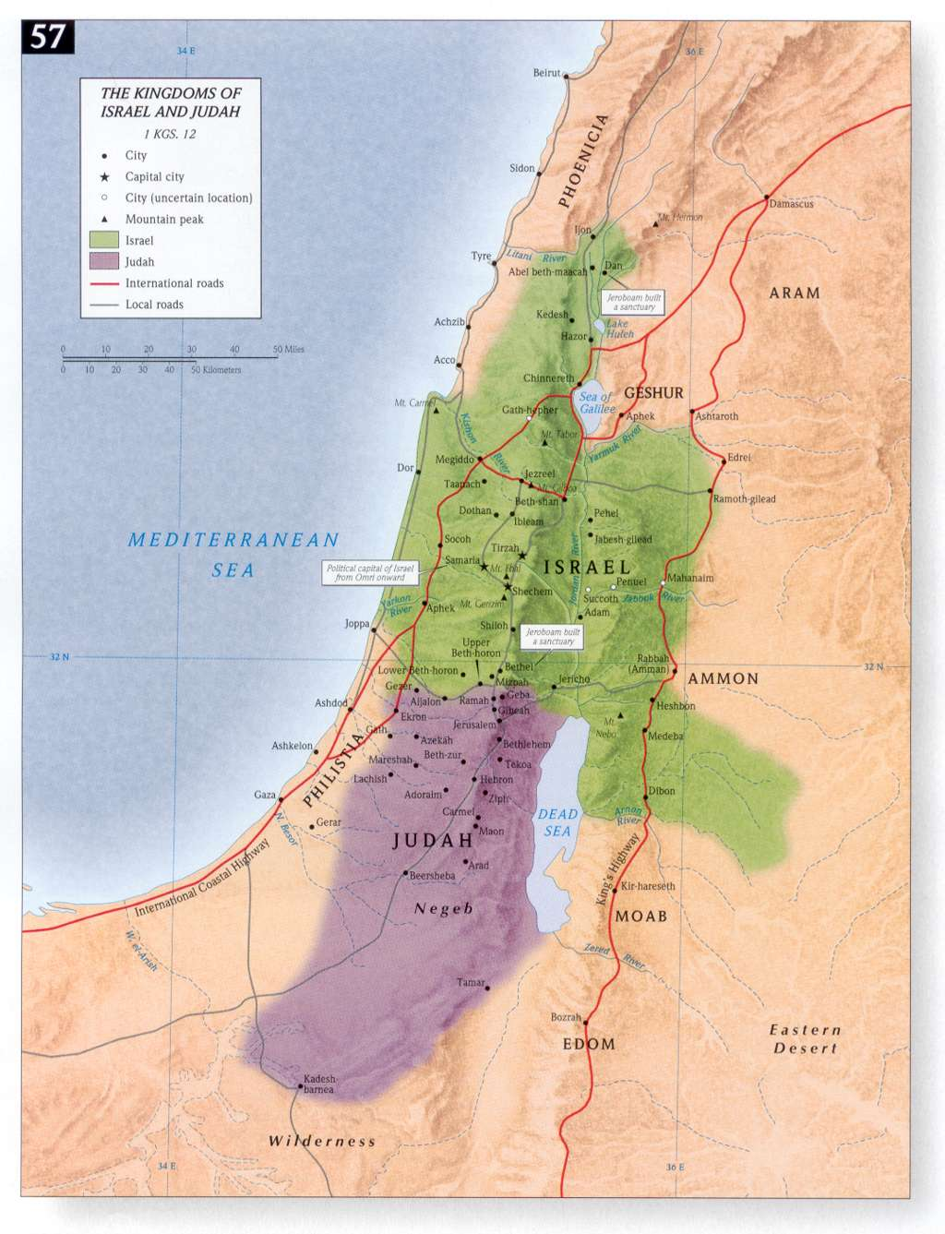
Divided Kingdom Under Rehoboam and Jeroboam
930 BC

Slide 147
Key Events in 2 Kings:
Ministry of Elishah 2 Kings 2-8
2. Samaria Destroyed. 2 Kings 17
3. Reign of Hezekiah. Sennacherib’s army destroyed. 2 Kings 18-20
4. Reign of Josiah The most righteous king of Judah. 2 Kings 23
5. Jerusalem destroyed 2 Kings 25 Jeremiah 52:4-13

Slide 148


Slide 149


Slide 150

The Moabite Stone or Mesha Stele 870 BC
the Louvre
Ahab “of the house of Omri”
1 Kings 16:28

Slide 151

The Tel Dan Inscription
820 BC
2 Kings 8:28-29
‘I killed Jehoram, son of Ahab, king of Israel and I killed Ahaziah, son of Jehoram, king of the house of David”

Slide 152



Black Obelisk of Shalmanezer III 840 BC
British Museum 2 Kings 17:3-6

Slide 153

The Siloam Inscription.
2 Kings 20:20-21
"Now the rest of the acts of Hezekiah--all his might, and how he made a pool and a tunnel and brought water into the city--are they not written in the book of the chronicles of the kings of Judah? So Hezekiah rested with his fathers."

Slide 154

Lachish Room, British Museum

Slide 155

Israeli Captives Being Led from Lachish

Slide 156

Jewish captives skinned alive in front of Lachish Walls

Slide 157

The Sennacherib Cylinder or Taylor Prism British Museum, London (2 Kings 18) 691 BC
As to Hezekiah the
Jew… I made him…
“like a bird in a
cage”

Slide 158
The Prophets

Slide 159
Prophets
Ex 4:16;7:1 Aaron was Moses’ prophet
A prophet is a speaker of and for God
A prophet does more forth telling than fore telling
Jer.20:9 It is like fire in my bones.

Slide 160
Prophets
nibba- one who has been called or appointed to proclaim as a herald the message of God
Seer- the prophet received special visions to convey spiritual realities other men could not see.
Deut 18:22 What he says must come to pass.

Slide 161
Message of the Prophets
I. Repentance
II. The Day of the Lord Doom, Judgment.
III. Salvation and Deliverance – a remnant.
IV. Advocates for social justice.

Slide 162
Audience of the Prophets
Prophets to Israel- Amos and Hosea
Prophets to Judah pre-exile- Isaiah, Micah, Habakkuk, Zephaniah.
Prophets to Gentiles/other nations Jonah, Obadiah, Daniel
Judah during the exile- Jeremiah, Ezekiel
Judah post-exile-Haggiah, Zechariah, Joel and Malachi

Slide 163
The 7th And 8th
Century Prophets
The Demise of a Nation
The Petrification of the Law

Slide 164
Prophets to Samaria/Israel
Amos
Hosea
(Jonah was from Israel, but preached to Gentiles)

Slide 165

Hosea, the Savior of Israel

Slide 166
Theme of Hosea:
Our Unfaithfulness to God
And
God’s Gracious Love for Us

Slide 167
Hosea
Hosea = Jeshua = Savior
A prefigure of Christ.
The situation: Israel is a mess because of her sin. Hosea 4:1-3

Slide 168
God’s Solution to the Mess
God’s solution: Go marry an adulterous wife Hosea 1:2
And raise unfaithful children Hosea 1:3-9
Lo-Ruhamah = not loved
Lo-Ammi = not my people
This was us at one time!!!!

Slide 169
God’s Grace
Hosea 1:10-2:1 Great news!
You will be “my people”, “my loved ones”
Hosea 2:14-23 (Romans 5:5-8)
God’s love is beyond reason

Slide 170
Hosea 3
As With God, So With Hosea
3:1 Go love your wife again.
3:2 Hosea brought Gomer back to live with him (as did God with us)
Hosea now understands God’s love
Hosea 3:5 A messianic prophecy.

Slide 171
God’s Unending Love For Us
Despite all these things. Despite the fact that we acted like Gomer…
Hosea 11:1 I called you out of Egypt. (Matthew 2:15)
Hosea 11:8 I cannot give you up!
Hosea 12:9 I spoke to you through the prophets.

Slide 172

Amos (A Moose)

Slide 173
Themes of Amos
Background: Israel is relatively prosperous at this time under Jeroboam II
Themes:
Insincere worship is an abomination to God.
God’s servant must show social justice.

Slide 174
Amos
Amos 3:2 Privilege brings responsibility.
Amos 5:14 Seek good, not evil
Amos 6:1 Woe to those who are at ease in Zion…

Slide 175
Through out the book of Amos- I brought you out of Egypt- Remember where you came from.
When God’s people forget who saved them and become content with being like everyone else, destruction is on its way.

Slide 176

Jonah, Prophet to the Gentiles

Slide 177
Theme of Jonah:
The Grace of God
Message of Jonah:
Repentance and Salvation is for the Gentiles too!
You Cannot Run From God

Slide 178
Setting of Jonah
782 BC
Syria is Israel’s most hated enemy
Assyria in a temporary decline
More open to the gospel?

Slide 179
Jonah: A Prefigure of the Messiah
Matthew 12:39-41 The “sign of Jonah”
John 7:52 Gath Hepher 3 km from Nazareth.
All are about to die.
Sleeping in a boat during a massive storm. (Luke 8:32)
Gambling at his feet. (Luke 23:34)

Slide 180
Jonah: A Prefigure of the Messiah
Jonah 1:15 Jonah calms the storm (Mark 4:39)
Jonah 1:12 Jonah willingly offers his life to save the Gentiles.
It is a miracle Jonah is in the Bible!

Slide 181


Gath Hepher and Nazreth 3 km apart

Slide 182
Outline of Jonah
Ch 1 Running from God.
Ch 2 Running to God.
Ch 3 Running with God.
Ch 4 Running ahead of God.

Slide 183
Jonah Ch 1 Running from God
Jonah 1:1-3 Go and preach against Nineveh.
Jonah 1:4-17 God is in control.
Point: When God asks you to do something you desparately do not want to do, do it anyway!!!

Slide 184

Jonah tries to avoid doing God’s will

Slide 185
Jonah Ch 2 Running to God.
Q: Why did Jonah wait three days to repent?
v. 1-7 Jonah is us!
v. 8,9 These heathens do not deserve to be saved, but if you INSIST…
Has Jonah been humbled?
Are we like Jonah?

Slide 186
Jonah Ch 3 Jonah Runs With God
3:1-9 v. 3 Did Jonah really repent?
Did he preach the entire message?
A very effective preacher.
Message: Some people you think will not be open will be open!
Is Jonah happy that 100,000 were saved?

Slide 187

Jonah Ch 4.
Jonah Runs Ahead of God
Jonah 4:1-3 Jonah having a pity party.

Slide 188
Jonah Ch 4.
Jonah Runs Ahead of God
Jonah 4:4-5 Waiting for disaster.
Jonah 4:11-12 The Grace of God.
v. 6 How has God provided a vine for you?
Are you, like Jonah, more concerned with your own comfort that the salvation of the lost?

Slide 189
Prophets to Judah
Isaiah, Micah, Habakkuk, Zephaniah, Joel, Nahum

Slide 190

Isaiah (I Say Ah)

Slide 191
Isaiah’s Audience
Four kings of Judah: Uzziah, Jotham, Ahaz, and Hezekiah 740-690s BC

Slide 192

Isaiah Historical Context
Notes:
Tiglath-pileser III 2Kings 15:19-20 - known as Pulu in Babylon or Pul in Israel.
Sargon II 2 Chronicles 28:1-27 - covers various events from reign of Tiglath-pileser to Sargon II
Sennacherib 2 Chronicles:29-33, Is 36:1-7, 37:21,35-37 - constant threat to Judah under king Hezekiah

Slide 193
Outline of Isaiah
God Judges the Nations (Ch. 1-35)
God Comforts his People (Ch. 36-48)
God’s Prince of Peace (Ch. 49-57)
God’s Program for Salvation (Ch. 58-66)
Is Isaiah 40-66 DeuteroIsaiah? I doubt it.

Slide 194
Themes In Isaiah
The Sinfulness of Judah and Jerusalem
An Appeal to Turn to God and Repent
If Not, Judgment is Coming
The Messiah is Coming
God Rules the Nations
Social Justice

Slide 195
Theme Verses
Isaiah 1:3-4 The ox knows its master, the donkey knows its owner’s manger, but Israel does not know, my people do not understand. Woe to the sinful nation, a people whose guilt is great, a bood of evildoers, children given to corruption! They have forsaken the Lord; they have spurned the Holy One of Israel and turned their backs on him.
Is 1:16-17 Wash and make yourselves clean. Take your evil deeds out of my sight; stop doing wrong. Learn to do right; seek justice. Defend the oppressed. Take up the cause of the fatherless; plead the case of the widow.

Slide 196
Prophecies about Judah
Isaiah prophesied that because of continued idolatry God would send Judah into Babylonian captivity, yet he would graciously restore them (through the work of his Servant, who would bear away their sins by his death), so that his kingdom would be unending in the new heavens and the new earth.
Do you see the foreshadowing here?

Slide 197
Noteworthy
Isaiah contains 111 separate predictions. Of the 1,292 verses in the book, 754 (59%) deal with future events.
Forty-seven chapters of this book were directly quoted or alluded to by Christ or the Apostles. With more than four hundred allusions, Isaiah stands second only to Psalms as the most cited book in the New Testament.

Slide 198
Kingdom Prophecies
1. The future temple which attracts Gentiles (2:2–4).
2. The glorious Branch (4:2–6).
3. The virgin birth of Immanuel (7:13–14).
4. The dawning of a new day in the birth of a child (9:1–7).
5. The Shoot of the stem of Jesse (11:1–10).
6. The conversion of Gentiles (19:18–25).
7. The new Jerusalem (54:9–13; 60:19–22).

Slide 199
Messianic Prophecies
8 The marriage supper of the Lamb (25:6–8; 26:19).
9. The ministry of the Messiah (42:1–4).
10. The Servant as a light to the Gentiles (49:1–13).
11. The willing obedience of the Servant (50:4–11).
12. The redemption achieved by the Servant (52:13–53:12).
13. The promises made to David to be fulfilled (55:1–5).

Slide 200
God Rules The Nations
Isaiah 14:24-27 I will crush the Assyrian in my land
Isaiah 39:5-7 All will be carried to Babylon.
Is 42: 1- 4 God raises up His gentle servant. A bruised read he will not bend….
Isaiah 44:28-45:6 God raises up Cyrus

Slide 201
Important scriptures in Isaiah
Isaiah 40:1-5 A message of comfort. A voice of one calling in the wilderness: prepare the way for the Lord. John the Baptist is coming. (also Malachi 4)
Isaiah 42:1-4 The gentle Messiah A bruised reed he will not break.
Isaiah 49 A great evangelism passage.
Then, of course, there is Isaiah 52:13-53:12.
Social justice: Isaiah 58:5-8
Isaiah 61:1 Quoted in Luke 4:18
Isaiah 65:17-20 The Kingdom is Coming.

Slide 202

Micah

Slide 203
Micah
“Who is like the Lord”
Audience: Jotham, Ahaz, and Hezekiah (mainly about 740–700 B. C.)
Much parallel with Isaiah.
Theme: Those who live luxurious lives and seek to placate God through offering money are vampires in the sight of God—sucking the life out of the poor.

Slide 204
Judgment and Blessing
First cycle
  Judgment (1:1–2:11) Trust in themselves
  Blessing (2:12–13) Gather a remnant
Second cycle
  Judgment (3:1–12) Unjust Rulers
  Blessing (4:1–5:15) Just Ruler is Coming
Third cycle
  Judgment (6:1–7:7) God requires
  Blessing (7:8–20) God Saves

Slide 205
The Messiah is Coming
Micah 5:2 But you, Bethlehem Ephrathah, though you are small among the clans of Judah, out of you will come for me one who will be ruler over Israel, whose origins are from old, from ancient times.

Slide 206
Micah 6:6-8
With what shall I come before the Lord, and bow myself before God on high?
Shall I come before him with burnt offerings,
with calves a year old? Will the Lord be pleased with thousands of rams, with ten thousands of rivers of oil? Shall I give my firstborn for my transgression, the fruit of my body for the sin of my soul?” He has told you, O man, what is good; and what does the Lord require of you but to do justice, and to love kindness, and to walk humbly with your God?

Slide 207
Joel: The Day of the Lord
Introduces the idea of The Day of the Lord. Mentioned 5 times (1:15, 2:1,11,31, 3:14)
The Day of the Lord signifies “The moment when Jehovah grasps the reigns, which he seems to have held slackly before, when the currents of his moral rule, which have been running sluggishly, receive a mysterious quickening, and the Lord’s work on the earth is at last fully performed.”
Or “The Day in which Jehovah will manifest himself as God.”
Describes prophetically the outpouring of the Holy Spirit at Pentecost. Acts 2:16f.

Slide 208
Joel: The Day of the Lord
The Day of the Lord is one before which one ought to consider repenting. (2:12-17)
Describes prophetically the outpouring of the Holy Spirit at Pentecost. Acts 2:16f.

Slide 209

Habakkuk
Late 7th Century BC

Slide 210
Habakkuk
When Habakkuk asked God questions about the nature of evil and its punishment, God answered by revealing his righteousness and sovereignty, and the prophet then responded with worship and faith.

Slide 211
Questions
Habakkuk’s first question: “Why is evil in Judah not being punished?” (1:1–4)
God’s first answer: “God will use Chaldea to punish evil in Judah” (1:5–11)

Slide 212
But
Habakkuk’s second question: “How can God righteously use the more wicked (Chaldea) to punish the less wicked (Judah)?” (1:12–2:1)
God’s second answer: “Chaldea will also be punished for its evil” (2:2–20)

Slide 213

Zephaniah- (Ze fan niah)
640-609 BC

Slide 214
Day of the Lord
Although Zephaniah prophesied coming judgment against the nations, his main message was against Judah, whose sins were so serious that they would go into exile on “the day of the Lord,” but later they would be restored to righteousness

Slide 215
Zeph.3:17
The Lord your God is in your midst,
a mighty one who will save;
he will rejoice over you with gladness;
he will quiet you by his love;
he will exult over you with loud singing.

Slide 216
Prophets of the Exile:
Jeremiah, Ezekiel, Daniel

Slide 217

The Book of Ezekiel

Slide 218
Ezekiel: Resources
The Book of Ezekiel Jim McGuiggan Montex Publishers
Ezekiel Iain M. Duguid The NIV Application Commentary
Prophets of the Exile
Jeremiah 627-585 BC (or a bit later)
Lamentations
Ezekiel 593-570 BC
Daniel 605-535 BC

Slide 219

Ezekiel’s Place in History

Slide 220
Themes in Ezekiel
1. The Sovereignty/glory of God
a. Theodicy: Free will
2. The utter sinfulness of humanity/Judah
3. The inescapability of God’s justice
4. The Messiah is coming/ The restoration of God’s Remnant.

Slide 221
Motifs in ezekiel
Captivity Motif
Exile Motif
Restoration Motif

Slide 222
Ezekiel Outline
I. Ezek Ch 1-24 Jerusalem must fall. 592-586 BC
II. Ezek Ch 25-32 Judah’s enemies must fall as well.
III. Ezek Ch 33 Bridge from Ch 24 to Ch 34
IV. Ezek Ch 34-48 Jerusalem must be comforted. The Messiah will come and save a remnant. 585-570 BC

Slide 223

Ezekiel 1
1:1 5th year of Jehoiachin’s exile 592 BC
10,000 captives—the cream of the crop (2 Kings 24:14)
Ezek 1:4-28 Ezekiel sees the glory of God
On the throne, surrounded by the cherubim (Rev 4:6f).
The cherubim are the ones who guard God’s holiness

Slide 224
Ezekiel’s vision
1:4 cloud, flash of lightening (also fire in v. 13) = judgment From the North = Babylon
v. 5 four living creatures = cherubim Rev 4:6b-8 Identified as such in Ezek 10:1
v. 10 four faces man, lion, ox (Hebrew could be bull), eagle (Rev 4 lion, ox, eagle, man)
v. 12, 17 move God’s judgment coming like a chariot
v. 15-18 Wheels in wheels, with eyes all over = searching to protect God’s holiness (the version in Ezek 10:12, Rev 4:6 has eyes all over).
v. 22-28 The throne of God.
v. 28 rainbow = hope (hope recalls Lam 3:22-23)

Slide 225
Ezekiel 2 & 3
Ezekiel Commissioned
Ezek 2:1-7 Ezekiel’s mission
v. 4 say to them: this is what the Lord says.
2:1 “Son of man” (ben-adam) stresses his humanness
v. 4 Ezekiel needs to be obstinate and stubborn. Why? Because the people are obstinate and stubborn.

Slide 226
Ezekiel’s Commission (cont.)
Ezek 2:5 Whether they listen or fail to listen….
v. 5 They knew a prophet had been among them….
Ezek 2:8-3:3 Ezekiel eats the scroll. To be God’s prophet we must:
1. Have a personal encounter with God (1:4f)
2. Digest his Words (Jeremiah 15:16, Rev 10:9-11)
Ezek 3:4-9 They have heard it all before. They are very religious.
3:8 God’s solution: We need to be as hard and stubborn as they are.

Slide 227

Ezekiel: The Watchman of Israel
Ezekiel 3:16-21 Ezekiel a watchman
Q: Are you willing to be God’s watchman?
Eph 2:1-3 and Eph 2:4-10.

Slide 228
Ezekiel 4 & 5
Dramatic symbolism
Ezek 4:1-3 Ezekiel acts out the siege of Jerusalem (588-586 BC)
a. Draws the city
b. Siege works: Babylon
c. Iron pan God is against Jerusalem and will not hear
their prayers
4:4-7 430 Days = 430 years = symbolically, length of captivity in Egypt
390 days for sin of Ephraim/Samaria/Northern Kingdom
40 days for sin of Judah
v. 4 “bear their sin” = bear the consequences
4:9-11 mixing, weighing grain = shortage of food during siege.
4:12 cook over human dung = unclean during exile.

Slide 229
Ezekiel 5 Ezekiel gets a haircut
A haircut: The point: From those to whom much has been given, much will be expected.
Cutting off hair and beard a big deal for Jews.
v. 2 fire, sword and exile
v. 3 The remnant motif (but even some of them will suffer v. 4)
v. 5 I have set you in the center of the nations. Great responsibility.

Slide 230
Ezekiel 6 & 7 Judgment on Judah
(and a ray of hope)
v. 2 Judgment on the Mountains, not just on Jerusalem.
v. 8 But a remnant will be saved. (because they “loathe themselves for the evil they have done)
v. 10 An ominous passage. “And you will know that I am the Lord” 72 times in Ezekiel.
Jeremiah 7 The end has come. Too late to repent
Ezek 7:4 We can reach the point that God shows no pity. Amos 5:24 Let justice roll on like a river.
v. 7 doom!!!

Slide 231
Ezekiel 7 Cursed Money
Ezekiel 7:19-22 They will throw their silver into the streets. On the Day of Judgment, what the world holds to be valuable will be abominable.
Things you can buy Things you cannot buy
Medicine health
Books knowledge of God, wisdom
Position favor with God
Attention love

Slide 232
Ezekiel 9
9:1 Executioners from North (Babylon).
9:2 Put a mark on the foreheads of those who grieve and lament. Rev 7:1-17 Mark = protect from eternal judgment. (note: not protected from temporal judgment Ezek 21:3-4)
For us, the mark is the Holy Spirit Eph 1:13-14.

Slide 233
Ezekiel 9 (cont.)
Ezek 9:5 Kill without pity or compassion. Whew!
9:6 Begin at my sanctuary (leaders, the church)
(1 Pet 4:17)
9:9-10 They brought this on themselves
9:11 It (God’s wrath) is accomplished!

Slide 234
Ezekiel 10,11 Necessity of Judgment
Ezek 10:1 God on a sapphire (blue, royal) throne with his cherubim protecting his holiness.
Ezek 10:18 A momentous event. The Lord departs from the temple in Jerusalem. Judgment is around the corner. Jerusalem is doomed.

Slide 235
Ezekiel 11 Judgment on the Leaders of Judah
Remember, this is being said to the elders.
Their sin? Ezek 11:3 They say “peace, peace” when there is no peace.
11:23 The end of the road (so much for the P in TULIP)
God goes to Mt. of Olives. An interesting foreshadow.
.

Slide 236
Ezekiel 12 Acting out the destruction of Jerusalem
12:3 Son of man, pack your bags… A visual prophecy. Hopefully we, like Ezekiel, have packed our bags (Heb 11:13f)
12:5-10 A prophecy about Zedekiah. Dig through wall (v. 5) Cover your face (v. 6) At night (v. 7). Zedekiah (v. 10-14)
All fulfilled in detail. Jeremiah 52:4-11, 2 Kings 25:1-7 Ezekiel is a prophet!
12:16 But I will spare a remnant.
12:28 God replies: No more delay!

Slide 237
Ezekiel 14 It is too late
14:13-14 I have decided. Even Noah, Daniel and Job could not change my mind! (parallel: Jer 15:1-2)

Slide 238
Ezekiel 16 Shameful history I
Ezek 16:1 What to do about sin? Confront it!
16:2-5 You were the lowest of the low.
16:6-7 Yet I chose you.
16:8-14 I even entered an intimate relationship with you (Mosaic covenant).
16:15-34 But you trusted in self and made yourself a prostitute with Egypt, Philistia, Assyria and Babylon.
16:35-41 Therefore you will be destroyed.
16:43 The antidote: Remember the days of your youth.
16:60-62 Great news!!! I will remember the first covenant and will make a new covenant with you. (Hosea Ch 3, Jeremiah 31:31)

Slide 239
Ezekiel 17 Parable of two eagles
The two eagles are Babylon and Egypt. Message: Do not rely on the world for security. Do not make alliances with the world.
Ezek 17:2-4 Nebuchadnezzar takes a topmost shoot: Jehoiachin (597 BC) “Lebanon” = Israel (Jer 22:23) “Lebanon” = palace of Lebanese cedar.
17:5-6 A low-spreading vine: The Jews, although powerless, could flourish if they accept discipline and serve Nebuchadnezzar.
17:7-8 But Judah relied on the less powerful eagle: Egypt
17:9-10 This is a big mistake. 17:11-21 Parable interpreted.

Slide 240
Ezekiel 18 Individual Righteousness
Ezek 18:2 A bogus proverb: Sour grapes.
The exiles: It is not our fault. Blame it on our fathers!
God: Wrong! Everyone is accountable for their own actions. So much for predestination/Original sin.
Ezek 18:4 All souls are mine. All can be saved (Rom 8:28-30)
Ezek 18:5-18 God’s justice. (does this contradict Exodus 20:4?)

Slide 241
Ezek 18 (cont) individual righteousness
Ezek 18:20 (for emphasis) God repeats himself.
Ezek 18:21-24 Our final state determines our eternal destiny (but be aware of Hebrews 6:4-6 and 2 Peter 2:20-22)
18:22 For the righteous: None of his offenses will be remembered
18:24 For the unrighteous: None of his good deeds will be remembered.
18:25-29 Godly vs human justice. (Matthew 20:1-16 exp. v. 14)
18:30 Here is the bottom line for us: Each will be judged according to his own ways.
18:32 The bottom line for God. He wants all to be saved. 1 Tim 2:4 The T and the P in TULIP are a lie.

Slide 242
Ezekiel 21:18-24 A Signpost
21:18-24 A signpost. The lot (of judgment) will fall on Jerusalem, not Rabbah/the Ammonites.

Slide 243
Ezekiel 23 Oholah and oholibah
Shameful History IV
Oholah (Heb: her tent) is Samaria/Ephraim/Northern Kingdom
Oholibah (Heb: my tent is in her) is Jerusalem/Judah
This chapter is R-rated. It is shocking on purpose.
Message: God will give us over to our lusts if we live by sight, not by faith (Romans 1:24-28)
Ezek 23:5-10 Oholah prostituted herself with Egypt and Assyria.
Ezek 23:11-27 Oholibah was worse than her sister!
v. 20 This is disgusting! Sin is disgusting. Their mistake: They were not satisfied with God. 1 Tim 6:8 Are you satisfied with what God has for you?

Slide 244
Oholah and Oholibah cont.
Ezek 23:22 The take-home lesson: I will give you over to what you give yourself to.
Ezek 23:25 God: I am jealous. Amazingly, God still loves Samaria and Judah. This is the story of Hosea. Romans 5:8 While we were still sinners, Christ died for us.
Ezek 23:28 I will give you over to the very thing you hate. This is what sin does. John 10:10 The thief comes to steal and kill and destroy. Jesus came that we can have life.
Summary: 23:49 Then you will know that I AM the Lord.

Slide 245
Ezekiel 24 The cauldron Ezekiel refuses to mourn
Jan 588 BC A date to mark down. The date Jerusalem was put under siege. Again, Ezekiel proves himself to be a prophet.
Ezek 24:6 A cauldron with encrusted layers of unrepented sin. Judah. 24:12 A heavy deposit.
Ezek 24:11,13 When God’s wrath is poured out, it will get hot enough to burn off the encrusted layers.
24:14 I will not have pity (as illustrated later in Ezek 24:15-24)
24:15-24 God to Ezekiel: Do not mourn when your wife dies. I will take away the delight of your eyes. How does God feel about judging Judah? Like Ezekiel feels about God taking away his wife.
The point: When we suffer discipline for our sins, we should accept it without complaint.

Slide 246
Part III Ezekiel 33 Transition jerusalem has been destroyed
Ezekiel 33 is a transition from Ch 1-24 to Ch 34-48
God’s judgment has now been completed, so the message will turn from principally rebuke to principally encouragement. The Messiah is coming.
Ezek 33:1-6 The watchman of Israel. Ezekiel did his part.
Ezek 33:7-9 Ezekiel recommissioned.
Ezek 33:10 The people finally repented. Or did they…. “Our offenses and sins weigh us down and we are wasting away because of them.”
Sounds like they are whining! v. 12

Slide 247
Ezekiel 33 Jerusalem has fallen
33:21 A key transitional moment in Ezekiel. A messenger arrives (as prophesied in Ezek 24:26). Jerusalem has fallen!!! Ezekiel is vindicated as a prophet.
33:30-33 Ezekiel now a popular prophet. Ezekiel not impressed
v. 31 They express devotion.
v. 32 Looking for entertainment. (one who sings a love song)
v. 33 A faithful watchman looks for true repentance.

Slide 248
IV ezekiel 34-48 Comfort for God’s people. The Messiah is coming!
The tone noticeably shifts in this part toward offering comfort, now that God’s wrath against his people has been completed.
There is much double (or even triple) prophecy in this section. Much of what God says through Ezekiel can be applied to the restored remnant which will return under Zerubbabel and Nehemiah, but it applies even more so to the messianic kingdom and the Church.

Slide 249
Ezekiel 34
The Messiah: A better shepherd
The job of a shepherd:
Ezek 34:2 To care for the flock, not for yourself.
Ezek 34:4 To care for the weak
Ezek 34:4 To bring back the strays.
Ezek 34:4 To bring in the lost.
God’s charge: You treated my sheep harshly. The result is the sheep are scattered.
Ezek 34:7-10 I will hold you accountable.
I will remove you from leading my flock

Slide 250
I will Shepherd my flock
34:11-22 I will shepherd the flock myself.
34:13-16 Q: Is he talking about Judah restored to the Promised Land, or is he talking about the us, restored to a relationship with God?
v. 17-20 Even in the absence of good shepherds, the sheep have some responsibilities.

Slide 251

Ezek 34 The Good shepherd is coming
Ezek 34:23f God’s shepherd is coming. “My servant David.”
John 10:1-18 I am the good shepherd.
34:26 Showers of blessings
34:27 Much fruit, Security, Freedom (John 8:31f)
34:29 Spiritual food, the bread of life.

Slide 252
Ezek 36 a new covenant
Ezek 36:24f A remnant devoted to God. A New Covenant.
v. 24 all nations
v. 25 cleansed by water
v. 26 a new heart and a new spirit
v. 27 receive the Holy Spirit
v. 29-30 blessings
v. 31 repentance
No wonder Jesus challenged Nicodemus he should have known
v. 32 not because you are awesome

Slide 253

A new eden
v. 33 much fruit
v. 35 imagery from the Garden of Eden. The Kingdom of God Isaiah 65:19-25
v. 36 When people see how God has blessed us, “Then they will know that I am the Lord”

Slide 254

Ezekiel 37 the valley of dry bones
The promise of resurrection (on many levels and in many ways)
He’s Alive!

Slide 255
Ezek 37 The valley of dry bones
Ezek 37:2 The bones are “very dry” No hope!!! God specializes in this kind of situation.
Ezek 37:3 Son of man, can these bones live?
Q: Can your neighbor live? Can your marriage live? Can you spiritual life be revived?
37:4 The solution to spiritual death: “Dry bones, hear the word of the Lord.” Sometimes we need to preach to dry bones!
37:5 Revived by receiving the Holy Spirit. Zech 4:6 Rom 8:9-11
37:7-10 A bizarre vision!
37:11-14 Primary application is to Israel. God will bring them back to life in Canaan. (but it is a double prophecy)

Slide 256
Ezekiel 37 cont.
37:22f Messianic prophecy
I will make them one nation in the land
One king
I will save them v. 23
I will cleanse them v. 23
They will be my people v. 27 (Hosea 1:10-11 Hosea 2:23 Hos 11:1)
My servant David will be king over them v. 24
A new covenant. v. 26
I will dwell (tabernacle) with them v. 26-27 John 1:14
This is about the Church but it is also about heaven—the Kingdom

Slide 257
Ezekiel 38-39 gog and magog
This is an idealized vision of enemies attacking God’s people and God defending them. The Jews need assurance that after God restores them to the Land, it will not happen all over again.
Jim McGuiggan: “Gog is a grand illustration of any and all who oppose God’s people.”
v. 8 You will invade the Promised Land “gathered from many nations to the mountains of Israel”
v. 11 unwalled cities. God’s people living in security. No problem. God will destroy them without a shot.

Slide 258
Ezekiel 40-48 The Temple rebuilt restoration of the remnant
The purpose of this section is to illustrate the Kingdom of God/God with his people. Do not get caught up in the details. It gives very precise instructions for building the restored temple.
Is it about restoration of the kingdom and temple in 516 BC? Yes
Is it about the church and the heavenly tabernacle? Yes
Is it about the ultimate embodiment of the tabernacle/Kingdom of God/Heaven? Yes.
Hebrews 8:3-6 “See to it that you make everything according to the pattern shown you on the mountain.” (or in Ezekiel 40-48).
Ultimately, it is about God’s holiness—his perfection.

Slide 259
Ezekiel 40-48
Ezek 40:1 The twenty-fifth year of the exile (572 BC)
Ezek 43:1 The glory of the Lord returns to the temple (after leaving it Ezekiel 8:6). He enters through the East Gate (as he had exited it through the East Gate).
43:10 Why all the details? “that they may be ashamed of their sins.”
44:2 The East gate is to stay shut (because only the holy can enter through the East gate.
46:1-3 Except on Sabbaths and New Moons.

Slide 260
We are the zadokites!
44:15f Only the Zadokites (also 43:19) can minister in the temple.
v. 16 We are the Zadokites (1 Pet 2:9)
v. 23 We are to teach difference between the holy and common.
v. 28 I am to be their only inheritance. They will have no possessions in the land.

Slide 261

Back in the garden
Ezekiel 47 The river from the temple. (Revelation 22:1-5, Zech 14:8-9) Imagery from the Garden of Eden.
It comes from the temple—from God.
It cleanses (Zech 13:1)
It is living water (Zech 14:8, John 7:37-39)

Slide 262
Summary of Ezek 40-48 (and perhaps of the entire book of ezekiel)
Ezekiel 48:35 And the name of the city from that time on will be:
THE LORD IS THERE
We are back in the Garden if Eden—in the fully realized Kingdom of God, where God intended us to be all along.

Slide 263

Jeremiah: The Burden of the Lord

Slide 264
Jeremiah’s Nicknames
The Weeping Prophet
The Burden (Oracle) of the Lord (Jeremiah 23:33)

Slide 265
Historical background to Jeremiah
a. Ministry began 13th year of Josiah (627 BC) One year after his reform. Started out great.
b. Shallum/Jehoahaz 609 3 months. Deposed by Pharaoh.
c. Jehoiakim 609-597 Unfaithful, worshipped Baal, etc. surrendered to Babylon, rebelled went to Egypt.
d. Jeconiah/Jehoiachin 597 Also unfaithful. Blinded and taken into exile.
e. Zedekiah 597-586 Also unfaithful. Turned to Egypt again. Jerusalem destroyed, Zedekiah killed, temple burned.
d. Captivity and humility. Rebelled again. Ishmael murdered Gedaliah. The people panic. Jeremiah taken to Egypt.
e. Stoned to death in Egypt Bummer!

Slide 266
Themes in Jeremiah
False Religion
God’s Judgment
The Remnant

Slide 267
God’s Remnant
Jer 6:9 God gleans the remnant
Jer 29:1-11 God has plans for the remnant (written within days of captivity)
Jer 31:7, Jer 33:14-18 God saves the remnant
Jer 39:9 God directs the remnant
Jer 40:11 God abundantly blesses the remnant
Jer 42:1-3, 15, 19 God releases the remnant
Jer 43:4-7, 44:14
Jer 50:20 God forgives the remnant

Slide 268
Symbolism
Jer 1:11-16 The Almond Tree
Jer 13:1-11 The Linen Belt
Jer 13:12-14 The Wineskins
Jer 18:1-10 The Potter’s House
Jer 19:10-13 The Jar
Jer 24:1-10 The Fig baskets
Jer 27:1-8 The Yoke
Jer 32:1-41 The Field
Jer 43: 8-13 The Stones

Slide 269
Jeremiah: A prophet for today
Arguably, Jeremiah, of all the prophets, has a message which resonates with the mindset and issues of the modern and post-modern age.
Francis Schaeffer (Death in the City) called Jeremiah the quintessential prophet for the postmodern age, with its moral relativism and its “open-mindedness.”
“Jeremiah provides us with an extended study of an era like our own, where men have turned away from God, and society has become post-Christian.”
Schaeffer

Slide 270
Jeremiah’s relationship with God
An interesting aspect of Jeremiah’s relationship with his God was his openness about questioning the will of God, yet his trust and willingness to submit to his will.
Jeremiah 4:10 “You have deceived this people and Jerusalem by saying, ‘You will have peace,’ when the sword is at our throats.”
Jeremiah 12:1 “You are always righteous, O Lord, when I bring a case before you, Yet I would speak with you about your justice: Why does the way of the wicked prosper? Why do the faithless live at ease?”

Slide 271
Jeremiah: a prophet of social justice
Jer 5:26-29 …they have become rich and powerful and have grown fat and sleek. Their evil deeds have no limit; they do not plead the case of the fatherless to win it, they do not defend the rights of the poor. Should I not punish them for this?
Jeremiah 22:15-16 Does it make you a king to have more and more cedar? Did not your father have food and drink? He did what was right and just, so all went well with him. He defended the cause of the poor and needy, and so all went well. Is that not what it means to know me? Declares the Lord.
Jer 22:2-3 To the king: Do what is just and right. Rescue from the hand if his oppressor the one who has been robbed. Do not wrong or violence to the alien, the fatherless or the widow, and do not shed innocent blood in this place.

Slide 272
Outline of jeremiah
I. Jeremiah’s mission Ch 1
II. God’s charge against his people Ch 2 You have left God!
III. Jeremiah’s message Ch 3-5 Return and repent!
IV. Jeremiah’s critique Ch 6 The leaders say peace, peace…
V. Judgment is coming on Judah Ch 7-22
VI. Good News! Ch 23-33 God will gather a remnant.
VII. History surrounding the destruction of Jerusalem Ch 34-45
VIII. Judgment on Judah’s enemies Ch 46-51.
IX. Epilogue Ch 52 The Fall of Jerusalem

Slide 273
Archaeological support of events recorded by jeremiah and baruch
1. The fall (but not destruction) of Jerusalem in 597 BC
2. The destruction of Lachish.
3. The raising up of Jehoiachin by Evil-Merodach 560 BC

Slide 274

The Babylonian Chronicles British Museum, London, 597 BC 2 Kings 24:10-17
[In] the seventh year, the month of Kislev, the king of Babylonia mustered his forces and marched to Syria. He camped against the city of Judah (Jerusalem) and on the second day of the month of Adar he took the city and captured the king. He appointed a king of his own choice there, took its heavy tribute and brought them to Babylon.

Slide 275

One of the Lachish Letters, 588 BC
Jeremiah 34:6,7

Slide 276


Slide 277
The lachish letters
The Lachish Letters 588 BC 6 letters on clay shards
Send an army of relief or the city will fall to Nebuchadnezzar
The light at the top of Azekah just went out, and we are next Jeremiah 34:6,7
Within two days, the author of this letter was killed. Two years later, Jerusalem fell.

Slide 278

Yaukin (Jehoiachin), king of the land of Judah
Jeremiah 52:31-34

Slide 279
I. Jeremiah’s Mission Ch 1
Jer 1:4 I have set you apart before you were born as a prophet to the nations.
His mission:
1. Say whatever I command you. 1:7-8
2. Preach judgment is coming.
A seething cauldron (1:13)
Disaster from the North (Babylon) 1:14
3. A positive mission to build and to plant (1:9)
like the branch of an almond tree (the first to bud in the early spring) Jer 1:11

Slide 280
Jeremiah’s commission
Jer 1:6 Jeremiah insecure. Are you sure you want me to be your prophet?
No wonder. He was terribly persecuted by his own people!
Jeremiah 20:1-8 Q: Are you prepared to be a “laughing stock?” Are you prepared to “sit alone?” (Jer 15:17) to be thrown into a miry pit (Jer 38:6}?
Remember that God will put words in our mouth (Luke 12:11-12) Jer 1:8 he will be with us 1:19 he will rescue us. Jer 15:19-21

Slide 281
II. God’s charge against his people:
They have betrayed his love Ch 2
Jer. 2:4-5 You became worthless to God.
Q: Is God exaggerating? (Titus 1:15-16)
v. 5 Q: Is God enough for you? Or do you need more? Are you willing to accept what God gives you?
You (v. 6) and the priests (v. 8) do not ask “Where is the Lord?” They stopped seeking the Lord.
2:11-13 Q: How do we become worthless? Answer: By seeking the blessings of the world rather than the blessings God offers.
v. 11 Has a nation ever changed its gods? Even the pagans are more loyal than you!

Slide 282
II. God’s Charge against his people (cont.)
v. 13 Q: Have you “dug your own cisterns”—looked for satisfying water elsewhere than in the living water from God? (Jer 18:14-15a)
2:20-22 You are like a runaway bride—loved deeply by her lover, yet you went for prostitution. (also 2:32)
v. 23 You are like a wild donkey in heat… ouch!
v. 27 We say to an inanimate piece of wood, “You are our father.” Who, me???? (Rom 1:25)

Slide 283
III. Jeremiah’s Message:
Repent and Return Ch 3-5
3:14-18 Return and I will choose you. I will bring you back from the northern land and I will make a new covenant.
3:22 Return from backsliding. Rev 2:1-7
4:1-4 What “unplowed ground” do you need to break up?
4:8 Do you need to put on sackcloth and ashes? (ie not take care of even your most basic needs as you attend to repentance) (2 Cor 7:11-12)

Slide 284
Disaster from the north
The result: Disaster from the North (Babylon) 4:5,6 a lion = Babylon
Jer 4:23-26 The natural result of sin: an empty life in ruins.
The postmodern attitude: Jer 5:12-13
Jeremiah: a prophet of social justice. Jer 5:26-29
A passage relevant for the postmodern, post-Christian world: Jer 5:30-31 A horrible and shocking thing has happened in the land: The prophets prophesy lies, the priests rule by their own authority, and my people love it that way. But what will you do in the end?
This is our struggle!!!

Slide 285

Disaster from the North: Babylon
Jeremiah 4:5,6
The Ishtar Gate, Babylon, Pergamum Museum

Slide 286
IV. Jeremiah’s critique:
The Leaders say “peace, peace” Ch 6
Jer 6:13-15 The leaders dress the wounds of my people lightly. They say “peace, peace.” Leaders: Is that you?
v. 15 no longer ashamed…. Are you able to be ashamed as you once were? Some of us are no longer willing to confront sin.
If you are friends of the world, God says it is no longer peace, peace for you. 2 Tim 4:1-5
God’s solution: 6:16-20 Stand at the crossroads and look… Seek the good way and walk in it. We already know what to do….
6:20 It is not simply about being more religious. Jeremiah 23:16-24, 33-40

Slide 287


Peace, peace! They dress the wounds of my people lightly

Slide 288
The temple of the Lord, the temple of the lord
Jer 7:1-8 Do not trust in deceptive words.
The sanctuary will not save you if you are not already sanctified.
Q: Equivalent for us?
Trusting in the church rather than in Jesus, who is the head of the church.
Notice: Jesus quoted Jer 7:11 in Matthew 21:13 Might we view the church as the source of our livelihood or a business opportunity?

Slide 289
v. Judgment is coming on judah
Ch 7-22
Jer 15:1-2 Even if Moses and Samuel were to stand before me, my heart would not go out to this people. Death, sword, starvation, captivity. (Ezek 14:13-14)
17:5 Do not trust in man
17:7 Blessed is the man who trusts in the Lord
17:9 The heart is deceitful above all things
17:10 I, the Lord, search the heart.
God’s plan for his people Jer 18:1-12 (sounds like Ezek 18) Q: What is God saying about us?

Slide 290
Keeping the Sabbath as a measuring line of our heart
17:19-27 If you keep the Sabbath, you will have kings on their throne in Jerusalem forever, but if you do not, I will kindle an unquenchable fire.
Q: Is God exaggerating? As how we view and use our money is an accurate reflection of how we view God, so how we accept and use an opportunity from God to rest, reflect and enjoy a relationship (putting aside the worries, pleasures and attractions of the world) with him is an accurate reflection of our wider spiritual health. Thus, this is not a gross exaggeration. Amos 8:5 expresses this well. “When will the New Moon be over that we may sell grain, and the Sabbath be ended that we may market meat.” (also Isaiah 58:13-14)

Slide 291
vi. Good news!
God will gather a remnant Ch 23-33
Jeremiah 23:1-8 God will gather a remnant and place shepherds over them.
v. 5 a righteous branch. the Hebrew for branch is nazer Jesus is called the branch in that he is the “branch” of David/Jesse (Isaiah 11:1,11) , but also in that he is a Nazarene. (Matthew 2:23)
v. 6 a king. The Lord our Righteousness.
Jer 25:8-14 70 years

Slide 292
Jer 29:10-14
I know the plans I have for you
Jeremiah 29:10-14 I will rescue you from captivity. I will bring you back to the Promised Land.
Do you believe God has great plans for you if you will plow up the unplowed ground, seek the ancient paths, and seek him with all your heart?
Will you wait seventy years for God to bless you?
Jeremiah 30:1-11
v. 10 Has God saved you from a distant place?

Slide 293
Jeremiah 31:27-37 A new covenant
v. 32 It will not be like the covenant I made with their forefathers. How is that?
v. 28 A covenant only of blessing.
v. 29-30 About individuals in a relationship with God. No more group blessings and curses (such as Deut 29,30)
v. 34 It won’t be you are born then you get to know me. You will be born knowing me.
v. 34b I will forgive their wickedness. (Q: Wasn’t that also true with Israel? Heb 9:6-10, 10:15-18)
v. 35-37 Great assurance!

Slide 294
A sign of hope: Jeremiah buys a field
Jer 32:1-15 Jeremiah buys a field. This represents confidence that God will do what he says.
Note v. 4 Zedekiah will see it all with his own eyes (but then will have his eyes taken out)
Destruction (v. 26-29) and renewal (36-44)
Jeremiah 33:12-22 Still more encouragement. Why does God make such a strong promise?

Slide 295

vii. History surrounding the destruction of jerusalem ch 34-45
The tragic events of 588-586 BC serve as vindication of God’ justice and of Jeremiah as a true prophet of God.

Slide 296
Jeremiah 35 The Recabites
Jer 35:1-16 The Recabites.
Q: What is God’s point to his people?
Q: What is God’s message to us?

Slide 297
Jeremiah 36
Jehoiakim Burns the scroll
Jer 36:1-3 What was on the scroll?
36:4 What if they had repented?
36:15-26 How might we be like Jehoiakim?
Q: Did God’s word work? (Isaiah 55:11) Is it true that God’s word always works (either to judge or to save).
36:27-32 We cannot destroy God’s word, but if we reject his word we will be destroyed.

Slide 298

More events surrounding the destruction of Jerusalem
Jer 39 Jerusalem falls

Slide 299
Don’t go down to egypt!
Jer 41 Gedaliah assassinated, Jews flee to Egypt.
Jer 42:10-12 Serve Nebuchadnezzar I will save and deliver you. Will you trust God?
Jer 42:19-22 If you go to Egypt, you will die by the sword.
42:19 A clarion call to all who would follow God. DO NOT GO TO EGYPT!

Slide 300
viii. Judgment on judah’s enemies ch 46-51
Judgment may begin with the household of God, but God’s enemies should not take this as a sign that they will escape a similar judgment.
1 Pet 4:17

Slide 301
ix. Epilogue the fall of jerusalem ch 52
This passage clearly is an epilogue, given Jeremiah 51:64 “The words of Jeremiah end here.”
It may have been added by Baruch or by another editor.
The events of Jer 52:31-34 have been confirmed by archaeological discovery, as mentioned previously.

Slide 302
Daniel, Prophet to the Nations
Is the Bible the inspired word of God?

Slide 303


Slide 304
Theme of Daniel:
God Rules the Nations: Do Not Fear!
Message of Daniel:
Stay Righteous in an Unrighteous World
God is in Control!

Slide 305


Principle Audience of Daniel
Jews suffering incredible persecution under Antiochus Epiphanes

Slide 306
Daniel is Unique Because…
Daniel ↔ O T like Revelation↔ N T
  Apocalyptic
  End Times (eschatology)
  Written to a persecuted people
Daniel is the fighting ground for Bible skeptics
Daniel and angels
Set in a pagan nation
A prophet to the nations
A history book… of the future!

Slide 307
Sir Isaac Newton
The folly of Interpreters has been, to foretell times and things, by this Prophecy, as if God designed to make them Prophets. By this rashness they have not only exposed themselves, but brought the Prophecy also into contempt. The design of God was much otherwise. He gave this and the Prophecies of the Old Testaments, not to gratify men's curiosities by enabling them to foreknow things, but that after they were fulfilled they might be interpreted by the event; and his own Providence, not the Interpreters, be then manifested thereby to the world. For the event of things predicted many ages before, will then be a convincing argument that the world is governed by providence.[7]

Slide 308
Was Daniel Written about 150 BC?
Pro:
  Greek words in the text?
  A modern form of Aramaic?
  The real reason…
Con:
  Septuagint translation
  Dead Sea Scrolls
  Credulity of Rabbis
  Prophecies fulfilled after 150 BC

Slide 309
Historical Background
722 BC Northern Kingdom Destroyed by Assyria
605 BC Nubuchadnezzar (Bablyon) enters Judah, taking tribute and hostages (DSM&A)
586 BC Zedekiah rebels, Nebuchadnezar destroys Jerusalem and the temple
538 BC Cyrus takes Babylon, Persians/Medes take control of Babylon and Judea.
536 BC Captives return to Judea and Jerusalem.
334-332 BC Alexander destroys and conquers Persian Empire
185-163 BC Antiochus Epiphanes, Seleucid Emperor, rules over Jerusalem. Great persecutions. 1 Maccabees
167 BC Temple desecrated
164 BC Temple rededicated by Macabeean leaders.

Slide 310
Historical Background (cont.)
Battle of Actium 31 BC Ptolemaic Greek power destroyed Dan 11:36f
6 BC Birth of Jesus
AD 30 Crucifixion and resurrection of Jesus
AD 70 Destruction of Jerusalem by Titus
AD 81-96 Domitian, emperor of Rome
AD 395 Final division of Rome into East and West
AD 476 Last emperor of Western Rome
AD 1453 Byzantium (Eastern Rome) taken by Ottomans
AD 2014 Jesus comes back to rule in Jerusalem

Slide 311

Babylonian Empire c. 1750 BC and c. 600 BC

Slide 312

Achaemenid Persian/Median Empire at its Height c. 450 BC

Slide 313

Alexander the Great Empire Nations c. 330 BC

Slide 314
Very Brief Outline of Daniel
Practical examples in the lives of Daniel, Shadrach, Meshach and Abednego: how to remain righteous in an unrighteous world. Ch 1, 3-6
Prophecies of the future: God Rules the Nations Ch 2, 7-12

Slide 315
Daniel Chapter One
Righteous behavior on the job.
Pressure from the world to compromise and conform.
  Isaiah 39:6,7 (note: they are eunuchs)
  Belshazzar = Bel protects
God is in control
  1:2 The Lord delivered Jehoiachim…
  1:9 God caused the official to show favor to Daniel
  1:17 God gave them knowledge and understanding
1:8 Daniel resolved not to defile himself.
What about you?

Slide 316
Daniel Chapter Three
Righteousness in a religious context: Standing up for God and for the truth
The fires of persecution.
“I will bow my head, but not my heart.”
What would you have done?
App’n: Persecution of Diocletian

Slide 317


Slide 318
Daniel Chapter Four
Those who walk in pride, he will humble.
Pride in our accomplishments: “Look at this great Babylon that I have built… by my mighty power and for the glory of my majesty.”
(1 Corinthians 4:7, Deuteronomy 8:6-18, 2 Cor 12:7-10)
Two ways to be humbled:
  God’s blessings
  God’s discipline

Slide 319
The city stands on a broad plain, and is an exact square 120 furlongs (13.5 miles) in length each way, so that the entire circuit is four hundred and eighty furlings. It is surrounded, in the first place, by a groad and deep moat, full of water, behind which rises a wall fifty royal cubits in width (87 feet) and twoo hundred in height (350 feeet). On the top, along the edges of the wall, they constructe buildings on a single chamber facing one another, leaving between them room for a four hourse chariot to turn… The city is divided into two portions by the river which runs through the midst if it.
Herodotus, c. 450 BC

Slide 320




Slide 321

Daniel Chapter Five
Party animal meets man of God.
The writing is on the wall, literally!!!
Oct 12, 538 BC
Side note: v. 8 “I will make you third highest ruler in the kingdom.” Q: Why third?
Message: If you stand up against unrighteousness, God will cover your back and he will take revenge on the unrighteous.

Slide 322

Ziggurat in Ur: Nabonidus and Belshazzar

Slide 323

Daniel Chapter Six
Thrown to the lions for being righteous.
Righteousness on the job.
v. 4-5 “We will never find any basis for charges against this man Daniel unless it has something to do with the law of his God.”
Would they say that about you?
Why did he pray with his windows open?

Slide 324

Cyrus Cylinder British Museum 535 BC
Ezra 1:2-4

Slide 325
Daniel Chapter Two:
Nebuchadnezzar’s Vision of a Great Statue
Part of the Statue | Nation
Head of Gold | Babylon
Chest of Silver | Persia/Media (539 BC)
Belly of Bronze | Greece (331 BC)
Legs of Iron | Rome (31 BC)

Slide 326

Babylon
Persia/Media
Greece
Rome: A divided kingdom

Slide 327
Babylonian Empire c. 1750 BC and c. 600 BC

Slide 328
Achaemenid Persian/Median Empire at its Height c. 450 BC

Slide 329
Alexander the Great Empire Nations c. 330 BC

Slide 330

Rome At Its Height
Divided:
Diocletian AD 284
Theodosian AD 395
West:
Fell AD 476
East Byzantium):
Fell 1453

Slide 331



Daniel Chapter 7 Four Beasts

Slide 332

Daniel 7: Ten Horns and a Little Horn

Slide 333
The First Eleven Emperors of Rome
Emperor
Dates of Rule
Significance to Biblical Events
Augustus
27 BC-14 AD
Birth of Christ
Tiberius
14 AD-37 AD
Crucifixion of Christ
Gaius (Caligula)
37 AD-41 AD
Claudius
41 AD-54 AD
Jews Exiled from Rome
Nero
54 AD-68 AD
First persecutions, Execution of Paul and Peter
Galba
68 AD-69 AD
One of the three overcome by Vespasian
Otho
69 AD-70 AD
One of the three…
Vitellius
69 AD-70 AD
One of the three…
Vespasian
69 AD-79 AD
Attack on Jerusalem
Titus
79 AD-81 AD
The general who destroyed Jerusalem
Domitian
81 AD-96 AD
First Systematic Persecutor of the Church

Slide 334

Domitian (c. 81-96 AD)

Slide 335


Daniel Chapter Eight: A Ram and a Goat
Ancient Susa and the Ulai Canal

Slide 336


Alexander the Great
Died “at the height of his power” at the age of 35

Slide 337
The Four Horns of Daniel Seven
Horn (King) | Territory Ruled
Antigonus | The East. From Syria to India.
Cassander | The West. Macedonia and Greece.
Lysimachus | The North. Thrace and Asia Minor.
Ptolemy | The South. Egypt and Palestine.

Slide 338
Daniel 8: The Abomination of Desolation

Slide 339
Daniel Chaper Nine: The Messiah Comes to Jerusalem
Seventy sevens = 490 years
The decree to restore and rebuild Jerusalem
Ezra 7:13-16 458 BC
458 - 490 = AD 32
No…… (no zero BC) = AD 33
Actually, during the last week: AD 26-33

Slide 340

The Destruction of Jerusalem AD 70
Josephus: The Jewish Wars

Slide 341

Romans Taking Spoils of Jerusalem from the Arch of Titus, Rome, c. 81 AD

Slide 342

Roman General and Emperor Titus who destroyed Jerusalem in AD 70

Slide 343
The Kings of the South and the Kings of the North in Daniel Eleven
Kings of the South
Kings of the North
Daniel 11 Verse
Ptolemy I 323-283 BC
Seleucus I Nicator 321-282 BC
Daniel 11:5
Ptolemy II Philadelphus 283-247 BC
Antiochus I Soter 280-261 BC
Daniel 11:6
Antiochus II Theos 261-246 BC
Daniel 11:6
Ptolemy III Eugertes 247-221 BC
Seleucus II Callinicus 246-226 BC
Daniel 11:7,8
Seleucus III Soter 226-223 BC
Daniel 11:8
Ptolemy IV Philopator 221-203 BC
Antiochus III “The Great” 223-187 BC
Daniel 11:9-19
Ptolemy V Epiphanes 203-181 BC
Seleucus IV Philopator 187-175 BC
Daniel 11:20
Ptolemy VI Philometor 180-146 BC
Antiochus IV Epiphanes 175-164 BC
Daniel 11:21-35
Antiochus V Eupator 164-162 BC
(v. 6) After some early, indecisive struggles, the Ptolemaic kingdom and the Seleucid kingdom will agree to share power peacefully. In order to seal the deal, Ptolemy II

Slide 344
The Theme of Daniel Eleven
Those who are wise will instruct many, though for a time they will fall by the sword or be burned or captured or plundered. When they fall, they will receive a little help, and many who are not sincere will join them. Some of the wise will stumble, so that they may be refined, purified and made spotless until the time of the end, for it will come at the appointed time. 11:33-35

Slide 345

Daniel 11:36-45 The End of the Greek Kingdoms: The Battle of Actium.

Slide 346
Daniel Chapter Twelve: The Time of the End
Those who are wise will shine like the brightness of the heavens, and those who lead many to righteousness, like the stars for ever and ever.
Daniel 12:3-4
How do I know that I will raise from the dead?

Slide 347

Post-Exile Prophets and
Historical Books
Ezra, Nehemiah, Esther, Haggai, Zechariah, Malachi
Esther and Mordecai

Slide 348
Ezra: Teacher of Righteousness
Ezra, Teacher Ezra 7:10
Ezra, Historian
Outline of Ezra
  Ch 1-3 Decree of Cyrus to rebuild Jerusalem 538-535 BC. 42,000 return to Jerusalem. Foundation and an altar laid.
  Ch 4-6 Opposition and Darius’ decree to complete the temple. The temple is built. 520-516 BC.
  Ch 7-8 Artaxerxes decree to restore and rebuild Jerusalem. Return under Ezra. 458 BC.
  Ch 9-10 Ezra, teacher/preacher of righteousness.

Slide 349
Cyrus Cylinder British Museum 535 BC
Ezra 1:2-4

Slide 350
Haggai: Build the Lord’s House
Cyrus had commanded the Jews to build the temple. (536 BC) (Ezra 1:1-4)
Darius had to challenge them to do it! (520 BC) (Ezra 4:1-5)
Message of Haggai: Build the Lord’s House, not your own. Particularly appropriate to men.
  Submessage: Discouragement is not an excuse to neglect the work on God’s house

Slide 351
Haggai: No more excuses! Build the temple
Haggai 1:2 We’re too busy!
Haggai 1:3-4 You’re not too busy to put an addition on your home!
Haggai 1:5-6 Consider your ways. Is it working?
Haggai 1:7-11. The solution: Get working on my house!
  V. 9 You expected much, but it turned out to be little.
  Q: Can anyone relate?
  The irony of Haggai
Haggai 1:12-15 The people repented and the temple got built!

Slide 352
Haggai 2
Haggai 2:4 Be strong and do the work.
Haggai 2:6 In a little while, I will once more shake the heavens and the earth, the sea and the dry lands.
Question: Do you believe this?
Final encouragement: Haggai 2:20-23. The Messiah is coming.

Slide 353
Zechariah: The Messiah is Coming!
Get Your House in Order.
• Dated prophecies: Nov. 520 BC – Dec 518 BC
• Mentioned in Ezra 5:1
• The book is apocalyptic (it contains vivid symbolism which represents spiritual truths).
• The book contains many predictive prophecies, especially of the Messiah, but also of the Kingdom.
• The book is eschatological in nature (it is about end times).

Slide 354
Outline of Zechariah
Zech 1:1-6 It is time to repent!
Zech 1:7-6:8 Eight visions
Zech 6:9-15 Coronation scene (a messianic prophecy)
Zech 7:1-14 Religion vs. true worship.
Zech 8:1-14:21 The Messiah is coming! Get ready!

Slide 355

Vision #1 A Messenger on a red horse
The Message Zech 1:16 I will rebuild my house!

Slide 356

Vision #2 Four Horns and Four Craftsmen
Message: God will judge your enemies.

Slide 357

Vision #3 A Man with a measuring line
Message: God will protect his city/kingdom/church/people.

Slide 358

Vision #4 Joshua Accused by Satan
Message: I am sending a savior to remove your sins!
Zech 3:8-10

Slide 359

Vision #5 The Golden Lampstand and the Two Olive Trees
Message: Not only am I sending the Messiah, I am also sending the Holy Spirit.
Olive Trees: an endless supply
Zech 4:6 Not by might or by power but by my Spirit, says the Lord.

Slide 360
Great passages in Zechariah
Zech 1:3 Return to me… And I will return to you, says the Lord of Hosts.
Zech 3:8 I am about to bring my servant the Branch..and I will take away the guilt of this land in a single day.
Zech 4:6 Not by might, nor by power, but by my Spirit says the Lord of Hosts.
Zech 7:9-10 The Lord of Hosts says this: Render true justice. Show mercy love and compassion to one another. Do not oppress the widow or the fatherless, the alien or the poor. In your hearts do not think evil of each other.

Slide 361
Messianic Prophecies in Zechariah
Zechariah 3:8-9 My servant the branch (of Jesse Isaiah 11:1,10)
Zechariah 6:11-13 Crowning the Messiah/Branch Joshua = Jesus
Zech 9:9 Jesus triumphal entry into Jerusalem. (Matt 21:2-7)
Zech 11:7-13 30 pieces of silver Matt 26:14-15
Throw it to the potter Matt 27:3-10
Zechariah 12:10-14 The one they have pierced (John 19:31-37)
Zechariah 13:7 Strike the shepherd and the sheep will be
scattered. (Mark 14:27)

Slide 362
Kingdom Prophecies in Zechariah
Zechariah 6:15 Those who are far away will come and help build the temple of the Lord.
Zechariah 8:1-7 I will return to Zion and dwell in Jerusalem.
Zechariah 9:10 His rule will extend from sea to sea and from the River to the ends of the earth.
Zechariah 13:1-3 On that day a fountain will be opened to the house of David.…. Pentecost.
Zechariah 14:1-21 The Lord reigns in heaven.

Slide 363
Esther: God saves his people
Esther: Queen of Xerxes (485-465 BC) or Ahasuerus/Artaxerxes (465-425 BC)
Esther in the “writings” in Hebrew Bible.
Included by the Jews, in part, because of the festival Purim.
Esther is a prefigure of the Messiah.

Slide 364
Nehemiah: God’s leader does great things for God
1:2-3 Nehemiah sees a need.
1:4-11 Nehemiah seeks God for help.
2:1-5 Nehemiah steps out on faith.
2:6-9 God blesses Nehemiah’s faith.
2:11-16 Nehemiah comes up with a practical plan.
2:17-20 Nehemiah gives vision to the people and calls them to unity.
3:1-6:16 The work gets done (despite an incredible amount of opposition).
9:1-10:39, 13:1-30 Nehemiah calls the people to repentance.

Slide 365
Malachi: Be Faithful to God
Offer True Worship
Date: After 445 BC. Chronologically, last book in the Bible.
Malachi = My Messenger. May not be an actual name.
Situation: Both people and priests have faith in God but are not being faithful to God.
“Socratic Style” You have robbed God. How have we robbed you? In tithes and offerings.

Slide 366
Outline of Malachi
Introduction: God still loves Israel 1:1-5
I The Priests have been unfaithful 1:6-2:9
a. Unworthy offerings. 1:6-10 With such offerings…
b. What a burden. 1:13
II The People have been unfaithful 2:10-3:18
a. In marriage and divorce 2:10-16
b. In tithes and offerings 3:6-12
c. What did we gain? 3:13-15
III The Day of the Lord is coming 4:1-6

Slide 367
Malachi 4:1-6 The Day of the Lord
A bridge to the New Testament.
Malachi 4:5-6 See, I will send you the prophet Elijah before the great and dreadful day of the Lord comes. He will turn the hearts of the fathers to their children, and the hearts of the children to their fathers; or else I will come and strike the land with a curse.
Luke 1:17 John comes in the spirit and power of Elijah, Matt 11:14 He [John] is the Elijah who is to come.

Slide 368
WISDOM LITERATURE
Mark Wilkinson
SDCOC- 2-12

Slide 369

Wisdom Books
Scripture-3 Divisions
The Law- Torah
The Prophets- Nebhi-im
The Writings- Kethubhim

Slide 370
Wisdom Books
Written in Hebrew Poetry
Not historically oriented
Issues of universal concern
Writers speak for man to God

Slide 371
Wisdom
Dealing with life’s basic issues within society and moral structure
God rules the world and a right relationship with him produces true wisdom.
Wisdom is not directly related to covenant relationship but God’s just and ordered rule of the world.

Slide 372
Job
God’s Rule- Just or Unjust

Slide 373


Slide 374
Key Term: Suffering
“Speculative wisdom”- Question of human existance
Key Text: Job 1:21
Naked I came from my mother’s womb,
and naked I will depart.
The Lord gave and the Lord has taken away;
may the name of the Lord be praised.

Slide 375
Examples of Parallelism
Parallel in thought not rhyme
Synonymous- Job5:10
Antithetic- 10:3
Sythentic- 31:15

Slide 376
Outlines
The Narrative prologue (1-2)
Poetic dialogues and monologues (3-41)
Epilogue (42)
Job’s Distress- 1-3
Job’s Defense- 4-37
Job’s Deliverance- 38-42

Slide 377
One Sentence Summary
After the upright Job suddenly lost family, health, and possessions, he and his friends dialogued at length about the reasons for his sufferings, but God alone had the final word and ultimately restored Job’s losses.

Slide 378
Job
Name- “Where is the father?” or “hated one”
Date- Debatable
Patriarchal
Job performed his own sacrifices (1:5)
Wealth measured in herds (1:3)
Roving tribes (1:15-17)
Life span 140 years consistent with patriarchs

Slide 379
Fictitious or Real
Ezek.14:14,20 James 5:11
His Character Job1:1
Blameless and Upright
Feared God
Shunned Evil

Slide 380
Job Guilty or God Unjust
Three friends come to restore Job
Claim that all suffering in the result of sin and prosperity is the result of virtues
BE CAREFUL NOT TO BELIEVE THIS!

Slide 381
Three Friends
Eliphaz knew that God judged the wicked therefor Job must be guilty (4;15; 22)
Bildad (8; 18; 26) If you repent God will restore you. Plant without water (8).
Zophar (11; 20) Caustic and unsympathetic. Boasting over your innocence

Slide 382
Job’s Case
The heart of Job’s case was that God did not always bless the righteous and judge the wicked as his friends claimed. No, many wicked people were happy and prosperous (21:7–34; 24:1–17)
Job needed an explanation

Slide 383
God Questions Job
God’s second longest speech in the Bible
Asks Job Questons and expects Answers
Job 38:3; 40:1-7 Time to man up and face God
Read 38-42 and you will grow in amazement of the greatness of God
Job’s Response 42:1-6 note verse 5

Slide 384
Theological Significance of Job
1. God may allow people to be tested so that they can demonstrate their dedication to God and His will for their lives.
2. It is an error to conclude that all sickness and trouble come because of sin. Sometimes the innocent suffer, and the wicked are not immediately judged.
3. Since people on earth cannot see the whole picture and have a very limited understanding of God’s plans and wise purposes, they should not question God’s justice.
4. Comforting the sufferer is not achieved by naive accusations, but by identifying with their grief and praying for God’s mercy.

Slide 385
Danger of Religious Knowledge
Religion gives people the notion that they have God under control. Religion says that we can understand God absolutely and completely. We can predict what the Almighty will do tomorrow. The Christian religion teaches that the Bible answers virtually every question that’s brought to the sacred text. The problem with this line of thought is that the true God cannot fit into anyone’s box. God will always end up breaking out of our human expectations and understanding. Every attempt to capture God and cram and ram Him in a system will ultimately fail.
The true God is an untamed lion. He cannot be controlled. The true God is the controller.

Slide 386

Old Testament
Survey

Slide 387
Psalms
Mark Wilkinson
San Diego

Slide 388


Slide 389
Poetic Parallelism
Synonymous- verbal parallel in initial line is in succeeding line.
Ps.19:1 The heavens declare the glory of God
The skies proclaim the work of his hands

Slide 390
Chiastic parallelism
- ideas presented in opposite order
ABBA; ABCBA
Ps.51:1
Have mercy on me, O God, (A)
according to your unfailing love;(B)
according to your great compassion(B)
blot out my transgressions(A)

Slide 391
Antithetic Parallelism
The second line is the opposite of the first.
Ps.1:6
For the Lord watches over the way of the righteous,
but the way of the wicked leads to destruction

Slide 392
Synthetic or Constructive
Ps.2:6 the second line completes the first
Prov.15:17 There is a comparison
Ps.1:1 Builds to a climax

Slide 393
Lost in Translation
Alliteration- Use of similar sounds
Paranomasio- Play on sound or meaning of words
Acrostic structure – Ps.119; Prov.31:10-31
Terseness- three to four word phrases
Imagery- Ps.23:1

Slide 394
Psalms
5 books (mirror Pentateuch)
Book One- 1-41 Genesis: living victoriously
Book Two- 42-72 Exodus: ruin and redemption
Book Three- 73-89 Leviticus: Worship, sanctuary, holiness
Book Four 90-106 Numbers: Wandering
Book Five- 107-150 Deuteronomy: Ready to take possession.
Luke 24:44 Jesus called the collection Psalms

Slide 395
Psalms
150 Psalms
Superscriptions- A Psalm of David
Of, to, and for same Hebrew word
Spans centuries- David (1000 BC- 580-540 BC)
PS. 90- Attributed to Moses

Slide 396
Authorship
Moses- PS. 90
73 Psalms- David
12 Psalms- Asaph (50,73,74,75, 76,77,78,79,80,81,82,83)
10 Psalms- sons of Korah (42,44,45,46,47,48,49,84,85,87)
2 Psalms- Solomon (72, 127)
1 Psalm – Heman (88)
1 Psalm- Ethan (89)
50- orphan

Slide 397
Historical Connections
Psalm 59 -1 Samuel 19:11.
Psalm 56 -1 Samuel 21:10-15.
Psalm 34 -1 Samuel 21:10-22:2.
Psalm 52 -1 Samuel 22:9.
Psalm 54 -1 Samuel 23:15-23.
Psalm 7 -1 Samuel 23:24-29 (but this is problematic).
Psalm 57 -(1 Sam. 22:1-2) or (1 Sam. 24).
Psalm 142, another passage that reports David’s being in a cave,
Psalm 60 -2 Samuel 8:8, 13; and 1 Chronicles 18:9-12.
Psalm 18 is almost identical to 2 Samuel 22.
Psalm 51 -2 Samuel 11-12.
Psalm 3 -2 Samuel 15-18.
Psalm 63 -2 Samuel 15:23.
Psalm 30 may be connected with 1 Chronicles 21:1-22:1

Slide 398
Categorizing the Psalms

Slide 399
Psalms of Lament
An Invocation- A call to God for Help
Psalm 13:1- How long, O Lord?
A Lament (Complaint)

Slide 400
Psalm 13:1-2 The Complaint
  God is not protecting me
  My enemies are winning
  I am in sorrow
Psalm 13:3-4
A Petition or request for God’s help
Psalm 13:5
Confession or statement of confidence
Psalm 13:6
A Vow of Praise

Slide 401
Psalm of Praise
A call to praise God
Reasons for praising God
Psalm 100
Psalm 147-148

Slide 402
Historical Psalms
Psalm 78 Review to teach the next generation
  78:5-8 Don’t be rebellious
  78:9-20 God’s Miraculous rescue from Egypt
  78:21-39 God’s Anger at unbelief
  78:40-53 Danger in forgetting God
  78:54-72 Entrance into the promised land
Psalm 105; 106; 135

Slide 403
Imprecatory Psalms
Curses against the enemies of God
Ps.35;69;109
Ps.139:19-22 David hates those who hate God
Ps.139:23-24 David asks to be searched for anything unclean
Gal.1:6-10

Slide 404
Psalms of Confession
Psalm 51 & 32 relate to David and his sin
Psalm 51
David asks for God’s grace and compassion. (51:1, 2).
David acknowledges that he did something that was evil and that he deserves His judgment (51:3, 4).
But David is turning from this evil way of life and asking God to purify him, to wash him clean, to create in him a clean heart (51:7–10).
He wants God to restore joy to his life so that he can share what he has learned with others (51:11–13).
Once God has forgiven him David will praise God and sing for joy (51:14–17).

Slide 405
Wisdom Psalms
a group of psalms that reflect the teachings of the wisdom books (Ps. 1; 37; 73; 112; 127; 128)
Ps.1 Contrast the righteous with the wicked
Ps. 73 Similar to Job

Slide 406
Royal Psalms
First group are Psalms 20, 21, 45, 72, 89, and 132. These psalms call on God to protect his anointed king
Greater importance are those psalms that celebrate the kingly rule of God Himself (Ps. 47; 93; 96–99).
Ps.47:2-7

Slide 407
Messianic Psalms
Psalm | Title | NT References
2 8 16 22 40 45 68 69 72 78:1f. 89 102 109 110 118 132 | The Enthroned Son The Last Adam Resurrection Death & Resurrection Before Bethlehem Messiah’s Deity Advent & Ascension Betrayer Punished Messiah’s Reign Parable Teller Promise to David Externality of Christ Judgment on Judas The Royal Priest Rejected Cornerstone Promise to David | Acts 4:25–27; 13:33 Heb 2:6 Acts 2:25ff.; 13:35 John 19:23f.; Matt 27:39ff. Heb 10:5ff. Heb 1:8 Eph 4:8 Acts 1:16f.; Matt 23:38; 27:34 Matt 13:34f. Acts 13:34 Heb 1:10ff. Acts 1:16f. Heb 1:8f.; 5:6, 10; 6:20; 7:17, 21 Matt 21:9, 42; Acts 4:11 Acts 13:34

Slide 408
Theology
Great Diversity but clear unity of Faith and covenant responsibility
Central Figure is God
  Elohim (344) Omnipotent Creator
  Yahweh (676) Self Existing God of the Covenant
  Adonay (53) Sovereign Ruler
Three Responses to the Grandeur of God
  Submission- Trust- Joy

Slide 409


Slide 410
Proverbs
Wisdom Literature
1. Practical instructions on how to live a good life.
2. Discussions of the meaning of life and the impact of suffering and tragedy.
A short sentence based on long experience.

Slide 411
Proverbs
Authors:
Solomon (1:1;10:1) 1Kgs.4:29-32
Men of Hezekiah (25:1)
Agur (30:1)
King Lemuel (31:1) (Actually his mom.)

Slide 412
Types of Proverbs
Parables (6:6-11; 7:6-27).
Instructions (4:23; 11:4).
Teaching poems (6:16-19).
A short saying involving a comparison (25:25; 26:8).
A short saying which does not involve a comparison (18:22,24).

Slide 413
Distich
A verse of two lines
The idea in the first line is presented in the second in slightly different form (11:25)
The second line serves as a contrast to the thought expressed in the first (10:1ff)
A distinct truth is presented in each line with lifttle or no connection between them (11:4,16,29)

Slide 414
Fear of the Lord
Chapter One
Verse 1 is the title
Verses 2-6 states the purpose
Verse 7 is the motto
“The fear of the Lord is the beginning of knowledge: but fools despise wisdom and instruction.”

Slide 415


Slide 416
Ecclesiastes
Words of the preacher- “Qoheleth”
Life under the Sun versus Life under the Son
Theme: The meaninglessness of man’s efforts apart from God.
Opposite of Job- God is minimally involved in human life.

Slide 417
Life under the Sun
Theme: Vanity (1:2).
Intro: Wealth doesn’t satisfy(1:3-11).
Pleasure doesn’t satisfy (1:12-11:6).
In the end everybody dies (11:7-12:7).
Theme repeated (12:8).
Conclusion: Fear God and keep his commandments (12:9-14).

Slide 418


Slide 419
Song of Solomon
It celebrates the joys of romance and marriage. (Gen 2; Heb 13:4).
Some think allegory of Christ and the Church (Eph.5:23; Rev.19:7)

Slide 420
The Song
Courtship 1:2-3:5
Wedding 3:6-5:1
Maturation of Marriage 5:2-8:4
Nature of Love 8:5-7
Epilogue 8:8-14

Slide 421
Theological Significance
Love expresses appreciation for the beauty (physical and mental) of the one loved.
  results in a powerful commitment
  mutual fulfillment.
2. Love can be given, but not required or purchased.
3. Sexual purity before marriage is essential.

