Slide 1
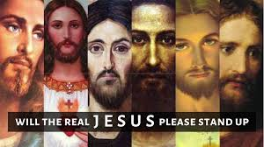
Will the Real Jesus Please Stand Up
John Oakes
Metro Region
2/22/2020

Slide 2
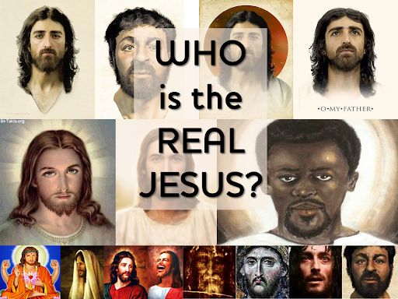

Slide 3
Will the Real Jesus Please Stand Up?
The created Jesus
Jesus who was not a person
The Mormon Jesus
The Hindu/Buddhist Jesus
The Calvinist Jesus
The black/ethnic Jesus
The liberal Jesus
The Universalist Jesus (the nice Jesus who does not judge anyone)
The prosperity Jesus.
The magical Jesus
The crucified Saviour/God Jesus

Slide 4
I. The Created Jesus
Jesus who is not God
Jesus who is a creature/created by God
Jesus of Arius and Jehovah Witness
Jesus is the first and highest of created beings. Jesus is an angel. He is the archangel Michael. (“Michael the great prince is none other than Jesus Christ Himself” (The Watchtower, Dec, 1984, p 29.)

Slide 5
Jesus is God
Jesus: John 8:58-59 “Very truly I tell you, before Abraham was born, I AM.” At this they picked up stones to stone him….
John 10:30 I and the Father are one. v. 33 We are stoning you….because you, a mere man, claim to be God.
Coll 1:16 If Jesus was created, then all things were not created through him.
John 20:28 Thomas: My Lord and my God!
Titus 2:13 Our great God and Savior Jesus Christ

Slide 6
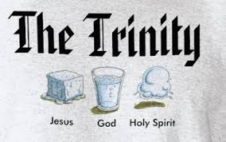
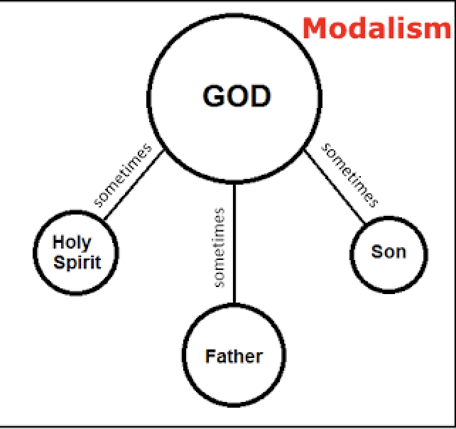
II. Jesus Who Is Not a Person
Jesus is not a “person”—not part of the Trinity
Modalism/Sabellianism
Three different “modes” (appearances) of one person

Slide 7
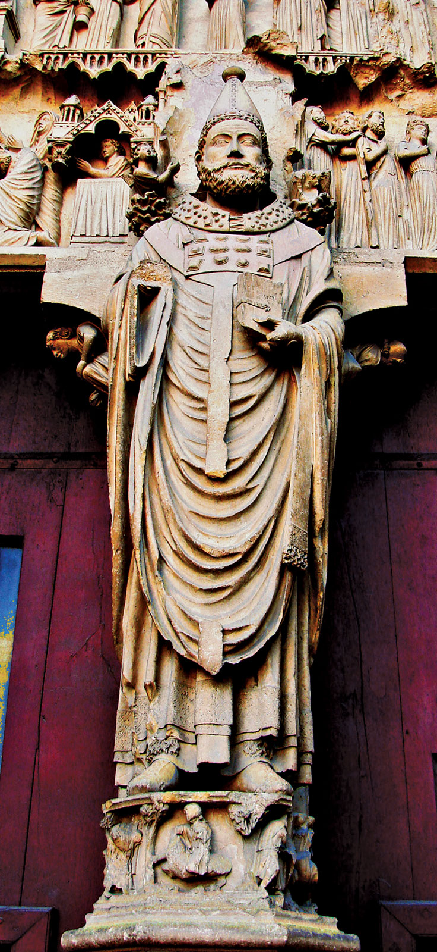
Sabellianism
Unitarian Universalists
Oneness Pentacostals
Matthew 28:18-20 Baptize in the name of the Father, the Son and the Holy Spirit.
2 Cor 13:14 May the grace of the Lord Jesus Christ and the love of God and the fellowship of the Holy Spirit be with you all.
Problem: The Trinity is about love/relationship
Sabellius?

Slide 8
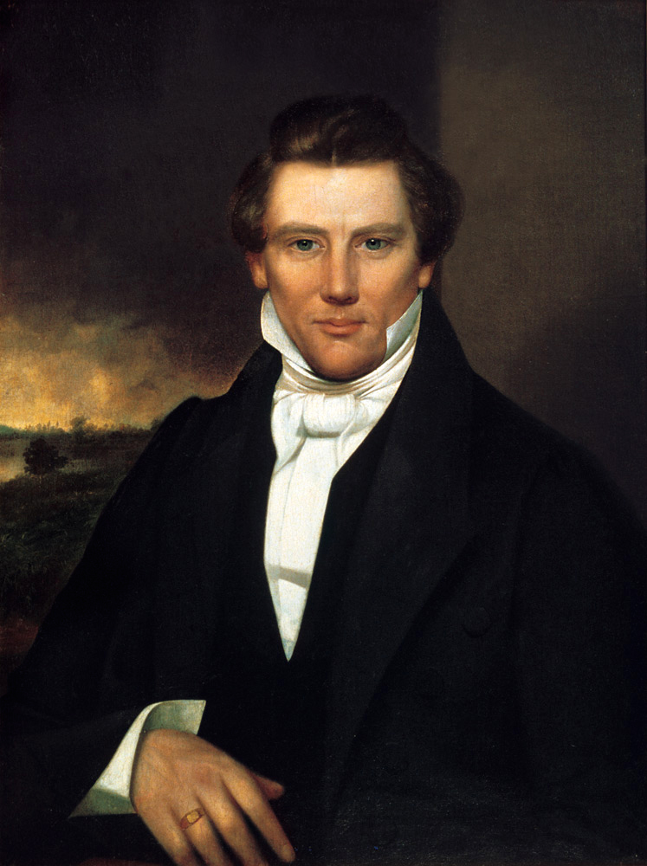
III. The Mormon Jesus
Jesus who is a person, and who is God, but then again, so are you and I.
Joseph Smith declared, "I will preach on the plurality of Gods. I have always declared God to be a distinct personage, Jesus Christ a separate and distinct personage from God the Father, and the Holy Ghost was a distinct personage and a Spirit: and these three constitute three distinct personages and three Gods" (Teachings of the Prophet Joseph Smith, p. 370).
Joseph Smith

Slide 9
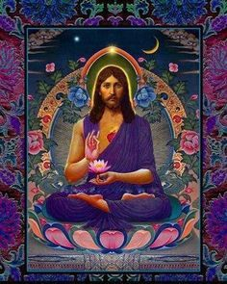
IV. The Hindu/Buddhist/New Age Jesus
Jesus is a great guru. Jesus is a sage.
Jesus is a great religious leader—one among many.
Jesus will help you to find the god-self inside you.
Jesus of Pantheism.
Jesus you find by doing yoga, focusing on your centered self.
The problem: You are not God!!!!

Slide 10
V. The Calvinist Jesus
This is the Jesus of Calvinistic Predestination/Reformed theology--of Ulrich Zwingli and John Calvin
This is the Jesus of Original Sin. In Adam’s fall we sinned all.”
Zwingli: “Those individuals who end up damned forever in hell are also eternally determined by God for that fate.”
Calvin: We call predestination God’s eternal decree, by which he determined with himself what he willed to become of each man. For all are not created in equal condition; rather, eternal life is foreordained for some, eternal damnation for others. Therefore, as any man has been created to one or the other of these ends, we speak of him as predestined to life or death.”

Slide 11
Calvinist Jesus
This is the Jesus of TULIP (Total depravity, Unconditional election, Limited atonement, Irresistible grace, and Perseverance of the Saints)
This is the Jesus who saves by “faith alone”
This is the Jesus who chooses who gets saved.
This is the Jesus of “Once saved, always saved”
This is the Jesus who you pray into your heart.

Slide 12
What’s Wrong With the Calvinist Jesus?
This is not the Jesus of the Bible
1 John 2:2 He is the atoning sacrifice for our sins, and not only for ours, but also for the sins of the whole world.
1 Timothy 2:3-4 This is good, and pleases God our Savior, who wants all people to be saved and to come to a knowledge of the truth.”

Slide 13
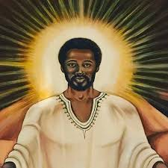
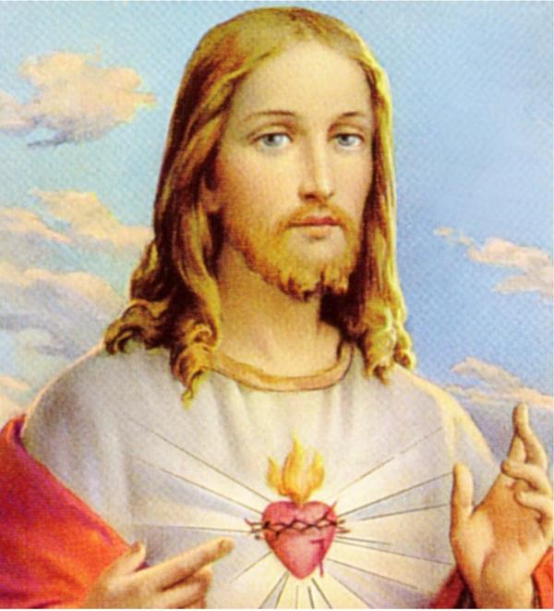
VI. The Black Jesus/The White Jesus/The ethnic Jesus
This is the Jesus who is involved in racial politics.
This is the Republican Jesus.
This is the Democratic Jesus.
This is the Jesus who fights using the weapons of this world.

Slide 14
VII. The Liberal Jesus
The Jesus of the liberal scholars.
The Jesus of those who deny the inspiration of the Bible.
The Jesus who was only a social revolutionary.

Slide 15
VIII. The Universalist Jesus
The “nice” Jesus who does not judge anyone.
The Jesus of funerals.
The Jesus of most Americans.
The Jesus of Unitarian Universalists.
The problem: This is not the Jesus of the Bible.

Slide 16
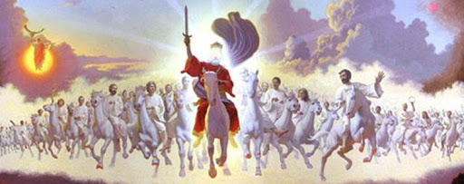
Does Jesus Judge?
John 12:48 “If anyone hears my words but does not keep them, I do not judge that person. For I did not come to judge the world, but the save the world.”
Jesus’ mission on the earth was to save, not to judge
But…
2 Timothy 4:1 In the presence of God and of Christ Jesus, who will judge the living and the dead, and in view of his appearing and his kingdom, I give you this charge: Preach the Word!

Slide 17



IX. The Prosperity Gospel Jesus.

Slide 18
The Prosperity Gospel Jesus
The Cosmic Butler Jesus.
The Jesus who promises health, happiness and financial success.
The Popular Jesus.
The Jesus of most Evangelical Christianity
The Prayer of Jabez Jesus.

Slide 19



Slide 20
Prosperity Jesus?
Jeremiah 29:11 For I know the plans I have for you… plans to prosper you and not to harm you, plans to give you hope and a future.
But… v. 10 When seventy years are completed…
Phil 3:10 “I want to know Christ—yes to know the power of the resurrection and participation in his sufferings, becoming like him in his death…”
Phil 1:21 “For to me, to live is Christ and to die is gain.”
2 Tim 3:12 “In fact, everyone who wants to live a godly life in Christ Jesus will be persecuted.”

Slide 21
X. Magical Jesus
The Jesus who heals all illnesses.
The Jesus who has the perfect spouse out there for you.
The Jesus who moves heaven and earth at our request.
The Charismatic Jesus.

Slide 22
The Biblical Jesus
The Crucified and Risen Savior of Mankind
Mark 10:45 For the Son of God did not come to be served but to serve and to give his life as a ransom for many.
1 Cor 1:18 For the message of the cross is foolishness to those who are perishing, but to us who are being saved it is the power of God.
1 John 4:10 This is love: not that we loved God, but that he loved us and sent his Son as an atoning sacrifice for our sins.

