Slide 1
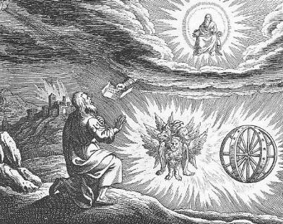
Ezekiel I God Calls a Prophet

Slide 2
Themes in Ezekiel
1. The Sovereignty/glory of God
a. Theodicy: Free will
2. The utter sinfulness of humanity/Judah
3. The inescapability of God’s justice
4. The Messiah is coming/ The restoration of God’s Remnant.

Slide 3
Ezekiel’s Place in History

Slide 4
Ezek 1:1-3 The Setting
Judah defeated by Nebuchadnezzar 597 BC
10,000 in Exile “the cream of the crop”
Jeremiah 30 years old
5th year of the exile 592 BC
Has Judah been humbled?

Slide 5
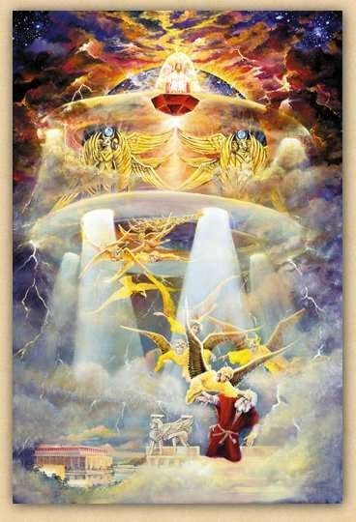
Ezekiel 1:4-28 I. We need to see god’s glory
Ezek 1:4-28 Ezekiel sees the glory of God—a prerequisite for being a prophet.
On the throne, surrounded by the cherubim (Rev 4:6f).
The cherubim are the ones who guard God’s holiness

Slide 6
Ezekiel’s vision
1:4 cloud, flash of lightening = judgment From the North = Babylon
v. 5 four living creatures = cherubim Rev 4:6b-8 Ezek 10:1
v. 10 four faces man, lion, ox, eagle
v. 12, 17 move God’s judgment coming like a chariot
v. 15-18 Wheels in wheels, eyes to protect God’s holiness
v. 22-28 The throne of God.
v. 28 rainbow = hope
Q: How do you see God in your own vision?

Slide 7
Ezekiel Commissioned II. We need to stand up for god
Ezek 2:1-7 Ezekiel’s mission
v. 4 say to them: this is what the Lord says.
2:1 “Son of man” (ben-adam) stresses his humanness
2:1 Stand on your feet.
v. 4 Ezekiel needs to be obstinate and stubborn. Why? Because the people are obstinate and stubborn. 2 Tim 4:3-4 teachers to say what their itching ears want to hear. Jer 7:4 Jer 6:13-14

Slide 8
Ezekiel’s Commission: Our Commission
Ezek 2:5 Whether they listen or fail to listen….
Jim McGuiggan: Successful evangelism is faithful proclamation by word and life.
v. 5 They will know a prophet had been among them…. How?
Because we declared the full counsel of God.

Slide 9
III. We need to eat the scroll
Ezek 2:8-3:3 Ezekiel eats the scroll. To be God’s prophet we must:
I. Have a personal encounter with God
II. Stand up for God
III. Digest his Words (Jeremiah 15:16, Rev 10:9-11)
Ezek 3:4-9 They have heard it all before. They are very religious.
3:8 God’s solution: We need to be as hard and stubborn as they are.

Slide 10
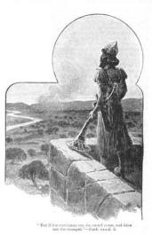
IV. The Watchman of Israel
Ezekiel 3:16-21 Ezekiel a watchman
Q: Are you willing to be God’s watchman?
Eph 2:1-3 and Eph 2:4-10.
We need to see God
We need to stand up for God
We need to eat the scroll
We need to be God’s watchman

Slide 11
Ezekiel 4 & 5 Dramatic symbolism
Ezek 4:1-3 Ezekiel acts out the siege of Jerusalem (588-586 BC)
a. Draws the city
b. Siege works: Babylon
c. Iron pan God is against Jerusalem and will not hear
their prayers
4:4-7 430 Days = 430 years = symbolically, length of captivity in Egypt
390 days for sin of Ephraim/Samaria/Northern Kingdom
40 days for sin of Judah
v. 4 “bear their sin” = bear the consequences
4:9-11 mixing, weighing grain = shortage of food during siege.
4:12 cook over human dung = unclean during exile.

Slide 12
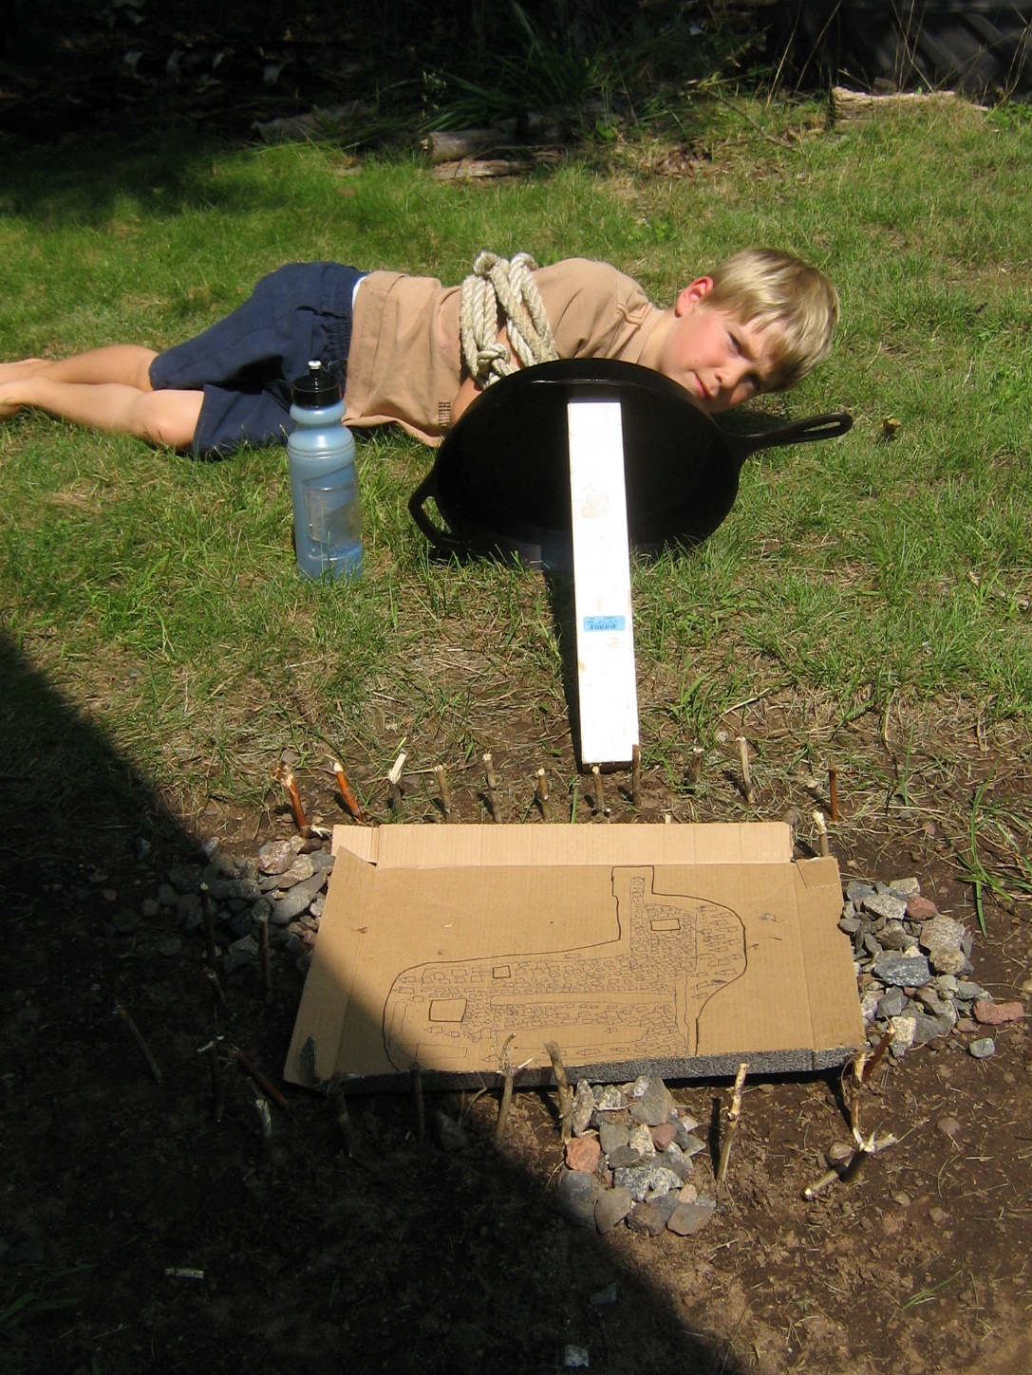
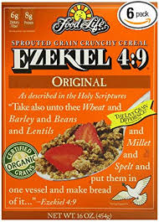

Slide 13
Ezekiel 5 Ezekiel gets a haircut
A haircut: The point: From those to whom much has been given, much will be expected.
Cutting off hair and beard a big deal for Jews.
v. 2 fire, sword and exile
v. 3 The remnant motif (but even some of them will suffer v. 4)
v. 5 I have set you in the center of the nations. Great responsibility.

Slide 14
Ezekiel 7 Cursed Money
Ezekiel 7:19-22 They will throw their silver into the streets. On the Day of Judgment, what the world holds to be valuable will be abominable.
Things you can buy Things you cannot buy
Medicine health
Books knowledge of God, wisdom
Position favor with God
Attention love

Slide 15
Ezekiel 9
9:1 Executioners from North (Babylon).
9:2 Put a mark on the foreheads of those who grieve and lament. Rev 7:1-17 Mark = protect from eternal judgment. (note: not protected from temporal judgment Ezek 21:3-4)
For us, the mark is the Holy Spirit Eph 1:13-14.

Slide 16
Ezekiel 9 (cont.)
Ezek 9:5 Kill without pity or compassion. Whew!
9:6 Begin at my sanctuary (leaders, the church) (1 Pet 4:17)
9:9-10 They brought this on themselves
9:11 It (God’s wrath) is accomplished!

Slide 17
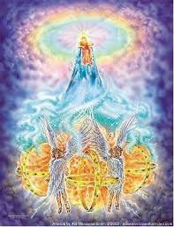
Ezekiel 10,11 Necessity of Judgment
Ezek 10:1 God on a sapphire throne with the cherubim.
Ezek 10:18 The Lord departs from the temple. Jerusalem is doomed.
Ezekiel 11:22-23 The end of the road for Jerusalem.
But… Good news in Ezekiel 43:1-5 God will return to his temple.

Slide 18
Ezekiel 12 Acting out the destruction of Jerusalem
12:3 Son of man, pack your bags… A visual prophecy. Hopefully we, like Ezekiel, have packed our bags (Heb 11:13f)
12:5-10 A prophecy about Zedekiah. Dig through wall (v. 5) Cover your face (v. 6) At night (v. 7). Zedekiah (v. 10-14)
All fulfilled in detail. Jeremiah 52:4-11, 2 Kings 25:1-7 Ezekiel is a prophet!
12:16 But I will spare a remnant.
12:28 God replies: No more delay!

Slide 19
conclusion so far
If we are in a relationship with God but become unfaithful, he will come in judgment. If the Holy Spirit leaves us we are lost. “Once saved always saved is not biblical!”
But… God will always save a remnant, no matter how bad it gets.
This is a pattern throughout the Bible.

Slide 20
An Outline of the Bible
I. Genesis 1 God created the universe and the earth. It was very good.
II. Genesis 2 God created man so that we could have an intimate relationship with him.
III. Genesis 3 and 4 We messed up very badly—destroying that relationship.
IV. Genesis 5-Rev 20 God is repairing the damage done by sin.
V. Rev 21-22 God has fixed the problem and we are back in a relationship with him.

Slide 21
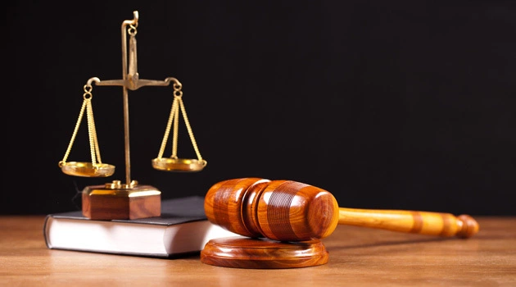
Ezekiel 18 God’s Justice
Q: Is God a just God?
If so, what is his justice like?
Theodicy

Slide 22
Ezekiel 18 Individual Righteousness
Ezek 18:2 A proverb: Sour grapes.
The exiles: It is not our fault. Blame it on our fathers!
Ezek 18:3 God: Wrong! Everyone is accountable for their own actions.
Ezek 18:4 All souls are mine. All can be saved (Rom 8:28-30)
Ezek 18:5-18 God’s justice. (does this contradict Exodus 20:4?)

Slide 23
individual righteousness
Ezek 18:21-24 Our final state determines our eternal destiny (but be aware of Hebrews 6:4-6 and 2 Peter 2:20-22)
18:22 For the righteous: None of his offenses will be remembered
18:24 For the unrighteous: None of his good deeds will be remembered.
18:25-29 Godly vs human justice. (Matthew 20:1-16 exp. v. 14)
18:30 The bottom line: Each will be judged by their ways.
18:32 The bottom line for God. He wants all to be saved.

Slide 24
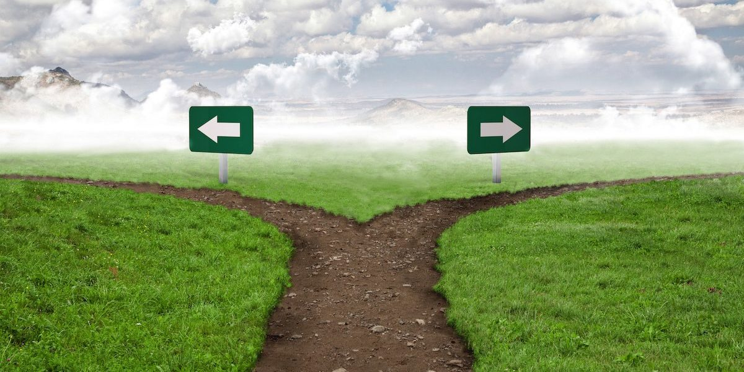
IV. The End of the road
Ezek 21:18-24 A signpost.
Ezekiel 21:27 A ruin!

Slide 25
Ezekiel 23 Oholah and oholibah
Oholah (Heb: her tent) is Samaria/Northern Kingdom
Oholibah (Heb: my tent is in her) is Jerusalem/Judah
Ezek 23:5-10 Oholah prostituted herself with Egypt and Assyria.
Q: What have you given yourself to?
Ezek 23:11-27 Oholibah was worse than her sister!
Their mistake: They were not satisfied with God. 1 Tim 6:8 Are you satisfied with what God has for you?

Slide 26
Oholah and Oholibah cont.
Ezek 23:22 The take-home lesson: I will give you over to what you give yourself to.
Ezek 23:28 I will give you over to the very thing you hate. This is what sin does.
Summary: 23:49 Then you will know that I AM the Lord.

Slide 27
Ezekiel 24 The cauldron Ezekiel refuses to mourn
Ezekiel 24:1 Jan 588 BC Mark it down. Jerusalem was put under siege. Ezekiel a prophet.
Ezek 24:6 A cauldron with encrusted layers of unrepented sin.
Ezek 24:11-14 When God’s wrath is poured out, it will get hot.
24:14 I will not have pity
24:15-24 God to Ezekiel: Do not mourn when your wife dies. I will take away the delight of your eyes.
God does not want to judge Judah, but he will, without mercy.
24:27 Ezekiel will be silent for two years.

Slide 28
Ezekiel 33 Jerusalem has fallen
Ezekiel 33 is a transition from Ch 1-24 to Ch 34-48
God’s judgment has now been completed, so the message will turn from principally rebuke to principally encouragement. The Messiah is coming.
33:21 A messenger arrives (as prophesied in Ezek 24:26). Jerusalem has fallen!!! Ezekiel is vindicated as a prophet.

Slide 29
V ezekiel 34-48 The Messiah is coming! God is saving a remnant
The tone shifts toward comfort, now that God’s wrath has been completed.
There is much double (or even triple) prophecy in this section.
1. The restoration of Judah under Zerubbabel.
2. The Church
3. The final kingdom of God—heaven.

Slide 30
Ezekiel 34 The Messiah: A better shepherd
The job of a shepherd:
Ezek 34:2 To care for the flock, not for yourself.
Ezek 34:4 To care for the weak
Ezek 34:4 To bring back the strays.
Ezek 34:4 To bring in the lost.
God’s charge: You treated my sheep harshly. The result is the sheep are scattered.
Ezek 34:7-10 I will hold you accountable.
I will remove you from leading my flock

Slide 31
I will Shepherd my flock
34:11-22 I will shepherd the flock myself.
34:13-16 Q: Is he talking about Judah restored to the Promised Land, or is he talking about the us, restored to a relationship with God?
v. 17-20 Even in the absence of good shepherds, the sheep have some responsibilities.

Slide 32
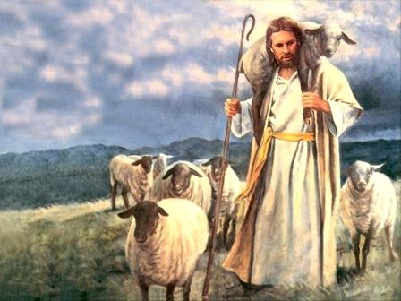
Ezek 34 The Good shepherd is coming
Ezek 34:23f God’s shepherd is coming. “My servant David.”
John 10:1-18 I am the good shepherd.
34:26 Showers of blessings
34:27 Much fruit, Security, Freedom (John 8:31f)
34:29 Spiritual food, the bread of life.

Slide 33
Ezek 36 a new covenant
Ezek 36:24f A remnant devoted to God. A New Covenant.
v. 24 all nations
v. 25 cleansed by water
v. 26 a new heart and a new spirit
v. 27 receive the Holy Spirit
v. 29-30 blessings
v. 31 repentance
No wonder Jesus challenged Nicodemus he should have known
v. 32 not because you are awesome

Slide 34
A new eden
v. 33 much fruit
v. 35 imagery from the Garden of Eden. The Kingdom of God Isaiah 65:19-25
v. 36 When people see how God has blessed us, “Then they will know that I am the Lord”

Slide 35
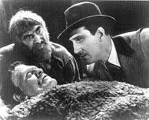
Ezekiel 37 the valley of dry bones
The promise of resurrection (on many levels and in many ways) God creates a remnant—something from nothing.
He’s Alive!

Slide 36
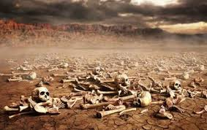
Ezek 37 The valley of dry bones
Ezek 37:2 The bones are “very dry” No hope!!! God specializes in this kind of situation.
37:11-14 Primary application is to Israel. God will bring them back to life in Canaan. (but it is a double prophecy)

Slide 37
Ezekiel 38:1-6 gog and magog
This is an idealized vision of enemies attacking God’s people and God defending them
Jim McGuiggan: “Gog is a grand illustration of any and all who oppose God’s people.”
Gog, Magog, Meshech, Tubal, Cush, Persia Put
God’s people are surrounded!
Q:Have you ever felt surrounded and outnumbered by Satan?

Slide 38
Meshech, Tubal and Magog

Slide 39
Ezekiel 38 & 39
v. 8 You will invade the Promised Land “gathered from many nations to the mountains of Israel”
v. 11 unwalled cities. God’s people living in security. No problem. God will destroy them without a shot.
Ezekiel 39:1-10 God will defeat our enemies.
2 Cor 10:3-5 We have powerful weapons.
Hebrews 13:5-6 What can man do to me?
Eph 6:10-20 Full armor. Mighty power.

Slide 40
Ezekiel 39:25-29 If God is for us….
v. 26 We can forget our shame and our unfaithfulness.
v. 27 God will prove himself holy through us.
v. 28 Sure, I sent them into exile, but I will restore them to their proper place with me.
v. 29 I will pour out my Holy Spirit on them.
Q: What will God do for you?

Slide 41
Ezekiel 40-48 The Temple rebuilt the remnant Has been restored
Is it about restoration and the rebuilding of temple in 516 BC?
Is it about the church and us as God’s tabernacle?
Is it about the Kingdom of God/Heaven? Yes.
Hebrews 8:3-6 “See to it that you make everything according to the pattern shown you on the mountain.” (or in Ezekiel 40-48).
Ultimately, it is about God’s holiness—his perfection.

Slide 42
Ezekiel 43 God returns to the Temple
Ezek 40:1 The twenty-fifth year of the exile (572 BC)
Ezek 43:1-7 The glory of the Lord returns to the temple (after leaving it Ezekiel 8:6). He enters through the East Gate (as he had exited it through the East Gate).
43:10 Why all the details? “that they may be ashamed of their sins.”
We do not need to feel ashamed, but we should remember the shame.

Slide 43
We are the zadokites!
44:15f Only the Zadokites (also 43:19) can minister in the temple.
v. 16 We are the Zadokites (1 Pet 2:9)
v. 23 We are to teach difference between the holy and common.
v. 28 I am to be their only inheritance. They will have no possessions in the land.

Slide 44
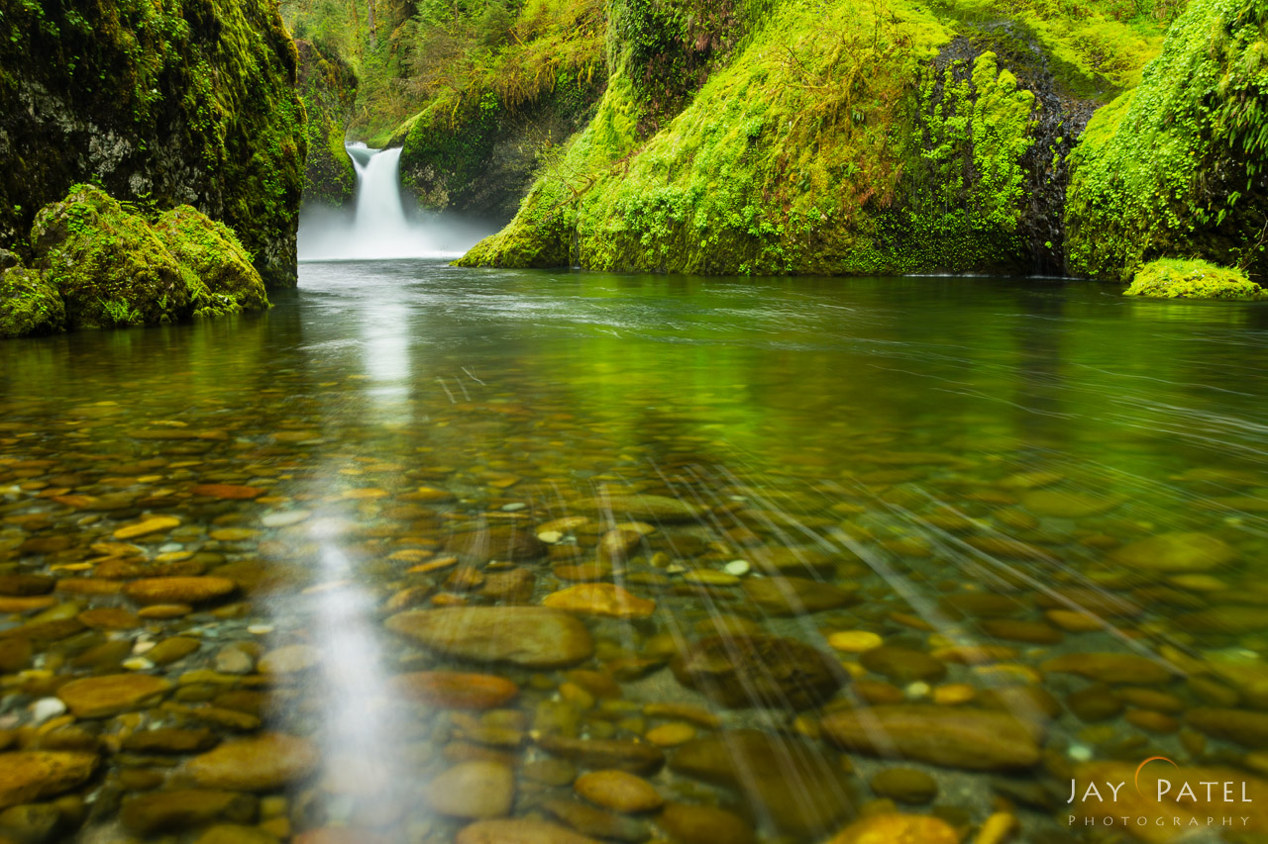
Back in the garden
Ezekiel 47 The river from the temple. (Revelation 22:1-5, Zech 14:8-9) Imagery from the Garden of Eden.
It comes from the temple—from God.
It cleanses (Zech 13:1)
It is living water (Zech 14:8, John 7:37-39)

Slide 45
Summary of Ezek 40-48 (and perhaps of the entire book of ezekiel)
Ezekiel 48:35 And the name of the city from that time on will be:
THE LORD IS THERE
We are back in the Garden if Eden—in the fully realized Kingdom of God, where God intended us to be all along.

