Slide 1
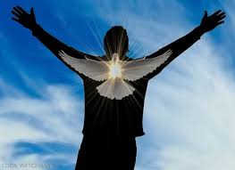
Galatians: Living by Law or Living by the Spirit
Bakersfield
Fall, 2020
John Oakes

Slide 2
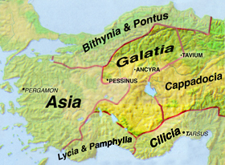
Fun Facts
About
Galatia

Slide 3
Theme Verse for Galatians
Galatians 5:6 For in Christ Jesus neither circumcision nor uncircumcision has any value. The only thing that matters is faith, expressing itself through love.

Slide 4
Background to Galatians
The church is in its first existential crisis.
“Judaizers” are insisting that Gentiles be circumcised.
They traveling from church to church insisting that Gentiles follow the Law of Moses in order to be part of the Christian fellowship (Gal 4:10-11, 6:12-2-13)
The doctrine of salvation by faith and grace is at stake.
The unity of the church is at stake.
What will Paul do?

Slide 5
Galatians 1:6-9
I am astonished that you are so quickly deserting the one who called you to live in the grace of Christ and are turning to a different gospel…. But even if we or an angel from heaven should preach a gospel other than the one we preached to you, let him be eternally condemned.
Wow!
Gal 5:2-4
Definition of falling away

Slide 6
Paul is really upset!
What made Jesus angry?
What made Paul angry?
What makes you angry?

Slide 7
Gal 1:11-2:10 Paul’s credentials
Q: Why circumcise Timothy (Acts 16:1-4), but not Titus (Gal 2:3-5)?
Q: How does this apply to us? 1 Cor 10:29-11:1

Slide 8
Gal 2:11-16 Paul has it out with Peter
v. 12 the circumcision group.
Peter tried to take an in-between position.
Paul: There is no in-between position between law and grace!
v. 16 No one will be justified by the works of the law. That includes us!!!
Justified (dikios) aligned with, declared not guilty, made righteous.

Slide 9
Gal 2:17-19
This section is hard to understand!!!
We are justified by faith (v. 16)
v. 18 “If I rebuild what I destroyed.” If we go back to trying to be justified by works/law, then we are under all the curses of the law.
v. 19 “Through the law I died to the law.” What I learned about sin from the law taught me that I needed Christ, and justification by faith, not law.
Rom 5:20-21, Rom 7:13 There is no going back!

Slide 10
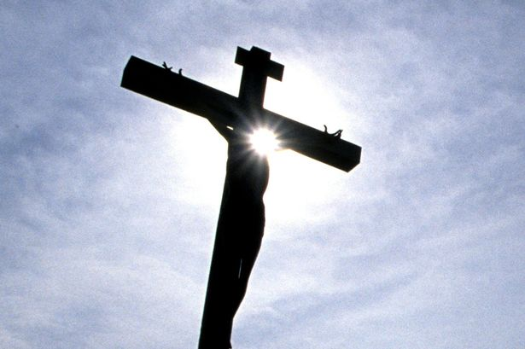
Galatians 2:20-21 I have been crucified with Christ! When? Rom 6:1-7 Now, I live by faith, not by law Q: Are you living by faith or by works?

Slide 11
Gal 3:1-9 Life Through the Spirit
We began with the Holy Spirit. Are we returning to the flesh/Law?
How are we saved? “Abraham believed God and it was credited to him as righteousness. Rom 4:18-25
What did Abraham believe? “He did not waver in unbelief regarding the promise.

Slide 12
Galatians 3:10-14 The righteous will live by faith vs Leviticus 18:5 The person who does these things will live by them v. 13 We were redeemed Why is living by law a curse? 1. It is not possible 2. It steals the joy of serving out of love

Slide 13
Gal 3:15-25 Why the Law at all?
It makes our need for salvation more obvious.
It was a guardian/tutor/custodian until the Seed (Christ) came.
Gal 3:26-29 In Christ (through baptism) all are sons of God. Jew and Gentile are the same. The Law does not matter.

Slide 14
Galatians 4:1-20
4:3, 9 Leave behind the stoicheia—the ABCs
4:4 When the set time had fully come (ie Christ)
4:6 Now we have the Holy Spirit and we can call God Daddy.
Paul: I plead with you!

Slide 15
Galatians 4:21-31 Slavery (Ishael, Hagar) vs Freedom (Isaac, Sarah)
We are children of the free woman!

Slide 16
1.
Galatians 5:1 Free at last!
It is for freedom that Christ set you free

Slide 17
1.
Spirit versus Law
Galatians 5:5-6
The only thing that matters is faith, expressing itself through love.

Slide 18
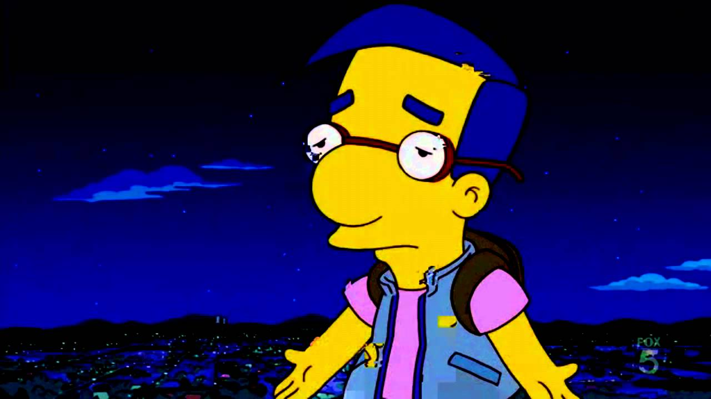
1.
Do I have to?
Gal 5:5-6
What are you doing because you love God?

Slide 19
Galatians 5:5-6 Our theme verse! The only thing that matters is faith expressing itself through love What are you doing because you love God?

Slide 20
The freedom we have comes from the Holy Spirit living in us. Ezek 36:27 I will put my Spirit in you and move you to follow my decrees and be careful to keep my laws.

Slide 21
1.
Galatians 5:13-15 The proper use of our Christian freedom:
Improper use: Sin and selfishness
Proper use: Make ourselves voluntary slaves of one another!
Why? Because we want to!

Slide 22
Galatians 5:16-18
Living by the Spirit versus living by Law (the flesh)
Trying harder is not the key!
v. 16 Walk by the Holy Spirit
v. 18 Be led by the Holy Spirit
Q: What does that mean?

Slide 23
Gal 5:22-24 Overcome the flesh by living by the Spirit
1. Gal 5:16 Walk by the Spirit.
2. Gal 5:18 led by the Spirit.
3. Gal 5:25 live by the Spirit.
4. Gal 5:25 keep in step with the Spirit.

Slide 24
Paul’s point:
Listening to the Spirit is more likely to lead to personal righteousness than living by law/rules/obligation

Slide 25
Gal 6:1-6 It is about community
6:2 burden = baros = massive weight one person cannot carry.
6:5 load = phortion = load, like a backpack. What one person can carry.
Carry your own load, and carry each other’s overwhelming burdens.

Slide 27
Gal 6:7-10 Time to get real.
Have you ever become weary in doing good?
What should you do?
Keep doing good…. You will reap a harvest.

