Slide 1
The Stone/Campbell Movement
Restoration or Reformation?
Dr. John Oakes

Slide 2
Influences
Francis Bacon and inductive logic: the scientific approach to the facts of the Bible.
John Locke: the “Christian Philosopher” Empiricism.
The Scottish school of Common Sense Philosophy (Adam Smith, Thomas Reid, etc.). Truth must be logical.
The Seceder Presbyterians, the Sandemanians and other radical restorationist sects.

Slide 3
James O’Kelly
We are “Christians simply”
The Christian Connection

Slide 4
Rice Haggard 1769-1819
“One thing I know, that whenever non-essentials are made terms of communion, it will never fail to have a tendency to disunite and scatter the church of Christ.”

Slide 5
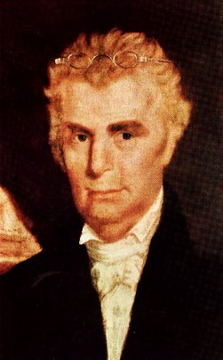
Barton W. Stone 1772-1844 The heart of the movement
The Cane Ridge Revival 1801
The Last Will and Testament of the Springfield Presbytery
“Let Christian Unity be our Polar Star.”
“Do you agree to the Westminister Confession?”
“I do, so far as I see it consistent with the word of God.”

Slide 6
The Presbytery of Springfield, sitting at Cane Ridge, in the county of Bourbon, being, through a gracious Providence, in more than ordinary bodily health, growing in strength and size daily; and in perfect soundness and composure of mind; but knowing what it is appointed for all delegated bodies once to die: and considering that the life of every such body is very uncertain, do take, and ordain this our Last Will and Testament, in manner and following,….
And with that the Springfield Presbytery no longer existed and the Stone movement began. 1804

Slide 7
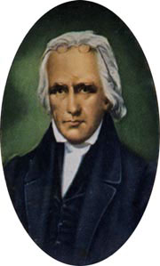
Thomas Campbell 1763-1851
Emigrated to Pennsylvania 1807
A Seceder Presbyterian
Suspended by Presbyterian Church
The Declaration and Address 1809
Principles for unity of Christians.
In esentials, unity, in matters of opinion liberality

Slide 8
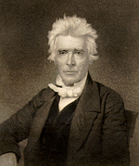
Alexander Campbell 1788-1866 The mind of the movement
Joined Thomas from Scotland 1809
Believers only baptism 1812
Campbell/Walker Debate 1820 McCalla Debate 1823
Robert Owen Debate 1828
The Millennial Harbinger 1830
Bethany College 1840

Slide 9
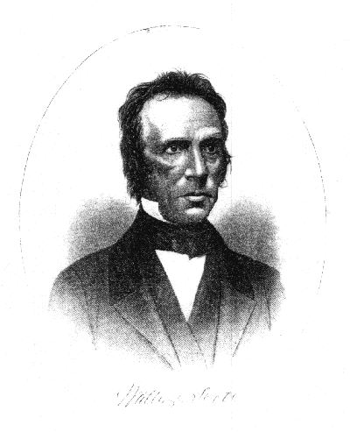
Walter Scott (1796-1861)
First evangelist in the Campbell’s movement
“Restored the gospel” in 1827
The five step “plan” of salvation
Scott’s: faith, repentance, baptism, remission of sins, Holy Spirit
CoC today: hear, believe, repent, confess, be baptized

Slide 10
The crowning event of the early years:
1824 Stone and Campbell met for the first time
Decided to form a unified movement
Problems:
Christian (Stonites) or Disciple (Campbellites)
2. Emotional vs intellectual movements (preachers vs teachers)
Teaching on baptism
Ordination of ministers
5. Doctrine of the Holy Spirit

Slide 11
Hermeneutics of the Movement
“Command, Example and Necessary Demonstrations.”
“Where the Bible speaks, we speak, where the Bible is silent, we are silent”
Sought Bible “facts.” Weak on principles. Tended toward legalism.

Slide 12
The Turning Point:
Were they a unity movement (a reformation) or a restoration movement?
Stone and Campbell favored reformation (example; the Christadelphians)
Walter Scott, Benjamin Franklin, Tolbert Fanning, David Lipscomb and others moved toward restoration. Sought “the perfect pattern.”

Slide 13
The Dominating Influences in the Movement
The Colleges (Bethany College, David Lipscomb College, etc.)
The Periodicals (editor/bishops) (The Millennial Harbinger, The American Christian Review, The Gospel Advocate, Firm Foundation, etc.)
These were forces for unity and for division

Slide 14
Points of disunity/division
Evangelism and inter-church organization (the Missionary Society)
The Civil War: pacifism, slavery, etc. (The Missionary Society supported the North)
The “instrument.” Moses Lard: “No preacher should enter a church where an organ stands.”
Daniel Sommer and David Lipscomb.
1906 US Census acknowledged two separate groups: The Church of Christ and the Christian Church/Disciples of Christ.

Slide 15
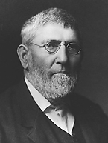
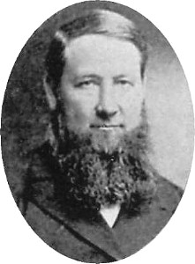
David Lipscomb (1831-1917)
“Father” of the Church of Christ
Founder of Lipscomb University
Editor of the Gospel Advocate 1866-1917
Daniel Sommer
“Watchdog” for the brotherhood.
“Daniel Sommer was a militant who left a legacy of legalistic wrangling and divided congregations.”

Slide 16
Other Controversies
One cup, Sunday School, “anti” churches
Premillennialism
For the Christian Church/Disciples of Christ; The Ecumenical Movement. Open Membership.
UCMS (United Christian Missionary Society) vs. NACC (North American Christian Convention)
Two denominations by about 1950

Slide 17
Lessons to be learned
Unity is extremely difficult to maintain without strong hierarchical structure.
Separating essential matters from the non-essential is harder than we think.
A movement without a strong hierarchical structure needs instruments to maintain unity.
Careful thinking about theology, church structure and history are required for long term growth and unity.
It is extremely difficult to avoid overreacting to groups with whom we disagree.

Slide 18
Hermeneutics of CoC and ICOC
Alexander Campbell: “Where the Bible speaks, we speak, where the Bible is silent, we are silent.”
Kip McKean: Where the Bible speaks, we are silent, where the Bible is silent, we speak.”
CoC: Strong emphasis on Bible Study, Bible colleges
Kip McKean: Anti-intellectual tendency and skeptical of theological training.

Slide 19
Book Recommendations:
Reviving the Ancient Faith (Hughes)
A Live of Alexander Campbell (Doug Foster)
The Stone Campbell Movement (Garrett)
Into All Nations (Foster Stanback)
The Search for the Ancient Order (West)

Slide 20
Suggestions
Get to know someone from the CoC or Christian Church.
Take part in John Teal’s Common Grounds group
Renew.org Bobby Harrington.

Slide 21
Crossroads/Boston/ICOC Movement
1960’s “College Chairs” Within CoC
1967 Chuck Lucas 14th Street CoC (Crossroads CoC)
Soul talks
Prayer partners
Emphasis on evangelism
After 1975 “campus ministries”
Tom Brown, Andy Lindo, Kip McKean, etc…
Many church splits resulted
1979 Kip McKean, Lexington/Boston CoC
“sold out” disciples only in the church
Amazing growth
Emphasis on world evangelism
Vertical discipling trees, uniformity and simplicity of methodology

Slide 22
Boston/LA/ICOC movement (cont.)
Chuck Lucas resigns at Crossroads CoC 1985
Official split with CoC 1986
Who’s fault was it?
Church Reconstructions 1988
You are in or you are out
Evangelization Proclamation 1994
Kip McKean removed as world evangelist/head of the movement November, 2001
Kreite letter/ICOC structure falls apart Feb 2003
Attempts at para-church organization, the “unity letter”

Slide 23
Where Should We Go From Here?
Balance of autonomy and cooperation
Finding a healthy model for “discipling”/implementing one another passages
Meeting the needs of mature disciples without losing our simple evangelistic plea—continuing to raise up young leaders
Appointing and finding the best role for elders and a balance with the role of evangelists (and teachers as well)
Our formal and informal relationship with mainline CoC and other groups.

