Slide 1
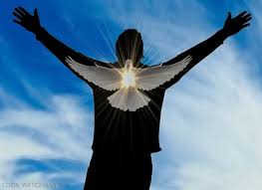
Galatians: Living by Law or Living by the Spirit
Bakersfield
Fall, 2020
John Oakes

Slide 2
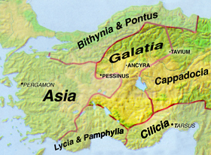
Fun Facts
About
Galatia

Slide 3
Theme Verse for Galatians
Galatians 5:6 For in Christ Jesus neither circumcision nor uncircumcision has any value. The only thing that matters is faith, expressing itself through love.

Slide 4
Background to Galatians
The church is in its first existential crisis.
“Judaizers” are insisting that Gentiles be circumcised.
They traveling from church to church insisting that Gentiles follow the Law of Moses in order to be part of the Christian fellowship (Gal 4:10-11, 6:12-2-13)
The doctrine of salvation by faith and grace is at stake.
The unity of the church is at stake.
What will Paul do?

Slide 5
Galatians 1:6-9
I am astonished that you are so quickly deserting the one who called you to live in the grace of Christ and are turning to a different gospel…. But even if we or an angel from heaven should preach a gospel other than the one we preached to you, let him be eternally condemned.
Wow!
Gal 5:2-4
Definition of falling away

Slide 6
Paul is really upset!
What made Jesus angry?
What made Paul angry?
What makes you angry?

Slide 7
Gal 1:11-2:10 Paul’s credentials
Q: Why circumcise Timothy (Acts 16:1-4), but not Titus (Gal 2:3-5)?
Q: How does this apply to us? 1 Cor 10:29-11:1

Slide 8
Gal 2:11-16 Paul has it out with Peter
v. 12 the circumcision group.
Peter tried to take an in-between position.
Paul: There is no in-between position between law and grace!
v. 16 No one will be justified by the works of the law. That includes us!!!
Justified (dikios) aligned with, declared not guilty, made righteous.

Slide 9
Gal 2:17-19
This section is hard to understand!!!
We are justified by faith (v. 16)
v. 18 “If I rebuild what I destroyed.” If we go back to trying to be justified by works/law, then we are under all the curses of the law.
v. 19 “Through the law I died to the law.” What I learned about sin from the law taught me that I needed Christ, and justification by faith, not law.
Rom 5:20-21, Rom 7:13 There is no going back!

Slide 10
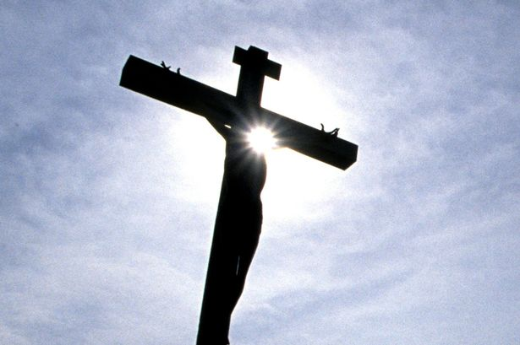
Galatians 2:20-21 I have been crucified with Christ! When? Rom 6:1-7 Now, I live by faith, not by law Q: Are you living by faith or by works?

Slide 11
Galatians 3:10-14 The righteous will live by faith vs Leviticus 18:5 The person who does these things will live by them v. 13 We were redeemed

Slide 12
Galatians 4:21-31 Slavery vs Freedom

Slide 13
1.
Galatians 5:1
Free at last!

Slide 14
1.
Spirit versus Law

Slide 15
1.
Do I have to?

Slide 16
Galatians 5:5-6 Our theme verse! For through the Spirit we eagerly await by faith the righteousness for which we hope. For in Christ Jesus neither circumcision nor uncircumcision has any value. The only thing that matters is faith expressing itself through love The freedom we have comes from the Holy Spirit living in us -Roger What are you doing because you love God?

Slide 17
1.
Are you living as a free person?
What are you doing because you love God?
Are you led (motivated) by the Spirit rather than by the Law?

Slide 18
Ezekiel 36:24-28 I will put my (Holy) Spirit in you and move you to follow my decrees and to be careful to keep my laws. Do you listen to the Holy Spirit? Ezekiel 37:1-10 I will put my Spirit in you and you will live. Has you let the Holy Spirit make you alive?

Slide 19
1.
Galatians 5:16-18
Living by the Spirit versus living by Law (the flesh)
If you live by the law you will gratify the sinful nature.
Galatians 5:22-24
The fruits of the Spirit.

Slide 20
1. Gal 5:16 Walk by the Spirit.
2. Gal 5:18 led by the Spirit.
3. Gal 5:25 live by the Spirit.
4. Gal 5:25 keep in step with the Spirit.

Slide 21
Galatians: Living by Law or Living by the Spirit

Slide 23
1.

