Slide 2
REPENT,

Slide 3
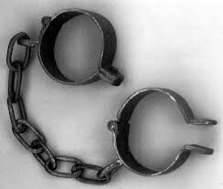
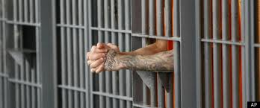
Here was Your Situation:
Lost
Enslaved
Captured
Imprisoned

Slide 4
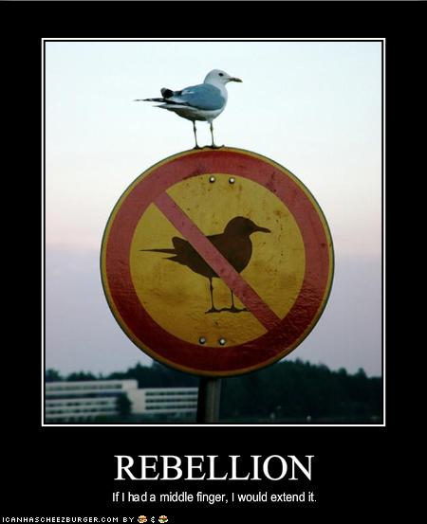
How Did you get there?
You Rebelled.
You went after other gods.
You said that what God
wants for you is not
enough.

Slide 5
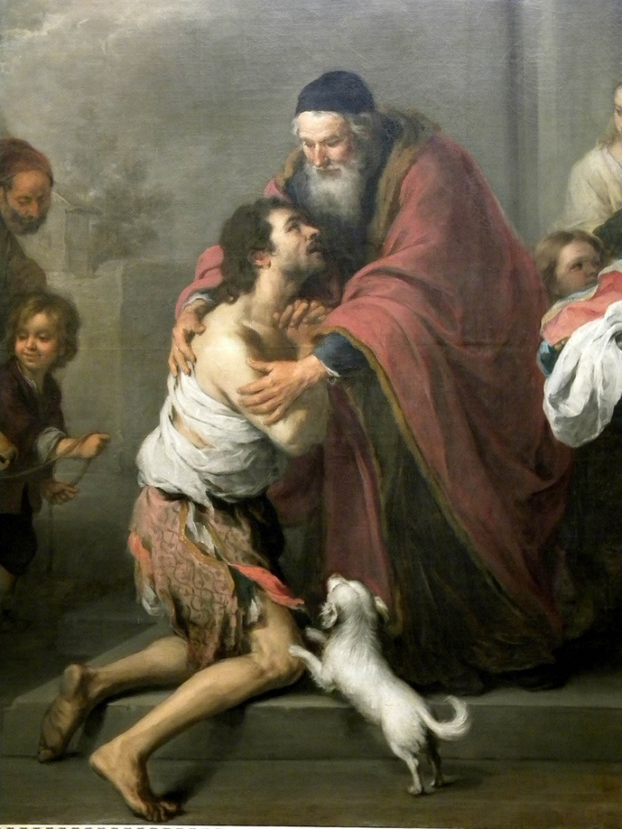
What is the solution?
Repent and Return
So that God can
Restore and Rebuild

Slide 6
Who are you?
You are people loved by God
You are Israel
You are any individual
You are the Church
You are a Church

Slide 7
Historical Background
722 BC Northern Kingdom destroyed by Sennacherib
605 BC First siege of Jerusalem by Nebuchadnezzar
597 2nd siege Ezekiel taken as captive to Babylon.
592 Ezekiel receives his commission.
586 Jerusalem Destroyed 70 years of captivity begins
538 Cyrus captures Babylon. Cyrus decrees the temple should be rebuilt. (Ezra 1:1-4)
537-536 First wave of remnant returns under Zerubbabel.
520 Zechariah begins to prophesy
518 Darius: Rebuild the temple! (Ezra 6:1-12) Haggai agrees.
516 Temple is completed (seventy years after Solomon’s temple destroyed)
458 Ezra returns to Jerusalem, second wave of exiles. Artaxerxes: Rebuild the city of Jerusalem. (Ezra 7:11-29)
445-444 Nehemiah returns and the city is built.

Slide 8
Prophets of the Exile

Slide 9
Post-exile books
Ezra, Nehemiah, and Esther History
Haggai, Zechariah, and Malachi Prophets
Theme of these books: God’s wrath is complete. It is time for his remnant to Repent and Return so that God can Restore and Rebuild them.

Slide 10
schedule
Week 1 Introduction, Ezra 1-6, Haggai
Week 2 Zechariah
Week 3 Rest of Zechariah, Esther, Ezra 7-12
Week 4 Nehemiah, Malachi

Slide 11
All this was prophesied
Deuteronomy 28:15-19 If you do not obey the Lord your God… you will be cursed.
Deuteronomy 28:36-37 You and your king will be taken to a foreign land.
Deut 28:49-57 The Lord will bring a nation against you. Terrible suffering. Cannibalism in Jerusalem.
Summary: Deut 29:22-29.

Slide 12
Deuteronomy 30:1-6 Repent, Return, Restore, REbuild
When all these blessings and curses I have set before you come on you and you take them to heart (repent) wherever the LORD your God disperses you among the nations, and when you and your children return to the LORD your God and obey him with all your heart and with all your soul according to everything I command you today, then the LORD your God will restore your fortunes[a] and have compassion on you and gather you again from all the nations where he scattered you. Even if you have been banished to the most distant land under the heavens, from there the LORD your God will gather you and bring you back. He will bring you to the land that belonged to your ancestors, and you will take possession of it. He will make you more prosperous and numerous than your ancestors. (rebuild) The LORD your God will circumcise your hearts and the hearts of your descendants, so that you may love him with all your heart and with all your soul, and live.

Slide 13
If God says it will happen It will happen
Jeremiah 4:5-6 6:1-2 Disaster from the North!
Jeremiah 7:30-34 The Valley of Slaughter.
But… Jeremiah 27:16-22
Ezekiel 4: God besieges Jerusalem.
Ezekiel 7:5-10 Disaster! Doom! 9:5-6 kill without pity 12:1-16 Pack your bags….
But…. Ezek 36:24-32

Slide 14
Summary
The story of Judah is our story. We, too, began as God’s people. We, too, went after other gods and told God that what he has to give us is not enough. We, too, rebelled. We, like them, were lost, enslaved, and imprisoned.
But… By his mercy and because of his love
We, too, repented and returned to God’s kingdom. Now, God is in the process of restoring and rebuilding us into a people who will give him glory in his kingdom.

Slide 15
2 Chronicles 36:6, 10, 19-21
Notes:
Nebuchadnezzar conquered Palestine. Happened in three waves (36:6 Jehoiakim, Daniel 605 BC; 36:10 Jehoiachin in 597 BC; and 36:20 Zedekiah in 587 BC). They stayed until Persia overtook Babylon (v. 22).

Slide 16
Jeremiah 29:10-14
Notes:
Context of “plans to prosper”: before captivity about return. Bear consequences of sin, but God still loves them! He will bring them back after 70 years. (Also Jeremiah 25:11-14 will punish Babylon after 70 years)

Slide 17
2 Views of 70 Year Return:
605-538 BC (Jehoiakim until Zerubbabel)
587-516 BC (destruction to temple rebuilt)
Notes:
If you’re good at math, only 49-50 years from destruction to return. Two possibilities. Take your pick (first as approximation). Either way, God fulfilled his promise.

Slide 18
Ezekiel 36:33-36
Towns resettled
Ruins rebuilt
I will do it!
Notes:
John: This was spoken right before the captivity. God knows what he is doing, bringing stress and bringing relief. They both show his power (not within our control) and his grace (using enemies, providing hope).

Slide 19
Ezekiel 37:11-14
Hope is gone
You will know I did it!
Notes:
Dry bones. Hopeless (going to be burned and taken captive), but God can bring you back (v. 12) and fill you with his spirit - breath! * Bro who (dad suicide) for 3 years couldn’t believe God would bless him; beginning to now.

Slide 20
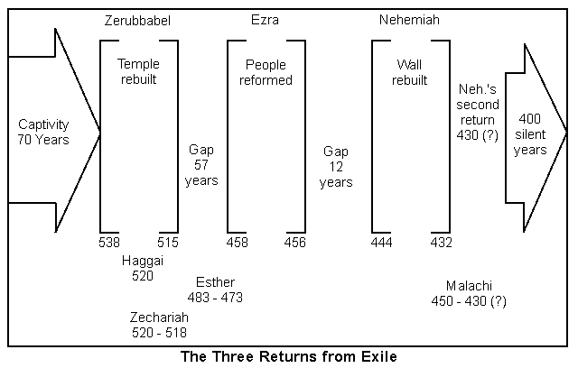
Notes:
Outline of period: Cyrus takes over Babylon in 539 BC, issued his decree next year. Jews left sometime afterward. Started building & stopped; began again after prophets. Then Esther in Susa. Then Ezra and Nehemiah.

Slide 21
Ezra 1:1-3
Notes:
Why? Goodwill, collection of tribute, god’s favor. Almost a century later: In 407 BC, letter to Persian governor requesting that a Jewish temple at Elephantine in Egypt be rebuilt after destroyed by Egyptians in 411 BC.

Slide 22
The Cyrus Cyllinder (British Museum)
Notes:
“I returned the statues of the divine patrons of every land…to their own sanctuaries. When I found their sanctuaries in ruins, I rebuilt them. I also repatriated the people of these lands and rebuilt their houses. Finally, with Marduk’s permission, I allowed statues of the dive patrons of Sumer and Akkad to be returned to their own sanctuaries.”

Slide 23
Isaiah 44:26-45:7
Notes:
Inhabited, rebuilt, restored! Isaiah prophecies through Hezekiah (1:1) - 4 kings before Jehoiakim! Cyrus as shepherd, anointed. Why? So that all may know. No other Lord. Prosperity and disaster; I do all!

Slide 24
Ezra 1:1, 5, 6
Notes:
The Lord moved: the king (Prov. 21:1), his people (moved from where they had settled) and their neighbors (like in Ex. 12:35-36 favorably disposed, so plundered—previous exodus). Easy to lack faith when lack resources, but God!

Slide 25
Ezra 2 / Nehemiah 7
Same list
Notes:
Assume is a composite list of all the Jews who returned from exile over that period of time. Zerubbabel went under Cyrus, Ezra & Nehemiah went under Artaxerxes (80 and 90 years later, respectively). Urim (v. 63) used in Ex. 28:30; Lev. 8:8; Nu 27:21; Dt 33:8; 1 Sam 28:6.

Slide 26
Ezra 3:1-3, 11-13
One
Fear
Joy
Sadness
Notes:
Can be together and still afraid. Courage, not absence of fear, but facing it. Despite. * Sharing faith, asking about purity etc. We must overcome! Finished foundation: Praise, but wept. * Building church (remember before).

Slide 27
Ezra 4:4-7
Notes:
Not totally chronological: Cyrus, Darius, Xerxes, Artaxerxes (115 years). Point opposition! Been, always will (Mt 5:10-12 same as prophets; 1 Peter 4:12-19 don’t be surprised; 2 Tim 3:12 everyone godly). * What you doin?

Slide 28
Ezra 5:1; 6:1-2, 6-8, 14-15
Notes:
Back to Darius (4:24). Prophets (Hag / Zech - John later) because stopped 20 years. Ecbatana (capital Medes, Persian summer residence). Persepolis ceremonial capital. Don’t interfere. Able to finish (God with kings)
Susa (winter residence), Babylon (veared river, satrapy).

Slide 29
Ezra 7-10
Second Return under Ezra, Nehemiah. Jerusalem Rebuilt
(later)
Notes:
We’ll do the final chapters later, because they jump over to Artaxerxes’ time when Ezra arrives to put the ceremonial aspect of Judaism in order (not just temple).

Slide 30
Haggai
Message: Build up the house of the Lord, not your own house. (Matt 6:19-21)
Submessage: Discouragement is not sufficient excuse to neglecting the work of the Lord.

Slide 31
Historical Background
586 BC Jerusalem and the temple destroyed.
538 BC Cyrus defeats Belshazzar and Babylon.
537/536 BC First wave of Jews return to Jerusalem, altar built foundation of temple is laid. (Ezra 1:1-3:13). Opposition arises. Project abandoned.
521 BC Darius I takes the throne of Persia.
520 BC Haggai preaches. Build the temple!
Nov. 520 BC – Dec 518 BC Zechariah preaches to Jerusalem. (Ezra 5:1-6:22)
520 BC Work begins on the temple.
516 BC Temple completed.

Slide 32
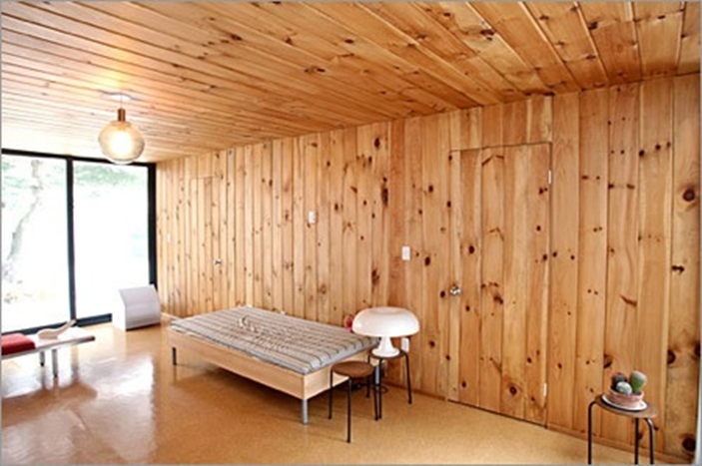
The People’s Excuse
Haggai 1:2 We’re too busy to build the temple.
Q: Can you relate?
Haggai 1:3-4 Hmmm…. You seem to have time to build your house.
Haggai 1:5-6 You have
planted much but
harvested little.
Q: Can you relate?

Slide 33
God’s Solution
“Indifference to the things of God produces calamity.”
1. Haggai 1:7 Give careful thought to your ways.
2. Haggai 1:8 Bring down timber to build God’s temple.
Haggai 1:12-15 The people obeyed, the leaders led, the people’s spirits were inspired and the work got started.

Slide 34
Rebuild
Haggai 1:12-15 The people repented and the temple got rebuilt.
Result: God: I am with you (Matthew 28:20)
Haggai 2:1-9 The work is hard and we humans can get discouraged, but God encourages us.
God really gets carried away with excitement when he sees his people repenting and returning so that he can restore and rebuild.

Slide 35
Two Great Memory Verses
Haggai 2:6
“In a little while I will once more shake the heavens and the earth, the sea and the dry land.”
Haggai 2:8
“'The silver is mine and the gold is mine,’ declares the Lord Almighty.”

Slide 36
Haggai 2:10-18 “parable of defiled flesh
Does coming into contact with clean meat make you clean? No!
Does coming into contact with defiled meat make you unclean? Yes!
Defilement is a thing. Holiness is a lack of a thing.
Sin is contagious. Holiness is not necessarily contagious. We need to deal with the plague of materialism.

Slide 37
Haggai 2:19-23
If we repent, God will bless us.
“I will shake the heavens and the earth. I will overturn royal thrones and shatter the power of the foreign kingdoms. I will overthrow chariots and their drivers; horses and their riders will fall, each by the sword of his brother.”

Slide 38
Zechariah
Theme: The Messiah is coming: Get your house in order.
Message: It is time to build the temple: Repent, Return, Restore, Rebuild.

Slide 39
Things to bear in mind When reading zechariah
• Dated prophecies: Nov. 520 BC – Dec 518 BC
• Contemporary of Haggai
• Mentioned in Ezra 5:1-2 6:1-10, 13-15
• The book is apocalyptic
• The book has many Messianic prophecies
• The book has many prophecies of the Kingdom of God
• The book is eschatological (it is about end-times)

Slide 40
The messiah is coming
Q: Is your (spiritual) house ready for guests right now?
(Or would you be scrambling around, trying to straighten up all the mess)

Slide 41
Outline of Zechariah
1:1-6 Prologue: Repent, Return, Restore and Rebuild
1:7-6:8 Eight visions. Highly apocalyptic, not so prophetic
6:9-15 Coronation of Joshua/Jesus
7:1-8:23 Two sermons.
9:1-14:21 Two Oracles concerning Jerusalem. More prophetic, less apocalyptic. More Messianic.

Slide 42
Zech 1:1-6 Introduction
God: Repent and Return so I can Restore and Rebuild
v. 2 Why was God so angry with their forefathers?
v. 3 The solution: Repent and Return
v. 4-6 Those faithless Jews are no longer around, but my Words are still in place.
v. 6 Good news. They repented and the temple got rebuilt.
We are seeing the end of the story right at the beginning.

Slide 43
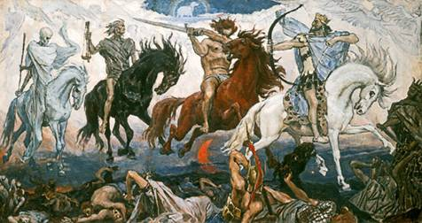
Vision #1 Zech 1:7-17 A man on a red horse
v. 11 All is quiet and at peace, is that good? No! Because God’s people are still in captivity.
Isn’t God the prince of peace? Matthew 10:34-36
Does God want people to feel secure? Amos 6:1-7
That depends….

Slide 44
Vision #1 cont.
Zech 1:16-17
This, in essence, is the theme of Zechariah: The Messiah is coming: Get your house in order!
God’s reply: I will return to Jerusalem and rebuild my house! Do not look at outward appearances.
Application: If your situation or church seems stagnant, do not look at the outward appearance. God can and will work in your life.

Slide 45
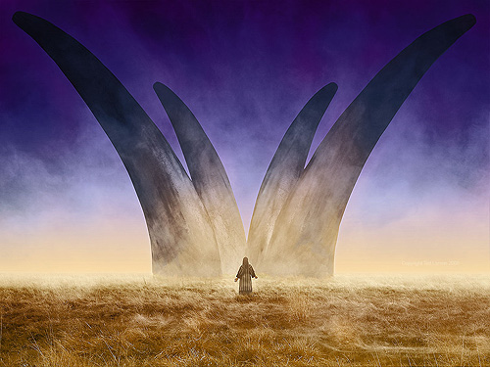
Vision #2 The vision of four horns
The four horns are four nations which scattered God’s people as a judgment for their sins.
Assyria, Egypt, Babylon, Persia?
Zech 1:21 God will throw down those horns. How do you feel about the fact that God will judge your enemies?

Slide 46
Vision #3 a man with a measuring line
God: I will make my kingdom into a city without walls.
Zech 2:1-2 Measuring = Protecting Rev 11:1-6, Ezekiel 38:7-16
2 Sam 24 Do not rely on “statistics”
Message: Do not rely on protection the world provides. Rely on God for your safety.

Slide 47
Vision #3 (cont.)
Zech 2:6 Repent and Return from the North—from captivity.
2:8 You are the apple of my eye.
2:10-13 A kingdom prophecy. (parallel: Ezek 36:24-38 and Ezek 37:11-14)

Slide 48
Kingdom prophecies in Zechariah
Zechariah 2:10-13
Zechariah 6:15 Those who are far away will come and help build the temple of the Lord.
Zechariah 8:1-7 I will return to Zion.
Zechariah 9:10 His rule will extend from sea to sea
Zechariah 13:1-3 On that day…. Pentecost.
Zechariah 14: the whole thing!!!
And many more….

Slide 49
Vision #4 Zech 3:1-10 Joshua accused and exonerated
Zech 3:1-2 Who is Joshua symbolic of here?
Satan is an accuser (Zech 3:2, Rev 12:10)
Satan is a deceiver (John 8:44)
What would Satan say to/about you?
Zech 3:3-10 can be a bit confusing
Is it about the high priest Joshua? yes
Is it the Messiah? yes
Is it about you and me? yes

Slide 50
Vision #4 cont.
Zech 3:6-7 If you repent and return, I will restore and rebuild.
Zech 3:8-9 In case you were wondering, Joshua is Jesus. The Branch. Hebrew nazer. The nazarene. The Messiah is coming, get your house in order.
Zech 3:10 Let’s invite our neighbor to sit under the vine and the fig tree with us.

Slide 51
Vision #5 The Golden Lampstand and the Two Olive Trees
Zechariah 4:1-3
A vision of the menorah in the Temple.
The oil in the menorah is the Holy Spirit.

Slide 52
Vision #5 (cont.)
Another great memory scripture: Zech 4:6 “Not by might, nor by power, but by my Spirit says the Lord Almighty.”
The two olive trees represent the permanent, unending, limitless supply of the Holy Spirit in our lives. John 7:37-39 Streams of living water….
4:10 seven channels = seven spirits (Rev 2:1)
4:12-14 The two trees represent the two anointed to serve: Joshua and Zerubbabel and Joshua. Jesus is priest and king.

Slide 53
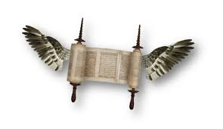
Vision #6 The flying scroll
Judgment on sinners and on all the enemies of God’s people.

Slide 54
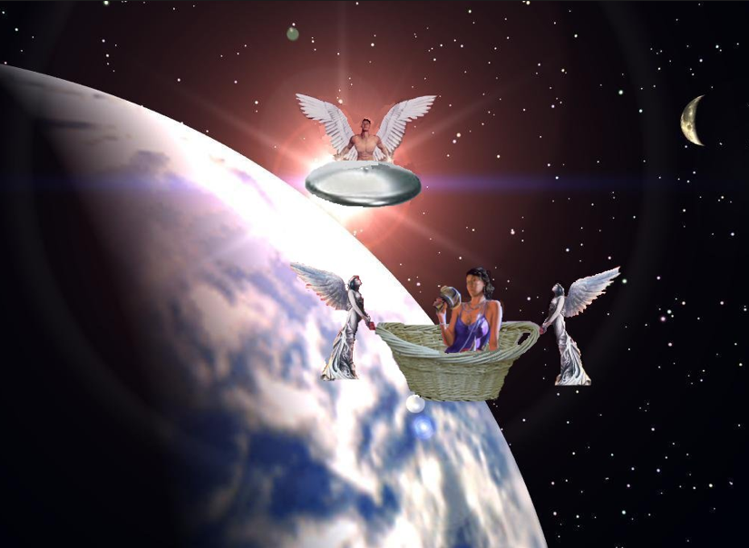
Vision #7 A woman in a basket
Message:
Judgment on sinners
Measuring basket:
Judgment
v. 7 Woman = sin = Babylon
v. 10-11 Those who sin will be sent to Babylon

Slide 55
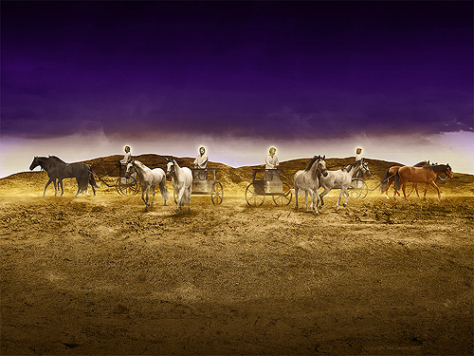
Vision #8 Four Chariots
Message: Judgment is coming!
Parallel passage: Revelation 6:2-7

Slide 56
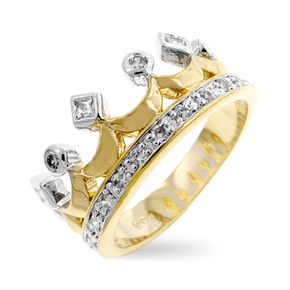
Zechariah 6:9-15 The coronation scene
The Messiah is coming!
v. 11 Does a priest wear a crown?
v. 12 Branch = nazer = Nazarene (Matthew 2:23)
v. 13 Harmony between the two = between the priest and the king.
v. 15 Those who are far away will come

Slide 57
IV. Zech 7 & 8 Two Sermons
Zech 7:1-14 True worship versus religion.
v. 3 Should I mourn and fast in the 5th month?
5th month: for the destruction of the temple 586
7th month: for the assassination of Gedaliah
10th month: for the capture of Jerusalem in 597
Do I have to serve God? Do I have to help the poor?

Slide 58
Should I mourn and fast?
Zech 7:4-7 Why were you fasting? Was it about me or was it about you?
Zech 7:9-10 How can we be sure that our motivation is pure? Practice social justice. Memory verse:
“Administer true justice; show mercy and compassion to one another. Do not oppress the widow or the fatherless, the alien or the poor. In your hearts do not think evil of one another.”
In other words: act like God! Isaiah 58:6

Slide 59
Should I mourn and Fast?
Zech 8:18-19. No! The Messiah is coming! You should party. It is time for joy and gladness.
Zech 7:11-14 You need to repent!
Zech 8:1-11 Then you will return, be restored and rebuilt!
v. 3 God will return and rebuild Jerusalem
v. 6 A miracle
v. 7 Restoration
v. 9 Get building!
Zech 8:23 A great Bible talk.

Slide 60
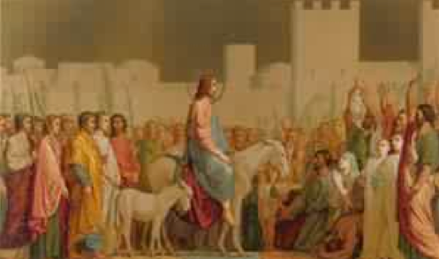
Zech 9-11 The First oracle
Zech 9:9-17 The Messiah is coming to Jerusalem
Zech 9:9 What do you see about Jesus here?

Slide 61
Messianic Prophecies in Zechariah
Zechariah 3:8-9 My servant the branch
Zechariah 6:11-13 Crowning of the Messiah/Branch
Zech 9:9 Triumphal entry (Matt 21:2-7, Mark 11:4)
Zech 11:7-13 30 pieces of silver Matt 26:14-15 The potter Matt 27:3-10
Zechariah 12:10-14 The one pierced (John 19:31-37)
Zech 13:7 Strike the shepherd (Mark 14:27)

Slide 62
Zech 9:10-17 A kingdom prophecy
Zech 9:10-11 Q: What do you see about the kingdom here?
Q: What kind of waterless pit did God pull you out of?
v. 13 God will “bend Judah”
Does Zech 9:14-15 contradict Zech 9:10 (he will proclaim peace)? Matthew 10:34-36.
v. 16-17 We will sparkle. We will be beautiful!

Slide 63
Zechariah 10
Return
Restore
Rebuild

Slide 64
Zechariah 11:4-14
God will revoke the first covenant and establish a new covenant.
11:4-9 God has had enough: Rome will judge the Jews who rejected Jesus. (fulfilled in AD 70)
v.9 Cannibalism! As predicted in Leviticus 26:29 and as confirmed by Josephus
v. 10-11 The Covenant (my staff called favor) with Moses will be revoked.

Slide 65
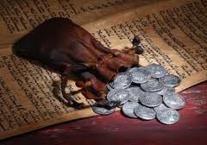
Zech 11:11-12 A messianic prophecy
Thirty pieces of silver… Matthew 26:14
Throw it to the potter… Matthew 27:1-10
The price at which they priced Me

Slide 66
Oracle #2 Zechariah 12-14
Zech 12:1-9 A kingdom prophecy: God will bless his
people
Is this about restored Judah?
Is this about the church?
Is this about us, individually?
Is this about heaven?
Zech 12:7-8 The feeblest in the kingdom will be greater than David! Luke 7:28 Greater than John the Baptist.

Slide 67
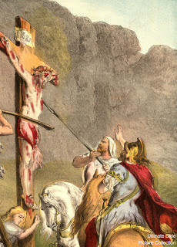
Zechariah 12:10-14 A messianic prophecy
Zech 12:10 I will pour out my spirit (Acts 2 Pentecost)
They will look on me (ie God) the one they have pierced. John 19:31-37
Hadad Rimmon Where Josiah, the most righteous king of Judah, died. 609 BC

Slide 68
Zechariah 13 The kingdom of god (cont.)
13:1 on that day a fountain will be opened Pentecost
13:2-6 Prophecy will cease.
13:7 The sheep will be scattered Mark 14:49
13:8-9 The church will be persecuted but also refined.

Slide 69
Zechariah 14 The end of time
Parallels with Ezekiel 47:1-12, Revelation 21:1-22:5, Daniel 12 and Matthew 24:4-35
On that day… The Day of the Lord Is 2:12, 13:6-9, 34:4, Jer 46:10, Lam 2:22, Ezek 13:5,30:3, Joel 1:15, 2:1,11, 31 Joel 3:14 Amos 5:18-20, Obad 15, Zeph 1:8,14, Mal 4:5
Zech 14:2-7 more affinity with AD 70 and the destruction of Jerusalem.
v. 5 earthquake in the time of Uzziah Amos 1:1
Zech 14:8-21 more affinity with end-times

Slide 70
Zech 14:8-21 The time of the end
v. 8-9 Living water from Jerusalem
Heaven Ezek 47:3-12, Rev. 22:1-5
v. 10-11 Jerusalem will be secure
v. 12-15 But God’s enemies will be judged
v. 16 Perpetual Feast of Tabernacles: Celebrating being in a relationship with God.
v. 17-19 But some choose not to go. God accepts their decision.
v. 20-21 Holy, Holy is the Lord.
No Canaanite = no merchant = all will be supplied by God

Slide 71
Esther 1:1-3
Notes:
From India to Cush - largest empire of that time! 127 provinces (20 Satrapies - Judah was a province of the 5th, Syria). Specific!
Where’s God? His people aren’t ruling; emphasis on Persia, not Judah.

Slide 72
Achaemenid Dynasty
• 559-530 - Cyrus the Great (Zerubbabul, arrive 1st yr, work 2nd)
• 529-522 - Cambyses (son)
• 522 - Smerdis (Bardiya) (brother)
• 521-486 - Darius I, the Great (Haggai & Zechariah, finished 6th)
• 485-465 - Xerxes I (son) - (Esther)
• 464-424 - Artaxerxes I, Longimanus (son) - (Ezra went 7th yr)
• 424 - Xerxes II (son)
• 424 - Sogdianus (brother)
• 423-405 - Darius II, Nothus (brother)
• 404-359 - Artaxerxes II, Mnemon (son) - possibly Esther
• 358-338 - Artaxerxes III (Ochus) (son)
• 337-336 - Artaxerxes IV ( Arses) (son)
• 335-330 - Darius III (Codomannus) (great-grandson of Darius II)
Macedonian (Alexander) conquest of the Persian empire 330
Notes:
Not know for sure where Esther fits. Possibly Xerxes or Artaxerxes II (80 years apart).

Slide 73
Identity of Ahasuerus
Artaxerxes II (403-359 BCE)
Septuagint
Josephus
Xerxes I (486-465 BCE)
Name is similar;
Herodotus describes Xerxes as lusty for women and wine, and as reigning from India to Ethiopia; convoked assembly in 483 to plan against Greece; returned from defeat of Salamis in 479 for consolation; about 3 generations from original deportation in 597 (2:5-6);
The magnificent palace had been burned in the reign of Artaxerxes I (before Artaxerxes II);
In Sippar, an administrative record was discovered noting that during Cyrus’ reign, Marduka served as royal treasurer;
Order of the kings in Ezra 4:4-7

Slide 74
Esther 1:1-3
Notes:
3rd year of Xerxes’ reign (485-465 BCE). 1st return from captivity (Cyrus) 538 BCE (55 yrs). Finished temple Jerusalem, nothing happening, another 50 for walls! Where’s God? People scattered / unfocused / limbo / stuck. Been there? Christian for 15 / 25 yrs, but rut. Where?

Slide 75
Esther 2:5-7
Notes:
Two main heroes: Esther (Hadassah), Mordecai (great-grandson). Orphan / Cousin. Tragedy! Where’s God? Gave her a cousin, beauty and character (submission). She’s taken to evaluation by king (what a risk). $, school, share faith, confront someone.

Slide 76
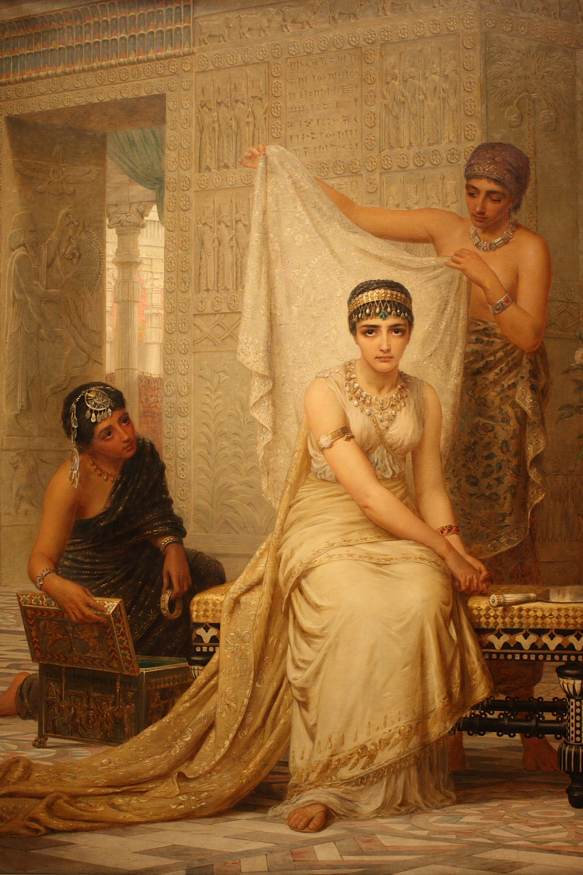
Esther 2:10, 20
Notes:
Not reveal identity. Interesting - he commands her, but emphasizes own nationality (3:4), reason for edict. Possibilities: 1) afraid of not being chosen if from exiles, foreigners looked down on; 2) from family of King Saul, so better to be of low birth so not be chosen. Not known motives.

Slide 77
Esther 2:21-3:2, 5-6
Notes:
Mordecai is honest man, helping the king. Deserves a reward, but overlooked. Good guys have down times (Joseph, David, Jeremiah).

Slide 78
Esther 4:12-16
Notes:
M tells of the plot / asks her talk to king. She’s afraid, he expresses faith that if not her, rescue from somewhere else. Discipleship (calling higher)! How? No explanations - Faith! No mention of God, but does she believe? Fasts. To whom? God! What is her resolve? Even if die!

Slide 79
Hebrews 11:1-2
Notes:
Not end of story, but the end didn’t really matter to Esther (willing though tragedy), nor the means to Mordecai (confident though forgotten). They couldn’t touch God, not everything was going their way, and when did go well, presented challenges and risks. Faith!

Slide 80
Where’s God?
Notes:
What situation..in right now that requires faith? What situation happened..causes you to question: Where’s God? Broken relationship / illness / loss of loved one / Financial pressures / Unreasonable children or parents… God is invisible, but always there! Faith.

Slide 81
God is present!
Notes:
Lost job (relative), Rebecca born. Dad visiting. Money, time, how support - pride / insecurity. I’m alive, daughter survived, dad respects.
God is invisible, silent, but always there orchestrating! Like Esther, don’t need his name to see presence. His purpose is Faith. (Pray)

Slide 82
Esther 5:1-8
Notes:
After 3 days of fasting, waits outside, the king extends scepter & asks. Now! Requests banquet (preparing during fast). He asks. Come on! Another banquet. No rush (we get in too much of a hurry). We ask for opportunities, God works (our patience, circumstances, others).

Slide 83
Esther 5:13-14
Notes:
Before the next banquet 2 things happen: Haman decides to erect poles to impale Mordecai-eventually Romans add nails. (rage is getting out of hand) Slap our kids, yell at our spouse, hit a wall, swear at a car! Get it together! Esther’s waiting on Lord, Haman’s fuming inside!

Slide 84
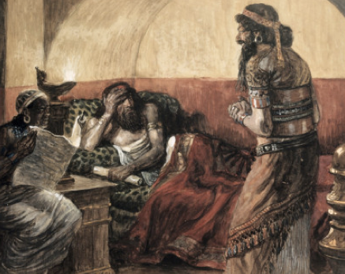
Esther 6:1-3
Notes:
2nd: The king can’t sleep, so he listens to book of records! (David would wake up and pray) Mordecai had saved the king, yet nothing done. That night! God working / E and M waiting and praying. * Praying to go to Brazil, Jorge, Beto out of blue ask to help

Slide 85
Esther 6:6-12
Notes:
Coincidentally, asks Haman what to do. Haman thinks it is him. Treat him like royalty! Surprise! Haman expects what Mordecai receives. Mordecai gets accolades, but returns to the gate. (accepts but does not seek the limelight - what a contrast!) Titles or service? Self or others?

Slide 86
Esther 7:3-6
Notes:
Finally! I am a Jew and Haman wants to kill us all! Then king left, Haman grovels, touching the queen. King returns, impaled on poles prepared for Mordecai. (reap what sow) * (Christian B) not give respect, not get it; potential, fired; * I avoid conflict, wife wants, others not change quickly.

Slide 87
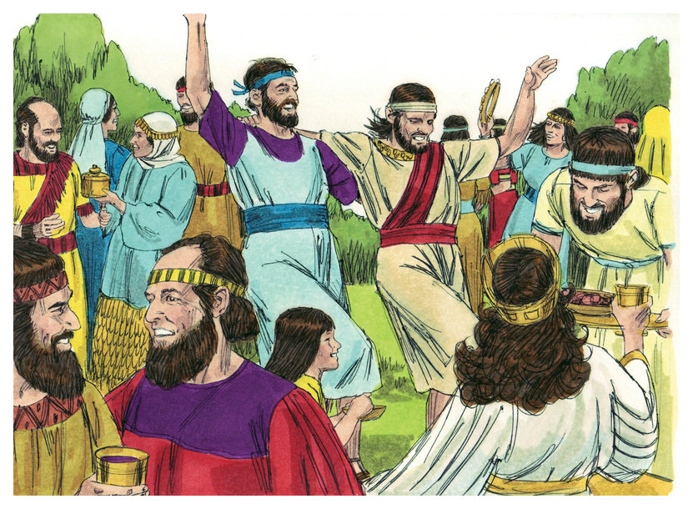
Esther 9:16-17
Notes:
The king can’t revoke the law signed that people can kill Jews, so he passes a law allowing the Jews to defend themselves and plunder their enemies. They are able to do it and their fear and grief is turned to joy. * SP event, debt - gov’t passed law allowing to payments, office relief!

Slide 88
Humility / Restraint
1 Peter 5:5-6
Notes:
2 obs: God blesses humility 1 Peter 5:6. Neither E or M sought positions (she taken-2:8, he by sleep / Haman-6:4). E asks for nothing (2:13). Lift others (her credit-2:22, him for people-10:5). Not clung to status (willing -4:16, back gate-6:12). Able plunder, not advantage (9:10, 15, 16).

Slide 89
Esther: A Prefigure of the Messiah
• Jesus / Esther - helpless child becomes a savior (2:7; 4:14 / Luke 2:7, 10); pleads for the people (4:8; 7:3; 10:3 / Lk 13:34; 22:32; John 17:24-26); willing to sacrifice self for the sake of the people (John 11:50-52 / Esther 4:14-16); salvation is by grace through faith (Romans 4:16, 21; 5:1-2).

Slide 90
Notes:
Ezra 1-6 Cyrus allowed return (538 BCE) and began temple, completion under Darius (23 years later). Esther during Xerxes. Ezra comes under Artaxerxes.

Slide 91
Ezra 7:8-10 Ezra devoted himself to studying and the observance of the Scripture.
Notes:
He is a priest (direct descendant of Aaron, v. 1-5) and scribe. Devoted to studying, obeying and teaching!

Slide 92
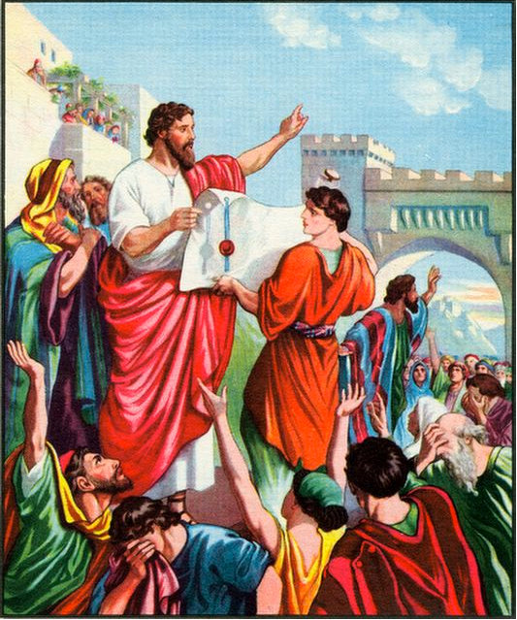
Ezra 7:27-28 God moved the heart of Artaxerxes 458 BC Daniel 9:24-25 490 years from the decree to restore and rebuild Jerusalem. 33 AD
Notes:
God moved his heart (Pv 21:1). God did it! Because of his relationship with God, he gathered men to go with him.

Slide 93
Ezra 8:21-23 Ezra humbles himself before God. Reliant on God (didn’t want to ask for military help)
Notes:
v. 1-14 lists 2 priests and a descendant of David, then 12 clans (to recall the Exodus and the return in ch. 2, same clans).
Humble before God. Ask God for safe trip (Nehemiah didn’t mind asking the king). God used both. He answered!

Slide 94
Ezra 9:1-3 Ezra 10:1-4 Israel takes foreign wives. Ezra weeping, throwing himself down before the Lord, pulling out his hair.
Notes:
What was the issue here? Married foreign women. Pulled out his hair (9:3). Why so upset? List (v. 18-44) only has 111 people out of 42k (2:64): 0.26%. Nations worshiped other gods (9:10-11) and Dt 7:1-6 specified prohibition. Still hope-v. 2 (never too late for repentance!).

Slide 95
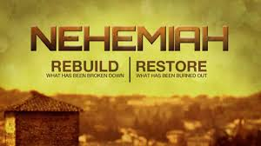
Nehemiah
Nehemiah: The greatest leader in the OT?
What are the traits of a great leader of God’s people?
Ezra, the teacher, returned and was restored.
Nehemiah the leader repented and rebuilt.

Slide 96
Nehemiah 1:1-11
Nehemiah: God’s leader wept, mourned, fasted and prayed over the condition of God’s kingdom.
Nehemiah: God’s leader prays humbly and powerfully.
Nehemiah: “I confess the sins we Israelites, including myself, and my father’s family, have committed against you.”

Slide 97
Nehemiah 1:10-11 Nehemiah prays boldly
Notes:
Once again a prayer for God to have the king extend favor. Did Nehemiah have control? No, but God did and he was God’s servant!

Slide 98
Nehemiah 2:11-16 God’s leader prepares a plan to build God’s kingdom.
Notes:
God’s idea becomes mine. Idea prompted by a conversation (1:2-3) in disgrace. Then prayer for success in 1:8-9, based on Dt. 30:4 that God would bring them back. God put it in his heart and it germinated.

Slide 99
Nehemiah 2:17
Notes:
Progression: Other people’s trouble becomes ours. “We”, yet he didn’t start out there, out of way and initiates: “Let’s do this!”. * My heart is touched and I initiate (they may not respond, but their trouble becomes mine).

Slide 100
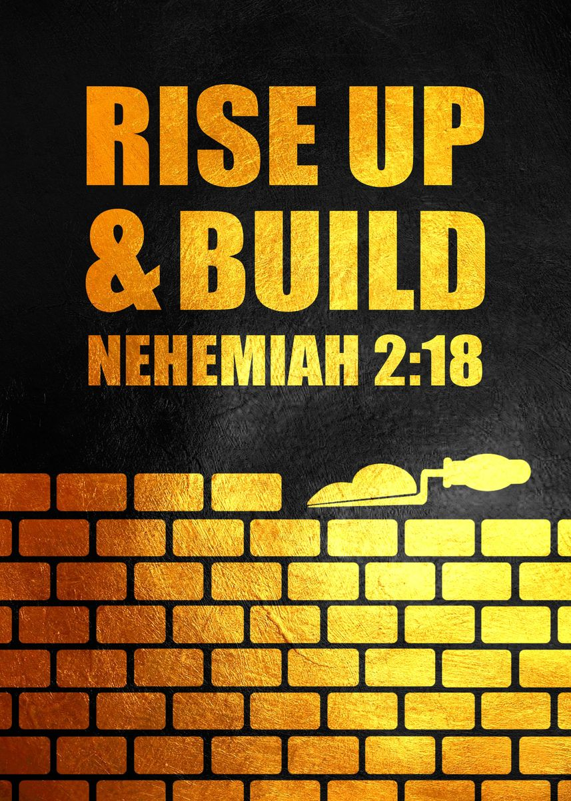
Nehemiah 2:18
Notes:
Progression: When we share what God does in our life, it encourages others. * Share what God has done: met someone, got promotion, child prayed spontaneously, paid a bill etc. And give him credit!

Slide 101
Nehemiah 3
Notes:
Learn from lists: Spiritual leaders are involved (3:1). It begins with dedication to God (3:1). Some give even though no direct benefit: Jericho (2), Tekoa (5), Gibeon (7), Mizpah (7, 15, 19), Zanoah (13), Beth Hakkerem (14), Beth Zur (16) and Keilah (17, 18). Not perfect (3:5).

Slide 102
his becomes ours
Notes:
God starts the spark. We connect on a heart level. We share God’s action with each other. We each commit enthusiastically, differently and imperfectly. And we see it (idea, ministry) become our victory too!

Slide 103
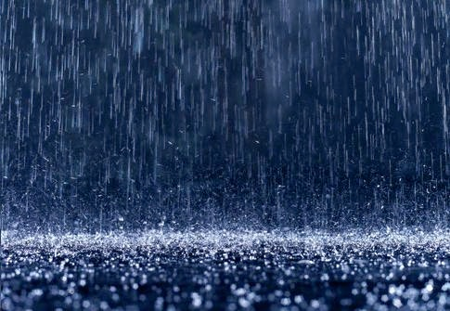
When It Rains…
Notes:
Chapter four begins a series of challenges. There are common phrases or sayings that promote the idea of a series of problems. Do you recognize them? (read slides to complete phrase).

Slide 104
It Pours!

Slide 105
If It’s Not One Thing…

Slide 106
It’s Another!

Slide 107
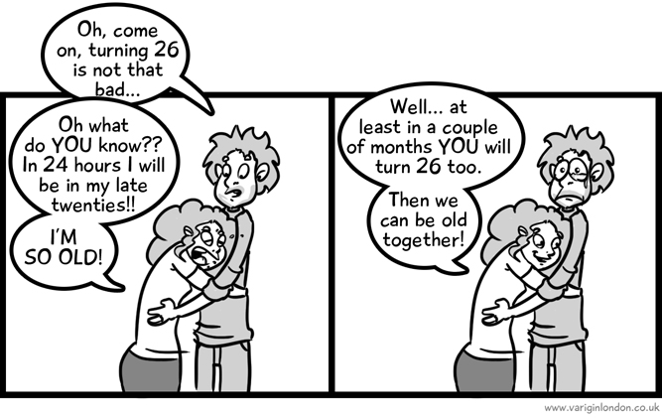
Misery Loves…

Slide 108
Company!

Slide 109
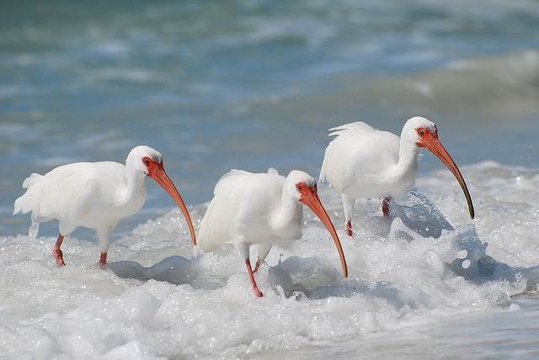
Trouble Comes In…

Slide 110
Threes!

Slide 111
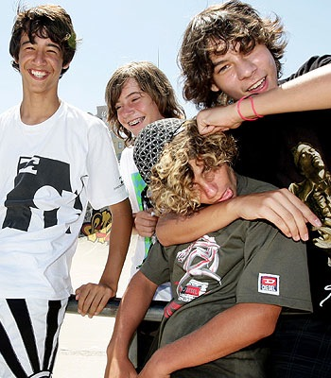
Nehemiah 4:1-3
Notes:
Satan pouring it on! Ridicule, belittling! And publicly.

Slide 112
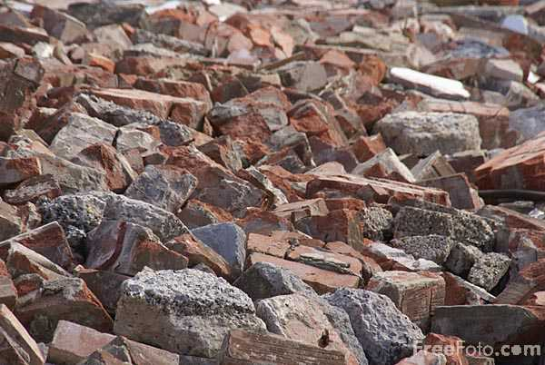
Nehemiah 4:10
Notes:
Strength giving out and so much rubble!

Slide 113
Nehemiah 5:1-5
Too many of us, not enough food (v. 2)
Famine sent us into debt (v. 3)
Taxes are so much, we’re losing our fields (v. 4)
Even our own people are subjecting us to slavery (v. 5)
Notes:
Drought, so food in shortage. Having to sell homes and fields ($). Taxes high. Worse—own countrymen enslaving them!

Slide 114
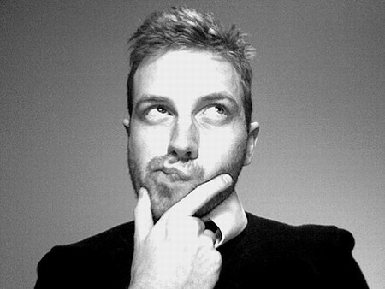
Nehemiah 5:6-7a
Notes:
Lots of issues (really pouring down rain)! Nehemiah heard what they were saying, then thought about it and confronted the ones who were acting unjustly.

Slide 115
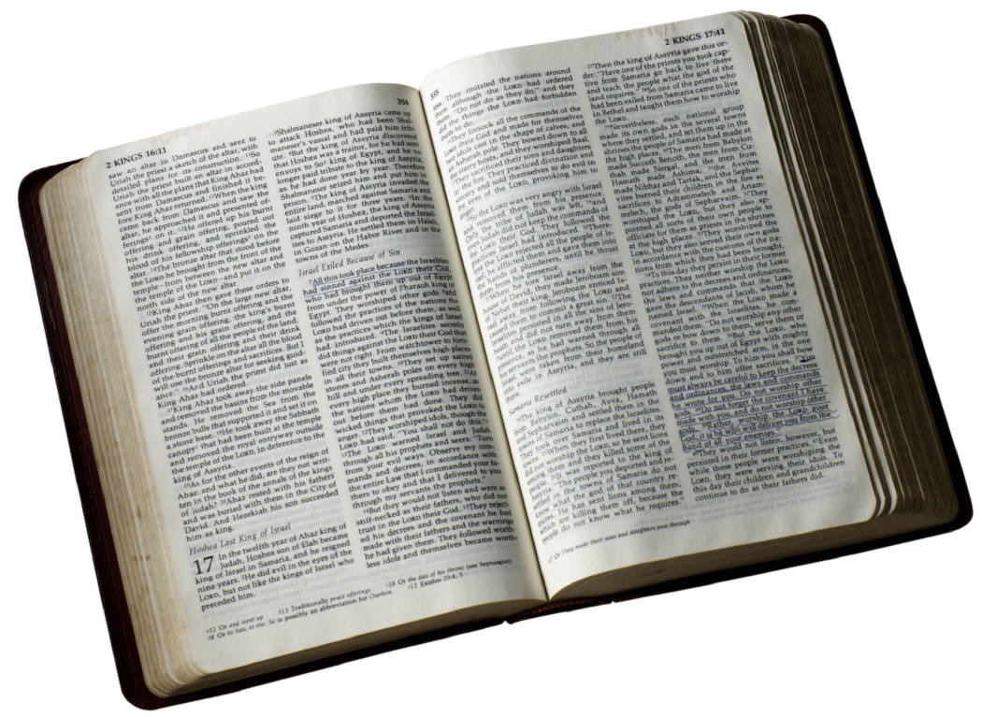
Nehemiah 5:9-13
Notes:
v. 9 - How do we know what is right? The Word! Dt. 23 not lend at interest.
Fear God! That’s the only way to be consistent and upright.

Slide 116
Nehemiah 5:9-13
Stop sinning!
Make restitution
Have accountability
Before God

Slide 117
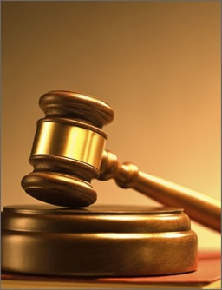
Nehemiah 5:19
Notes:
Lots of problems faced, but God sees it all. Know that your efforts are rewarded in the end. Even in conflicts and troubles, there is confidence in the Lord!

Slide 118
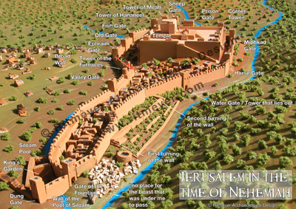
Nehemiah 6:15-16
Notes:
They finally finish the wall! Really fast. Only because of God’s mercy and the people working hard. Amazing what can be accomplished. Pray and roll up sleeves when given direction from leaders.

Slide 119
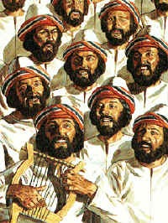
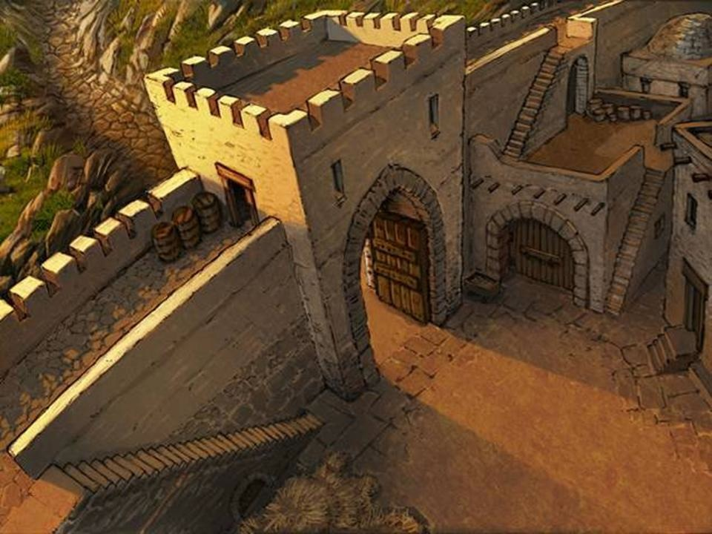
Nehemiah 7:1
Notes:
First physical structure, then the organizational structure for the city. Important to have men of integrity, who fear the Lord (elders and deacons) and point us to God! * Greg in intense conversations, reminding us of Jesus.

Slide 120
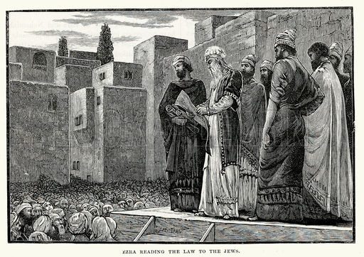
Nehemiah 8:1-3
Notes:
Ezra is contemporary and overlaps with Nehemiah. He keeps the focus spiritual by reading the Word.

Slide 121
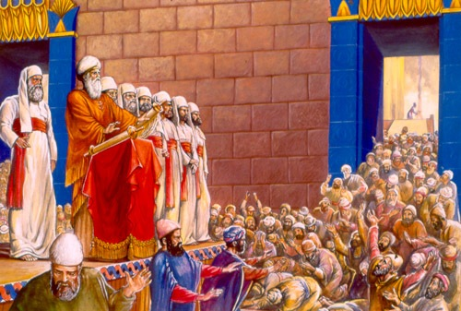
Nehemiah 8:5-6
Notes:
Respect for Word! We get to read it every day!

Slide 122
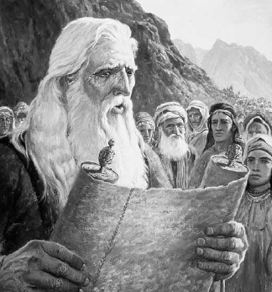
Nehemiah 9:1-3
Notes:
Fourth of the day reading Word and another fourth confessing and worshiping.

Slide 123
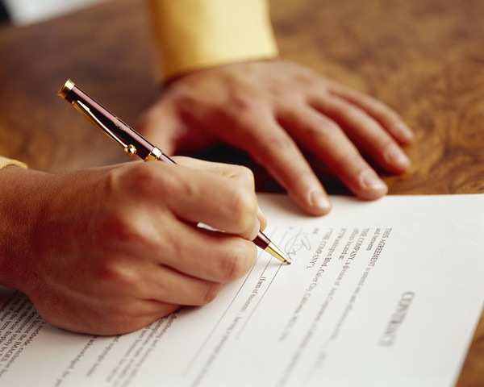
Nehemiah 9:38
Notes:
They decided to make a binding agreement in writing!

Slide 124
Nehemiah 10:30
Notes:
The first promise: spiritual marriages / families. I’m grateful for men and women with good priorities.

Slide 125
Nehemiah 10:31
Notes:
Second Promise: Not work on Sabbath / Priority worship over business. Too many people miss services because of homework or unnecessary work.

Slide 126
Nehemiah 10:32-39
Notes:
Third Promise: Commitment to giving
Not neglect the House of God.
These are basics. Are you committed?

Slide 127
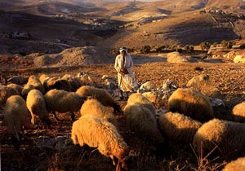
Nehemiah 11:1-2
1) Relocate
Notes:
Besides the basic promises, there were other decisions that some made (but all willing). The city needed to be repopulated, so people had to move. It was done by a draft system (one of every ten). * Changing FGs, KK, mission fields etc.

Slide 128
Casting Lots
Choosing the scapegoat (Lev. 16:8)
Tribal lands (Jos. 18:6-10)
Order of priests (1 Chron. 24:5, 31)
Duties of singers (1 Chron. 25:8)
Gatekeepers where (1 Chron. 26:13)
Times for altar wood (Neh. 10:34)
Sailors choose Jonah (Jon. 1:7)
Matthias as apostle (Acts 1:26)
From God (Prov. 16:33)
Notes:
A common way of determining things. We are so uptight, even after praying, seeking advice, weighing the pros and cons, we complain or resist! We probably need to trust much more.

Slide 129
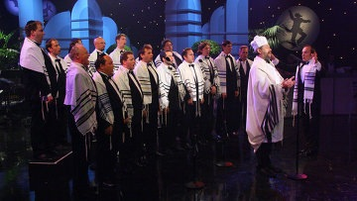
Nehemiah 12:27
2) Rejoice
Notes:
It was a special occasion and they brought in all the Levites to celebrate! Two choirs in procession on or near the wall in opposite directions and met at the temple. * We may have a fight in the car on the way…but God’s mercy is greater!

Slide 130
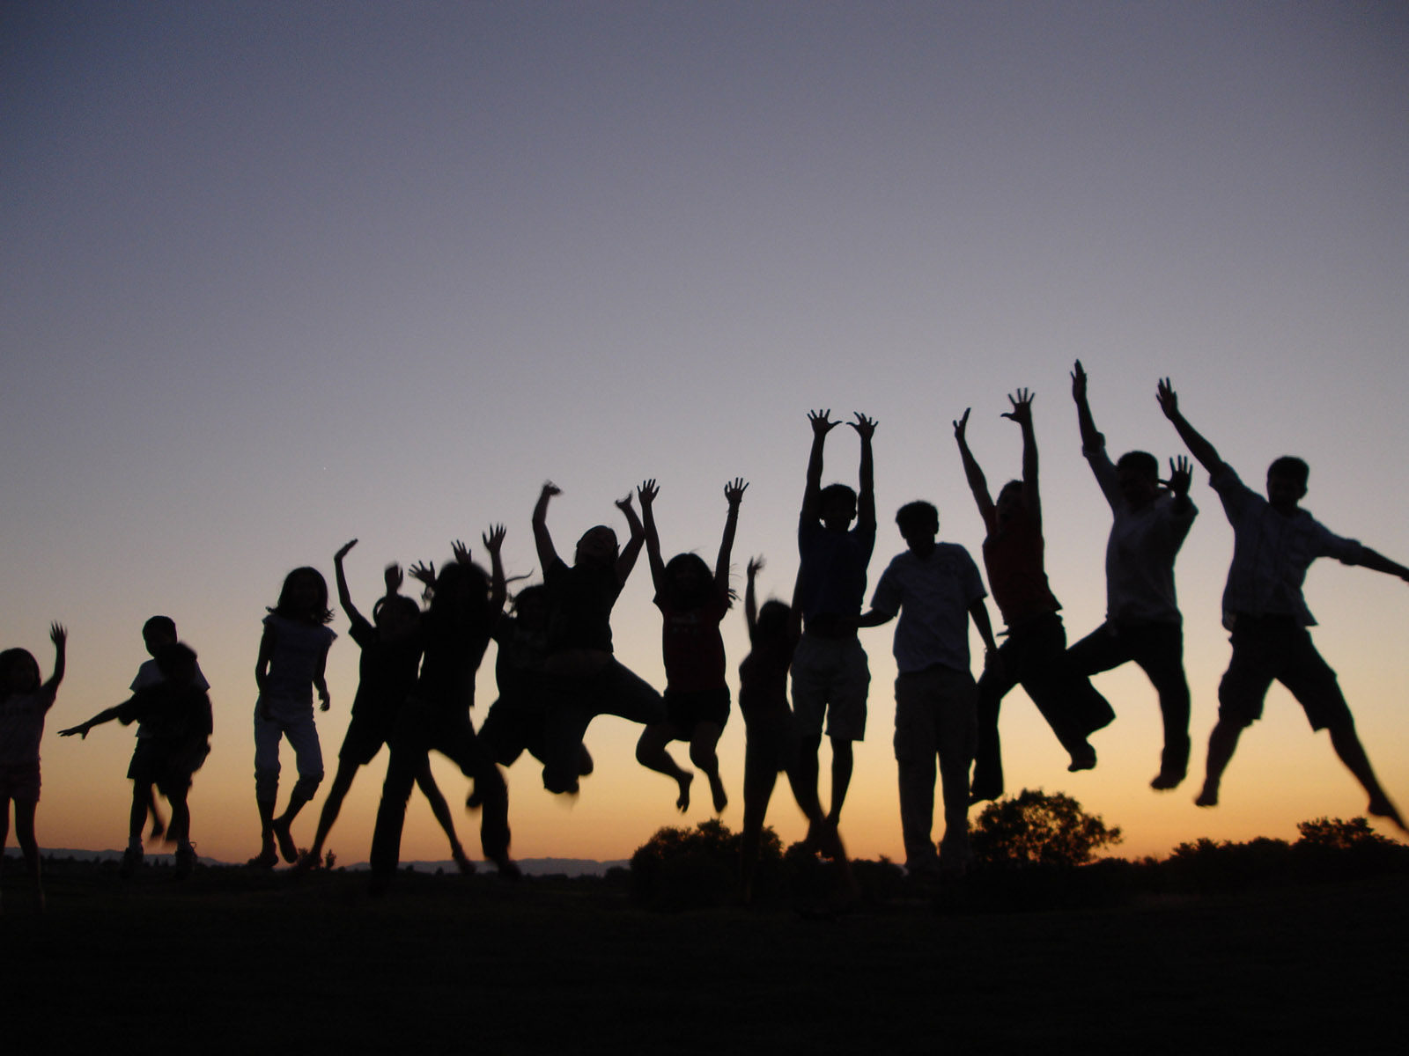
Nehemiah 12:43
Notes:
They rejoiced while giving (cheerful giver). Everyone, women and children too. It was even loud! * It’s ok to get into the worship! God blesses us in so many ways and we should give him abundant glory.

Slide 131
Nehemiah 13:6-9
3) Refocus
Notes:
Nehemiah stayed for 12 years, went away and came back. A time of reevaluating. Tobiah the Ammonite (2:10, 19; 4:3, 7; 6:1; 13:4) had invaded a room in the temple court, so he threw his stuff out!

Slide 132
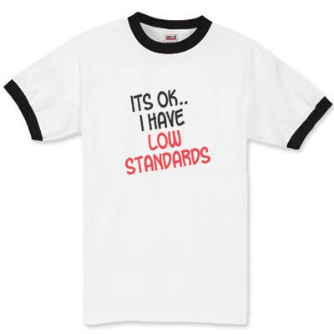
Nehemiah 13:6-9
Notes:
Some people were okay with it, but Nehemiah made sure it was purified. Don’t put up with blatant sin.

Slide 133
Nehemiah 13
Not giving offerings, so Levites go back to farm (13:10-14)
Working on the Sabbath; not resting or honoring the Lord (13:15-22)
Marrying non-Israelites, and children don’t know God’s Word (13:23-29)
Notes:
He tackled these. They all had to do with honoring God and strengthening God’s people.

Slide 134
Nehemiah
Dealt with them before.
Faced them head on.
Refocused on what they should do.
Notes:
Not new
Upfront
Direction to go

Slide 135
3 “R”s of Finishing the Task
Relocate – Be willing to go and change
Rejoice – celebrate progress, even in the middle of challenges
Refocus – as things get out of hand, bring it back to God and His Word in obedience
Notes:
Willingness to change.
Celebrating progress along the way.
As veer (and we will), bring it back to God / Word.

Slide 136
ezra / Nehemiah
Time periods overlap
Ezra: temple and law / Nehemiah: wall and people
Ezra ashamed to ask (8:22) / Neh, though afraid, asked the king (2:2-8)
Lengthy prayers (Ezra 9 / Nehemiah 1; 9)
Enemies (Ezra 4; 5 / Nehemiah 2; 3; 6)
Assembly (Ezra 3; 10 / Nehemiah 8; 9)
Mercy (Ezra 9:8-9, 13 / Nehemiah 1:8, 18; 6:16; 9:31-33)
Notes:
Contrasts and similarities between the two books.

Slide 137
ezra / Nehemiah
return, restore, rebuild
Notes:
The temple was rebuilt, the wall was finished, but repentance had to continue. That’s why we need Jesus; he covers all our sins and exemplifies the right path. Return to the Lord (repent), Restore convictions and obedience to the Word, Rebuild his holy nation!

Slide 138
Malachi: God’s Messenger

Slide 139
Theme: Covenant

Slide 140
Malachi: God’s Messenger
Message: Faithful to God vs. Faith in God
Malachi = my messenger
Date of writing 458-432 BC
Malachi is God’s last word to the Jews. It is a capstone to the message of the Old Testament and a final preparation for the ministry of John the Baptist and of Jesus. The next word from God will be “Repent for the kingdom of heaven is near” (John the Baptist)

Slide 141
Background to Malachi
The earlier generation had repented, returned been restored and rebuilt. The new generation are becoming cynical and questioning that God has fulfilled his promise to restore and rebuild. They need personal repentance and restoration. Will they have faith in God or will they be faithful to God?
Socratic Style
God: You have robbed me.
People: How have we robbed you?
God: In tithes and offerings.

Slide 142
Outline of Malachi
Introduction: God still loves Israel. God has been faithful to Israel. 1:1-5
I The Priests have been unfaithful 1:6-2:9
II The People have been unfaithful 2:10-3:15
III The Day of the Lord is coming Malachi 3:16-4:6

Slide 143
Introduction: Malachi 1:1-5
God: I still love you. I have kept my covenant with you. I have been faithful to you.
God: I have loved you.
People: How have you loved us? Cynical. Do not feel that God has been faithful. God has not loved them the way they expected to be loved.
Jacob have I loved, Esau I have hated….
This sets the tone for the book. I have been faithful to you, will you be faithful to me (or will you merely have faith in me)?

Slide 144
I. The Priests have been unfaithful
It is you, O priests, who show contempt for my name.
Priests: Who,… Us?
How have we shown contempt?
Remember: We are the priests!
1 Pet 2:5,9 a royal priesthood
Exodus 19:6 A kingdom of priests.

Slide 145
Unfaithful priests
People: How have we shown contempt?
God: You place defiled food on my altar.
People: Who, us?
God: Yes, you. You have not show me the respect I deserve.
People: Who us? How?
God: You gave me your second best.
People: Oh……
God: Try offering that to your boss.

Slide 146
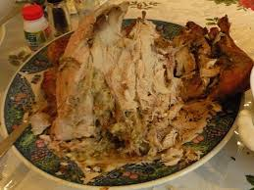
Unfaithful priests
Message: We can be religious, yet show complete contempt for God by giving Him our second best.
Faith: Giving something to God.
Faithful: Giving your very best to God.
Q: Do you give God your
left-overs?

Slide 147
Does God get your leftovers?
Malachi 1:9 Let’s reason together. Do you really feel that God should accept the second best?

Slide 148
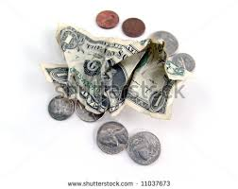
Unfaithful priests
Q: Is it better to give $5 or $0?
Malachi 1:10-11 God: Do me a favor. Leave your leftovers at home. Giving nothing at all is better than publicly disrespecting me.
My name will be great!!!!!

Slide 149
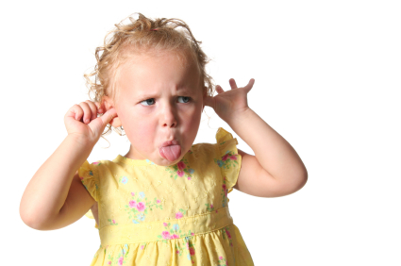
Unfaithful priests
Malachi 1:12-14 The key point:
Malachi 1:12 Have you “sniffed contemptuously” to God? People: How?
Malachi 1:13a “What
a burden.”
Zech 7:2-3

Slide 150
Unfaithful priests
Malachi 1:14 If you give your second best, God calls you a “cheat.”
God: I am a king and I expect to be treated as one.

Slide 151
Malachi 2:1-9 Warnings for priests
A. Malachi 2:1-4 If you give me the leftovers—if you do not honor me, I will smear your faces with your sacrifices. Wow!
Q: Is God being harsh here?
v. 4 It is about my covenant. God has been faithful to his covenant.
… this calls for reverence.

Slide 152
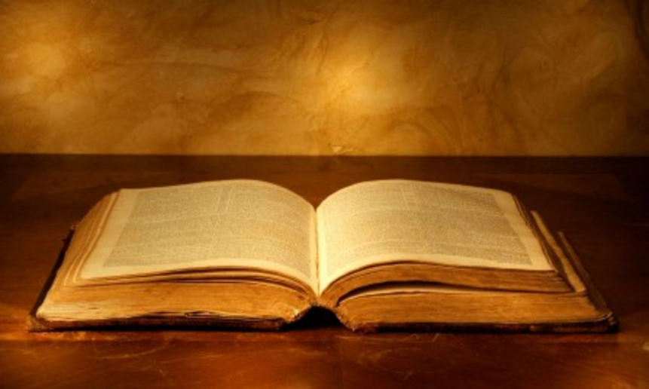
Malachi 2:1-9 Warnings for priests
Malachi 2:5-9. My priests have not taught my Word.
v. 6 true instruction
v. 7 preserve knowledge
Quoting Tyndale commentary: “Right behavior on the part of the people of Israel in covenant relationship with Jehovah was dependent on sound priestly instruction in the Torah and the virtuous example of the priests as covenant-keepers themselves.

Slide 153
II. Malachi 2:10-3:18 The people have been unfaithful
A. Malachi 2:10-16 Divorce as a sin and as a metaphor for unfaithfulness.
2:10 “Breaking faith” –unfaithful to one another is unfaithful to God.
2:14 You have “broken faith.” It is about covenant.
2:16 “I hate divorce.” God sees divorce as a kind of social violence against the wife and the people.

Slide 154
II. Malachi 2:10-3:18 The people have been unfaithful
B. Malachi 2:17 The people have stopped trusting in God’s love.
The people are accusing God of not living up to his side of the covenant. They do not trust God’s justice.

Slide 155
Malachi 3:1-5 The Day of the Lord Part I
Malachi 3:1 I will send my messenger (Malachi).
John the Baptist (Matthew 11:3, 10, 14)
The Lord you are seeking will come to his temple.
The messenger of the covenant whom you desire = The Messiah.
Malachi 3:2-5 Are you sure you want God to come?
The people will get what they are asking for (God to come) but not what they want (a free ride without judgment).

Slide 156
Malachi 3:6-15 The People have been unfaithful
Malachi 3:6-7 God: Return to me and I will return to you.
People: Who, me? I never left!!
Q: Can you leave God while still
attending church?

Slide 157
Malachi 3:6-15 The People have been unfaithful
Malachi 3:8 God: You have robbed me!
People: Who… Me?
v. 9 God: Yes, you. In tithes and offerings.
v. 10 Trust me in this….
It is not about money, it is about trusting God. It is about covenant
You are Stingy

Slide 158
The key question
Here is the key question of Malachi:
Do you really, in your heart of hearts, believe that if you put all your trust in God, that he will take care of you.
Do you feel that what God has for you is enough?
If so, then you will be faithful to God.

Slide 159
Malachi 3:6-15 The people have been unfaithful
Malachi 3:13
God: You have said harsh things against me.
People: I have????
God: Yes!!! When you said “it is futile to serve God.”
What am I getting out of this?
You have said that you do not believe that God will take care of you.
1 Timothy 6:6-10

Slide 160
III. The Day of the Lord Malachi 3:16-4:6
The Day of the Lord is a Day when God comes.
This is principally about end times, but it is also about the coming of John the Baptist and of Jesus.
3:16 A scroll of remembrance Rev 20:15 The book of life. v. 17 They will be mine.
v. 18 righteous vs evil will be clear.

Slide 161
Malachi 4 The Day of the Lord
The Day of the Lord will be either disaster or deliverance.
4:1 Disaster. stubble… root and branch…
4:2 Deliverance by the sun of righteousness
Jesus Christ.

Slide 162
Malachi 4:4-6 God’s final word to his people
1. Remember my law—remember Moses (v 4)
2. Be ready. I will send Elijah before that day. John the Baptist.
Matthew 17:11 “To be sure, Elijah comes and will restore all things.” Then the disciples understood that he was talking to them about John the Baptist.
Repent, Return, Restore, Rebuild All this is fulfilled in Jesus of Nazareth.

