Slide 1
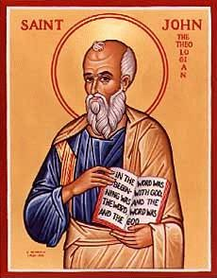
The Gospel of John II Let’s Meet jesus
John Oakes
Bakersfield
Fall, 2020

Slide 2
In John Jesus is revealed through his miracles and his statements about himself

Slide 3
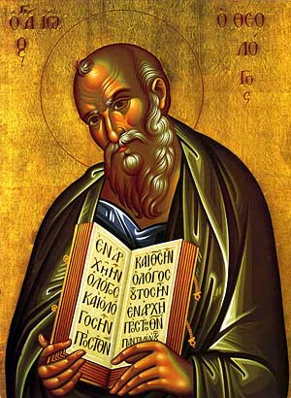
Theme and Purpose of John
Theme: Jesus is the Son of God who reveals the Father, providing eternal life to all who believe.
Purpose: John 20:30-31 But these are written that you may believe that Jesus is the Messiah, the Son of God and that by believing you may have life in his name.
Key verse: John 1:14

Slide 4
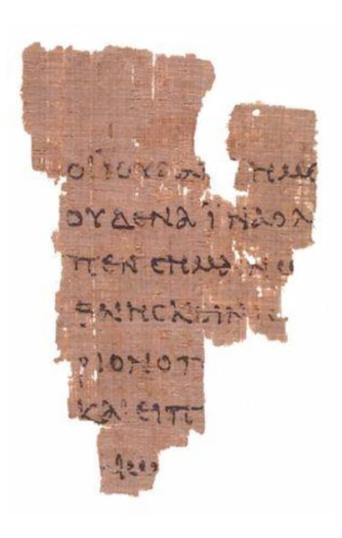
Things to Bear in Mind in John
Chronology based on the Jewish festivals (the three year ministry.
The nature of Jesus is revealed through the festivals as well.
Use of metaphors (light, life, bread, gate, door, lamb, glory…)
Use of irony.
The Rylands Papyrus
AD 125

Slide 5
Seven I Am Statements
I AM the bread of life John 6:35
I AM the light of the world John 8:12, John 9:5
I AM the door (and the gate) John 10:7
I AM the good shepherd John 10:1,14
I AM the resurrection and the life John 11:25
I AM the Way the Truth and the Life John 14:6
I AM the true vine John 15:1
All are metaphors

Slide 6
Jesus Revealed Through Seven Signs
[knew thoughs of Nathanael 1:43-50]
Water to wine John 2:1-11
Healing of official’s son John 4:43-54
Healing at pool of Bethesda John 5:1-5
Feeding of 5000 John 6:1-14
Walking on water John 6:16-21
Healing man born blind John 9:1-12
Resurrection of Lazarus John 11:1-44
[miraculous catch of fish John 21:1-13]

Slide 7
Outline of John
I. Prologue 1:1-1:18
II. Book of Signs 1:19-12:50
III. Book of Glory Passion Story 13:1-20:31
IV. Epilogue 21:1-21:25
Theme: The Son of who reveals God’s glory.
Theme verses 1:14, 1:18, 3:16

Slide 8
Prologue John 1:1-18
John 1:1 In the beginning was the Word. The Word was with God and the Word was God.
En archon In the Beginning (Genesis 1:1)
The Word logos
word, underlying principle, omnipresent wisdom, reason
The Word: Psalm 33:6 Isaiah 55:11

Slide 9
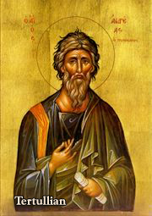
John 1:1 The “Trinity”
The Word was with God and the Word was God.
Yesterday I was with Vince. I am Vince.
Deuteronomy 6:4 Hear, O Israel the Lord is one God.
The “Trinity” is about relationship. God is essentially relational.
A God who would be known.
Tertullian AD 160-220

Slide 10
John 1:2-5 Important Metaphors
Creator Through Him all things were made. Without him nothing was made that has been made.
Life In Him was life
Light The light shines in the darkness and the darkness has not overcome/understood it.

Slide 11
John 1:9-13
To all who did receive him… he gave the right to become children of God.
…born of God.

Slide 12
John 1:14 A Key Verse!
The Word became flesh and made his dwelling among us. We have seen his glory, the glory of the one and only Son, who came from the Father, full of grace and truth.
The Word became flesh. Logos became sarx
He made his dwelling (tabernacled) among us.
We beheld his glory (doxa).
Full of grace and truth.

Slide 13
Grace and Truth!
John 1:17 The Law was given through Moses, grace and truth came through Jesus Christ.
The Law vs Grace and Truth
Which is more important to you?
Grace or Truth?

Slide 14
John 1:16 Grace upon Grace
grace grace grace grace grace grace grace grace grace grace grace grace grace grace grace grace grace grace
Piles of grace

Slide 15
John 1:18
No one has ever seen God, but the one and only Son, who is himself God, the one who is at the Father’s side, has made him known.
The only begotten Son monogeneis The only one like that. The unique Son.
Jesus has made God known.
What would Jesus do?

Slide 16
Let’s Meet Jesus
Behold the glory of God.
Behold the unique One.
Behold God the Son who tabernacled with us
Full of grace and truth!

