Slide 1
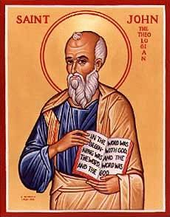
The Gospel of John IV
Jesus and Nicodemus

Slide 2
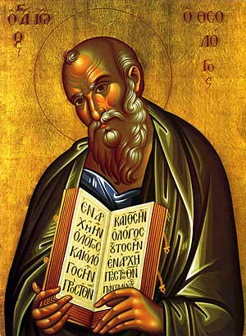
Theme of John
Jesus is the Son of God who reveals the Father, providing eternal life to all who believe.

Slide 3
Seven I Am Statements
I AM the bread of life John 6:35
I AM the light of the world John 8:12, John 9:5
I AM the door (and the gate) John 10:7
I AM the good shepherd John 10:1,14
I AM the resurrection and the life John 11:25
I AM the Way the Truth and the Life John 14:6
I AM the true vine John 15:1

Slide 4
Jesus Revealed Through Seven Signs
Water to wine John 2:1-11
Healing of official’s son John 4:43-54
Healing at pool of Bethesda John 5:1-5
Feeding of 5000 John 6:1-14
Walking on water John 6:16-21
Healing man born blind John 9:1-12
Resurrection of Lazarus John 11:1-44

Slide 5
John 1:14 A Key Verse!
The Word became flesh and made his dwelling among us. We have seen his glory, the glory of the one and only Son, who came from the Father, full of grace and truth.
The Word became flesh. Logos became sarx
He made his dwelling (tabernacled) among us.
Jesus came, full of grace and truth.

Slide 6
John 1:18
No one has ever seen God, but the one and only Son, who is himself God, the one who is at the Father’s side, has made him known.
Jesus explains God.

Slide 7
John 1:35-51 Jesus meets Nathanael
Come, and you will see!!!
Who is Jesus?
Messiah
Son of God
King of Israel

Slide 8
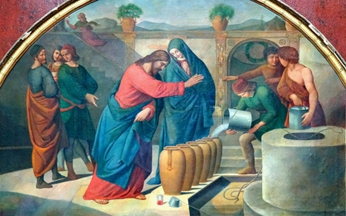
John 2:1-12 Jesus at Cana The First of Seven Signs

Slide 9
Why Did Jesus Do the Miracle?
Because his mom asked him to.
Because of the symbolic meaning.
We are invited to a marriage feast.
Jesus’ miracles do two things:
They reveal God’s glory
And they help us to believe in Jesus

Slide 10
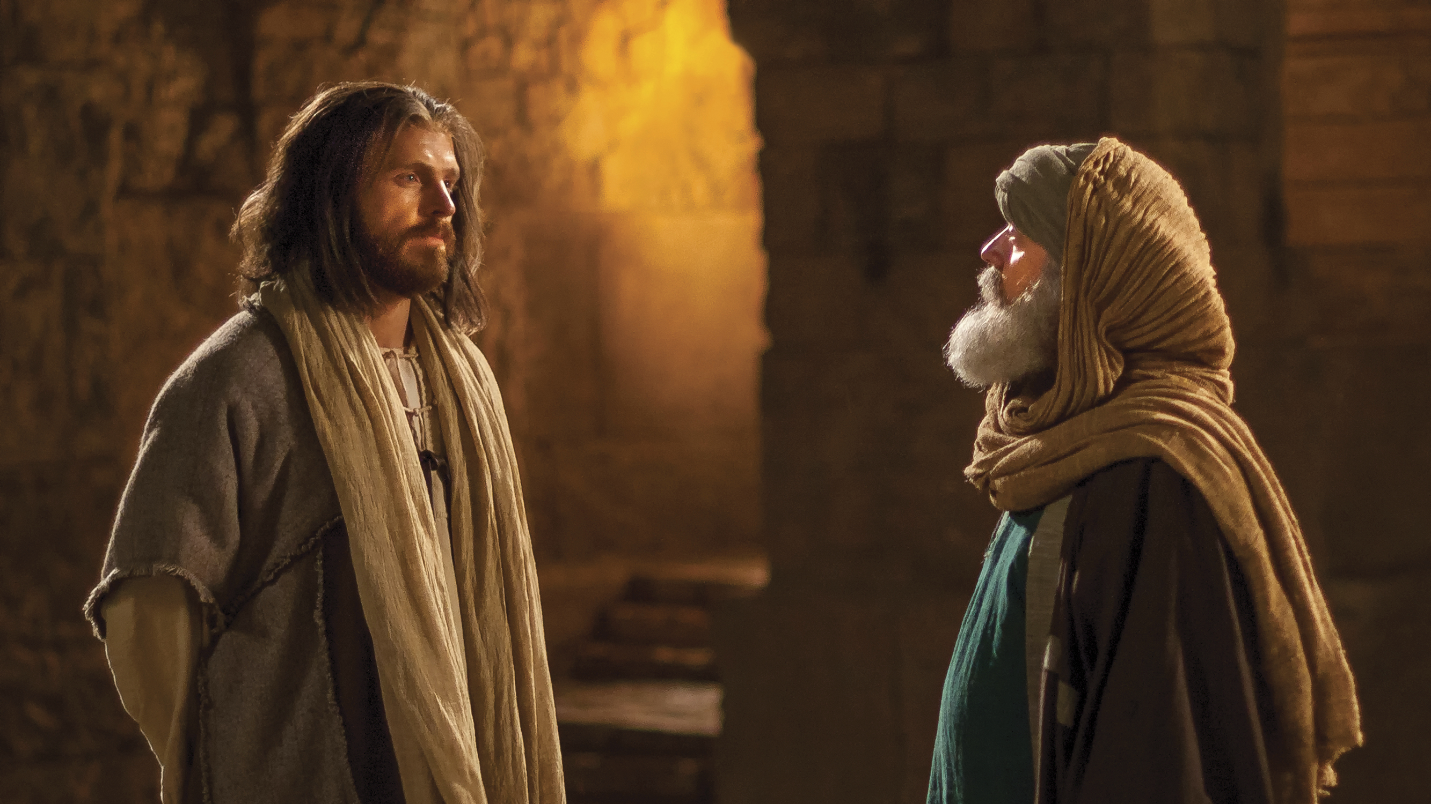
John 3:1-21 Jesus and Nicodemus
Who is Jesus?

Slide 11
John 3:1-21 Jesus and Nicodemus
Jesus’ interviews: a pattern
Jesus makes an enigmatic statement which provokes thought
Confusion
Jesus explains the statement
Jesus identifies himself

Slide 12
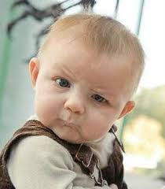
John 3 Nicodemus John 4 Samaritan Woman
John 3 The insider believes
John 4 The outsider believes
Nicodemus: Let’s have a spiritual conversation.
Jesus: You must be born again!

Slide 13
You Must Be Born Again
Truly I tell you, unless you are born again of the water and of the spirit, you will never enter into the kingdom of God.
Nicodemus: How can this be?
Jesus: You are Israel’s teacher, and you do not know Ezekiel 36:24-28? (Acts 2:36-38)

Slide 14
John 3:10-13
v. 11 We testify to what we have seen.
Jesus is talking about John the Baptist and his disciples baptizing people.
v. 12 Now I will speak of heavenly things.
The Son of Man came to reveal these greater things.

Slide 15
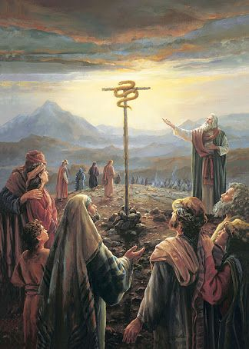
John 3:16
Numbers 21:7-9
Just as Moses lifted up the snake in the wilderness, so the Son of Man must be lifted up.

Slide 16
Jesus Must Be Lifted Up
a. The snake in the desert by Moses.
b. Jesus on the cross.
c. Jesus lifted from the grave.
d. Jesus lifted up (ascended) to heaven.
e. We lift Jesus up as we share our faith in him.
f. So we, too will be lifted up to heaven, as Jesus was lifted up.

Slide 17
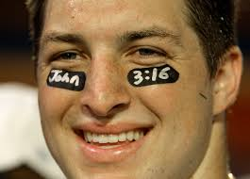
John 3:16
For God loved the world in this way: He gave his One and Only Son, so that everyone who believes in him will not perish, but have eternal life.
Tim Tebow

Slide 18
John 3:16-21 Stark Contrasts!
v. 16 perish vs have eternal life
v. 18 condemned already vs not condemned
v. 19 darkness vs light
Where is the grey area?

Slide 19
Come Into the Light!
Are there any deeds that you have been keeping in the darkness?
Bring it out into the light!!! Today!!!

