Slide 1
Christianity and Culture: Christianity in a Post-MODERN Age John Oakes 2013 ICEC

Slide 2
Christianity and Postmodernism: Friend or Foe?
The good news is that secular humanism is on the way out. The bad news is that something worse is taking its place. That something worse is called postmodernism. -David McAlister
Evangelicals have often uncritically accepted the modern view of knowledge despite the fact that at certain points the postmodern critique is more in keeping with Christian theological understandings -Stanley Grenz A Primer on Postmodernism

Slide 3
Our Outline
What is Modernism and why has it been rejected by most intellectuals?
What is Postmodernism?
Postmodernism and Culture
A Christian Response to Postmodernism

Slide 4
A Very Brief Intellectual History
Pre-modern
Age
Modern
Age
Post-modern
Age
Rationalism breeding skepticism
Relativism breeding situationism

Slide 5
The seismic shift
Pre-modern | Modern | Post-Modern
Belief in divinity | Ambivalent about divinity | Divinity as self-expression
Conviction is virtue Tolerance is evil | Rationality is virtue | Tolerance is virtue Conviction is bad
Authority is God | Authority is logic and science | Authority is self or the group
Change brought about by adherence to a standard | Change brought about by what is rational | Change contingent on self-expression and culture

Slide 6
A Slightly More Detailed Outline
Pre-modern: Catholicism
Renaissanace/Humanism: Protestantism
Early Modernism/Enlightenment Age of Reason
Late Modernism: Deism and Skepticism
Postmodernism

Slide 7
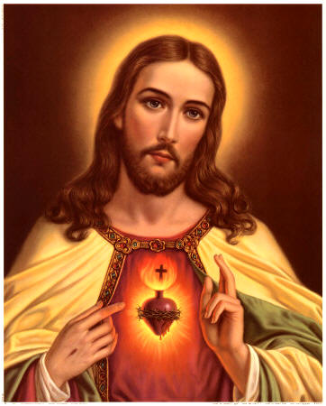
Pre-Modern Age
Middle Ages
Christendom
Knowledge based on faith and authority
Anselm of Cantebury “I believe in order to know.”
Emphasis on corporate rather than individual
Late Middle Ages: Scholasticism and Aristotle

Slide 8
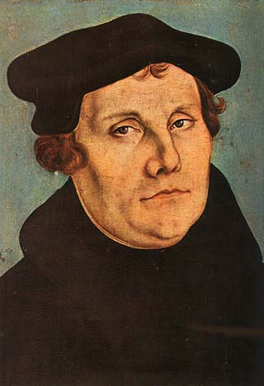
Renaissance and Reformation
More emphasis on the value of the individual
Led to the Reformation
Led to the Scientific Revolution and to Modernism

Slide 9
The Scientific Revolution and the turn to Modernism
Copernicus, Kepler and Galileo
Francis Bacon and Empiricism
Nature, to be commanded, must be obeyed.
The end of our foundation is the knowledge of causes, and secret motions of things; and the enlarging of the bounds of human empire, to the effecting of all things possible". Humans will conquer nature.
From knowledge comes power.

Slide 10
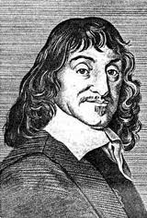
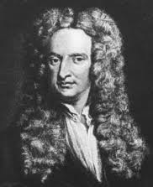
The Birth of Modernism
Rene Descartes: Rationalism. I think, therefore I am. Reason is king.
Isaac Newton: Principia
The Mechanical Universe. Do we need God any more?

Slide 11
Modernism
The autonomous rational human of Descartes meets the mechanical universe of Newton.
Modernism is essentially optimistic
Knowledge is objective, good, and accessible to humans
Human reasoning is the ultimate authority for truth.

Slide 12
The Enlightenment
The Age of Reason
Using Reason we can ask and answer all important questions.
Elevates the role of the individual and the value of personal freedom (John Locke)
How would that have impacted Christianity?

Slide 13
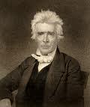
Modernism and Christianity
The “Restoration Movement” is a good example of Modernist Christianity
Common Sense Philosophy
Command, Example, Necessary Demonstration
Scientifically analyze the Bible
Weak on principles
Strong doctrinal orientation
Alexander Campbell

Slide 14
Characteristics of a “Modern” Church
Stresses doctrine over practice. Either/or approach to truth.
Stresses individuality over corporate aspects of Christianity.
Right belief leads to right practice.
Rejects superstition, minimizes the miraculous and the influence of the Holy Spirit.

Slide 15
Characteristics of a “Modern” Church
More sectarian, less ecumenical because of the influence of propositional truth. More judgmental.
Emphasis on preaching more than worship
Relies on evidence, a stronger emphasis on verbal inspiration of the Bible
The ICOC is a modern, not a postmodern church movement

Slide 16
The Death of Modernism
Modernism is not dead, by the way, but….
WWI, WWII, Hiroshima
Exposure to alternative world views from the East—Western mindset is not the only powerful one.
Pessimism and Rejection by most of Modernism.

Slide 17
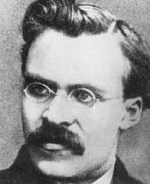
Rise of (Intellectual) Postmodernism
Nietzche (1844-1900): God is dead. Truth is dependent on language. Truth is created not discovered.
Reject the correspondence theory of truth: A proposition is “true” if it corresponds to or is consistent with reality.

Slide 18
Martin Heidegger (1884-1976)
Rejects correspondence theory of truth
Truth is relational
Truth is found in culture, narrative, not facts

Slide 19
The Big Three: Foucault, Derrida and Rorty
Michael Foucault: Truth is a fabrication or a fiction. Science is an ideology. History has no objective meaning. It is socially produced. Truth is social.
Jacques Derrida: Reading is a violent act of mastery over the text. Invented deconstruction.
Richard Rorty: Truth a matter of human convention. Truth is found in coherence rather than correspondence.

Slide 20
Postmodern Thinking
Postmoderns have no worldview (except the view that there is no correct worldview)
Truth is found in the community, not in the individual.
Postmodernism rejects ontological truth and metanarritives. (in other words it accepts relativism)
The goal of postmodern scholarship is to “deconstruct” beliefs such as Christianity—to find out where it came from—to destroy its violent metanarrative—to make it meaningless.
The distinction between truth and fiction nearly vanishes

Slide 21
Postmodernism and Culture
Postmoderns prefer difference to uniformity heterogeneity to homogeneity
Postmoderns prefer the local to the universal “Think globally, act locally”
Postmoderns value the community over the individual.
Postmodernist is not searching for truth but collecting experience.
Current pop culture is a reflector of postmodern thinking.
The Postmodern values the eclectic.
The postmodern values, above all, diversity and tolerance.

Slide 22
Strengths of Postmodernism
1. Celebrates cultural and other kinds of diversity.
2. Open-minded.
3. Tolerant (generally but not always a good thing).
4. A more accurate view of history than the modern view.
5. Open to Eastern and other ways of thinking. Not married to Western as the only good way of thinking.
6. Celebrates relationships and community.
7. Refutes the false and prideful claims of Modernism— especially the idea that humans can discover truth.

Slide 23
Weaknesses of Postmodernism
1. Denies the existence of truth when truth is real. Its most basic premise is simply not true.
a. Surely science is on to something.
2. Circular reasoning. Are you absolutely sure there is no absolute truth?
3. No moral compass. This is scary!
4. Dismisses the role of the revolutionary, the idealist (for example Jesus)
5. Reduces the importance of the individual. Reduces human dignity.

Slide 24
Postmodernism and Christianity
Christianity clearly includes propositional truth!
Jesus: Your Word is Truth. (John 17:17)
Christianity tells us history IS a story. God reveals himself in history.
Postmodernists: There is no center. No metanarative
Christianity: Jesus is the center. Jesus/salvation is a metanarative
Postmodernism can be a helpful critique to modernist approach to scripture but it rejects the idea that a scripture has a single interpretation (2 Peter 1:21). This is absolutely unacceptable in the Christian context.

Slide 25
Strengths of Postmodernism for Christianity (yes, there are some!)
Allows us to recognize that in Christianity which is not strictly rational. Helps us to appreciate that which is “mysterious” in Christianity.
Helps us to know that principles have different applications in different cultures.
Helps us to recognize that much of what we call Christianity is really just Americanity/Westernism—viewed through this lens
Helpful in hermeneutics—to recognize influence of culture and world view on scripture.

Slide 26
Positives (cont.)
Rightly points out that the Enlightenment ideal of discovering universal truth through rational analysis is not realistic.
Helps us to understand why not all will interpret the Bible the same. It will help us to be less judgmental when this might be a good idea.
Helps us to appreciate and celebrate the communal aspects of Christianity and to defeat the hyper individualism which has crept into the Church.
Helps us to remember the need to do social good, to help and be involved in our communities.

Slide 27
Characteristics of the Postmodern Church
1. Ecclectic. More open to a wide variety of ideas and beliefs.
2. More interested in community and relationships than in individual faith.
3. More socially aware and more oriented toward social justice.
4. Less interested in doctrine.

Slide 28
The Postmodern Church: A Case Study The Emerging Church
1. Reject propositional truth. Avowedly antidogmatic. Value broad-mindedness.
2. A response to dogmatic “modern” and fundamentalist Christianity and a response to the megachurch movement.
3. Reject leadership and authority. Spontaneous worship services. Judges 17:6 (also Judges 21:25): “In those days Israel had no king; everyone did as he saw fit.”
4. Both/and rather than either/or approach to truth.
5. Avowedly postmodern

Slide 29
The Emerging Church (cont.)
6. Emphasize life over truth orthopraxy over orthodoxy. Your life is a measure of your religion, not your beliefs.
7. Non judgmental. Christianity not primarily about salvation but about living correctly. Christianity more about a journey than a destination.
8. Strong emphasis on social justice.
9. Lean more left politically than evangelicals.

Slide 30
Quotes
“Christianity should be presented through loving attitudes rather than through doctrines.” “It is not what we believe that matters; it is what we do in serving others.” “The Bible is intended to teach us through narratives lessons about life, not through statements of propositional truth.”
No matter what the weaknesses of the emerging churches may be, reactions to traditional religion are not only understandable, they are called for by the teachings of the Bible itself! The question is whether the reactions of the Emerging Church are in fact biblical reac­tions producing biblical directions. Therein lay the deeper problems with this emerging movement. Gordon Ferguson.

Slide 31
Advice for Interacting with the Postmodern World
Remember, neither Modernism nor Postmodernism is the enemy. Satan is the enemy.
We need to be well aware of how the postmodern mind thinks and be prepared to correct this thinking where that is needed.
We need to consider how we can adapt what we do to make Christianity more appealing to the postmodern person (without, of course, in any way watering down the truth!!!!!!!) We need to think about how the Christian message resonates with the postmodern person.

Slide 32
Positive Responses to Help Make Church More Attractive to the Postmodern Mind
Emphasize service to the community—especially group outreach.
Include a variety of kinds of music and cultural influence in how you do church.
Emphasize the communal and relational aspects of Christianity in your outreach.
Be prepared to deconstruct the deconstruction mindset. Be prepared to identify and correct postmodern tendencies which are destructive to Christianity.
While stressing servant leadership and multiple points of view, explain the need for strong leadership and organization for the church to be effective.
Although doctrine is important and it must be taught carefully and emphasized, doctrine will not be what draws the postmodern person in to church. The same can be said for classic apologetics.
Remember repentance is not a group activity. Personal, individual reflection and repentance for individual sins is required for salvation.

Slide 33
Summary
Watch your life (postmodernism) and your doctrine (modernism) closely. Persevere in them, for if you do so, you will save both yourself and your hearers (1 Tim 4:16)

