Slide 1
A Question….
What is the most common word or expression used in the New Testament for a person who is saved?

Slide 2
A Question….
What is the most common word or expression used in the New Testament for a person who is saved?
Saved?
Christian? Disciple?
Forgiven?

Slide 3
The Answer….
In Christ
In Christ, in Him, In the Lord 164 times in Paul alone.

Slide 5
You Were Outside of Christ at One Time
Ephesians 2:1-3 You were dead in your sins… You were by nature an object of wrath.
Ephesians 2:12 You were separate from Christ, excluded from citizenship in Israel and foreigners to the covenants of promise, without hope and without God in the world.
This was not good!

Slide 6
If We are in Christ, How and when did we get into Christ?
Gal 3:26 Baptized into Christ
Romans 6:4 Baptized into Christ
Believe into Christ?
Repent into Christ?
Pray into Christ?
Matthew 22:11-13
How do you get in there?
You were out here

Slide 7
So… What do we have in Christ?
Eph 1:7, Coll 1:14 Redemption in Christ
John 8:34-35
Hosea 2:5, Hosea 3:1-3
1 Cor 6:20 bought at a price
1 Cor 1:2 Sanctified/Saints in Christ
Philippians 1:1 Holy people in Christ Jesus

Slide 8
Already But Not Yet
We were made these things.
We are being made these things.
We will be made these things.
We have been made holy.
We are being made holy.
We will be made holy.
God sees us as he is making us!!!!!!

Slide 9
Righteous in Christ
Mark 10:17-19 No one is good.
Romans 3:9-12 No one is righteous; not even one.
God made him who had no sin to be sin for us, so that in him we might become the righteousness of God. (2 Corinthians 5:21)
Challenge: Let us become what he has made us: Let us live righteously.

Slide 10
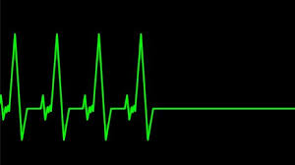
Alive in Christ
Eph 2:1-4 You were dead in your sins, but God made you alive.
Romans 6:8-11
1 Corinthians 15:20-22
Challenge: What are you going to do with the second chance that God has given you?

Slide 11
New Creation in Christ
Therefore, if anyone is in Christ, there is a new creation; old things have passed away and look, new things have come. Everything is from God, who reconciled us to Himself through Christ and gave us the ministry of reconciliation: That is, in Christ, God was reconciling to the world to Himself, not counting their trespasses against them, and He has committed the message of reconciliation to us. (2 Corinthians 5:17–19 HCSB)
Challenge: How can you live a renewed life?

Slide 12
No Condemnation in Christ
Therefore, there is now no condemnation for those who are in Christ Jesus, because through Christ Jesus the law of the Spirit who gives life has set you free from the law of sin and death. (Romans 8:1–2)
Isaiah 1:18
Challenge: Now that you are exonerated, what will you do with the life you have regained?

Slide 13
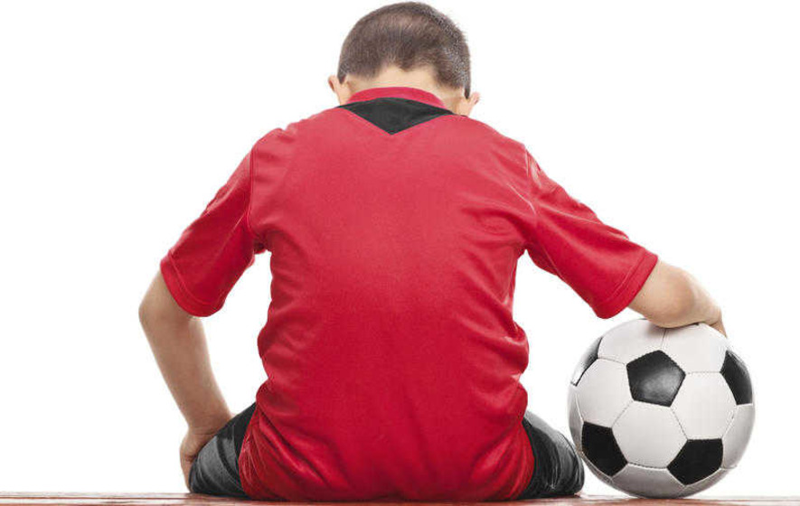
In Christ We are Chosen by God
For he chose us in him before the creation of the world to be holy and blameless in his sight. (Ephesians 1:4)
GOD CHOSE YOU!

Slide 14
Chosen! Included!
In him we were also chosen, having been predestined according to the plan of him who works out everything in conformity with the purpose of his will, in order that we, who were the first to put our hope in Christ, might be for the praise of his glory. And you were also included in Christ when you heard the message of truth, the gospel of your salvation. (Ephesians 1:11-13)

Slide 15
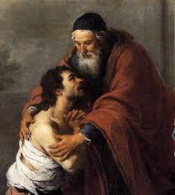
If You Have Strayed, God Wants You Back
This is what the Lord says: “What fault did your ancestors find in me, that they strayed so far from me? They followed worthless idols and became worthless themselves.” (Jeremiah 2:5)

Slide 16
Challenge
If you have been straying, Return to him and let him choose you again. God wants to say to you, “Well done, good and faithful servant.”
To the faithful:
Revel in the fact that God has chosen you and live a chosen life—one dedicated to pleasing his/her master.

Slide 17
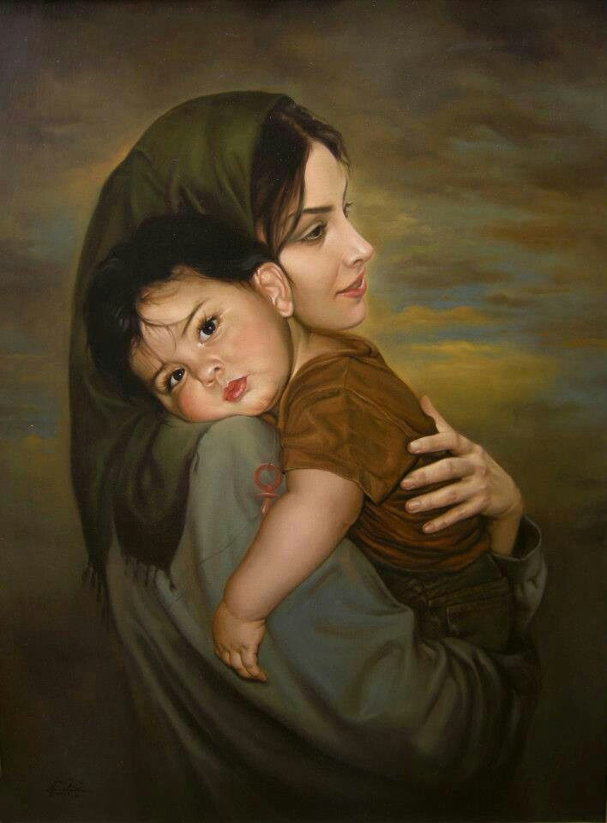
We Are Children of God in Christ
So in Christ Jesus you are all children of God through faith, for all of you who were baptized into Christ have clothed yourselves with Christ. (Galatians 3:26)

Slide 18
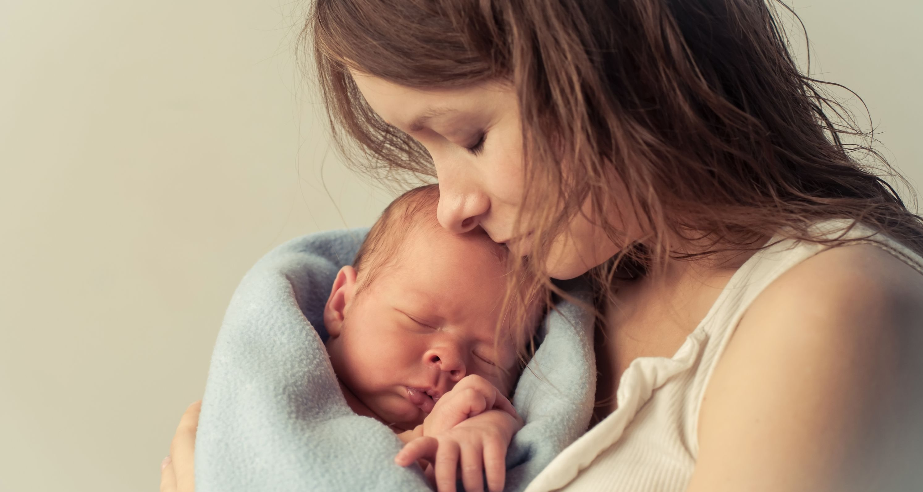
God: I will never forget you!
Can a mother forget the baby at her breast and have no compassion on the child she has borne? Though she may forget, I will not forget you! (Isaiah 49:15)

Slide 19
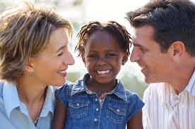
God Wants to Adopt You
For he chose us in him before the creation of the world to be holy and blameless in his sight. In love, he predestined us for adoption to sonship through Jesus Christ, in accordance with his pleasure and will—to the praise of his glorious grace, which he has freely given us in the One he loves. (Ephesians 1:4-6)

Slide 20
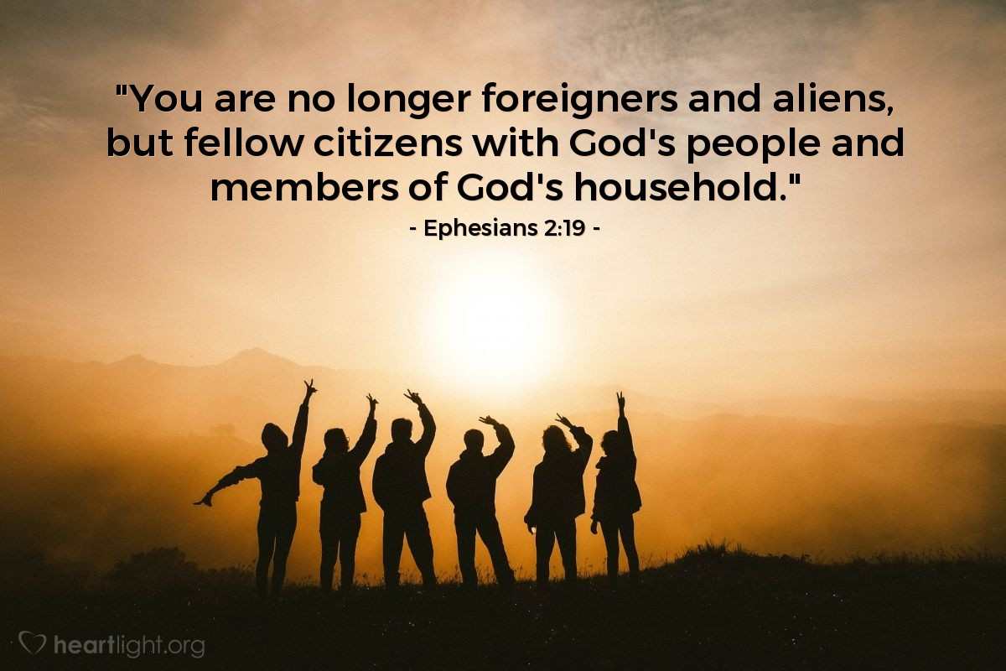
Members of God’s Household
household.

Slide 21
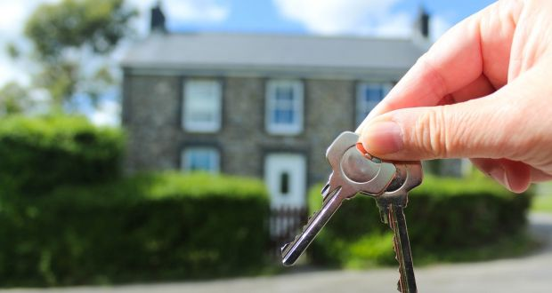
We Get the House
“Now if we are children, then we are heirs—heirs of God and co-heirs with Christ.” (Romans 8:16-17)

Slide 22
Privileges and Obligations
Challenge: Being part of a family has his privileges, but it also has its obligations. Are you taking on the obligations as well as the privileges that come with being part of God’s family?

Slide 23
We Have Secure Love in Christ
Security is one of the most basic of human needs.
It is a “bare necessity”

Slide 24
Secure Love
For I am convinced that neither death nor life, neither angels nor demons, neither the present nor the future, neither height nor depth, nor anything else in all creation will be able to separate us from the love of God that is in Christ Jesus our Lord. (Romans 8:38-39)

Slide 25
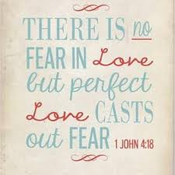
What Scares You?
Death
Demons/Evil
The Past
The Future
Philippians 1:21-26

Slide 26
Challenge
Challenge: What are you doing in your life which is “risky” because you have a secure love in Christ. What is your security in Christ allowing you to do that you would not otherwise have done?
We have secure love in Christ.

Slide 27
We have eternal life in Christ Jesus
But now that you have been set free from sin and have become slaves of God, the benefit you reap leads to holiness, and the result is eternal life. For the wages of sin is death, but the gift of God is eternal life in Christ Jesus our Lord. (Romans 6:22–23)
We were “dead in our sins and in the uncircumcision of our flesh” (Colossians 2:13).
And this is the testimony: God has given us eternal life, and this life is in his Son. (1 John 5:11)

Slide 28
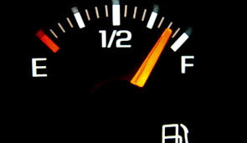
Eternal Life = Full Life
John 10:10 Jesus came that we might have life, and have it to the full.
Philippians 1:22 Fruitful labor.
2 Corinthians 5:18-20 Ambassadors, Ministers of reconciliation.
Mark 10:29-30 One hundred-fold blessing

Slide 29
Eternal Life
“Look! God’s dwelling place is now among the people, and he will dwell with them. They will be his people, and God himself will be with them and be their God” (Revelation 21:3).

Slide 30
Challenge
Let us embrace the full life we have now as a foreshadow of the eternal life we will have in heaven.
Let us do so by embracing the “fruitful labor and service” and acting as a “ministers of reconciliation.”

Slide 31
Peace With God in Christ Jesus
Do not be anxious about anything, but in every situation, by prayer and petition, with thanksgiving, present your requests to God. And the peace of God, which transcends all understanding will guard your hearts and your minds in Christ Jesus. (Philippians 4:6–7)

Slide 32
Justified = Aligned With
Romans 5:1 “Therefore, since we have been justified by faith, we have peace with God through our Lord Jesus Christ”
Lack of conflict Isaiah 11:6-9
Lack of fear Matthew 6:25, John 14:27
This peace is “already but not yet.”

Slide 33
Challenge
Let us embrace the peace of God by
prayer and by
“not giving a thought to our lives.”

Slide 34
Fullness of God in Christ
For in Christ all the fullness of deity lives in bodily form, and in Christ you have been brought to fullness. (Colossians 2:9–10)
1. The fullness of deity is in Christ.
2. In Christ we have fullness—We become like Christ.

Slide 35
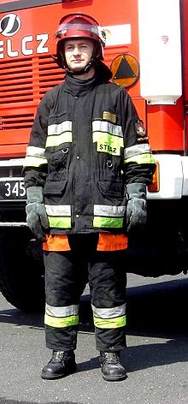
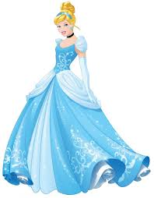
Question:
What is the best version of you that you can imagine?

Slide 36
Imagine this!
Imagine becoming like God!!!!
. “God said, let us make mankind in our image, in our likeness… So God made mankind in his own image, in the image of God he created them; male and female he created them” (Genesis 1:26–27).
God is love, and the one who remains in love remains in God, and God remains in him. In this, love is made complete with us so that we may have confidence in the day of judgment, because as he is, so also are we in this world. (1 John 4:16–17 CSB)

Slide 37
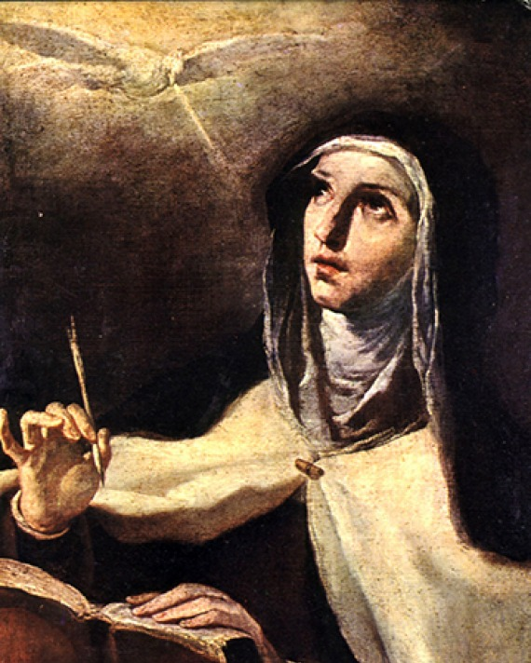
Theresa of Avila (1515–1582)
Christ has no body now but yours,
No hands, no feet on earth but yours.
Yours are the eyes through which He looks
Compassion on this world.
Yours are the feet with which He walks to do good.
Yours are the hands through which He blesses all the world.
Yours are the hands, yours are the feet,
Yours are the eyes, you are His body.
Christ has no body now on earth but yours.

Slide 38
The Aroma of Christ
Who, me? Yes, you.
2 Corinthians 2:15
2 Corinthians 3:3
2 Corinthians 4:10–11
2 Corinthians 4:16
2 Corinthians 3:12–13, 16–18

Slide 39
Challenge
Let us present our bodies as living sacrifices so that God can transform us by the renewing of our mind. (Romans 12:1-2)
Eternal Life in Christ
Peace of God in Christ
Fullness/Christlikeness in Christ

Slide 40
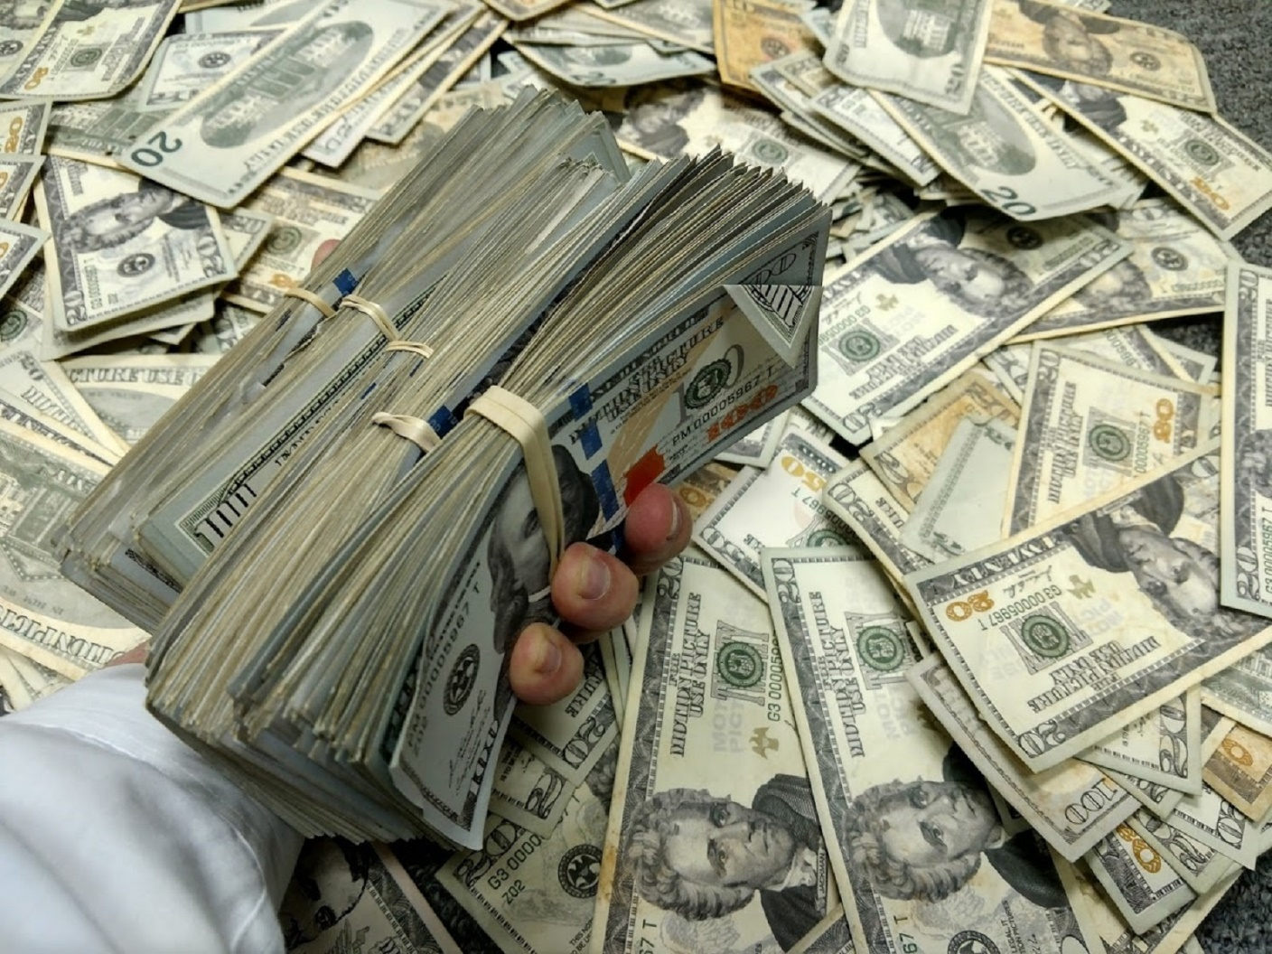
We Have Surpassing Worth in Christ
0.00000012%
$3.50
1972 Ford Pinto $200,000
Phil 3:5-11
< 0 “garbage”

Slide 41
Phil 3:8 Overwhelming gain
2 Cor 5:20 ambassadors
Rom 8:17 co-heirs with Christ
1 Cor 6:3 we will judge angels

Slide 42
Precious!
Isaiah 49:16 See, I have engraved you on the palms of my hands….
Exodus 19:5 …out of all the nations you will be my treasured possession.
Matt 10:29-31
1 John 3:1

Slide 43
Challenge
Let us treat our bodies, our time, our energy, our purity, our relationships as being of surpassing worth.

Slide 44
We Are All One in Christ
Gal 3:26-28 So in Christ you are all children of God through faith, for all of you we were baptized into Christ have clothed yourselves with Christ. There is neither Jew nor Gentile, neither slave nor free, nor is there male and female, vor you are all one in Christ Jesus.

Slide 45
What Do We Have in Common?
Christ
What is our uniform?
Christ

Slide 46
One in Christ
Matt 5:14-16 A city on a hill…
Micah 4:1-3 Many nations…
Zechariah 8:23 All languages and nations
Psalm 133 How good and pleasing it is…
John 17:23 …may they be brought to complete unity

Slide 47
Challenge
Let us celebrate and maintain our unity of culture, race and generations.
Let us build stronger bridges between generations and the cultures we have not yet reached.

Slide 48
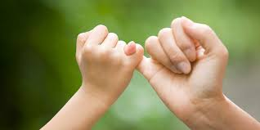
All the Promises of God Find Their ‘Yes’ in Christ
But as surely as God is faithful, our message to you is not “Yes” and “No.” For the Son of God, Jesus Christ, who was preached among you by us—by me and Silas and Timothy—was not “Yes” and “No,” but in him it has always been “Yes.” For no matter how many promises God has made, they are “Yes” in Christ. (2 Corinthians 1:18–20a)

Slide 49
Promises, Promises
“You will be for me a kingdom of priests and a holy nation” (Exodus 19:6)
“I will be their God, and they will be my people” (Jeremiah 31:33).
“I will forgive their wickedness and will remember their sins no more” (Jeremiah 31:34).
“I will sprinkle clean water on you, and you will be clean... I will put my Spirit in you and move you to follow my decrees and be careful to keep my laws” (Ezekiel 36:25–27).

Slide 50
And Still More Promises
Heb 13:5, Deut 31:6 “Never will I leave you; never will I forsake you.”
Matthew 28:20 Surely I am with you always, to the very end of the age.
John 11:25-26 “I am the resurrection and the life. The one who believes in me will live, even though they die; and whoever lives by believing in me will never die.”
Isaiah 54:10
“Though the mountains be shaken and the hills be removed,
yet my unfailing love for you will not be shaken nor my covenant of peace be removed.” (Isaiah 54:10)

Slide 51
Abraham Believed God’s Promises
Romans 4:18-22 Against all hope, Abraham in hope believed and so became the father of many nations, just as it had been said to him, “So shall your offspring be.” Without weakening in his faith, he faced the fact that his body was as good as dead—since he was about a hundred years old—and that Sarah’s womb was also dead. Yet he did not waver through unbelief regarding the promise of God, but was strengthened in his faith and gave glory to God, being fully persuaded that God had power to do what he had promised. This is why “it was credited to him as righteousness.”

Slide 52
Challenge
Let us believe God’s promises without wavering in unbelief so that God can deliver on his promises.

Slide 53
You Have Every Spiritual Blessing in Christ
Eph 1:3 Praise be to the God and Father of our Lord Jesus Christ, who has blessed us in the heavenly realms with every spiritual blessing in Christ.

Slide 54
hesed
hesed.
lovingkindness, mercy, loyalty or faithfulness.
Covenant love. Loyal love, in which everyone involved looks out for the best interest of the others, not self.
The love Ruth had for Naomi.
The love God has for us.
Malachi

Slide 55
Every Spiritual Blessing
Old Testament: Primarily Physical Blessings
(Deut 30:9, 19-20)
New Testament: Primarily Spiritual Blessings

Slide 56
Spiritual Blessings
Value
Purpose
Security
Love, Intimacy
Hope

Slide 57
Challenge
Let us embrace hesed. Let us have a loyal covenant-love for God so that he can do what he wants as our father—to give us an abundant life and every blessing in Christ.

Slide 58
The Mystery of God Is Revealed in Christ
What is the meaning of life?
Does history have a purpose and a direction, or is everything random?
Where is truth to be found?
Who holds the keys to the great mysteries of life?
Deut 29:29, 1 Pet 1:10-12

Slide 59
Mystery Revealed
Colossians 1:25-27
I have become its servant by the commission God gave me to present to you the word of God in its fullness—the mystery that has been kept hidden for ages and generations, but is now disclosed to the Lord’s people. To them God has chosen to make know among the Gentiles the glorious riches of this mystery, which is Christ in you, the hope of glory.
The Mystery? Christ in You!

Slide 60
Mystery
Colossians 2:2-3
My goal is that they may be encouraged in heart and united in love, so that they may have the full riches of complete understanding, in order that they may know the mystery of God, namely, Christ, in who are hidden all treasures of wisdom and knowledge.

Slide 61
Questions Answered
What is my purpose? To become like Him, to give Him glory.
What is the meaning of life? For to me, to live in Christ.
What is my value? Jesus died for you.
Where am I going? Eternal life with God (if you are in Christ)
What is God’s will for my life? That all people be saved
Who am I? A child of God.

Slide 62
Challenge
Let us, as ambassadors, make this mystery known to as many as possible, which is Christ in us, the hope of glory.

Slide 63
The Reality of Christ is Found in Christ
Colossians 2:16-17 Therefore do not let anyone judge you by what you eat or drink, or with regard to a religious festival, a New Moon celebration or a Sabbath day. These things are a shadow of the things that were to come; the reality, however, is found in Christ.
Heb 8:3-6 They serve at a sanctuary that is a copy and shadow of what is in heaven.
Heb 10:1 Heb 10:1 “The law is only a shadow of the good things that are coming—not the realities themselves”

Slide 64
A Copy hupodeigma

Slide 65
A Shadow skia

Slide 66
Challenge
Challenge: Let us go for the real thing. Let us throw of being religious and embrace the reality of life in Christ with all that entails.

Slide 67
We Have the Promised Holy Spirit in Christ
Ephesians 1:13-14 And you also were included in Christ when you heard the message of truth, the gospel of your salvation. When you believed, you were marked in him with a seal, the promised Holy Spirt, who is a deposit guaranteeing our inheritance until the redemption of those who are God’s possession—to the praise of his glory.

Slide 68
A Deposit, Guaranteeing our Inheritance
Acts 2:38 Peter replied, “Repent and be baptized, every one of you, in the name of Jesus Christ for the forgiveness of your sins. And you will receive the gift of the Holy Spirit. The promise is for you and your children and for all who are far off—for all whom the Lord our God will call.”
Gal 3:26 Baptized into Christ = clothed with Christ
= receive the Holy Spirit

Slide 69
Challenge
Let us live holy lives and not quench the Spirit (1 Thess 5:19)
Let us keep in step with the Spirit (Gal 5:25)

Slide 70
Freedom in Christ

