Slide 1
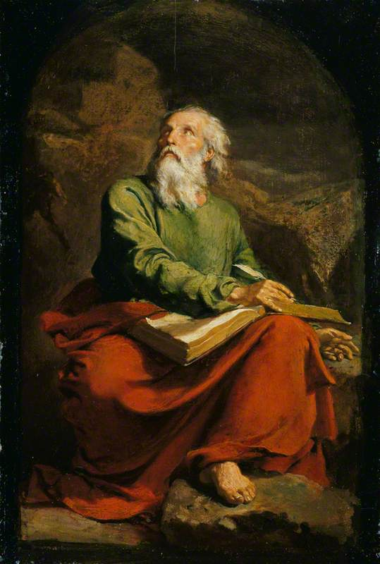
The Book of Isaiah The Lord Is Salvation
John Oakes
March, 2021

Slide 2
Isaiah Timeline
732 BC Syro/Ephriamite War (Isaiah 7, 2 Kings 15) Ahaz unfaithful.
722 BC Ephraim/Samaria destroyed by Assyria under Shalmaneezer V
701 BC Sennacherib takes Judah, puts Jerusalem under siege. Isaiah 1:7 Hezekiah faithful.

Slide 4
Tiglath- Pileser (Pul) standing with driver. (British Museum)

Slide 5
More Historical Context
Tiglath-pileser III 745-727 BC 2Kings 15:19-20 - known as Pulu in Babylon or Pul in Israel. Syro/Ephraim War, Jezreel.
Shalmaneezer V 727-722 BC Hosea 10:14, 2 Kings 17 Began destruction of Israel.
Sargon II 722-705 BC 2 Chronicles 28:1-27
Finished destruction of Samaria/Northern kingdom.
Sennacherib 705-681BC 2 Chronicles:29-33, Is 36:1-7, 37:21,35-37 - constant threat to Judah under king Hezekiah

Slide 6
Worth Noting
Isaiah contains 111 separate predictions. Of the 1,292 verses in the book, 754 (59%) deal with future events.
Forty-seven chapters of this book were directly quoted or alluded to by Christ or the Apostles. With more than four hundred allusions, Isaiah stands second only to Psalms as the most cited book in the New Testament.

Slide 7
Isaiah I and Isaiah II? (Deuteroisaiah)
Isaiah Ch 1-38 primarily about Assyria (the present)
Isaiah Ch 39-55 primarily about Babylon and Persia (the near future)
Isaiah Ch 56-66 is about the whole world and the kingdom of God. (the distant future)
But there is a strong unity of theme and even literary style. We will treat it as the result of one author.

Slide 8
One Outline of Isaiah
Isaiah 1-39 Messiah the king -Assyria
Isaiah 40-55 Messiah the Servant -Babylon
Isaiah 56-66 Messiah the Conqueror -World

Slide 9
Another Outline of Isaiah
God Judges the Nations (Ch. 1-35)
God Comforts his People (Ch. 36-48)
God’s Prince of Peace (Ch. 49-57)
God’s Program for Salvation (Ch. 58-66)

Slide 10
Themes of isaiah
1. The utter sinfulness of Judah and Jerusalem
2. Appeal of God to turn to him—to repent.
3. Judgment if they do not.
4. The Messiah—the Suffering Servant—is coming to save.
5. Restoration of a Remnant

Slide 11
Subthemes
God rules the nations.
The glory of the Lord.
Social Justice

Slide 12
Isaiah ch. 1-5 Intro to Isaiah
Isaiah 1 themes
The utter sinfulness of Jerusalem/Judah (v 3-8)
Tender appeal by Jehovah that Judah repent (v. 16-19)
The inevitability of judgment (v. 24-25, 29-31)
The possibility of salvation (v. 26-27)

Slide 13
Isaiah 1:2-4
Isaiah 1:2 A courtroom scene, with Judah as defendant and the heavens and earth as witnesses.
(Deut 30:19)
v. 2-4 God: I have always maintained hesed. I have been like a parent with its children (Hos 11:1-4)
But we have rebelled. We are worse than dumb animals.
v. 3 yada know intimately
My people (ammi as opposed to Lo-Ammi Hos 1)

Slide 14
ISAIAH 1:4-9
Would Judah agree with the assessment in 1:4?
Would you?
Isaiah 1:5-8 God’s compassion.
Isaiah 1:7 is literally true at this time for Judah under Sennacherib.
Isaiah 1:9 Hope. The remnant.
Remnant theology: Isaiah 10:20-23 Zeph 2:7-11, Hos 11:8-11, Ezek 5:1-3

Slide 15
Isaiah 1:10-20 God is angry repent!
Isaiah 1:10-15 God is very angry. Why? Empty religion without faithfulness/hesed.
v. 13 Could our worship become “worthless assemblies?”
Isaiah 1:16-17 Repent. How? By seeking justice.
Isaiah 1:18-20 Come, let us reason together. God offers salvation.
We can willingly obey or we can resist and rebel.

Slide 16
Though your sins are like scarlet

Slide 17
Isaiah 1:21-31
Isaiah 1:21-23 No more justice. The rich get richer. Does that sound familiar?
v. 24-25 Therefore, wrath.
v. 26-27 Hope. Zion—the Kingdom will be delivered.
v. 29-31 The idols will be destroyed.

Slide 18
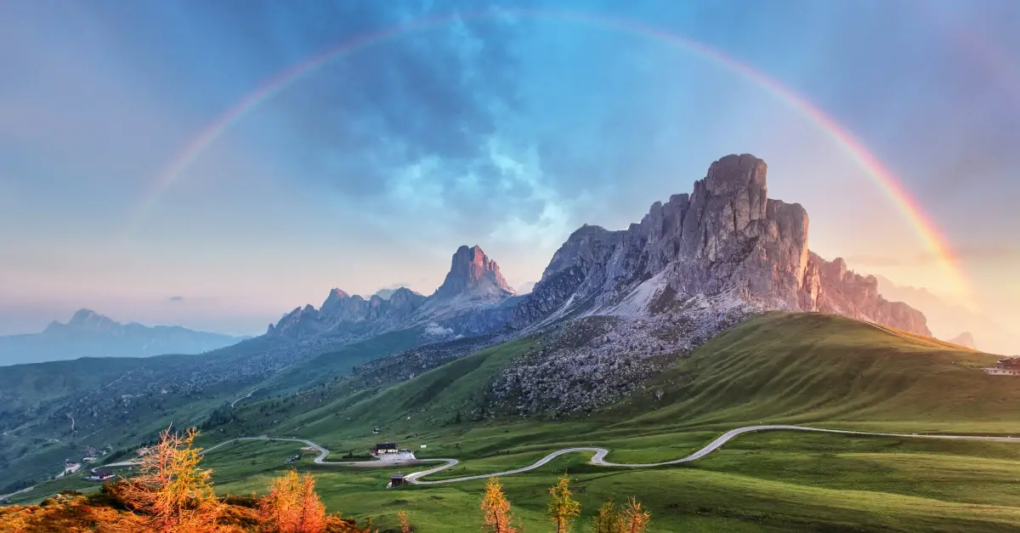
Isaiah 2:1-5 A Kingdom prophecy
Isaiah 2:2 In the last days Heb 1:2, Acts 2:17, Joel 2:28-32
The mountain of the Lord is Mt. Zion/Jerusalem/the kingdom of God (and maybe even the Church).
v. 3 Pentecost.
v. 4 Inscribed at the UN.

Slide 19
Kingdom Prophecies
1. The future temple which attracts Gentiles (2:2–4).
2. The glorious Branch (4:2–6).
3. The virgin birth of Immanuel (7:13–14).
4. The dawning of a new day in the birth of a child (9:1–7).
5. The Shoot of the stem of Jesse (11:1–10).
6. The conversion of Gentiles (19:18–25).
7. The new Jerusalem (54:9–13; 60:19–22).

Slide 20
Isaiah 11:1-12:6 Another kingdom prophecy
Isaiah 11:1 A root, a branch of Jesse nazer
Matthew 2:23 He will be called the nazerene

Slide 21
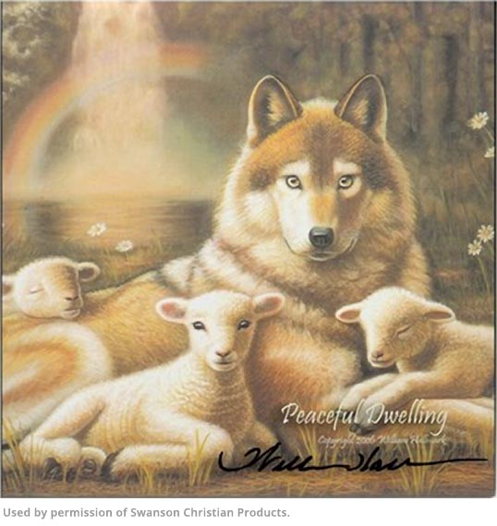
Isaiah 11:1-16 The Kingdom of god
v. 4-5 Messiah/Branch brings justice and righteousness.
v. 6-9 A kingdom of peace/shalom.
Already but not yet!
v. 10-16 A banner, a resting place, a gathered remnant, a highway to heaven.
Get the picture!

Slide 22
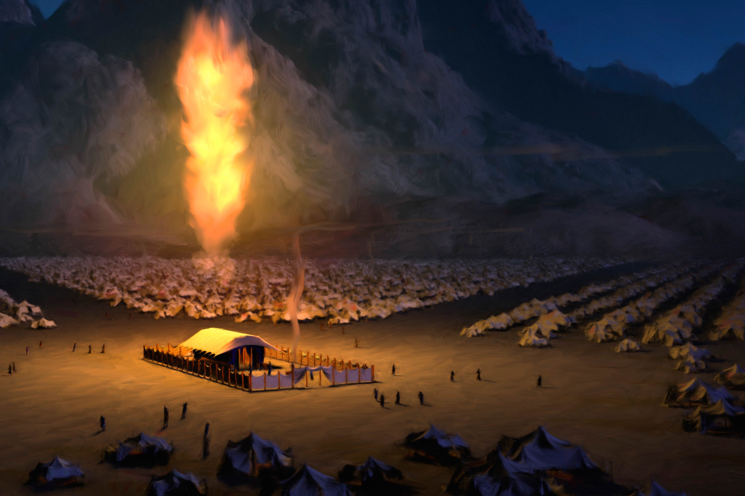
Isaiah 2:2-4 Isaiah 4:2-6 a sandwich
Isaiah 4:2 Branch will be beautiful and glorious.
Emphasis here on glory!!!
Isaiah 4:5 The shekinah—glory of God.
John 1:18

Slide 23
Isaiah 2:6-22 The Day of the lord
TDOTL Obadiah 4, Amos 5:2, Amos 3:2, Micah 3:12 Zephaniah 1:14-18 Is. 2:12 Is. 13:6-9Is. 13:10-13 Is. 34:4, 8-10 Jer. 46:10 Lam. 2:22 Ezek. 13:5 Ezek 30:3 Joel 1:15 Joel 2:1 Joel 2:11 Joel 2:31 Joel 3:14
The Day of the Lord signifies “The moment when Jehovah grasps the reigns, which he seems to have held slackly before, when the currents of his moral rule, which have been running sluggishly, receive a mysterious quickening, and the Lord’s work on the earth is at last fully performed.”
Or “The Day in which Jehovah will manifest himself as God.”

Slide 24
Isaiah 2:6-22
v. 10 The unrighteous are hiding in the rocks.
v. 12-17 The proud, the rich and prosperous… All will be brought low.
v. 20 TDOTL is a day people throw away what they formerly valued greatly.
v. 22 Great advice Stop trusting in mere humans.

Slide 26
Sennacherib Prism

Slide 27
Glory is With the Lord
Is 43: 1- 13 Glory of God’s Children
Is 2: 1-5 Glory of God’s Kingdom
Is 16: 1- 3 Glory of God’s Power
Is 65: 17 – 20 Glory of God’s Salvation

Slide 28
Theme Verses
Isaiah 1:3-4 The ox knows its master, the donkey knows its owner’s manger, but Israel does not know, my people do not understand. Woe to the sinful nation, a people whose guilt is great, a bood of evildoers, children given to corruption! They have forsaken the Lord; they have spurned the Holy One of Israel and turned their backs on him.
Is 1:16-17 Wash and make yourselves clean. Take your evil deeds out of my sight; stop doing wrong. Learn to do right; seek justice. Defend the oppressed. Take up the cause of the fatherless; plead the case of the widow.

Slide 29
God Rules The Nations
Isaiah 14:24-27 I will crush the Assyrian in my land
Isaiah 39:5-7 All will be carried to Babylon.
Is 42: 1- 4 God raises up His gentle servant. A bruised read he will not bend….
Isaiah 44:28-45:6 God raises up Cyrus

Slide 30
Important scriptures in Isaiah
Isaiah 40:1-5 A message of comfort. A voice of one calling in the wilderness: prepare the way for the Lord. John the Baptist is coming. (also Malachi 4)
Isaiah 42:1-4 The gentle Messiah A bruised reed he will not break.
Isaiah 49 A great evangelism passage.
Then, of course, there is Isaiah 52:13-53:12.
Social justice: Isaiah 58:5-8
Isaiah 61:1 Quoted in Luke 4:18
Isaiah 65:17-20 The Kingdom is Coming.

