Slide 1
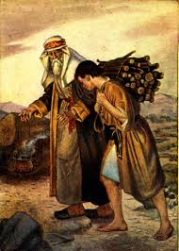
Jesus in the Old Testament:
From Shadow to
Reality
John Oakes

Slide 2
John 5:39-40 You diligently study the Scriptures because you think that by them you possess eternal life. These are the Scriptures that testify about me, yet you refuse to come to me to have life.
Old Testament like a play….
Old Testament like a mystery….

Slide 3
Foreshadow: An object, event, person or situation which stands for something similar, but of greater significance in the future.
Prefigure: A specific thing which stands for another specific thing similar to it in the future.
Type and Antitype: A person or thing regarded as the symbol of someone or something which is yet to appear

Slide 4
III. Earthly Tabernacle Foreshadows the Heavenly Tabernacle
To “tabernacle” is to dwell among.
History:
Tabernacle in the desert, cloud by day, pillar of fire by night
Tabernacle at Shiloh
Solomon’s Temple 1 Kings 8:10-11 Shekinah
Destroyed 586 BC Ezekiel 10:18-19 Ezek 11:22-23
Rebuilt 516 BC Ezekiel 43:1

Slide 5
History (cont.)
God leaves the temple (AD 30)
Temple finally destroyed for good (AD 70)
Follow the exact pattern Exodus 25:8-9,
Hebrews 8:5 Ezekiel 43:10 “so that you might be ashamed…”

Slide 6
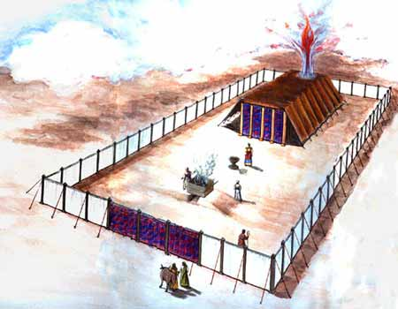
Model of The Jewish Tabernacle
Hebrews 10:19-20

Slide 7
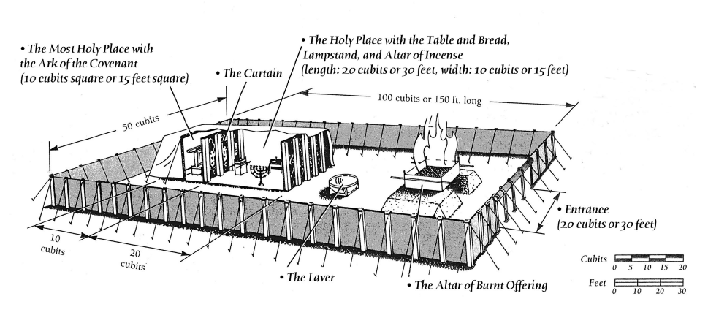

Slide 8
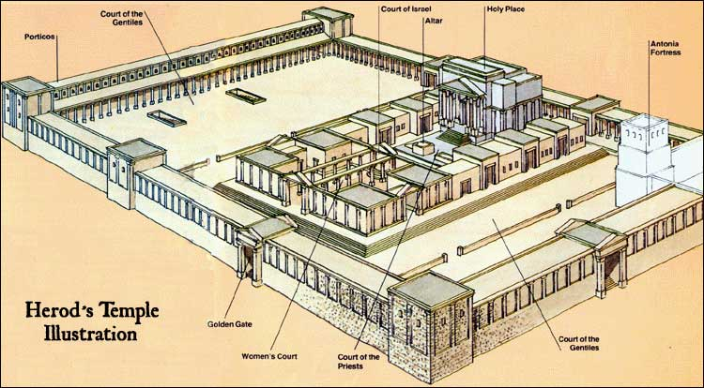
Solomon’s Temple
Court of Gentiles Court of Women
Court of Men Court of Levites/Priests
Holy Place Most Holy Place Get the point?

Slide 9
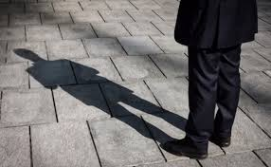
The Tabernacle in Hebrews 8 & 9
Hebrews 8:1-2 the true tabernacle.
Hebrews 8:5
A copy (hupodeigma sketch-plan, diorama)
A shadow (skia shadow, reflection silhouette)

Slide 10
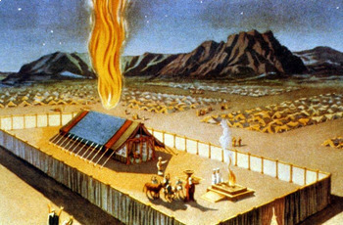
The Tabernacle in Hebrews 8 & 9
Hebrews 9:1-5 tabernacle described
Hebrews 9:11 a greater and more perfect tabernacle
Hebrews 9:23-26 Jesus ministering for us there

Slide 11
Hebrews 9:1-11 A Better Tabernacle
Holy Place, Most Holy Place, altar, laver, bread, menorah, incense altar, curtain, ark, mercy seat, cherubim, etc…
Gentiles could only enter the court of Gentiles
Female Jews could only enter the court of Women
Male Jews could only come to the gate of the tabernacle/temple
Levites could only enter the courtyard
Priests could only enter the Holy Place
The High Priest could only enter the Most Holy Place once a year.
Separation!

Slide 12
Type/Antitype Relationships in the Tabernacle
ITEM IN TABERNACLE OR TEMPLE
ANTITYPE IN THE NEW COVENANT
SCRIPTURE REFERENCE
The tabernacle itself
God dwelling with his people
John 14:1-3, John 1:14J. Rev 1:13
The bronze altar of sacrifice
The sacrifice of Jesus for sins
Hebrews 9:14
The basin/laver
Baptism
Titus 3:5
The show bread
The bread of life, Jesus Christ
John 6:48-51
The lampstand
The Holy Spirit
Zechariah 4:1-6
The altar of incense
The prayers of the saints
Revelation 5:8
The blue, purple and scarlet yarn
The heavens, the kingship of God, the blood of Jesus
The curtain
Separation from God
Matthew 27:51
The ark of the covenant
The presence of God
Psalm 132:7,8
The Mercy Seat
The grace of God
The Cherubim
The angels in heaven
Ezekiel 10:15-22

Slide 13
Type and Antitype in the Tabernacle
Bronze Altar = Our need for a sacrifice to come into the presence of God
Laver = The need for cleansing/baptism in order to come into a relationship with God 1 Peter 3:21
Shew Bread = Jesus, the bread of life John 6:35
Menorah = The Holy Spirit Zechariah 4:1-6
Altar of incense = Our prayers Rev 5:8

Slide 14
Type and Antitype in the Tabernacle
Curtain = Separation between man and God because of his holiness
Cherubim = Protectors of God’s holiness Revelation 4:6-8, Genesis 3:24 Ezekiel 10:9-19
Mercy seat = God’s throne Ezekiel 1 Revelation 4
Note, the mercy seat covers the Law of Moses

Slide 15
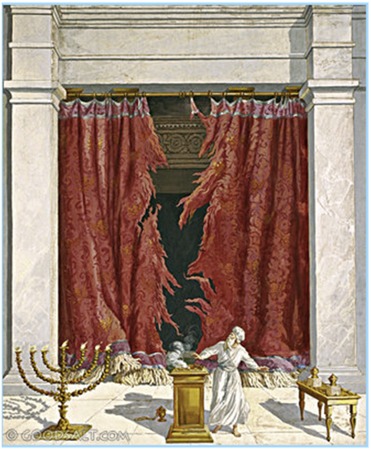
Great News
When Jesus died, the curtain was rent in two.
Now, we walk boldly into the true, the heavenly tabernacle Heb 10:19-22!!!!!!

Slide 16
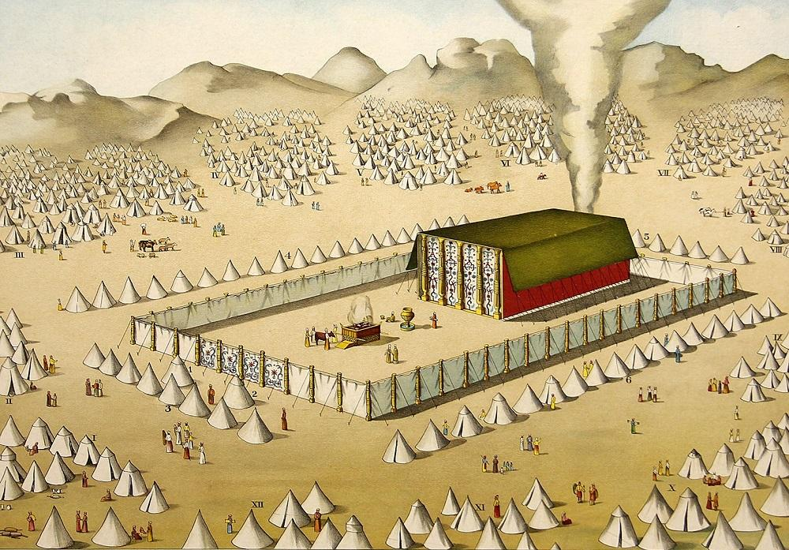
Tabernacles and Jesus
The Word became flesh and tabernacled among us. We have beheld his glory, the glory of the one and only Son of God who came from the father full of grace and truth.
John 3:14

Slide 17
Jesus Clears the Temple
Jesus clears the temple John 2:12-17 a “sign”
Jesus cleanses the temple –his house—as one does before the Passover.
Jesus’ authority over the temple. The temple of God is my body!

Slide 18
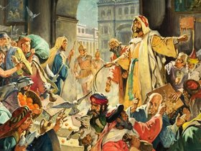
Jesus Clears the Temple
John 2:18-19. What is the sign of Jesus?—the sign proving my right to be greater than the temple? I will be raised from the dead on the third day.

Slide 19
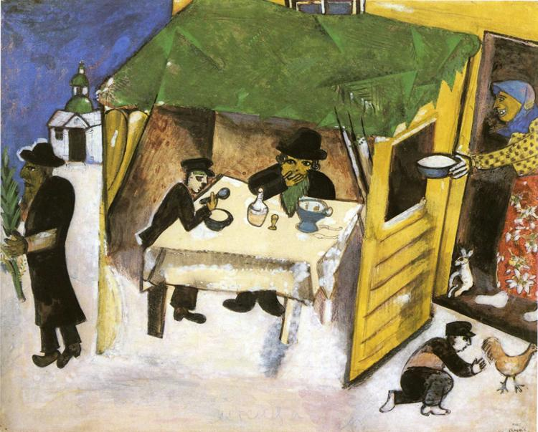
John 7:1-9:41 Tabernacles Discourses
Tabernacles (Sukkot)
Harvest Festival
Remembrance of Wandering in the Wilderness = living by faith in a relationshiip with God
John 1:14

Slide 20
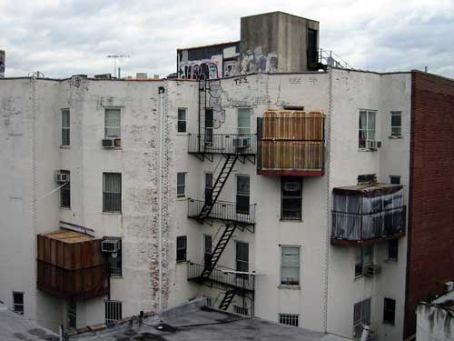
Sukkot in a City

Slide 21
Tabernacles/Booths/Sukkot
A Celebration of Wandering in the Wilderness: Living in Close Fellowship with God (John 1:14 Jesus tabernacled with us)
Water Motif: Water Pouring Ceremony
Light Motif: The Illumination of the Temple

Slide 22
The Water-Pouring Ceremony
Every Day of the Feast
Procession from the Temple to the Pool of Siloam
Priest fills a golden pitcher with water from Siloam (“living” water, by the way)
Recite Isaiah 12:3
Back through the Water Gate to the Temple
Pour the water out over the altar of sacrifice
A symbol of the Holy Spirit and of salvation.
Isaiah 12:3, Zechariah 14:8,16, Joel 3:18, Ezek 45:25 41:1-11
Jesus: The Messianic Age has come.

Slide 23
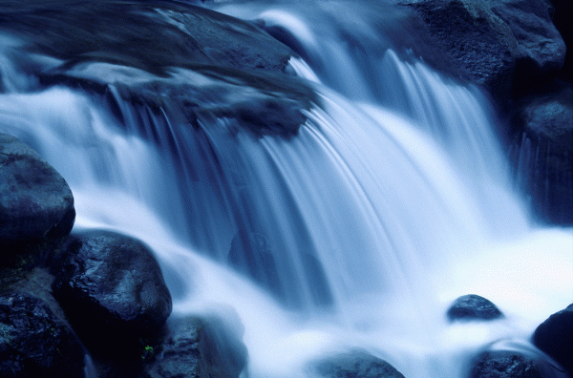
John 7:37 Living Water
If anyone is thirsty, let him come and drink. Whoever believes in me, as the Scripture has said, streams of living water will flow from within him
Isaiah 12:3
Zech 14:8,16
Joel 3:18

Slide 24
The Illumination of the Temple
Every night during Tabernacles.
Entire Temple lit up with lamps.
Celebration in the Court of Women.
A symbol of the shekinah—God’s glory which was in and above the Tabernacle.
Jesus: I am the shekinah of God.
John 12:36 Through Jesus we can become sons of light, and no longer walk in darkness.
Jesus: I am the fulfillment of Tabernacles.

Slide 25
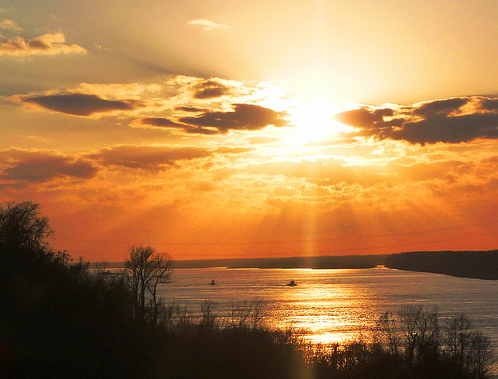
John 8:12 I Am The Light of the World
Shekinah
John 8:12 I AM the light of the world.
John 9:5 While I am in the world, I AM the light of the world.
John 12:46 I have come into the world as a light, so that no one who believes in me should stay in darkness.

Slide 26
Summary
The Tabernacle/Temple is about God dwelling in his people.
Every item in the Tabernacle/Temple points to a specific aspect of our relationship with God through Jesus.
The ultimate antitype to the Tabernacle is Jesus dwelling among us. Jesus who dwells now in the true Tabernacle, interceding for us.
This is well-illustrated through Jesus teaching at the Feast of Tabernacles about water and light.

Slide 27
Class #4
Type/antitype relationships in the sacrificial system and in the Jewish festivals.

Slide 28
Sacrificial Type and Antitype
Old Testament Sacrifice
New Testament fulfillment
Scriptures
Sweet Savor Sacrifices
The Burnt Offering
Jesus’ and our devotion to God
Ephesians 5:1,2 Romans 12:1,2
The Grain Offering
Giving back a contribution to God
Matthew 6:19-21
Romans 8,9
The Drink Offering
Pouring out our life for God
Luke 22:20 Philippians 2:16
The Fellowship Offering
Celebrating our blessings from God
John 10:10
1 Thess 5:16
Blood Sacrifices
The Sin Offering
Jesus’ sacrifice for our sins
1 Peter 1:18,19
2 Corinthians 5:21
The Guilt Offering
Maintaining a relationship with one another
Matthew 5:23,24

Slide 29
Gifts/Offerings/Sweet Smelling Sacrifices
The Burnt Offering olah Leviticus 1
The Grain Offering minchah Leviticus 2
The Drink Offering nesek Leviticus 23
The Fellowship Offering shelem Lev 3

Slide 30
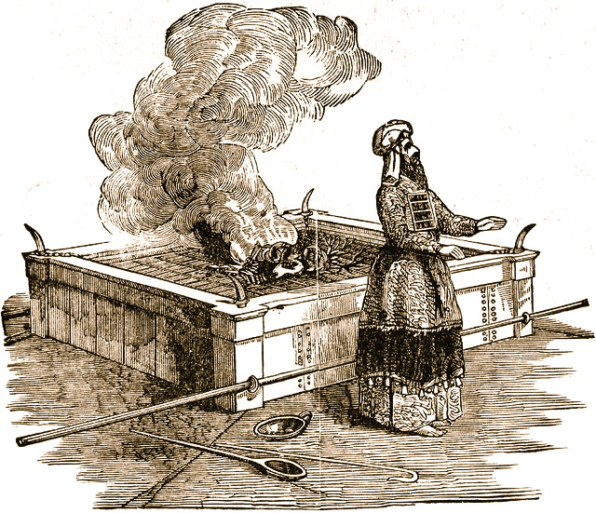
The Burnt Offering Leviticus 1
Lay hands on the animal.
Sacrifice the animal
Clean the body but not the head
Burn them on the altar
Meaning: Total commitment of one’s life to God.

Slide 31
The Burnt Offering
Jesus gave a burnt offering: Ephesians 5:1-2
God calls us to give a burnt offering. Romans 12:1-2 … in view of God’s mercy. Phil 1:20-22
Isaiah 6:8 Here am I, send me
What will you lay on the altar?

Slide 32
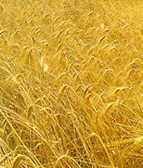
The Grain Offering
Give the FIRST FRUITS of what God has blessed you with.
NOT voluntary.
Grain = hard work
Oil = joy
Incense = prayer
Salt = eternal blessings, “treasures in heaven”
No yeast!!! 1 Cor 5:6-8 (or honey)

Slide 33
The Grain Offering
Application: Our contribution to God 2 Cor 8,9
For us, 10% is not mandatory, but giving sacrificially is.
Malachi 3:7-10
Matthew 5:20

Slide 34
The Drink Offering
Drink Poured out on the altar.
Application: Pouring out our life on the altar.
Usually given with the grain offering.
Application: We give our tithe, but God wants much more. He wants us to be “all in.”

Slide 35
The Drink Offering
Jesus gave a drink offering Luke 22:20
Paul gave a drink offering Phil 2:16-17 2 Tim 4:6,7
Haggai 1:3 What are you saving for?
1 Tim 6:6-10 Are you content?
The greatest joy comes from giving a drink offering.

Slide 36
The Fellowship Offering
Party Time!!!!! Celebrate the blessings of God.
Voluntary
Vow Offering Leviticus 11:16
  Blessings hoped for Future
Thank Offering Leviticus 7:11-15
  Blessings already received. Past
Free Will Offering Leviticus 22:23
  Thankful for blessings in general Present

Slide 37
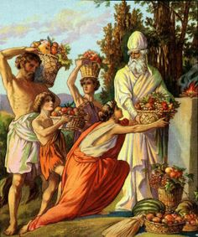
The Fellowship Offering
Application I Thess 5:16-18
  Rejoice always (free will offering)
  Pray continually (vow offering)
  Give thanks in all circumstances (thank offering)
Placed on top of the burnt offering

Slide 38
Blood Sacrifices
The Sin Offering chatat Leviticus 4
  For sins against God
The Guilt Offering asham Leviticus 5
  For offenses against a fellow Jew
Hebrews 9:13-14
No sacrifice for willful sin! Lev 4:13-14 (Heb 10:26)

Slide 39
A Better Sacrifice
Hebrews 9:23 It was necessary, then, for the copies of the heavenly things to be purified with these sacrifices, but the heavenly things with better sacrifices than these
The lesser sacrifice: Bulls, goats, red heifer | The greater sacrifice: Jesus
Outward (appearance) | Inward (reality)
Temporary, repeated many times | Eternal, done only once
Ceremonial | Real
Not voluntary | Voluntary

Slide 40
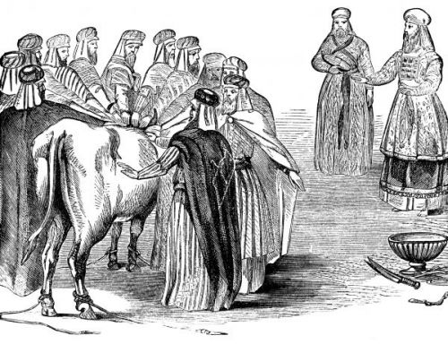
The Sin Offering Lev 4:1-5:13
Unblemished bull or goat (like Jesus)
Offender laid their hands on the animal (God put our sins on Jesus on the cross) Isaiah 53:6

Slide 41
The Sin Offering (cont.)
Offender killed the animal. (We killed Jesus) Matt 27:25
Blood sprinkled on the altar, as well as on the curtain.
Body burned outside the camp (like Jesus) Heb 13:11-13

Slide 42
The Guilt Offering Lev 5:14-6:7
Only for offenses of individuals, not groups.
Offender must make restitution first before bringing the sacrifice. (Matthew 5:23-24)
Is 53:10 Jesus offered himself as a guilt offering.
But….
God wants us to be confident Heb 10:19-22

Slide 43
The Red Heifer Sacrifice
Aspects of the Red Heifer Sacrifices | Antitype in the sacrifice of Jesus
A very rare red heifer | A unique son
Sacrificed outside the camp | Sacrificed outside Jerusalem
Purifies both Jew and Gentile | Atones for the sin of both Jew and Gentile
A sacrifice without blemish | A sacrifice without sin
Had never been yoked | Offered himself voluntarily
Scarlet wool and wood included | Blood was shed on a wooden cross
Hyssop included (for purification from the effects of death) | Purifies us from the effects of sin
Water included for purification | We are baptized into Christ for forgiveness

Slide 44
First Covenant Festivals as Types
Jewish Festival
Antitype in the Christian Life
Passover (pesach)
The Sacrificial Death of Jesus Christ
Feast of Firstfruits
The Resurrection of Jesus Christ
Feast of Unleavened Bread
Celebrating Being Free of Sin in Our Lives
Feast of Weeks/Pentecost (shavoat)
The Giving of the Holy Spirit and the Initiation of the Church
Feast of Trumpets (rosh hashanah)
Judgement Day, Jesus Coming Back
Day of Atonement (yom kippur)
The Day We Were Saved—Spiritual Birthday
Feast of Booths
(Tabernacles)
Celebrating Life in Fellowship with God

Slide 45
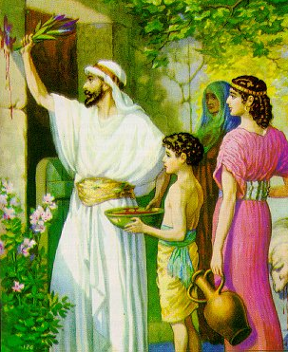
Passover/Pesach (Exodus 12:24-28)
Under a death sentence
Pure, undefiled Passover lamb (1 Cor 5:7-8, Rev 13:8)
Blood sprinkled on the wooden beam above the door.

Slide 46
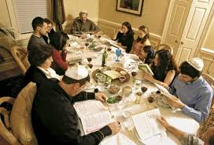
Passover/Pesach (Exodus 12:24-28)
A remembrance of salvation from death
A remembrance of salvation from slavery
No bone broken (Exodus 12:46 Psalm 22:17 Jn 19:31-33
Remove all the leaven (1 Cor 5:7)
Bitter herbs
The third cup:
the cup of redemption.

Slide 47
PASSOVER
CELEBRATE BEING FREED FROM OUR SINS

Slide 48
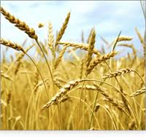
Feast of Firstfruits Lev 23:9-14
A harvest festival when there was no harvest.
A promise of a future harvest.
A foreshadow of the final resurrection.
A prefigure of the resurrection of Jesus. 1Cor 15:20-21
Coll 1:18 The first born from among the dead.

Slide 49
FEAST OF FIRSTFRUITS
CELEBRATE OUR PRESENT AND FUTURE RESURRECTION

Slide 50
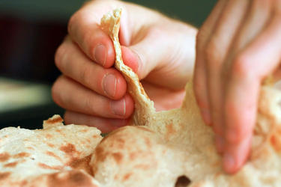
Feast of Unleavened Bread
Exodus 12:17-19 Celebrating a life of freedom in Christ. Freedom from sin.

Slide 51
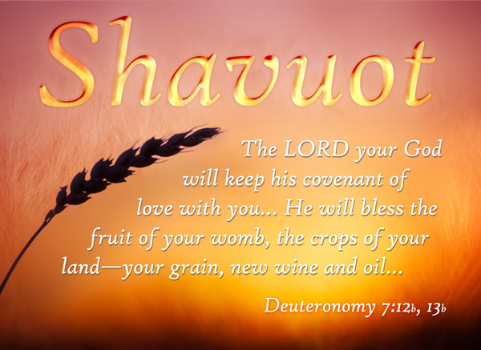
The Feast of Weeks/Pentecost/Shavuot
50 days after the Passover 49 days (7 weeks) after the Feast of Firstfruits.
Leviticus 23:15-17
Celebrating the harvest
of souls for eternity
1 Cor 3:5-9 The harvest
is the Lord’s

Slide 52
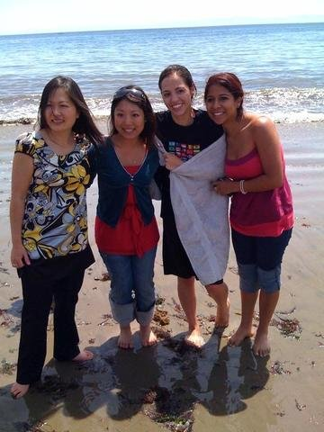
FEAST OF WEEKS/PENTECOST
CELEBRATING OUR OWN SALVATION AND THAT OF OTHERS

Slide 53

Feast of Trumpets Rosh Hashanah/Yom Teruah
Leviticus 23:23-25 A Harvest festival.
A foreshadow of the Return of Jesus.
  Matt 25:30-31, I Thess 4:13-14 Trumpet call.
A foreshadow of Judgment Day
Rabbis: Stay awake all night so you will be prepared.

Slide 54
FEAST OF TRUPMETS
LET US REFLECT ON OUR LIVES AND BE PREPARED FOR THE COMING OF JESUS

Slide 55
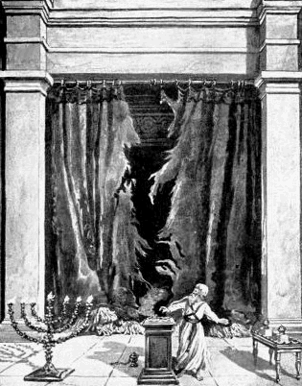
The Day of Atonement Yom Kippur
Sacrificial goat and scape goat.
Sins laid on sacrificial goat, killed outside the camp.
Incense fills the Holy of Holies
Priest enters the Holy of Holies and puts blood on the Mercy Seat

Slide 56
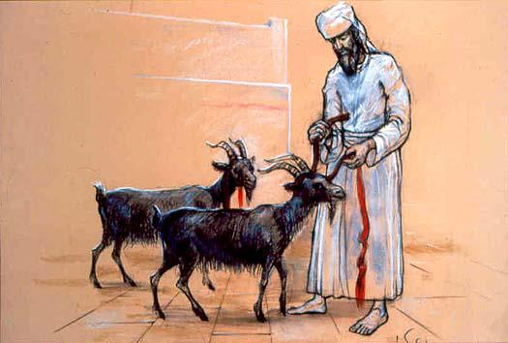
The Day of Atonement Yom Kippur
Scapegoat (Azazel) sent off into the wilderness
Bodies burned outside the camp (Hebrews 13:11-14)
Prefigure of the salvation of Jesus. Hebrews 9:11-15, 23-24

Slide 57
Sukkot/Feast of Booths/Tabernacles
Seven day festival
Harvest Festival
Build a booth and live in it for a week. Leviticus 23:33-43
Remembrance of Wandering in the Wilderness = living in a relationshiip with God.
John 1:14

Slide 58
Sukkot in a City

Slide 59
Tabernacles/Booths/Sukkot
A Celebration of Wandering in the Wilderness: Living in Close Fellowship with God (John 1:14 Jesus tabernacled with us)
Tabernacles in the OT Ezek 37:24-27 Ezek 48:35 Zech 14:16
Tabernacles in the NT 2 Cor 5:1-5
Water Motif: Water Pouring Ceremony
Light Motif: The Illumination of the Temple

Slide 60
John 7:37-39 Living Water
If anyone is thirsty, let him come and drink. Whoever believes in me, as the Scripture has said, streams of living water will flow from within him
Isaiah 12:3
Zech 14:8,16
Joel 3:18

Slide 61
TABERNACLES
EXPERIENCING LIFE IN FELLOWSHIP WITH CHRIST AND WITH THE HOLY SPIRIT

Slide 62
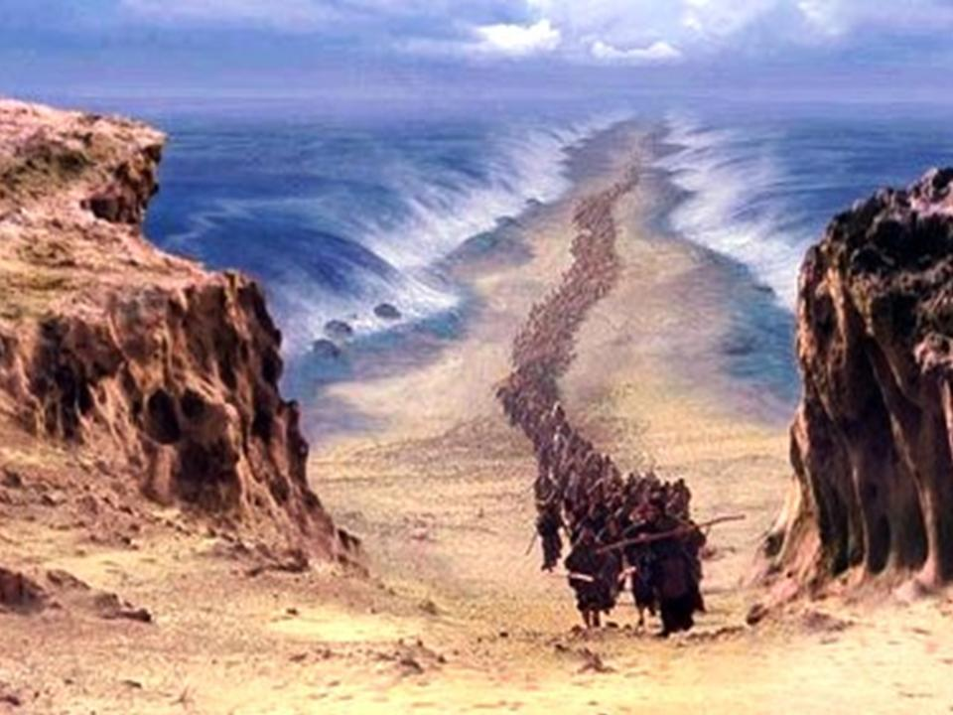
Class #5 Historical Foreshadows
1 Corinthians 10:11 These things happened to them as examples and were written down as warnings for us, on whom the fulfillment of the ages has come.

Slide 63
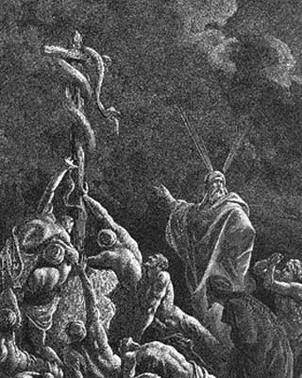
A little example: Numbers 21:4-9.
Snake-bite = sin. Both result in death Romans 6:23
The solution? Look to the snake, lifted up on a wooden pole John 3:14
Why a snake? 2 Corinthians 5:21

Slide 64
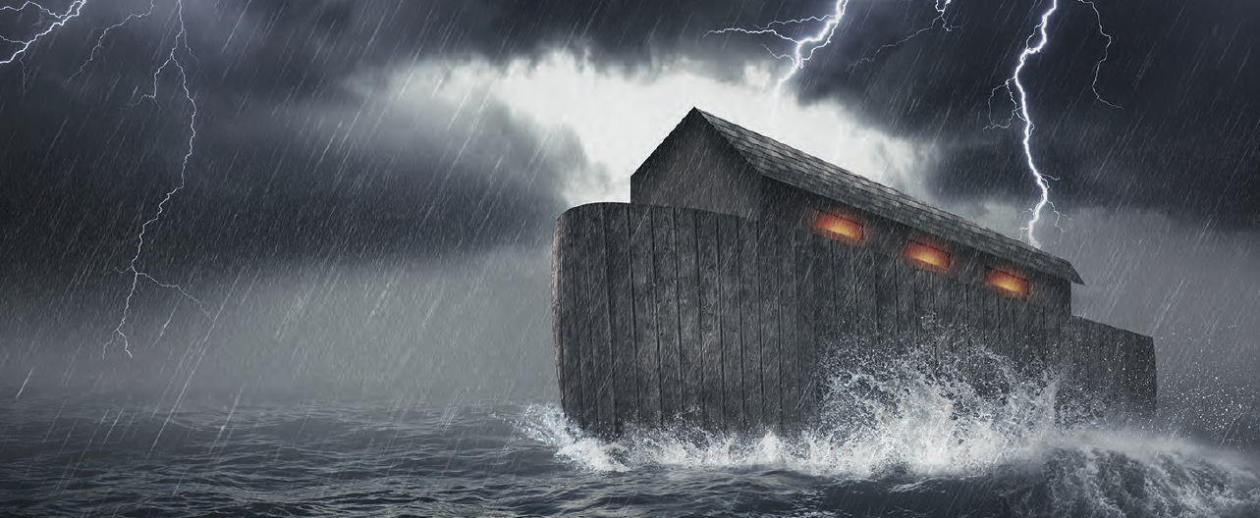
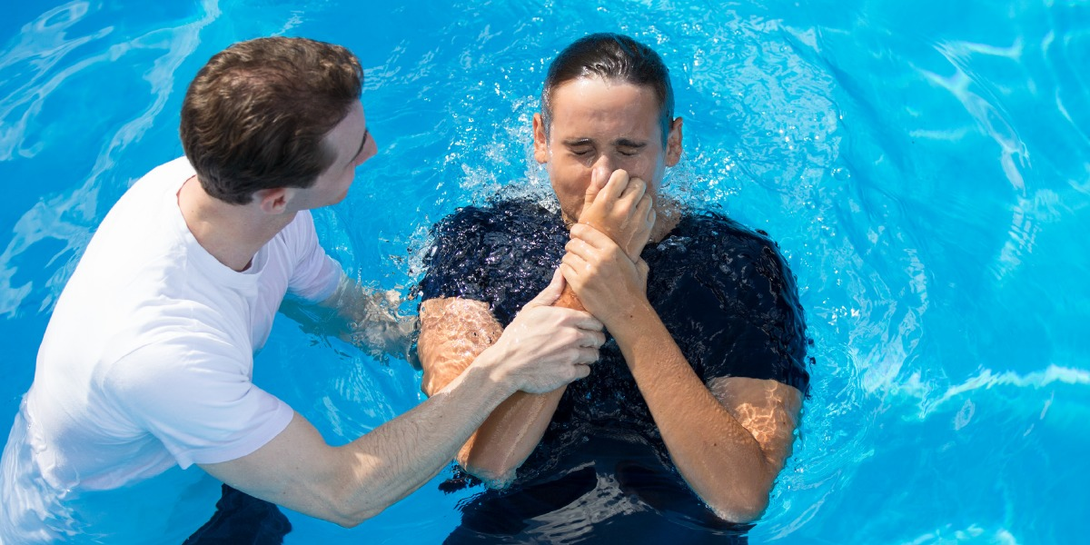
The Flood as a Foreshadow

Slide 65
Foreshadows surrounding Abraham
Isaac = children of promise = us
Ishmael = children born in the usual way = Israel
Hagar = Old Covenant = Mt. Sinai = “present Jerusalem”
Sarah = New Covenant = “the Jerusalem that is above”

Slide 66
Genesis 22:1-11
Your only son…
Mt. Moriah
On the 3rd day
Isaac carries the wood
Abraham carries the knife
Raised from the dead (figuratively, Heb 11:19)

Slide 67
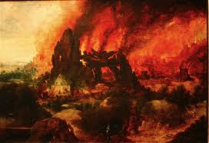
Sodom and Gomorrah
Sodom is symbolic of “the world.”
Sodom = Egypt = Babylon Revelation 11:8
Rev 18:2-3
Sodom is a symbol of what God will do to the unrighteous Luke 17:28-31
Who is Lot? 2 Peter 2:6
Who is Lot’s wife? Luke 17:32

Slide 68
Historical type/antitype in the Exodus
OLD TESTAMENT TYPE
NEW TESTAMENT ANTITYPE
SLAVERY IN EGYPT
LOST, SLAVE TO SIN
WANDERING IN THE WILDERNESS
SAVED, BUT LIVING THE LIFE OF A DISCIPLE
ENTERING THE PROMISED LAND
ENTERING HEAVEN

Slide 69
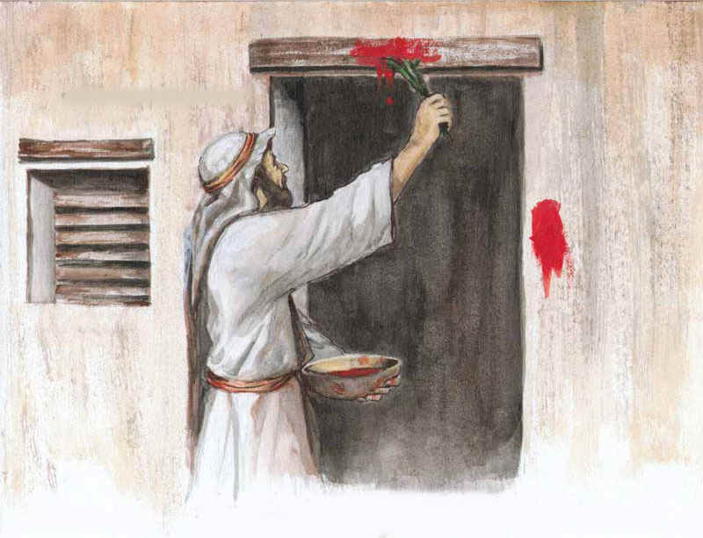
Foreshadows in the Exodus
Exodus 3:7-10 The people are enslaved: God sends a savior.
Moses = Jesus
Pharaoh = Satan
Plague #10: A death sentence
1 Cor 5:7

Slide 70

Passing Through the Red Sea
We’re free!!!
Not yet!!!
1 Cor 10:1-4

Slide 71
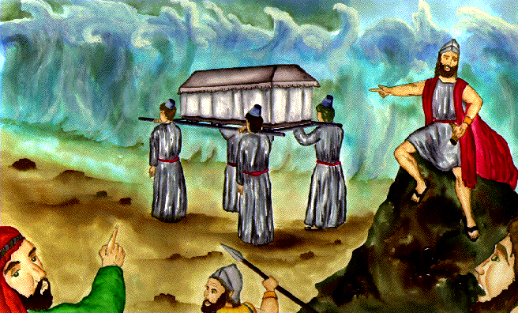
Crossing the Jordan
First generation: Baptized into Moses.
Second generation: Baptized into Joshua.
The type/antitype relationship shifts.

Slide 72
Prefigures of Jesus Christ
Adam
Melchizedek, Isaac, Joseph
Moses
Joshua
Deborah, Samson, Saul
David
Elijah, Jonah
Daniel, Cyrus
Joshua the priest, Esther

Slide 73
To Be a Prefigure of the Messiah
Prophet, Priest or King (or prince…)
Save Israel (or Gentiles)

Slide 74
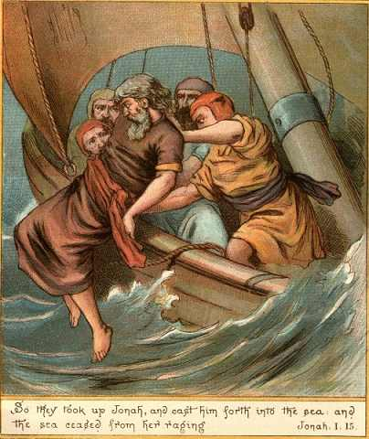
Jonah
John 7:52 No prophet ever came from Galilee…
Gentiles under death sentence.
Jonah sleeping in the boat
Jonah 1:7 Gambling
Jonah 1:12 Willingly offered his life to save the Gentiles
Jonah calmed a storm
Matthew 12:39,40 Three days and three nights

Slide 75
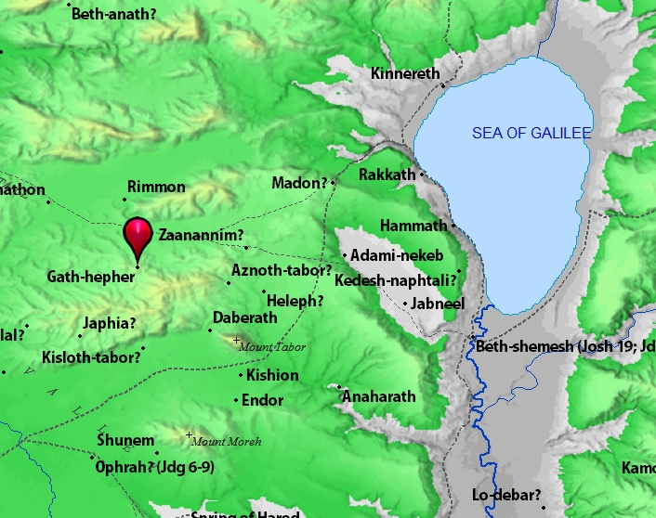
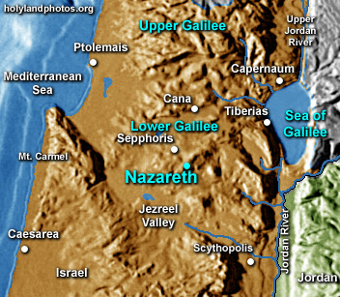
Gath Hepher and Nazreth 3 miles apart

Slide 76
Melchizedek: Prefigure of Christ
Melchizedek means King of Righteousness.
King of Salem means King (prince?) of Peace.
He blessed Abraham. (Genesis 14:19)
Abraham offered him a tithe/sacrifice (Genesis 14:20).
High Priest because of his character, not by descent. Heb 7:15-16
Greater than Abraham Heb 7:4.
Gave Abraham bread and wine (last supper, Lord’s Supper)
A priest for everyone; not just for the Jews.

Slide 77
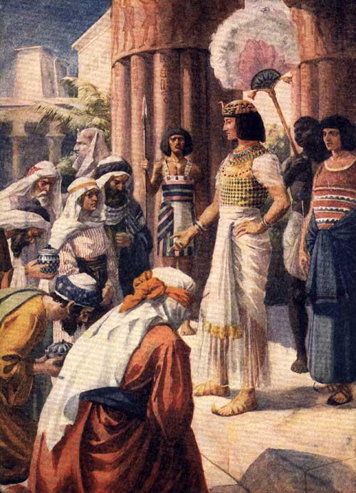
Joseph: Savior of Israel
From the right hand of his father, he became a slave in Egypt and was later raised to the right hand of the king
A shepherd
A dream: You will be King of the Jews
Jealous brothers decided to kill him
Betrayed for 20 pieces of silver
Went down to Egypt
Saved Israel

Slide 78
Parallels Between Moses and Jesus
Moses
Jesus
Pharaoh tried to kill him
Herod tried to kill him
Called by God to leave Egypt
Carried out of Egypt
Forty years in the wilderness to prepare for his ministry
Forty days in the wilderness to prepare for his ministry
Left his position with the king of Egypt to dwell with the Jews
Left the right hand of the Father to life with the Jews
Led Israel out of slavery in Egypt
Leads Spiritual Israel out of sin
Aaron prepared the way
John the Baptist prepared the way
Baptized Israel in the Red Sea in order to free them
Commands baptism in water for freedom from sin
Gave manna in the wilderness
(sort of)
Gives spiritual bread to all who hunger
Gave water to the people in the desert
Gives spiritual water: the Holy Spirit
Spoke to God on Mt. Sinai
Spoke to God on Mt. Hermon

Slide 79
David My Servant (Ezek 37:24-25)
Born in Bethlehem Micah 5:2
A very good shepherd John 10:11
Anointed king (parallel to Jesus’ baptism) 1 Sam 16:13
Physical king of physical Jerusalem
Brought God (the ark) to Jerusalem (Palm Sunday)
Saved Israel from slavery to Philistia
Offered a sacrifice on Mt. Moriah that saved Israel

Slide 80
Other Prefigures of the Messiah
Adam
Samson
Deborah
Samuel
Cyrus
Joshua the Priest (Zech 3:1-10 Zech 6:9-15)
Esther

Slide 81
Conclusion
The Old Testament testifies about Jesus (John 5:39)
The Old Testament is inspired by God.

