Slide 1
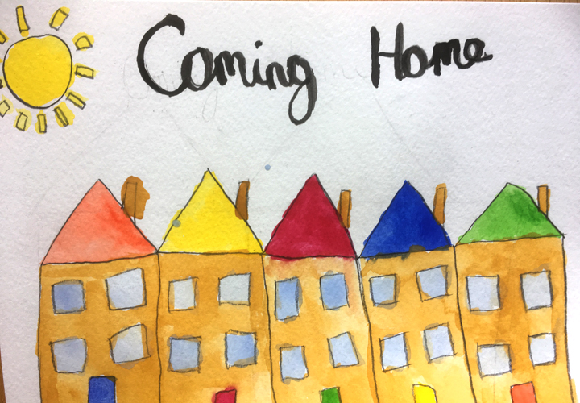
Coming Home One Another Scriptures #1
Ephesians 2:11-12
Outside of Christ we were:
v. 11 Uncircumcized
v. 12 Separate from Christ
v. 12 Excluded from citizenship
v. 12 Without hope
v. 12 Without God
No home!!!!

Slide 2
Ephesians 2:13-22 But in Christ we have come home
v. 13 We are brought near by the blood of Christ.
v. 14 We are made one (Jew and Gentile)
v. 14 The barrier of hostility has been destroyed.
v. 16 We are one body
v. 19 We are fellow-citizens with God’s people.
v. 19 We are members of God’s household/family.
v. 21 We are a holy temple in the Lord
v. 22 We are a dwelling in which God lives by his Spirit.

Slide 3
So, How Do We Create Home? By implementing the One Another Passages
I. Love One Another
John 13:34-35
Agape
1 Peter 1:22 Sincere
love (phileo) for
one another

Slide 4
Coming Home One Another Scriptures
II Submit to one another
Ephesians 5:21 Submit yourselves to one another or of reverence for Christ.
III. Serve One Another
Gal 5:13 Serve one another in love

Slide 5
IV. Carry each other’s burdens Gal 6:2
Gal 6:5 Carry your own burden (Gr. Photion, backpack)
Self-reliance, on some level, is biblical.
But..
Gal 6:2 Carry one another’s burden (Gr. baros, heavy load)

Slide 6
Carry your own burden
Carry one another’s burdens

Slide 7
Bear One Another’s Burdens

Slide 8
V. Bear with one another Eph 4:2 Col 3:13
Love the differences
Love those who dress poorly and love those who pay too much attention to how they dress.
Love those with poor personal hygiene.

Slide 9
VI. Accept one another Romans 15:7
Romans 15:1, 14:19-23
Accept people with differences on debatable matters.
Worship
Women’s roles
Entertainment
This does not mean everything goes!

Slide 10
VIII Forgive One Another Col 3:14 Eph 4:32
Forgive as the Lord forgave you.
Matthew 18:21-34 Parable of the unforgiving servant.

Slide 11
More One Another Passages
Encourage one another
Be devoted to one another/honor one another
Teach and admonish one another
Confess your sins to one another and pray for each other
Encourage each other/Build each other up

Slide 12
Discussion Questions
1. Can you think of a situation in which someone else bore your burdens? What was that like?
2. What are some things that other people do you struggle to bear with?
3. Are there any hot-button gray areas you tend to become judgmental about?

