Slide 1
The God Delusion: A Response or The Dawkins Delusion
John Oakes, PhD June, 2008

Slide 2
Richard Dawkins
Considered by many the preeminent evolutionist of our time. A popularizer of science and an avowed atheist.
River out of Eden
The Blind Watchmaker
The Selfish Gene
Unweaving the Rainbow

Slide 3
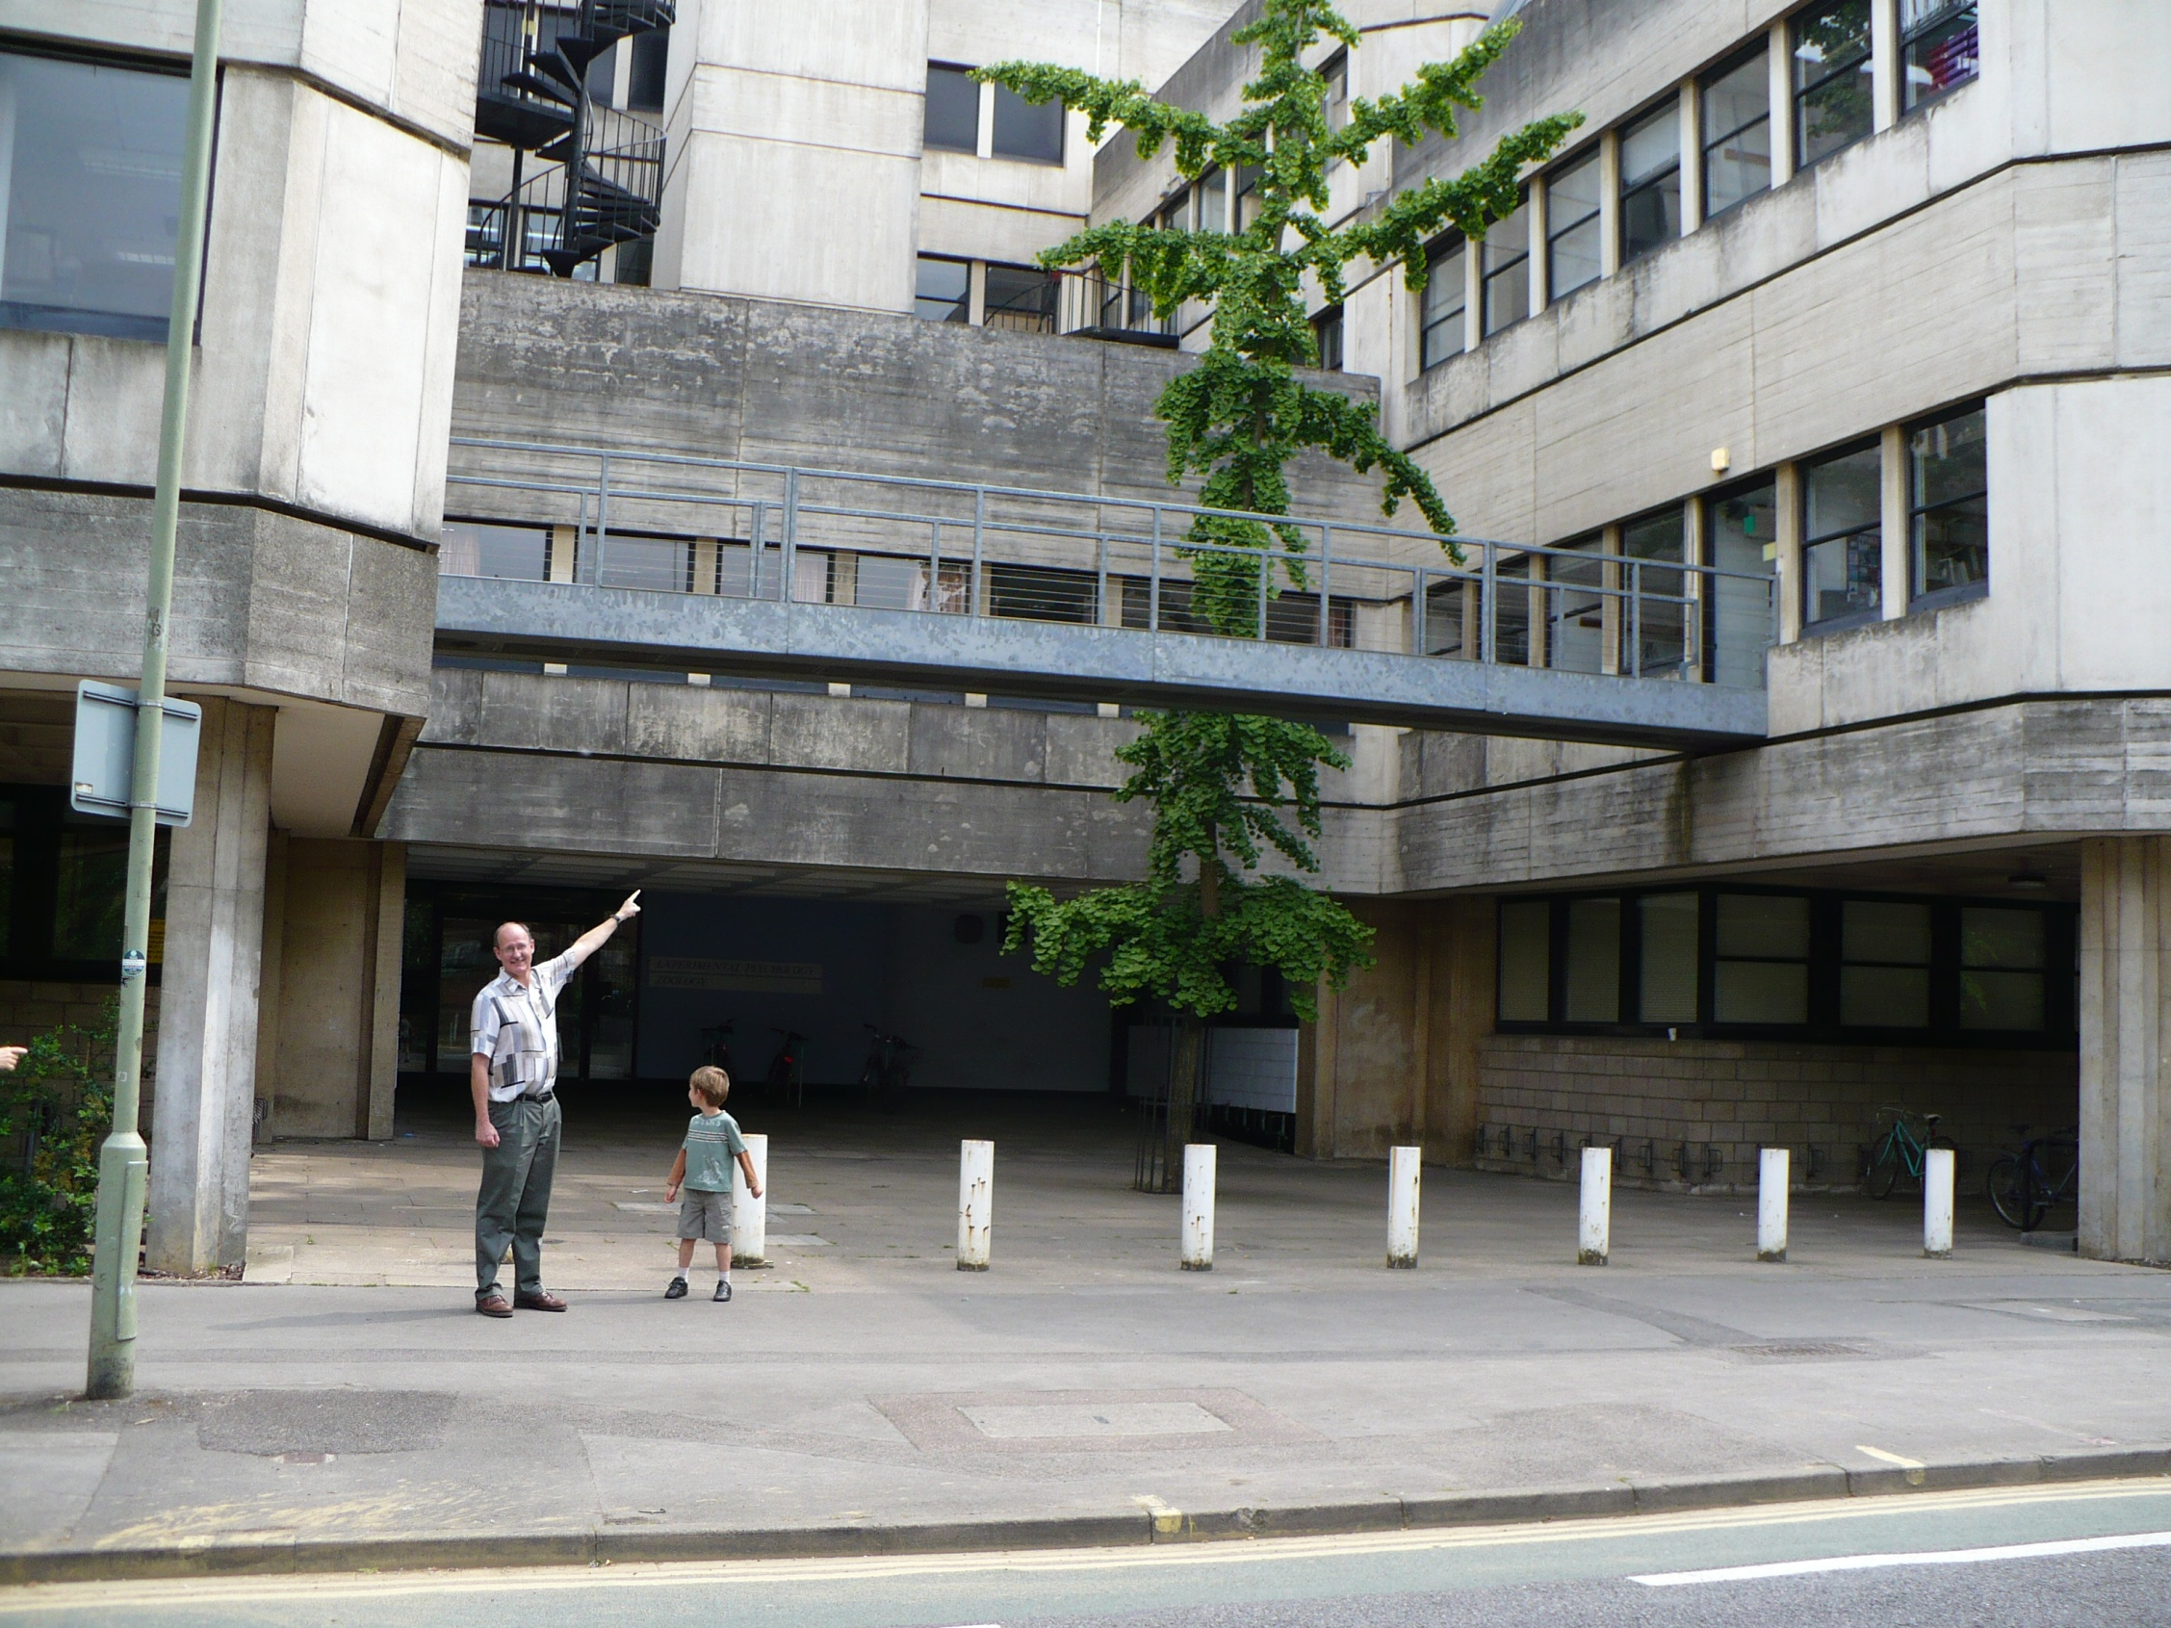

Slide 4
Key Points of “The God Delusion”
There exists a known mechanism by which organic evolution creates greater complexity through genetic mutation, gene crossing, natural selection etc.
Therefore it is settled that nature can spontaneously create complexity as a general rule (although he proposes no mechanism for this outside of Darwinism).
By analogy, there must be some sort of complexity-creator which can explain why the fine-tuned universe we live in was created. (and the multiverse speculation is assumed to be true, by the way)

Slide 5
Key Points of “The God Delusion”
This being proved (that the universe can spontaneously create complexity and information), then there is no need to invoke the Anthropic Principle or the idea of a designer.
Therefore it is proven that there is no God, no supernatural presence. All of reality can be explained by random action of material forces.

Slide 6
Key Points in “The God Delusion”
It being proven that there is no designer, no supernatural presence, then belief in God, in the soul, in spiritual reality is a delusion—a psychological illness.
The tendency—common to almost all humans—toward religious belief is the result of the formation of a “meme”. A meme is a gene-like evolved cultural idea. Like a virus that infects a culture. The religion meme is an artifact of brain evolution—a very unfortunate one.

Slide 7
Key Points in “The God Delusion”
Not only is all religious thought a delusion, it is in fact the most dangerous, pernicious, destructive force in human culture. It is the natural enemy of the only true source of knowledge: the scientific method.
Those who refuse to give up all religious belief are at least indirectly responsible for all the evil in the world. Religion has had absolutely nothing positive to offer to humanity. The sooner we abandon belief in morality and absolute ethical beliefs, the faster humans will approach their ultimate potential.

Slide 8
One More Thing
The existence of God is a scientific hypothesis, to be decided by empirical scientific experiment.

Slide 9
Problems with Dawkin’s arguments.
Extremely biased and emotional argument.
Religionists are:
“silly”
“weird”
“unworthy”
“the root of all evil”
“not enlightened”
Etc.

Slide 10
Problems With Dawkin’s Argument (cont.)
A prevalent use of logical fallacy to make his argument.
Ad hominem arguments
No True Scotsman
Begging the Question (circular reasoning)
Straw man argument
Etc.

Slide 11
Problems With Dawkin’s Reasoning (cont.)
“The God Delusion” is pseudoscience.
Argument by analogy (virus of the mind)
Claims of persecution
Quoting authors out of context
Bogus use of statistics (correlation vs. cause and effect)
Appeals to mystery and myth (the bicameral mind)
Proposal of theories which have no experimental support at all.

Slide 12
“The God Delusion makes me embarrassed to be an atheist” Michael Ruse

Slide 13
A Response to Dawkin’s Arguments
One can concede that random mutation/natural selection can produce complexity.
However to argue by analogy that life was spontaneously generated or that an Anthropic Universe is naturally selected is not scientific.

Slide 14
A Response to Dawkin’s Thesis
It is true that evil had been done in the name of God.
Islamic extremism
Crusades, Inquisition, etc.
But Jesus certainly would not have accepted this behavior at all (and perhaps neither would Muhammad have, for that matter) Matthew 5:38-48
Christianity has done more to improve the human condition than any other force in human history.
Woman’s rights.
Abolition of slavery
Human rights in general
Christian groups do the majority of all benevolent acts in the world James 1:27 Micah 6:8 etc.

Slide 15
Naturalism/Scientism/Materialism
The belief that the only reliable or valid instrument to deciding the truth or even the value of any proposition is the scientific method.
No ethics, no morality, no supernatural, no God, no truth (except that found by science), no consciousness, no “I.” Justice is a figment of our imagination.

Slide 16
Richard Dawkins
In the universe of blind physical forces and genetic replication, some people are going to get hurt and other people are going to get lucky: and you won’t find any rhyme or reason to it, nor any justice. The universe we observe has precisely the properties we should expect if there is at the bottom, no design, no purpose, no evil and no good. Nothing but blind, pitiless indifference. DNA neither knows nor cares. DNA just is, and we dance to its music.

Slide 17
Thomas Huxley
We are as much the product of blind forces as is the falling of a stone to earth, or the ebb and flow of the tides. We have just happened, and man was made flesh by a long series of singularly beneficial accidents.
A Question for Huxley: If you believe in scientism, then in what sense is it beneficial that we exist?

Slide 18
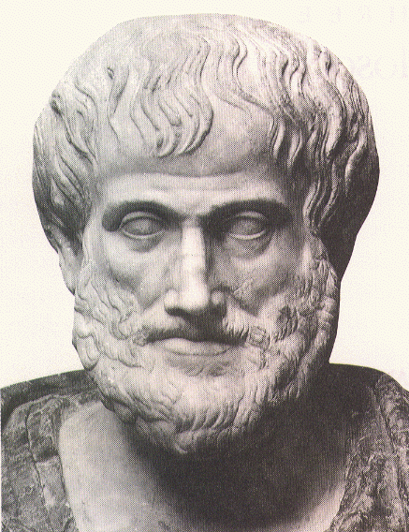
Aristotle:
The truth is known through human logic and reason
Aristotle’s science was very bad.

Slide 19
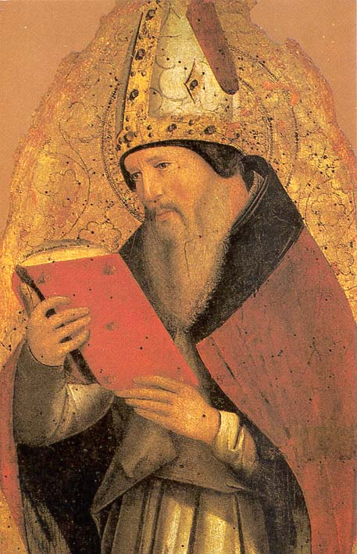
Augustine of Hippo
354-430 AD
One’s Scripture cannot contradict what we know from nature. Rejected Manichaeism because Mano contradicted science.

Slide 20
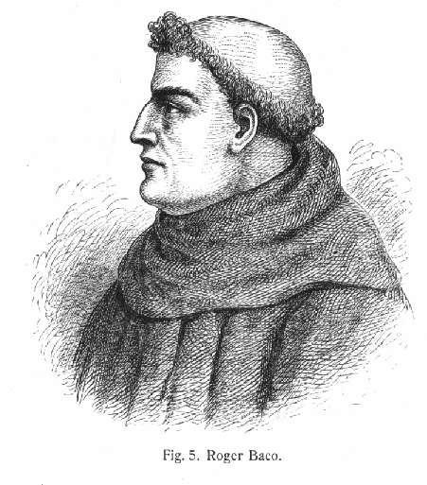
Roger Bacon
1214-1294
To acquire truth about nature, use “External experience, aided by instruments, made precise by mathematics”

Slide 21
The Fundamental Presuppositions of Science
These men began with an assumption: The universe was created by a single, all-powerful, loving, unchanging God with the single purpose in mind: that we can live in it and experience a relationship with him.
The universe is ordered and essentially unchanging.
The universe is observable and understandable. There is a 1:1 match between how the human mind works and how the universe in which live functions.
The universe is governed by mathematically precise laws.

Slide 22
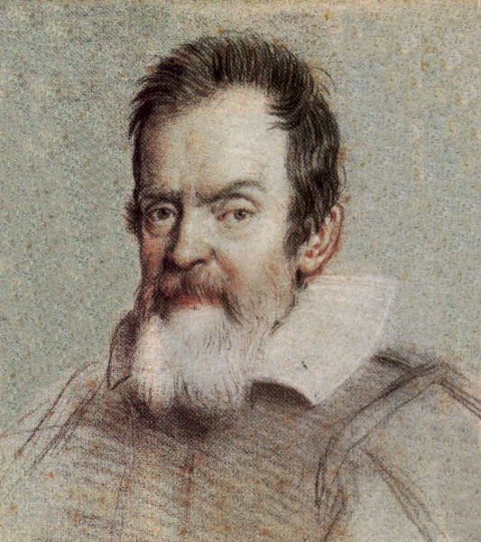
Galieo Galilei
1564-1642
For the Holy Scripture and the phenomena of nature proceed alike from the divine Word, the former as the dictate of the Holy Spirit and the latter as the observant executor of God’s commands.”

Slide 23
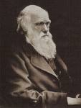
19th Century Materialism/Naturalism (cont.)
Charles Darwin
1809-1882
“Origin of Species”
“The Descent of Man”
Modernism/Materialism seems triumphant

Slide 24
The 20th Century
Science appears triumphant
Scientism proposed. Beyond Morality. Eugenics.
Quantum Mechanics. Is determinism reality?
WWI WWII Hiroshima Modernity loses its luster. Humans are not getting better and better.
Scientific Materialism cannot answer our deepest questions. Scientism is hubris.
Enter, Postmodernism!

Slide 25
A Response to Naturalism/Materialism/Scientism
It is a faith/religious belief based on circular reasoning.
It is patently and demonstrably false.
It is dangerous

Slide 26
Materialism
“We exist as material beings in a material world, all of whose phenomena are the consequences of material relations among material entities." In a word, the public needs to accept materialism, which means that they must put God in the trash can of history where such myths belong.”
Richard Lewontin
Retrospective essay on Carl Sagan in the January 9, 1997 New York Review of Books,

Slide 27
Circular Reasoning
Unprovable assumptions of science.
The universe is ordered and essentially unchanging.
The universe is observable and understandable. i.e.
There is a 1:1 match between how the human mind
works and how the universe in which live functions.
The universe is governed by mathematically precise
laws.
Language is adequate to describe the natural realm.
None of these assumptions can be proved by experiment. In
a sense, science is not scientific.

Slide 28
Materialism is Patently False
If Materialism/Naturalism is right then;
“I” do not exist. Consciousness is just random moving around of chemicals.
No soul, no spirit, no non-physical reality.
Belief in God is just a “meme” the unfortunate accidental result of brain evolution.
Life has no value. Human beings have no value. What is value?
Love is chemicals moving around (vs. God is love)

Slide 29
If the Materialist is right, then…
Religious thought is absolute nonsense. Prayer is chemical moving around in your brain.
Art, Literature, Music have no intrinsic value.
Justice is a meaningless word.
Human rights have no basis.
Etc….

Slide 30
Scientism is Patently False Because….
The universe was created.
Life was created.
The Anthropic Principle. The universe is ridiculously well fine-tuned for us to exist.
The Bible is inspired by God.

Slide 31
Naturalism is a Dangerous (Evil?) Philosophy
If the naturalist is right then:
Good and evil are meaningless ideas.
Stealing is not wrong.
Any kind of sexual behavior is as right as any other.
There is nothing evil about genocide.
Racism is not only acceptable, it is supported.

Slide 32
If the Materialist is Right Then…
Violence and greed are acceptable behavior.
Justice is a meaningless construct.
The words “ought and should” are meaningless.
There is no such thing as sin or wrong behavior.
Consider the only societies in human history controlled by atheists. USSR, Communist China, Khmer Rouge….
Is this where human beings want to head?

Slide 33
Jesus Christ: “I came to testify to the truth.”
Pontius Pilate: “What is truth?”

Slide 34
So, What is Truth?
John 14:6 I AM the way the TRUTH and the life. no one comes to the Father, except by me.
Why are Postmodernism and Scientism and every other ism wrong?
Because Jesus is truth.
Two Possibilities: Either Jesus is truth or he is not…..

Slide 35
Jesus is Truth
John 8:32-32
John 1:14

Slide 36
Christian Theology Answers the Big Questions
How did I get here?
Why am I here?
Where am I going?
Why are human beings able to comprehend the universe?
Why is there pain and suffering and evil in the world?

Slide 37
Christianity Offers Solutions to the Big Problems of Human Beings
The Problem of Sin (the substitutionary death of Jesus)
Romans 7:24,25
The Problem of Suffering (compassion)
Matthew 9:35-36
The Problem of Death
1 Corinthians 15:54-56

Slide 38
Jesus: Miracle Worker
Acts 2:22 “Jesus of Nazareth was a man accredited by God to you by miracles, wonders and signs, which God did among you through him, as you yourselves know.”
Jewish Talmud (1st Century) “Yeshu… has practiced sorcery.”

Slide 39
Jesus: Miracle Worker
John 10:30-38.
Is this a mere man? Look at the response.
Even though you do not believe me, believe the miracles…

Slide 40
Jesus, Miracle Worker
John 6:35 “I am the bread of life. He who comes to me will never go hungry, and he who believes in me will never be thirsty”
John 6:1-15 Jesus feeds 5000 men, plus women and children.

Slide 41
How Do I Know Jesus is Truth?
John 8:42-51 Can anyone prove me guilty of sin?
temple and I will raise it in three John 2:18-19 Destroy this days.

Slide 42
Jesus, Miracle Worker
John 11:25 “I am the resurrection and the life. He who believes in me will live, even though he dies.”
John 11:17-44 Jesus raises Lazarus from the dead.
John 11:45-54 Two reasonable responses to Jesus.

Slide 43
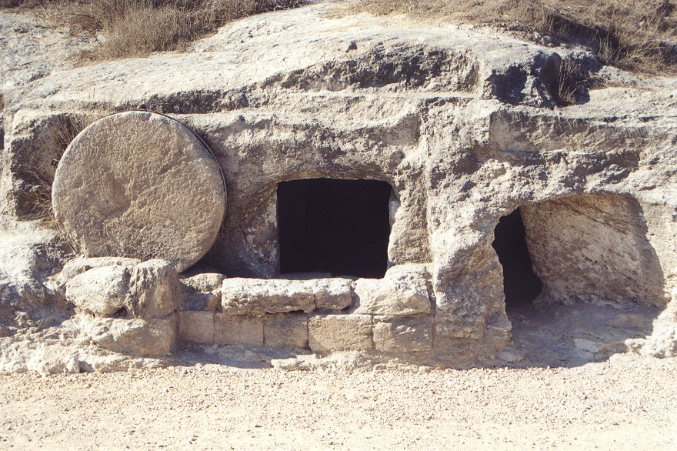
Notes:
43

Slide 44
What is Your Response?
Mark 16:25 “But what about you?” he asked, “Who do you say I am?
A mere man?
A myth?
A dangerous man?
Messiah, Lord and Savior who is calling you to repent.

Slide 45
The Resurrection
John 2:18-19 Destroy this temple and I will raise it in three days.

Slide 46
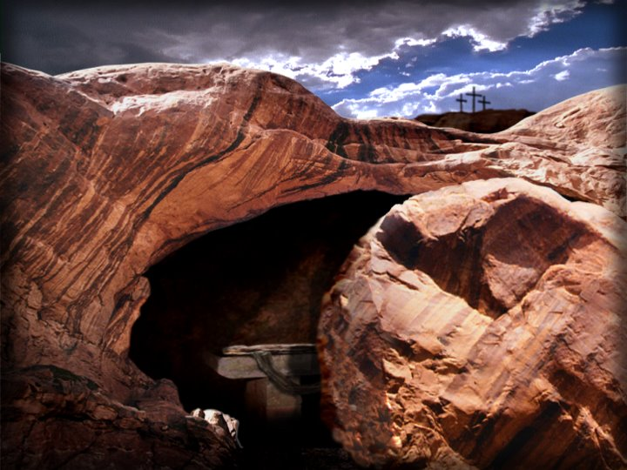
The Resurrection of Jesus from the dead
Romans 6:5,11 “If we have been united with him in his death, we will also certainly be united with him in his resurrection… In the same way, count yourself dead to sin but alive to God in Christ.

