Slide 1
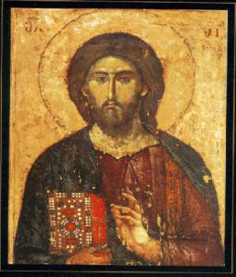
Jesus and Christian Apologetics
I Who Was Jesus of Nazareth?
II The Miracles of Jesus
John Oakes
Foster Stanback

Slide 2
ARS recent debate: Jesus: Man, Myth or Messiah?
The trilemma (C. S. Lewis) Liar, Lord, Lunatic
More modern version (Doug Jacoby) Liar, Lord, Lunatic, Legend

Slide 3
Who Was Jesus?
Sage
Prophet
Liar
Crazy person
Messiah
Son of Man
God in the flesh
Legend/Myth
Man (ie. mere man)
An important religious leader among many

Slide 4
Our Outline
I Claims of Jesus
II Jesus and Other Religious Leaders
III Extra-Biblical sources on Jesus
IV Reliability of the Witnesses
V Messianic Prophecies
VI The Jesus Myth Hypothesis
VII Transformed Lives
VIII The Miracles of Jesus
IX The Resurrection

Slide 5
I. The Claims of Jesus
If we can assume the gospels faithfully record the claims of Jesus then he is either:
  Crazy
  A manipulative liar
  Or
  The Messiah and Son of God.

Slide 6
JESUS’ CLAIMS ABOUT HIMSELF IN THE BOOK OF JOHN
Claim of Jesus | Scripture | Hearer’s Response
Fulfilled all the O.T. prophecies of the Messiah | John 5:39 | Refused to come to him
I am the bread of life | John 6:35 | Grumbled
A life without sin | John 8:46 | Jesus is demon-possessed (crazy)
I AM God | John 8:58 | Attempted to stone him
I and the Father are one | John 10:30 | Attempted to stone him
I am the resurrection and the life | John 11:25 | Plotted to murder him
I am the only way to God | John 14:6 | No negative response (Jesus talking to disciples)

Slide 7
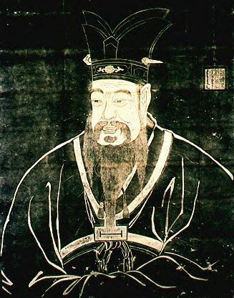
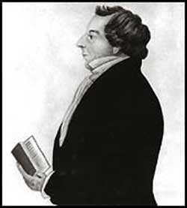
II. Is Jesus just one of many similar religious leaders?
Confucius
Joseph Smith

Slide 8
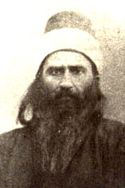
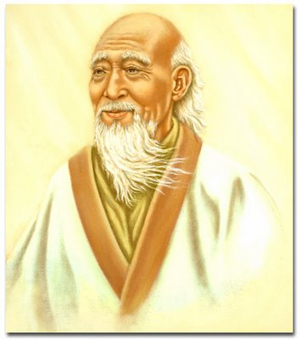
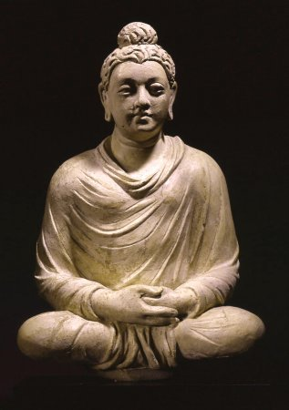
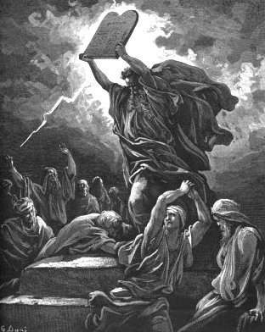
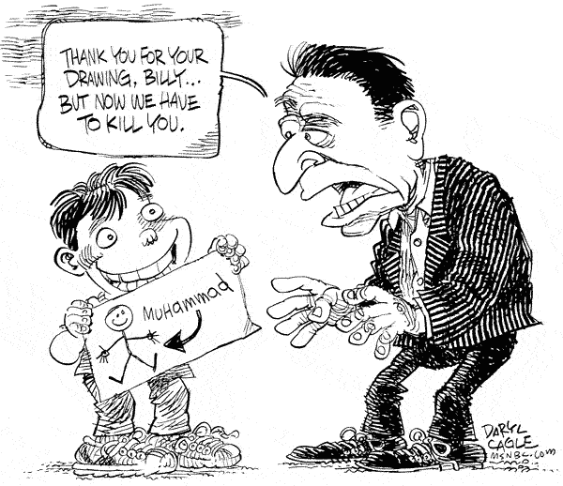
Lao Tzu
Baha’u’llah
Buddha
Moses
Is Jesus a Guru?
A Great Prophet?
One of Many Important Spiritual Leaders?
Muhammad?

Slide 9
III. Jesus and Extra-Biblical Sources
Roman (7)
Jewish (2)
Christian (33)

Slide 10
Cornelius Tacitus approx AD 114
Not all the relief that could come from the man, not all the bounties that the prince could bestow, nor all the atonements which could be presented to the gods, availed to relieve Nero from the infamy of bbeing believed to have ordered the conflagration, the fire of Rome. Therefore, to squelch the rumor, Nero created scapegoats and subjected to the most refined tortures those whom the common people called ‘Christians,’ [a group] hated for their abominable crimes. Their name comes from Christ, who, during the reign of Tiberius, had been executed by the procurator Pontius Pilate. Suppressed for the moment, the deadly superstition broke out again, not only in Judea, the land which originated this evil, but also in the city of Rome, where all sorts of horrendous and shameful practices, from every part of the world converge and are fervently cultivated.
Annals 15.44

Slide 11
Josephus AD 38-100
About this time there lived Jesus, a wise man, if indeed one ought to call him a man. For he was one who wrought surprising feats and was a teacher of such people as accept the truth gladly. He won over many Jews and many of the Greeks. He was the Messiah. When Pilate, upon hearing him accused by men of the highest standing amongst us, had condemned him to be crucified, those who had in the first place come to love him did not give up their affection for him. On the third day he appeared to them restored to life, for the prophets of God had prophesied these and countless other marvelous things about him. And the tribe of Christians, so called after him, has still to this day not disappeared.
Antiquities 18:3:3

Slide 12
Talmud (1st and 2nd Century AD)
On the eve of Passover they hung Yeshu and the crier went forth for forty days beforehand declaring that "[Yeshu] is going to be stoned for practicing witchcraft, for enticing and leading Israel astray. Anyone who knows something to clear him should come forth and exonerate him." But no one had anything exonerating for him and they hung him on the eve of Passover. Ulla said: Would one think that we should look for exonerating evidence for him? He was an enticer and G-d said (Deuteronomy 13:9) “Show him no pity or compassion and do not shield him.” him? He was an enticer and G-d said (Deuteronomy 13:9) "Show him no pity or chow him no pity or compassion,”
Babylonian Sanhedrin 43a-b

Slide 13
Seutonius (about AD 120)
"As the Jews were making constant disturbances at the instigation of Chrestus, he (Claudius about AD 50) expelled them from Rome”

Slide 14
Lucian of Samosata
The Christians, you know, worship a man to this day—the distinguished personage who introduced their novel rites, and was crucified on that account… You see, these misguided creatures start with the general conviction that they are immortal for all time, which explains the contempt of death and voluntary self-devotion which are so common among them; and then it was impressed on them by their original lawgiver that they are converted, and deny the gods of Greece, and worship the crucified sage, and life after his laws.
(Lucian The Death of Peregrine)

Slide 15
Pliny the Younger AD 112
Those who denied that they were or had been Christians, when they invoked the gods in words dictated by me, offered prayer with incense and wine to your image, which I had ordered to be brought for this purpose together with statues of the gods, and moreover cursed Christ — none of which those who are really Christians, it is said, can be forced to do — these I thought should be discharged. Others named by the informer declared that they were Christians, but then denied it, asserting that they had been but had ceased to be, some three years before, others many years, some as much as twenty-five years. They all worshiped your image and the statues of the gods, and cursed Christ

Slide 16
Thallus AD 50
We know of Thallus only from a third century Christian historian named Julius Africanus who wrote a three-volume treatise of world history in the 50s AD. In discussion the darkness at the time of the resurrection of Jesus, Julius Africanus mentions that in the 3rd book of Thallus’ history, he mentions the darkness and calls it an eclipse of the sun. Africanus believes that Thallus is wrong. Whether or not this source proves the darkness at the time of Jesus’ crucifixion is dubious, but it does seem to support the idea that even non-Christians were aware of the resurrection as early as the 50s AD—at about the time the first book of the NT was written. It also supports the claim, not necessarily of the darkness having occurred, but of the darkness having been claimed and believed by the Christians. Because we do not have Thallus’ history and because we have a Christian interpreting rather than quoting it, this is rather dubious support to Christian claims.

Slide 17
V. Are the Gospel Witnesses Reliable?
Martyrdoms. (Romans 5:6-8)
  James, the brother of Jesus AD 62 (Josephus Ant 20.9.1)
  Apostle James, brother of John (Acts 12:1-2)
  Peter and Paul in Rome about AD 64
  Tradition: all but John
Compare to the Book of Mormon.
  Three witnesses
  Eight witnesses

Slide 18
Reliability of the Gospel writers
The embarrassment factor.
Written and read in Jerusalem when could be refuted.
Galatians AD 49 1 Corinthians AD 55 Mark AD 60?
Independent attestation.
Luke the historian.

Slide 19
Sir William Ramsay
I found myself brought into contact with the Book of Acts as an authority for the topography, antiquities, and society of Asia Minor. It was gradually borne upon me that in various details the narrative showed marvelous truth. In fact, beginning with a fixed idea that the work was essentially a second century composition, and never relying on its evidence as trustworthy for first century conditions, I gradually came to find it a useful ally in some obscure and difficult investigations.
Luke is a historian of the first rank; not merely are his statements of fact trustworthy; he is possessed of the true historic sense; he fixes his mind on the idea and plan that rules in the evolution of history, and proportions the scale of his treatment to the importance of each incident. He seizes the important and critical events and shows their true nature at greater length, while he touches lightly or omits entirely much that was valueless for his purpose. In short, this author should be placed along with the very greatest of historians.
Sir William Ramsay, St. Paul, the Traveler and the Roman Citizen, (Hodder and Stoughton, 1920).

Slide 20
VI. The Jesus Myth Myth
Is the biblical Jesus an interpolated “Christian” myth?
Adonis (Greek)
Osiris (Egypt)
Tammuz (Egypt)
Dionysus (Greek)
Mithra (Persia)
Krishna (India)
Appolonius of Tyana
Peregrinus
Empodocles
Attis
Hercules
Romulus
Baal

Slide 21
Osiris
An Egyptian god/man. Very obviously a mythical figure.
Killed by his brother. Body cut up into 13 pieces. His wife Isis reassembles and sews back together 12 of the 13 pieces (see the parallel to the apostles?) He comes back to life and goes to rule in the underworld to judge the living and dead.

Slide 22
Appolonius of Tyana
A miracle worker. A Pythagorean in the city of Tyana in 1st century AD. Saves a friend in Corinth. Predicts a plague in Ephesus. Says: stone this beggar to death to end the plague. The do so, and when they remove the stones they find a large dog alive and well. Appolonius disappears and is never seen again.
No death. No resurrection. No ascension.
Only one very unreliable source. 100+ years after he died. No eye witness testimony. Which story is mythical?

Slide 23
Christian Myths
Acts of Peter (3rd century) Peter squares off with Simon Magus. A dog tells Simon Magus to repent. Jesus raises a smoked fish to life.
Gospel of Thomas. Jesus works whacky miracles as a baby which seem quite silly. Jesus kills a child for carelessly bumping into him.
There is nothing like this is the New Testament.

Slide 24
Conclusion
Given Jesus’ claims about himself
Given the historical evidence, both from Christian and Pagan sources
Given the strong evidence that Jesus worked wonders and signs.
Given the quality and quantity of the witnesses
Given the fulfillment of clear messianic prophecies
and... Given the evidence for the resurrection
I conclude that Jesus is the Son of God, the Messiah. Jesus is who he said he was.

Slide 25
One More Point: VII. Changed Lives
Jesus has had more influence on human history than any other person.
How to explain the vitality and growth of a religious movement started by uneducated, ordinary men.
Millions of lives transformed by a personal experience with Jesus Christ.

Slide 26
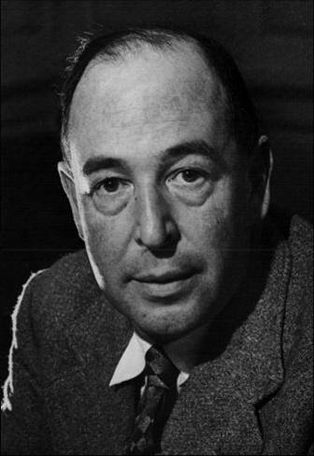
Miracles
What is a miracle?
Lewis: I use the word miracle to mean an interference with nature by a supernatural force.”
Webster: “A miracle is an event which apparently contradicts know scientific laws”
Oakes: An event which requires the intervention of God
C. S. Lewis

Slide 27
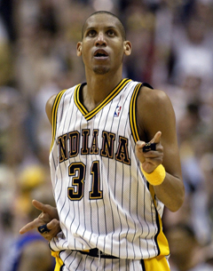
Miracles?
Reggie Miller scores 9 points in last 11 seconds to win a playoff game.
1969 “Miracle Mets”
A man rescued after 28 days in the rubble in Haiti
Miraculous transformation of lives by God

Slide 28
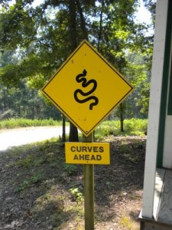
Miracles: Acts 2:22
Jesus… accredited by… miracles, wonders and signs.
miracle = dunamis “Power or ability, physical or moral, residing in a person or thing.”
wonder = teras “Something strange… a marvel”
sign = semeion “Sign or signal”
In apologetics we are most interested in the third definition.

Slide 29
Do Miracles Happen?
If miracles happen then supernatural/God exists, but that is circular reasoning.
What does science tell us?
Science cannot answer the question of miracles; it can only help us to define the miraculous.
If that happened, it would definitely be a miracle!

Slide 30
VIII. Jesus and Miracles
Four Possibilities:
  He neither worked miracles nor claimed to work miracles
  He claimed to work miracles, but he was a charlatan.
  He worked genuine miracles, but as a sorceror/by the power of Satan.
  He worked genuine miracles and his claims about himself are validated by those miracles.

Slide 31
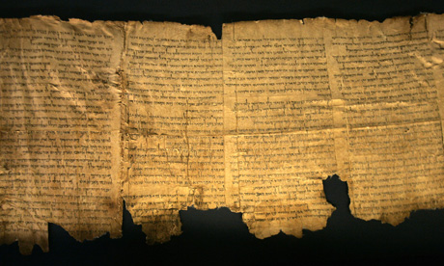
The Jews Expected the Messiah to Give Miraculous Signs
4Q5:21

Slide 32
Reasons to believe Jesus worked miracles
1. A great number of the miracles were done publicly, often in front of the
greatest skeptics and harshest critics of Jesus.
2. There were tens of thousands of eyewitnesses from every background to
these events.
3. The apostles openly proclaimed that Jesus worked a great variety of
miracles during the lifetime of those who could have refuted the claims.
4. Both Roman and Jewish histories report at least the general fact that
Jesus worked “wonders.”
5. Pharisees and Rabbis did not deny miracles, but instead claimed Jesus
did his signs by the power of demons.
6. Those who recorded the miracles as eye-witnesses (the gospel writers
except Luke) have every appearance of being credible.

Slide 33
Josephus AD 38-100
About this time there lived Jesus, a wise man. For he was one who wrought surprising feats and was a teacher of such people as accept the truth gladly. He won over many Jews and many of the Greeks. When Pilate, upon hearing him accused by men of the highest standing amongst us, had condemned him to be crucified, those who had in the first place come to love him did not give up their affection for him. For the prophets of God had prophesied these and countless other marvelous things about him. And the tribe of Christians, so called after him, has still to this day not disappeared.
Antiquities 18:3:3

Slide 34
Talmud (1st and 2nd Century AD)
On the eve of Passover they hung Yeshu and the crier went forth for forty days beforehand declaring that "[Yeshu] is going to be stoned for practicing witchcraft, for enticing and leading Israel astray. Anyone who knows something to clear him should come forth and exonerate him." But no one had anything exonerating for him and they hung him on the eve of Passover. Ulla said: Would one think that we should look for exonerating evidence for him? He was an enticer and G-d said (Deuteronomy 13:9) “Show him no pity or compassion and do not shield him.” him? He was an enticer and G-d said (Deuteronomy 13:9) "Show him no pity or chow him no pity or compassion,”
Babylonian Sanhedrin 43a-b

Slide 35
Why Did Jesus Do Miracles?
Because he had compassion. Matt 14:14
To fulfill prophecy. Matt 12:40
To validate his message. John 10:36-39
Because of people’s faith. Matt 15:21-28
To create faith in people. John 20:30-31
Because his mom asked him to. John 2:1-11

Slide 36
The Miracles of Jesus
Why he did it
What it tells us about Jesus
Go and report to John what you hear and see: The blind receive sight, the lame walk, those who have leprosy are cured, the deaf hear, the dead are raised, and the good news is preached to the poor. Matthew 11:4-5

Slide 37

John 2:1-11 Water to Wine
Jesus the Creator
Why? To meet a need and because his mom asked him to.

Slide 38
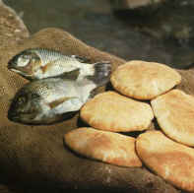
John 6:1-14 Feeding 5000
Surely this is the Prophet!
Jesus the creator and the sustainer of life
Jesus is “the bread of life”
Jesus is spiritual food
Jesus the source of eternal life

Slide 39
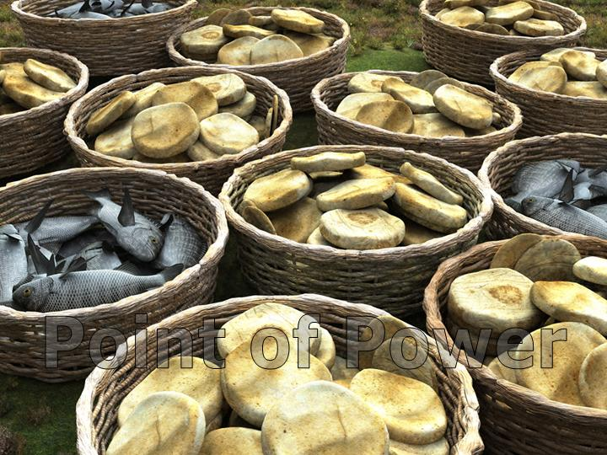
Jesus, Miracle Worker
John 6:35 “I am the bread of life. He who comes to me will never go hungry, and he who believes in me will never be thirsty”
John 6:1-15 Jesus feeds 5000 men, plus women and children.

Slide 40
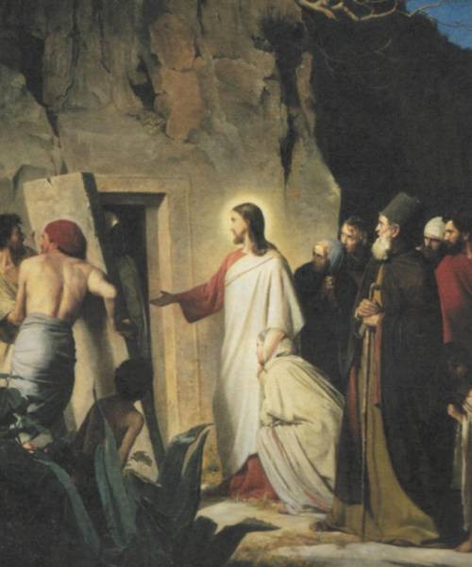
John 11:1-53 Jesus Raises Lazarus
Jesus is the resurrection and the life.
Jesus will raise those who put their faith in him.
  Hundreds present
  The smell of death was strong
  Lazarus came out
  Look at the responses. There are only two rational responses to Jesus the miracle-worker.

Slide 41
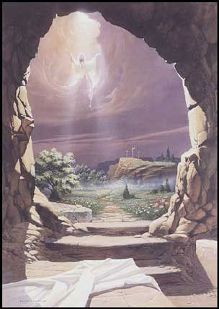
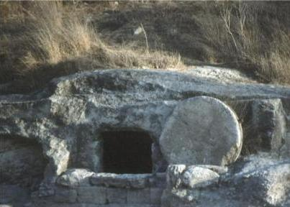
The Ultimate Miracle: The Resurrection of Jesus

Slide 42
Why is the resurrection so important?
1 Cor 15:13-19 If Christ has not been raised then your faith is futile; you are still in your sins.
If Jesus was raised, then there is life after death.

Slide 43
“Extraordinary claims require extraordinary proof”
David Hume

Slide 44
Fact #1
Jesus of Nazareth was crucified under Pontius Pilate in Jerusalem

Slide 45
Fact #2
From the very beginning, the church unanimously claimed that Jesus was resurrected

Slide 46
Fact #3
The tomb was empty

Slide 47
Fact #1
Jesus of Nazareth was crucified under Pontius Pilate in Jerusalem

Slide 48
Josephus AD 38-100
About this time there lived Jesus, a wise man. For he was one who wrought surprising feats and was a teacher of such people as accept the truth gladly. He won over many Jews and many of the Greeks. When Pilate, upon hearing him accused by men of the highest standing amongst us, had condemned him to be crucified, those who had in the first place come to love him did not give up their affection for him. The prophets of God had prophesied these and countless other marvelous things about him. And the tribe of Christians, so called after him, has still to this day not disappeared.
Antiquities 18:3:3

Slide 50
Cornelius Tacitus approx. AD 114
To squelch the rumor [that he had started the Great fire in Rome], Nero created scapegoats and subjected to the most refined tortures those whom the common people called ‘Christians,’ [a group] hated for their abominable crimes. Their name comes from Christ, who, during the reign of Tiberius, had been executed by the procurator Pontius Pilate.
Annals 15.44

Slide 51
Talmud (1st and 2nd Century AD)
On the eve of Passover they hung Yeshu
Babylonian Sanhedrin 43a-b

Slide 52
Thallus
We know of Thallus only from a third century Christian historian named Julius Africanus who wrote a three-volume treatise of world history in the 50s AD. In discussion the darkness at the time of the resurrection of Jesus, Julius Africanus mentions that in the 3rd book of Thallus’ history, he mentions the darkness and calls it an eclipse of the sun. Africanus believes that Thallus is wrong. Whether or not this source proves the darkness at the time of Jesus’ crucifixion is dubious, but it does seem to support the idea that even non-Christians were aware of the resurrection as early as the 50s AD—at about the time the first book of the NT was written. It also supports the claim, not necessarily of the darkness having occurred, but of the darkness having been claimed and believed by the Christians. Because we do not have Thallus’ history and because we have a Christian interpreting rather than quoting it, this is rather dubious support to Christian claims.

Slide 53
Fact #2
From the very beginning, the church unanimously claimed that Jesus was resurrected
Acts 2:24 But God raised him from the dead…
How else to explain the growth of the church?

Slide 54
Fact #3
The tomb was empty
If not….

Slide 55
Question:
What is the most reasonable explanation of the facts?
Jesus’ body was taken from the tomb.
Jesus did not actually die (swoon theory).
Jesus was bodily resurrected from the dead.

Slide 56
The Stolen Body Theory
Who would have stolen the body?
  The Jews?
  The Romans?
  The disciples?
Could they have stolen the body?
Did they, in fact, steal the body?

Slide 57
The Swoon Theory
Beaten to the point of near death.
No food or water for more than two days.
Crucified and died.
Pierced with a sword.
Separated blood and “water” (plasma)

Slide 58
The Mass Hallucination Theory
The women at the tomb.
Peter and John.
The twelve apostles, including doubting Thomas.
Many other appearances.
Over 500 witnesses.
Do hallucinations eat fish?

Slide 59
The Resurrection of the Messiah was prophesied
Genesis 22:1-12 Abraham received Isaac back from the dead on the third day. (Hebrews 11:17-19)
Jonah 1:7 Jonah was raised from the dead on the third day. (Matthew 11:40 For as Jonah was three days and three nights….)

Slide 60
Prophecies of the Resurrection
Feast of Firstfruits. Lev 23:9-14
Jesus is the firstfruit from among the dead. His resurrection is a promise of ours. Colossians “the first fruit from the dead.”
Romans 6:2-7 If we have been united with him in his death, we will certainly also be united with him in his resurrection.

Slide 61
Implications of the Resurrection:
Validates the claims of Jesus
  John 11 I am the resurrection and the life
It confirms that we, too, will be resurrected.
  1 Peter 1:3-4
It confirms that there will be a judgment day.
Our doubts become much less significant.
  What about…. Jesus was raised from the dead!

Slide 62
What Is Your Reasonable Response?
John 11:45-48 Either;
  Put your faith in Jesus or
  Radically reject him and all he stood for.
A Challenge:
Have Resurrection Faith.

