Slide 1
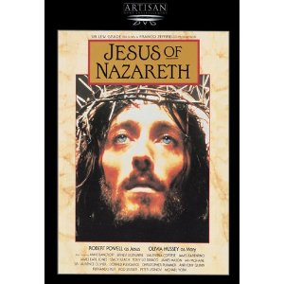
Who Is the Real Jesus?
Dr. John Oakes,
King’s College, London
June, 2014

Slide 2
Who Does This Man Think He Is?
The Claims of Jesus
Sage
Prophet
Liar
Crazy person
Messiah
Son of Man
God in the flesh
Legend/Myth
Man (ie. mere man)
An important religious leader among many

Slide 3
Was Jesus Insane?
Mark 3:22-30
His family: “He is out of his mind.”
Rabbis: “He is possessed by a demon.”
Jesus: This is totally illogical

Slide 4

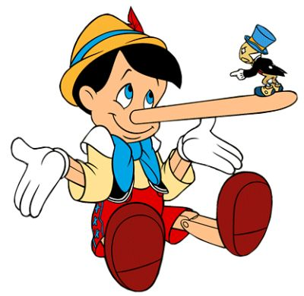
Was Jesus a Liar?
What do liars do?

Slide 5
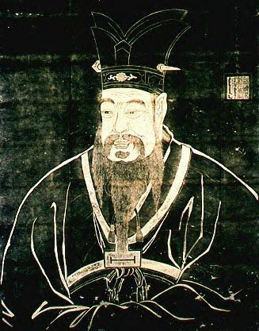
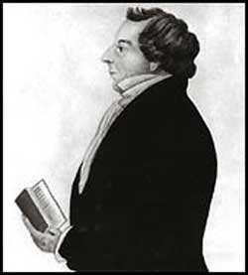
II. Is Jesus just one of many similar religious leaders?
Confucius
Joseph Smith

Slide 6
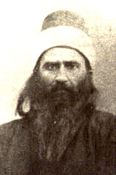
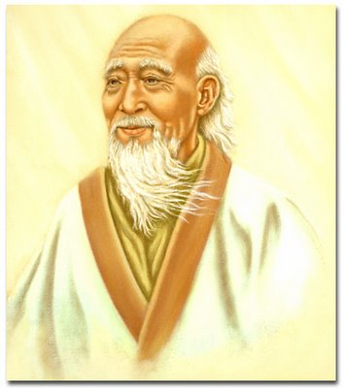
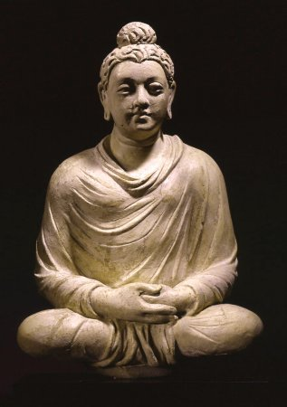
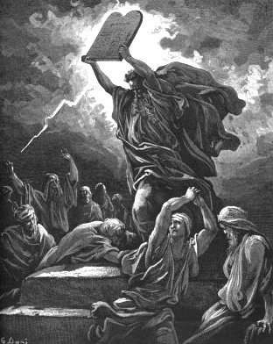
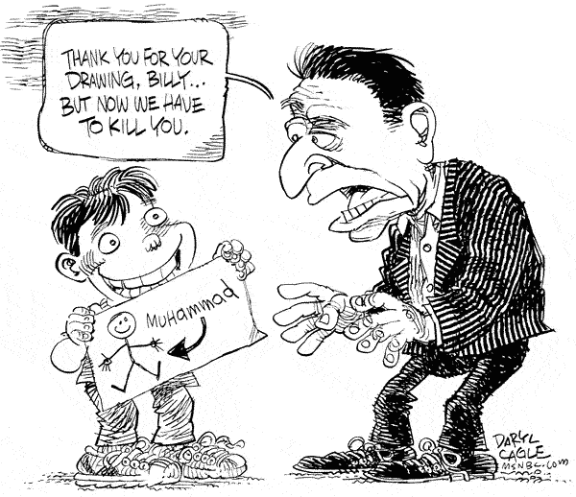
Lao Tzu
Baha’u’llah
Buddha
Moses
Is Jesus a Guru?
A Great Prophet?
One of Many Important Spiritual Leaders?
Muhammad?

Slide 7
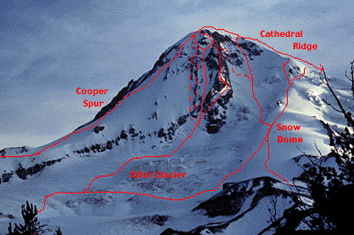
Different Paths to the Same Goal?
God
Islam
Ba’hai
Mysticism
Buddhism

Slide 8
Our Outline: Who Does This Man Think He Is?
Messianic Prophecies
Jesus: Miracle Worker
What is a Reasonable Conclusion?
What is a Reasonable Response?

Slide 9
Who Does This Man Think He Is?
The Claims of Jesus
John 8:46 Can anyone prove me guilty of sin?
Response: Is this guy crazy?
John 8:58 Before Abraham was born, I AM
Response: Picked up stones to stone him.
John 10:30 I and the Father are one.
Response: Picked up stones to stone him.
Matthew 28:18 All authority in heaven and earth
has been given to me.

Slide 10
So, Why Should I Believe These Claims? #1 Messianic Prophecies
Luke 24:44
He said to them, “This is what I told you while I was still with you: Everything must be fulfilled that is written about me in the Law of Moses, the Prophets and the Psalms.
John 5:39-40
You diligently study the Scriptures because you think that by them you possess eternal life. These are the Scriptures that testify about me, yet you refuse to come to me to have life.

Slide 11
Question #1: How do I know these prophecies were written hundreds of years before the events?
Septuagint translation of the Old Testament into Greek 220-150 BC
Dead Sea Scrolls.250-50 BC

Slide 12
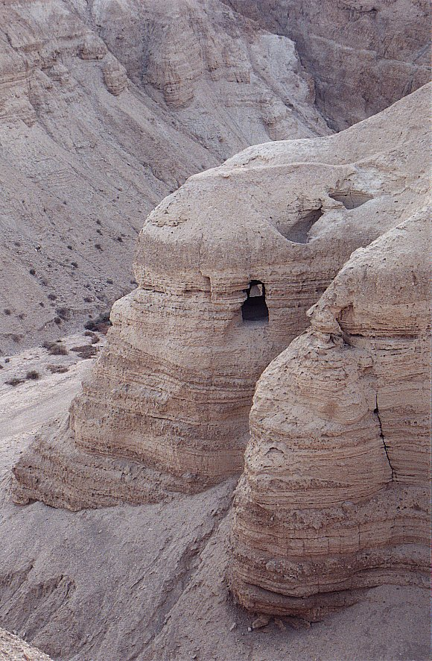
Qumran
Cave #4

Slide 13
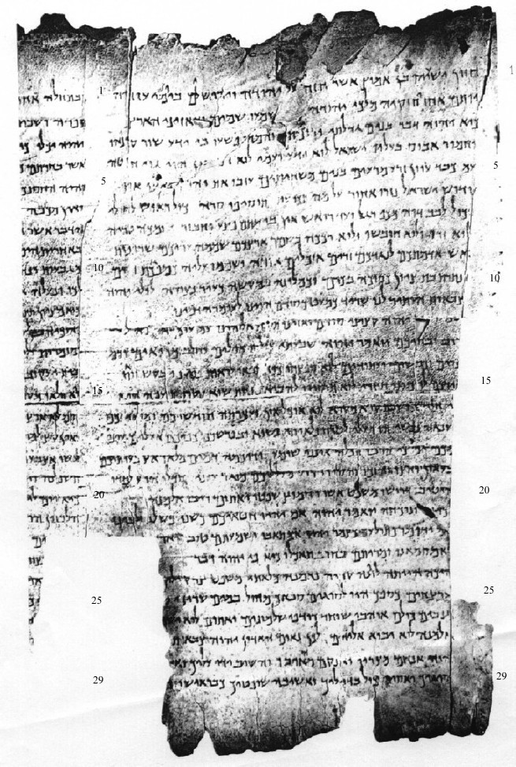
Column I
The Great Qumran Isaiah Scroll
150 BC

Slide 14
Question #2: How do I know these things really happened?
Josephus: “When Pilate, at the suggestion of the principal men among us, had condemned him to the cross, those that loved him at the first did not forsake him… And the tribe of Christians so named from him are not extinct to this day.”
Cornelius Tacitus: “Hence, to suppress the rumor, [Nero] falsely charged with the guilt and punished with the most exquisite tortures, the persons commonly called Christians, who were hated for their enormities. Christus, the founder of the name, was put to death by Pontius Pilate, procurator of Judea in the reign of Tiberius…
Jewish Talmud “On the eve of the Passover they hanged Yeshu and the herald went before him for forty days saying Yeshu… has practiced sorcery and beguiled and led astray Israel.

Slide 15
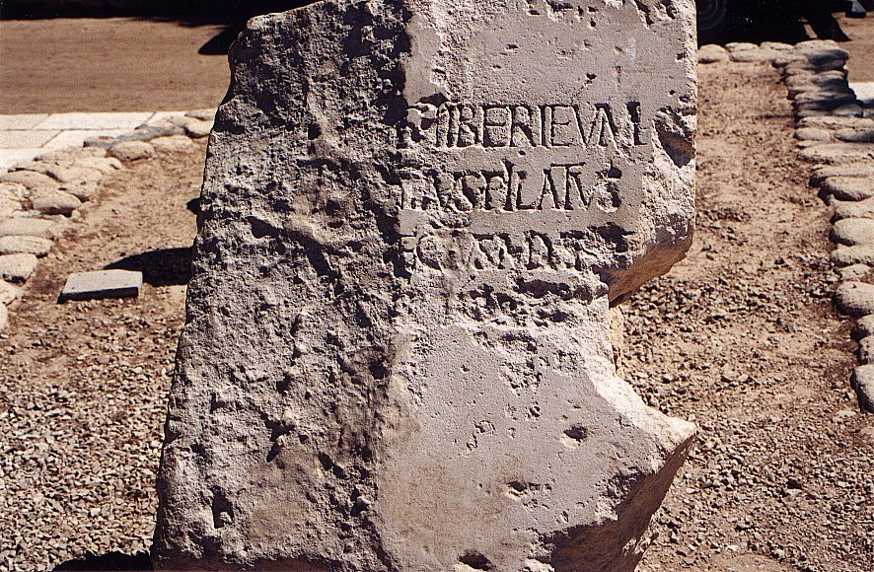
Tiberius Pontius Pilatus Procurator Judea

Slide 16
Question #3 Are these, in fact, prophecies of the Messiah? (or are we taking them out of context)
Hint: If the Jews themselves acknowledged them to be messianic, that is very strong evidence.

Slide 17
Question #4 Could Jesus, planning on deceiving the people into believing he was the Messiah, have read the Old Testament and tried to fulfill all the prophecies?

Slide 18
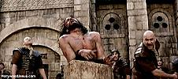

Slide 19
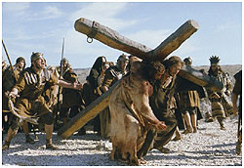

Slide 20
Isaiah 53:1-13:
He was despised and rejected by men, a man of sorrows, familiar with suffering. (v. 3)
But he was pierced for our transgressions, he was crushed for our iniquities; the punishment that brought us peace was upon him, and by his wounds we are healed. (v. 5) (John 19:31-37)
He was oppressed and afflicted, yet he did not open his mouth; he was led like a lamb to the slaughter and as a sheep before her shearers is silent, so he did not open his mouth. (v. 7)

Slide 21
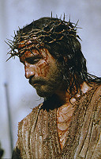

Slide 22
Micah 5:2
But you, Bethlehem Ephrathrah, though you are small among the clans of Judah, out of you will come for me one who will be ruler over Israel, whose origins are from old, from ancient times.
Isaiah 9:1,6
In the past he humbled the land of Zebulun and the land of Naphtali, but in the future he will honor Galilee of the Gentiles, by the way of the sea, along the Jordan…. For to us a child is born… And he will be called Wonderful Counselor, Mighty God, Everlasting Father, Prince of Peace.

Slide 23
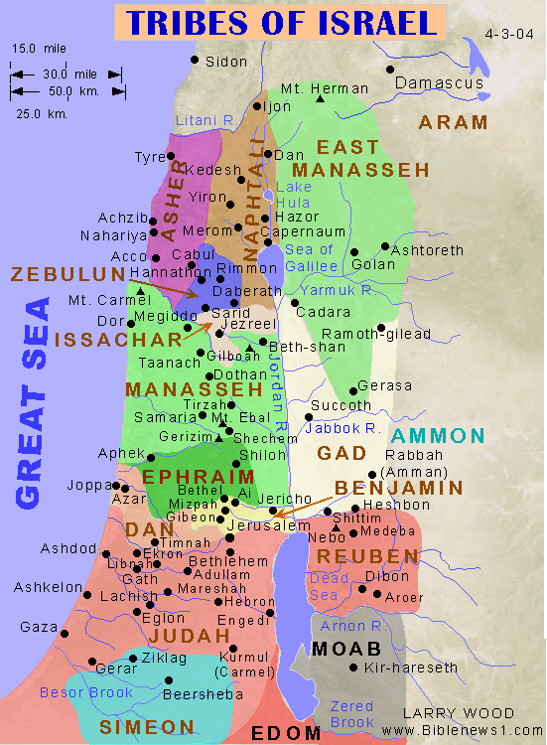

Slide 24
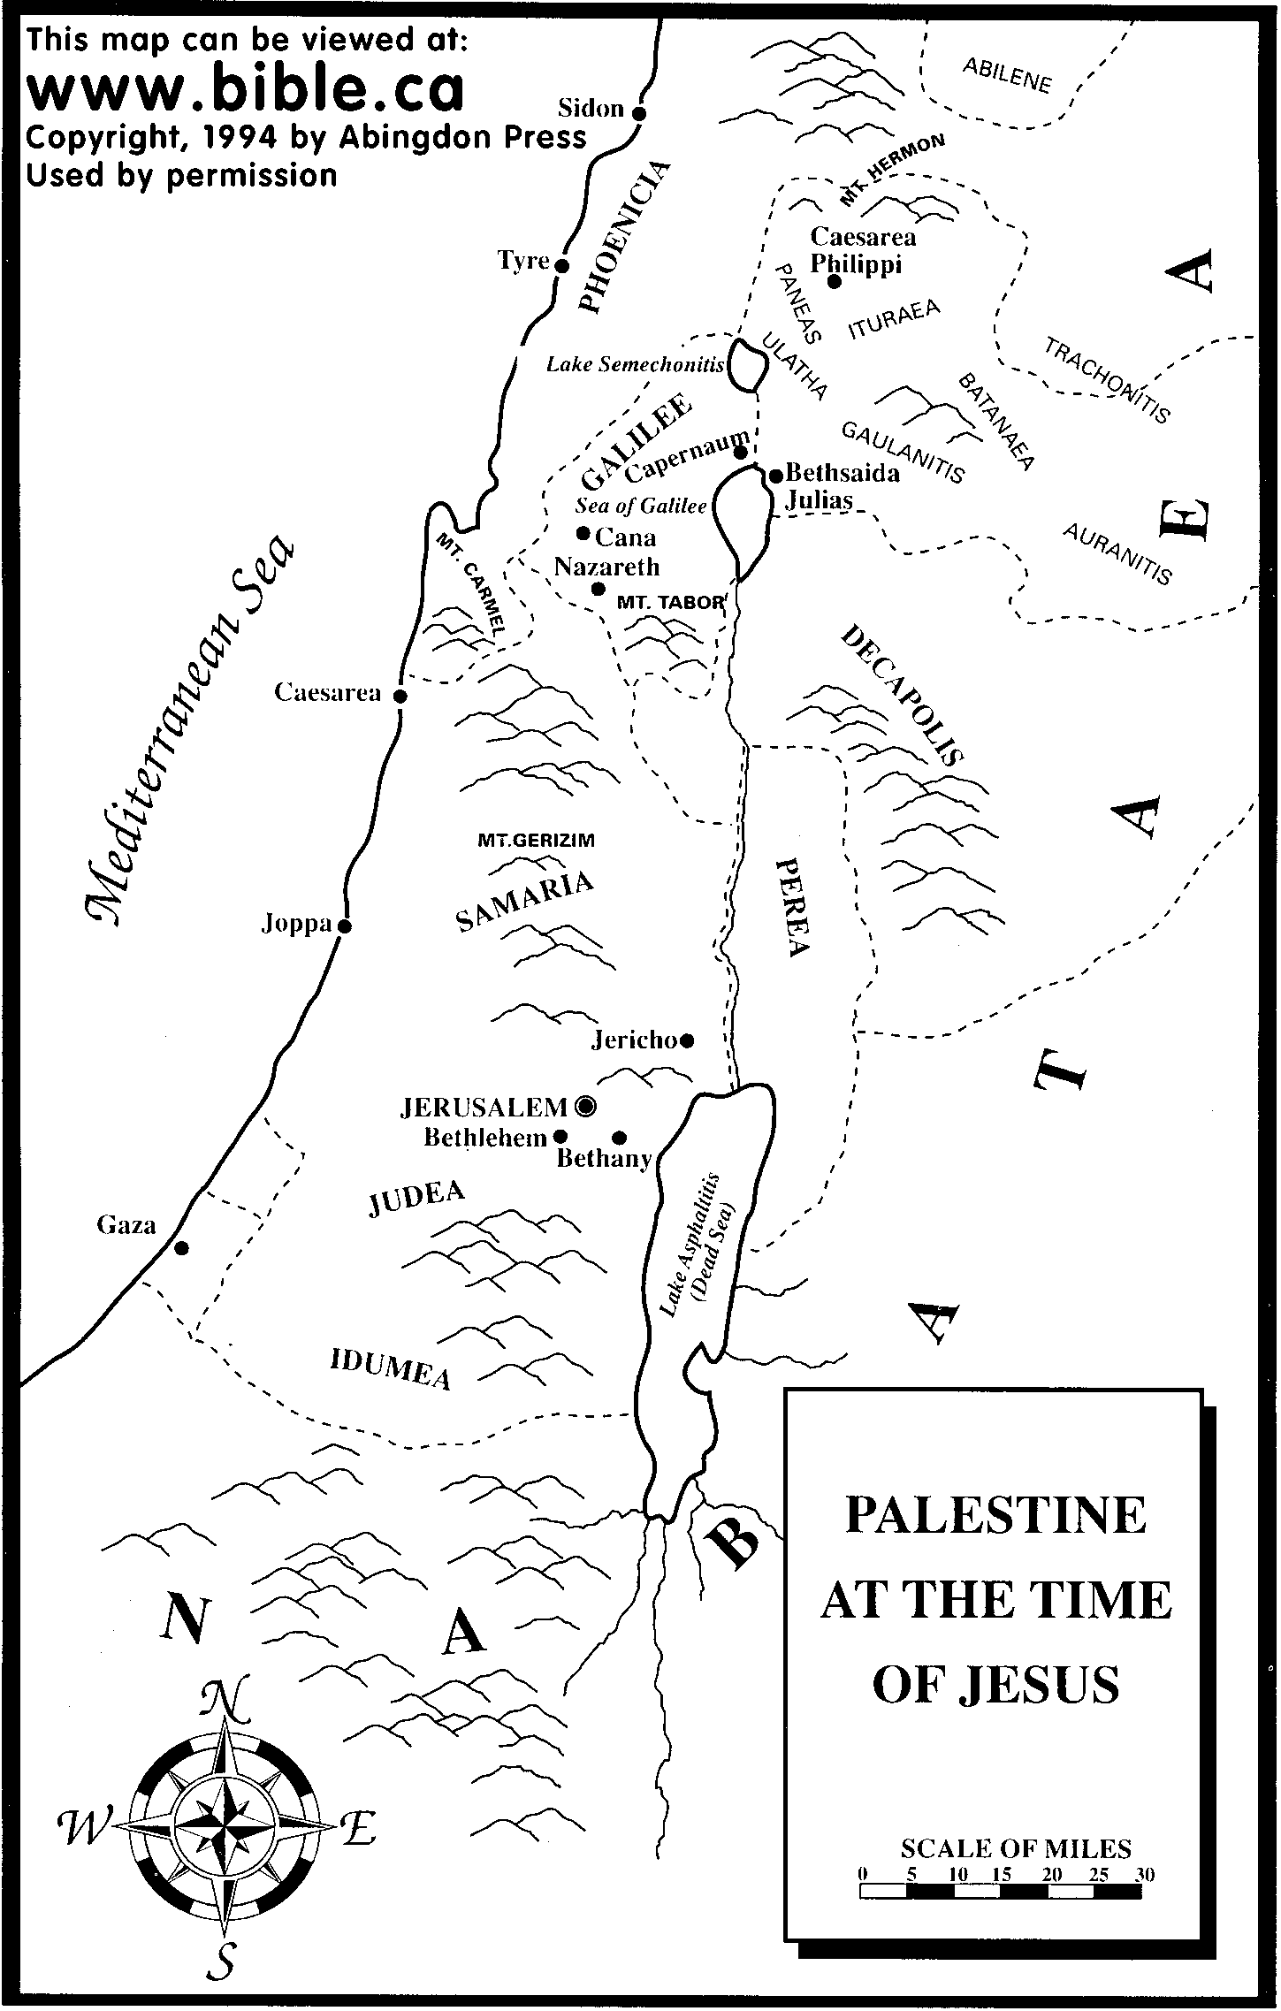

Slide 25
Psalm 22:16-18
Dogs have surrounded me;
a band of evil men have encircled me,
they have pierced my hands and my feet.
I can count all my bones; (John 19:3-37)
people stare and gloat over me.
They divide my garments among them
and cast lots for my clothing. (John 19:23,24)

Slide 26
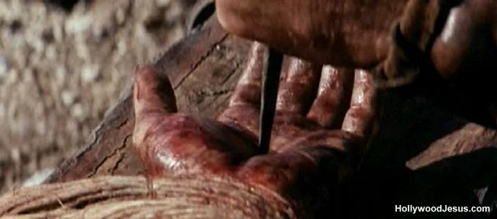

Slide 27
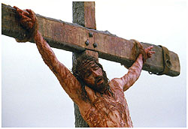

Slide 28
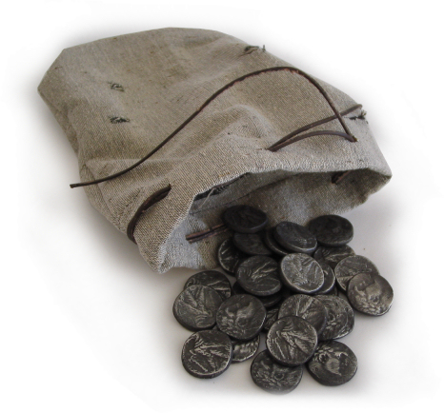
Zechariah 11:12,13
I told them, “If you think it best, give me my pay; but if not, keep it.” so they paid me thirty pieces of silver. (Matthew 26:14-16)
And the Lord said to me, “Throw it to the potter”—the handsome price at which they priced me! So I took the thirty pieces of silver and threw them into the house of the Lord, to the potter. (Matthew 27:3-8)

Slide 29
Daniel 9:24-26
Seventy ‘sevens’ are decreed for your people and your holy city to finish transgression, to put an end to sin, to atone for wickedness, to bring in everlasting righteousness, to seal up vision and prophecy and to anoint the most holy.
Know and understand this: From the issuing of the decree to restore and rebuild Jerusalem, until the Anointed One, the ruler comes, there will be seven ‘sevens’ and sixty two ‘sevens’
Decree of Artaxerxes (Ezra 7:12-26) 458 BC
458 BC - 490 years = -32 (no zero BC)

Slide 30
According to the Old Testament, the Messiah must:
Be born in Bethlehem
Be raised in Galilee near Nazareth
Be despised and rejected by men
Be meek and silent before his accusers
Be “pierced”
Be crucified
Have his garments divided and gambled over
Be betrayed for 30 pieces of silver
Come to Jerusalem to make atonement for sin in about AD 33
And many more….
Was all this an accident, or did God plan all along for the death of Christ for forgiveness of sins? What do you think?
Man, Myth or Messiah?

Slide 31
But There is More… A Lot More!
Historical Foreshadows
Prefigures of the Messiah

Slide 32
Foreshadows of the Messiah
You diligently study the Scriptures becauseyou think that by them you possess eternal life. These are the Scriptures that testify about me, yet you refuse to come to me to have life. John 5:39,40
Numbers 21:4-9 (John 3:14, Romans 6:23, 2 Corinthians 5:21)
Genesis 22:1-10 Abraham and Isaac

Slide 33
Prefigures of the Messiah
Jonah (Matthew 12:39-40, Jonah 1:12)
Adam
Melchizedek
Joseph
Moses
David
Elijah
Joshua
Deborah
Esther
Etc….

Slide 34
Parallels Between Moses and Jesus
Moses
Jesus
Pharaoh tried to kill him
Herod tried to kill him
Called by God to leave Egypt
Carried out of Egypt
Forty years in the wilderness to prepare for his ministry
Forty days in the wilderness to prepare for his ministry
Left his position with the king of Egypt to dwell with the Jews
Left the right hand of the Father to life with the Jews
Led Israel out of slavery in Egypt
Leads Spiritual Israel out of sin
Aaron prepared the way
John the Baptist prepared the way
Baptized Israel in the Red Sea in order to free them
Commands baptism in water for freedom from sin
Gave manna in the wilderness
(sort of)
Gives spiritual bread to all who hunger
Gave water to the people in the desert
Gives spiritual water: the Holy Spirit
Spoke to God on Mt. Sinai
Spoke to God on Mt. Hermon

Slide 35
So, Why Should I Believe These Claims?
#2 Jesus: Miracle Worker
Acts 2:22 “Jesus of Nazareth was a man accredited by God to you by miracles, wonders and signs, which God did among you through him, as you yourselves know.”
Jewish Talmud (1st Century) “Yeshu… has practiced sorcery.”

Slide 36
Jesus: Miracle Worker
John 10:30-33.
Is this a mere man? Look at the response.
John10:38 Even though you do not believe me, believe the miracles…

Slide 37
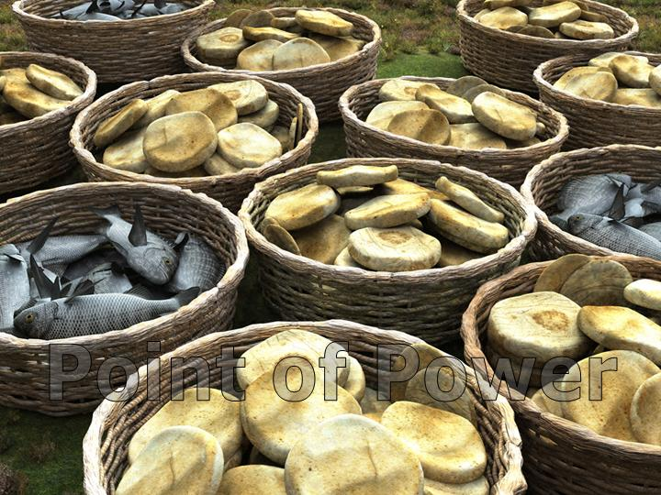
Jesus, Miracle Worker
John 6:48 “I am the bread of life. … If anyone eats of this bread he will live forever. This bread is my flesh, which I give for the life of the world.”
John 6:1-15 Jesus feeds 5000 men, plus women and children.
This miracle was very public!

Slide 38
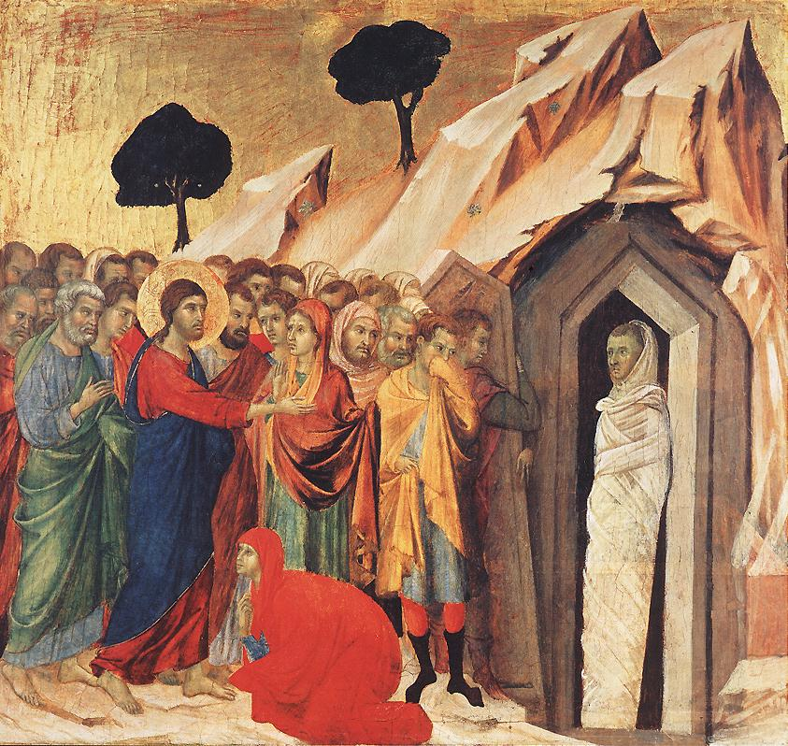
Jesus, Miracle Worker
John 11:25 “I am the resurrection and the life. He who believes in me will live, even though he dies.”
John 11:17-44 Jesus raises Lazarus from the dead.
Hundreds of eye-witnesses.

Slide 39
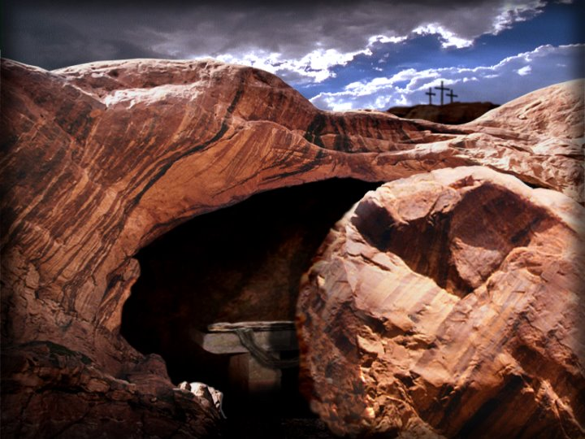
The Resurrection of Jesus from the dead
John 3:19 “Destroy this temple, and I will raise it again in three days.”
Fact: The tomb was empty.
Fact: The resurrection was preached, beginning in Jerusalem.
Fact: There were more than 500 eye-witnesses to the resurrection. 1 Cor 15:3-6.

Slide 40
What is Your Response to the Claims of Jesus?
John 11:45-54 Two reasonable responses to Jesus.
John 20:30 Jesus did many other miraculous signs in the presence of his disciples, which are not recorded in this book. But these are written that you may believe that Jesus is the Christ, the Son of God, and that by believing you may have life in his name.

Slide 41
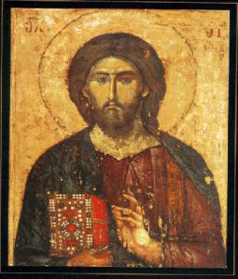
Questions?
www.evidenceforchristianity.org

