Slide 2
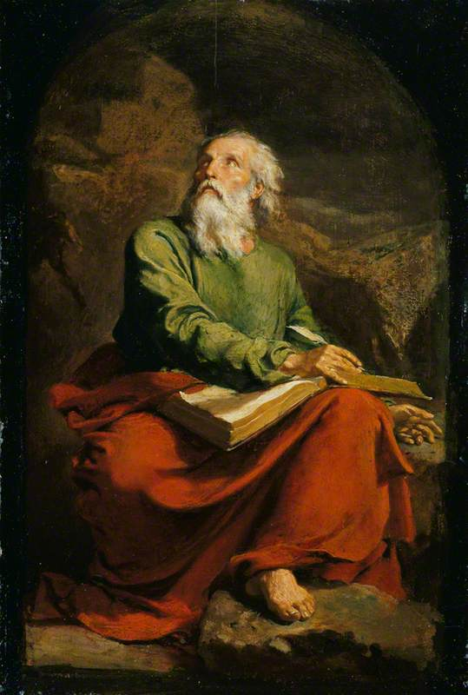
The Book of Isaiah I The Lord Is Salvation
John Oakes
July 18, 2021

Slide 3
One Outline of Isaiah
Isaiah 1-39 Messiah the king -Assyria
Isaiah 40-55 Messiah the Servant -Babylon
Isaiah 56-66 Messiah the Conqueror -World

Slide 4
Themes of isaiah
1. The utter sinfulness of Judah and Jerusalem
2. Appeal of God to turn to him—to repent.
3. Judgment if they do not.
4. The Messiah—the Suffering Servant—is coming to save.
5. Restoration of a Remnant

Slide 5
Isaiah ch. 1 Intro to Isaiah
Isaiah 1 themes
The utter sinfulness of Jerusalem/Judah (v 3-8)
Tender appeal by Jehovah that Judah repent (v. 16-19)
The inevitability of judgment (v. 24-25, 29-31)
The possibility of salvation (v. 26-27)

Slide 6
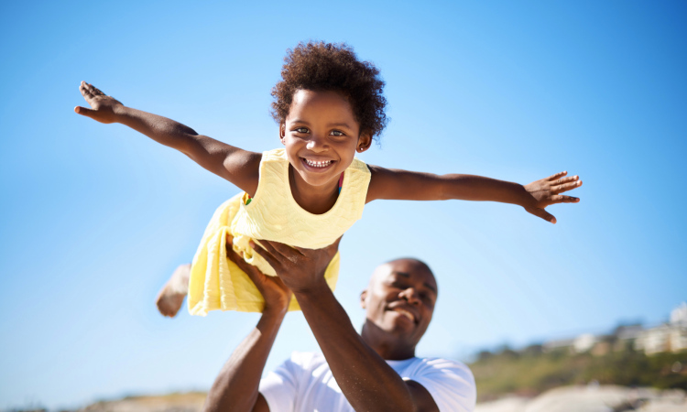
Isaiah 1:2-4
Isaiah 1:2 A courtroom scene, with Judah as defendant and the heavens and earth as witnesses.
(Deut 30:19)
v. 2-4 God: I have always maintained hesed. I have been like a parent with its children (Hos 11:1-4)

Slide 7
Like a Father for his children

Slide 8
Like a Father for his children

Slide 9
Isaiah 1:2-4
v. 3 The ox knows its master….
But we have rebelled. We are worse than dumb animals.
v. 3 yada know intimately
v. 4 My people (ammi as opposed to Lo-Ammi Hos 1)

Slide 10
ISAIAH 1:4-9
Would Judah agree with the assessment in 1:4?
Would you?
Isaiah 1:5-8 God’s compassion.
Isaiah 1:7 is literally true at this time for Judah under Sennacherib.
Isaiah 1:9 Hope. The remnant.
Remnant theology: Isaiah 10:20-23 Zeph 2:7-11, Hos 11:8-11, Ezek 5:1-3

Slide 11
Isaiah 1:10-20 God is angry. So repent!
Isaiah 1:10-15 God is very angry. Why? Empty religion without faithfulness/hesed.
v. 13 Could our worship become “worthless assemblies?”
Isaiah 1:16-17 Repent. How? By seeking justice.
Isaiah 1:18-20 Come, let us reason together. God offers salvation.
We can willingly obey or we can resist and rebel.

Slide 12
Though your sins are like scarlet

Slide 13
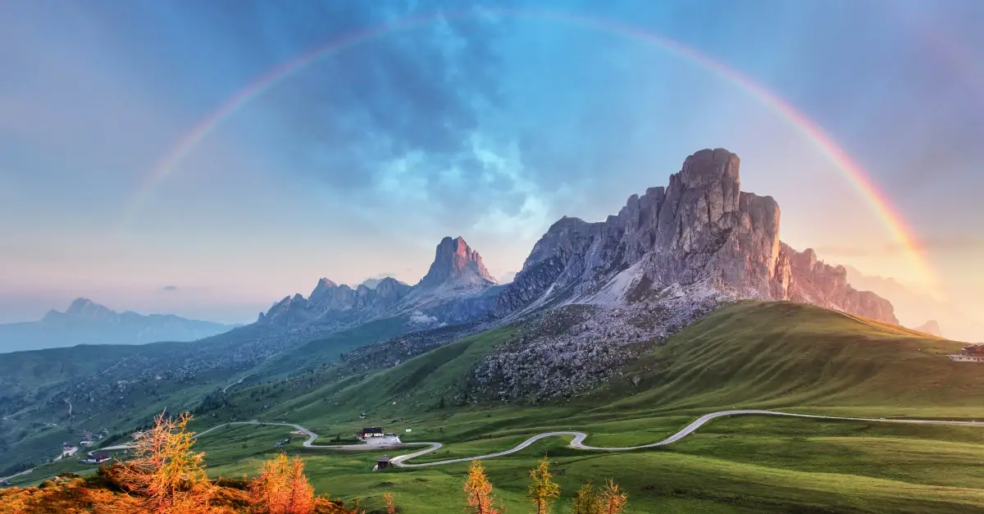
Isaiah 2:1-5 A Kingdom prophecy
Isaiah 2:2 In the last days Heb 1:2, Acts 2:17, Joel 2:28-32
The mountain of the Lord is Mt. Zion/Jerusalem/the kingdom of God (and maybe even the Church).
v. 3 Pentecost.
v. 4 Inscribed at the UN.

Slide 14
Isaiah 11:1-16 Another kingdom prophecy
Isaiah 11:1 A root, a branch of Jesse nazer
Matthew 2:23 He will be called the nazerene

Slide 15
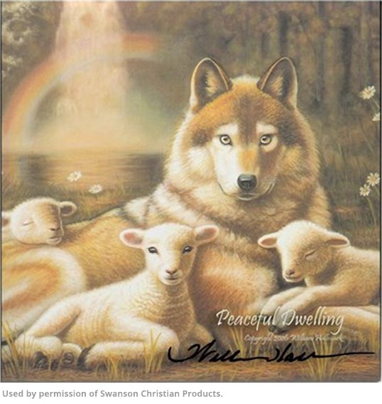
Isaiah 11:1-16 The Kingdom of god
v. 4-5 Messiah/Branch brings justice and righteousness.
v. 6-9 A kingdom of peace/shalom.
Already but not yet!
v. 10-16 A banner, a resting place, a gathered remnant, a highway to heaven.
Get the picture!

Slide 16
A highway for god’s people

Slide 17
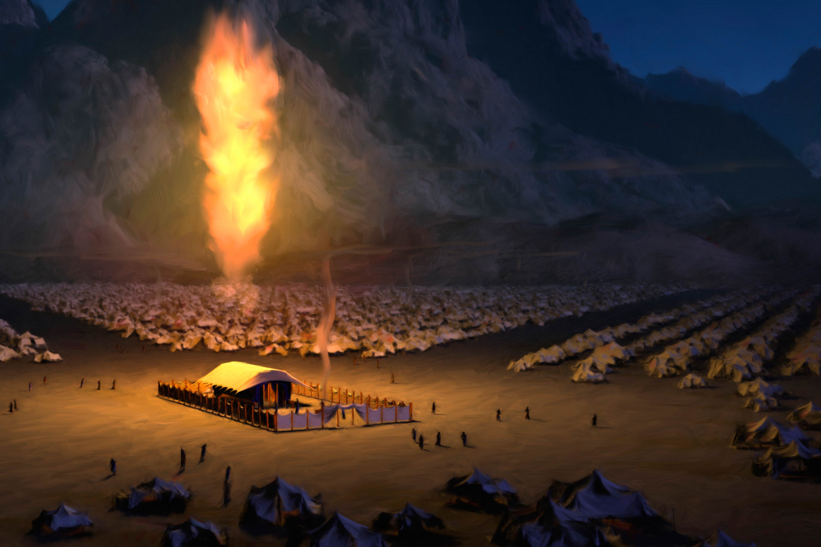
Isaiah 2:2-4 Isaiah 4:2-6 a sandwich
Isaiah 4:2 Branch will be beautiful and glorious.
Emphasis here on glory!!!
Isaiah 4:5 The shekinah—glory of God.
John 1:18

Slide 18
summary
The Lord is our salvation.
He has loved us like a father loves his children
But we rebelled
So God has disciplined us
But He is preparing a remnant.
He is calling us into his kingdom.
Jesus is our banner and he is our glory.

Slide 19
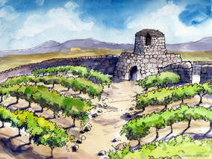
Isaiah 5 Song of the Vineyard
The vineyard is Israel and Judah. The vineyard is the church.
prepared the land
Set up a watchtower
Built a winepress—gave us work to do in the vineyard

Slide 20
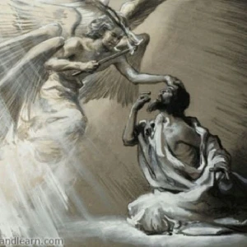
Isaiah 6 God commissions Isaiah
Holy, Holy, Holy…
Woe is me!
Sin removed.
Here am I, send me.
I am sending you to a stubborn people.
How long?
v. 13b. A ray of hope

