Slide 1
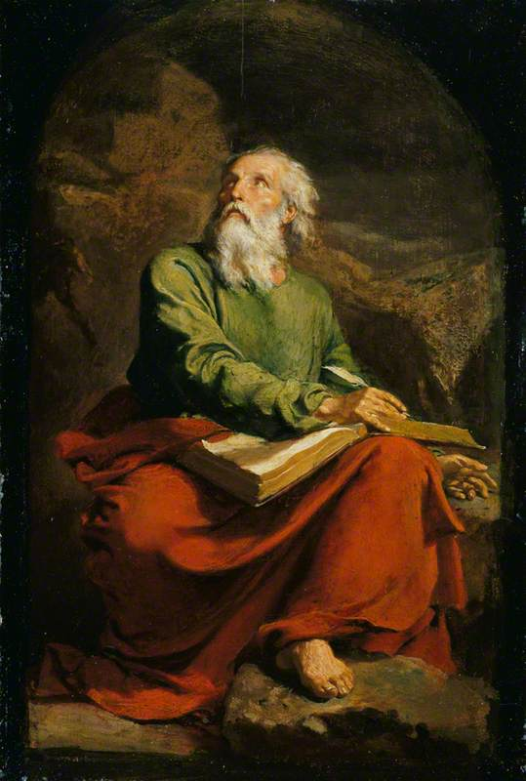
The Book of Isaiah II Here Am I, Send Me
John Oakes
July 25, 2021

Slide 2
Themes of isaiah
1. The utter sinfulness of Judah and Jerusalem
2. Appeal of God to turn to him—to repent.
3. Judgment if they do not.
4. The Messiah—the Suffering Servant—is coming to save.
5. Restoration of a Remnant

Slide 3
Isaiah 1:2-4
God: I have always maintained hesed. I have been like a parent with its children (Hos 11:1-4)

Slide 4
Isaiah 1:2-4
v. 3 The ox knows its master….
But we have rebelled. We are worse than dumb animals.

Slide 5
Though your sins are like scarlet

Slide 6
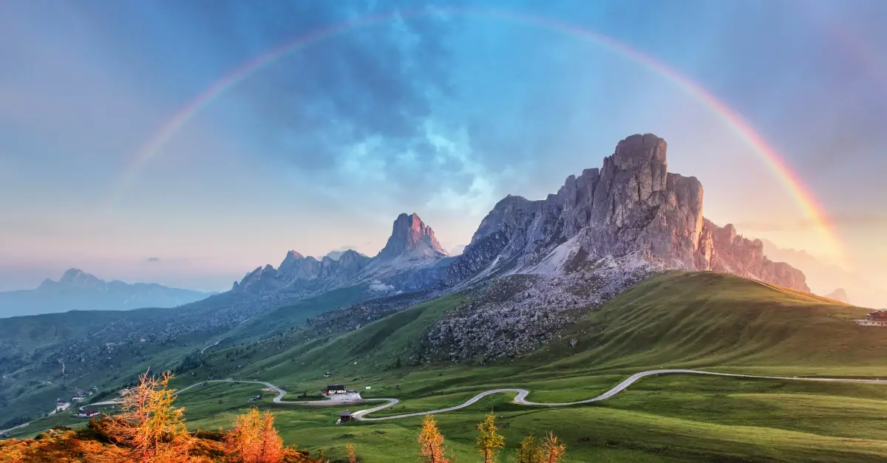
Isaiah 2:1-5 A Kingdom prophecy
The mountain of the Lord is Mt. Zion/Jerusalem/the kingdom of God.
The Law will go out from Zion.
Many nations!

Slide 7
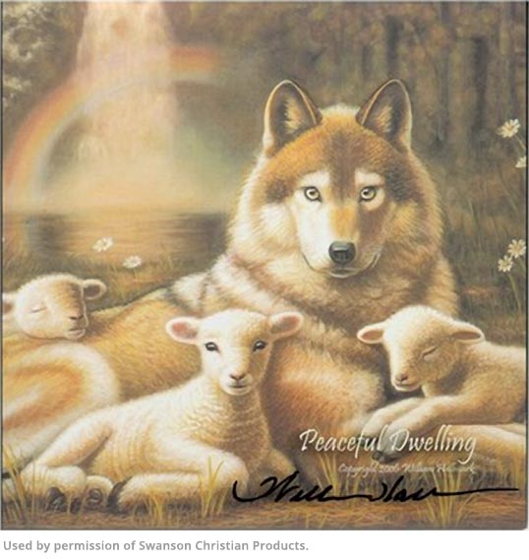
Isaiah 11:1-16 The Kingdom of god
v. 4-5 Messiah/Branch brings justice and righteousness.
v. 6-9 A kingdom of peace/shalom.
v. 10-16 A banner,
a resting place,
a gathered remnant,
a highway to heaven.

Slide 8
A highway for god’s people

Slide 9
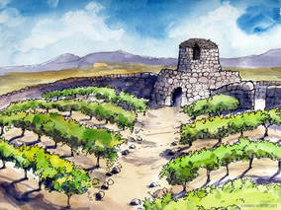
Isaiah 5 Song of the Vineyard
The vineyard is Israel and Judah. The vineyard is the church.
Prepared the land
Set up a watchtower
Built a winepress—gave us work to do in the vineyard
But God Expects Us To Yield a Crop!

Slide 10
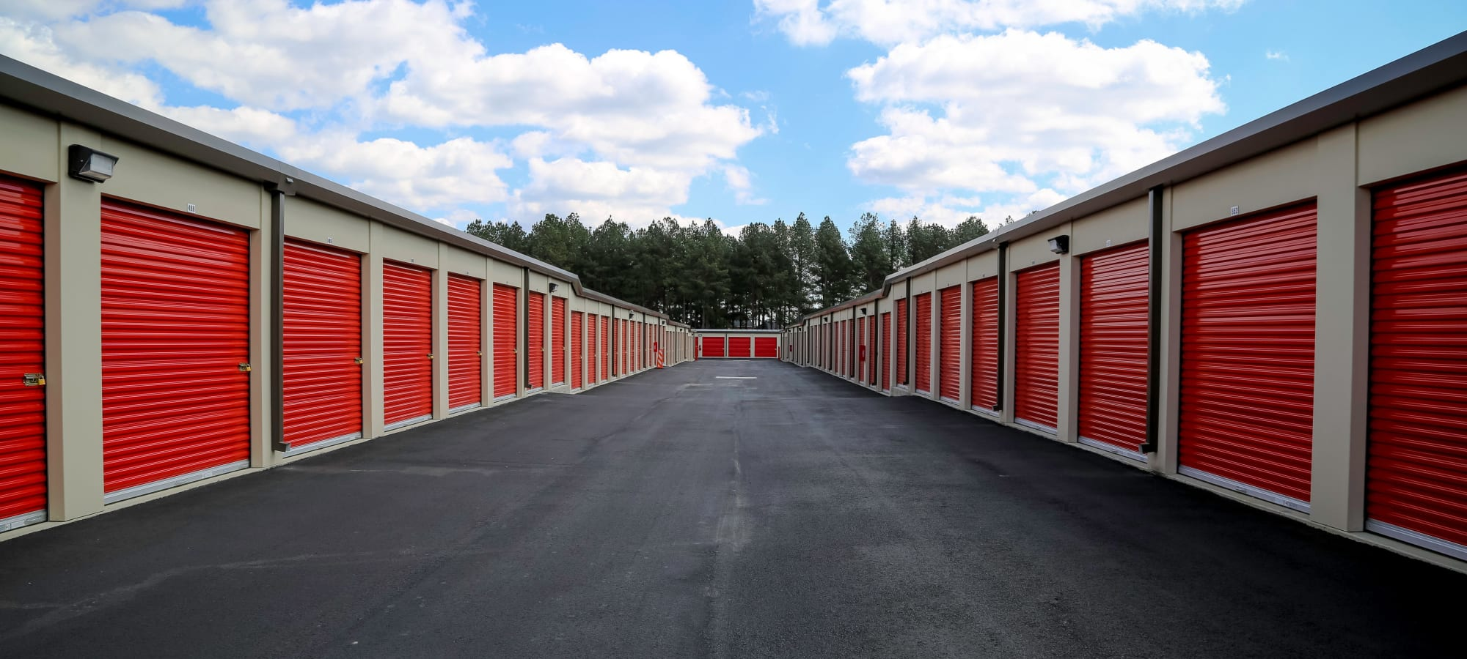
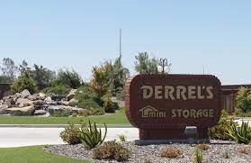
Isaiah 5:8-30 The sins of god’s people
The average size of a new American home:
1950: 950 sq. ft.
1960: 1100
1970: 1500
1980: 1740
1990: 2080
2000: 2266
2010: 2392
2014: 2657

Slide 11
What are you doing with god’s vineyard?
v. 8 Woe to those who add house to house…
Their homes will become desolate.
v. 11 Woe to those who … run after their drinks.
v. 13 Therefore, my people will go into exile.

Slide 12
Isaiah 5:20-23
Woe to those who call evil good and good evil.
“making love” vs. adultery, fornication.
“boys will be boys” vs. pornography.
“believe in yourself” vs. pride.
“take care of #1” vs. selfishness

Slide 13
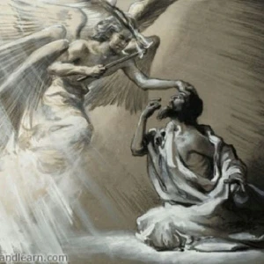
Isaiah 6 God commissions Isaiah
v. 3 Holy, Holy, Holy…
v. 5 Woe is me!
We have to see God.
We have to be cleansed.

Slide 14
Isaiah: I AM A Man of unclean lips

Slide 15
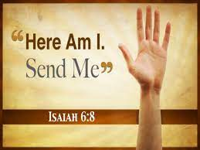
Whom shall I send?
Who can God send:
To BC, CSUB
To Aera Energy
To Tehachapi
To Merced

Slide 16
Will you be god’s prophet?
We have to see God.
We have to be cleansed.
We have to accept his commission. We have to GO!

Slide 17
Fortunately, it will be easy!
Is 6:9 Ever hearing but never understanding
Is 6:10 A people of calloused heart.
Is 6:11 How long must I go?
Is 6:12 Until the job is done.
Isaiah 6:13 A ray of hope. Leave a stump—the holy seed.

Slide 18
summary
God has created a beautiful vineyard for us to enjoy and to work.
1. We need to keep the vineyard clean—to keep sin out.
2. We need to produce wine—to be productive with what he has given us.
God has work to do—people need to hear the message. Will you say, “Here am I, send me?”

Slide 19
Isaiah 7 Unfaithful Ahaz
Is 7:1-9 Ephraim and king Pekah allied with
Rezin of Syria attack Jerusalem/Judah
The Syro/Ephraim war of 734 BC
v. 3 Shear-Jashum a remnant will return
v. 9 If you do not stand firm in your faith, you will not stand at all.
Isaiah 7:10-12 Ahaz does not ask for God’s deliverance. He chooses to rely on Egypt, not God.

Slide 20
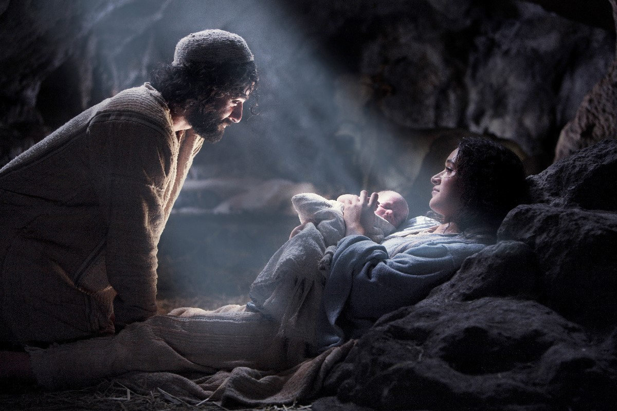
Isaiah 7:13-17 a sign The virgin will be with child
v. 14 a sign The virgin
(Heb alma, young maiden) will be with child.
He will be God-with-us Immanuel Matt 1:22, 28:20

