Slide 1
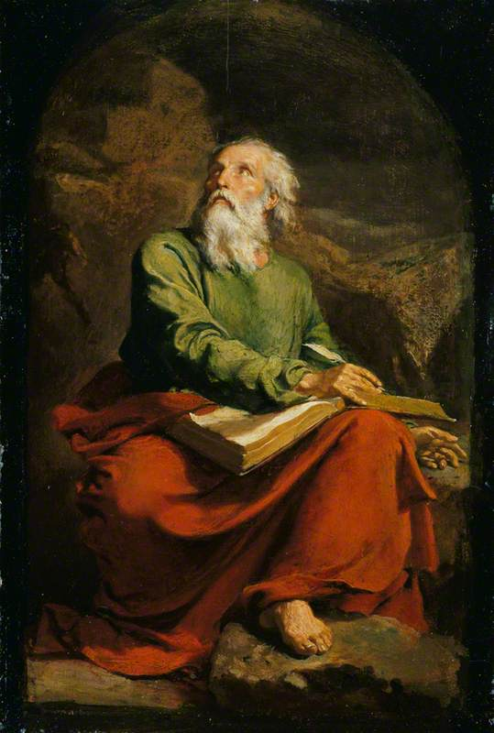
The Book of Isaiah III Ahaz and Hezekiah: A Tale of Two Kings
John Oakes
Aug. 1, 2021

Slide 2
Message of isaiah
Be faithful to God’s promises. Be like Hezekiah, not like Ahaz and God will be your salvation.

Slide 3
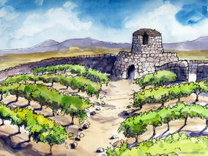
Isaiah 5 Song of the Vineyard
The vineyard is Israel and Judah. The vineyard is the church.
Prepared the land
Set up a watchtower
Built a winepress—gave us work to do in the vineyard
But God Expects Us To Yield a Crop!

Slide 4
What are you doing with god’s vineyard?
v. 8 Woe to those who add house to house…
Their homes will become desolate.
v. 11 Woe to those who … run after their drinks.
Woe to those who call good evil and evil good.
We need to call sin, sin.

Slide 5
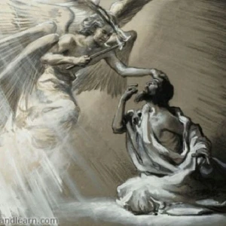
Isaiah 6 God commissions Isaiah
v. 3 Holy, Holy, Holy…
v. 5 Woe is me!
We have to see God.
We have to be cleansed.

Slide 6
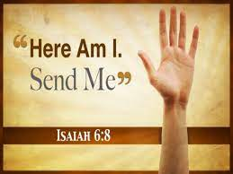
Whom shall I send?
Who can God send:
To BC, CSUB
To Aera Energy
To Tehachapi
To Merced

Slide 7
Will you be god’s prophet?
We have to see God.
We have to be cleansed.
We have to accept his commission. We have to GO!

Slide 8
Isaiah 7 Unfaithful Ahaz
Is 7:1-9 Ephraim and king Pekah allied with
Rezin of Syria attack Jerusalem/Judah
The Syro/Ephraim war of 734 BC
v. 3 Shear-Jashum a remnant will return
v. 9 If you do not stand firm in your faith, you will not stand at all.
Isaiah 7:10-12 Ahaz does not ask for God’s deliverance. He chooses to rely on Egypt, not God.

Slide 10
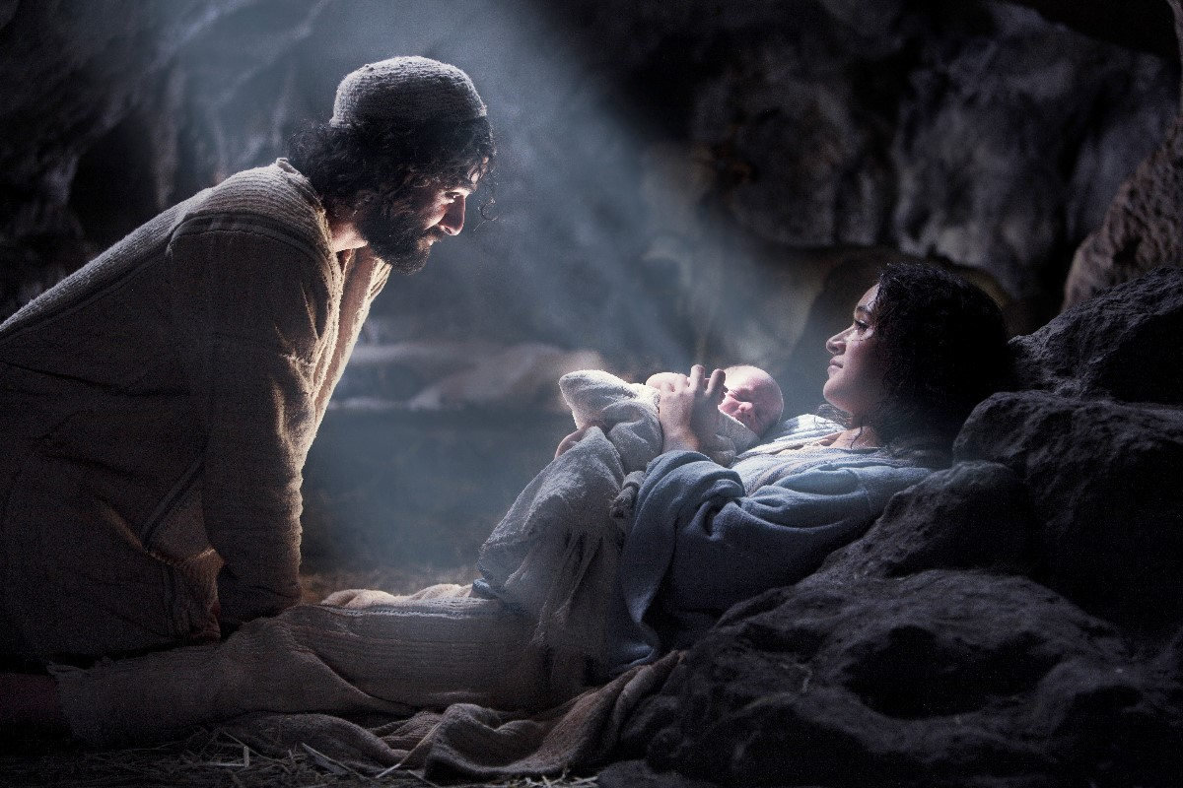
Isaiah 7:13-17 a sign The virgin will be with child
v. 14 a sign The virgin
(Heb alma, young maiden) will be with child.
He will be God-with-us Immanuel Matt 1:22, 28:20

Slide 11
Isaiah 9:1-7 The Lord’s deliverance
Isaiah 9:1-2 Nevertheless, there will be no more gloom for those who were in distress. In the past he humbled the land of Zebulun and the land of Naphtali, but in the future he will honor Galilee of the Nations, by way of the Sea, beyond the Jordan.
Isaiah 9:6 For to us a child is born, to us a son is given. He will be called Counselor, God, Father, Prince of Peace
v. 7 He will reign on David’s throne 2 Sam 7:16

Slide 12
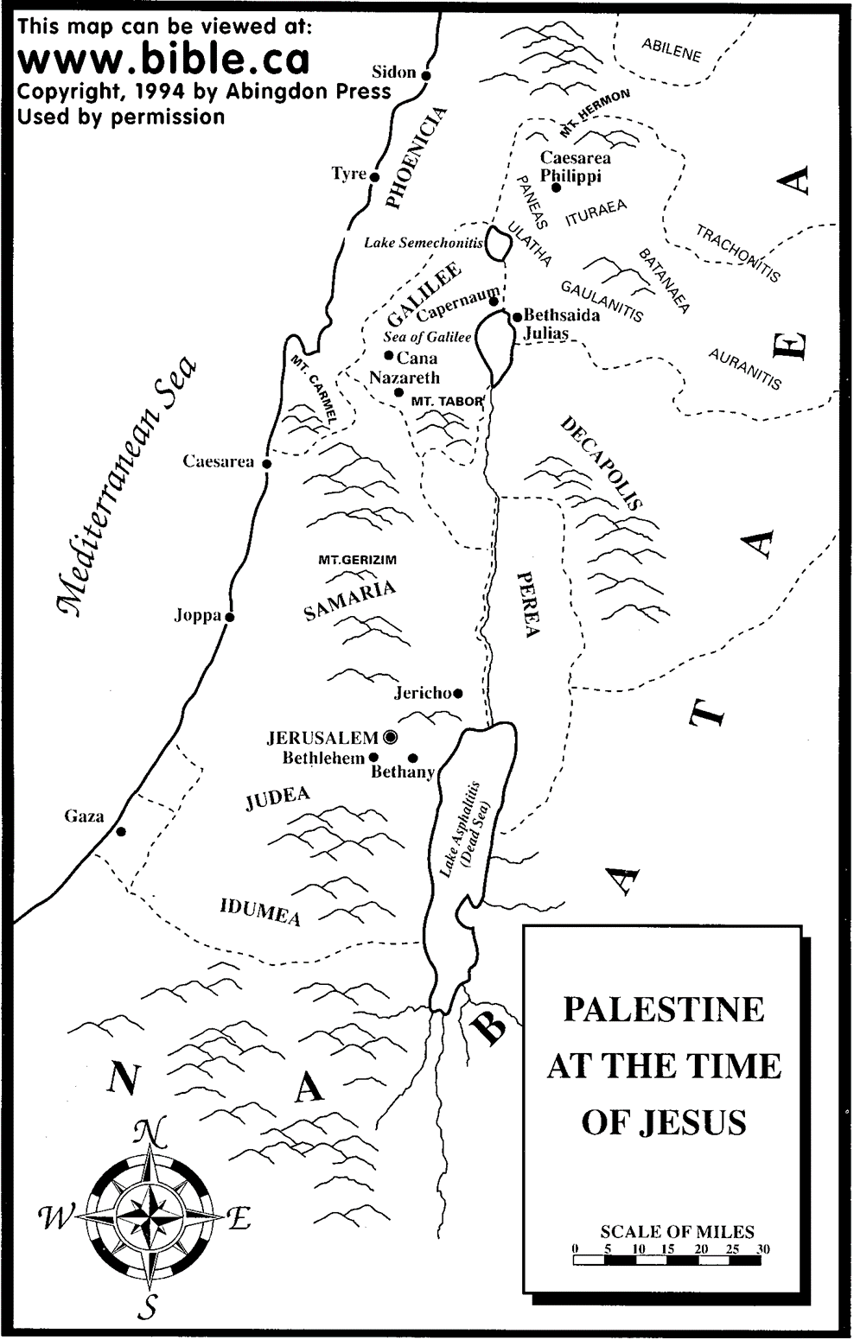
The Land of Zebulun and naphtali

Slide 13
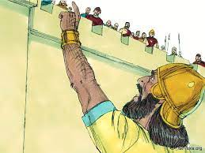
Isaiah 36 & 37 Faithful Hezekiah
36:5 Who are you relying on? A great question!
Satan’s schemes:
Don’t rely on Jehovah. I beat him already
Don’t rely on a godly leader Hezekiah
God told me to tell you.
Let’s make a compromise
Have the other gods saved them?

Slide 14
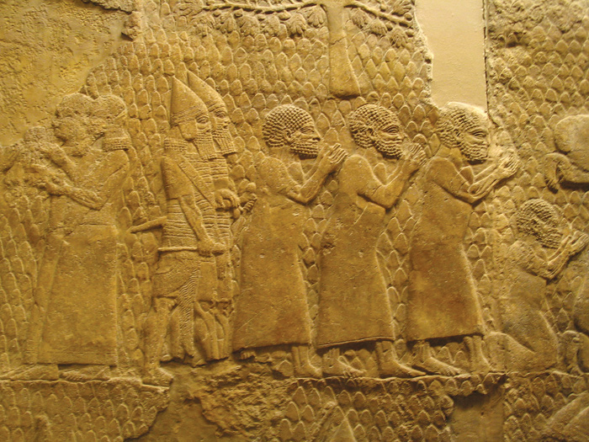
Israeli Captives Being Led from Lachish

Slide 15
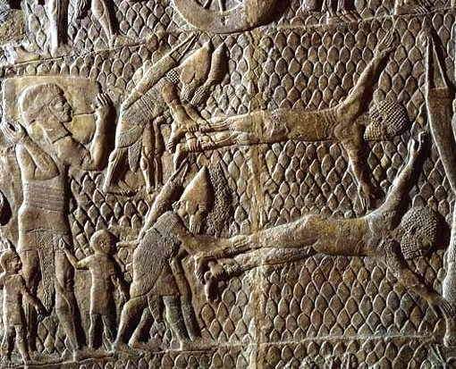
Jewish captives skinned alive in front of Lachish Walls

Slide 16
Isaiah 36-37 Hezekiah trusts in jehovah
Hezekiah: A model for trusting God. Isaiah 37
v. 1 He humbles himself before God
v. 2 He seeks advice from his spiritual mentor.
v. 3-4 He repents and decides to trust in God, not Egypt.
v. 15-20 He prays to God for deliverance
God’s answer Isaiah 37:30-35
I will save a remnant
A band of survivors will come from Mt. Zion.

Slide 17
Isaiah 37:36-37 Jehovah vindicates Hezekiah

Slide 18
conclusion
Let us not be like Ahaz who trusted in the things of the world for his strength.
Let us be like Hezekiah who ignored the visible situation but chose to rely on God for his protection and salvation.
God vindicated Hezekiah and destroyed Sennacherib’s army!!!

