Slide 1
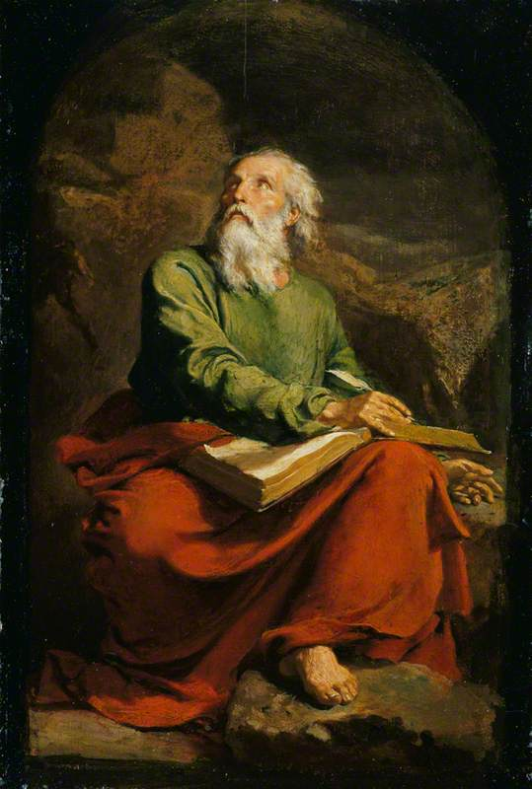
The Book of Isaiah IV Isaiah 40 Comfort, Comfort God’s People
John Oakes
Aug. 15, 2021

Slide 2
Last Week: A Tale of two kings Isaiah 7 Unfaithful Ahaz
Ahaz had three choices:
Submit to Israel and Aram
Form an alliance with Assyria
Trust in God
v. 9 If you do not stand firm in your faith, you will not stand at all.
Isaiah 7:10-12 Ahaz trusts Assyria, not God.

Slide 3
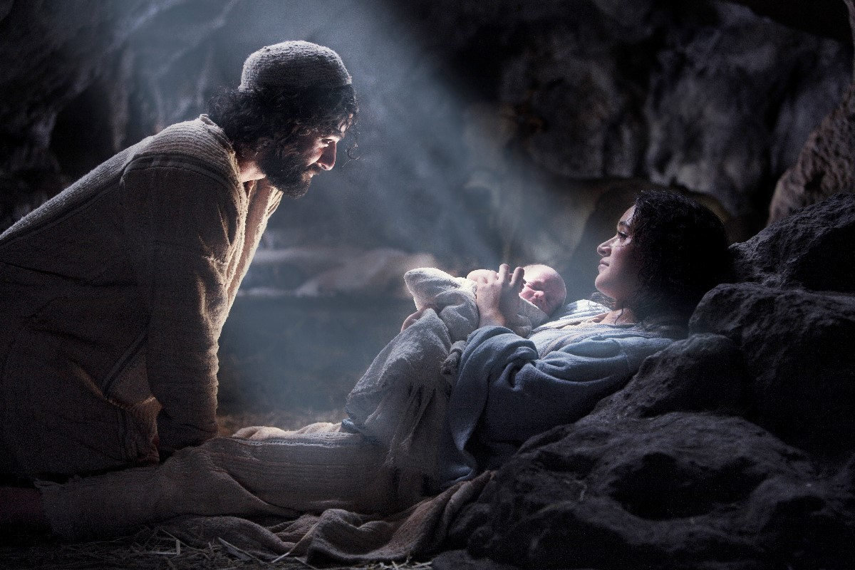
Isaiah 7:13-17 a sign The virgin will be with child
v. 14 God will give you a sign. The virgin will be with child.
He will be Immanuel,
God-with-us

Slide 4
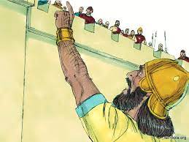
Isaiah 36 & 37 Faithful Hezekiah
Hezekiah has three choices:
Submit to Sennacherib/Assyria
Form an alliance with Egypt.
Rely on God
Satan’s schemes:
You are too weak
God does not love you
Let’s compromise. Let’s bargain.
God told me this.

Slide 5
Isaiah 36-37 Hezekiah trusts in jehovah
Hezekiah: A model for trusting God. Isaiah 37
v. 1 He humbles himself before God
v. 2 He seeks advice from his spiritual mentor.
v. 3-4 He repents and puts his trust in God.
God’s answer Isaiah 37:30-35
I will save a remnant
A band of survivors will come from Mt. Zion.

Slide 6
Isaiah 37:36-37 Jehovah vindicates Hezekiah

Slide 7
One Outline of Isaiah
Isaiah 1-39 Messiah the king -Assyria
Isaiah 40-55 Messiah the Servant -Babylon
Isaiah 56-66 Messiah the Conqueror -World

Slide 8
Isaiah 39 Hezekiah’s fatal error Transition to Isaiah 40
Isaiah 39:1-2 Envoys from Babylon appeal to the pride of Hezekiah.
Hezekiah shows them all the treasure in the temple.
v. 3-7 Isaiah: All this treasure will be carried off to Babylon.
Your descendants (Daniel, Hananiah, Azariah and Mishael) will be made eunuchs in the palace in Babylon.

Slide 9
do not make a faustian bargain

Slide 10
Isaiah 40:1-5 Comfort, comfort my people
Isaiah 40 Judah will go into captivity. But what about those promises?...
Isaiah 40:1-2 Comfort, Comfort my people. My anger is complete. A remnant will return.
Isaiah 40:3-5 A voice calling in the wilderness…
Make straight a highway for our God.
John the Baptist Matthew 3:3

Slide 11
Every mountain will be made low

Slide 12
Every canyon will be raised up

Slide 13
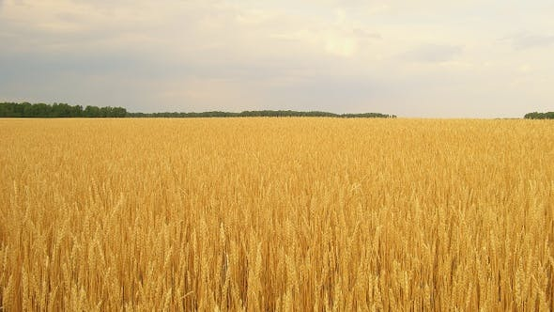
Isaiah 40:6-20 God is awesome you are not
All people are like grass!

Slide 14
If we are grass, what can we count on?
Isaiah 40:8 The grass withers and the flowers fail, but the Word of our God endures forever.
Isaiah 40:10 God’s mighty arm
(Jesus Is 53:1-3)

Slide 15
Is 40:12 Who has… marked off the heavens

Slide 16
The nations are a drop in the bucket

Slide 17
Is 40:26 Who created these things?

Slide 18
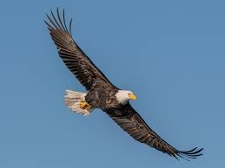
Those who hope in the Lord will renew their strength. They will soar on wings like eagles; they will run and not grow weary, they will walk and not be faint.

