Slide 1
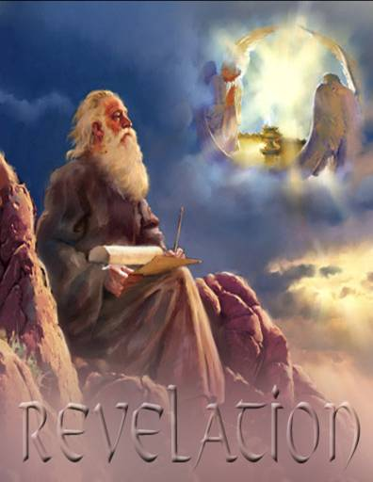
Revelation and Apocalyptic Literature
Dr. John Oakes
Fall, 2013
San Diego
www.bakersfieldchurchofchrist.com

Slide 2
Our Outline:
Apocalyptic Literature
Intro to Revelation
Revelation chapter by chapter
Resources:
“Revelation Revealed” Gordon Ferguson
“Revelation” Jim McGuiggan
“Worthy is the Lamb” Ray Summers
Revelation: A Shorter Commentary G. K. Beale
Revelation’s Rhapsody Robert Lowery

Slide 3
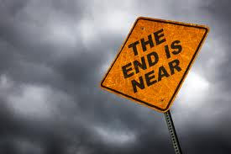
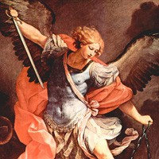
Apocalyptic Literature
Rev 1:1 The revelation of Jesus Christ
revelation = apokalupsis αποκαλυψισ
= unveiling.
Apocalyptic literature is an unveiling
Vision as a literary device

Slide 4
Purpose of Apocalyptic Writing
To show in dramatic fashion that God is in control.
To reveal (unveil) the kingdom of God.
“The purpose of these writings was to stress the virtue of loyalty and of stimulate faith by showing in vivid fashion the certain overthrow of evil and final victory for God’s righteous cause.” (Summers: Worthy is the Lamb)

Slide 5
Characteristis of Apocalyptic Literature
1. Written in times of trouble
Isaiah: Destruction of Israel
Ezekiel and Daniel: Captivity of Judah
Zechariah: Persian conquest
1 Enoch: Antiochus Epiphanes
Revelation: Roman persecution
2. Cryptic in style
Wisdom, caution
Keep the uninitiated in the dark

Slide 6
Αποκαλυφισ Characteristics Continued
3. Prophecy vs Apocalyptic
Prophecy mainly preaching, secondarily prediction
Apocalyptic mainly predictive, preaching secondary
Apocalyptic a wider scope: The whole world!
Apocalyptic: more eschatology (end times)
(although apocalyptic is not chiefly eschatology)
4. Always has a definite historical setting
Daniel: Antiochus Epiphanes
Revelation: Domitian

Slide 7
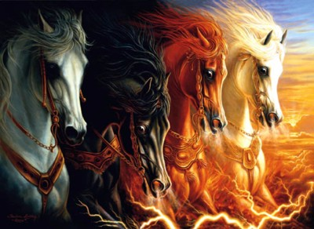
Αποκαλυφισ Characteristics Continued
5. Pseudonymous (falsely attributed author)
1 Enoch
Assumptiom of Moses
Baruch etc.
Does not apply to Daniel, Revelation, etc.
6. Visions (rare in prophecy Daniel 9?)

Slide 8
Αποκαλυφισ Characteristics Continued
7. Symbolic Apocalyptic literature is saturated
with symbolism.
Other literature: Assume a statement
or description is literal unless the context
demands otherwise.
Apocalyptic: Assume a statement or description
is symbolic unless the context demands otherwise
(the seven churches or Rev. 17 for example)

Slide 9
Numbers in Apocalyptic Literature
1 = unity, unique, alone.
2 = strength, courage, energy
3 = divine number. Number of God.
4 = the world, the cosmos, creation.
6 = sinister, Satan 6 falls one short of seven. Doom.
7 = perfection, completeness 4 + 3 = 7 cosmos + God
= perfection
3-1/2 = incomplete, partial (1260 days, “time, times and half a time”)

Slide 10
Numbers in Apocalyptic Literature (cont.)
10 = completeness
Multiples of 10 70 = perfect completeness
1000 = 10x10x10 = ultimate completeness
12 = Number of religion. God’s people. 4x3 = 12
Ex. 144,000 is the full number of God’s people (12x12x10x10x10)
We should hesitate to take these numbers literally. The 144,000 is certainly NOT literal!

Slide 11
Colors in Apocalyptic Literature
Red war, sacrifice Zech 6:2, Rev 6:4, Is 63:1-6, Joel 2:31, Rev 12:3, 17:3
White purity and innocence Dan 7:9, Rev 1:14, Zech 6:3,6 Rev 7:9,13-14, 19:?
Purple royalty or voluptuous ease Jer 10:9, Rev 17:4, 18:12
Blue heaven, sky, Holy Spirit Rev 9:17
Black famine, death, distress Zech 6:2, 6 Rev 6:5,12,
Pale yellow near the end of life Rev 9:17
Pale death, terror-stricken Jer 30:6, Dan 10:8 Rev 6:8
Crimson blood, atonement
Gold divinity, splendor Rev 1:13 15:6
Green death? 6:8, 8:7, 9:4

Slide 12
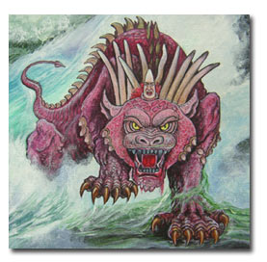
Αποκαλυφισ Characteristics Continued
8. Dramatic.
Arguably, the chief aspect of the Apocalyptic is that it is dramatic.
Dramatic, vivid,
forceful, terrifying,
grotesque

Slide 13
Non-canonical Apocalypses The Pseudepigrapha
1 Enoch 150 BC
Assumption of Moses 1st half of 1st century
Secrets of Enoch (2 Enoch) early 1st century
Baruch after AD 70
4th Ezra after AD 70

Slide 14
Old Testament Apocalyptic Passages
Joel 3:18-21 Joel 2:1-12 Day of the Lord—a coming of the Kingdom.
Daniel 7:7-8, 11-14
Isaiah 34;2-8
Ezek 32:1-10
Pattern: All are about the future. All are about God coming to defend or to judge his people. All are about the kingdom of God. All have a definite historical application. These passages will help us greatly to interpet Revelation

Slide 15
Summary: How to Interpret Apocalyptic:
There will be a definite historical setting and cause for the visions. Interpret in light of this setting and cause.
About the imagery: get the big picture and do not get too caught up in the details—do not “push” the details.
After correctly observing the first two steps, you can apply apocalyptic passages to all people and all situations and all times.

Slide 16
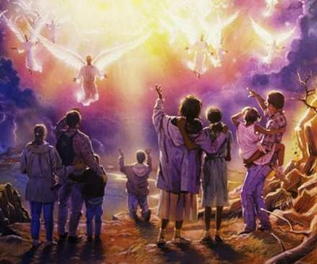
End-Time Theories (Eschatology)
Preterist
Most or all of Revelation Already fulfilled
Amillenialism
No physical millenial reign
Premillenialism
Jesus comes back before the millenium
Postmillenialism
Milennium happens, then Jesus comes back
Philosophy of History

Slide 17
Approaches to Interpreting Revelation
1. It is either principally or entirely about the time of
Roman persecution of the church.
2. It is principally about the apostasy of the Roman
Catholic Church.
3. It is about the entire history of the [western] world
until Jesus comes back.
4. It is principally about end-times—about Armageddon,
the rapture and the millennial reign of Christ which
will ensue. Revelation is principally unfulfilled
prophecy.
5. It is about how God deals with mankind in all ages,
with no particular specific historical context.

Slide 18
Approaches to Interpreting Revelation
1. It is about the time of Roman persecution of the
church. Historical Background View.
3. It is about the entire history of the [western] world
until Jesus comes back. Continuous Historical
Wyclyffe, Luther, Fox. The Reformation.
1st seal = Domitian to Commodus AD 180
2nd seal = Commodus to Caracella
3rd seal = Caracella to Decius
4th seal = Decius to Gallienus (243-268) (many persecutions)
5th seal = Diocletian and friends (284-315) (greatest persecutions of all)
6th seal = Barbarian invasions (see below)

Slide 19
Approaches to Interpreting Revelation
3. Continuous Historical
7th seal = trumpets
1st trumpet = Goths 395-410 (sacked Rome)
2nd trumpet = Genseric 428-468 (sacked Rome)
3rd trumpet = Atilla 433-457
4th trumpet = Odoacer 476-490 (ended Western Roman empire for good)
5th trumpet = Muslim invaders
6th trumpet = Turks
Great Angel = The Reformation
Great Harlot = The Papacy etc.
Criticism: Too narrow, stretches the symbols way too much

Slide 20
Approaches to Interpreting Revelation
4. Futurist The most common premillennial theory:
Revelation 4-19 is about a seven year period called the Tribulation after the rapture, but before Jesus comes to dwell in physical Jerusalem.
Use Daniel 9:24-27 to prophesy a future “week” of tribulation.
This “week” marks the end of the “Christian era”.
The temple will be rebuilt in Jerusalem
The two prophets and the antichrist will be literal people.

Slide 21
Approaches to Interpreting Revelation
4. Futurist The most common premillennial theory:
Antichrist defeated after 3-1/2 year reign in a battle called Armageddon
After this, Jesus comes back and reigns in Jerusalem, ushering in the Kingdom of God, beginning the millennium
After the Millennium Satan and the Beast are thrown into the Abyss and final judgment occurs.

Slide 22
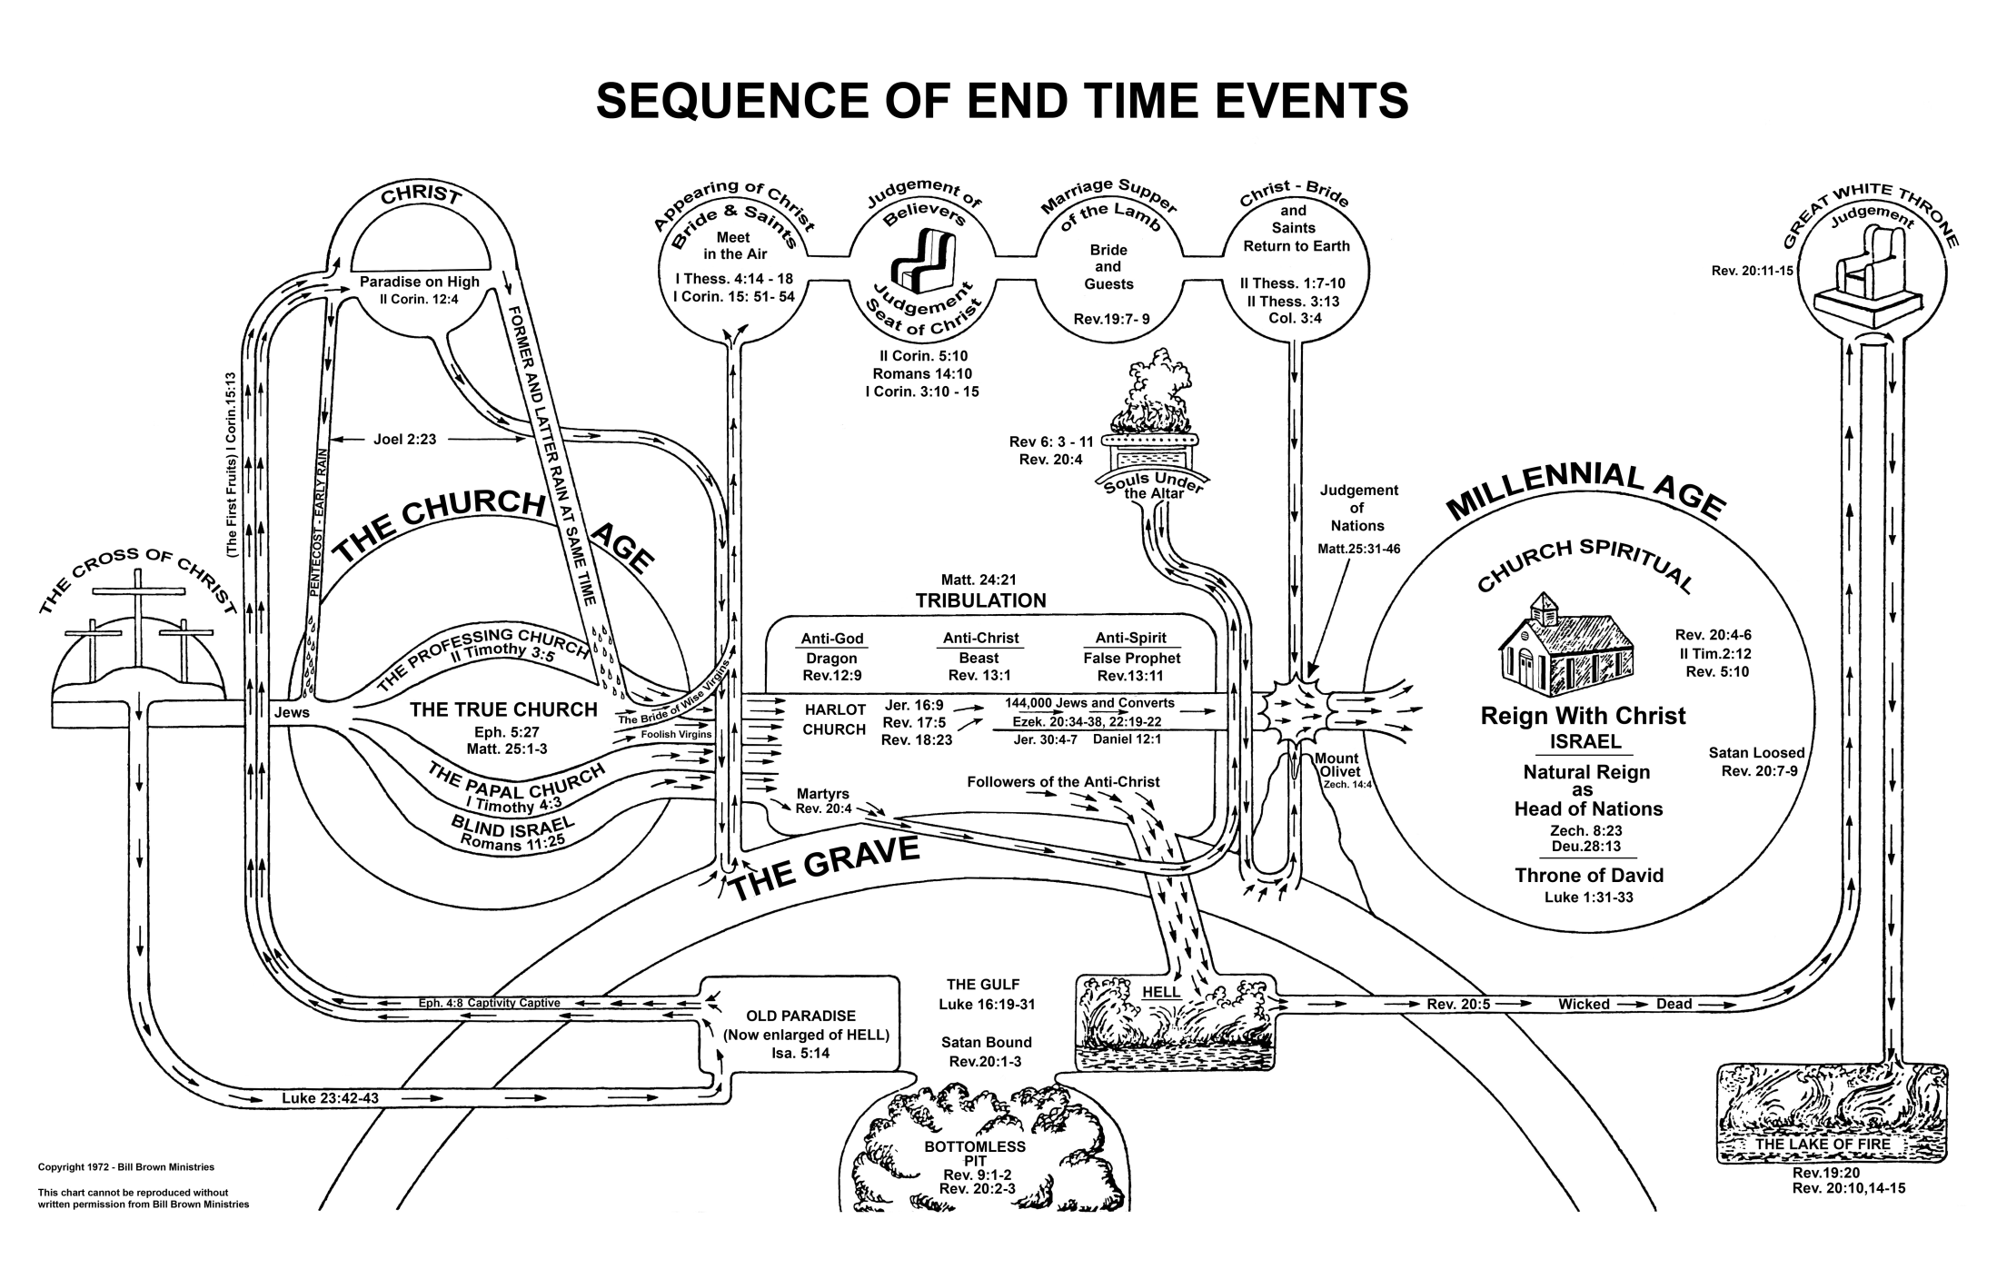
Premillenialism

Slide 23
Sir Isaac Newton
The folly of Interpreters has been, to foretell times and things, by this Prophecy, as if God designed to make them Prophets. By this rashness they have not only exposed themselves, but brought the Prophecy also into contempt. The design of God was much otherwise. He gave this and the Prophecies of the Old Testaments, not to gratify men's curiosities by enabling them to foreknow things, but that after they were fulfilled they might be interpreted by the event; and his own Providence, not the Interpreters, be then manifested thereby to the world. For the event of things predicted many ages before, will then be a convincing argument that the world is governed by providence

Slide 24
Problems with Premillenialism
1. Seems to contradict Revelation 1:1,3
2. Means that Revelation has virtually no meaning to its
primary audience: the Church in the first centuries.
3. Blatant overliteralizing
4. Covenant error: Reestablishing Jewish sacrifices. A
step back. Jesus goes from heaven to ruling on an
earthly throne.
5. Makes the Kingdom of God a physical kingdom.
Radically downplays the coming of the kingdom in
the church. Luke 17:20-21 John 18:36)

Slide 25
Approaches to Interpreting Revelation
5. It is about how God deals with mankind in all ages,
with no particular specific historical context.
Philosophy of History method.
Revelation is a description of things that happen again and again throughout history and it is equally applicable to all Christians at any time.
Multiple fulfillment theory
Conclusion: There is validity to the preterist/Historical Background view and to the Philosophy of History view. Revelation is principally about and for the persecuted early church, but it is also applicable to all Christians everywhere.

Slide 26
Historical Background to Revelation
Revelation 1:9 I, John, your brother and companion in the suffering and kingdom and patient endurance that are ours in Jesus, was on the island of Patmos because of the word of God and the testimony of Jesus.
Persecutions of the Church:
Nero AD 64
Domitian 95-96 *
Trajan 98-117
Septimus Severus 202-211
Decius 249-251
Valerian 257-261
Diocletian and Galerian 303-311

Slide 27
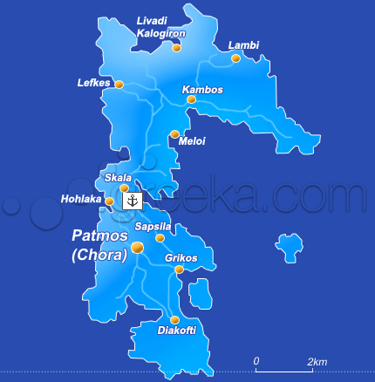
Patmos

Slide 28
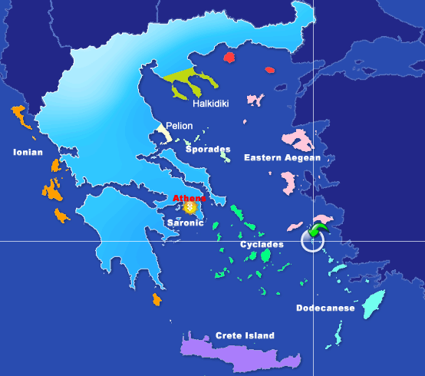

Slide 29
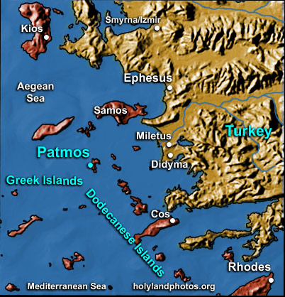

Slide 30
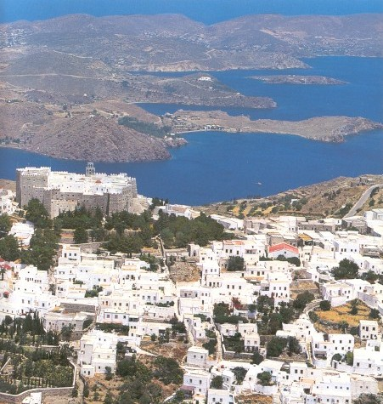

Slide 31
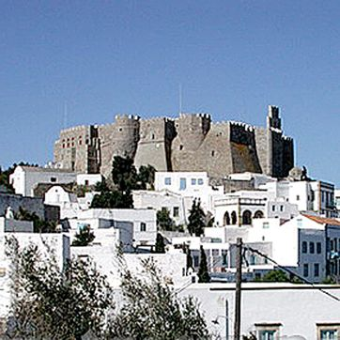
Monastery of St. John, Patmos

Slide 32
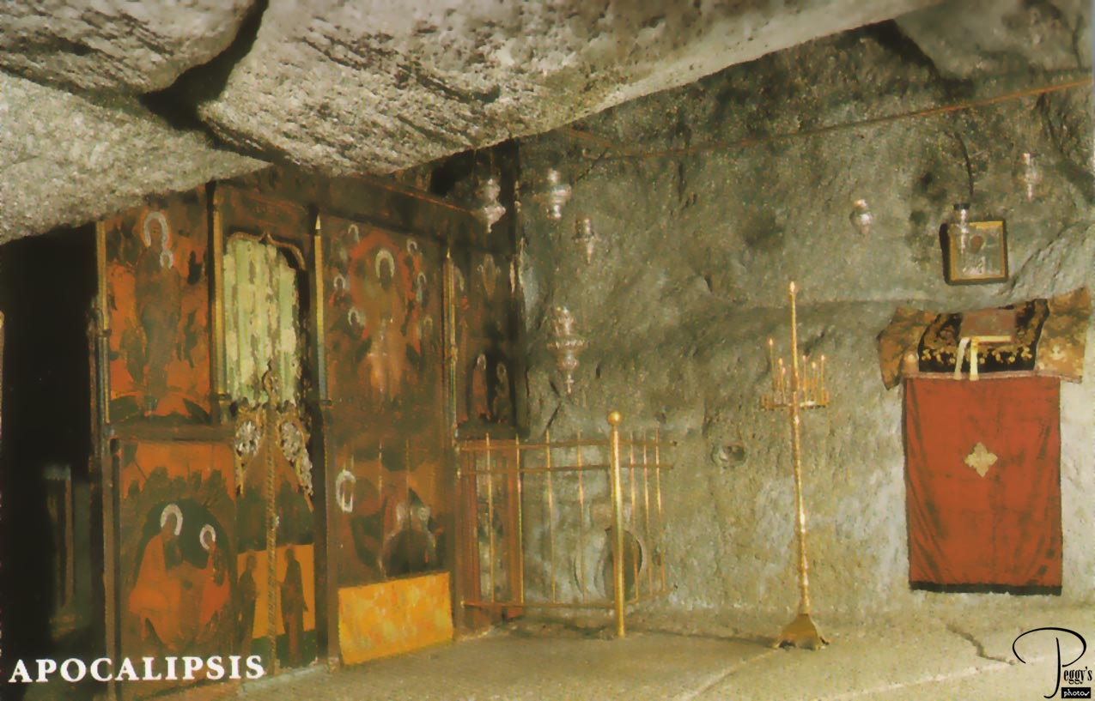
John’s cave?

Slide 33
Date of Authorship
Nero AD 64
Persecution only in Rome
No record of required emperor-worship
Vespasian AD 69-79
Based on Rev 17:9-11 Five have fallen (Augustus, Tiberius, Caligula, Claudius, Nero) one is (Vespasian) one who is to come for a little while (Titus, ruled two years) and “the beast who was, and is not and is also an eighth and is of the seven = Domitian.
Domitian AD 81-96
First systematic persecutor AD 95-96
Ordered worship of emperor, Christianity illegal
Unanimous opinion of the early church.

Slide 34
Author: The Apostle John
External Evidence:
Papias 125 AD
Justin Martyr Dialogue with Trypho AD 150
Irenaeus AD 170
Origen AD 220
Also: Tertullian (AD 200), Clement of Alexandria (AD 210), Hippolytus (Rome, 220), Cyprian, Athanasius, Ambrose, Augustine, Jerome.
Internal Evidence:
The writer is clearly a Jewish Christian
The writer assumes great authority over the churches in Asia (John came to Ephesus some time after AD 70 was over the church in Ephesus for 25 years)

Slide 35
Authorship: Alternative Views
Internal Evidence Only
Dionysius of Alexandria AD 250 The writing style too different to allow the same author as the gospel of John.
Eusebius AD 330 quotes Papias, and concludes that it was Presbyter/Elder John, a separate John. (but Irenaeus is definite that the “elder John” is the apostle John)
If, then, any one should come, having followed personally the elders, I would question him concerning the words of the elders, what Andrew or what Peter said, or what Philip, or what Thomas or James or what John or Matthew or any one of the disciples of the Lord said, and the things which Aristion and the elder John, disciples of the Lord said.

Slide 36
Authorship: Alternative Views
Why such different styles?
Was John written in the late 70s or early 80s?
John was very carefully constructed, Revelation was written in haste.
Conclusion: If we allow that two different people wrote John and Revelation, then Revelation would be the one written by John

Slide 37
Theme, Message and Objective of Revelation
Theme of Revelation: Peel back the layers of history and even the terrible persecutions and what do we find? The lamb is on the throne and God is in control.
Message of Revelation: Be encouraged and faithful to Jesus Christ. Jesus, not Caesar, is Lord.
Objective: to comfort persecuted Christians.
Description of Revelation: A “divine picture-book”. “Spiritual cartoons,” representing the historical development of the early Christian church.
Romans appeals to the intellect/mind
Psalms appeals to the emotions
Revelation appeals to the imagination.

Slide 38
Outline of Revelation
Ch 1 Prologue
Ch 2-3 Letters to the seven churches
Ch 4-7 The Seven Seals
Ch 8-11 The Seven Trumpets
Ch 12-16 Seven Mystical Figures
Ch 15-16 The Seven Vials
Ch 17-20 Enemies of the Church Overthrown
Ch 21-22 The Kingdom of God Revealed

Slide 39
An Outline of the Bible
I. Genesis 1 God created the universe and the earth. It was very good.
II. Genesis 2 God created man so that we could have an intimate relationship with him.
III. Genesis 3 and 4 We messed up very badly—destroying that relationship.
Genesis 5-Rev 20 God is repairing the damage done by sin.
V. Rev 21-22 God has fixed the problem and we are back in a
relationship with him.
Revelation is the culmination of the Bible story

Slide 40
Revelation Chapter 1 Prologue
Revelation 1:1 The revelation of Jesus Christ which God gave to him to show to his servants what must soon come to pass (things it is necessary to come to pass shortly).
What is the book about? Things that will soon take place.
Dei δει “must” morally necessary. God’s justice requires that these prophecies must be fulfilled soon
En taxeos εν ταχέως quickly 2 Tim 4:9 taxeos
Rev 1:1, 22:6 must soon take place
Rev 1:3, 22:10 is at hand (right near by)
Compare to Daniel 9:26 which concerns “the distant future.” (written 550 BC about 167 BC)

Slide 41
Seven Beatitudes in Revelation
Rev 1:3 Blessed is he who reads this prophecy and takes it to heart.
Rev 14:13 Blessed are the dead who die in the Lord.
Rev 16:15 he who watches and is prepared for the Lord’s coming.
Rev 19:9 those invited to the Lamb’s wedding supper.
Rev 20:6 those who have a part in the first resurrection.
Rev 22:7 he who keeps the words of this book.
Rev 22:14 those who wash their robes.

Slide 42
Revelation 1 Prologue (cont.)
Rev 1:4,11
Who from? God the father, the Holy Spirit (the seven spirits) and Jesus Christ
Who to? v. 4 to the seven churches in the province of Asia
v. 11 Ephesus, Smyrna, Pergamum, Thyatira, Sardis, Philadelphia and Laodicea.
Why these churches? They are the ones over which John was a shepherd.
1:3 to all who hear 2:7 to anyone who has an ear.
… what the Spirit says to the churches.

Slide 43
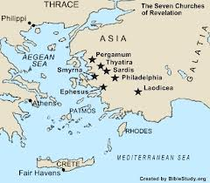

Slide 44
Revelation 1 Prologue (cont.)
Rev 1:9 John can totally relate to the persecutions that the church will soon be going through.
Why was he on Patmos? Because of the Word of God.
1:10 On the Lord’s day = Sunday = the 8th day.
1:12-18 Is this the picture we get of Jesus in the
gospels?
The principle picture of Jesus in Revelation is of incredible power and of judgment.
Why? Because of the message. God will judge the persecutors!

Slide 45
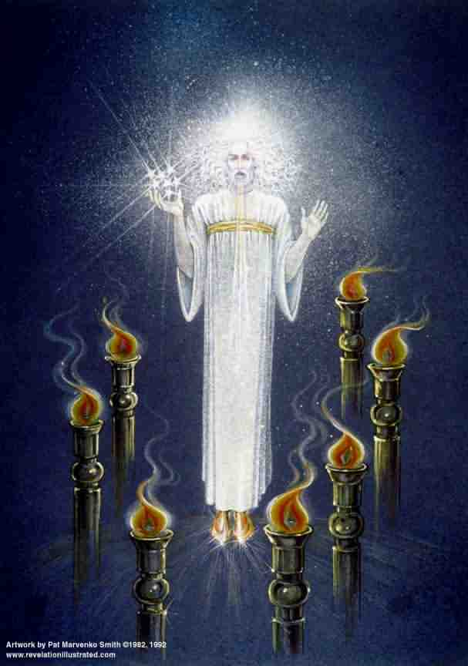
Revelation 1 Prologue (cont.)
Rev 1: 10,12-18
Similar to Daniel 7:9-10 and Daniel 10:4-9
Voice “like a trumpet” A loud and clear message
Blazing eyes See everything clearly. Nothing escapes his notice.
Double-edged sword in his mouth Authority and power of his words (John 12:48)
Q: How does this picture of Jesus make you feel?

Slide 46
Revelation 2 & 3 Letters to the Churches in Asia
Pattern:
1. Greeting
2. A description of Jesus
3. A commendation (except Sardis and
Laodicea)
4. A criticism (except Smyrna and
Philadelphia)
5. An appeal and a warning
6. Exhortation and promise

Slide 47
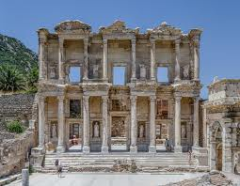
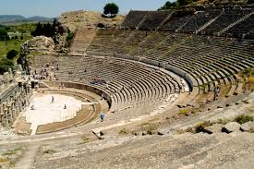
Revelation 2:1-7 Ephesus

Slide 48
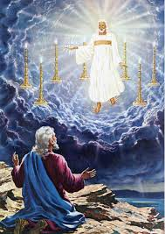
Ephesus
Rev 2:1
…holds the seven stars in his hand
…walking among the golden lampstands
“Long live Artemis of the Ephesians” One of the seven wonders of the ancient world.
The capital of Christian Asia.

Slide 49
Ephesus: Commendations
Rev 2:2-3,6
Hard work
Perseverence
Staunch opposition to sin and false doctrine
Nicolaitins Acts 6:5?
They had not grown weary
Q: Is this possible, even when we have lost our first love?

Slide 50
Ephesus: Admonitions
Rev 2:4-5
Remember, this is the church John himself was responsible for!
Lost their first love.
Q: What, exactly, had they lost? What was their day-to-day Christian life like?
The solution: Remember and repent!
Do what you did at first. Do it the way you did it at first.

Slide 51
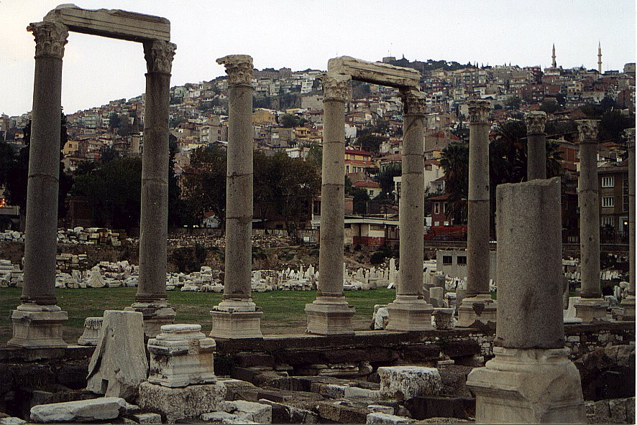
Revelation 2:8-11 Smyrna

Slide 52
Smyrna: Commendations Only
Rev 2:9 Poor but rich.
Q: Do you feel poor? Why? Do you feel rich? Why?
The Synagogue of Satan Jewish persecution.
1 Tim 6:6-10
Admonition: Stay faithful, even unto death …you will receive a crown
…you will be untouched by the second death (Rev 20:14)

Slide 53
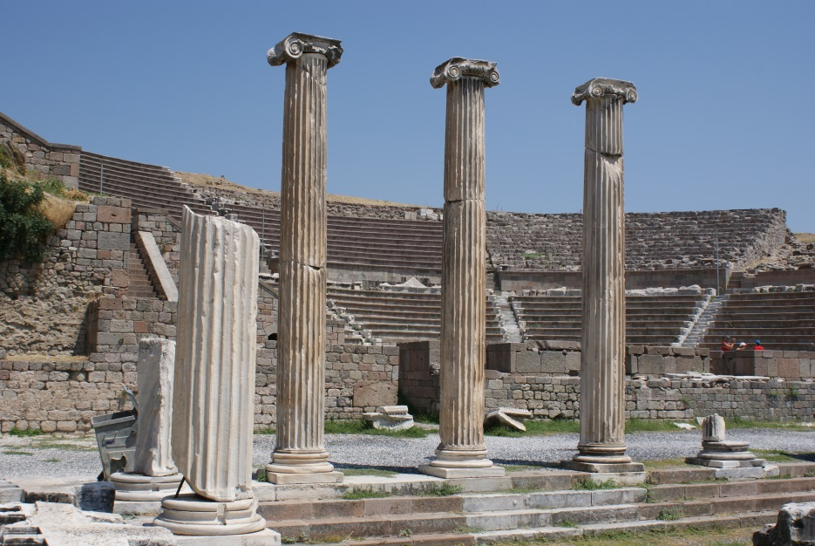
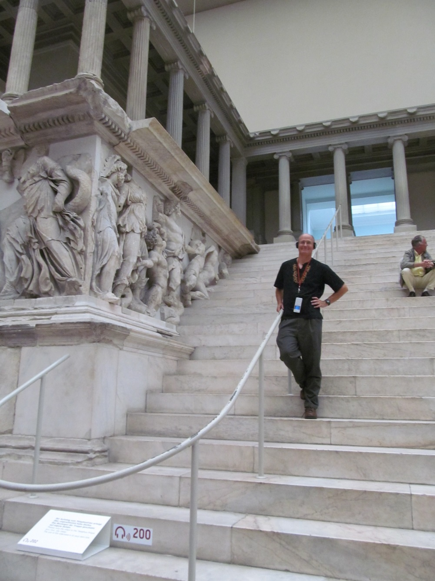
Revelation 2:12-17 Pergamum

Slide 54
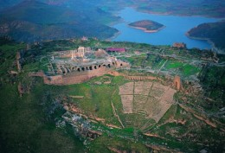
Pergamum
Largest city in Asia at the time
Capital of Roman power
Seat of paganism in Ionia
“Throne” of Satan = Temple of Zeus
Pergamum Library

Slide 55
Pergamum: Commendations
Rev 2:12 the sharp, double-edged sword. Watch out!
2:13 Pergamum is a tough city to build a church!
How would you like to live where Satan lives?
You have endured extreme persecution
Antipas witness = martarus

Slide 56
Pergamum: Warnings
Some hold to Balaam’s teaching.
Some hold to the teachings of the Nicolaitins
Their problem: lack of church discipline
Q: Is tolerance a Christian virtue?
Q: Does Jesus get angry?
God expects the church to discipline these teachers. Q: Why doesn’t he just deal with them?

Slide 57
Pergamum: Reassurance
Rev 2:17
Hidden manna
A white stone
Symbol of acquittal in a trial
Symbol of being freed from slavery
A name known only to him who receives it.

Slide 58
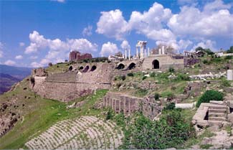
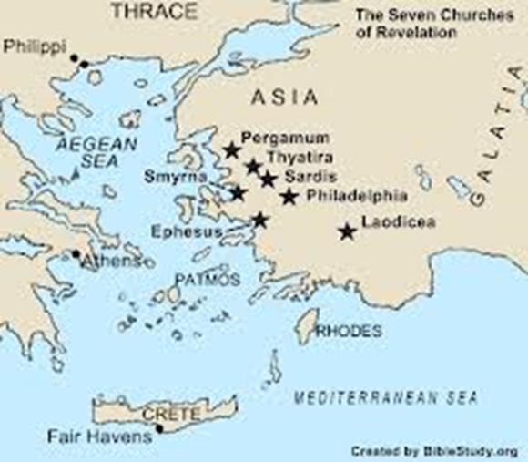
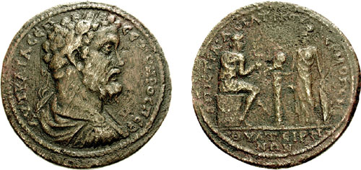
Revelation 2:18-29 Thyatira
Hephaestus: the god of the foundry

Slide 59
Thyatira
Thyatira a city of trades and unions/guilds
Specialized in purple cloth (Lydia)
Specialized in bronze craft
Being in a guild required participation in pagan sacrifices, including fornication.

Slide 60
Thyatira: Commendation
Jesus: Eyes like blazing fire, feet like burnished bronze.
Rev 2:19
Giving
Serving
Growing!
But…. The seeds of spiritual disaster had already been planted!

Slide 61
Thyratira: Warnings
Rev 2:20 You tolerate that woman Jezebel
Probably a prominent and charismatic woman
Her sin? Probably encouraging participation in the idolatry required to keep a job in one of the trades in Thyratira
Those who “committed adultery” with her and “her children” are those who accepted her teaching.
A warning against divisiveness

Slide 62
Thyratira: Warnings and Encouragement
Rev 2:21-23
I have given her time to repent
I will deal with Jezebel (unlike in Pergamum)
2:24 “deep teaching” a reference to Gnosticism
2:25 Assurance: Hold on until the end… I will
give you authority over nations (1 Cor 6:2-4)

Slide 63
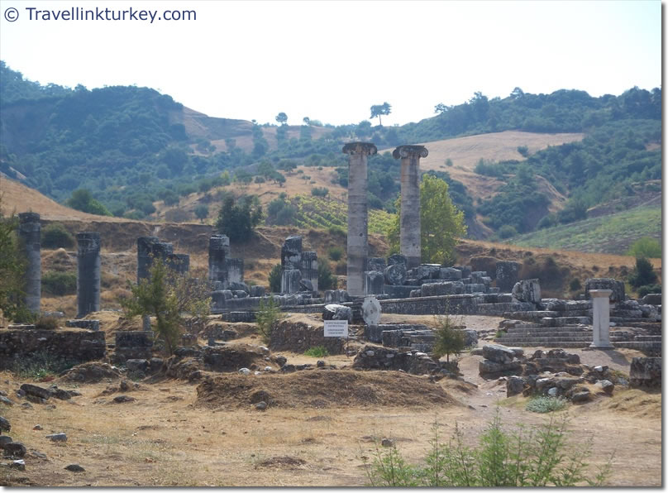
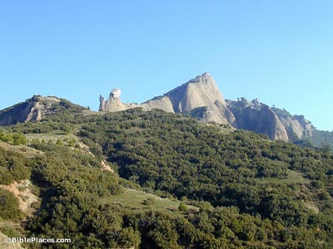
Revelation 3:1-6 Sardis

Slide 64
Sardis
Capital of Lydia and of King Croesus
On a very steep mountain—thought to be impregnable
Nevertheless, conquered by Cyrus 549 BC
Conquered by Antiochus III 218 BC
A symbol of overconfidence and unjustified pride. Living on past greatness.
Famous for robbers.

Slide 65
Sardis: Warnings First!
Rev 3:1 You have a great reputation, but you are dead, spiritually!
Their problem was not sin, per se, but lack of doing things God expected them to do.
Q: What about you?
Rev 3:2 Solution? WAKE UP!!!! (Hebrews 2:1)
Remember, obey and repent.
I will come like a thief

Slide 66
Sardis: Encouragement
No encouragement to the church as a whole
3:4 Yet you have a few in Sardis…
Even in a dead church, some will be alive. Despite what Jesus is saying to the churches, we are saved individually.
3:5 To all disciples: He who overcomes will, like the few faithful Sardisians, be dressed in white.

Slide 67
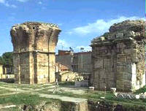
Revelation 3:7-13 Philadelphia

Slide 68
Philadelphia
A significant Jewish population. The Synagogue of Satan
Rev 3:7 Jesus holds the key of David.
Isaiah 22:21-22 A messianic prophecy

Slide 69
Philadelphia: Encouragements Only
Rev 3:8 You are small and weak, but you are doing great!
3:9 You are the true Jews
The Jews will fall at your feet some day. Wow!
I will give you a crown
I will make you a pillar
You will never again have to leave it
Your will have a new name.
All these are relevant to specifics of Philadelphia

Slide 70
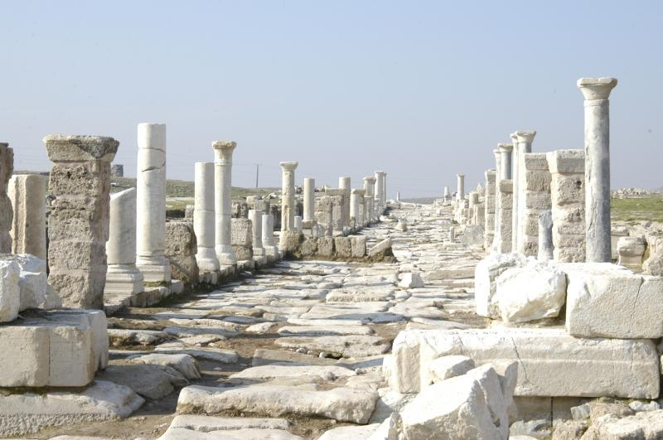
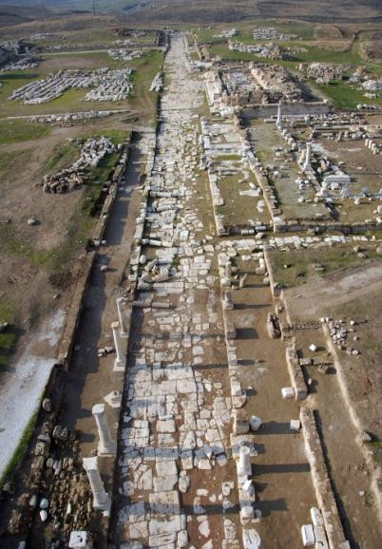
Revelation 3:14-22 Laodicea

Slide 71
Laodicea
A center of banking. A very rich city
A center of the wool industry. Black wool.
Most famous school of Medicine. Famous for their eye salve.
All these are used by Jesus in his admonition

Slide 72
Laodicea: Warnings Only
Their sin? Lukewarmness. Hypocrisy
Jesus: You make me want to throw up!
Wouldn’t it be better to be a half-hearted Christian than a blatant pagan?
Why not?

Slide 73
Laodicea: Lukewarm Christianity
Rev 3:17 How do we become lukewarm?
By relying on self rather than God.
You say you are rich
You say you need nothing (from God)
Q: Do they actually say this?
Reality check: You are wretched, pitiful, poor, blind and naked.

Slide 74
Laodicea: It’s Not Too Late!
1. Admit you are wretched, pitiful, poor blind and naked.
2. Rev 3:18 Buy gold from Jesus.
3. Apply the eye-salve of Jesus John 9:31
Q: Do you need some of this salve to see
your need for God?
4. Rev 3:19 Accept God’s rebuke and
discipline

Slide 75
Laodicea: Summary
Repent!
I stand at the door and knock.
Jesus is waiting, but he will not force his people to eat with him.
Does this prove that we can pray Jesus into our hearts?
Message of Revelation: To him who overcomes, I will give the right to sit with me on my throne
We are about to get a view of that throne!

Slide 76
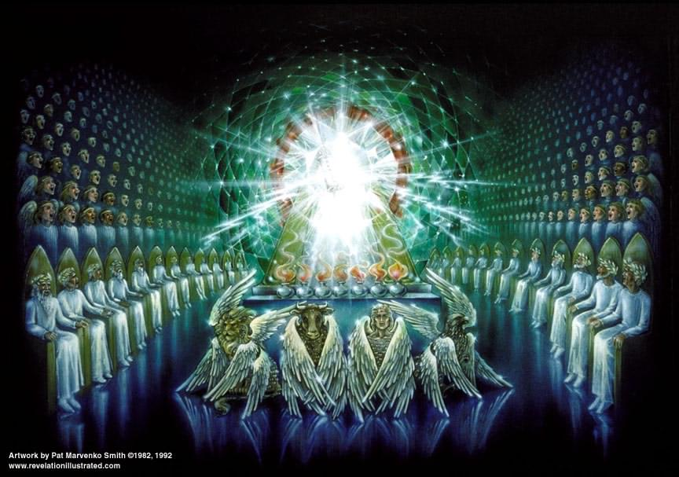
Revelation Chapter 4 Enter the Throne Room

Slide 77
Revelation Chapter 4
Now the visions begin.
Be prepared to use your imagination.
Rev 4:1 John sees a door open in heaven.
How does the vision begin? God is on his throne!!!!!!

Slide 78
The Throne Room
Jasper white Holiness
Carnelian red Justice
Rainbow God’s promise/covenant

Slide 79
The Throne Room (cont.)
Rev 4:4 24 elders: 12 tribes and 12 apostles
The 24 elders is, in essence us—God’s people.
Symbolism in Rev 4 & 5 is of the tabernacle.
Rev 4:5 thunder, etc. Like Exodus 19:6
Rev 4:6 Sea of crystal = separation of holy from profane.
Rev 4:6b-4 Four living creatures = cherubim = protecting the holiness of God.

Slide 80
The Throne Room (cont.)
The four creatures: Eyes = vigilance
Garden of Eden Curtain in the Tabernacle.
Isaiah 6:2 Ezek 1:5-14 Ezekiel 10
Lion Ox Man Eagle
Rev 4:8-11 Q: What impression of God does this give you?

Slide 81
Revelation CH 4 & 5
John 14:1
Ch 4 Trust in God
Ch 5 Trust also in me
Throughout the rest of the visions, remember Ch 4 & 5. It is the background.

Slide 82
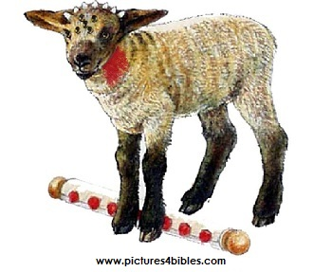
Revelation Ch. 5 The Lion and the Lamb
A scroll with seven seals which no one was worthy to open.
Sealed = something to be revealed
7 seals = completely sealed.

Slide 83
Enter: Jesus Christ
Jesus is a lion Q: What image comes to mind?
Jesus is the Root of Jesse Messiah
Jesus is triumphant
Jesus is a lamb Q: What image comes to mind?
7 horns = perfect in power
7 eyes = perfect in knowledge

Slide 84
Worship the Lamb who was slain
The most amazing worship service ever!
Harps = singing to the Lamb
Incense = prayers of the saints
Rev 5:9-14 A New Song (compare to the Song of Moses Exodus 15)
Theme of the song: Worthy is the Lamb
He has made a kingdom of priests Exodus 19:6 has been fulfilled!
v. 11,13 hundreds of millions of angels and all creation worship the lamb.

Slide 85
Revelation 6 The Lamb opens the Scroll
Now the action really begins!
Structure of Revelation 6-16:
Seven seals Revelation 6-7
Seven trumpets Revelation 8-9
Seven symbolic creatures Revelation 10-14
Seven bowls Revelation 15-16

Slide 86
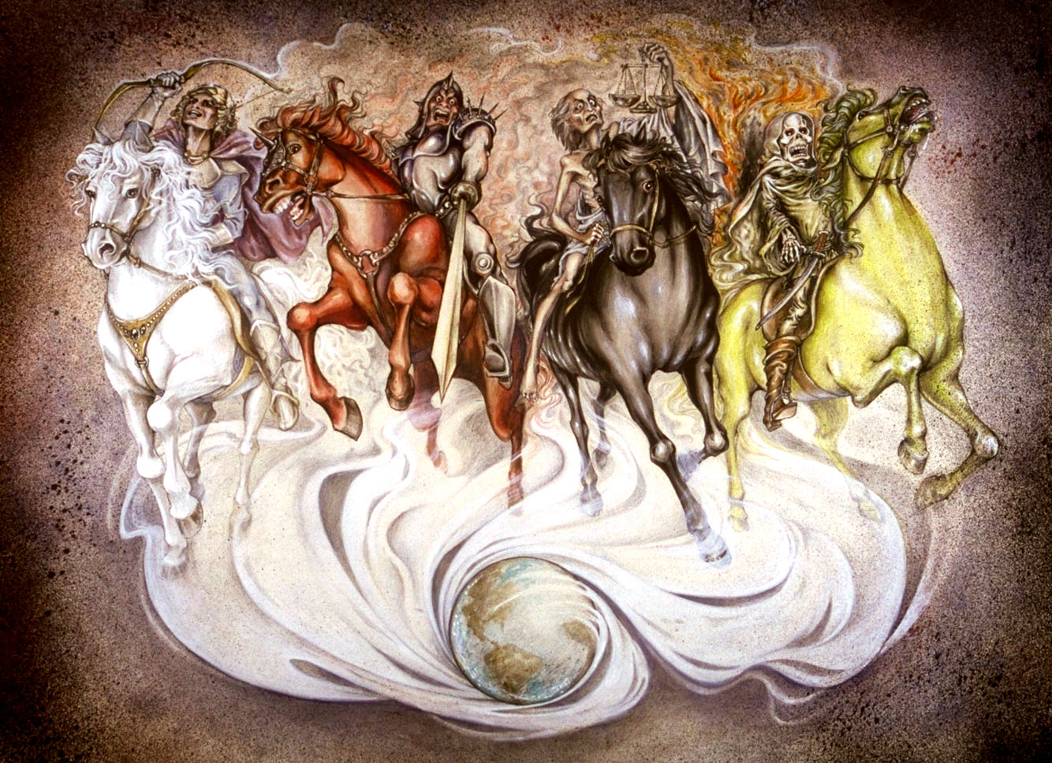
The Seven Seals God’s Judgment on the Roman Persecutors
Revelation 6:1 Come!!! Come see the vision.
Hoofbeats are heard in the distance
The Four Horsemen

Slide 87
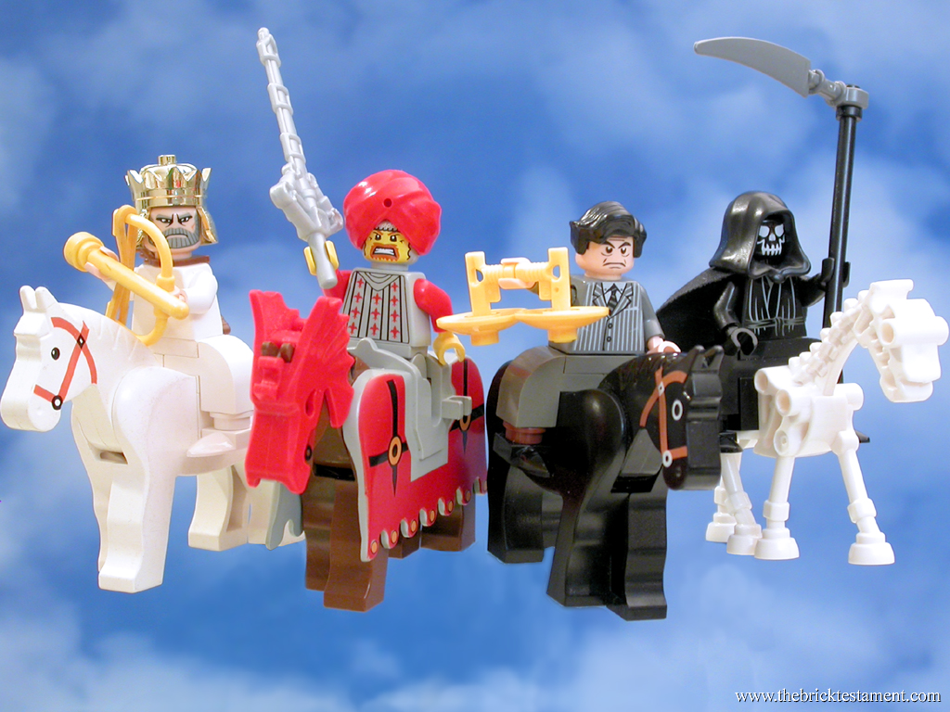
The Four Horsemen

Slide 88
Revelation 6 Four Horsemen
Seal #1 A rider on a white horse. Jesus comes as a conqueror. A crown and a bow. A Parthian symbol of victory (over Rome)
Seal #2 Red horse = War “the power to take peace from the earth.” Represents persecution to the church.
Seal #3 Black horse = Famine Scale to measure food. Oil and wine available: The rich are still doing fine. Represents financial depravity due to persecution of the church.
Seal #4 Pale yellow-green horse = Death Ezekiel 14:12-20. Represents martyrdom to the church.

Slide 89
Revelation 6 The first six seals
Q: How do you feel about persecution for preaching the gospel?
Rev 6:9-11 The fifth seal. Martyrs before the throne of God.
How long… before God judges the wicked?
Retribution for God’s people Psalm 94:1-3 Rev 11:7-18 Rev 16:5-6
Do you long to see vengeance on God’s enemies?
God’s answer: Rev 6:11 Not yet. There are more martyrs to follow you.

Slide 90
The Sixth Seal: The Day of the Lord
Rev 6:12-17 The sixth seal.
Earthquake, sun turns black, moon turns red, stars fall from the sky, the sky recedes like a scroll and the mountains removed. Everyone hides in caves and among the rocks.
Judgment is coming. The Day of the Lord is here. Hide!
Rev 6:17 Who can stand under this? Answer: Revelation 7!

Slide 91
Revelation 7 Interlude: The Saints are Sealed
Four angels hold back the winds. Winds = the action of God to judge his enemies. Daniel 7:1
An angel from the East.
The sealing of the 144,000 Ezekiel 9:1-6
Seal = ownership
12 x 12 x 10 x 10 x 10 All of God’s people. Every single one!!!
A multitude no one could count is the same people: Those saved from the coming wrath of God.

Slide 92
The 144,000 Sealed
Q: Does this sealing mean that the disciples will escape the suffering brought on by the tribulation? (Ezekiel 9:1-6)
White robes = pure, forgiven, righteous
Palm branches = joy The Feast of Tabernacles Celebrating salvation and living in a relationship with God.
Rev 7:10-15 A worship service
An elder: Who are these people? John: You know!
Rev 7:15 God spreads his tabernacle over us.

Slide 93
Revelation 8 & 9 The Seven Trumpets
Rev 8:1 The seventh seal is the seven trumpets
Trumpets:
Warning of impending judgment
Feast of Trumpets /Yom Teruah /Rosh Hashanah
Rabbis: Stay awake all night
Numbers 10:5 Sound the warning
Matthew 25:32-31 1 Thess 4:13-14
All this applies to Rev Ch 8-9

Slide 94
Revelation 8 Judgment on the Persecutors
Rev 8:1 Silence in heaven for ½ hour God is still holding back his judgment. 2 Pet 3:9 Ezek 33:11
Rev 8:3-5 What are the saints praying for? They are praying for God to take vengeance on the Roman persecutors. (Rev 6:10)
God’s response: Don’t make the mistake of going after my Saints. Rome made a big mistake when she did.
8:5 Thunder, rumblings, lightning and an earthquake. Judgment is coming!

Slide 95
Revelation 8 The First Four Trumpets Judgment on Nature
Rev 8:7 Trumpet #1 Hail, fire and blood Egypt plague #7 God goes after the crops of the persecutors of his saints.
1/3 = a limited judgment
Rev 8:8-9 Trumpet #2 Sea turns to blood Plague #1 God goes after the means of commerce Jer 51:25
Rev 8:10-11 Trumpet #3 Wormwood God goes after the fresh water. Jer 9:15
Rev 8:12 Trumpet #4 God goes after the heavenly objects. Plague #9 Isaiah 34:4-5 Joel 2:10

Slide 96
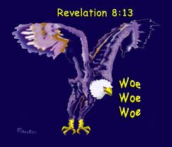
Rev 8:13 Woe!
An Eagle says woe, woe, woe. Three woes are coming (trumpet #5,6,7)
Trumpet #1-4 Judgments on the earth. Trumpet #5,6 Judgment on people

Slide 97
Revelation 9 Trumpet #5,6 Woes!
Rev 9:1-12 Trumpet #5. First of two judgments on men. Locusts (plague #8)
Fallen Star = Satan who holds the key to the Abyss
Locusts = Demons who torment those who do not
worship God.
Q: Can a Christian be possessed by a demon?
v. 5-6 Their sin will cause the sinful to loath
themselves. Can you relate?

Slide 98
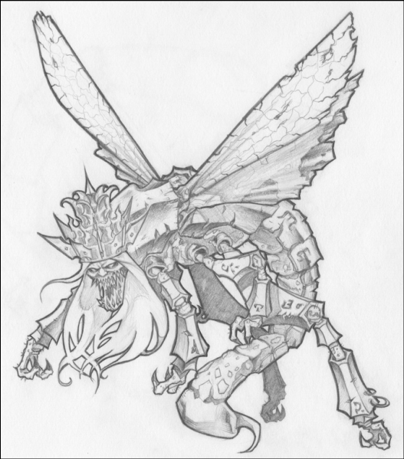
Trumpet #5 (cont.)
v. 7-10 Bizarre locusts!!!
Satan is their king!
Ephesians 2:2 The ruler of the kingdom of the air
John 14:30 The prince of this world.
Summers: “The locusts represent the hellish rottenness, the internal decadence in the Roman Empire.”

Slide 99
Revelation 9:13-20 Woe #2 War comes to Rome
9:14 bound at the River Euphrates = Parthia: the chief military rival of Rome.
Q: Will the church suffer because of this warfare?
Rev 9:21 A depressing result. Rome did not repent. It is time for the 7th trumpet and the seven bowls!

Slide 100
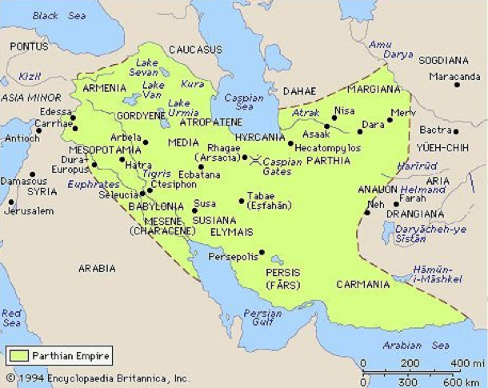
Revelation 9:13-20 Trumpet #6

Slide 101
Revelation 10:1-11:14 A Second Encouraging Interlude
10:1-2 A very mighty angel with a little scroll
v. 3 Seven thunders are sealed (ie not heard
for now)
v. 5 Right hand = oath NO MORE DELAY Judgment is at hand.
v. 9-11 Eat the scroll
Tasted sweet (it is God’s word after all!
Turned sour in the stomach (bad news for the saints)
Judgment on God’s enemies and trial for God’s people

Slide 102
Rev 11:1-14 Encouraging Interlude (cont.)
God measures the temple courts, but not the court of the Gentiles.
God will protect the heart of the church, but he will give Rome some freedom to go after his saints.
v. 2 The court of the Gentiles will be trampled for 42 months. Limited persecution of the church—allowed by God.

Slide 103
3-1/2 Years in the Bible
1. The period the church will be persecuted Rev 11:2
2. The period during which the two witnesses will testify Rev 11:3
3. The period over which the Woman is nourished in the wilderness Rev 12:6,14
4. The period of the Beast’s authority Rev 13:5
5. The period the little horn persecutes the saints Daniel 7:25
6. The period of the abomination of desolation by Antiochus Ephiphanes Dan 12:11 (1290 days for some reason)

Slide 104
Rev 11:3-6 The Two Witnesses
The two witnesses are the “witness” of the church during the time of the trampling.
In sackcloth (there will be much suffering, but they will still witness for me)
The two olive trees and the two lampstands: Zechariah 4:12-14 Joshua (priestly authority) and Zerubbabel (civic authority). Zechariah 4:4-6 The witness of the Holy Spirit.
v. 5-6 The Church’s testimony will be very powerful!! (shut up heavens and water to blood)

Slide 105
Rev 11:7-12 The Serpent Attacks the Church and is Defeated.
v. 7 Some saints will be killed by Domitian/Rome.
v. 8 Sodom/Egypt/Jerusalem = Rome
(Rev 13:7)
v. 9-10 The “world” will gloat over the defeat of the church, but only for 3-1/2 days.
v. 11-12 But the church will come back, seemingly from the dead. The saints will be victorious.

Slide 106
Rev 11:13-14 The Third Woe is at Hand
But first….. Worship service #4 breaks out in heaven.
v. 18 The time for your wrath to break out has come.
v. 19 Hold your breath…. Act I is over.

Slide 107
Rev 12 Now We Look Behind the Scene
Rev Ch 1-11 Act I The view from the perspective of the church—up front.
Rev Ch 12-22 Act II The view of matters from the perspective of heaven—behind the scene.
Rev 12:1 A wondrous sign appeared in heaven

Slide 108
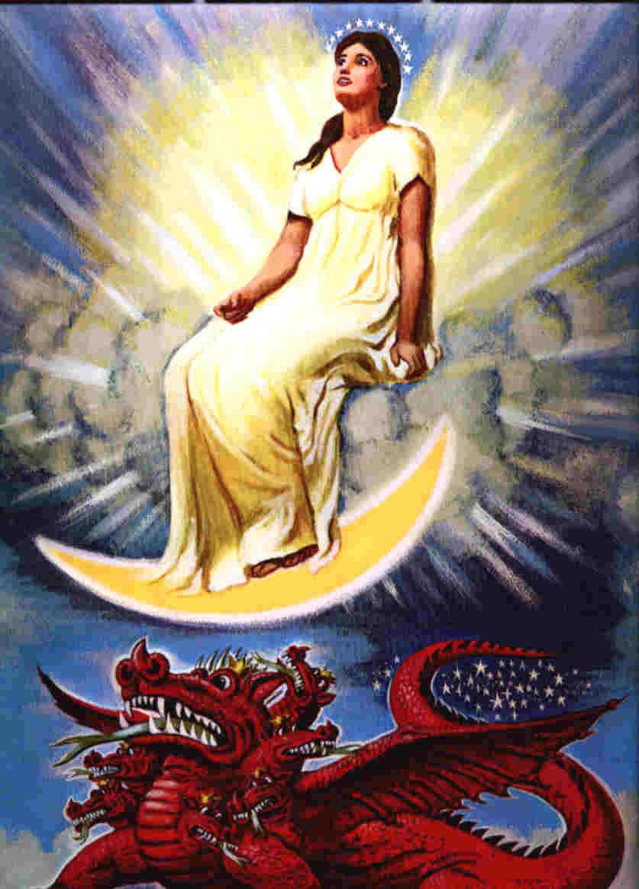
Revelation 12 The Woman and the Beast

Slide 109
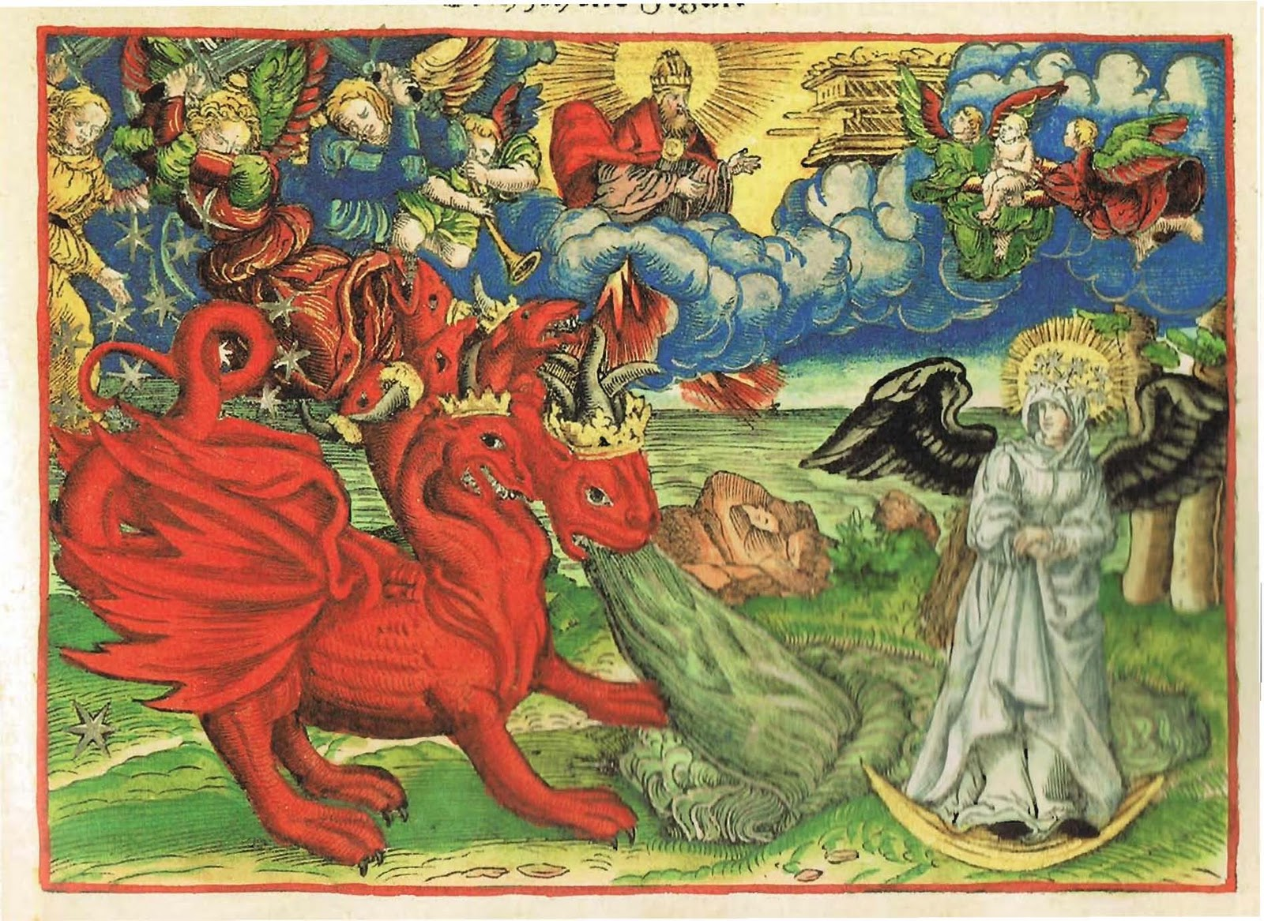

Slide 110
Revelation 12:1-3
A great and wondrous sign.
Who is the woman?
She is Israel—about to give birth to the Messiah
She is the Church—about to be persecuted
She is God’s kingdom in any of its aspects.
Another sign: An enormous red dragon.
7 heads (great wisdom)
10 horns (very powerful)
7 crowns (great authority (on the earth at least))
Satan! Rome! (Rev 17)

Slide 111
Rev 12:4-6 Satan Goes After the Son and, Later, His Church
12:4 Satan tries to devour the child when the woman (Israel/Mary) gives birth. Herod kills the children of Bethlehem.
v. 5 The child “who will rule all the nations” is snatched up to heaven.
v. 6 The woman (the Church) flees to the desert and is cared for by God for 1260 days. Persecuted but protected.

Slide 112
Rev 12:7-17 Spiritual War in Heaven… and On Earth
12:7-10. Satan is defeated and cast down to the earth.
Q: Is this a good thing for the Church?
The result: vicious persecution of the church! (12:13)
The Devil: Deceiver (9:9) Accuser (9:10)
Q: Which method does Satan use with you?

Slide 113
How Do We Overcome the Work of Satan in Our Lives? (Rev 12:11)
1. By the blood of Jesus.
2. By the word of their testimony.
Remember the two witnesses.
3. By our willingness to give up our very
lives rather than worshipping the Beast.
They “loved not their lives” Gal 2:20
Rev 12:14-16 The Church will be protected from the Serpent 3-1/2 years.

Slide 114
Revelation 13 The Two Beasts
Rev 13:1 An ominous passage. The dragon stood on the shore of the sea. Sea = the nations.
Rev 13:2 A beast from the sea = Rome!
10 heads = Augustus, Tiberius, Claudius, Caligula, Nero, Galba, Otho, Vitellius, Vespasian and Titus. Daniel 7:7 Rev 17:12
Alternately, they may be ten “client-kings” of Rome who did the dirty work of ruling the provinces. Rev. 17:12 supports this.
7 horns = Augustus, Tiberius, Claudius, Caligula, Nero, Vespasian and Titus Rev 17:9

Slide 115
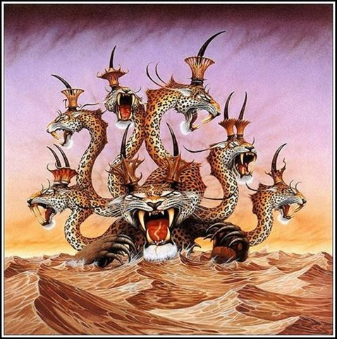
The Beast From the Sea

Slide 116
The First Eleven Emperors of Rome
The Ten Horns and the Seven Heads
Emperor
Dates of Rule
Significance to Biblical Events
Augustus
27 BC-14 AD
Birth of Christ
Tiberius
14 AD-37 AD
Crucifixion of Christ
Gaius (Caligula)
37 AD-41 AD
Claudius
41 AD-54 AD
Jews Exiled from Rome
Nero
54 AD-68 AD
First persecutions, Execution of Paul and Peter
Galba
68 AD-69 AD
One of the three overcome by Vespasian
Otho
69 AD-70 AD
One of the three…
Vitellius
69 AD-70 AD
One of the three…
Vespasian
69 AD-79 AD
Attack on Jerusalem
Titus
79 AD-81 AD
The general who destroyed Jerusalem
Domitian
81 AD-96 AD
First Systematic Persecutor of the Church

Slide 117
The Beast From the Sea
v. 2 The dragon (Satan) gave the beast (Rome) its power to attack the saints.
v. 3 One of the heads had a fatal wound (Nero who ended the Claudian Dynasty.
But the wound was healed. (Vespasian started the Flavian Dynasty)
v. 5-7 Domitian given temporary power over the saints (42 months) and to make war on the saints.
v. 8 Everyone (except the Saints, of course) will worship Domitian. This was literally true.
This is very scary for the church!!!!!

Slide 118
Assurance For the Saints
v. 8 Those who do not join them and worship the beast will have their name written on a different list that the Romans kept: The Lamb’s book of life!!!
v. 9-10 But…. Reality check here…. Some who refuse to worship the beast will be put in jail and some will be killed.
v. 11 This calls for patient endurance of the Saints. I would say so!!!

Slide 119
Revelation 13:11-18 The Beast Out of the Earth: Roman Religion
Rev 13:11 Another beast. Domitian
The eight king of Revelation 17
The eleventh horn of Daniel 7 who uprooted
three horns (Galba, Otho and Vitellius)
13:14 An obvious reference to Domitian
13:17 The mark of the beast was not a literal mark, but it was an official document declaring that you made the sacrifice
Domitian’s number is 666. He is Satan’s man.

Slide 120
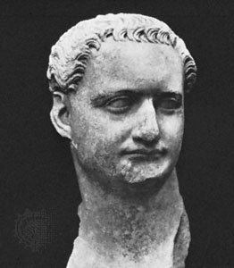
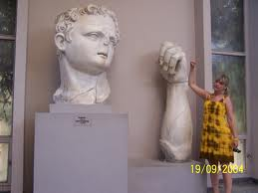
Domitian (c. 81-96 AD)
The Beast out of the Earth
666

Slide 121
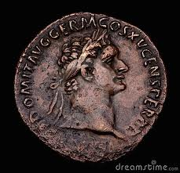
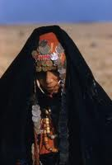
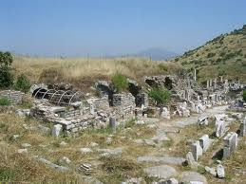
Rev 13:17 The Mark of the Beast

Slide 122
Revelation 14 The Wine of God’s Wrath
After Rev 12, 13 We need some encouragement.
Rev 14:1-4 The 144,000 who have been sealed.
”who have not defiled themselves with women” is about spiritual purity.
v. 4 the firstfruits of God and the Lamb. The first and best of the harvest for eternity. (1 Cor 15:20,23, Ex 34:26, 23:19, Deut 26:9-11.)
Rev 14:6-12 The absolute last chance to repent. (as far as God is concerned) Babylon the Great (Rome) has fallen!

Slide 123
Revelation 14 Forever and Ever
Those who worship the beast will:
1. Drink the wine of God’s fury. (v. 10)
2. Be tormented forever and ever. (11)
Question: Is this torment literally forever (ie for an infinite amount of time)?
v. 12 Conclusion: This calls for patient endurance on the part of the saints (ie to not offer sacrifice to the Beast (Rome)
v. 13 A beatitude: Blessed are those who die in the Lord from now on. This is not about martyrdom.

Slide 124
Rev 14:14-20 Harvest Time Has Come
Rev 14:14-16 The harvest of wheat. God’s people are harvested for eternity.
Rev 14:17-20 The harvest of grapes. The wicked are harvested. They go to a winepress, with blood up to the bridles of the horses.
A lot of blood!

Slide 125
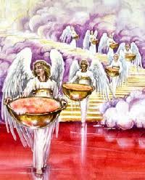
Revelation 15 & 16 The Seven Bowls
15:1 Seven angels with seven bowls.
15:2 The sea is still there, but it is red and the elders are ON the sea.
Our suffering for Christ brings us closer to the throne. Coll 1:24 Phil 2:10
The sea = the laver (the bronze sea)
The sea = the Red Sea (1 Cor 10:1)
15:2-4 Worship breaks out again!
15:5-8 The Temple

Slide 126
Revelation 16 The Seven Bowls It is Done!
The six seals and the six trumpets were partial judgment, with the intention of bringing about repentance
The seven bowls are complete judgment and are intended as retribution, not as discipline.
Revelation 16:1 God says go!

Slide 127
The Seven Bowls
First four bowls: Land, sea, fresh water, heavens.
First bowl 16:1-2 “On the land” painful sores (plague #6)
Second bowl 16:3 On sea. Dead man’s blood. (plague #1)
Third bowl 16:4-7 On fresh water v. 6 Justice.
Fourth bowl 16:8-9 On the heavenly objects. Rather than repent, they cursed God.
Fifth bowl 16:10-11 On the beast (Rome). Darkness (plague #9)
Sixth bowl 16:12 dries up the Euphrates—opening the way for military conquest. “Kings from the East”
Parthia?

Slide 128
Rev 16:13-15 The Seven Bowls (cont.)
Rev 16:13. Three “evil spirits that looked like frogs”
They come from the Serpent (Satan), the Beast (civic Rome) and the False Prophet (religious Rome)
These are lying spirits—demons 2 Thess 2:9-12
1 Kings 22:19-23
Rev 16:15 I come like a thief. Be prepared with your spiritual clothes. (Matthew 22:11-13, Gal 3:25-26)

Slide 129
Rev 16:16-23 The Final Bowl
v. 17 It is done. This brings the judgment on Rome to completion.
Bowl #7 On the air (ie on Satan Ephesians 2:2)
v. 16 A war at Har Megiddo.
1. Israel defeated Jabin Judges 4,5
2. Gideon defeated the Midianites. Judges 7,8
3. Saul defeated by the Philistines.
4. Ahaziah defeated by Hazael and killed by Jehu.
5. Necho slew Josiah (2 Chron 35:20-25)

Slide 130
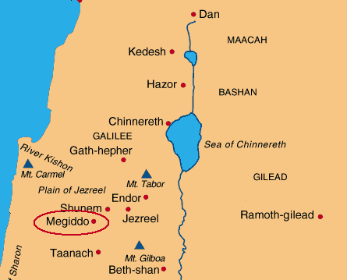
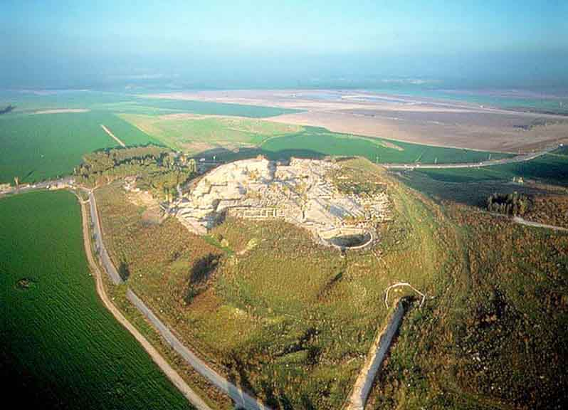
Megiddo

Slide 131
Armageddon
A literal battle?
300 million + soldiers
Between Parthia and Rome?
Rev 16:19 An Earthquake. Rome is divided and destroyed.

Slide 132
Revelation 17 The Woman and the Beast
Revelation Ch 17-19 The victory of the Lion/Lamb
Rev 17:1 The Great Prostitute = Rome Dan 11:36-39
Rev 17:3 A woman (the city of Rome) on a beast (the Roman Empire, including its client kings)
Purple = corrupt political power
Scarlet = blood
17:6 Who is the woman? The one who is “drunk with the blood of the saints.” Rome/Nero/Domitian/Galerian/Decius/Diocletian

Slide 133
Who Are the Woman and the Beast? (in case there is any doubt)
v. 8,10 The beast who was (Nero), now is not (Vespasian), and yet will come (Domitian)
v. 8 He comes from the Abyss
v. 9 Seven hills. (the Palatine, Aventine, Capitoline,
Caelian, Esquiline, Quirinal, Viminal)
v. 10 Seven kings.
Five have fallen (Augustus, Tiberius, Caligula, Claudius, Nero)
One is (Vespasian)
One has not yet come, but will remain for a little while (Titus, who ruled for less than two years).
v. 11 The eighth king, the one who will yet come. Domitian!

Slide 134
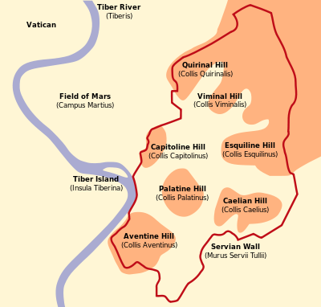

Slide 135
Domitian: Nero Redivivus
Jesus is the resurrected one. His is the eighth day.
Sibylene Oracles: Jesus is 888—the resurrected one.
The eighth king is a resurrection of the head who was dead.
Tertullian: Domitian was “a limb of the bloody Nero”
v. 11 But do not fear! Domitian is “going to his destruction.”

Slide 136
Rev 17:12-14 The Ten Horns
Rev 17:12 The ten horns are ten kings-without-a-kingdom.
They take their authority from the Beast (Rome)
They will make war against the Lamb (and his saints)
But do not fear “the Lamb will overcome them because he is Lord of lords and King of kings”
v. 16 The Beast and the ten horns who will destroy the woman—the great city—Rome.
This is exactly what happened! God rules the nations! Do not fear!

Slide 137
Revelation 18-20:10 The Enemies of God and of the Church Are Destroyed
Revelation 18 The Great Prostitute is judged and destroyed.
Revelation 19 The Beast and the False Prophet are judged and destroyed.
Revelation 20:1-10 The Serpent/Satan is judged and destroyed.

Slide 138
Rev 18:1-8 Fallen is Babylon the Great
Babylon/The Great Prostitute is Rome in its materialistic aspect. It is “the world” of 1 John 2:15-17 and James 4:4 as personified in Rome.
Rev 18:4 God’s advice about the world: Come out of her!
Q: Why is “the world” so enticing? Rev 18:3 she made them rich. 1 Jn 2:15-17
18:6-8 The fate of the world. Advice: Make sure this does not apply to you! 1 Cor 11:32.

Slide 139
Revelation 18:9-24 The World is Weeping
Rev 18:9 Crying over the destruction of Babylon/Rome. Why? v. 11-13 Greed! This is worldly grief.
Rev 18:15-16 Sad because they lost $$$
Rev 18:17-24 This is literally what happened to both the city of Rome and its empire.
The population dropped from 1.5 million (AD 120) to about 15 thousand (AD 800)

Slide 140
Revelation 19 The Fall of the Beast and the False Prophet
Rev 19:1-5 What are they cheering about?
Justice and vindication.
Q: How many times does Hallelujia appear in the Bible?
Rev 19:6-9 Now, what are they cheering about? We are getting married to Christ!
2 Cor 11:2 Now we are engaged to Christ.
19:7 Our fine linen is righteous deeds.
Wearing the right clothes for the banquet: Matthew 22:14 Galatians 3:25-26.
19:9 Right now, we have only been invited. The marriage has not yet been consummated.

Slide 141
Revelation 19 (cont)
Rev 19:10 An angel refuses worship Jesus does not refuse worship! Rev 5:9-14, Heb 1:6, John 20:28
Rev 19:11-16 Jesus a warrior on a white horse.

Slide 142
Revelation19 (cont)
Rev 19:14 Who are these soldiers on white horses?
They are us! We are the triumphant army.
Two banquets:
Rev 19:6-9 The banquet of the lamb
Rev 19:17-21 The banquet of vultures.
The Beast and the False Prophet are judged!
This happened when Rome was judged. The Serpent’s judgment will come much later.
Rev 19:21 The rest of them…. Those who allied themselves with Rome.

Slide 143
Revelation 20:1-10 The Dragon/Satan is Judged
What is the 1000 year reign/binding of Satan?
What it is not:
1. No mention of the second coming of Christ.
2. No mention of Jesus being on the earth.
3. No mention of a bodily resurrection.
4. No mention of a rapture.
5. No mention of people living in modern times
What it is:
A time of partial binding of Satan’s power on earth of unknown but significant length of time which began at a time near to when John wrote Revelation.

Slide 144
Revelation 20:1-3
v. 2 Satan “chained.” for 1000 years.
1000 represents a complete and long time, but the actual duration is unknown.
In what sense was/is Satan bound?
He certainly was not completely bound!
A possible explanation: He no longer has the Beast, the False Prophet and the Great Prostitute to use to attack the saints. (which actually happened after AD 325)

Slide 145
Satan Bound
Rev 20:3 After the 1000 years of binding, Satan will be “set free” of the chain “for a short time.”
Rev. 20 implies this “short time” will end with the second coming of Jesus.
Likely interpretation: Satan is still “bound.” An outburst of state-based persecution of fairly short duration may break out at the end of time.

Slide 146
Revelation 20:4-7 The First Resurrection
20:4 Martyrs killed by Domitian or other Roman persecuting emperors.
They are given power to judge. Who will they judge? Their former persecutors?
This “first” (v.5) resurrection is of only the righteous.
Is it a literal resurrection, or is it a symbolic resurrection of the saints in triumph over the Roman power and the Beast?
Was the resurrection in Rev 11:11 a literal resurrection? Probably not.
Historically, the non-literal interpretation works

Slide 147
The First Resurrection (cont.)
A symbolic resurrection: Ezek 37:1-13 (esp. v. 12)
Rev 20:5 In any case, the vast majority of the righteous and all the unrighteous will be resurrected after the 1000 years. Daniel 12:2
Don’t miss the main point. Satan is bound and the martyrs are free!
Revelation 20:7 A Fast-Forward Similar to Daniel 12:1
End Times Have Arrived.

Slide 148
Rev 20:7- Rev 22 End Times
Rev 20:7 Satan released and goes out to deceive the nations.
Gog (ungodly people) and Magog (ungodly nations ruled by those ungodly people) attack the church.
But this lasts for a very short time!
20:10 The Devil The Serpent is Destroyed!!! Game over.

Slide 149
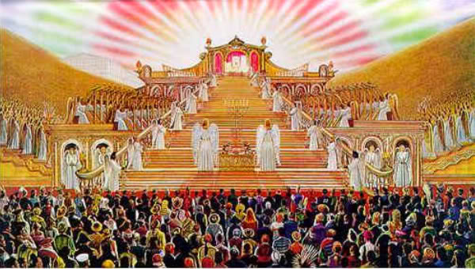
Revelation 20:11-15 Judgment Day The Great White Throne

Slide 150
Revelation 20:11-15 Judgment Day and the Second Death.
Parallel verse: Daniel 12:1-4
v. 12 … the dead, both great and small No favoritism at final judgment. 1 Pet 1:17
Two books:
A book of works
The Lamb’s book of life
v. 14 Death and Hades are destroyed. Good news for those in heaven. Bad news for those in hell.
Who goes to the second death? Rev 21:8, 21:27 22:15

Slide 151
Revelation 21-22 The New Jerusalem
Rev 21:1-8 Perfect fellowship with God
Rev 21:9-26 Perfect protection by God
Rev 22:1-5 Perfect provision with God
Rev 22:6-21 Epilogue

Slide 152
A New Heaven and a New Earth
Heaven→
Earth→

Slide 153
Rev 21:1-8 Perfect Fellowship with God
Rev 21:1 No more sea. No more separation at all. Full and free access to the throne.
Especially poignant for John who was separated by the sea from all he loved.
Rev 21:3 The dwelling (tabernacle) of God is with men. How great is that?
Rev 21:4 tears wiped away, no more death or pain.
Q: How can this be? Can there be joy without suffering?
21:6 You can count on it!
21:7 Those who overcome—ie those who do not worship the beast will have this!

Slide 154
Revelation 21:9-26 Perfect Protection
v. 12 …it had a great, high wall. Well protected
With twelve gates. Lots of access.
v. 15 a measuring rod. Protection
v. 17 a wall 200 feet thick
v. 21 gates made of pearls. The only jewel which is formed by pain.
v. 22 no temple in the city. The city is a temple.
v. 23 no sun needed
v. 25 Gates never shut. Security.

Slide 155
Revelation 22:1-6 Perfect Provision
Garden metaphor.
The Bible begins and ends with a garden—with man in perfect fellowship with his maker in a garden where every need is supplied by God.
We need water (crystal clear water v. 1), food (twelve crops of fruit v.2) and health (leaves for healing).
v. 3 What will we “do” in heaven? “his servants will serve him.” We will serve God.
In the New Jerusalem we have fellowship, protection, provision and an opportunity to serve the God of the universe.

Slide 156
Revelation 22:7-21 Epilogue
Rev 22:7 I am coming soon (in judgment on Rome)
v. 10 Do not seal it up. Publish this book to the churches.
v. 11 An odd statement. Parallel: Daniel 12:10
22:12 I am coming soon. The things in this book will happen soon.
22:13 You can count on it!

Slide 157
Come!
22:17 The Spirit and the Bride say come! An evangelism passage. We say come! Whoever wishes can come too.
22:18-19 Do not add or take away from this prophecy. This would be particularly relevant to apocalyptic writing in the first century.
What is our conclusion? Amen! Come Lord Jesus!
At the end of Revelation, what do we know?
Come what may, Christ is supreme and no power can take from him the victory that is rightfully his.

Slide 158
Throne References
Rev 3:21 To him who overcomes, will sit with me on throne
Rev 4:2 Throne in heaven
Rev 4: 5 From throne flashes of thunder and lightning
Rev 4:10 Set their crowns before throne
Rev 5:11 Millions of angels surround throne in praise
Rev 7:9-12 Multitude standing before throne
Rev 8:3 Incense, prayer of saints, on golden altar before the throne
Rev 13:2 Satan has a throne as well
Rev 16:10 Satan’s throne will be judged

