Slide 1
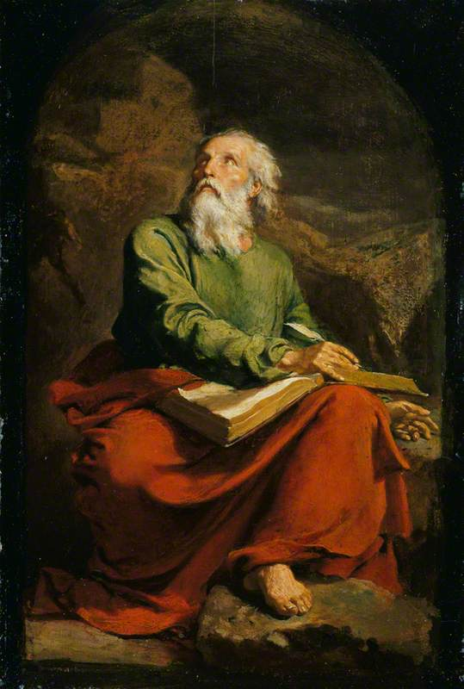
The Book of Isaiah V God Will Save a Remnant
John Oakes
Aug. 22, 2021

Slide 2
Isaiah 40:1-5 Comfort, comfort my people
Isaiah 40:1-2 Comfort, Comfort my people. My anger is complete. A remnant will return.
Isaiah 40:3-5 A voice calling in the wilderness…
Make straight a highway for our God.
Every valley will be raised up.
Every mountain will be brought low.
And the glory of the Lord will be revealed.

Slide 3
Every mountain will be made low

Slide 4
Every canyon will be raised up

Slide 5
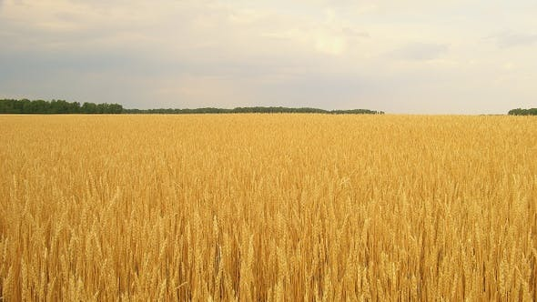
Isaiah 40:6-20 God is awesome you are not
All people are like grass!

Slide 6
If we are grass, what can we count on?
Isaiah 40:8 The grass withers and the flowers fail, but the Word of our God endures forever.
Isaiah 40:10 God’s mighty arm
(Jesus Is 53:1-3)

Slide 7
Is 40:12 Who has… marked off the heavens

Slide 8
The nations are a drop in the bucket

Slide 9
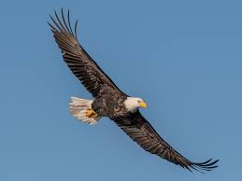
Those who hope in the Lord will renew their strength. They will soar on wings like eagles; they will run and not grow weary, they will walk and not be faint.

Slide 10
Background to Isaiah 44-45
Prophecy: God judges and God calls a remnant.
God will judge Deut 28:15, Deut 28:49-52
But God will save a remnant Deut 30:1-6
God will judge Isaiah 39:5-7
But God will call a remnant Isaiah 10:21-22
God will judge Jeremiah 25:8-14
But God will save a remnant Jeremiah 29:10-14
When God says it, it will happen!

Slide 11
God Proposes and disposes
605 BC Nebuchadnezzar takes Daniel, Hananiah, Azariah and Mishael as hostages (Dan 1:1).
586 BC Nebuchadnezzar destroys Jerusalem and the temple.
70 years
536 BC Cyrus the Persian defeats Babylon and sends a remnant back to Jerusalem (Ezra 1:1-4)
516 BC The temple is completed.

Slide 12
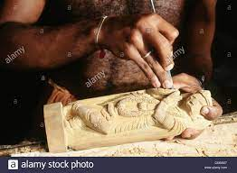
Isaiah 44 Who is like me? Let them declare… what is to come.
Isaiah 44:6-20 YHWH vs idols
v. 6-8 I am the alpha and omega. I am the only God! Can the other “gods” foretell the future?
Is there any God besides me?
v. 9-20 The foolishness of idols.
Is 44:21-23 They make idols.
I made you.

Slide 13
Isaiah 44:26-45:13 I am sending cyrus
Is 44:26-28 I can call Cyrus 120 years before he is born!
Cyrus is the savior of my people. Reinhabit Jerusalem. Rebuild Judah. Restore the cities.
Confirmed by the Cyrus Cyllinder
God says to us: Let it be rebuilt!
Is 45:1-7 Cyrus is a prefigure of the Messiah
Isaiah 45:9-13 The potter will raise up Cyrus.

Slide 14
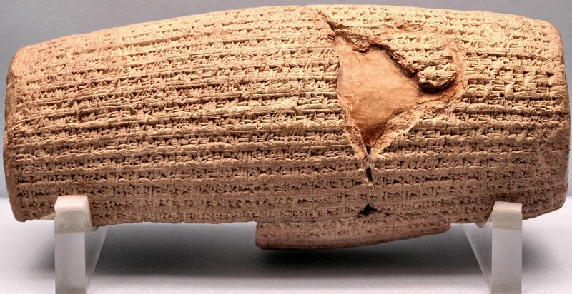
Cyrus Cylinder British Museum 535 BC
Ezra 1:2-4

Slide 15
Isaiah 49 God restores a remnant
Isaiah 49:1-13 2nd Servant Song
Is 49:1-7 I planned to send Messiah from the beginning.
What will Messiah do?
v. 5 bring Jacob back to God.
v. 6 restore the remnant of Israel.
v. 7 He will be despised and abhorred.

Slide 16
Isaiah 49:8-13 God’s remnant.
v. 8 restoring a remnant.
v. 9b pasture on every barren hill.
v. 10 no more spiritual hunger or thirst.
v. 10 compassion on them.
v. 10 lead them to springs of water.
v. 11 prepare a smooth road to the kingdom.
v. 12 all nations, North, South, East, West.
Porterville, Taft, Tehachapi, Shafter
v. 13 comfort.

Slide 17
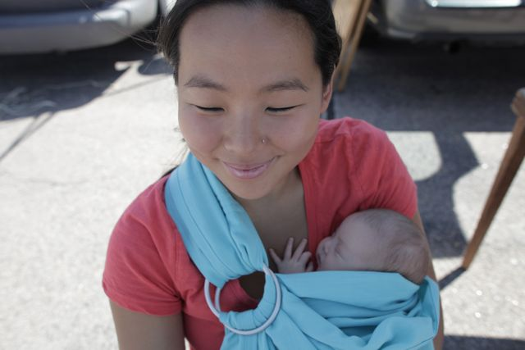
Isaiah 49:15
Can a mother forget the baby at her breast and have no compassion on the child she has born? Though she may forget, I will not forget you!

Slide 18
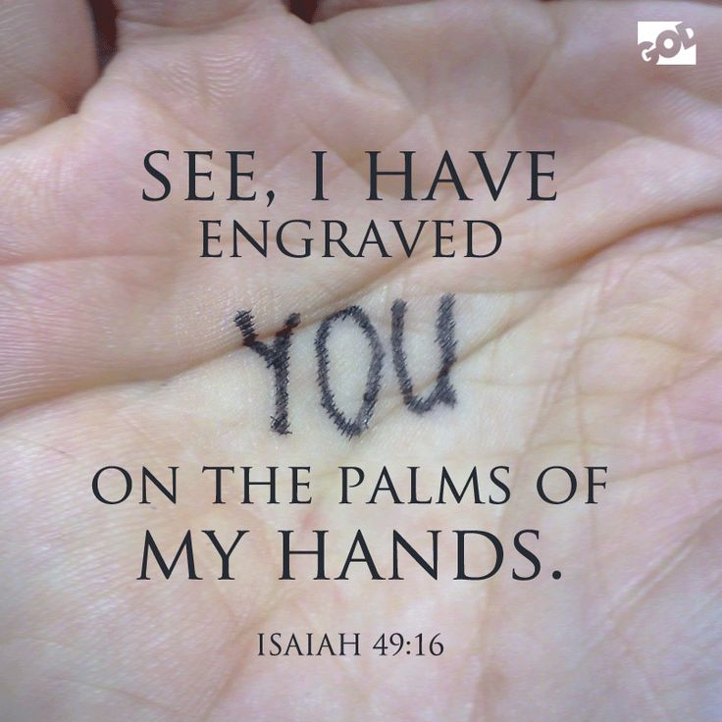
Isaiah 49:16
See, I have engraved you on the palms of my hands

Slide 19
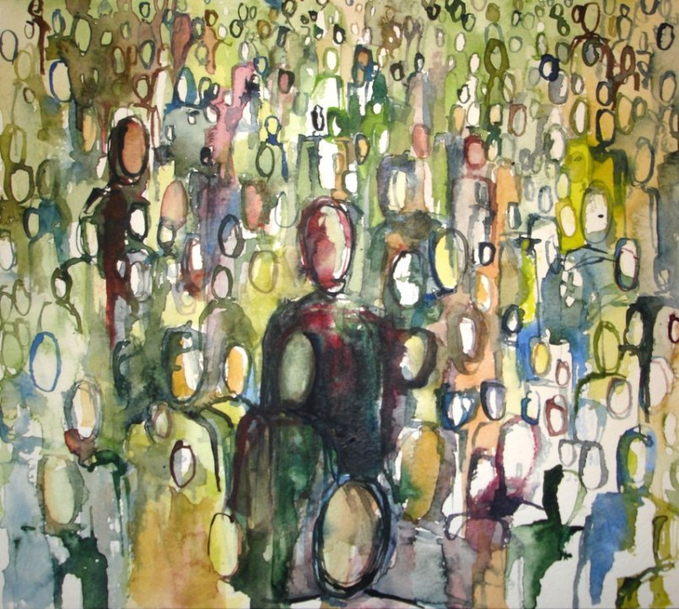
Isaiah 49:18-26 A fruitful remnant
v. 18-20 Your spiritual children are gathered around you.
v. 19-23 The barren become very fruitful.

Slide 20
Summary
To the idols God says I am the only God. There is none like me.
I raise up nations and tear them down.
I reveal the future like no other.
I will use Cyrus to do this: To restore my people to me—to release them from captivity
The Servant Messiah will do this. He will restore my people.
I will do this.
Will you come back form captivity and be restored to me?

