Slide 1
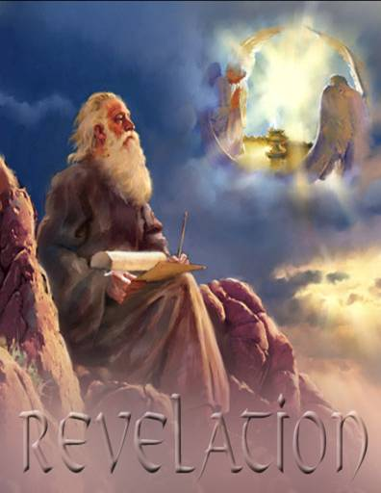
Revelation I
Jesus, The Alpha and the Omega
Dr. John Oakes
Bakersfield
9/5/21

Slide 2
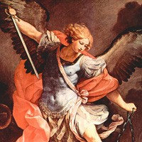
Apocalyptic Literature
Rev 1:1 The revelation of Jesus Christ
revelation = apokalupsis αποκαλυψισ
= unveiling.
Apocalyptic literature is an unveiling
Vision as a literary device

Slide 3
Purpose of Apocalyptic Writing
To show in dramatic fashion that God is in control.
“The purpose of these writings was to stress the virtue of loyalty and of stimulate faith by showing in vivid fashion the certain overthrow of evil and final victory for God’s righteous cause.” (Summers: Worthy is the Lamb)

Slide 4
Characteristis of Apocalyptic Literature
1. Written in times of trouble
2. Cryptic in style
3. Prophecy vs Apocalyptic
4. Always has a definite historical setting
5. Symbolic
Other literature: Assume literal unless
the context demands symbolic.
Apocalyptic: Assume symbolic unless the
context demands literal.

Slide 5
Numbers in Apocalyptic Literature
2 = strength, courage, energy
3 = divine number. Number of God.
4 = the world, the cosmos, creation.
6 = sinister, Satan 6 falls one short of seven. Doom.
7 = perfection, completeness
3-1/2 = incomplete, partial (1260 days, “time, times and half a time”)

Slide 6
Numbers in Apocalyptic Literature (cont.)
10 = completeness
1000 = 10x10x10 = ultimate completeness
12 = Number of religion. God’s people. 12 tribes, 12 apostles.
144,000 = 12x12x10x10x10 All of God’s people

Slide 7
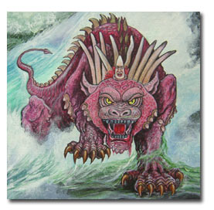
Αποκαλυφισ Characteristics Continued
6. Dramatic.
Arguably, the chief aspect of the Apocalyptic is that it is dramatic.
Dramatic, vivid,
forceful, terrifying,
grotesque
A cosmic graphic novel

Slide 8
Summary: How to Interpret Apocalyptic:
There will be a definite historical setting and cause for the visions. Interpret in light of this setting and cause.
About the imagery: get the big picture and do not get too caught up in the details—do not “push” the details.
After correctly observing the first two steps, you can apply apocalyptic passages to all people and all situations and all times.

Slide 9
Historical Background to Revelation
Revelation 1:9 I, John, your brother and companion in the suffering and kingdom and patient endurance that are ours in Jesus, was on the island of Patmos because of the word of God and the testimony of Jesus.
Persecutions of the Church:
Nero AD 64
Domitian 95-97 *
Trajan 98-117
Septimus Severus 202-211
Decius 249-251
Valerian 257-261
Diocletian and Galerian 303-311

Slide 10
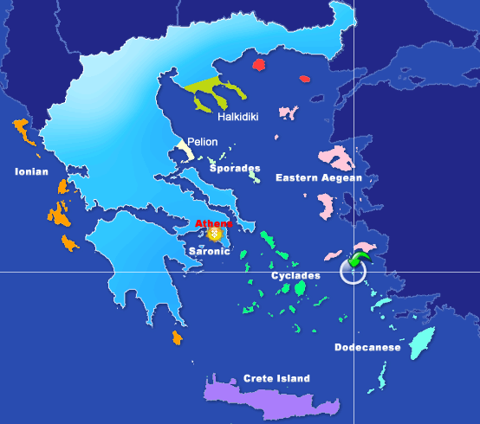

Slide 11
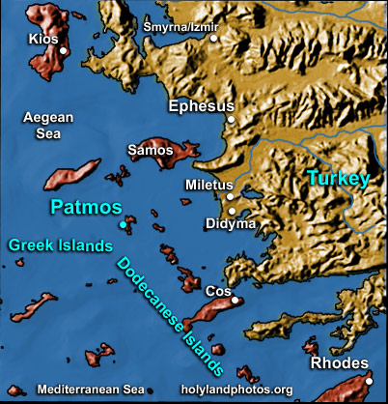

Slide 12
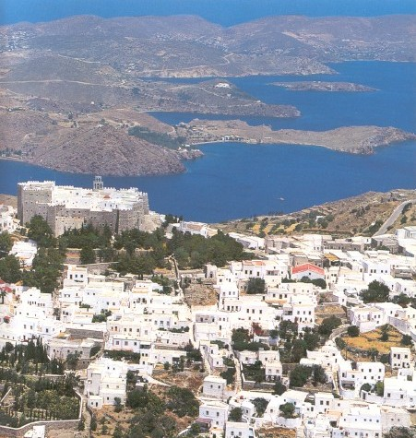

Slide 13
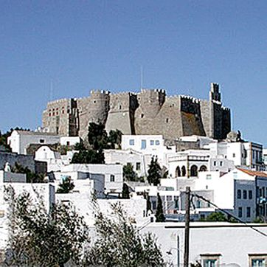
Monastery of St. John, Patmos

Slide 14
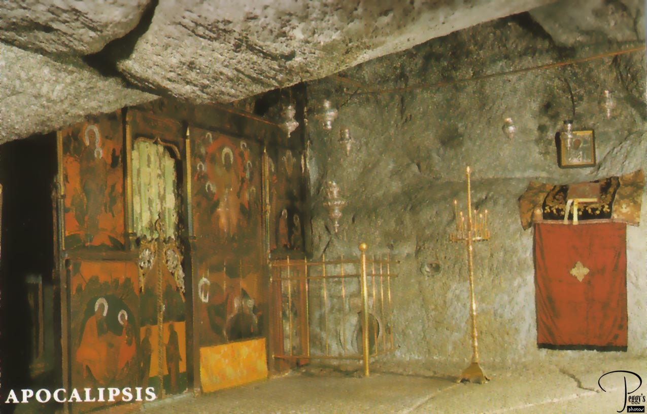
John’s cave?

Slide 15
Theme, Message and Objective of Revelation
Theme of Revelation: Peel back the layers of history and even the terrible persecutions and what do we find? The lamb is on the throne and God is in control.
Message of Revelation: Be encouraged and faithful to Jesus Christ. Jesus, not Caesar, is Lord.
Objective: to comfort persecuted Christians.
Description of Revelation: A “divine picture-book”. “Spiritual cartoons,” representing the historical development of the early Christian church.
Romans appeals to the intellect/mind
Psalms appeals to the emotions
Revelation appeals to the imagination.

Slide 16
Outline of Revelation
Ch 1 Prologue
Ch 2-3 Letters to the seven churches
Ch 4-7 The Seven Seals
Ch 8-11 The Seven Trumpets
Ch 12-16 Seven Mystical Figures
Ch 15-16 The Seven Vials
Ch 17-20 Enemies of the Church Overthrown
Ch 21-22 The Kingdom of God Revealed

Slide 17
An Outline of the Bible
I. Genesis 1 God created the universe and the earth. It was very good.
II. Genesis 2 God created man so that we could have an intimate relationship with him.
III. Genesis 3 and 4 We messed up very badly—destroying that relationship.
Genesis 5-Rev 20 God is repairing the damage done by sin.
V. Rev 21-22 God has fixed the problem and we are back in a
relationship with him.
Revelation is the culmination of the Bible story

Slide 18
Revelation Chapter 1 Prologue
Revelation 1:1 The revelation of Jesus Christ which God gave to him to show to his servants what must soon come to pass (things it is necessary to come to pass shortly).
Dei δει “must” morally necessary. God’s justice requires that these prophecies must be fulfilled soon
Rev 1:1, 22:6 must soon take place
Rev 1:3, 22:10 the time is near/at hand
Compare to Daniel 9:26 which concerns “the distant future.” (written 550 BC about 167 BC)
Is it about things 2000 years later? No!

Slide 19
Seven Beatitudes in Revelation
Rev 1:3 Blessed is he who reads this prophecy and takes it to heart.
Rev 14:13 Blessed are the dead who die in the Lord.
Rev 16:15 he who watches and is prepared for the Lord’s coming.
Rev 19:9 those invited to the Lamb’s wedding supper.
Rev 20:6 those who have a part in the first resurrection.
Rev 22:7 he who keeps the words of this book.
Rev 22:14 those who wash their robes in the blood of the lamb.

Slide 20
Revelation 1 Prologue (cont.)
Rev 1:4-8,11
Who from? God the father, the Holy Spirit (the seven spirits) and Jesus Christ
Who to? v. 4 the seven churches in the province of Asia
v. 11 Ephesus, Smyrna, Pergamum, Thyatira, Sardis, Philadelphia and Laodicea.
1:3 to all who hear 2:7 to anyone who has an ear.
… what the Spirit says to the churches.

Slide 21
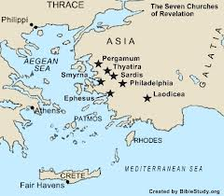

Slide 22
Revelation 1 Prologue (cont.)
Rev 1:9 John can relate to the persecutions that the church will soon be going through.
Why on Patmos? Because of the Word of God.
1:10 On the Lord’s day = Sunday
When you see Jesus, what do you see?

Slide 24
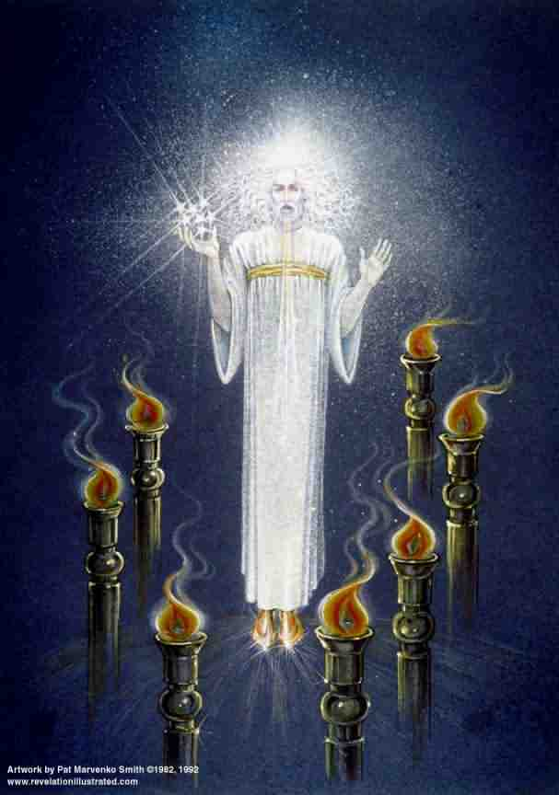
Revelation 1 Prologue (cont.)
Rev 1:12-18
Similar to Daniel 7:9-10
Voice “like a trumpet” A loud and clear message
Blazing eyes See everything
Double-edged sword in his mouth Authority and power of his words
Q: How does this picture of Jesus make you feel?

Slide 25
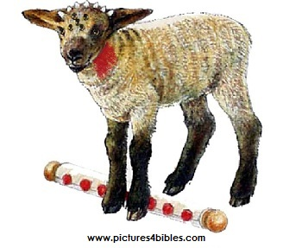
Revelation Ch. 5 The Lion and the Lamb
Jesus is a lion regal, powerful, a danger to enemies
Jesus is a lamb gentle, humble, sacrificial
7 horns = perfect in power
7 eyes = perfect in knowledge

Slide 26
Which is the Real Jesus Christ?
Jesus the ultimate powerful superhero
Jesus the ferocious king
Jesus the gentle, sacrificial lamb

