Slide 1
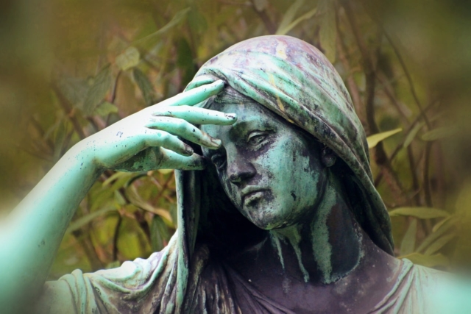
Emotionally healthy spirituality
Christianity and Suffering III

Slide 2
Job Hanging on to the Everything through Anything
Why is there evil in the world?
Why is there suffering in the world?
Why do we suffer?
What should we do when we suffer and when others suffer?

Slide 3
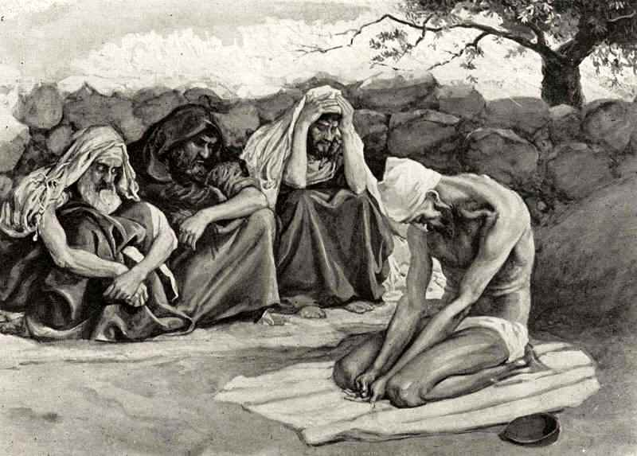
Eliphaz, Bildad and zophar
They sympathized and comforted him.
No one said a word to him.
They wept aloud with him.

Slide 4
Why do we suffer?
Sin of others (Exodus 34:6-7)
Our own sin (Exodus 34:6-7)
Natural Causes
Helps us to grow and be more reliant on God (James 1:2-4)
Our godly response gives glory of God (John 9:3)
No suffering, no joy (Psalms 30:5)
Come to know Christ (Colossians 1:24)

Slide 5
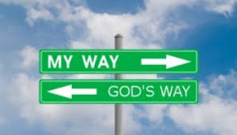
A question for us
Can you love a God you cannot control?
Psalm 77:19

Slide 6
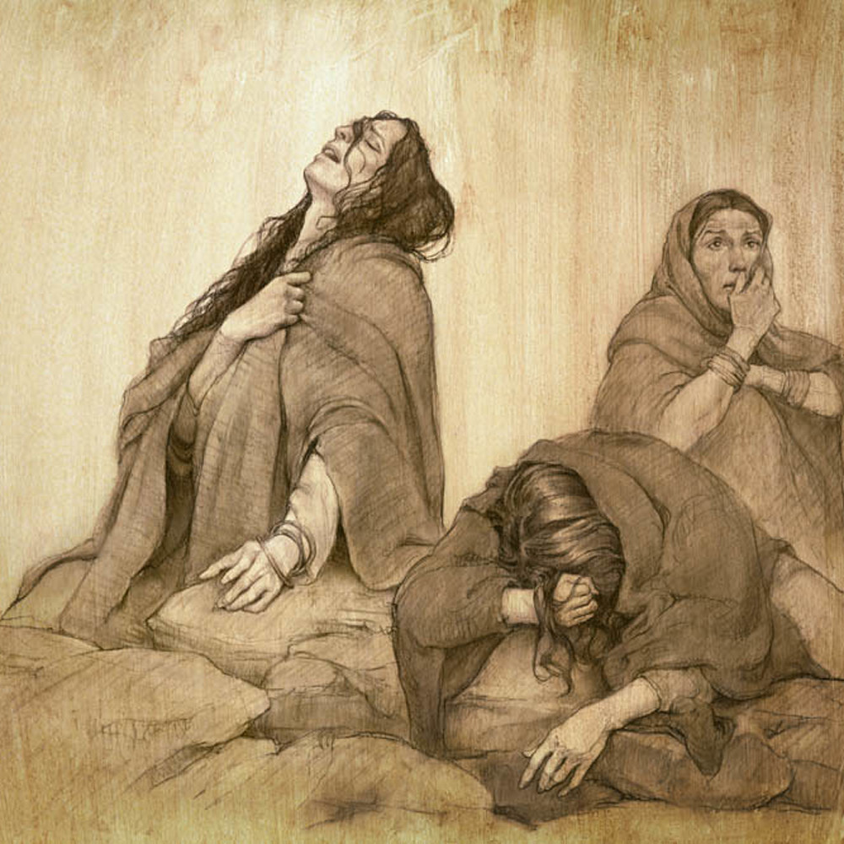
Job 3:1-26 Job is mourning! Lament
Job is discouraged, angry at God, depressed, lamenting…
But, Is Job sinning?
2/3 of Psalms are laments.
What about Lamentations? (Lamentations 3:22-23)

Slide 7
Job 4 & 5 Eliphaz speaks
Job 4:1-9 The innocent will not be destroyed.
You are reaping what you have sowed.
Our suffering is due to our own sin.
But Eliphaz is wrong!

Slide 8
Job 6 & 7 Job replies
Job 6:1-3 If you were in my sandals. How about a little support!
Job 6:14-21 You are lousy friends!
Job 6:22-30 I am a righteous man and deserve none of this suffering.
Job 7:17-21 I am innocent. God is unfair.

Slide 9
Job 8 Bildad agrees with eliphaz
Job 8:1-7
How dare you challenge God.
Your children got what they deserved.
If you stop sinning, God will restore you. Ouch!

Slide 10
Job 9 & 10 Job replies to bildad
Job 9:20-22 I am blameless. God destroys the blameless.
Job 10:1-8 You treat the wicked better than me.
I am blameless.

Slide 11
Job 11 Zophar’s turn
Job 11:13-19 If you are sufficiently devoted, if you stop sinning and repent, everything will be awesome. God will give you only blessings.
Job 13:13-19 Job: Repent of what? I will be vindicated.

Slide 12
Job 29 job’s defense
Job 29:7-20 I am actually quite awesome.
I, I, I, I, I, I did this and I did that.
Job has a little to learn about humility and compassion.
Job 31:1-6 I am blameless.

Slide 13
Job 30 Job reaches rock bottom
Job 30:16-23
v. 19 God threw me in the mud.
v. 21 God turned on me ruthlessly.
v. 23 God, you are killing me.

Slide 14
Job 32 & 33 Elihu weighs in
Job 32:1-5, Job 33:8-27
Job should not justify himself before God.
E, B & Z You are too judgmental. Don’t condemn Job
God’s ways are a mystery. He will let you know why you are suffering.

Slide 15
Job 38-40 God finally speaks
30 chapters of lament, 3 chapters of questions, 1 chapter of answers.
Job 38:1-18 Brace yourself like a man. Who do you think you are?
77 Questions
Job 40:1-2 Will you correct me? Will you accuse me?

Slide 16
Job 42 Job repents
Job 42:1-6 God, your ways are a mystery.
v. 5 Now my eyes have see you.
Job will never be the same again.

Slide 17
summary
Suffering, grief and loss are an opportunity to connect with God.
Job became a much better person. So can you.
Suffering and loss do NOT demonstrate God does not love us. On the contrary, they are how God refines us—how we come to know Him.
But we will mourn and lament when we suffer loss. It is OK and good.
We need to let the grieving grieve and support them with our presence more than with our words.
God is faithful. He will not abandon us.

